Slide 1




Future Circular Colliders
Frank Zimmermann
gratefully acknowledging input from FCC coordination group, study leader Michael Benedikt, the global design study team and all international contributors
LHC
PS
FCC
SPS
Ruprecht-Karls-Universität Heidelberg, 31 May 2016
http://cern.ch/fcc
Work supported by the European Commission under Capacities 7th Framework Programme project EuCARD-2, grant agreement 312453, and the HORIZON 2020 project EuroCirCol, grant agreement 654305

Slide 2
Outline
Motivation for Future Circular Colliders
FCC Study Scope & Time Line
Machine Design, Physics, Detectors
Technologies
FCC Organisation & Collaboration

Slide 3

FCC strategic motivation
European Strategy for Particle Physics 2013:
  “…to propose an ambitious post-LHC accelerator project….., CERN should undertake design studies for accelerator projects in a global context,…with emphasis on proton-proton and electron-positron high-energy frontier machines….coupled to a vigorous accelerator R&D programme, including high-field magnets and high-gradient accelerating structures,….”
U.S. strategy and P5 recommendation 2014:
  ”….A very high-energy proton-proton collider is the most powerful tool for direct discovery of new particles and interactions under any scenario of physics results that can be acquired in the P5 time window….”
ICFA statement 2014:
  ”…. ICFA supports studies of energy frontier circular colliders and encourages global coordination.….”

Slide 4

FCC motivation:
pushing the energy frontier
A very large circular hadron collider seems the only approach to reach 100 TeV c.m. collision energy in coming decades
Access to new particles (direct production) in the few TeV to 30 TeV mass range, far beyond LHC reach.
Much-increased rates for phenomena in the sub-TeV mass range →increased precision w.r.t. LHC and possibly ILC
The name of the game of a hadron collider is energy reach
Cf. LHC: factor ~4 in radius, factor ~2 in field → O(10) in E_{cms}
$$E∝B_{dipole}{×ρ}_{bending}$$

Slide 5

Future Circular Collider Study
GOAL: CDR and cost review for the next ESU (2018)
International FCC collaboration (CERN as host lab) to study:
pp-collider O(100) TeV (FCC-hh) → main emphasis, defining infrastructure requirements
80-100 km tunnel infrastructure in Geneva area
e⁺e⁻ collider (FCC-ee) as potential intermediate step
p-e (FCC-he) option
HE-LHC with FCC-hh technology
~16 T ⇒ 100 TeV pp in 100 km

Slide 6
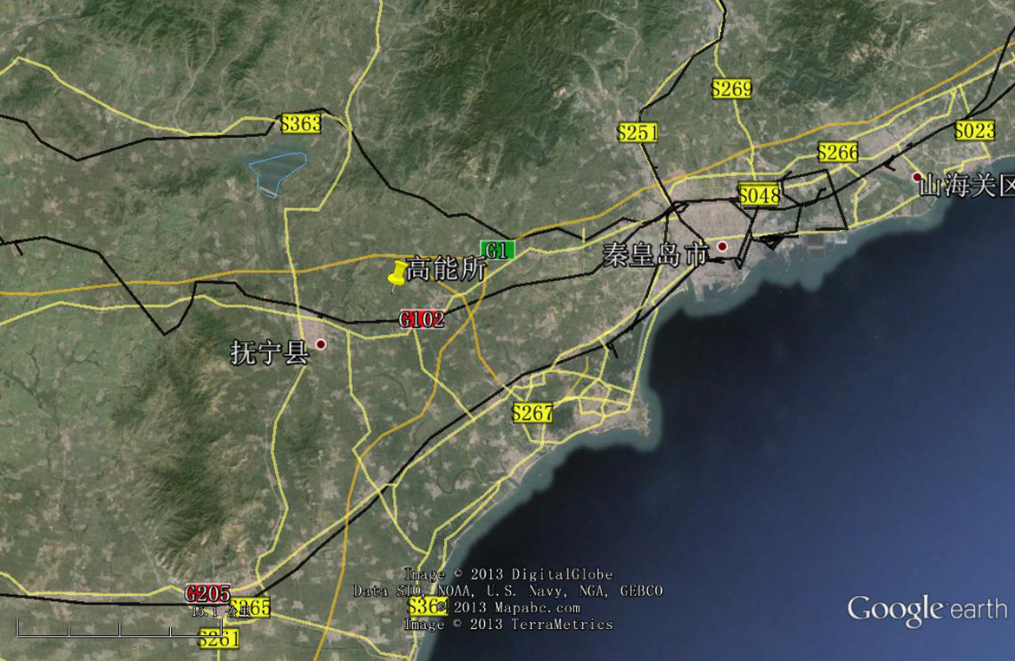
CepC/SppC study (CAS-IHEP) 54 km (baseline)
e⁺e⁻ collisions ~2028; pp collisions ~2042
Qinhuangdao (秦皇岛）
CepC, SppC
50 km
100 km
easy access
300 km east
from Beijing
3 h by car
1 h by train
“Chinese Toscana”
Yifang Wang

Slide 7


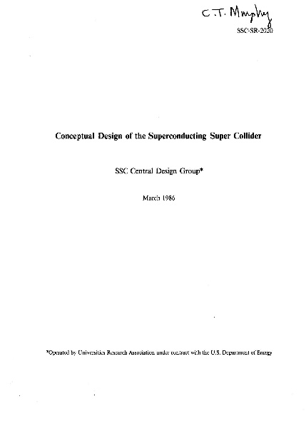
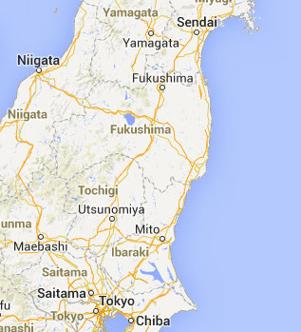
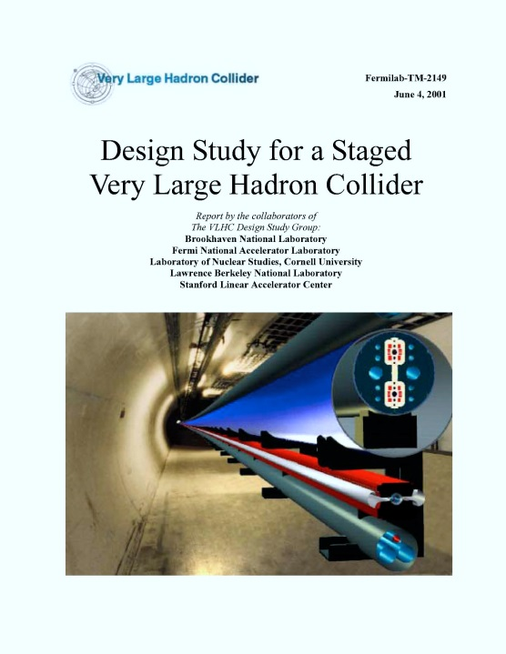
Previous studies in Italy (ELOISATRON 300km), USA (SSC 87km, VLHC 233km), Japan (TRISTAN-II 94km)
ex. ELOISATRON
ex. SSC
Supercolliders Superdetectors: Proceedings of the 19th and 25th Workshops of the INFN Eloisatron Project
SSC CDR 1986
ex. TRISTAN II
many aspects of machine design and R&D non-site specific
exploit synergies with other projects & previous studies
Tristan-II
option 2
ex. VLHC
F. Takasaki
H. Ulrich Wienands, The SSC Low Energy Booster: Design and Component Prototypes for the First Injector Synchrotron, IEEE Press, 1997
VLHC Design Study Group Collaboration
June 2001. 271 pp.
SLAC-R-591, SLAC-R-0591, SLAC-591,
SLAC-0591, FERMILAB-TM-2149
Tristan-II
option 1
http://www.vlhc.org/

Slide 8
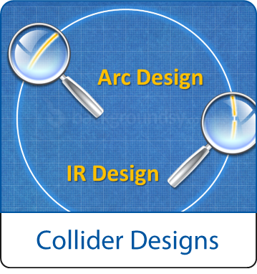
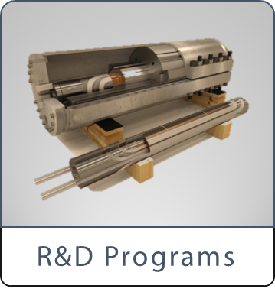
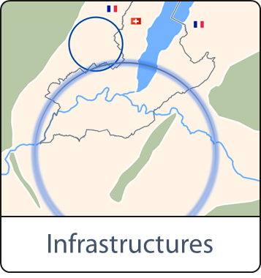
FCC Scope:
Accelerator and Infrastructure
FCC-hh: 100 TeV pp collider as long-term goal
→ defines infrastructure needs
FCC-ee: e⁺e⁻ collider, potential intermediate step
HE-LHC: based on FCC-hh technology
key technologies
pushed in dedicated R&D programmes, e.g.
16 Tesla magnets for 100 TeV pp in 100 km
SRF technologies and RF power sources
tunnel infrastructure in Geneva area, linked to CERN accelerator complex;
site-specific, as requested by European strategy

Slide 9

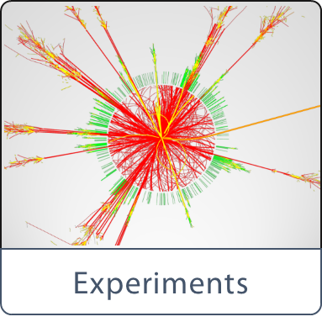

FCC Scope:
Physics & Experiments
physics opportunities
discovery potentials
experiment concepts for hh, ee and he
machine Detector Interface studies
concepts for worldwide data services
overall cost model ;
cost scenarios for collider options
including infrastructure and injectors ;
implementation and governance models

Slide 10
CERN Circular Colliders and FCC
1980
1985
1990
1995
2000
2005
2010
2015
2020
2025
2030
2035
Constr.
Physics
LEP
Design
Proto
Construction
Physics
LHC
Design
Construction
Physics
HL-LHC
20 years
FCC
Design
Proto
Construction
Physics
now is the right time to plan for the period 2035 – 2040
goal of phase 1: CDR by end 2018 for next update of European Strategy

Slide 11
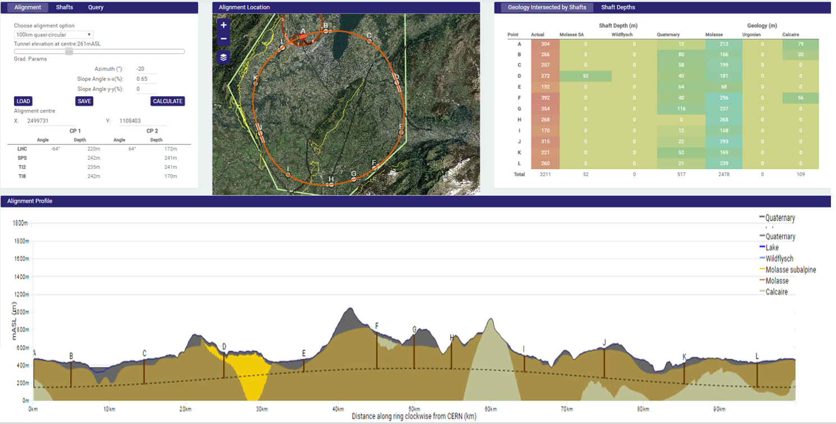
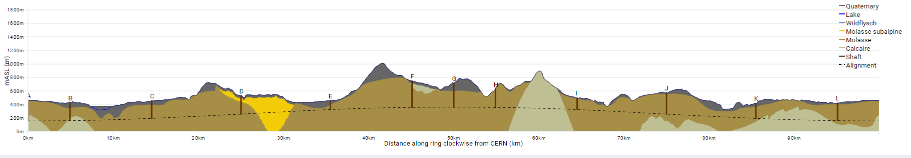
Progress on site investigations
Notes:
Use the latest slides from John/Charlie.
100 km machines, possibly with both versions intersecting and non-intersecting?

Slide 12
Progress on site investigations
90 – 100 km fits geological situation well
LHC suitable as potential injector
The 100 km version, intersecting LHC, is now being studied in more detail
Notes:
Use the latest slides from John/Charlie.
100 km machines, possibly with both versions intersecting and non-intersecting?

Slide 13
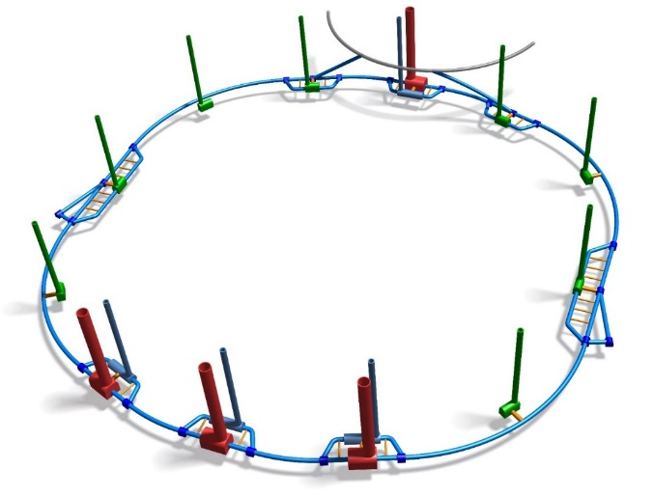
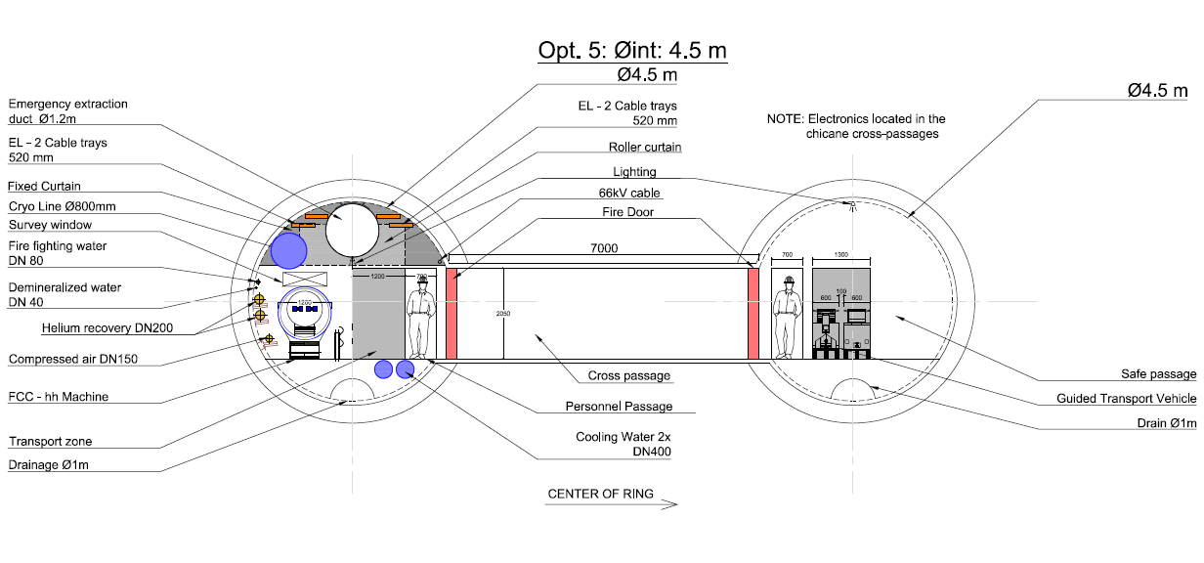
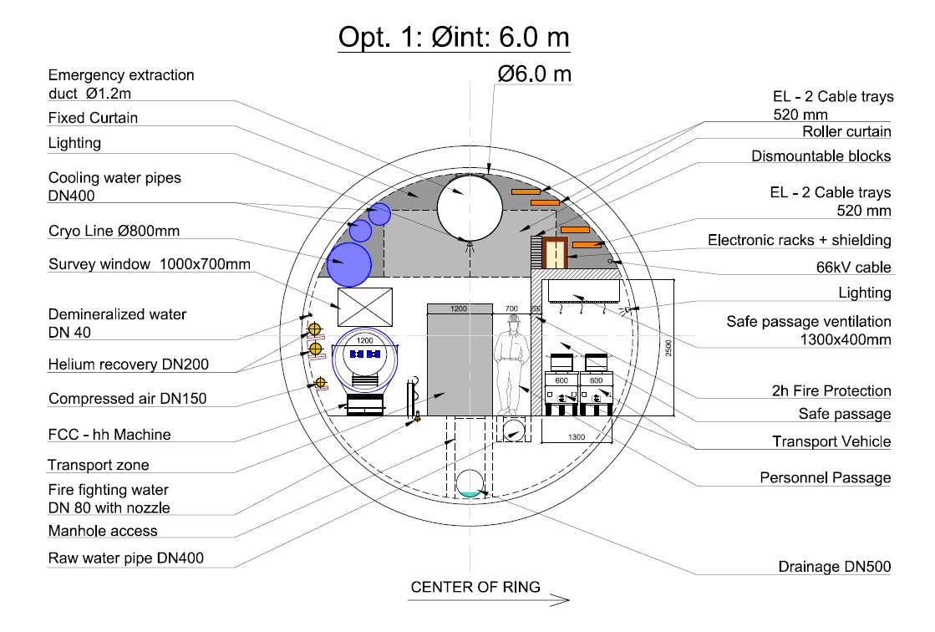
Further CE and TI optimisation
More detailed studies launched on
CE: single vs. double tunnels
CE: caverns, shafts, underground layout
technical infrastructures
safety, access
transport, integration, installation
operation aspects
Notes:
Studies are now shifting more on integration aspects, safety, access, installation.
Single vs. double tunnels, optimisation of cross sesctions, etc.

Slide 14
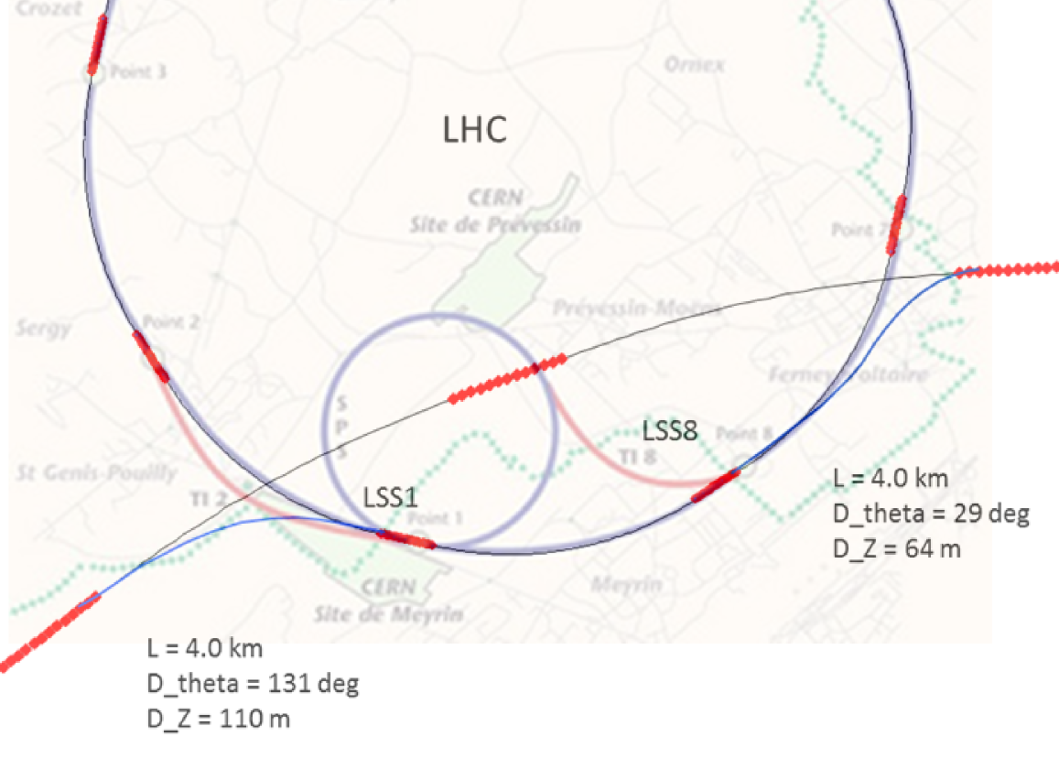
FCC-hh injector studies
injector options:
SPS → LHC → FCC
SPS/SPS_{upgrade} → FCC
SPS -> FCC booster → FCC
100 km FCC
intersecting version
SPS
FCC
current baseline is to fully re-use the existing CERN accelerator complex
injection energy 3.3 TeV from LHC
Notes:
See talk of Oliver on injection energy
Several options, present baseline is 3.3 GeV
Ínjection at 1.5 TeV studied as alternative, potentially compatible with SPS upgrade

Slide 15
Hadron collider parameters
parameter | FCC-hh |  | HE-LHC* | (HL) LHC
collision energy cms [TeV] | 100 |  | >25 | 14
dipole field [T] | 16 |  | 16 | 8.3
circumference [km] | 100 |  | 27 | 27
# IP | 2 main & 2 |  | 2 & 2 | 2 & 2
beam current [A] | 0.5 |  | 1.27 | (1.12) 0.58
bunch intensity [10¹¹] | 1 | 1 (0.2) | 2.5 | (2.2) 1.15
bunch spacing [ns] | 25 | 25 (5) | 25 | 25
beta* [m] | 1.1 | 0.3 | 0.25 | (0.15) 0.55
luminosity/IP [10³⁴ cm⁻²s⁻¹] | 5 | 20 - 30 | >25 | (5) 1
events/bunch crossing | 170 | <1020 (204) | >850 | (135) 27
stored energy/beam [GJ] | 8.4 |  | 1.4 | (0.7) 0.36
synchrotron rad. [W/m/beam] | 30 |  | 4.1 | (0.35) 0.18
*tentative

Slide 16
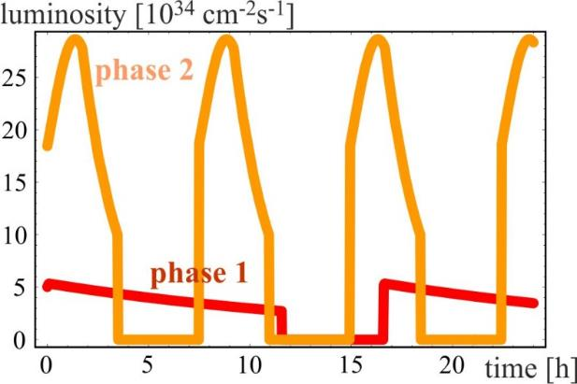
FCC-hh luminosity phases
phase 1: β*=1.1 m, ΔQ_{tot}=0.01, t_{ta}=5 h, 250 fb⁻¹ / year
phase 2: β*=0.3 m, ΔQ_{tot}=0.03, t_{ta}=4 h, 1 ab⁻¹ / year
radiation damping: τ~1 h
PRST-AB 18, 101002 (2015)
Total integrated luminosity over 25 years operation
O(20) ab⁻¹
consistent with
physics goals

Slide 17
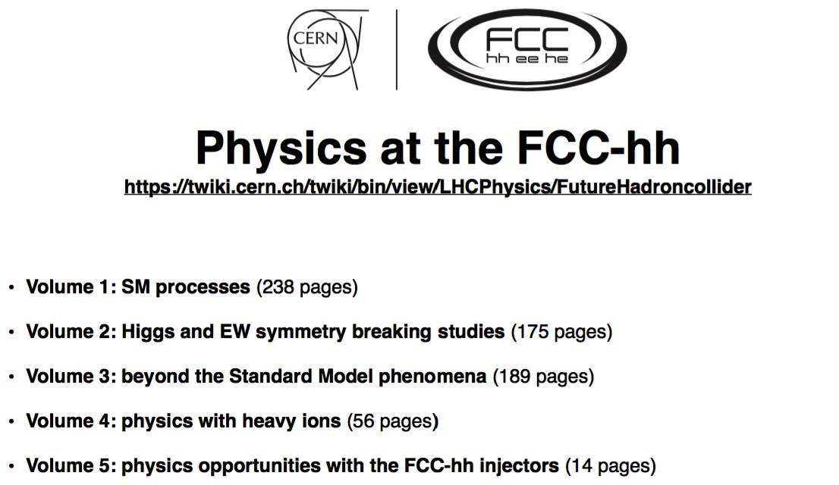
Physics prospects

Slide 18
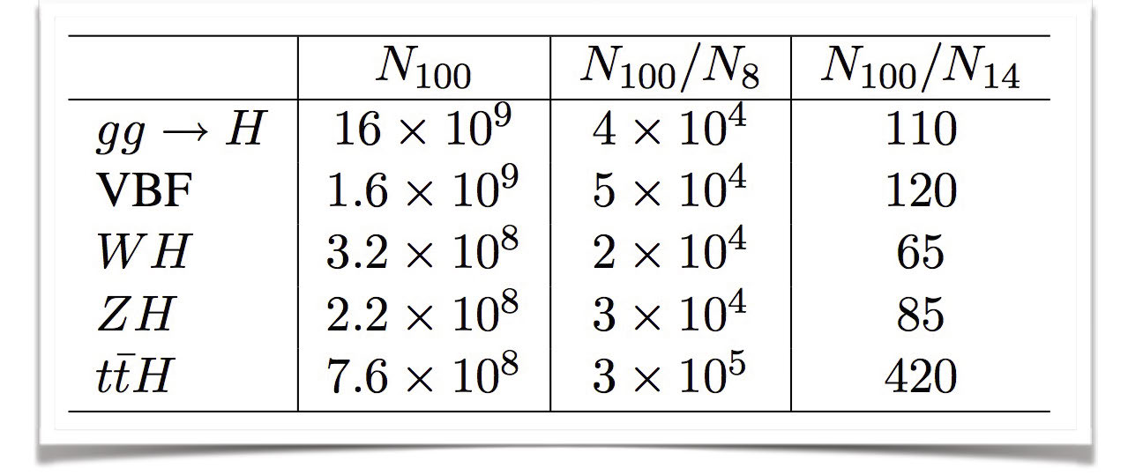
Higgs & EWSB physics at 100 TeV
Contino, Lee, Michelangelo, Reuter
huge production rates at 100 TeV imply:
can afford reducing statistics, with tighter kinematical cuts that reduce backgrounds and systematics
explore new dynamical regimes, with novel tests of the SM and EWSB

Slide 19
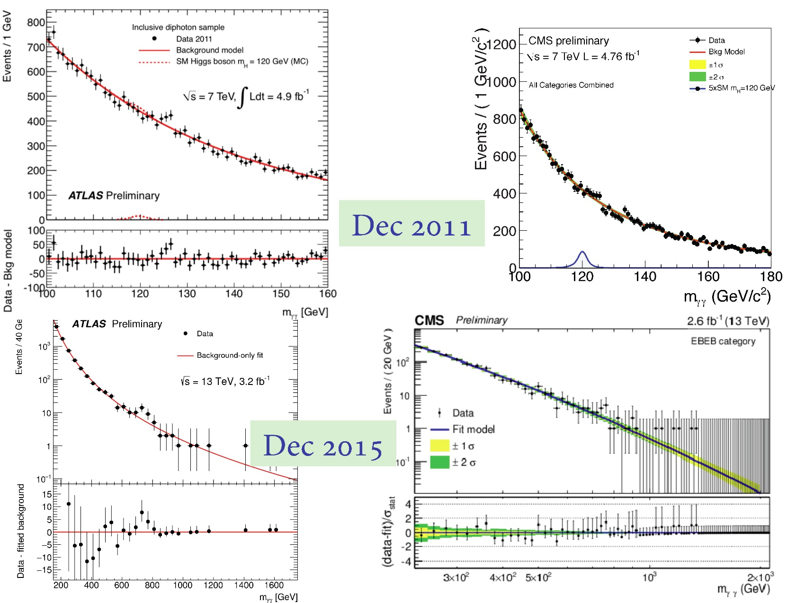
LHC results: need for higher energy
G. Giudice

Slide 20
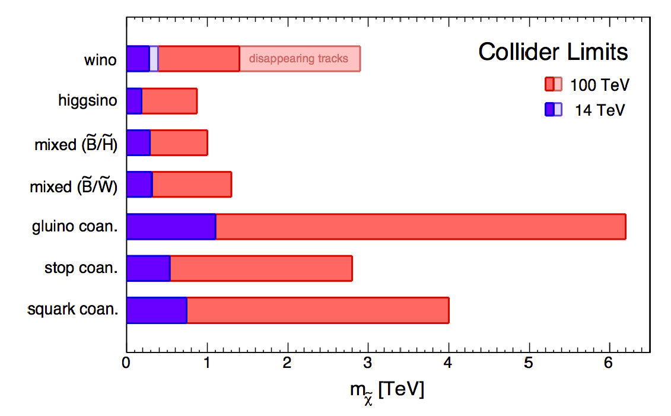
FCC-hh physics perspectives
G. Giudice

Slide 21
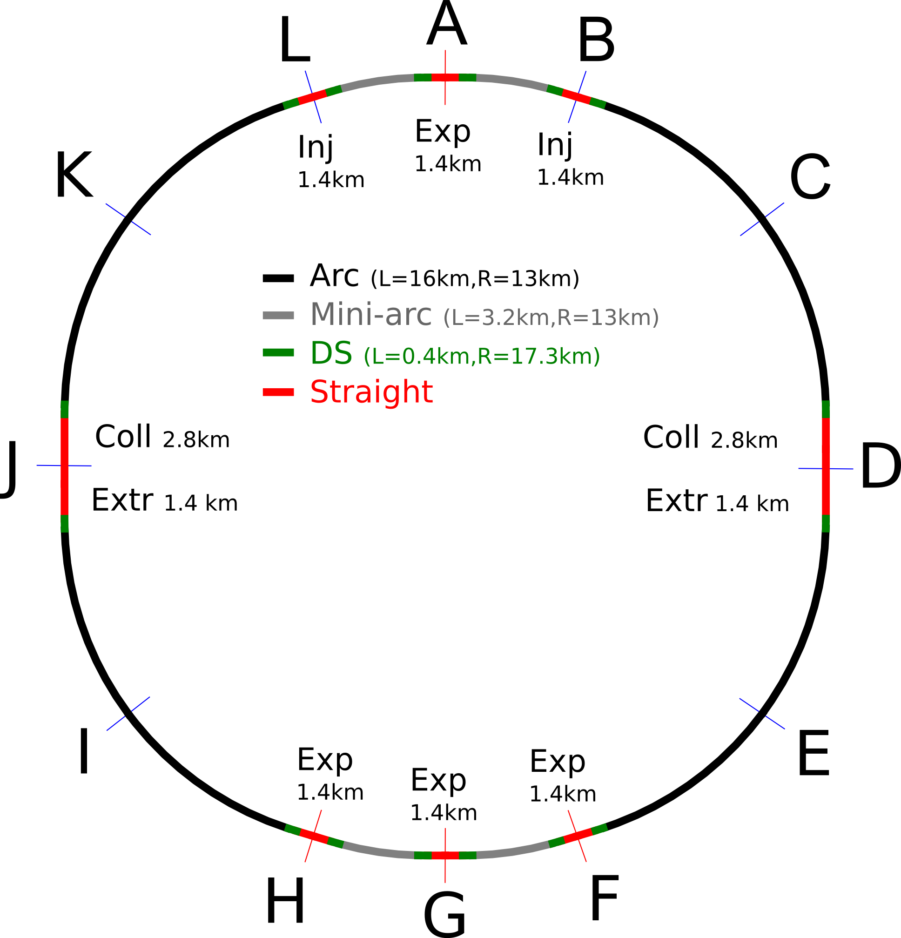
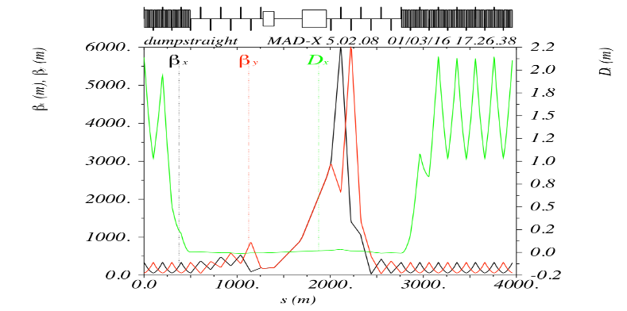
FCC-hh full-ring optics design
Regular arc cell
Interaction region
Injection with RF
Momentum collim.
Betatron collimation
full ring optics design
available as basis for:
beam dynamics studies
optimisation of each insertion
definition of system specifications (apertures, etc.)
improvement of baseline optics and layout
Extraction/dumping
Notes:
Add one slide showing optics, possibly with some smaller plots on insertions?
Detailed optimisation on optics of each insertion within overall defined boundaries.

Slide 22
FCC-hh MDI studies
design of interaction region
consistent for machine and detector
  L*=45 m
  integrated spectrometer and compensation dipoles
optics with long triplet with large aperture
  helps distributing collision debris
  more beam stay clear
Notes:
Add one slide showing optics, possibly with some smaller plots on insertions?
Detailed optimisation on optics of each insertion within overall defined boundaries.

Slide 23
protecting triplet from debris
total power of background events 100-500 kW per experiment
car or truck engine
already limit in LHC and HL-LHC
magnet lifetime, heat load
study of 3000 fb⁻¹ in older FCC-hh detector design
goal: survive at least 5000 fb⁻¹
one 5-year run
shield (TAS)
magnets
dose for
3000 fb⁻¹
30 MGy =
present limit
shielding
5mm
10mm
15mm
20mm
M. I. Besana, F. Cerutti, et al.

Slide 24
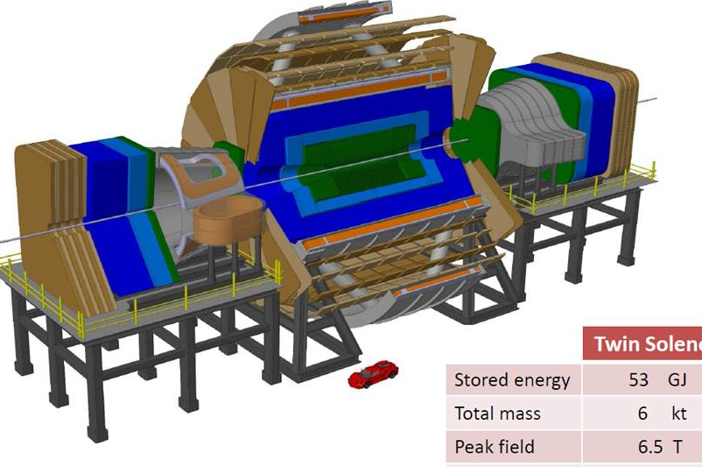
detector concepts for 100 TeV pp
a B=6 T, R=6 m solenoid with shielding coil and 2 dipoles has been engineered in detail. Alternative magnet systems are being studied
parametrized detector performance model (DELPHES) is available and integrated in FCC software framework for physics simulations
  https://twiki.cern.ch/twiki/bin/view/FCC/FccPythiaDelphes
some design challenges:
large η acceptance
radiation levels of >50 x LHC Phase II
pileup of ~1000
R&D for FCC detectors is a natural continuation of the R&D for LHC Phase II upgrade
Notes:
See with Werner about detector

Slide 25
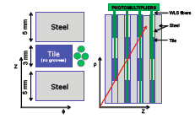
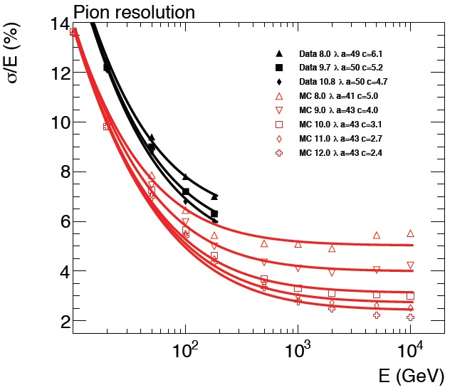
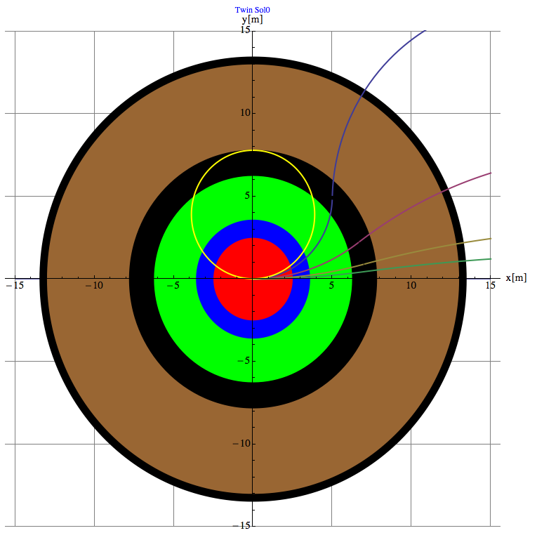
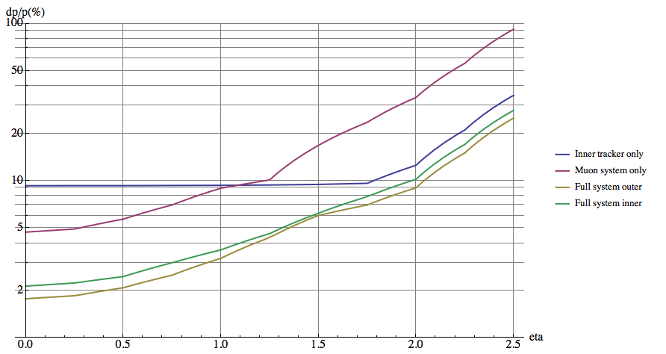
physics/detector simulation software
parametrized detector performance (DELPHES) is integrated in the FCC software framework and ready to use.
https://twiki.cern.ch/twiki/bin/view/FCC/FccPythiaDelphes
full simulation functional
reconstruction and fast simulation are very advanced
lots of effort on updating documentation and infrastructure
single entry point for all information: http://fccsw.web.cern.ch/fccsw/
Muon only
Tracker only
Combined
calorimeter resolution, containment studies
muon system performance studies and requirements
Notes:
See wth Werner for 1 slde on this

Slide 26
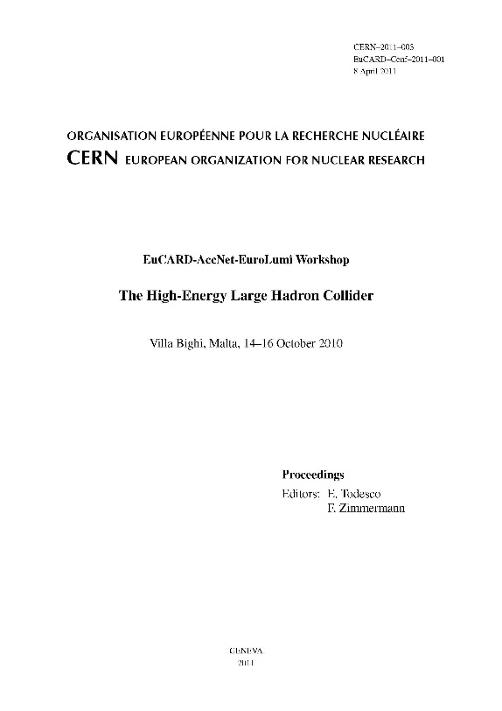
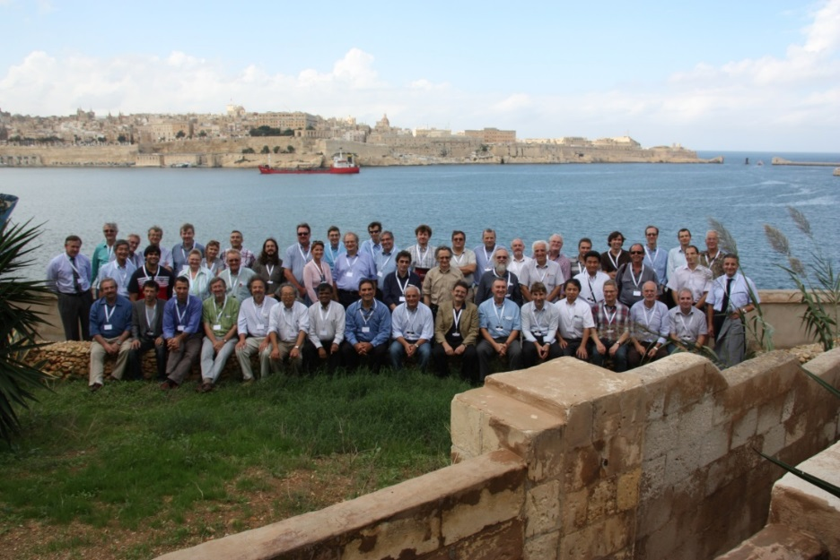
High-Energy LHC (HE-LHC)
FCC study continues effort on high-field collider in LHC tunnel
2010 EuCARD Workshop Malta;
Yellow Report CERN-2011-1
based on 16-T dipoles developed for FCC-hh
extrapolation of other parts from the present (HL-)LHC
and from FCC developments
EuCARD-AccNet-EuroLumi Workshop: The High-Energy Large Hadron Collider - HE-LHC10,
E. Todesco and F. Zimmermann (eds.), EuCARD-CON-2011-001; arXiv:1111.7188; CERN-2011-003 (2011)

Slide 27
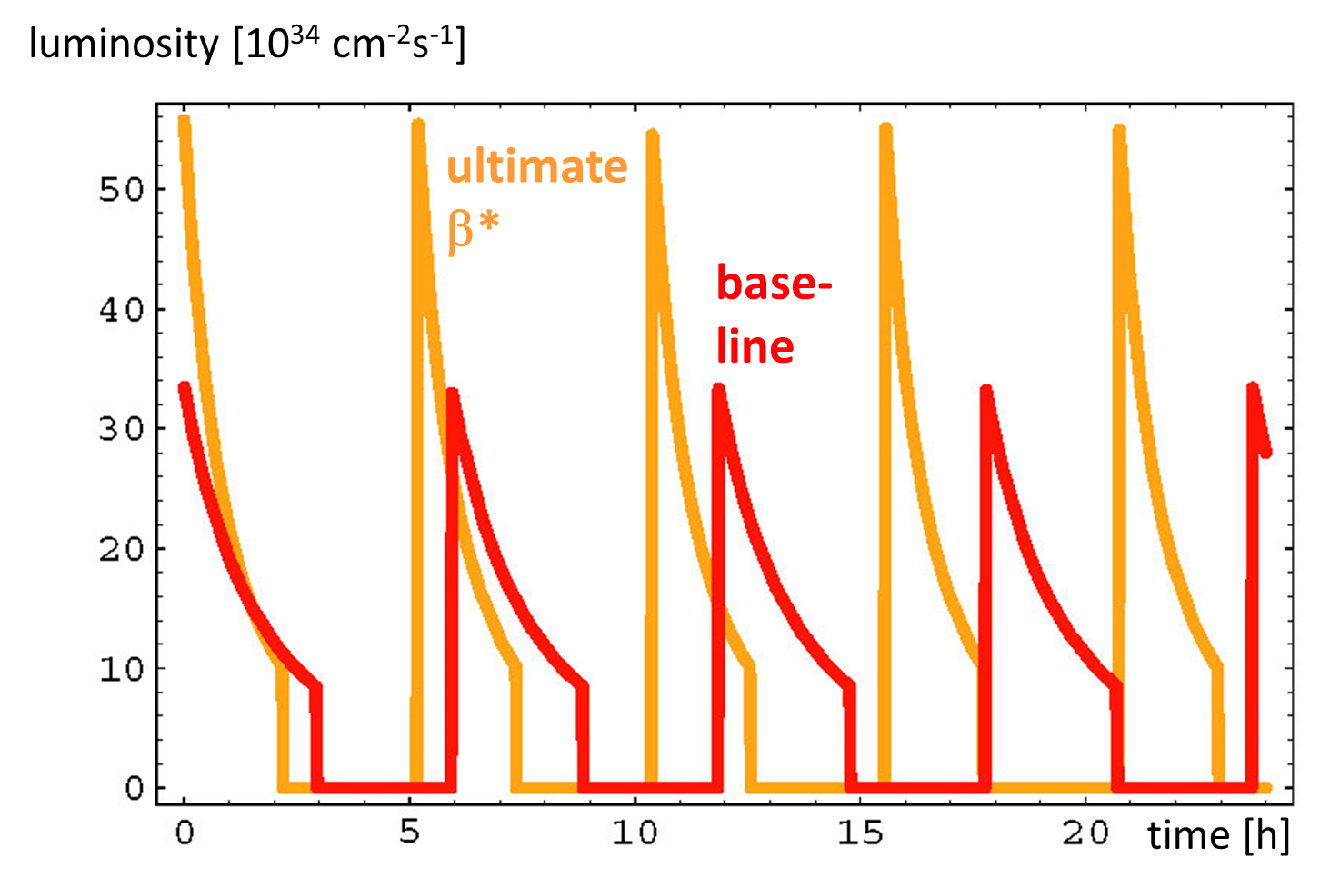
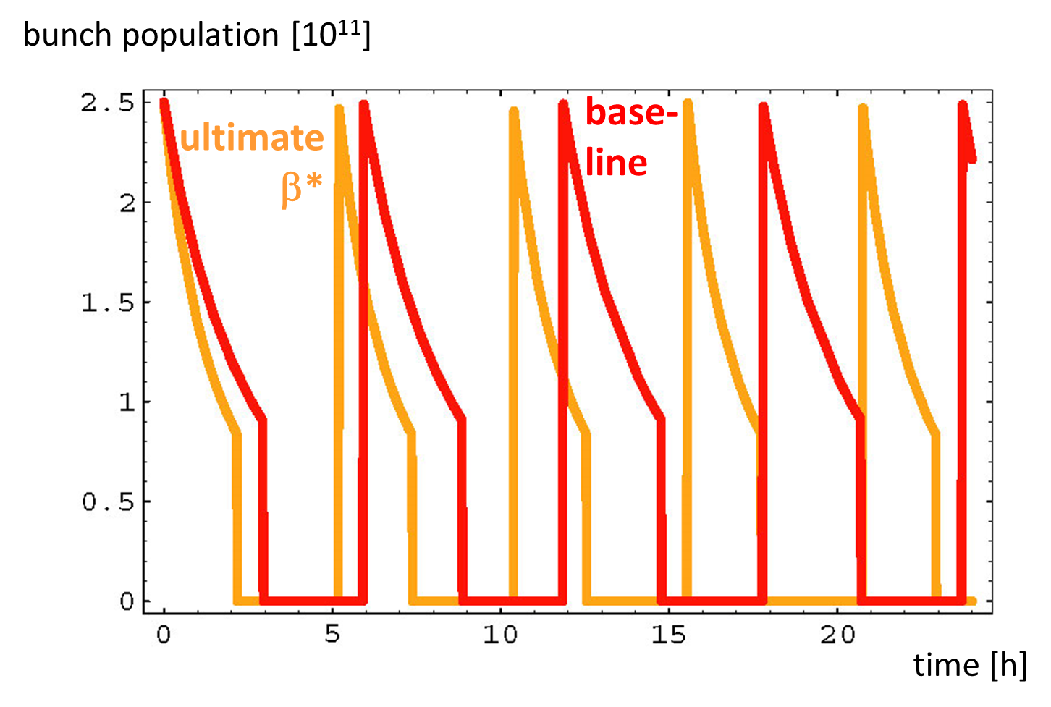
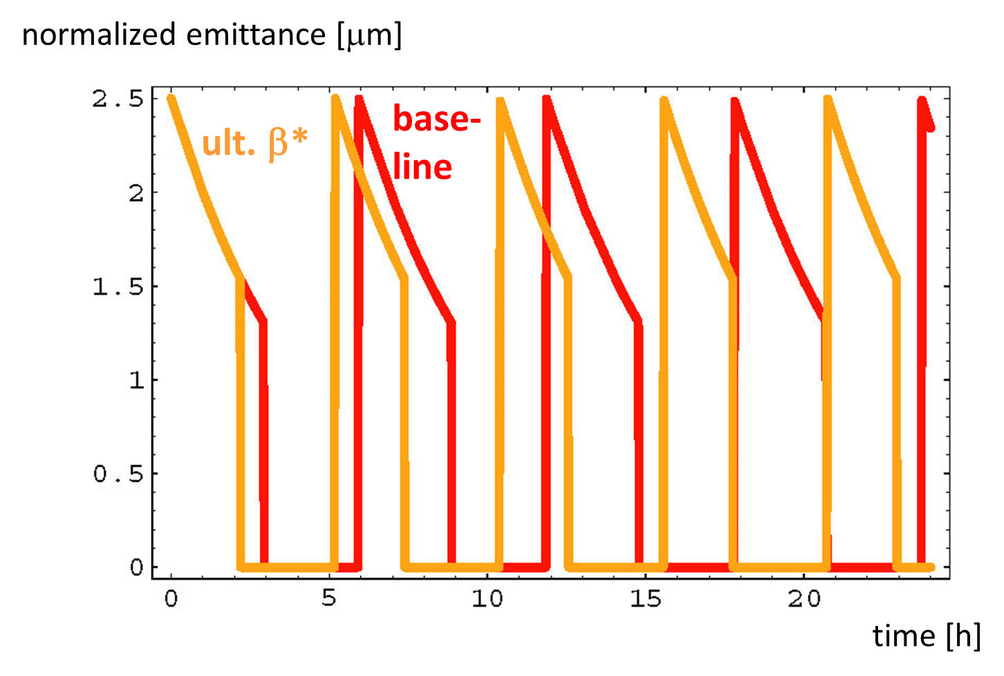
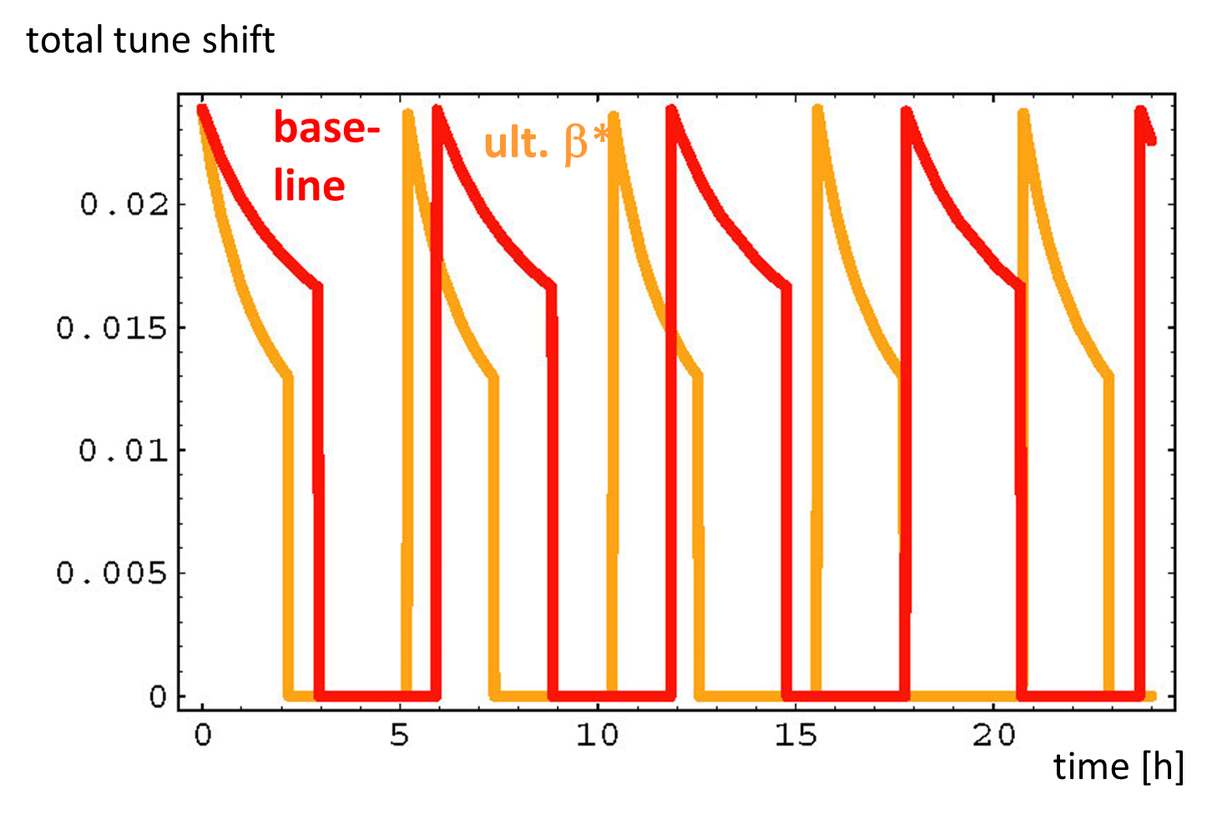
HE-LHC - 25 TeV c.m.
β*=25 cm or 15 cm
very preliminary

Slide 28
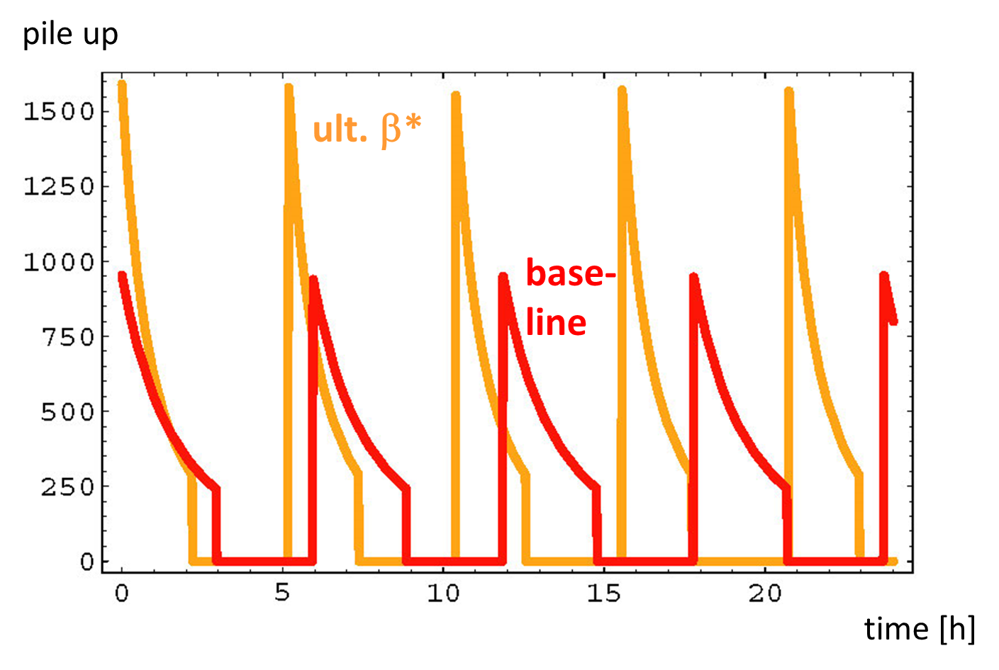
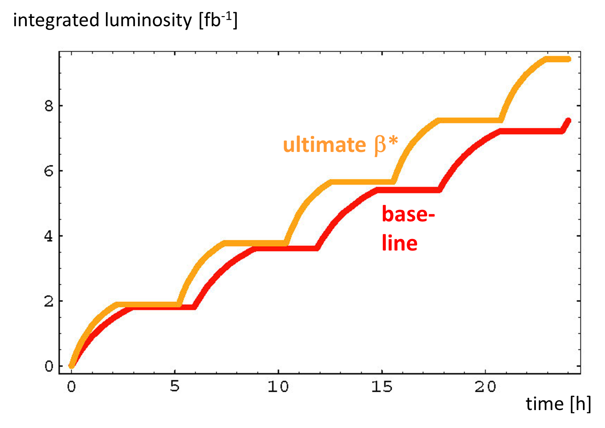
HE-LHC: pile up & performance
25 ns bunch spacing
very preliminary
with 160 days of physics, 70% availability, 3 h turnaround time
β*=25 cm: 920 fb⁻¹/year
β*=15 cm: 1100 fb⁻¹/year
pile up of 1000 or shorter (e.g. 5 ns) bunch spacing – what is easier?
M. Benedikt, S. Fartoukh, F. Zimmermann

Slide 29
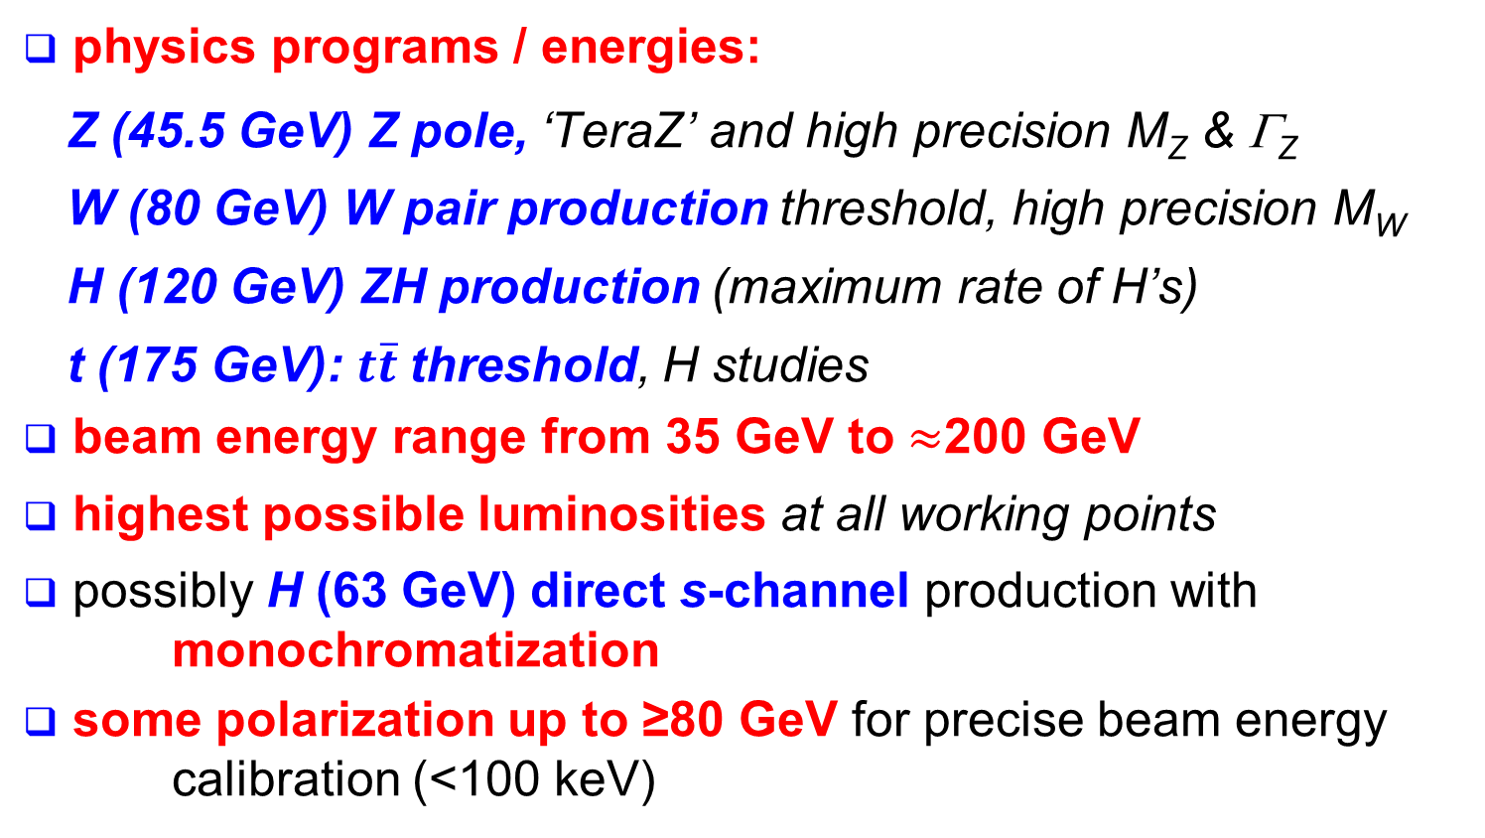
FCC–ee: physics requirements
physics programs / energies:
  Z (45.5 GeV) Z pole, ‘TeraZ’ and high precision M_{Z} & Γ_{Z}
  W (80 GeV) W pair production threshold, high precision M_{W}
  H (120 GeV) ZH production (maximum rate of H’s)
  t (175 GeV): $t\overline{t}$threshold, H studies
beam energy range from 35 GeV to $≈$200 GeV
highest possible luminosities at all working points
possibly H (63 GeV) direct s-channel production with monochromatization
some polarization up to ≥80 GeV for precise beam energy calibration (<100 keV)

Slide 30
lepton collider parameters
parameter | FCC-ee (400 MHz) |  |  |  |  | LEP2
Physics working point | Z |  | WW | ZH | tt_{bar}
energy/beam [GeV] | 45.6 |  | 80 | 120 | 175 | 105
bunches/beam | 30180 | 91500 | 5260 | 780 | 81 | 4
bunch spacing [ns] | 7.5 | 2.5 | 50 | 400 | 4000 | 22000
bunch population [10¹¹] | 1.0 | 0.33 | 0.6 | 0.8 | 1.7 | 4.2
beam current [mA] | 1450 | 1450 | 152 | 30 | 6.6 | 3
luminosity/IP x 10³⁴cm⁻²s⁻¹ | 210 | 90 | 19 | 5.1 | 1.3 | 0.0012
energy loss/turn [GeV] | 0.03 | 0.03 | 0.33 | 1.67 | 7.55 | 3.34
synchrotron power [MW] | 100 |  |  |  |  | 22
RF voltage [GV] | 0.4 | 0.2 | 0.8 | 3.0 | 10 | 3.5
identical FCC-ee baseline optics for all energies
FCC-ee: 2 separate rings LEP: single beam pipe

Slide 31
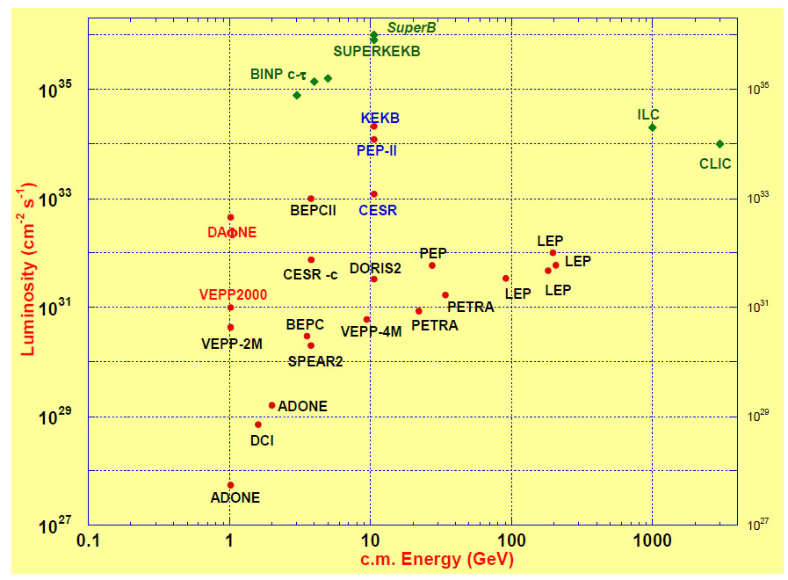
FCC-ee exploits lessons & recipes from past e⁺e⁻ and pp colliders
LEP:
high energy
SR effects
B-factories:
KEKB & PEP-II:
high beam
currents
top-up injection
DAFNE: crab waist
Super B-factories
S-KEKB: low β_{y}*
KEKB: e⁺ source
HERA, LEP, RHIC:
spin
gymnastics
FCC-ee
DAΦNE
TRISTAN
VEPP2000
combining successful ingredients of recent colliders → extremely high luminosity at high energies
Barry Barish
13 January 2011

Slide 32
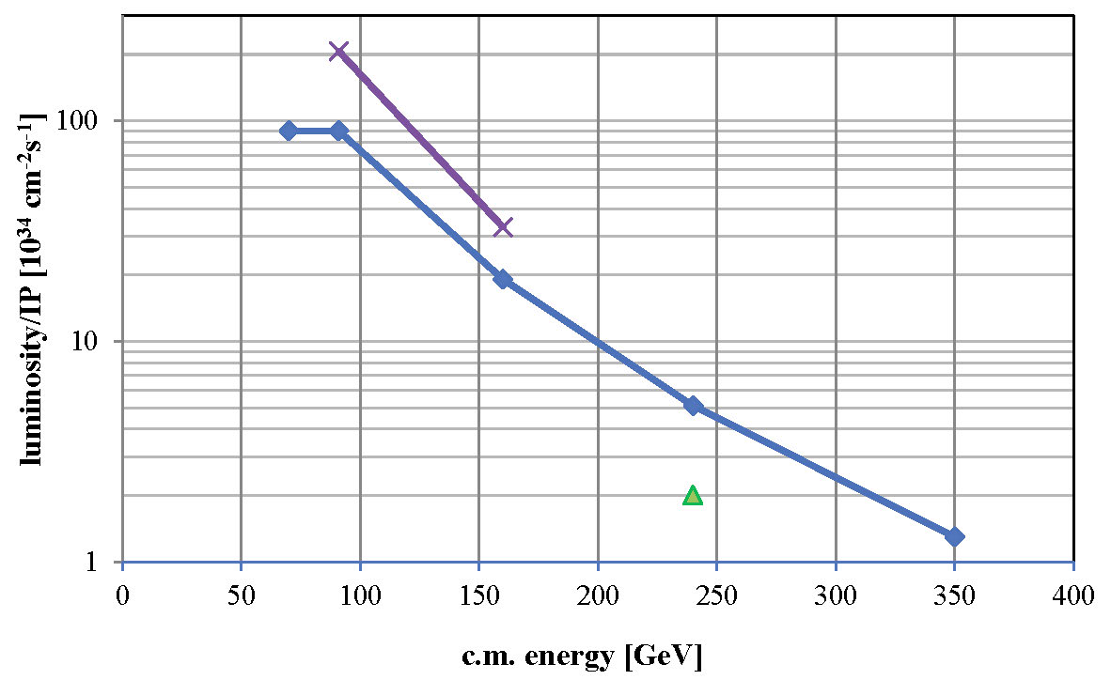
FCC-ee luminosity per IP
further increase with squeeze to β_{y}*=1 mm, β_{x}*=0.5 m
new baseline crab waist with 2 IPs
β_{y}*=2 mm, β_{x}*=1 m
solid baseline with functioning optics, space for improvement, esp. at Z and W
α_{QED}
Z
WW
HZ
$$t\overline{t}$$
?
CEPC

Slide 33
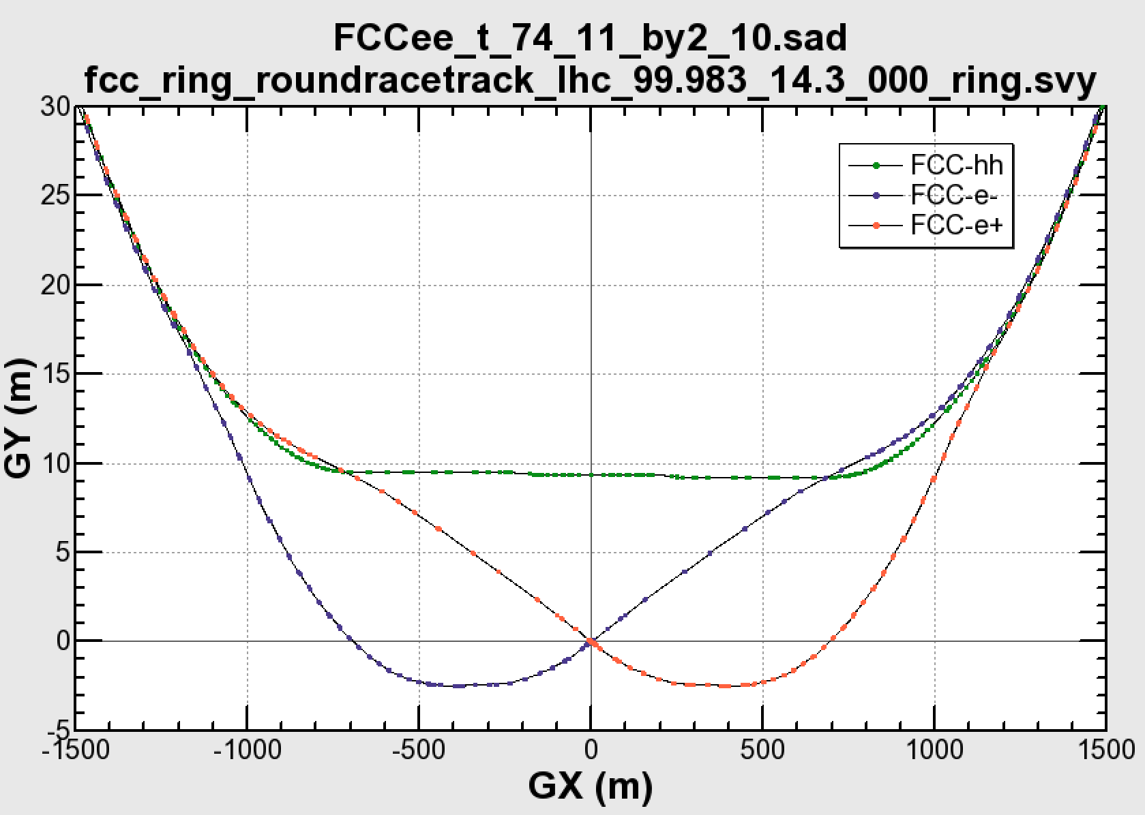

common layouts for hh & ee
FCC-ee 1, FCC-ee 2,
FCC-ee booster (FCC-hh footprint)
11.9 m
IP
30 mrad
FCC-hh/
ee Booster
9.4 m
0.6 m
Lepton beams must cross over through the common RF to enter the IP from inside.
Only a half of each ring is filled with bunches.
FCC-hh
layout
Common
RF (tt)
Common
RF (tt)
Max. separation of 3(4) rings is about 12 m:
wider tunnel or two tunnels are necessary around the IPs, for ±1.2 km.
2 main IPs in A, G for both machines
asymmetric IR optic/geometry for ee to limit synchrotron radiation to detector
IP
Notes:
Check with Katsunobu to have latest layout.
Check with detector people if 9 m offset is acceptable for ee detector

Slide 34
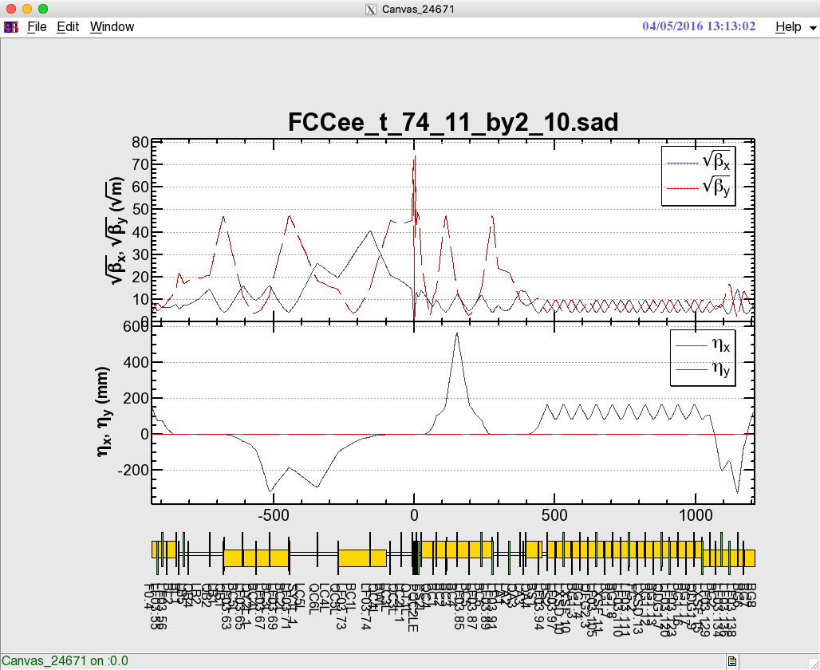

FCC-ee optics design
optics design for all working points achieving baseline performance
interaction region: asymmetric optics design
synchrotron radiation from upstream dipoles <100 keV up to 450 m from IP
dynamic aperture & momentum acceptance requirements fulfilled at all WPs
Local chromaticity correction
+ crab waist sextupoles
Local chromaticity correction
+ crab waist sextupoles
IP
Beam
Notes:
New slide from Katsunobu on converged optics, final focus and ring optics
Sufficient dynamic aperture and momentum
Injection details missing

Slide 35
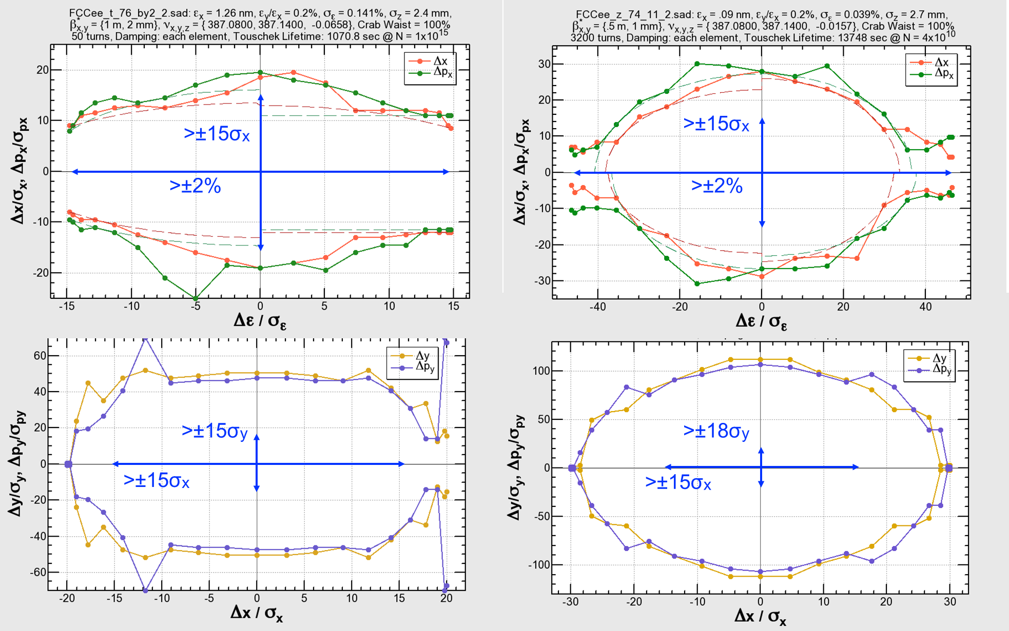
FCC-ee full-ring optics design
dynamic aperture and momentum acceptance requirements fulfilled
175 GeV,
β*x,y = (1 m, 2 mm)
45.6 GeV,
β*x,y = (0.5 m, 1 mm)
K. Oide
Notes:
New slide from Katsunobu on converged optics, final focus and ring optics
Sufficient dynamic aperture and momentum
Injection details missing

Slide 36

SuperKEKB: FCC-ee demonstrator
I_{e+}=3.6 A, I_{e-}=2.6 A
P_{SR} ~ 13 MW
C = 3 km
beam commissioning started this year
top up injection at high current
β_{y}* =300 μm (FCC-ee: 1 mm)
lifetime 5 min (FCC-ee: ≥20 min)
ε_{y}/ε_{x} =0.25% (similar to FCC-ee)
off momentum acceptance (±1.5%, similar to FCC-ee)
e⁺ production rate (2.5x10¹²/s, FCC-ee: <1.5x10¹²/s (Z cr.waist)
SuperKEKB goes beyond FCC-ee, testing all concept

Slide 37
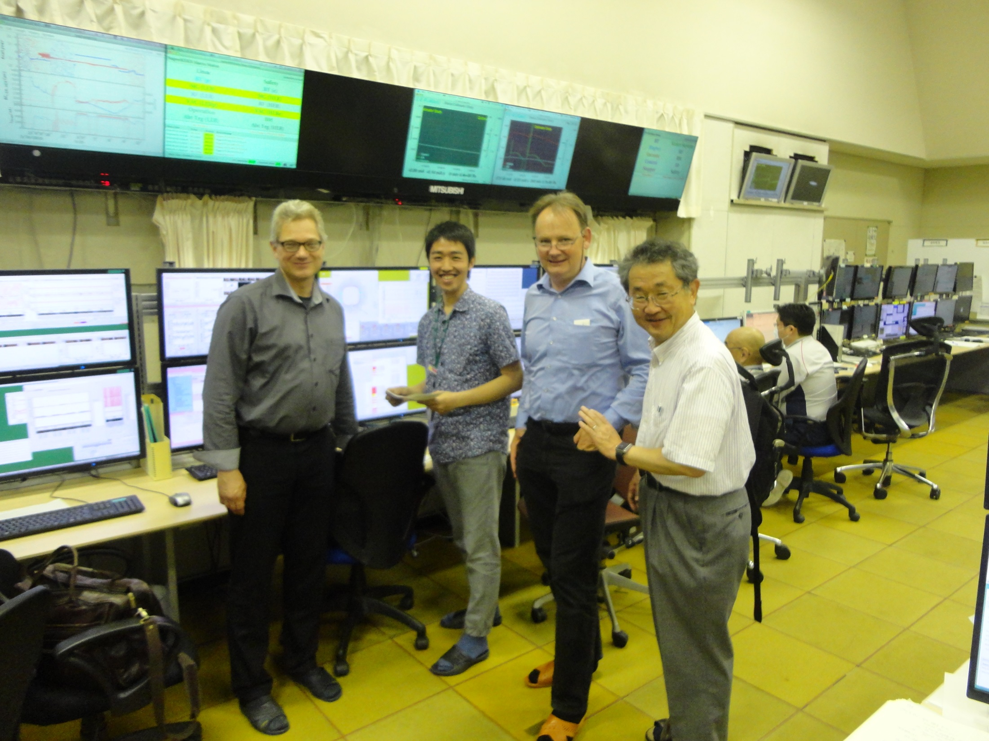

Slide 38
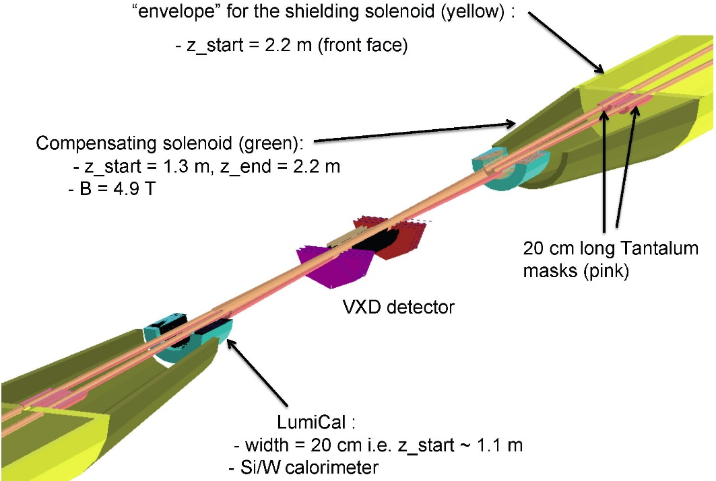
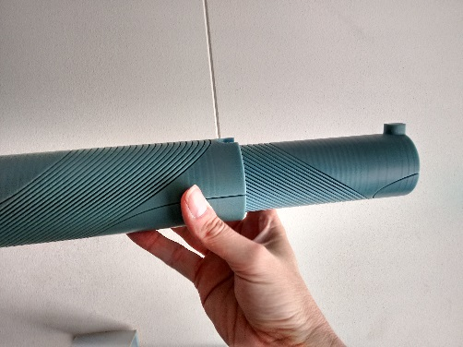
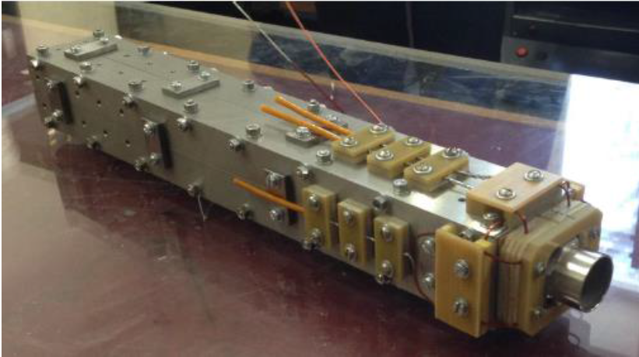
FCC-ee MDI optimisation
MDI work focused on optimization of
l*, IR quadrupole design
compensation & shielding solenoid
SR masking and chamber layout
CERN model of
CCT IR quadrupole
BINP prototype IR quadr.
2 cm aperture, 100 T/m
Notes:
New slide on MDI optimisation, L*, solenoid compensation, lumi monitoring, etc.
Slide from Mike Sullivan talk, synchrotron radiation IR, masking?
Possibly one slide on magnet design of Attilio?

Slide 39
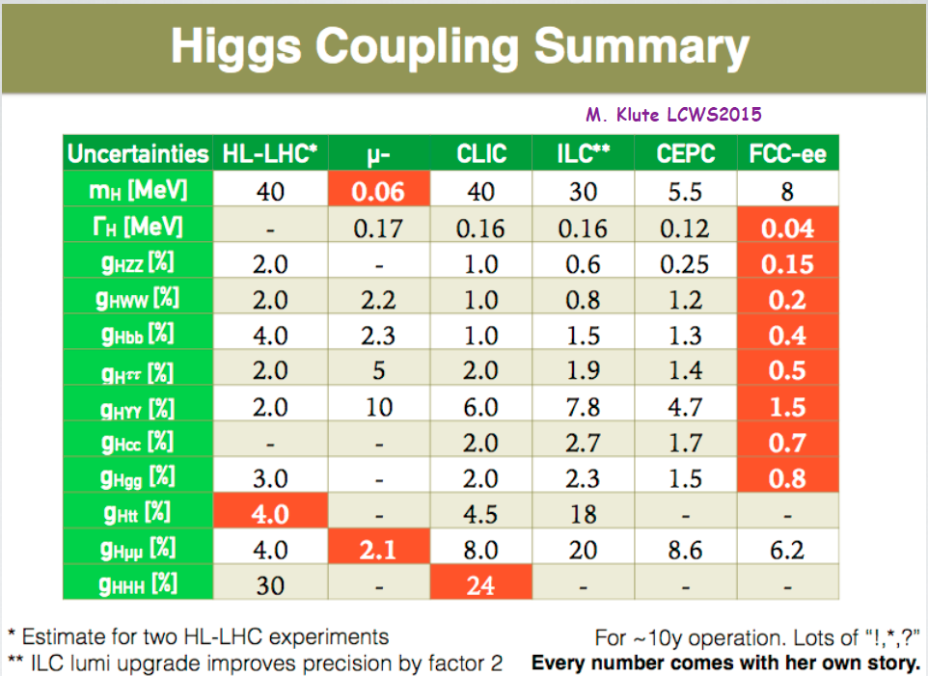
Higgs coupling summary
M. Klute
FCC-hh
statistical
errors after
10 years of
operation
1
1
5
the combination of FCC-ee and FCC-hh is «invincible»

Slide 40
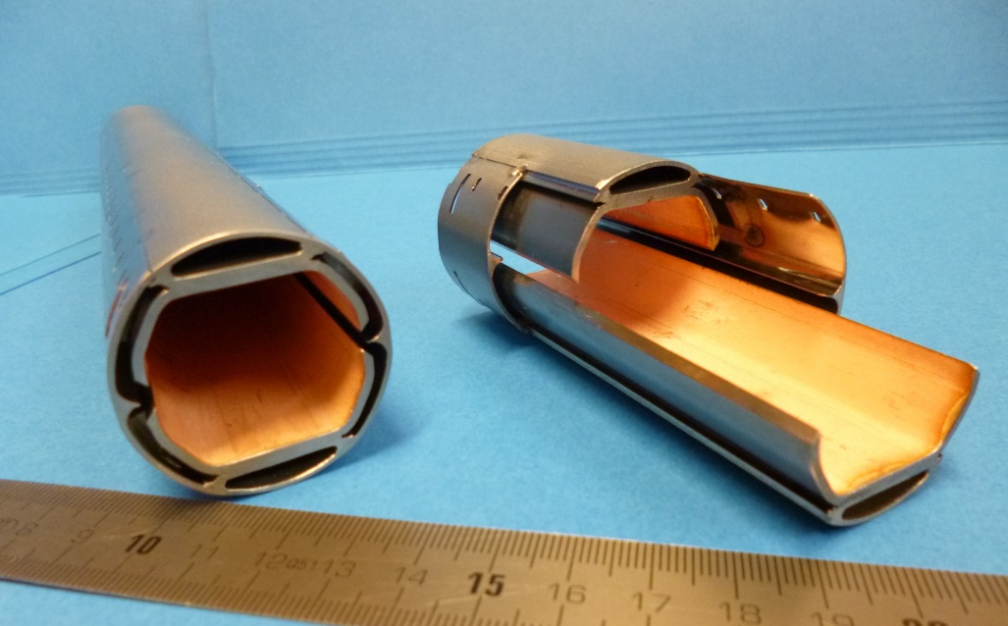
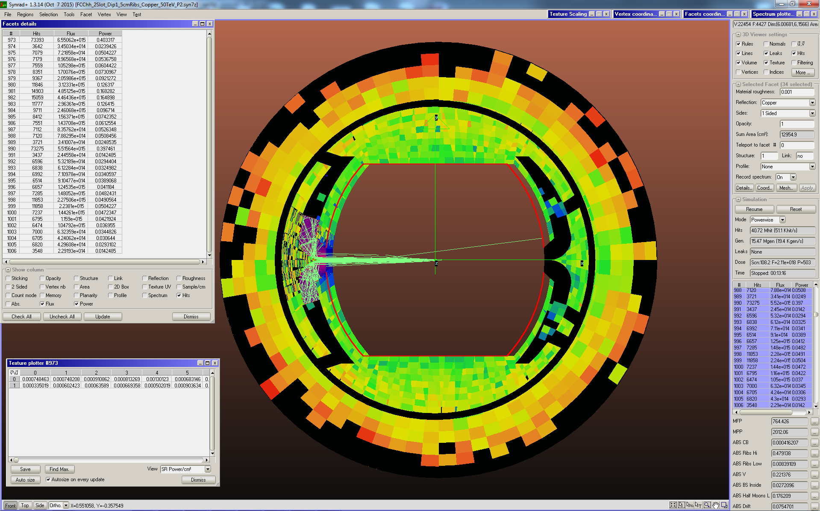
synchrotron radiation/beam screen
handling of high synchrotron radiation load of protons @ 50 TeV:
~30 W/m/beam (@16 T) (LHC <0.2W/m)
5 MW total in arcs
new beam screen with ante-chamber
absorption of synchrotron radiation at 50 K to reduce cryogenic power
avoids photo-electrons, helps vacuum
first FCC-hh beam screen prototype
testing 2017 at ANKA facility in Germany
Photon distribution

Slide 41
Cryo power for cooling of SR heat
contributions: beam screen (BS) & cold bore (BS heat radiation)
Overall optimisation of cryo-power, vacuum and impedance
Termperature ranges: <20, 40K-60K, 100K-120K
Ph. Lebrun
L. Tavian
V. Baglin
300MW
200MW
100MW
multi-bunch instability growth time: 25 turns 9 turns (ΔQ=0.5)

Slide 42
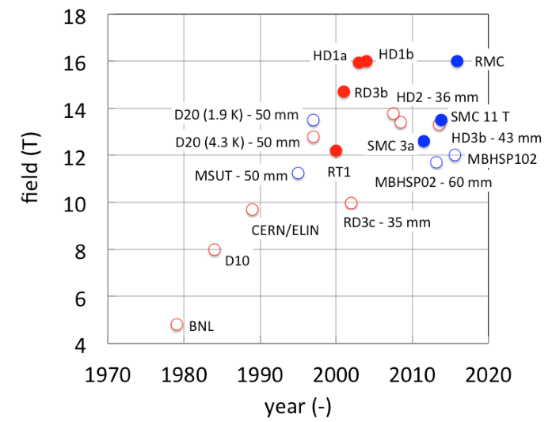
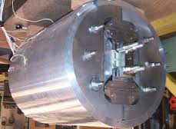
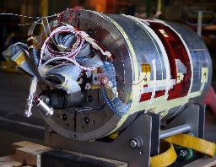
CERN & EuroCirCol 16T programs
Main Milestones of the FCC Magnet Program 2016 - 2019
Milestone | Description | 15 | 2016 |  | 2017 |  | 2018 |  | 2019 |  | 2020 |  | 21
M0 | High J_{c} wire development with industry
M1 | Supporting wound conductor test program
M2 | Design & manufacture 16T ERMC with existing wire
M3 | Design & manufacture 16 T RMM with existing wire
M4 | Design & manufacture 16T demonstrator magnet
M5 | Procurement of enhanced high J_{c} wire
M6 | EuroCirCol design 16T accelerator quality model
 | Manufacture and test of the 16 T EuroCirCol model
Magnets with bore
LBNL HD1
Field records
16 T “dipole” levels reached with small racetrack coils
LBNL 2004, CERN 2015
CERN RMC
ERMC (16 T mid-plane field) RMM (16 T in 50 mm cavity) Demonstrator (16 T, 50 mm gap) mid 2017 end 2017 end 2018

Slide 43
superconductor performance
Nb3Sn T = 4.5 K
Critical surface FCC
LHC at 1.9 K
16 T
HL-LHC
5400 mm²
3150 mm²
Different technology
~1.7 times less SC
Nb-Ti
Not possible
~10% margin
HL-LHC
~10% margin
FCC ultimate

Slide 44
Nb₃Sn conductor program
Nb₃Sn conductor is one of the major cost and performance factors for FCC-hh and must be given highest attention
Goals: J_{c} increase (16 T, 4.2 K) > 1500 A/mm², significant cost reduction
Actions ongoing and planned (in addition to activities at CERN):
  Purchase of wires in Europe, US
  Industrial R&D in Europe
  Collaboration agreements with KEK, Russia, Korea (in preparation), to stipulate conductor development with regional industry
  Collaborations with several European Universities and Research Centres
U.S. Magnet Development Program with conductor R&D program and focused on 16 T cos theta dipole model magnet.
Notes:
New slide from Davide.
Showing that conductor development is launched at international level, Russia, Japan, (Korea and Europe in preparation)
Underline importance of that development as main cost driver for the hadron collider machine.

Slide 45



RF system requirements
very large range of operation parameters
“Ampere-class” machines
Naive scale up from an hh system
 | V_{total} GV | n_{bunches} | I_{beam} mA | ΔE/turn GeV
hh | 0.032 |  | 500
Z | 0.4/0.2 | 30000/90000 | 1450 | 0.034
W | 0.8 | 5162 | 152 | 0.33
H | 5.5 | 770 | 30 | 1.67
t | 10 | 78 | 6.6 | 7.55
x6
x12
≈ 16 x 1 cell 400MHz,
“high gradient” machines
voltage and beam current ranges span more than factor > 10²
no well-adapted single RF system solution satisfying requirements
Notes:
New slide from Olivier
Common design for hadron and lepton low energy-high currecnt system
Synergies HL-LHC, HE LHC, FCC-hh, FCC-ee Z pole

Slide 46
RF system R&D lines
400 MHz single-cell cavities preferred for hh and ee-Z (few MeV/m)
Baseline Nb/Cu @4.5 K, development with synergies to HL-LHC, HE-LHC
R&D: power coupling 1 MW/cell, HOM power handling (damper, cryomodule)
hh
Z
W
≈ 16 cells per beam
≈ 100 per beam
(+ 100 for booster ring)
≈ 210 per beam
(+ 210 for booster ring)
400 or 800 MHz multi-cell cavities preferred for ee-H, ee-tt and ee-W
Baseline options 400 MHz Nb/Cu @4.5 K, ◄▬► 800 MHz bulk Nb system @2K
R&D: High Q₀ cavities, coating, long-term: Nb₃Sn like components
W
H
t
≈ 200 per beam
(+ 200 for booster)
≈ 800 per beam
(+ 800 for booster)
≈ common 2600 cells for both beams
(+ 2600 for booster)
Notes:
New slide from Olivier
Common design for hadron and lepton low energy-high currecnt system
Synergies HL-LHC, HE LHC, FCC-hh, FCC-ee Z pole

Slide 47


FCC Collaboration
A consortium of partners based on a
Memorandum Of Understanding (MoU)
Working together on a
best effort basis
Pursuing the same
common goal
Self governed
Incremental & open to
academia and industry

Slide 48




























FCC International Collaboration
75 institutes
26 countries + EC
Status: April, 2016

Slide 49
FCC Collaboration Status
75 collaboration members & CERN as host institute, April 2016
UT Enschede, Netherlands
U Geneva, Switzerland
Göthe U Frankfurt, Germany
GSI, Germany
GWNU, Korea
U. Guanajuato, Mexico
Hellenic Open U, Greece
HEPHY, Austria
U Houston, USA
IIT Kanpur, India
IFJ PAN Krakow, Poland
INFN, Italy
INP Minsk, Belarus
U Iowa, USA
IPM, Iran
UC Irvine, USA
Istanbul Aydin U., Turkey
JAI, UK
JINR Dubna, Russia
Jefferson LAB, USA
FZ Jülich, Germany
KAIST, Korea
KEK, Japan
KIAS, Korea
King’s College London, UK
ALBA/CELLS, Spain
Ankara U., Turkey
U Belgrade, Serbia
U Bern, Switzerland
BINP, Russia
CASE (SUNY/BNL), USA
CBPF, Brazil
CEA Grenoble, France
CEA Saclay, France
CIEMAT, Spain
Cinvestav, Mexico
CNRS, France
CNR-SPIN, Italy
Cockcroft Institute, UK
U Colima, Mexico
UCPH Copenhagen, Denmark
CSIC/IFIC, Spain
TU Darmstadt, Germany
TU Delft, Netherlands
DESY, Germany
DOE, Washington, USA
ESS, Lund, Sweden
TU Dresden, Germany
Duke U, USA
EPFL, Switzerland
KIT Karlsruhe, Germany
KU, Seoul, Korea
Korea U Sejong, Korea
U. Liverpool, UK
U. Lund, Sweden
MAX IV, Lund, Sweden
MEPhI, Russia
UNIMI, Milan, Italy
MIT, USA
Northern Illinois U, USA
NC PHEP Minsk, Belarus
U Oxford, UK
PSI, Switzerland
U Rostock, Germany
RTU, Riga, Latvia
UC Santa Barbara, USA
Sapienza/Roma, Italy
U Siegen, Germany
U Silesia, Poland
TU Tampere, Finland
TOBB, Turkey
U Twente, Netherlands
TU Vienna, Austria
Wigner RCP, Budapest, Hungary
Wroclaw UT, Poland

Slide 50

EuroCirCol EU Horizon 2020 Grant
European Union contributes with funding to FCC-hh study
Supports and makes essential contributions to the FCC-hh work packages:
Arc & IR optics design, 16 T dipole design, cryogenic beam vacuum system
Recognition of FCC Study by European Commission.

Slide 51
EuroCirCol Consortium + Associates
CERN | IEIO
TUT | Finland
CEA | France
CNRS | France
KIT | Germany
TUD | Germany
INFN | Italy
UT | Netherlands
ALBA | Spain
CIEMAT | Spain
STFC | United Kingdom
UNILIV | United Kingdom
UOXF | United Kingdom
KEK | Japan
EPFL | Switzerland
UNIGE | Switzerland
NHFML-FSU | USA
BNL | USA
FNAL | USA
LBNL | USA
Japan
KEK
Finland
TUT
United Kingdom
STFC, UNILIV, UOXF
Netherlands
UT
Germany
KIT, TUD
France
CEA, CNRS
CERN
Switzerland
EPFL, UNIGE
Italy
INFN
Spain
ALBA, CIEMAT
Consortium Beneficiaries, signing the Grant Agreement

Slide 52




First FCC Week
Conference
Washington DC
23-27 March 2015
http://cern.ch/fccw2015
“head shots” from Bob Palmer (BNL)

Slide 53


First FCC Week
Conference
Washington DC
23-27 March 2015
http://cern.ch/fccw2016
468
Participants
168
Institutes
http://cern.ch/fccw2015
24
Countries

Slide 54
Conclusions
There is a strong, rising interest in Future Circular Colliders and a community is forming to study these machines
International collaboration is needed to advance with this study on all of its challenging subjects
German expertise and participation in accelerators, experiments & physics are essential and most welcome!
Consolidated parameter sets for both machines FCC-hh and FCC-ee have been established. Work on all areas, accelerator physics, technologies, infrastructures, detectors and physics is advancing well.
Next milestone is a study review at FCC Week 2017, to define contents of the Conceptual Design Report.

Slide 55



FCC Week 2017
29 May – 2 June 2017
Berlin, Germany

