Slide 1
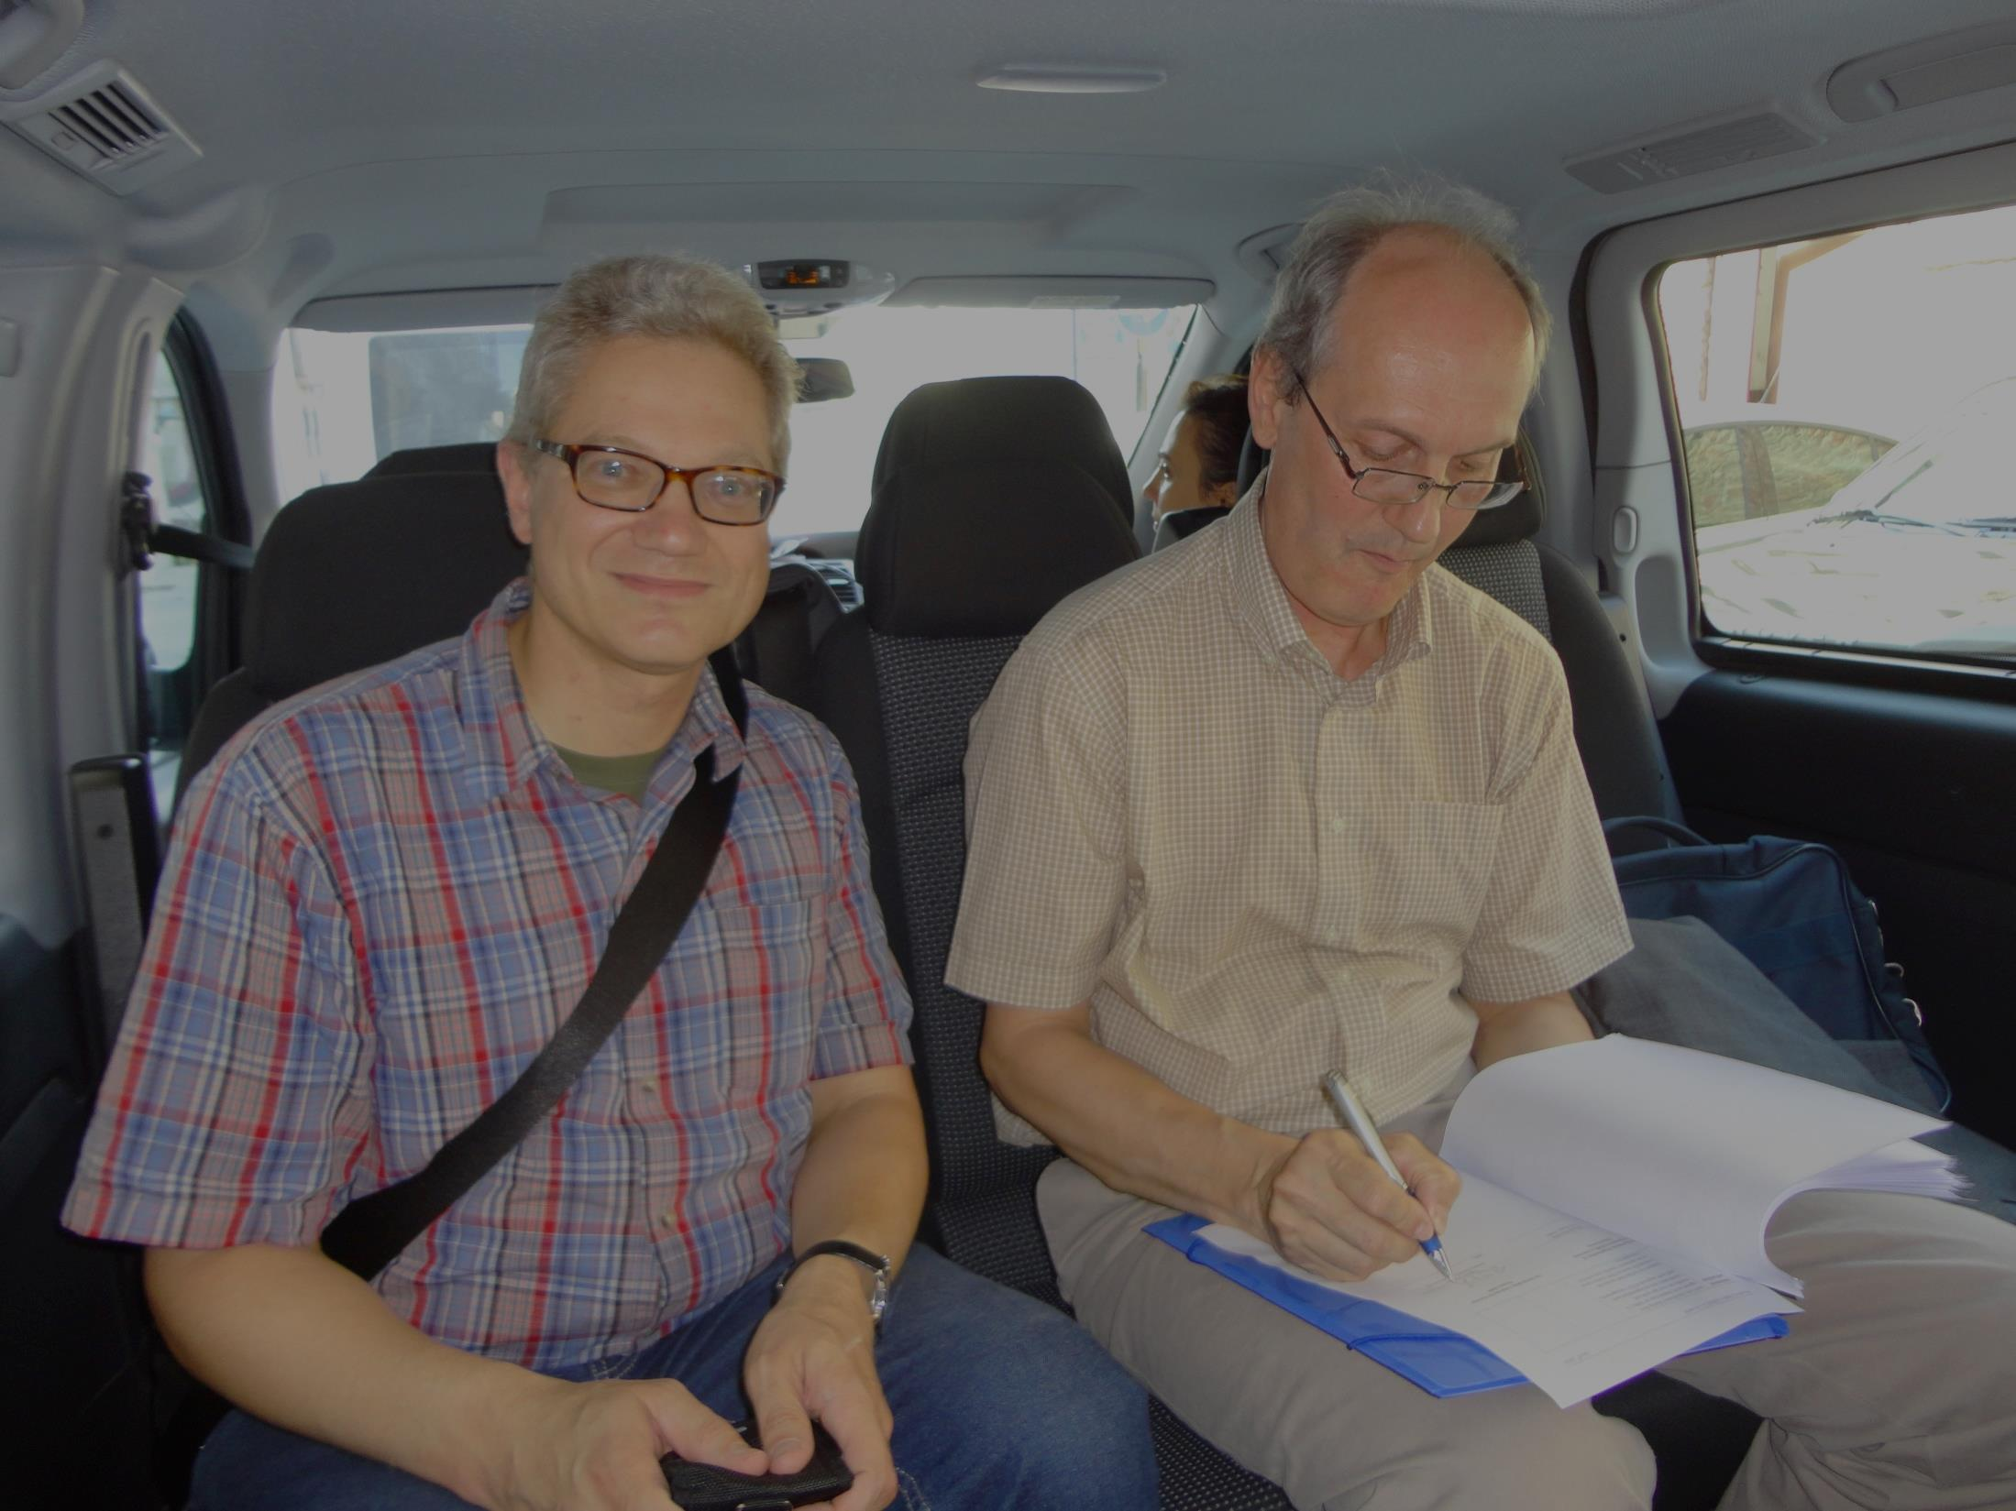
Summary WG1 parameters
Eugene Levichev, Frank Zimmermann
HF2014, 12 October 2014
Work supported by the European Commission under Capacities 7th Framework Programme, Grant Agreement 312453

Slide 2
WP1 parameters
Physics motivation and requirements, Alain Blondel (U. Geneva)
Choice of circumference, minimum & maxim energy, number of collision points, and target luminosity, Michael Koratzinos (U. Geneva)
Ring circumference and two rings vs one ring, Richard Talman (Cornell U.)
Beam-beam effects in high-energy colliders: crab waist vs. head-on, Dmitry Shatilov (BINP)
Optimizing beam intensity, number of bunches, bunch charge, and emittance, Chuang Zhang (IHEP)
Polarization issues in FCC-ee collider, Eliana Gianfelice (FNAL)
Constraints on the FCC-ee lattice from the compatibility with the FCC hadron collider, Bastian Haerer (CERN)
Polarization issues and schemes for energy calibration, Ivan Koop,
Optimizing costs of construction and operation, possible construction time line, Weiren Chou (FNAL)

Slide 3
physics requirements – Alain Blondel
precision of luminosity measurement needs to be improved; systematic errors likely to dominate; need for small-angle measurement to be revisited
duration of e⁺e⁻ run ~20 years, including physics staging
polarization more difficult for smaller machine
mono-chromatization: factor 10 smaller collisions energy spread for ten times lower luminosity?

Slide 4
Alain Blondel
A Sample of Essential Quantities:
X | Physics | Present precision |  | TLEP stat Syst Precision | TLEP key | Challenge
M_{Z} MeV/c2 | Input | 91187.5 ±2.1 | Z Line shape scan | 0.005 MeV <±0.1 MeV | E_cal | QED corrections
Γ_{Z} MeV/c2 | Δρ (T) (no Δα!) | 2495.2 ±2.3 | Z Line shape scan | 0.008 MeV <±0.1 MeV | E_cal | QED corrections
R_{l} | α_{s ,} δ_{b} | 20.767 ± 0.025 | Z Peak | 0.0001 ± 0.002 - 0.0002 | Statistics | QED corrections
N_{ν} | Unitarity of PMNS, sterile ν’s | 2.984 ±0.008 | Z Peak Z+γ(161 GeV) | 0.00008 ±0.004 0.001 | ->lumi meast Statistics | QED corrections to Bhabha scat.
R_{b} | δ_{b} | 0.21629 ±0.00066 | Z Peak | 0.000003 ±0.000020 - 60 | Statistics, small IP | Hemisphere correlations
A_{LR} | Δρ, ε_{3 ,}Δα (T, S ) | 0.1514 ±0.0022 | Z peak, polarized | ±0.000015 | 4 bunch scheme | Design experiment
M_{W} MeV/c2 | Δρ, ε_{3 ,} ε_{2,} Δα (T, S, U) | 80385 ± 15 | Threshold (161 GeV) | 0.3 MeV <1 MeV | E_cal & Statistics | QED corections
m_{top} MeV/c2 | Input | 173200 ± 900 | Threshold scan | 10 MeV | E_cal & Statistics | Theory limit at 100 MeV?

Slide 5
A possible TLEP running programme (07/2013)
to be updated including power/energy staging
1. ZH threshold scan and 240 GeV running (200 GeV to 250 GeV)
5+ years @2 10^35 /cm2/s => 210^6 ZH events
++ returns at Z peak with TLEP-H configuration
for detector and beam energy calibration
2. Top threshold scan and (350) GeV running
5+ years @2 10^35 /cm2/s ➔ 10^6 ttbar pairs ++Zpeak
3. Z peak scan and peak running , TLEP-Z configuration ➔ 10¹² Z decays
→ transverse polarization of ‘single’ bunches for precise E_beam calibration
2 years
4. WW threshold scan for W mass measurement and W pair studies
1-2 years ➔ 10^8 W pairs ++Zpeak
5. Polarized beams (spin rotators) at Z peak 1 year at BBTS=0.01/IP => 10¹¹ Z decays.
Higgs boson HZ studies
+ WW, ZZ etc..
Top quark mass
Hvv Higgs boson studies
Mz, Γ_{Z} R_{b} etc…
Precision tests and
rare decays
M_{W}, and W properties
etc…
A_{LR}, A_{FB}^{pol} etc
Alain Blondel

Slide 6
optimized parameters – Mike Koratzinos
choice of circumference, minimum & maximum energy, number of collision points, and target luminosity
optimized parameters for CepC:
80% higher luminosity at ZH appears possible
70 km: 20% more luminosity than 53 km
4 IPs: 53% more luminosity than 2 IPs
at 45 GeV: 4x34 cm⁻²s⁻¹ at 10 MW (160 bunches)
at 175 GeV factor 5 less luminosity than FCC-ee

Slide 7
Comparison with simulation
Mike Koratzinos
There exist two analytical calculations (By Valery Telnov and Anton Bogomyagkov) and (at least) a thorough simulation by K. Ohmi
Agreement at momentum acceptances of 1.5%-2% is reasonable – within a factor of 5

Slide 8
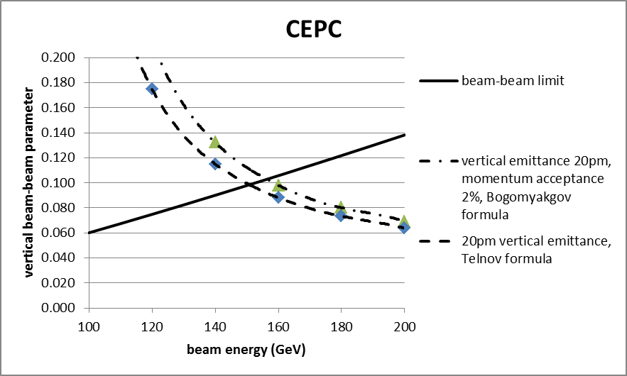
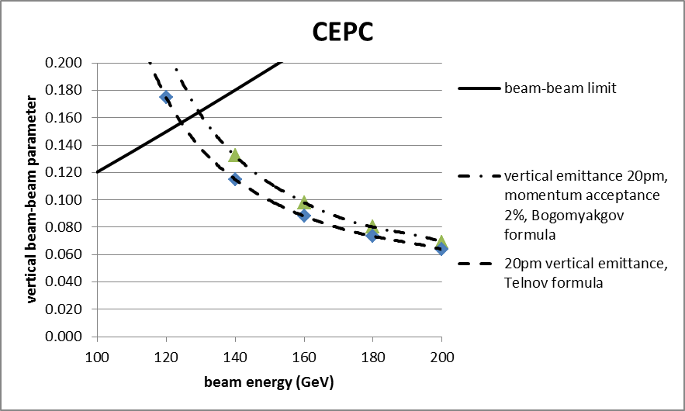
CEPC – the two limitations
Mike Koratzinos
The current CEPC design is conservative – vertical emittance is a factor of 10 larger than FCC-ee
Current CEPC design on left; extrapolating from FCC-ee anticipated xi_y on right. In both cases, 120GeV running is limited by beam-beam
A point of caution: the CEPC design I am using has different xi_x and xi_y values

Slide 9
1 vs 2 rings – Richard Talman
one ring better than two!? (controversial)
optimized design reaches all limits – power, beam-beam and beamstrahlung – at the same time
maximize circumference!
- larger radius possible in China

Slide 10
Richard Talman

Slide 11
Richard Talman

Slide 12
head on vs crab waist – Dmitry Shatilov
TLEP-Z: head-on collision → strong bunch lengthening, blow and long tails, weak damping
crab waist solves the problem
crossing angle changed to 30 mrad
luminosity for TLEP-Z can be further increased if emittance can be reduced below 1 pm
conclusions:
at Z, W: energy acceptance can be reduced
H, t: β_{y}* can be increased

Slide 13
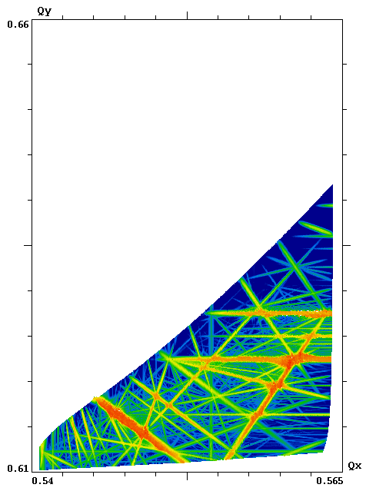
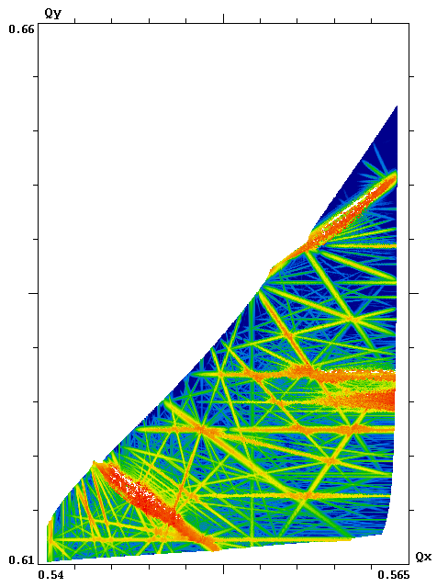
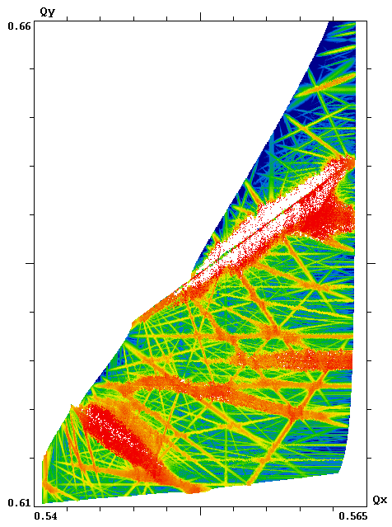
Impact of Bunch Lengthening
σ_{z} = β_{y} σ_{z} = 2β_{y} σ_{z} = 3β_{y}
FMA footprints in the plane of betatron tunes, synchrotron amplitude: A_{s} = 1 sigma.
Parameters as for TLEP Z from FCC-ACC-SPS-0004, ξ_{x} ≈ ξ_{y} ≈ 0.03 (nominal).
Dmitry Shatilov

Slide 14
Luminosity at Low Energies (Z, W)
Dmitry Shatilov
Energy | TLEP Z |  | TLEP W
Collision scheme | Head-on | Crab Waist | Head-on | Crab Waist
Np [10¹¹] | 1.8 | 1.0 | 0.7 | 4.0
θ [mrad] | 0 ? | 30 | 0 ? | 30
σ_{z} (SR / total) [mm] | 1.64 / 3.0 | 2.77 / 7.63 | 1.01 / 1.76 | 4.13 / 11.6
ε_{x} [nm] | 29.2 | 0.14 | 3.3 | 0.44
ε_{y} [pm] | 60.0 | 1.0 | 7.0 | 1.0
ξ_{x} / ξ_{y} [nominal] | 0.03 / 0.03 | 0.02 / 0.14 | 0.06 / 0.06 | 0.02 / 0.20
L [10³⁴ cm⁻²s⁻¹] | 17 | 180 | 13 | 45
Head-on: parameters taken from FCC-ACC-SPS-0004
Crab Waist scheme requires low emittances. This can be achieved by keeping the same lattice as for high energies (i.e. ε_{x} ~ γ²).
The numbers obtained in simulations (by Lifetrac code) are shown in blue.
For TLEP Z ξ_{y} can be raised up to 0.2. If we try to achieve this by 50% increase of N_{p}, additional bunch lengthening will occur due to beamstrahlung, so ξ_{y} increases by 15% only. Decrease of ε_{y} would be more efficient, since for flat bunches beamstrahlung does not depend on the vertical beam size.
One of the main limitations: very small vertical emittance is required. Is it possible to achieve ε_{y} < 1 pm?
The energy acceptance can be decreased from 2% to 1% (for Z) and 1.7% (for W).

Slide 15
Luminosity at High Energies (H, tt)
Dmitry Shatilov
Energy | TLEP H |  | TLEP tt
Collision scheme | Head-on | Crab Waist | Head-on | Crab Waist
Np [10¹¹] | 0.46 | 4.7 | 1.4 | 4.0
θ [mrad] | 0 ? | 30 | 0 ? | 30
σ_{z} (SR / total) [mm] | 0.81 / 1.29 | 4.82 / 9.33 | 1.16 / 1.60 | 5.25 / 6.78
ε_{x} [nm] | 0.94 | 1.0 | 2.0 | 2.13
ε_{y} [pm] | 1.9 | 2.0 | 2.0 | 4.25
ξ_{x} / ξ_{y} [nominal] | 0.093 / 0.093 | 0.02 / 0.13 | 0.092 / 0.092 | 0.03 / 0.07
τ_{bs} [min] | > 500 | 70 | 2 | 20
L [10³⁴ cm⁻²s⁻¹] | 7.4 | 8.4 | 2.1 ? | 1.3
Bending radius at IP:
L – interaction length (for crab waist – overlapping area)
To keep acceptable τ_{bs}, we need to make L larger than β_{y} (for tt – by a factor of ~2)
Again, very small vertical emittance is of crucial importance.
ξ_{y} can be raised by decreasing ε_{y}, but it requires the betatron coupling of ~0.1%. Is it possible?
In general, head-on and crab waist provide similar luminosity at high energies.
Since L > β_{y} and ξ_{y} is below the limit, we can increase β_{y} and luminosity will drop more slowly than 1 / . E.g. increase of β_{y} to 1.5 (2) mm lowers the luminosity by 2.5% (7.5%) for TLEP H, and by 1.5% (5%) for TLEP tt.

Slide 16
design optimization – Chuang Zhang
parameter optimization
for CepC margin in ξ_{y} and luminosity?
large hourglass means large actual ξ_{y}
_{- how about FCC-Z?}

Slide 17
Chuang Zhang
Cost
P_{rf}
ρ , R
k_{b}⋅ I_{b}
ε_{x0}
σ_{E}
L
ε_{y}
σ_{z}
ξ_{y}
β_{y}*
BS
DA
Beam lifetime

Slide 18
Beam-beam parameter
Chuang Zhang
* Data taken from FCC-ACC-SPC-0003
(N_{IP}=4)
FCC-tt
FCC-H
CEPC
N_{IP}=2
FCC-W
N_{IP}=4
FCC-Z

Slide 19
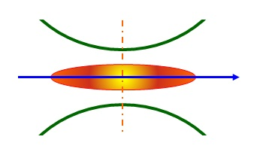
β_{y}*and bunch length σ_{z}
Chuang Zhang
FCC-H
FCC-W, tt
σ_{z}=1.17 mm
β_{y}*=1 mm
H_{g}=0.83
σ_{z}=1.49mm
β_{y}*=1 mm
H_{g}=0.78
CEPC
FCC-Z
σ_{z}=2.65mm
β_{y}*=1.2mm
H_{g}=0.68
σ_{z}=2.56 mm
β_{y}*=1 mm
H_{g}=0.64

Slide 20
polarization – Eliana Gianfelice
toy ring
to reduce polarization time at the Z pole:
add polarization wigglers (e.g. LEP wiggler by Blondel-Jowett) installed in dispersion-free sections & maintain energy spread below critical value (0.6 T field)
first SITROS result, w/o wigglers & w/o corrections
old prediction: polarization at high energy may be enhanced/preserved by higher Q_{s}

Slide 21
Eliana Gianfelice

Slide 22
Eliana Gianfelice

Slide 23
constraints from hadrons - Bastian Haerer
FCC-hh injection, beam dump, collimation and experiments define length of the straight sections
geology and FCC-hh transfer lines define location of FCC
length of IR(s)
choice of l* for protons?

Slide 24
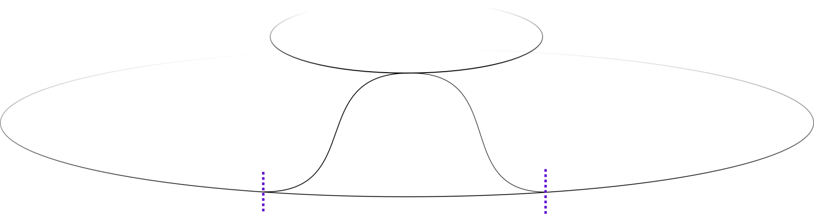
Location relative to LHC
LHC
d
FCC
Courtesy: W. Bartmann
L
FCC and LHC should overlap, if LHC is used as injector
Required distance L for transfer lines depends on:
Difference in depth d
Magnet technology
Beam energy
Max. slope of tunnel 5%
Bastian Haerer

Slide 25
FCC Interaction Region
FCC-hh
FCC-ee #1
Local chromaticity
correction scheme
FCC-ee #2
β_{y}* = 1 mm, L* = 2 m !!!
Large crossing angle
→ 30 mrad, 11 mrad
IR for leptons longer than for hadrons?
Bastian Haerer

Slide 26
polarization&energy calibration – Ivan Koop
proposed scheme: use polarized e⁻ source, measure energy on every injection shot, for e⁺ self polarization in 1-2 GeV intermediate ring
several snakes in booster ring
inject into collider with horizontal polarization vector
measure modulation from Compton polarimetry over first 10,000 turns ; 1e-6 accuracy
resonance strength must be known for getting correct beam energy (spin harmonic matching; measuring several points)
other Compton based energy measurements above 100 GeV: 1e-4 precision
effect of beamstrahlung on polarization?

Slide 27
Ivan Koop

Slide 28
Ivan Koop

Slide 29
cost & planning – Weiren Chou
cost optimization and construction time line
tunnel diameter 6.5 m
RF frequency choice 1.3 GHz (booster), 650 MHz (collider)
58 IHEP cryomodules for XFEL
dig & blast cheaper than TBM, 20-30% cheaper
CPD klystron in Japan: 70-80% efficiency
cost estimate, currency difference CHF/US$?
electronics in the tunnel ?
beam pipe: baseline copper,
- cheaper than Al with Pb cladding

Slide 30
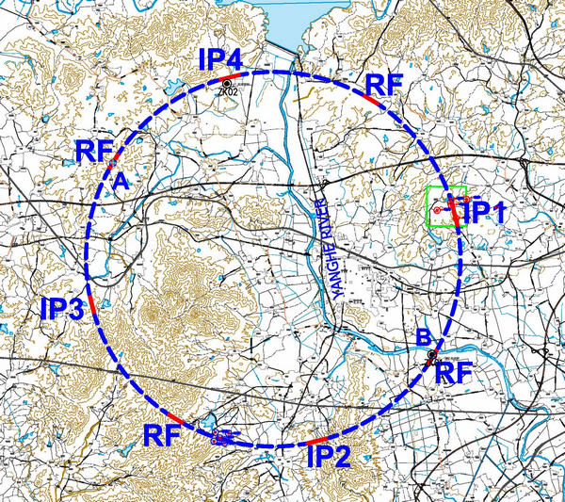
钻孔情况
Weiren Chou
本阶段在秦皇岛抚宁县场址布置了2个钻孔，进尺共200m。ZK1布置于线路东南部洋河南岸，了解工程区覆盖层可能的最大深度；ZK2布置于刘各庄西侧，了解残坡积厚度，深变质岩风化带分带特征。

Slide 31
CEPC Relative Cost Estimate
10%
4%
26%
2.4%
10%
2%
12%
19%
12%
Weiren Chou

Slide 32
CEPC Relative Power Consumption
2%
3%
9%
10%
6%
16%
5%
48%
Weiren Chou

Slide 33
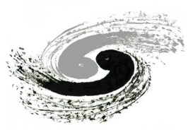
CEPC-SppC Project Timeline (dream)
CEPC
 |  | 2015 |  |  |  |  | 2020 |  |  |  |  | 2025 |  |  |  |  | 2030 |  |  |  |  | 2035
Pre-studies (2013-2015)
R&D Engineering Design (2016-2020)
Construction (2021-2027)
Data taking (2028-2035)
1st Milestone: pre-CDR (by the end of 2014) → R&D funding request to Chinese government in 2015 (China’s 13th Five-Year Plan 2016-2020)
SppC
 |  | 2020 |  |  |  |  |  |  | 2030 |  |  |  |  |  |  |  |  | 2040
R&D (2014-2030)
Engineering Design (2030-2035)
Construction (3035-2042)
Data taking (2042-2055)
Weiren Chou

Slide 34
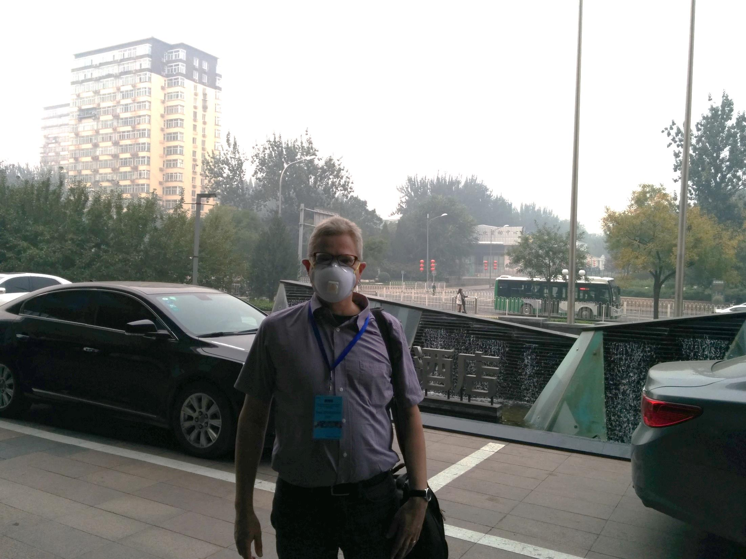
谢谢 !

