Slide 1


Future Accelerators
F. Zimmermann, CERN
oPAC School 2014
Royal Holloway, University of London
12 July 2014
Work supported by the European Commission under Capacities 7th Framework Programme, Grant Agreement 312453

Slide 2
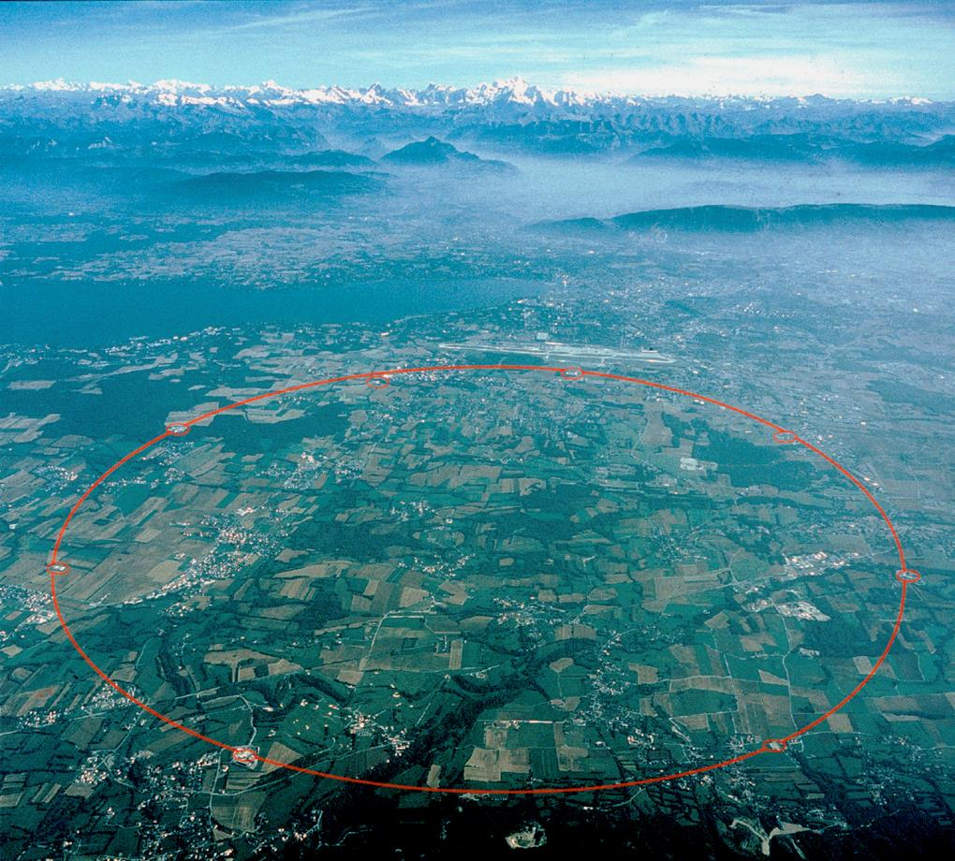
contents
history & past improvements
limitations
user needs
plans to overcome limitations
advanced future schemes
international R&D efforts

Slide 3
general accelerator history

Slide 4
basic types of accelerators
linear accelerator - LINAC
circular accelerators: synchrotrons, storage rings
hybrid: recirculating linacs
rf cavities
particles are
accelerated
many times by
same rf cavity
rf cavity

Slide 5
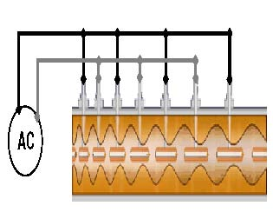
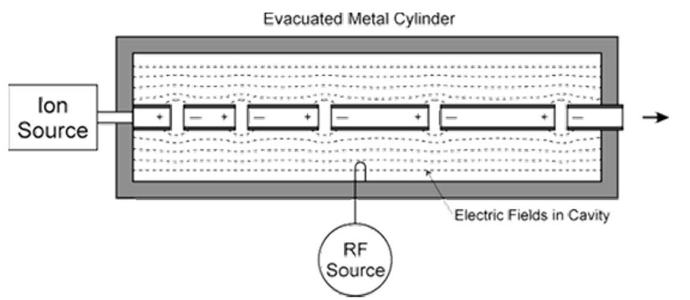
linear accelerators
1924 Ising, 1928 Wideroe, 50 keV Na & K ions (1 drift tube)
1931 Sloan and Lawrence, 2.8 MeV Hg ions (2 m, 36 drift tubes)
acceleration occurs only in gap between electrodes
1946 Alvarez
used for protons and ions, for p energies 50-200 MeV
resonant behavior of cavity provides longitudinal electric field ;
became possible due to the development of ultrahigh frequency
technology (e.g. klystron) before and during World War II
S. Feher, U Melbourne

Slide 6
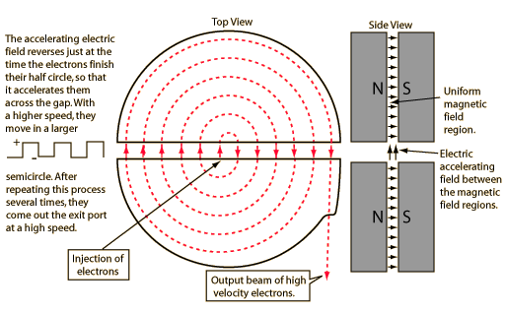
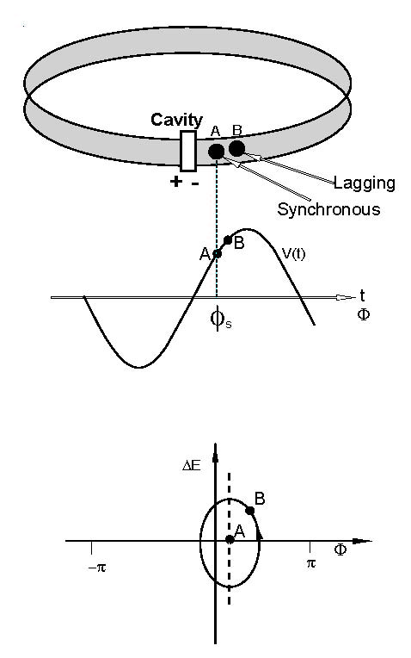
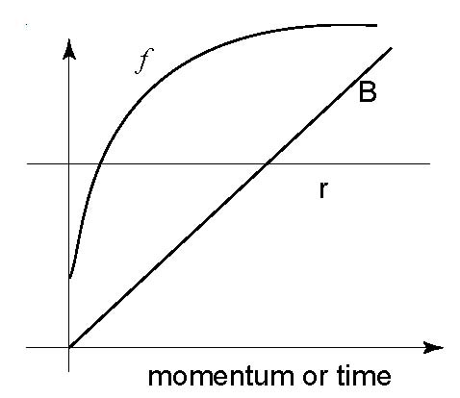
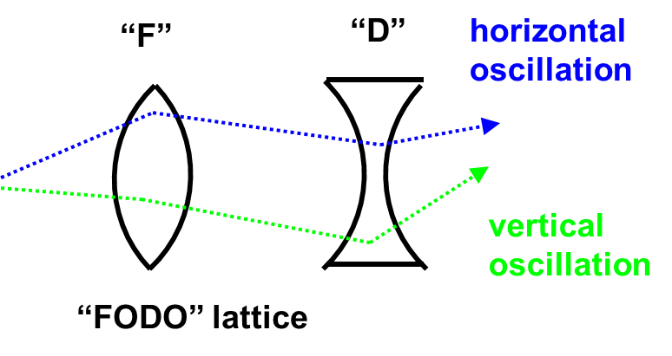
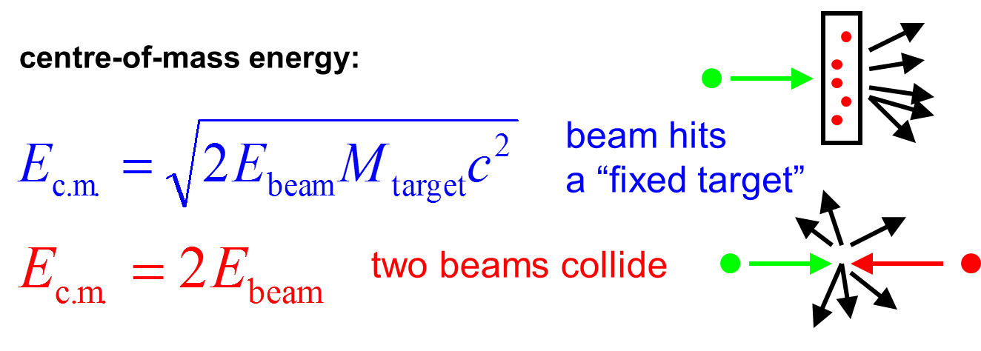
circular accelerators
cyclotron
synchrotron
strong focusing
colliding beams
acc. el. field
reverses each
half circle
(1929, 1930)
“phase stability”
rf frequency changes with magnetic field
so as to keep particles on a constant circle
(1934, 1943, 1944, 1945)
novel idea: combination of two lenses focuses in both planes simultaneously
(1950, 1952, 1959: PS)
much higher c.m. energies than for fixed target
(1943, 1956, 1961, 1971: ISR)

Slide 7
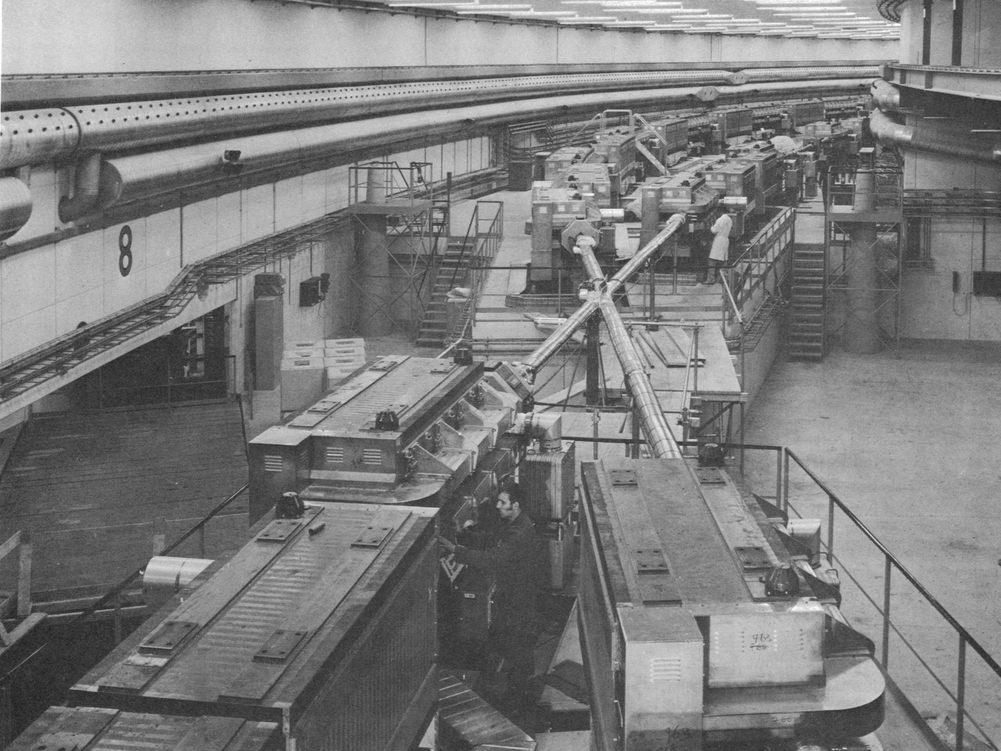
CERN ISR ~1971
the first hadron collider

Slide 8
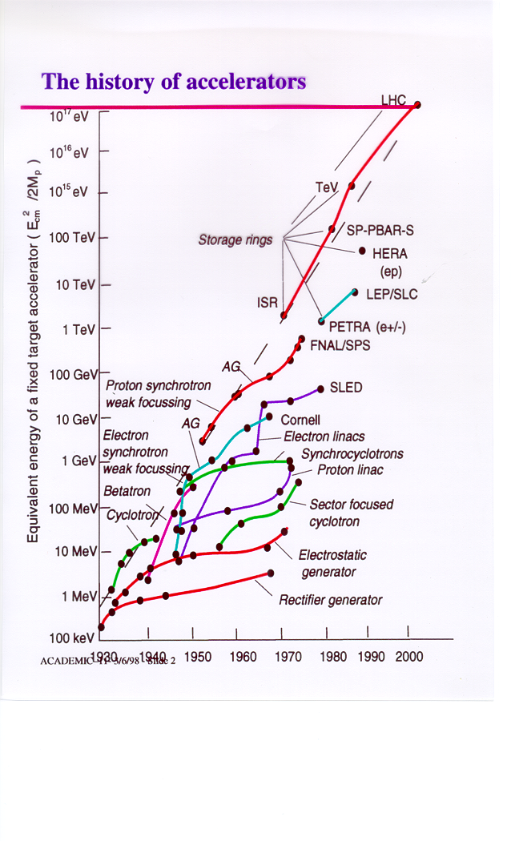
evolution of beam energy over 70 years
new technologies:
repeated jumps from saturating to emerging technologies
storage rings have been the frontrunner technology for the last ~50 years
Nb-Ti SC magnets
colliders
P. Lebrun

Slide 9
accelerator applications

Slide 10
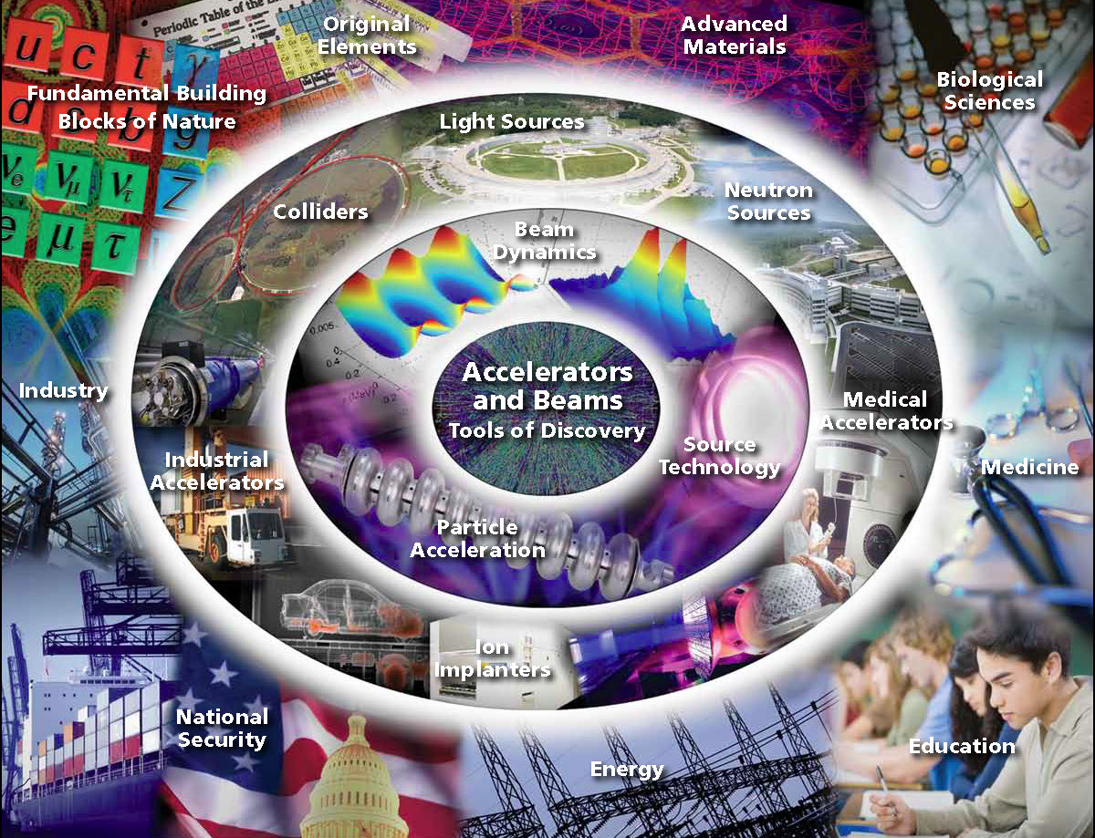
Source: Accelerators and Beams (APS-DPP), ORNL

Slide 11
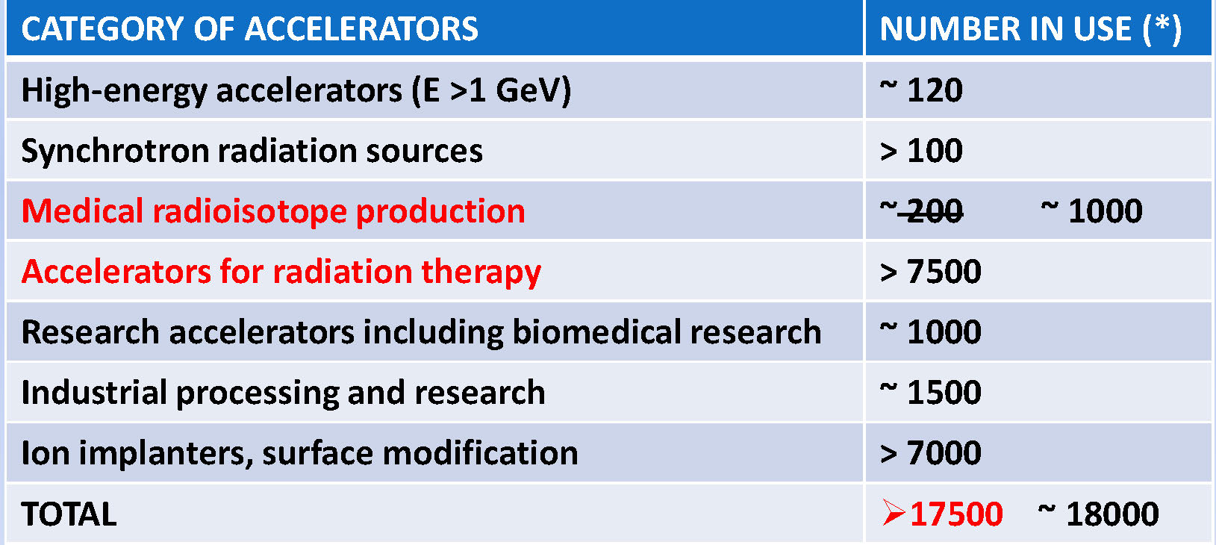
accelerators operating in the world
3 main applications:
Scientific research
Medical applications
Industrial uses
M. Silari, ASP 2010;
adapted from “W. Maciszewski and W. Scharf,
“Particle accelerators for radiotherapy, Present status and future”, Physica Medica XX, 137 - 145 (2004)

Slide 12
synchrotron radiation
sources

Slide 13
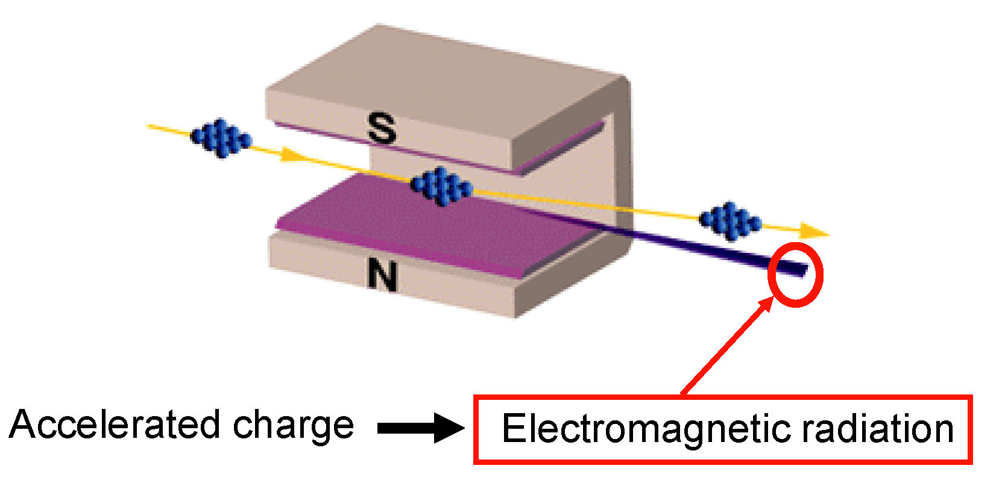
curved orbit of e⁻ in magnetic field
L. Rivkin

Slide 14
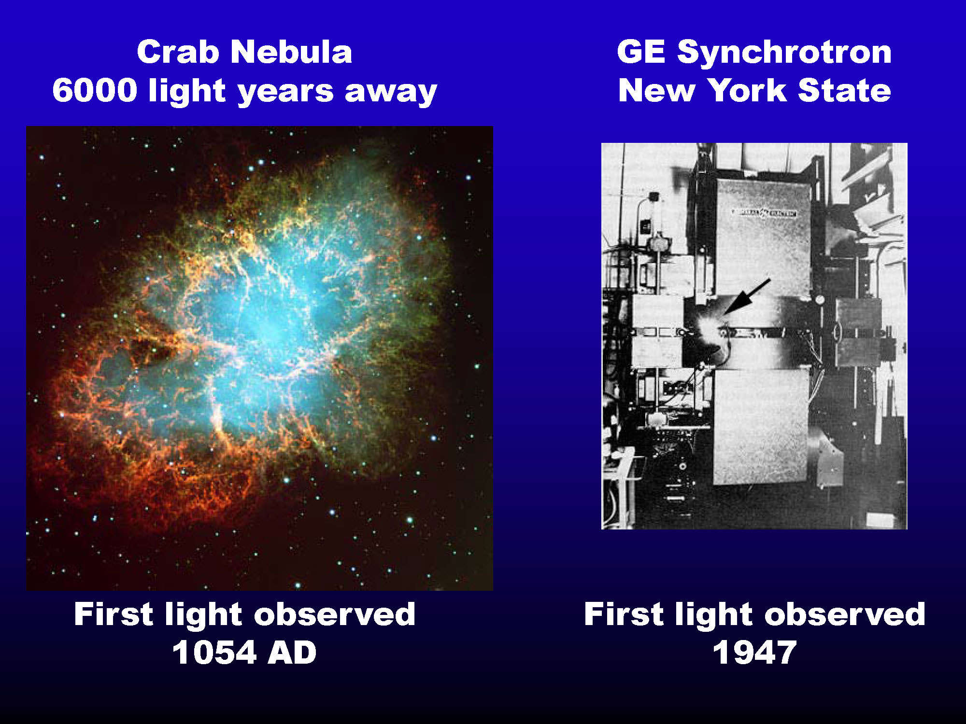
L. Rivkin

Slide 15
ascent of synchrotron radiation
year | event
1946 | Blewett observed energy loss due to synchrotron radiation at 100 MeV betatron
1947 | First visual observation of SR at 70 MeV synchrotron, GE laboratory
1949 | Theoretical paper by Schwinger
1953 | First undulator installed at Stanford by Motz
1961 | Experimental SR program at National Bureau of Standards
1976 | First demonstration of Free Electron Laser by Madey

Slide 16
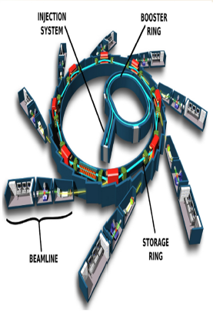
storage ring light source
R. Hettel, IPAC’14

Slide 17
spatial & temporal coherence
Coherence is a fundamental property of a radiation source. Most light sources including synchrotron radiation and FELs posses a certain degree of coherence.
Spatial coherence describes the degree to which the phase of the wave is correlated at two distinct points in the transverse plane.
Temporal coherence speciﬁes the extent to which the radiation maintains a deﬁnite phase relationship at two different times.
Z. Huang, IPAC13

Slide 18
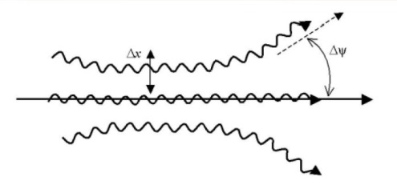
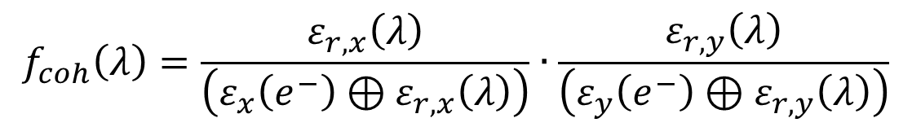
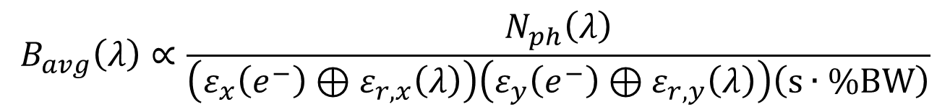
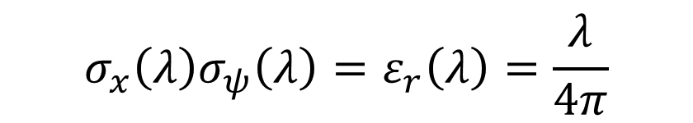
spectral brightness & related quantities
spectral brightness
$$B_{avg}\left(λ\right)∝\frac{N_{ph}\left(λ\right)}{\left(ε_{x}\left(e^{−}\right)⊕ε_{r,x}\left(λ\right)\right)\left(ε_{y}\left(e^{−}\right)⊕ε_{r,y}\left(λ\right)\right)\left(\text{s}∙\%\text{BW}\right)}$$
coherent fraction
$$f_{coh}\left(λ\right)=\frac{ε_{r,x}\left(λ\right)}{\left(ε_{x}\left(e^{−}\right)⊕ε_{r,x}\left(λ\right)\right)}∙\frac{ε_{r,y}\left(λ\right)}{\left(ε_{y}\left(e^{−}\right)⊕ε_{r,y}\left(λ\right)\right)}$$
diffraction-limited photon-beam emittance
$$σ_{x}\left(λ\right)σ_{ψ}{\left(λ\right)=ε}_{r}\left(λ\right)=\frac{λ}{4π}$$
for coherent Gaussian photon distribution
R. Hettel, IPAC’14

Slide 19
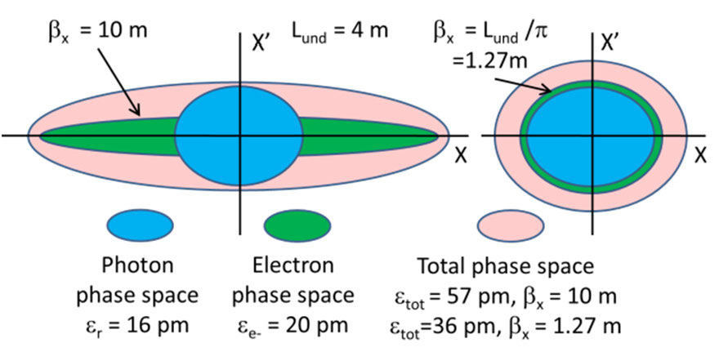
X-ray emittance from electron source
total emittance is minimized when ε_{x,y} is minimized and photon and e- phase space orientations are matched:
for undulator of length L optimum: β_{x,y}=L/π
R. Hettel, IPAC’14

Slide 20
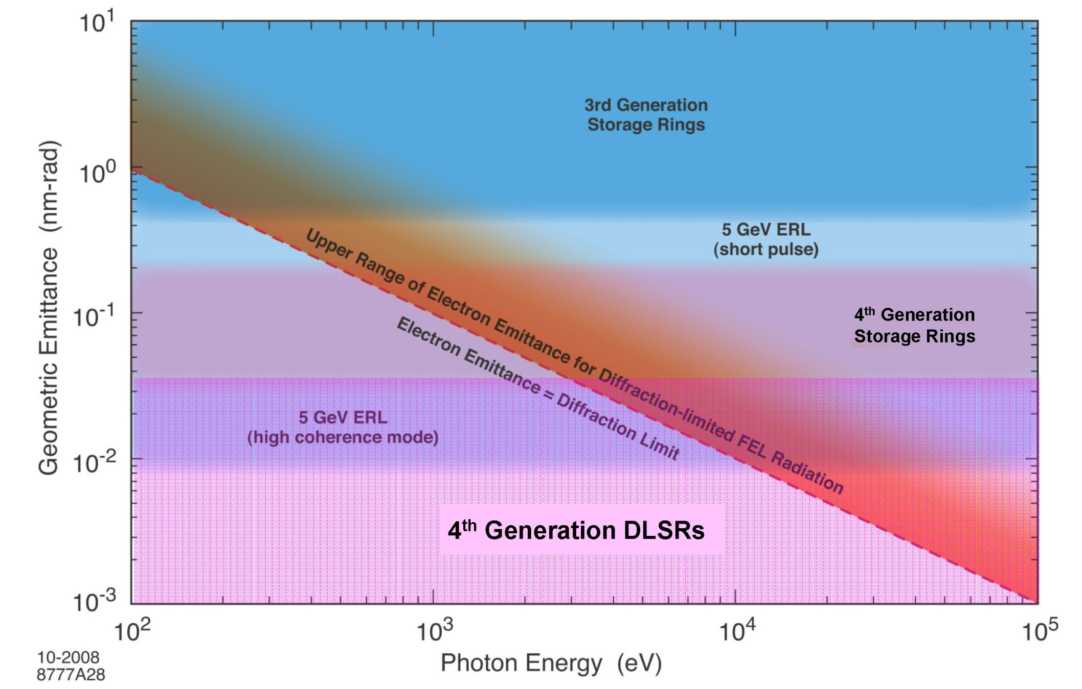

diffraction-limited emittance
R. Hettel, IPAC’14
$$ε_{r}\left(λ\right)=\frac{λ}{4π}$$

Slide 21
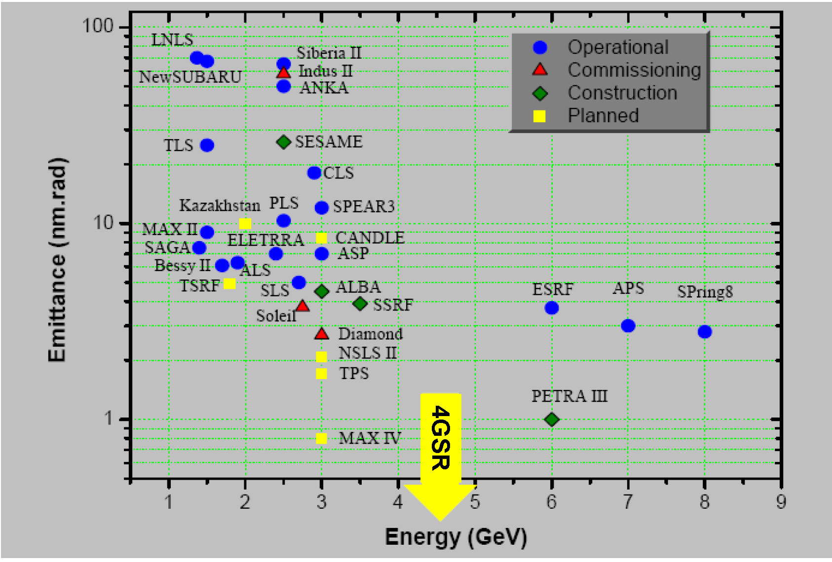
state of SR light sources
R. Hettel, IPAC’14

Slide 22
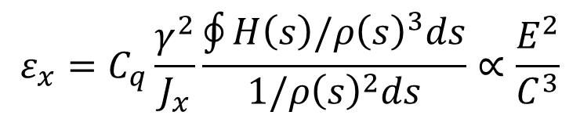
recent trends in light source design
$$ε_{x}=C_{q}\frac{γ^{2}}{J_{x}}\frac{\oint{H\left(s\right)/ρ{\left(s\right)}^{3}ds}}{1/{ρ\left(s\right)}^{2}ds}∝\frac{E^{2}}{C^{3}}$$
NSLS-II 2014-DW
TPS-2015
MAX-IV-2015-DW
PETRA-III
2009
ILSF - 2019 ?
TAC > 2020
SIRIUS-2016
circumference [m]
H. Wiedemann

Slide 23
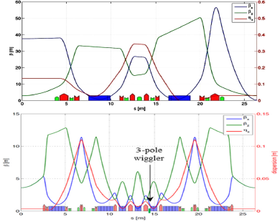
MBA lattice: smaller emittance
now: ESRF - DBA
minimizing
H(s)
below what
was
previously
thought
to be
possible
future: ESRF - 7BA
R. Hettel, IPAC’14

Slide 24
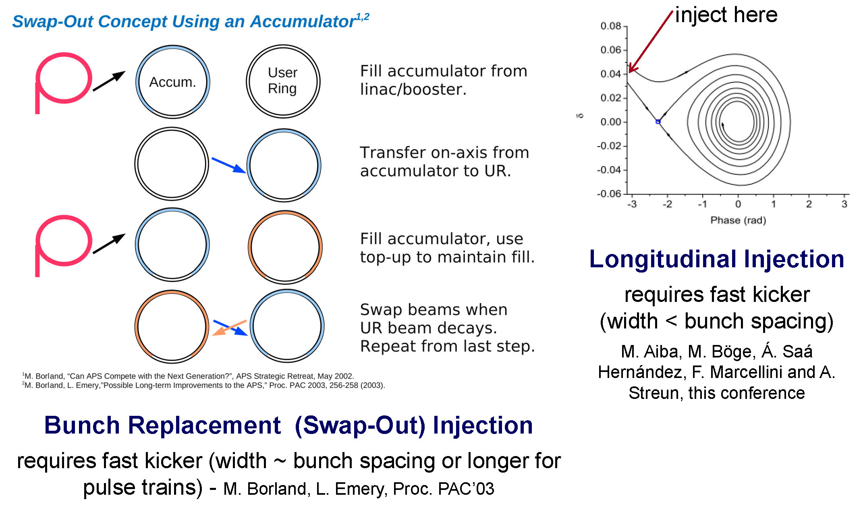
on-axis injection with small dyn. aperture
more cells, smaller dispersion → stronger & more sextupoles
→ low dynamic aperture
R. Hettel, IPAC’14

Slide 25
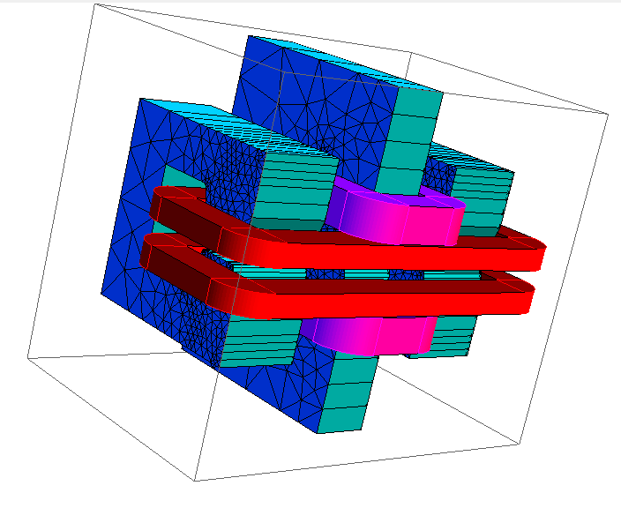
low-field bends & high-field inserts
how do we get hard x-rays from low-field bending magnets?
use high field inserts (1.8 to 2T)
produce radiation only where needed
ISLF
lower-energy rings with high-field inserts
H. Wiedemann

Slide 26
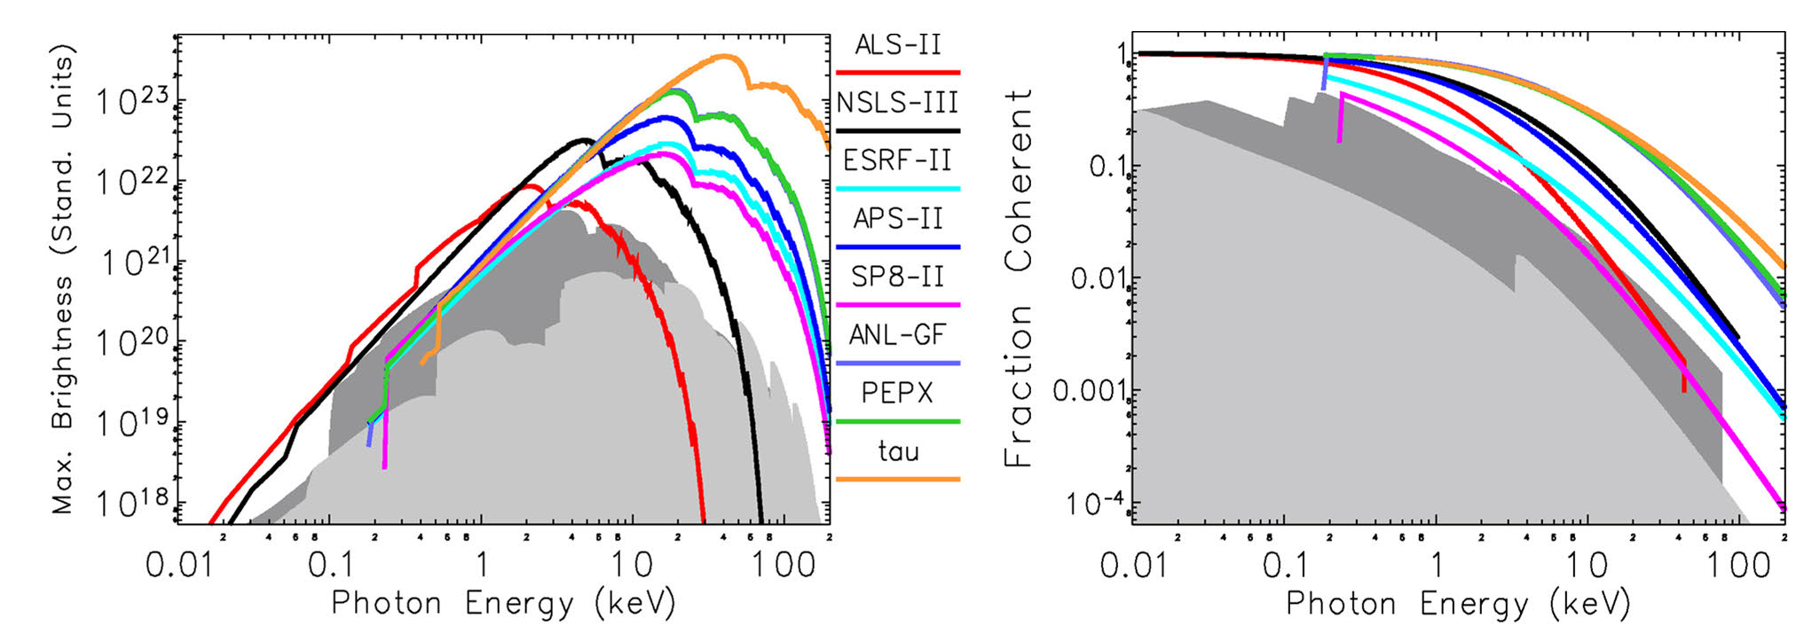
brightness and coherence of future rings
Compiled by M. Borland, July 2013
diffraction-limited rings now being designed with Nb₃Sn SC insertion devices
R. Hettel, IPAC’14

Slide 27
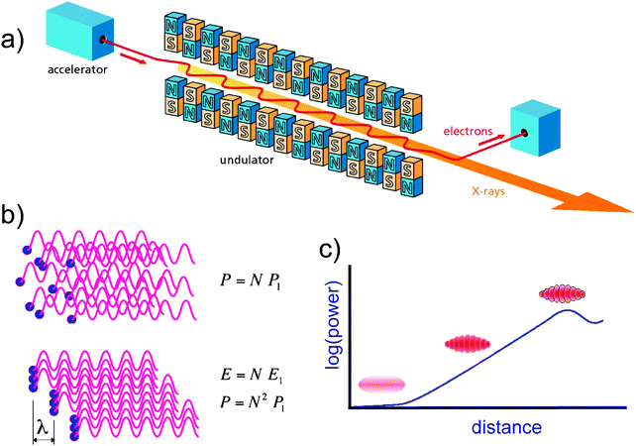
Free Electron Laser (FEL)
ultrafast dynamics, damage free imaging of nanostructure,…
coherence
T. Shintake

Slide 28
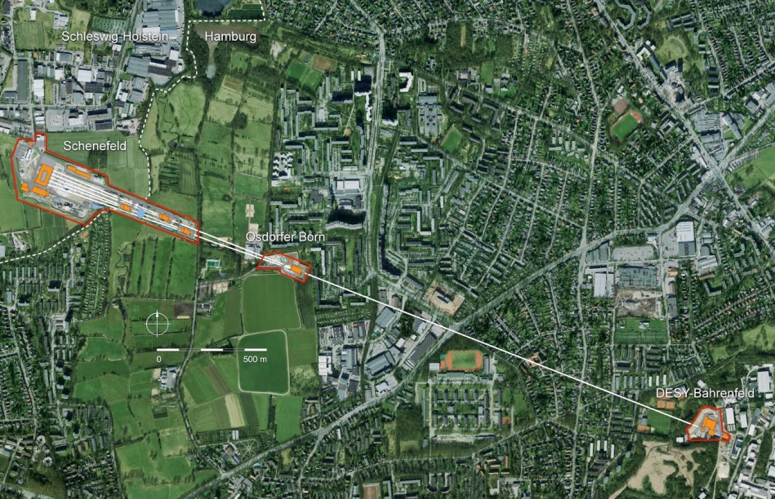
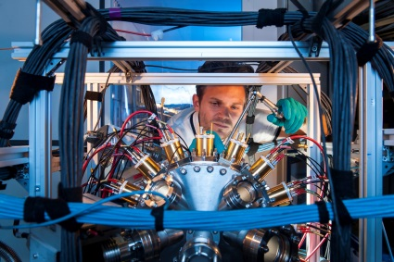
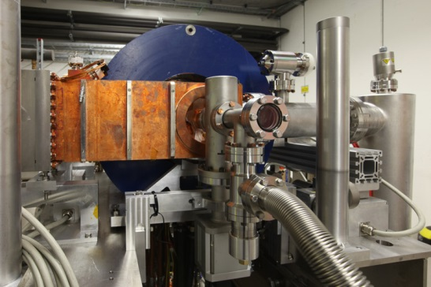
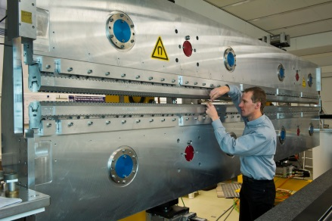
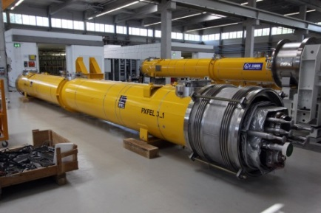
Status of the European XFEL, TAC ISAC Meeting, Istanbul, 7-8 July, 2014
European XFEL in Hamburg
Scientific instruments and instrumentation
Electron injector
Undulator systems
Superconducting electron accelerator
3.5 km
S.L. Molodtsov, European XFEL

Slide 29
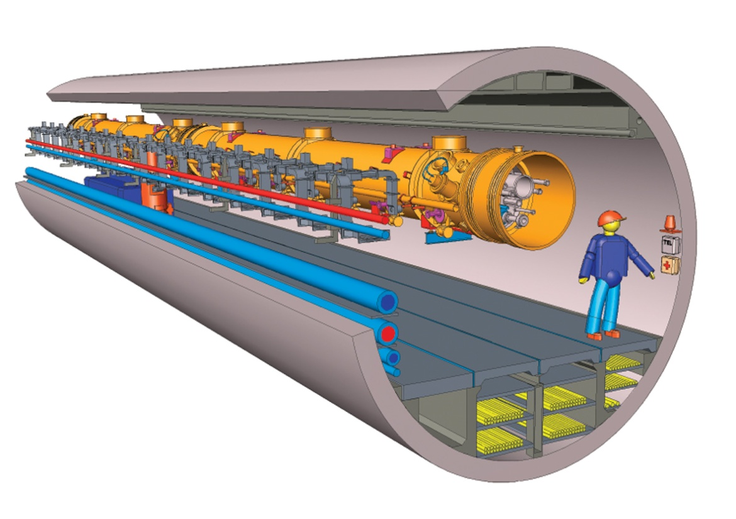
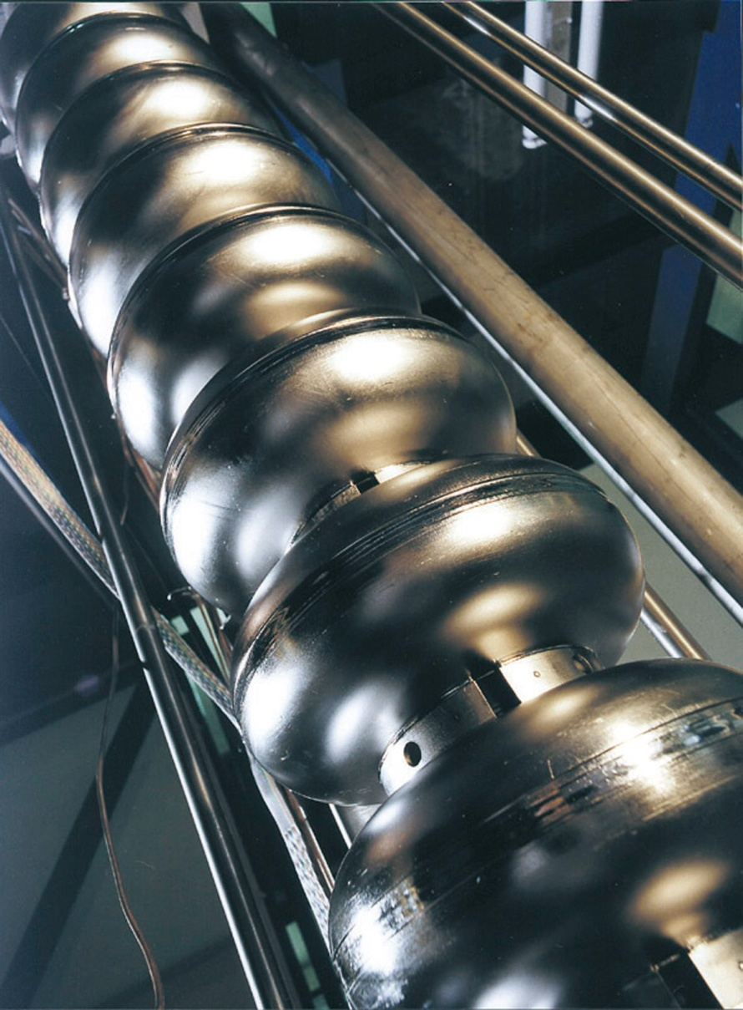
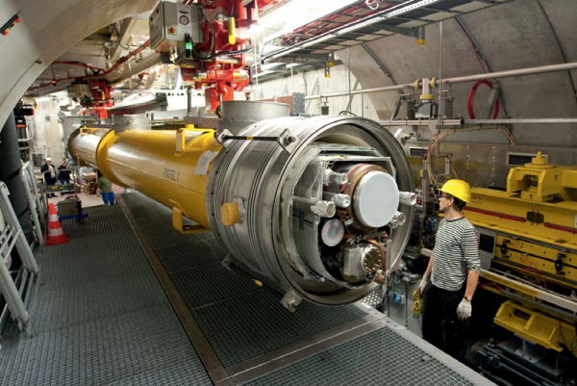
SC linac technology
100 8-Cavity modules, 1.4 km, 17.5 GeV Electron Energy
Module: 8x Cavities
module
protoype
PXFEL 1
Niobium Cavities
S.L. Molodtsov, European XFEL

Slide 30
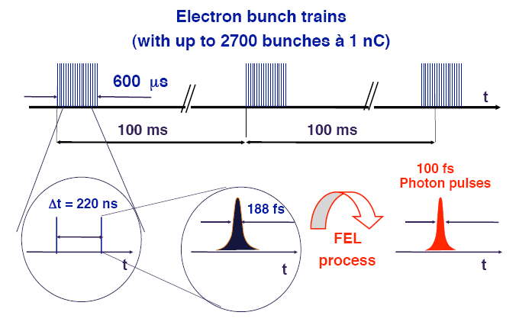
XFEL time structure
Superconducting LINAC technology provides 27.000 light pulses/s in burst-
like structure. It makes XFEL.EU attractive for photon-hungry experiments.
S.L. Molodtsov, European XFEL

Slide 31
Status of the European XFEL, TAC ISAC Meeting, Istanbul, 7-8 July, 2014
XFEL photon energy ranges
31
Photon energy ranges
284 eV - C K
2145 eV - P K
4038 eV - Ca K
7112 eV - Fe K
543 eV - O K
2470 eV - S K
4992 eV - Ti K
410 eV - N K
500-1300 eV
2p TM, 3d RE
12.4 keV
25 keV
water window
20 keV
Diffraction
(DAC, etc.)
500 -1300
6 -14 keV
18 - >25 keV
Hard x-ray undulators
SASE 1 & 2 (40 mm)
Soft x-ray undulator
SASE 3 (68 mm)
3.0 – ~25 keV
0.25 – ≥3 keV
Electron
energy sets
17.5 GeV
14.0 GeV
12.0 GeV
8.5 GeV
200 eV
1 keV
10 keV
~1 Angstrom
S.L. Molodtsov, European XFEL

Slide 32
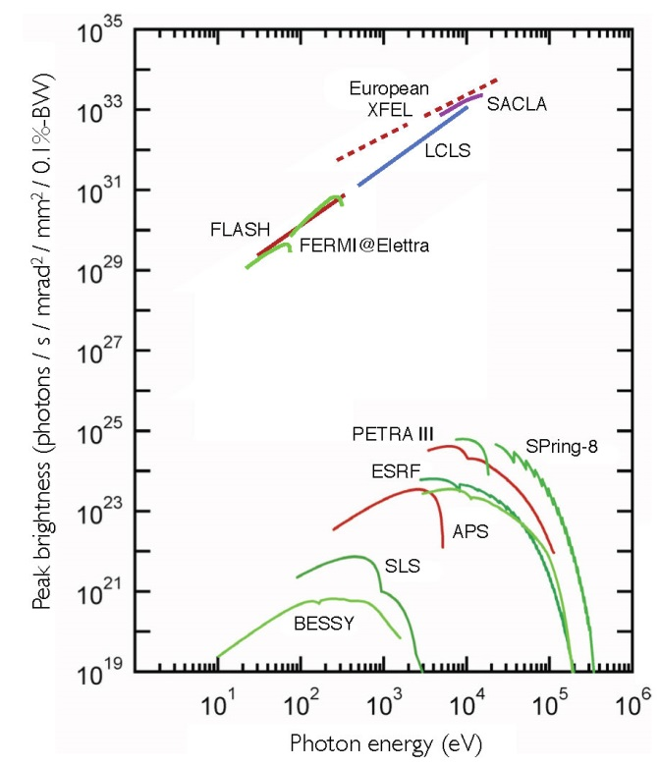
peak brightness comparison
Z. Huang, IPAC13

Slide 33
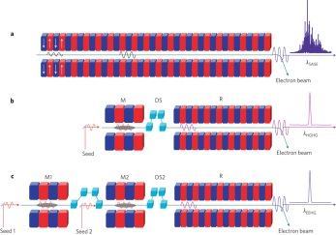
FEL seeding techniques
SASE FEL, with poor temporal coherence
HGHG FEL: full temporal coherence with limited harmonic number (N ≈ 10) for a single stage
EEHG FEL: full temporal coherence with very high harmonic number in single stage
. b,. c,
M, modulator; DS, dispersive section; R, radiator
Z.T. Zhao et al, Nature Photonics 6, 360–363 (2012)

Slide 34
high intensity proton beams
nuclear physics
radioactive ion beams
ADS
spallation sources
neutrino sources

Slide 35
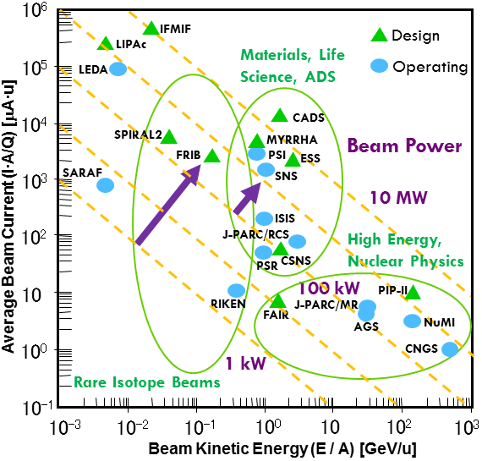
hadron-accelerator power frontier
J. Wei
IPAC’14

Slide 36
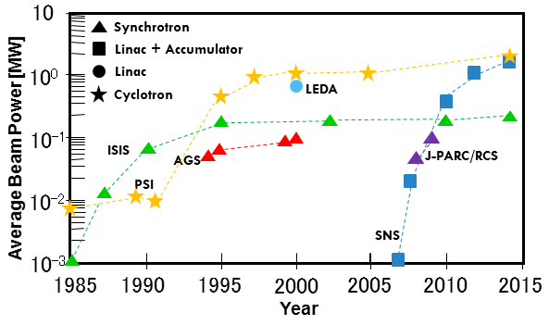
beam power growth at major facilities
J. Wei
IPAC’14

Slide 37
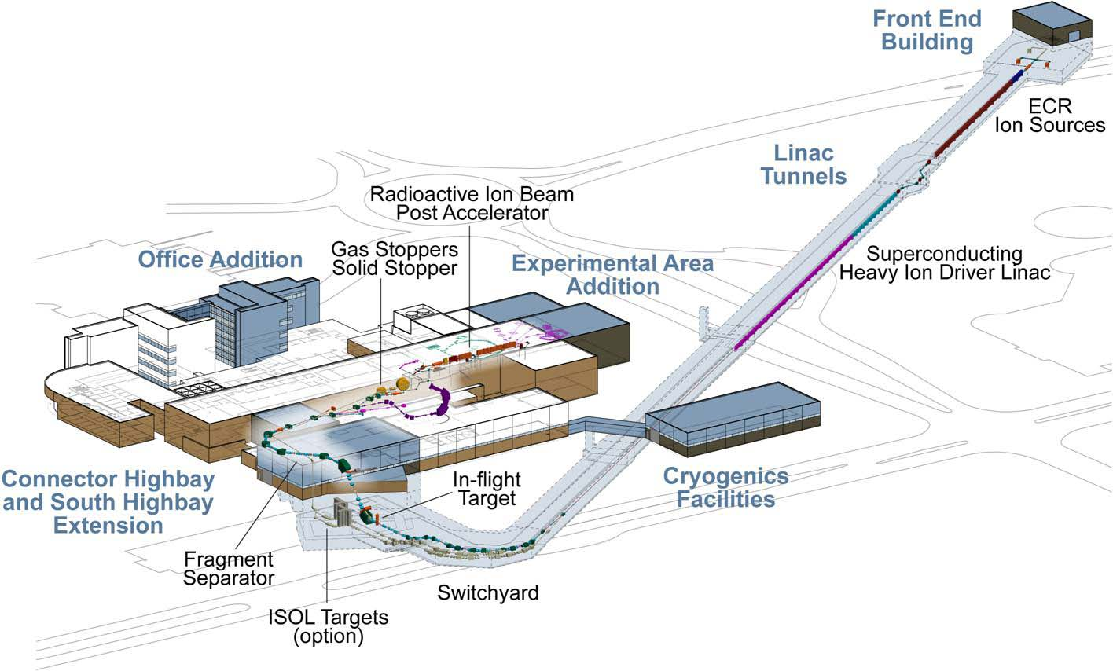
Rare Isotope Beams: FRIB

Slide 38
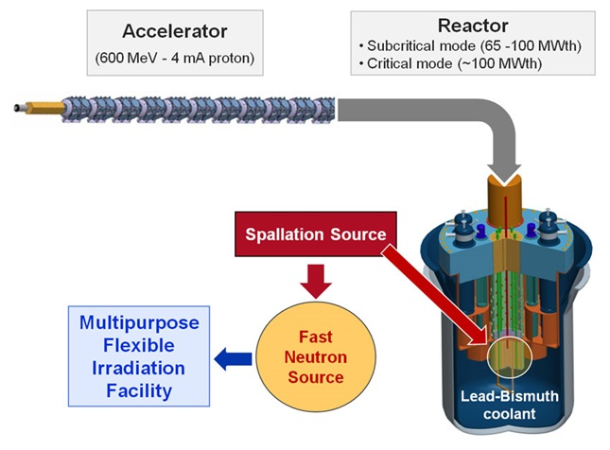
ADS: MYRRHA
An accelerator driven system (ADS): neutron source created by coupling a proton accelerator, a spallation source and a sub-critical core.
2.1 MW proton beam (600 MeV - 3.5 mA)
50-100 MW thermal power

Slide 39
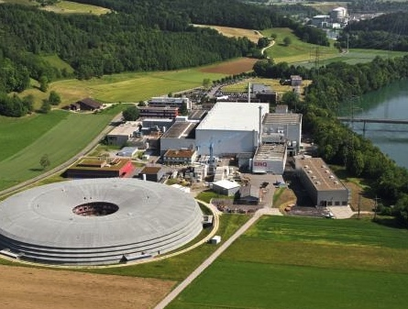
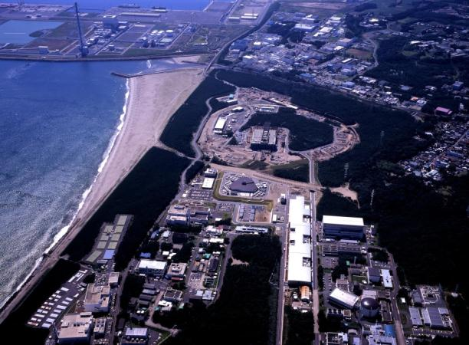
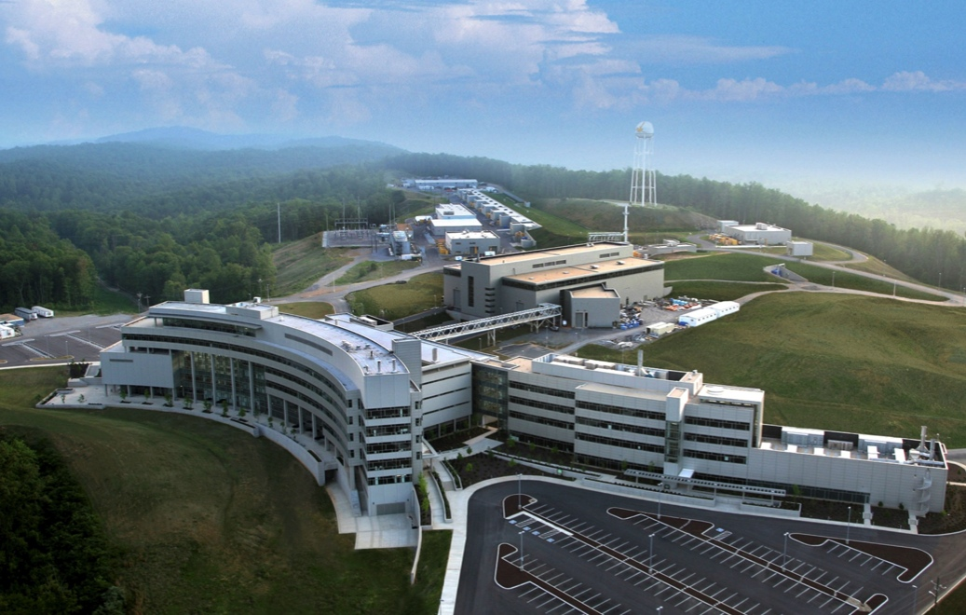
MW class spallation neutron sources
B. Riemer
SINQ at PSI
  Continuous beam, 570 MeV H⁺
SNS at the ORNL
  60 Hz, short-pulse, 1 GeV H⁺
JSNS at MLF / JPARC
  25 Hz, short-pulse, 3 GeV H⁺
Notes:
Three MW facilities at different levels of maturity.
These server neutron scattering science missions

Slide 40
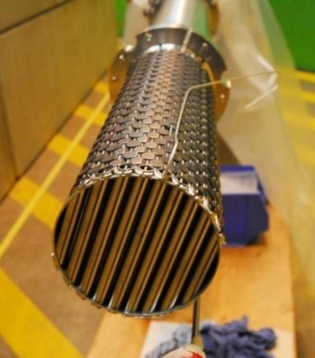
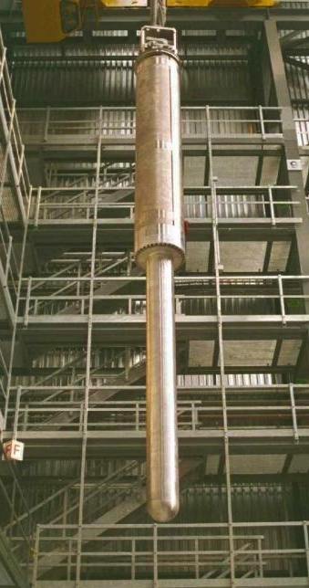
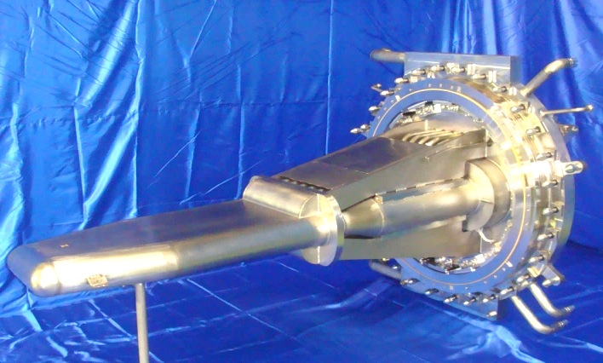

MW class spallation neutron targets
SINQ at PSI
  Pb in Zr tubes, D₂O cooled
SNS at the ORNL
  Circulating Hg in SS vessel
JSNS at MLF / JPARC
  Circulating Hg in SS vessel
Pb / Zircaloy target
Mercury
Mercury
B. Riemer, ICHEP’14

Slide 41


T2K/T2HK, LBNE(/F)
1300 km
physics data since 2010
3x10²⁰ p on target so far

Slide 42
medical accelerators

Slide 43

cancer treatment - X rays vs protons
X-rays vs. Protons
M. Schippers, M. Seidel
IPAC’14

Slide 44

cancer treatment - X rays vs protons
X-ray beams (IMRT ) from 7 directions
Proton beams from 3 direction
pictures: Medaustron
M. Schippers, M. Seidel
IPAC’14

Slide 45

the boost in particle therapy
M. Schippers, M. Seidel
IPAC’14

Slide 46
high-energy colliders

Slide 47


LEP – largest circular e⁺e⁻ collider so far
R. Assmann, Chamonix 2001
1000 pb⁻¹ from 1989 to 2000

Slide 48



Large Hadron Collider (LHC)
design:
c.m. energy 14 TeV (pp);
luminosity 10³⁴ cm⁻²s⁻¹; 1.15x10¹¹ p/bunch;
2808 bunches/beam;
360 MJ / beam
1983 first LHC proposal, launch of design study
1994 CERN Council: LHC approval
2010 first collisions at 3.5 TeV beam energy
2015 collisions at $\sim$design energy (plan)
now is the time to plan for 2040!

Slide 49


Discovery 2012, Nobel Prize in Physics 2013
The Nobel Prize in Physics 2013 was awarded jointly to François Englert and Peter W. Higgs "for the theoretical discovery of a mechanism that contributes to our understanding of the origin of mass of subatomic particles, and which recently was confirmed through the discovery of the predicted fundamental particle, by the ATLAS and CMS experiments at CERN's Large Hadron Collider”.

Slide 50

2014 Prospects for Particle Physics
With the discovery of a Higgs boson in 2012, we have completed the Standard Model (almost 80 years of theoretical and experimental efforts !)
However: SM is not a complete theory of particle physics, as several outstanding questions remain (e.g. composition of dark matter, cause of universe’s accelerated expansion [dark energy / inflation], origin of matter-antimatter asymmetry, neutrino masses, why 3 families?, lightness of Higgs boson, weakness of gravity, … ) which cannot be explained within the SM.
F. Gianotti et al.
These questions require NEW PHYSICS
Present knowledge is insufficient to determine energy scale of new physics ; LHC will provide new information from pp collisions at higher cm energy (13 TeV) by 2017-18

Slide 51
main questions in particle physics and main approaches to address them
question | high-energy colliders | high-precision experiments | neutrino experiments | dedicated searches | cosmic surveys
Higgs, EWSB | X
neutrinos | X |  | X | X | X
dark matter | X |  |  | X
flavour, CP violation | X | X | X | X
new particles and forces | X | X | X | X
universe acceleration |  |  |  |  | X
F. Gianotti et al.
most of these questions require high-energy and/or
high-intensity accelerators

Slide 52
European Strategy Update 2013
Design studies and R&D at the energy frontier
….“to propose an ambitious post-LHC accelerator project at CERN by the time of the next Strategy update”:
d) CERN should undertake design studies for accelerator projects in a global context,
with emphasis on proton-proton and electron-positron high-energy frontier machines.
These design studies should be coupled to a vigorous accelerator R&D programme, including high-field magnets and high-gradient accelerating structures,
in collaboration with national institutes, laboratories and universities worldwide.
http://cds.cern.ch/record/1567258/files/esc-e-106.pdf
strategy adopted at Brussels in May 2013, during exceptional session of the CERN Council in presence of the European Commission

Slide 53

Future Circular Collider (FCC) study ; goals: CDR and cost review for the next European Strategy Update (2018)
International collaboration :
pp-collider (FCC-hh) → defining infrastructure requirements
including HE-LHC option: 16-20 T in LHC tunnel
e⁺e⁻ collider (FCC-ee/TLEP) as potential intermediate step
p-e (FCC-he) option
100 km infrastructure in Geneva area
~16 T ⇒ 100 TeV in 100 km
~20 T ⇒ 100 TeV in 80 km
M. Benedikt

Slide 54

CepC/SppC study (CAS-IHEP), CepC CDR end of 2014, e⁺e⁻ collisions ~2028; pp collisions ~2042
Qinhuangdao (秦皇岛）
CepC, SppC
50 km
easy access
300 km from Beijing
3 h by car
1 h by train
70 km
“Chinese Toscana”
Yifang Wang

Slide 55


collider c.m. energy vs. year
pp
E_{cm}=2ec Bρ
hadron-lepton
factor 10 every
10 years
factor 10 every
20-30 years
ep
FCC-he
LHeC
e⁺e⁻
factor 10⁵-10⁷ in e⁺e⁻
luminosity
Courtesy V. Shiltsev,

Slide 56

FCC-hh: 100 TeV pp collider
Geneva
PS
SPS
LHC
B. Strauss
LHC
27 km, 8.33 T
14 TeV (c.m.)
“HE-LHC”
27 km, 20 T
33 TeV (c.m.)
FCC-hh (alternative)
80 km, 20 T
100 TeV (c.m.)
FCC-hh (baseline)
100 km, 16 T
100 TeV (c.m.)
Key technology: high-field SC magnets

Slide 57
parameter | LHC | HL-LHC | FCC-hh
c.m. energy [TeV] | 14 |  | 100
dipole magnet field [T] | 8.33 |  | 16 (20)
circumference [km] | 36.7 |  | 100 (83)
luminosity [10³⁴ cm⁻²s⁻¹] | 1 | 5 | 5 [→20?]
bunch spacing [ns] | 25 |  | 25 (5)
events / bunch crossing | 27 | 135 | 170 (34)
bunch population [10¹¹] | 1.15 | 2.2 | 1 (0.2)
norm. transverse emitt. [mm] | 3.75 | 2.5 | 2.2 (0.44)
IP beta-function [m] | 0.55 | 0.15 | 1.1
IP beam size [mm] | 16.7 | 7.1 | 6.8 (3)
synchrotron rad. [W/m/aperture] | 0.17 | 0.33 | 28 (44)
critical energy [keV] | 0.044 |  | 4.3 (5.5)
total syn. rad. power [MW] | 0.0072 | 0.0146 | 4.6 (5.8)
longitudinal damping time [h] | 12.9 |  | 0.54 (0.32)
Cms energy
Luminosity

Slide 58

cost-optimized high-field dipole magnets
15-16 T: Nb-Ti & Nb₃Sn
20 T: Nb-Ti & Nb₃Sn & HTS
only a quarter is shown
“hybrid magnets”
example block-coil layout
L. Rossi, E. Todesco, P. McIntyre

Slide 59





Nb₃Sn vs Nb-Ti SC wire production
US-CDP
ITER wires
HL-LHC wires
B. Strauss, data by courtesy of J. Parrell (US DOE OST)

Slide 60


superconducting magnet technology
SC solenoid magnets (dipoles to follow)
35 T Proof-of-Principle Demo
(4T HTS Test Coil in a
31T Background Magnetic Field)
SUPERCONDUCTING MAGNETS
g Demonstration Test Coils
g Commercial Magnet Systems
High
T_{c}
“contributing to a revolution in real time”
φ 39 mm
Nb₃-Sn
23.5 T (1GHz NMR) Nb₃-Sn Superconducting Magnets
(Manufactured Commercially)
Nb-Ti
G. Boebinger, NHMFL

Slide 61


magnet R&D - possible spin offs & synergies
example : electric power transmission
using HTS
cables
„Pilotstrecke AmpaCity: zum ersten Mal wird mitten in einer Großstadt (Essen) ein Supraleiter (HTS: BSSCO) für den Stromtransport in ein existierendes Stromnetz eingebunden.“

Slide 62

hadron-collider peak luminosity vs. year
Courtesy W. Fischer
LHC run 1 (2012-13) accumulated more integrated luminosity than all previous hadron colliders together!

Slide 63
FCC-ee: e⁺e⁻ collider up to 350 (500) GeV
circumference ≈100 km
A. Blondel
for top up injection
top-up injection is the key to extremely high luminosity;
requires full-energy injector
short beam lifetime (~τ_{LEP2}/40) due to high luminosity supported by top-up injection (used at KEKB, PEP-II, SLS,…);
top-up also avoids ramping & thermal transients, + eases tuning

Slide 64
parameter | LEP2 | FCC-ee |  |  |  |  | CepC
 |  | Z | Z (c.w.) | W | H | t | H
E_{beam} [GeV] | 104 | 45 | 45 | 80 | 120 | 175 | 120
circumference [km] | 26.7 | 100 | 100 | 100 | 100 | 100 | 54
current [mA] | 3.0 | 1450 | 1431 | 152 | 30 | 6.6 | 16.6
P_{SR,tot} [MW] | 22 | 100 | 100 | 100 | 100 | 100 | 100
no. bunches | 4 | 16700 | 29791 | 4490 | 1360 | 98 | 50
N_{b} [10¹¹] | 4.2 | 1.8 | 1.0 | 0.7 | 0.46 | 1.4 | 3.7
ε_{x} [nm] | 22 | 29 | 0.14 | 3.3 | 0.94 | 2 | 6.8
ε_{y} [pm] | 250 | 60 | 1 | 1 | 2 | 2 | 20
β∗_{x} [m] | 1.2 | 0.5 | 0.5 | 0.5 | 0.5 | 1.0 | 0.8
β∗_{y} [mm] | 50 | 1 | 1 | 1 | 1 | 1 | 1.2
σ∗_{y} [nm] | 3500 | 250 | 32 | 130 | 44 | 45 | 160
σ_{z,SR} [mm] | 11.5 | 1.64 | 2.7 | 1.01 | 0.81 | 1.16 | 2.3
σ_{z,tot} [mm] (w beamstr.) | 11.5 | 2.56 | 5.9 | 1.49 | 1.17 | 1.49 | 2.7
hourglass factor F_{hg} | 0.99 | 0.64 | 0.94 | 0.79 | 0.80 | 0.73 | 0.61
L/IP [10³⁴ cm⁻²s⁻¹] | 0.01 | 28 | 212 | 12 | 6 | 1.7 | 1.8
τ_{beam} [min] | 300 | 287 | 39 | 72 | 30 | 23 | 40

Slide 65

e⁺e⁻ luminosity vs energy

Slide 66

The Twin Frontiers of FCC-ee Physics
Precision Measurements
Rare Decays
Springboard for sensitivity to new physics
Theoretical issues:
  Higher-order QCD
  Higher-order EW
  Mixed QCD + EW
Direct searches for new physics
Many opportunities
Z: 10¹²
b, c, τ: 10¹¹
W: 10⁸
H: 10⁶
t: 10⁶
FCC-ee promises much higher precision & and many more rare decays than any competitors
HL-LHC
ILC500
FCC-ee 350
CepC, 4/ab
Higgs coupling
measurements
M. Bicer et al., “First Look at the Physics Case of TLEP,’’ JHEP 01, 164 (2014)
S. Dawson et al., arXiv:1310.8361v2
J. Ellis
P. Janot
M. Ruan

Slide 67


“at least 3 pieces are still missing”
A. Blondel, The Hunt for Heavy Neutrinos at the Z & H factory, ICHEP’14
neutrinos have mass...
and this very probably implies new degrees of freedom
➔ Right-Handed, Almost «Sterile» (very small couplings) Neutrinos
completely unknown masses (meV to ZeV), nearly impossinle to find.
.... but could perhaps explain all: DM, BAU,ν-masses
These would lead to spectacular ‘detached vertex’ signatures in Z-> neutrino decays at a Tera-Z factory like FCC-ee

Slide 68

SuperKEKB = FCC-ee demonstrator
beam commissioning will start in early 2015
top up injection at high current
β_{y}* =300 μm (FCC-ee: 1 mm)
lifetime 5 min (FCC-ee: ≥20 min)
ε_{y}/ε_{x} =0.25% (similar to FCC-ee)
off momentum acceptance (±1.5%, similar to FCC-ee)
e⁺ production rate (2.5x10¹²/s, FCC-ee: <1.5x10¹²/s (Z cr.waist)
SuperKEKB goes beyond FCC-ee,
testing all concepts

Slide 69


vertical β* history
β* [m]
year
SPEAR
PEP, BEPC, LEP
PETRA
TRISTAN
DORIS
CESR-c, PEP-II
BEPC-II
CESR
DAFNE
KEKB
SLC
FCC-ee
SuperKEKB
ILC
$$σ^{∗}=\sqrt{{εβ}^{∗}}$$

Slide 70

vertical rms IP spot size
collider / test facility | ${σ_{y}}^{∗}$ [nm]
LEP2 | 3500
KEKB | 940
SLC | 700
ATF2, FFTB | 45 (37), 77
SuperKEKB | 50
FCC-ee-H | 44
ILC | 5 – 8
CLIC | 1 – 2
β_{y}*:
5 cm→
1 mm
ε_{y}:
250 pm→
2 pm
in regular
font:
achieved
in italics:
design
values

Slide 71


FCC-he: high-energy lepton-hadron collider
LHeC CDR , published in 2012
RR LHeC:
new ring
in LHC tunnel,
with bypasses
around
experiments
LR LHeC:
recirculating
linac with
energy
recovery
similar two options for FCC:
(1) FCC-ee ring, (2) ERL – from LHeC or new

Slide 72

FCC-he: – 1st option ring-ring collider
– 2nd option: based on LHeC
FCC
J. Osborne

Slide 73
collider parameters | FCC ERL | FCC-ee ring |  | protons
species | e⁻ (e⁺?) | e± | e± | p
beam energy [GeV] | 60 | 60 | 120 | 50000
bunches / beam | - | 10600 | 1360 | 10600
bunch intensity [10¹¹] | 0.05 | 0.94 | 0.46 | 1.0
beam current [mA] | 25.6 | 480 | 30 | 500
rms bunch length [cm] | 0.02 | 0.15 | 0.12 | 8
rms emittance [nm] | 0.17 | 1.9 (x) | 0.94 (x) | 0.04 [0.02 y]
β_{x,y}*[mm] | 94 | 8, 4 | 17, 8.5 | 400 [200 y]
σ_{x,y}* [μm] | 4.0 | 4.0, 2.0 |  | equal
beam-b. parameter ξ | (D=2) | 0.13 | 0.13 | 0.022 (0.0002)
hourglass reduction | 0.92 (H_{D}=1.35) | ~0.21 | ~0.39
CM energy [TeV] | 3.5 | 3.5 | 4.9
luminosity[10³⁴cm⁻²s⁻¹] | 1.0 | 6.2 | 0.7
preliminary

Slide 74

lepton-hadron scattering facilities till FCC-he
FCC-he
M. Klein and H. Schopper CERN Courier June 2014

Slide 75

Higgs physics at LHeC & FCC-he
h-e Higgs-boson production and decay; and precision measurements of the H–bb coupling in WW–H production; FCC-he also gives access to Higgs self-coupling H–HH (<10% precision!? - under study), to lepto-quarks up to ≈4TeV & to Bjorken x as low as 10⁻⁷ - 10⁻⁸ [of interest for ultra high energy ν scattering]
M. Klein and H. Schopper, CERN Courier June2014

Slide 76

FCC global design study – time line
2014 |  |  |  | 2015 |  |  |  | 2016 |  |  |  | 2017 |  |  |  | 2018
Q1 | Q2 | Q3 | Q4 | Q1 | Q2 | Q3 | Q4 | Q1 | Q2 | Q3 | Q4 | Q1 | Q2 | Q3 | Q4 | Q1 | Q2 | Q3 | Q4
Prepare
Kick-off, collaboration forming,
→study plan and organisation
Ph 1: Explore options
“weak interaction”
Workshop & Review →identification of baseline
Ph 2: Conceptual study of baseline “strong interact.”
Workshop & Review, cost model, LHC results → study re-scoping?
Ph 3: Study
consolidation
4 large FCC Workshops distributed over participating regions
Workshop & Review
→ contents of CDR
Report
Release CDR & Workshop on next steps
  presently discussions with potential partners (MoUs)
  first international collaboration board meeting at CERN on 9 & 10 September 2014
M. Benedikt

Slide 77


FCC Kick-off Meeting
University of Geneva
12-15 February 2014
>340 participants
http://indico.cern.ch/e/fcc-kickoff
http://cern.ch/fcc

Slide 78








Slide 79









Slide 80


FCC Kick-Off Parallel Sessions
Session | # Participants
Technical infrastructure and civil engineering | 47
Hadron collider design (+ SC magnets + injectors) | 75
Lepton collider design (+ SC RF + injectors) | 62
Hadron Physics, Experiments, Detectors | 93
Lepton Physics, Experiments, Detectors | 54
e-p Option | 18
Overall physics and phenomenology | 63

Slide 81



signing FCC MoUs with partners

Slide 82
main questions in particle physics and main approaches to address them
question | high-energy colliders | high-precision experiments | neutrino experiments | dedicated searches | cosmic surveys
Higgs, EWSB | X
neutrinos | X |  | X | X | X
dark matter | X |  |  | X
flavour, CP violation | X | X | X | X
new particles and forces | X | X | X | X
universe acceleration |  |  |  |  | X
within the scope of FCC
F. Gianotti et al.
many questions require high-energy and/or
high-intensity accelerators

Slide 83

possible evolution of FCC complex
FCC-ee (80-100 km,
e⁺e⁻, up to 350
or 500 GeV c.m.)
PSB
PS (0.6 km)
LHC (26.7 km)
SPS (6.9 km)
FCC-hh
(pp up to
100 TeV c.m.
& AA)
HL-LHC
LHeC & SAPPHiRE (γγ)
FCC-he as ring-ring
collider ?!
LHeC as FCC-ee injector?
LHeC-based FCC-he collider?!
FCC-he: e± (60-250 GeV) – p(50 TeV)/A collisions
≥50 years e⁺e⁻, pp, e±p/A physics at highest energies

Slide 84


tentative time line
1980
1990
2000
2010
2020
2030
2040
LHC
Design,
R&D
Proto.
Constr.
Physics
HL-LHC
Design,
R&D
Constr.
Physics
LHeC/SAPPHiRE?
Design,
R&D
Constr.
Physics
FCC
ee
hh
he
Design,
R&D
Constr.
Physics

Slide 85
accelerator cost

Slide 86
Phenomenological Cost Model: Conventional Technology
Phenomenological Cost Model: Present Technology
Cost = α L^{1/2} + β E^{1/2} + γ P^{1/2}
where α,β,γ – technology dependent constants
  α≈ 2B$/sqrt(L/10 km)
  β≈ 10B$/sqrt(E/TeV) for RF
  β≈ 2B$/sqrt(E/ TeV) for SC magnets
  β≈ 1B$ /sqrt(E/TeV) for NC magnets
  γ≈ 2B$/sqrt(P/100 MW)
“Energy” – Cost of
Accelerator
Components
“Total Project Cost “
“Tunnel Length”
Civil Construction
“Site Power”
Infrastructure

Slide 87

Total Cost vs Model (Log-Log)
The model is good to +-30%
V. Shiltsev

Slide 88
remarkable advance in accelerator cost/energy
thanks to new technologies
1959
cost ~ E_{cm} ^{0.28}
1971
2008
P. Lebrun, RFTech 2013

Slide 89


energy consumption & cost (survey)
EuCARD-2 EnEfficient;
J. Torberntsson, ESS; M. Seidel, PSI

Slide 90

energy spot market prices
found on the internet
Renewable energies cause strong variations
impact on accelerators?
EuCARD-2 EnEfficient;
M. Seidel, PSI

Slide 91
energy management or „virtual power plant“
in the presence of more and more renewable energies, flexibility becomes more important
adapt operation to situation on Grid, e.g. through efficient standby modes
energy storage on site, e.g. utilizing cryogenic facility?
cost effective backup power station, gas turbine?
→ workshop planned for 2015 (J.Stadlmann, GSI)

Slide 92

energy recovery linacs
Example: LHeC
6-pass 2x10-GeV recirculating linac with energy recovery

Slide 93
far future schemes
dielectric wake field acceleration
driven by another beam or by laser
plasma wake field acceleration of electrons
driven by laser, e- beam or p beam
crystal acceleration
driven by x-ray lasers
dielectric laser acceleration
cystal bending

Slide 94

ILC: SC linear collider
total length (main linac) ~30 (500 GeV) - 50 km (1 TeV)
accelerating gradient ~30 MV/m

Slide 95
CLIC: warm X-band linear collider
total length (main linac) ~11 (500 GeV) - 48 km (3 TeV)
accelerating gradient
~100 MV/m

Slide 96

limits to accelerating gradients
G_{max}$≈$30 MV/m (Nb superconductor)
G_{max}$≈$100 MV/m (normalconducting metal)
due to surface breakdown
G_{max}$≈$1-3 GV/m (dielectrics)
G_{max}$≈$100 GV/m (n₀ [10¹⁸ cm⁻³])^{1/2} (plasma
with n₀ ≈10¹⁷-10¹⁸ cm⁻³ plasma density)
G_{max}$≈$10 TV/m (n₀ [10²² cm⁻³])^{1/2} (crystal
with n₀ ≈10²²-10²³ cm⁻³)
G_{max}$≈$10¹⁸ V/m (Schwinger critical field,
vacuum breakdown)
today
tomorrow?

Slide 97

proton-driven plasma acceleration
The plasma acts as an energy transformer: energy is transferred from the driver to the witness bunch that is accelerated.
The maximum energy gain of the accelerated beam in a single plasma stage is limited by driver energy (e- bunch, laser pulse, etc.)
Current proton synchrotrons can produce high energy protons, reaching up to multi TeV (LHC) ➔ p bunches are the most promising drivers of wakefields to accelerate e’s to TeV energy scale

Slide 98

PoP Experiment: Awake
Approved in August 2013
First p+ and laser beam in 2016 (Phase 1)
First e- beam in 2017-2018 (Phase 2)
Laser
RF gun
e- beam
e- spectrometer
Plasma cell
p+ dump
SPS p+ beam
accelerating gradient
>1 GV/m
Laser dump
OTR for SMI diagnostics
C. BV
Klystron
Incident, Reflected Power and phase
Incident, Reflected, transmitted Power
Spectrometer
Laser +Diagnostics
E, ΔE
MTV
Matching triplet
FCT
Emittance
MS
FC
BPR
BPR
BPR
RF GUN
Corrector
VPI
MTV,
Emittance
C. Bracco
Accelerator

Slide 99


far future p-driven plasma collider designs
An e+ e- collider
An e-p collider
accelerating gradient
>1 GV/m
S. Chattopadhyay

Slide 100






(r)evolutionary advancement: DLA
Traditional Manufacturing
Semiconductor Manufacturing
Room temp.
10E-4
Fibers
Gratings
Crystals
Superconducting
E_{acc} = 30 MV/m
E_{acc} = 2 GV/m *
λ = 10 cm
λ = 1 - 2 μm
* in theory
R. Byer

Slide 101


dielectric laser-driven accelerator
T. Plettner, et al. PRST-AB 9, 111301 (2006).
Electron microscope image of the bonded structure

Slide 102

experimental results from SLAC
measuring the gradient by observing
the resultant energy broadening
R. Byer

Slide 103

experimental results from SLAC
Cross correlation of electron and laser pulses in time
Measured acceleration gradient vs Peak Electric Field
R. Byer

Slide 104

chip accelerator w integrated injector
particle source
(Demonstrated at MPQ)
Image courtesy of P. Hommelhoff
injector
(Demonstrated at MPQ)
speed of light accelerator
(Demonstrated at SLAC)
R. Byer

Slide 105



multi-MeV (XFEL) device on wafer in 5-10 years
Electron
Source
Etched
Channel
Z
30 keV
e-
Laser Couplers
SiO₂ wafer
40 MeV
X
e-
y

Slide 106


with particles appropriately bunched, the laser to electron power transfer efficiencies approach 60%
power transfer efficiency
total wallplug to electron efficiency (12%) comparable to conventional accelerators
R. Byer

Slide 107

3-TeV particle collider based on DLA
total length of collider
~3.5 km
bunches of 10⁴ electrons at 100 MHz
one 6’’ wafer with 120
accelerator “chips” in series
x7700/TeV
Main Linac (one half)
1.5 TeV ⬄ 1750 meters
E. R. Colby, R. J. England, R. J. Noble, "A Laser-Driven Linear Collider: Sample Machine
Parameters and Configuration", PAC 2011.
R. Byer

Slide 108
circular colliders beyond FCC
circular crystal collider?
cryogenic?
crystal
bending
stage
cryogenic?
crystal
bending
stage
tunnel mostly empty
proton beam
a dream or our future ?
energy ramp using induction acceleration?

Slide 109
conclusions
particle accelerators
have had a glorious history,
are serving a large number of goals
for society and humankind,
may see a revolutionary development
in the coming decades, and
will sure have a bright future !
with oPAC you are at the right place

Slide 110

„A really good idea is easily recognizable. It’s one whose implementation seems doomed at the outset.”
Albert Einstein

