Slide 1


Future High-Energy Colliders Charting the Unknown
F. Zimmermann
CERN, Beams Department
OIST, Tancha, 18 February 2015
Work supported by the European Commission under Capacities 7th Framework Programme, Grant Agreement 312453

Slide 2
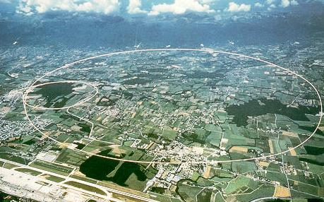
LEP – highest energy e⁺e⁻ collider so far
in operation from 1989 to 2000
maximum c.m. energy 209 GeV
maximum synchrotron radiation power 23 MW

Slide 3
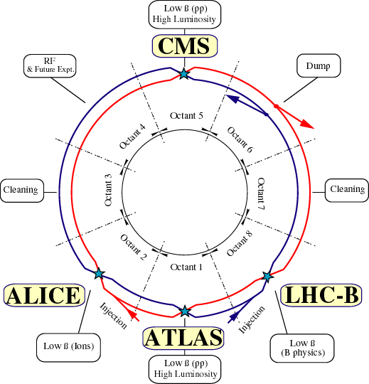
Large Hadron Collider (LHC)
design:
c.m. energy 14 TeV (pp);
luminosity 10³⁴ cm⁻²s⁻¹

Slide 4

collider figures of merit
particle type ($e^{+}e^{−},$ $pp$, $\overline{p}p$, heavy ions,… )
centre-of-mass energy E_{CM}=2 E_{beam}
luminosity
polarization
R= σ L
luminosity
reaction rate
cross section
σ_{pp→Higgs} ~ 30 pb → with 300 fb⁻¹ LHC produces ~ 10 million Higgs
where
N_{b} | Number of particles per bunch
f_{coll} | Collision frequency
σ* | Rms beam size at interaction point
F | Reduction factor due to crossing angle

Slide 5
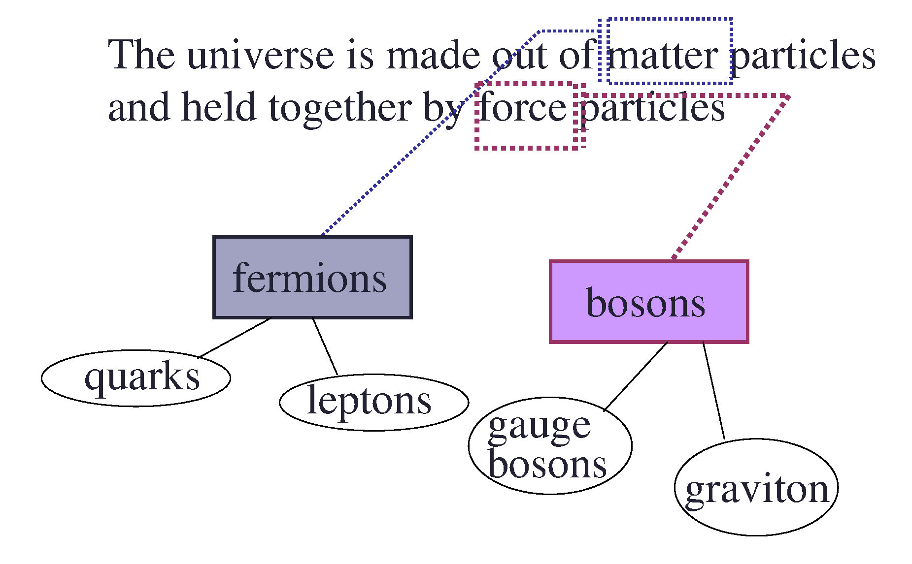
Forces of Nature & Fundamental Particles
M. Carena

Slide 6

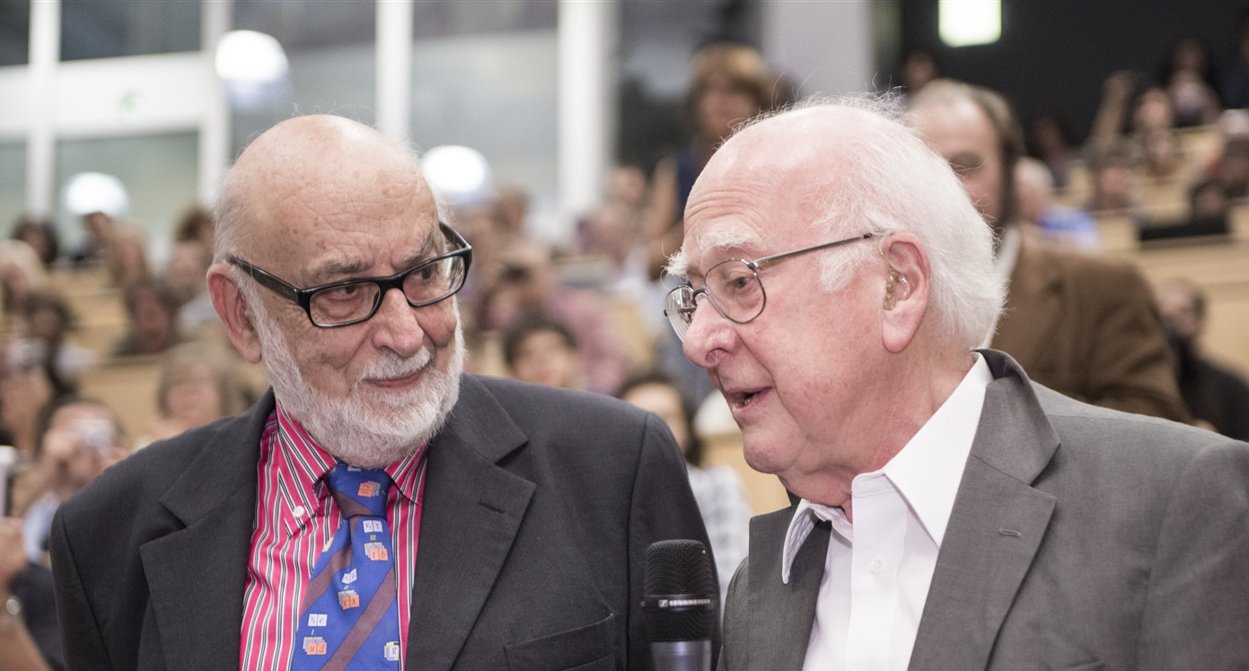
Discovery 2012, Nobel Prize in Physics 2013
The Nobel Prize in Physics 2013 was awarded jointly to François Englert and Peter W. Higgs "for the theoretical discovery of a mechanism that contributes to our understanding of the origin of mass of subatomic particles, and which recently was confirmed through the discovery of the predicted fundamental particle, by the ATLAS and CMS experiments at CERN's Large Hadron Collider”.

Slide 7
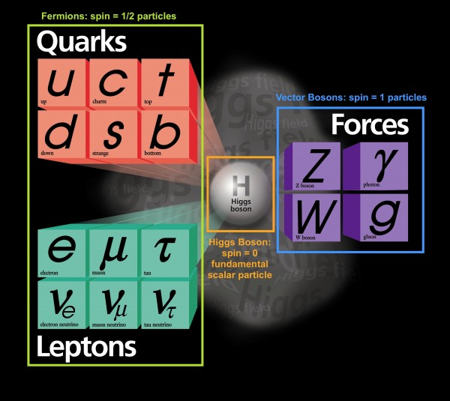
Standard Model of Particle Physics
With the discovery of a Higgs boson in 2012, we have completed the Standard Model (concluding almost 80 years of theoretical and experimental efforts !)

Slide 8
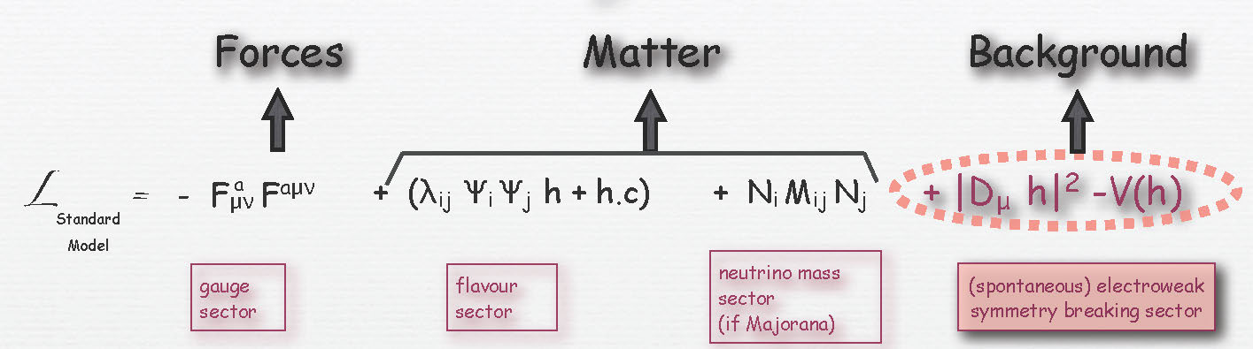

Standard Model of Particle Physics
Lagrangian
$$V\left(h\right)=−m^{2}{\left|h\right|}^{2}+λ{\left|h\right|}^{4}$$
We are surrounded by a constant Higgs field.
This Higgs field generates the masses of the
elementary particles (quarks, leptons, W, Z).
G. Servant,
S. Huber

Slide 9
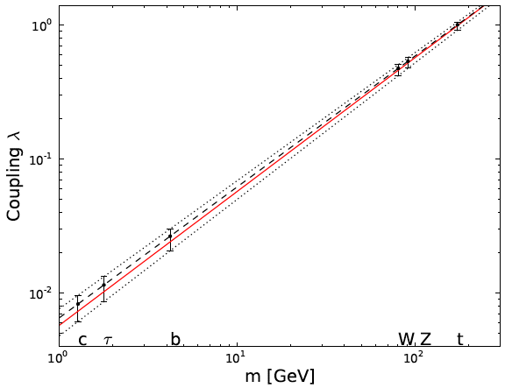

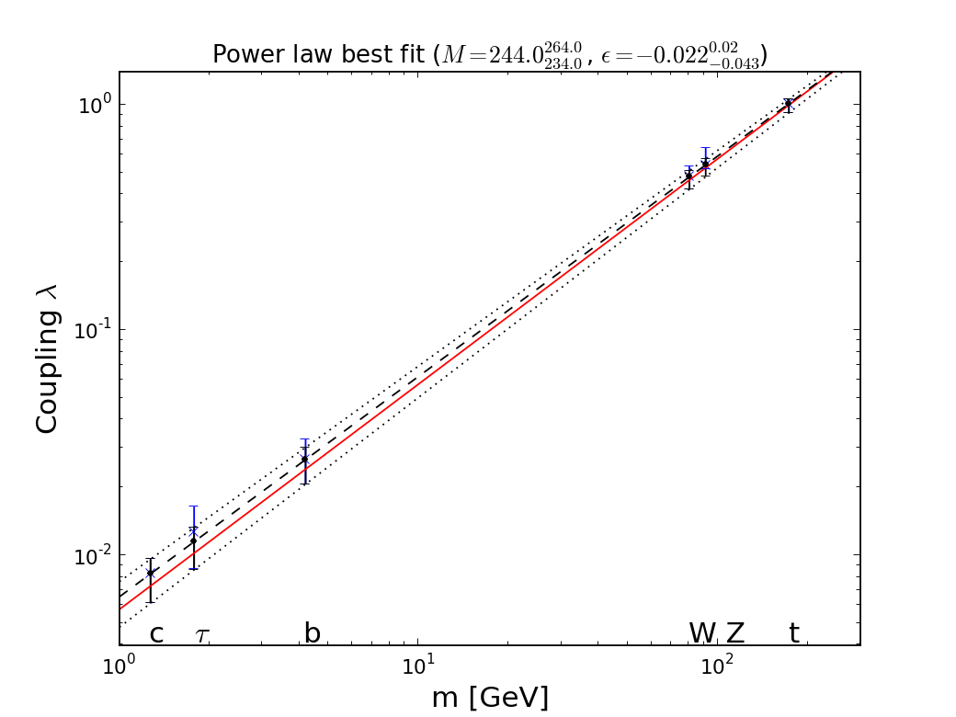

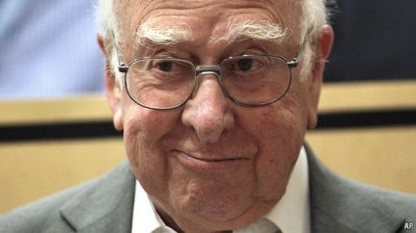

H Coupling Measurements at LHC so far
John Ellis & Tevong You

Slide 10
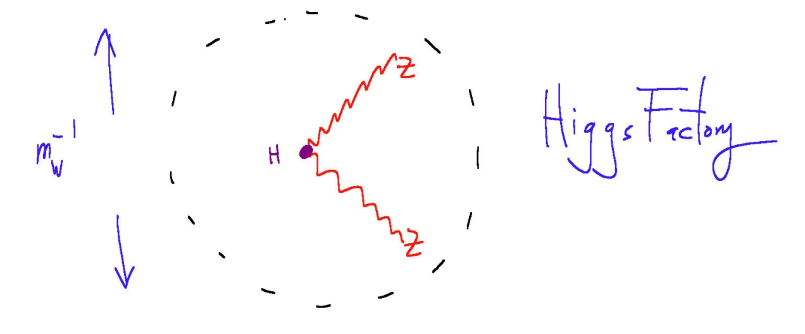
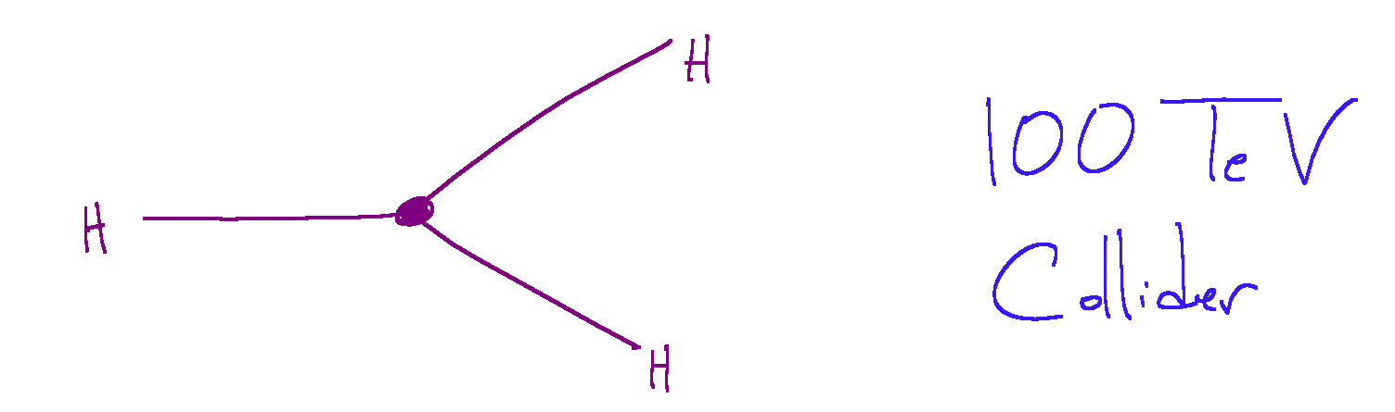
Higgs boson – portal to New Physics?
never before seen a point-like scalar particle
how point-like is it?
→ e⁺e⁻ Higgs factory
never before seen self-interacting fundamental
particle
→
100 TeV
pp collider
N. Arkani-Hamed

Slide 11

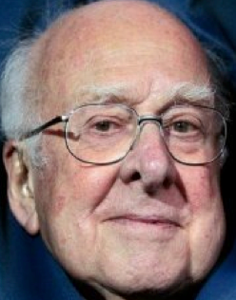
« Empty » space is unstable
Dark matter
Origin of matter
Masses of neutrinos
Hierarchy problem
Inflation
Quantum gravity
…
SUSY?
SUSY?
SUSY?
SUSY?
SUSY?
SUSY?
^{The} Standard Model
J. Ellis
Notes:
11

Slide 12
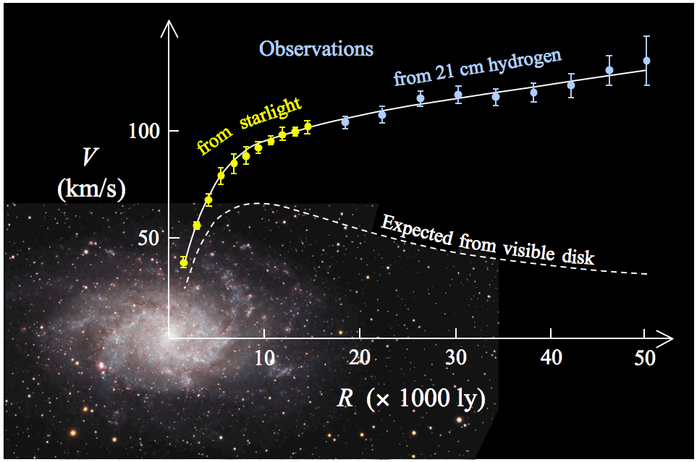
Rotation curve of the typical spiral galaxy M 33 (yellow and blue points …)

Slide 13
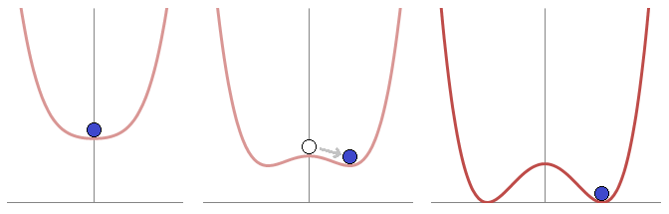
electroweak phase transition / symmetry breaking
the Higgs field was not present at high temperatures in the early universe
high temperature
low temperature
1st or 2nd order phase transition?
true shape of Higgs potential?
At high energy levels (left) the ball settles in the center, and the result is symmetrical. At lower energy levels (right), the overall "rules" remain symmetrical, but the "Mexican hat" potential comes into effect: "local" symmetry inevitably becomes broken since eventually the ball must at random roll one way or another.

Slide 14

Supersymmetry (SUSY)?
… could explain many open questions
& also is necessary ingredient of string theory
(only candidate for quantum theory of gravity)

Slide 15
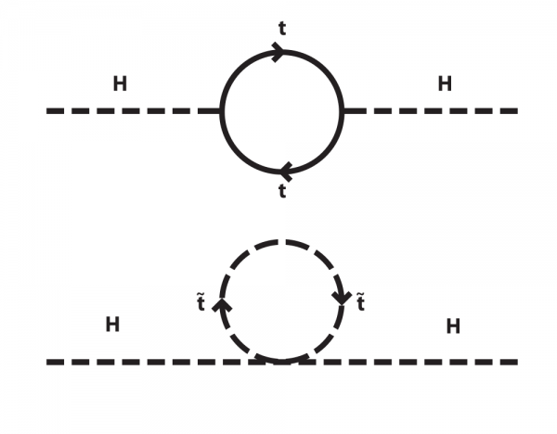
SUSY would solve “hierarchy problem”
$$m_{H}\sim {10}^{11} eV<< M_{Planck}\sim {10}^{28} eV$$

Slide 16
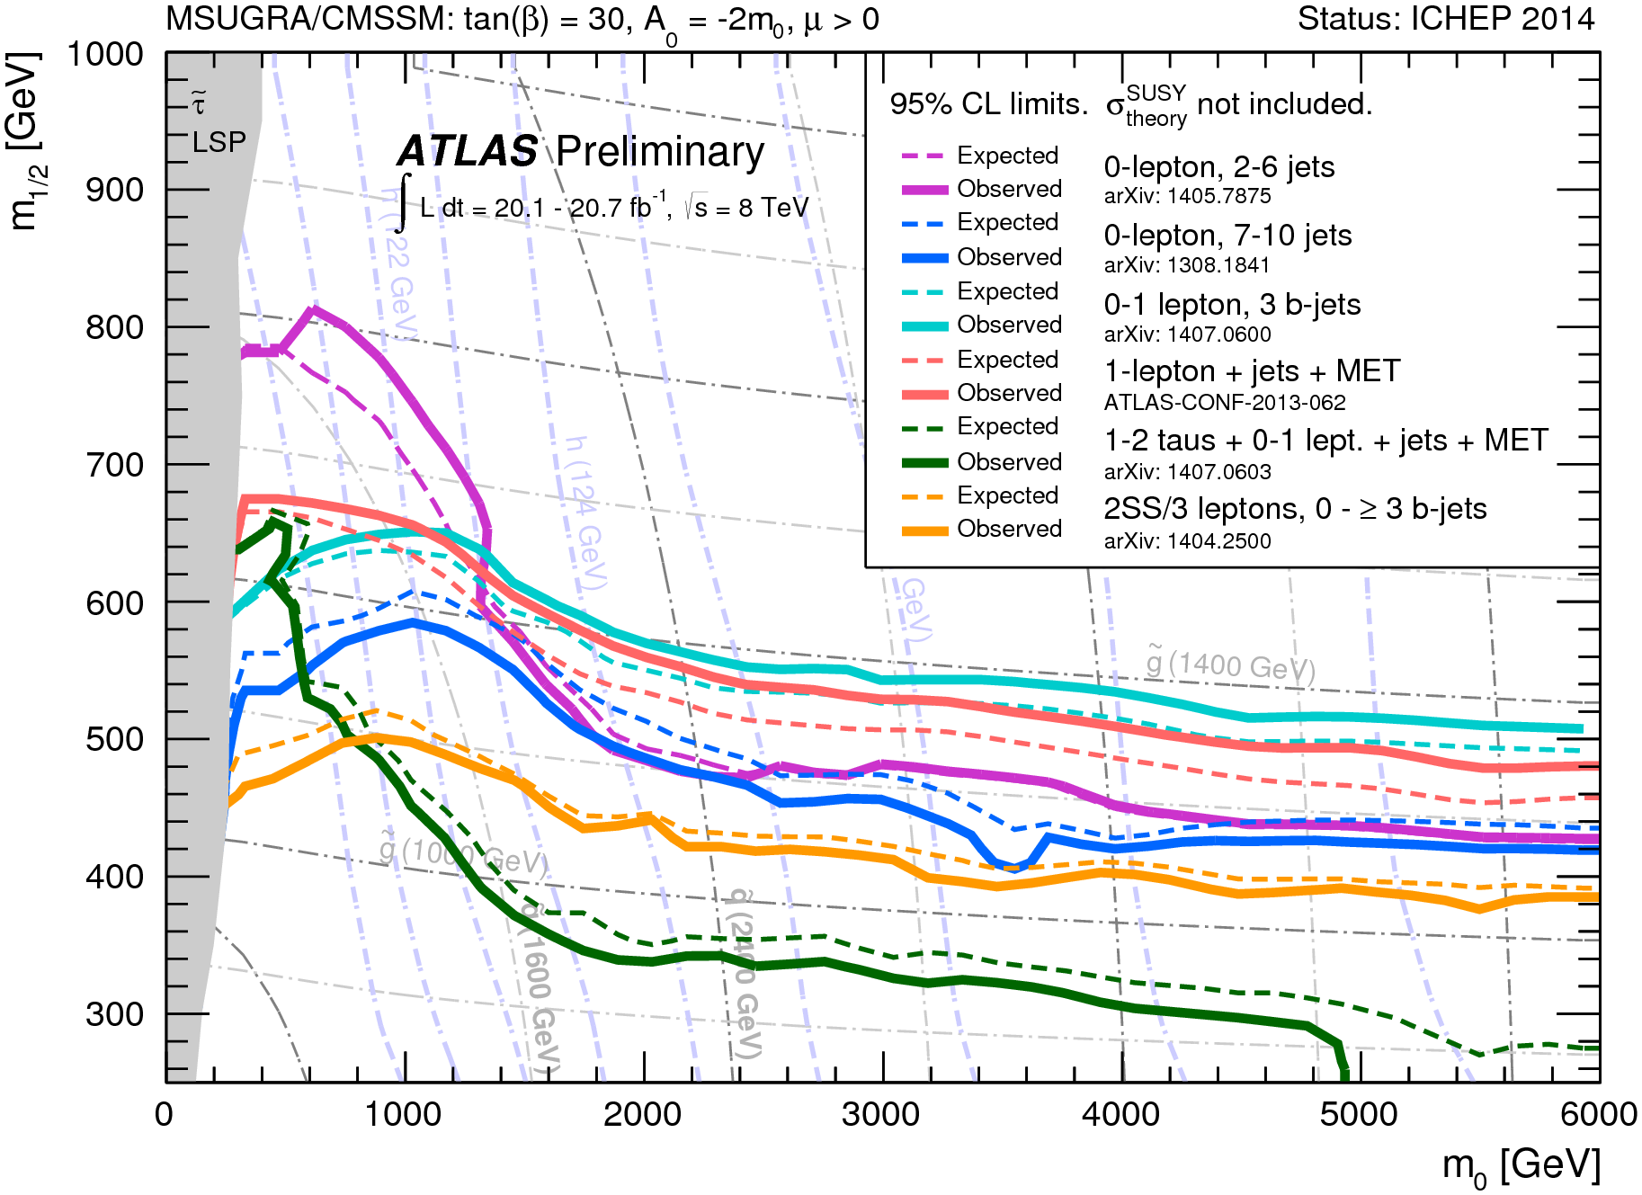
but: no sign of SUSY at the LHC so far
exclusion limits at 95% CL for 8 TeV analyses in the (m₀, m_{1/2}) plane for the MSUGRA/
CMSSM model with the remaining parameters set to tan(β) = 30,
A₀ = -2m₀,
μ > 0.
m₀ – common mass of scalars (squarks, sleptons,…)
m_{1/2} – common mass of gauginos and higgsinos

Slide 17
LHC roadmap: schedule until 2035
LS2 starting in 2018 (July) => 18 months + 3 months BC
LS3 LHC: starting in 2023 => 30 months + 3 months BC
Injectors: in 2024 => 13 months + 3 months BC
Physics
Shutdown
Beam commissioning
Technical stop
(Extended) Year End Technical Stop: (E)YETS
YETS
EYETS
YETS
LS 2
YETS
Run 2
Run 3
Run 2
LS 2
Run 3
30 fb⁻¹
PHASE 1
YETS
LS 3
Run 4
YETS
LS 3
Run 4
300 fb⁻¹
PHASE 2
LS 4
Run 5
LS 5
LS 4
Run 5
LS 5
3’000 fb⁻¹
F. Bordry
Phase 2: HL-LHC

Slide 18
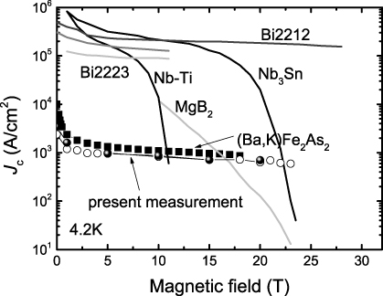
HL-LHC technology transition: Nb-Ti →Nb₃Sn
O. Bruning

Slide 19
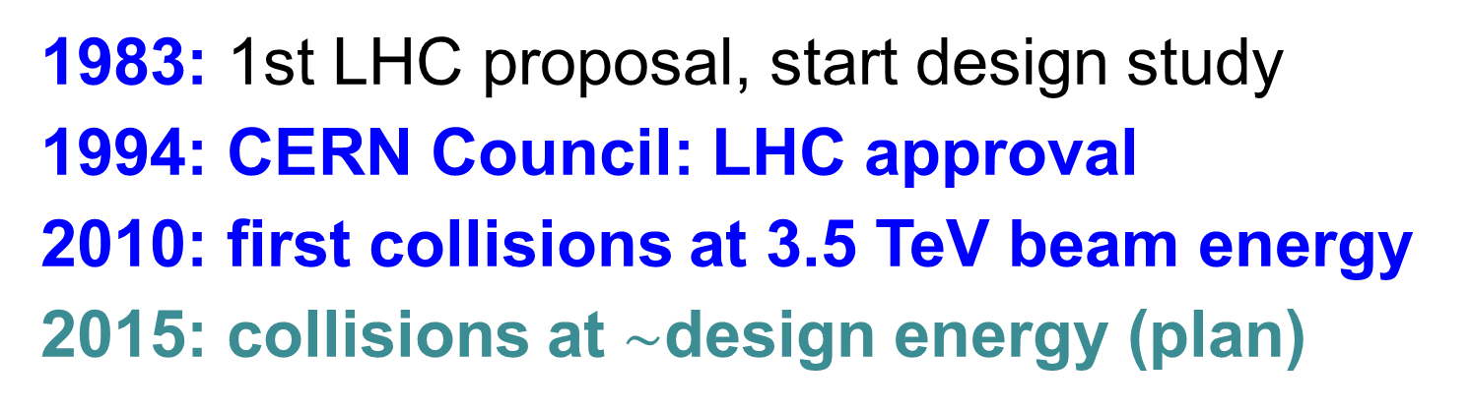
LHC history
1983: 1st LHC proposal, start design study
1994: CERN Council: LHC approval
2010: first collisions at 3.5 TeV beam energy
2015: collisions at $\sim$design energy (plan)
now is the time to plan for 2040!

Slide 20
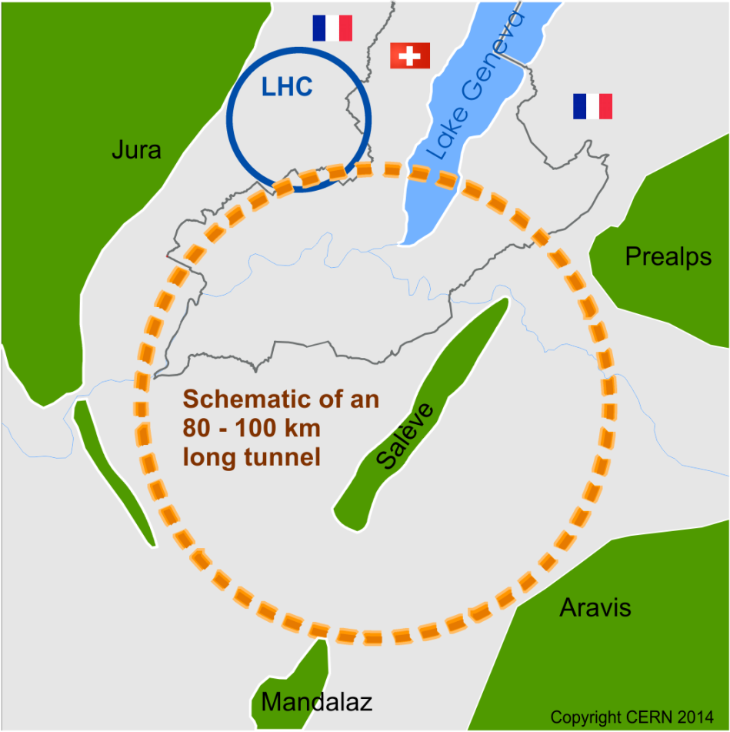
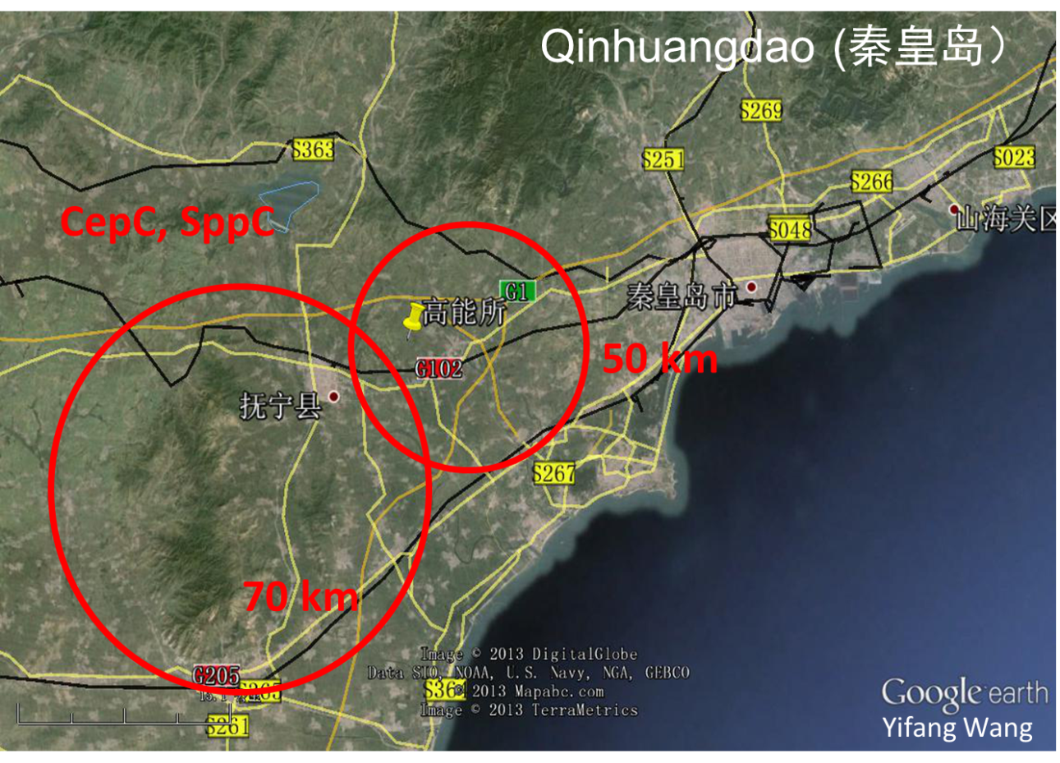
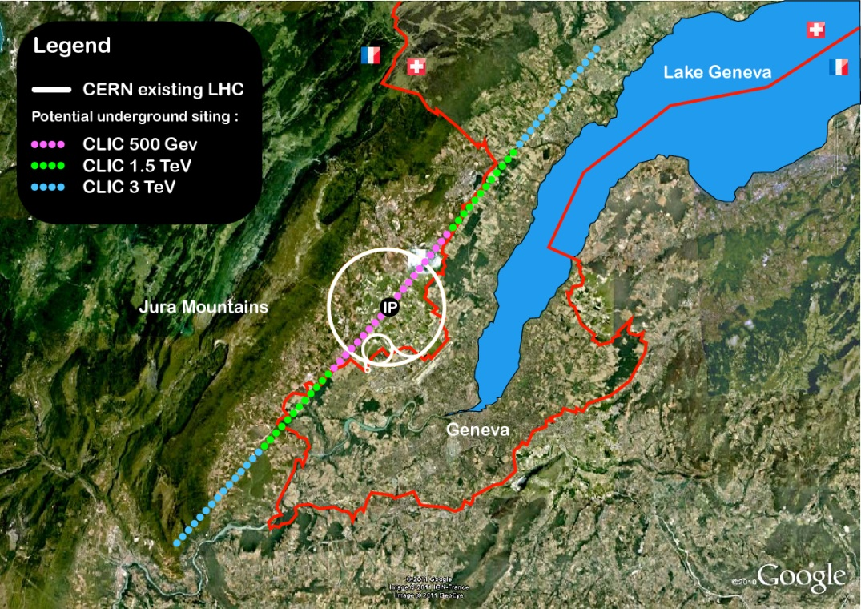
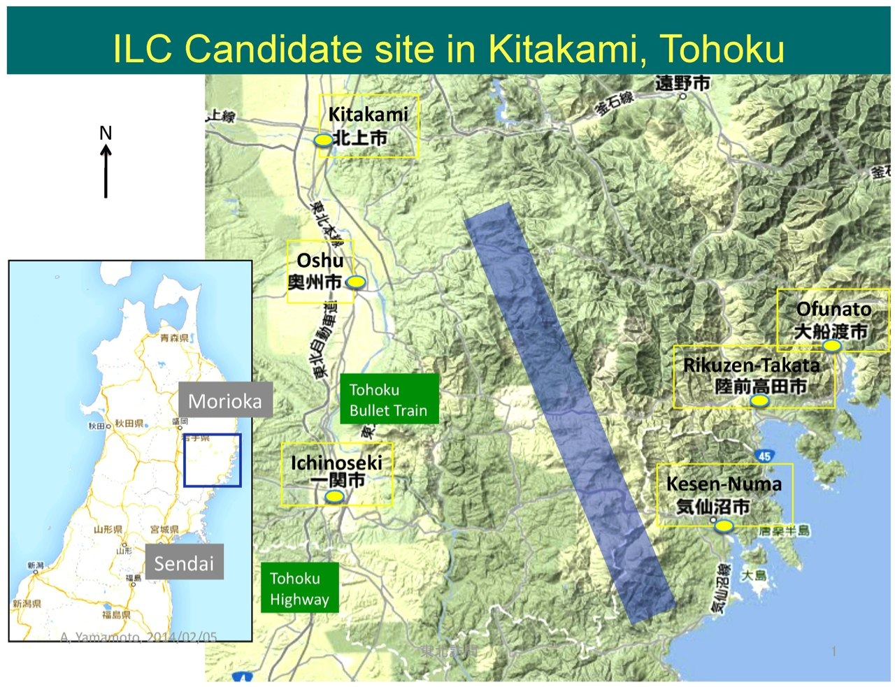
several proposals

Slide 21
circular or linear colliders
hadron (proton) colliders
almost all e⁺e⁻ colliders so far
particles collide many times
e⁺e⁻ lose energy due to synchrotron radiation ~E⁴/ρ
e⁻
e⁺
e⁻
e⁺
straight linacs for future e⁺e⁻ colliders?
no energy loss from synchrotron radiation
but only one collision per particle
requires a large accelerating system & small spot size

Slide 22
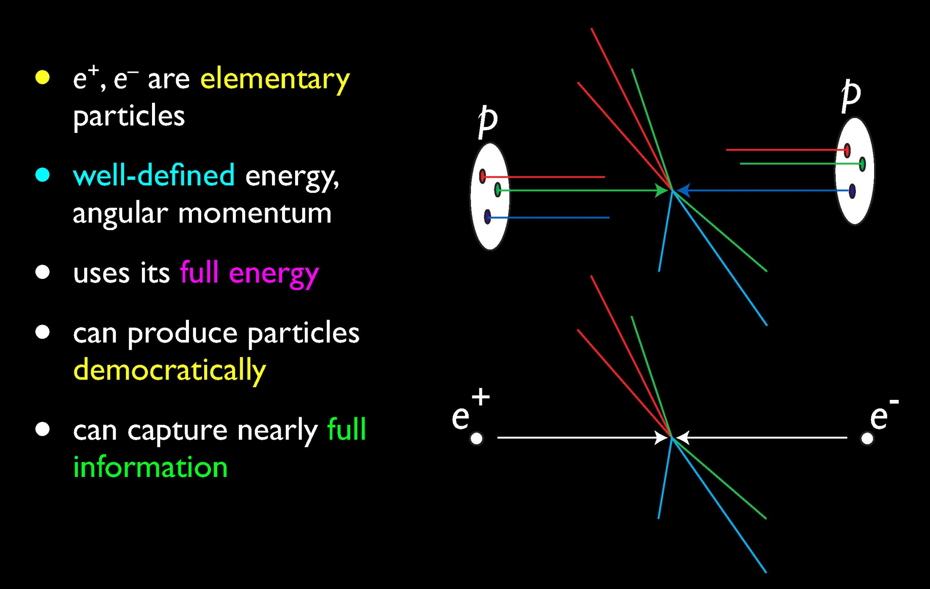
pp or e⁺e⁻ colliders
H. Murayama
(however, proton colliders can reach higher energies…)

Slide 23
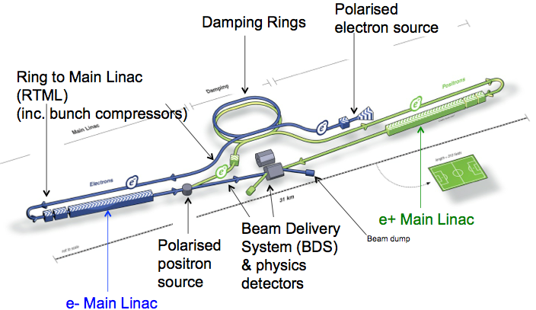
International Linear Collider (ILC)
total length ~30 (500 GeV) - 50 km (1 TeV)
SC acceleration structures ~ 30 MV/m; TDR completed in 2013, ILC technology used for XFEL at DESY; present optimistic time line: construction start in 2018 & 1st physics in 2027?

Slide 24
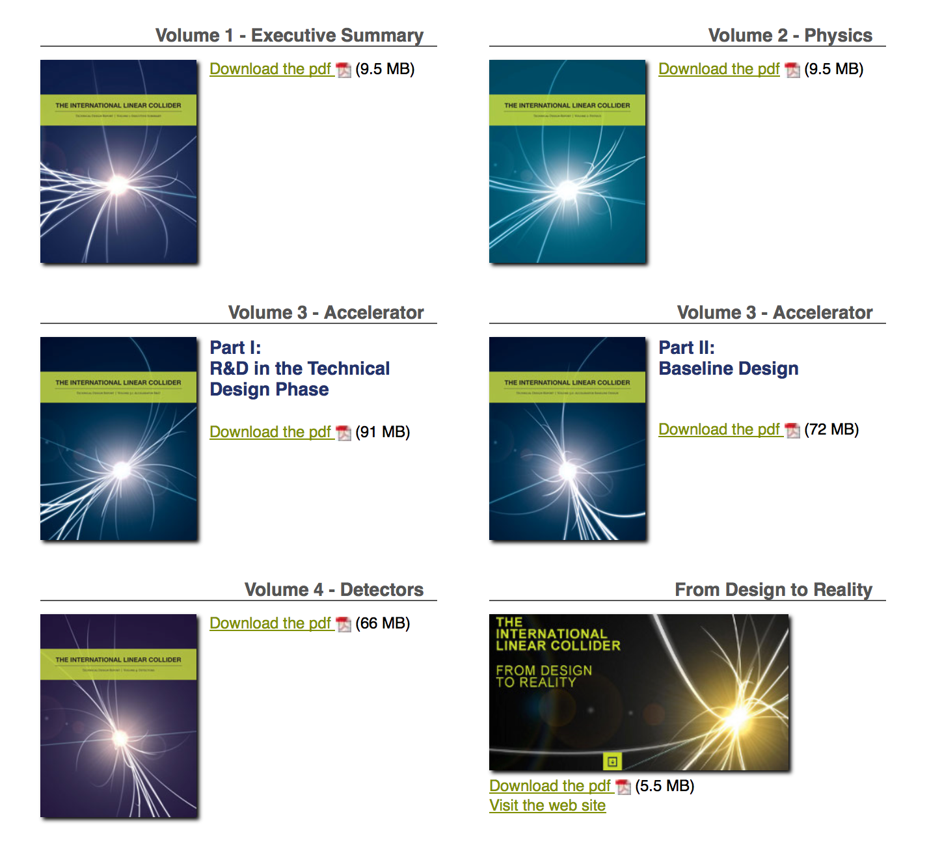
ILC – TDR (2013)
S. Stapnes
2399
signatories
5 volumes
Text about TDR and picture
http://www.linearcollider.org/ILC/Publications/Technical-Design-Report

Slide 25
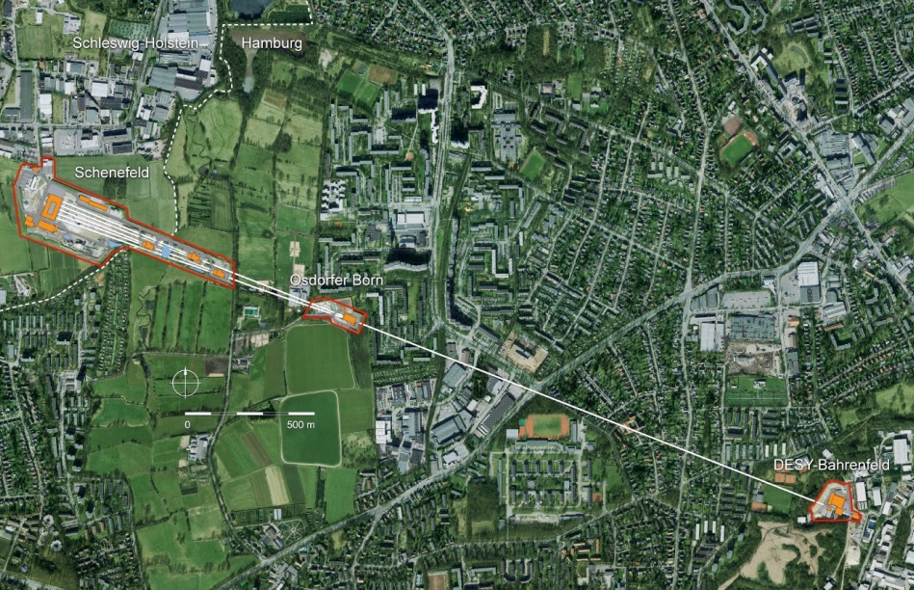
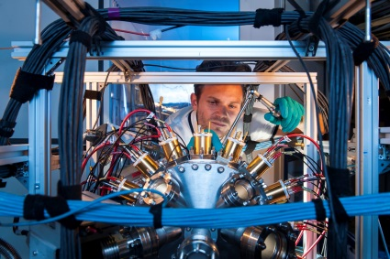
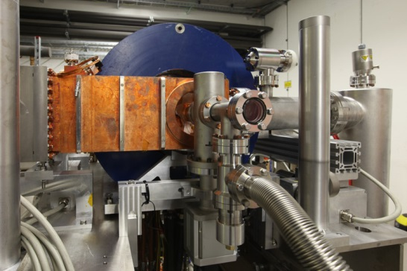
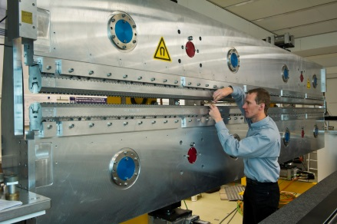
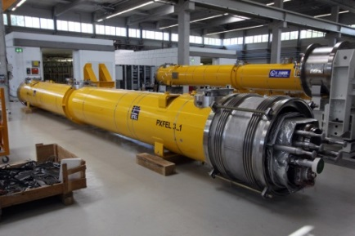
Status of the European XFEL, TAC ISAC Meeting, Istanbul, 7-8 July, 2014
ILC linac “demonstrator” - European XFEL in Hamburg
Scientific instruments and instrumentation
Electron injector
Undulator systems
Superconducting electron accelerator
3.5 km
S.L. Molodtsov, European XFEL

Slide 26

International Linear Collider (ILC) - 2
Japanese HEP community expressed interest in hosting the ILC. Site chosen: 北上市 (Kitakami) in Northern Japan. Under review by Japanese ministry MEXT.
MEXT has issued a call for tender for a company to investigate technology spin-off & economic ripple effects from ILC
Courtesy F. Simon

Slide 27
Summary: European Strategy Update 2013
Design studies and R&D at the energy frontier
….“to propose an ambitious post-LHC accelerator project at CERN by the time of the next Strategy update”:
d) CERN should undertake design studies for accelerator projects in a global context,
with emphasis on proton-proton and electron-positron high-energy frontier machines.
These design studies should be coupled to a vigorous accelerator R&D programme, including high-field magnets and high-gradient accelerating structures,
in collaboration with national institutes, laboratories and universities worldwide.
http://cds.cern.ch/record/1567258/files/esc-e-106.pdf
strategy adopted at Brussels in May 2013, during exceptional session of the CERN Council in presence of the European Commission

Slide 28
Compact Linear Collider (CLIC)
total length (main linac) ~11 (500 GeV) - 48 km (3 TeV)
accelerating gradient
~100 MV/m
key technologies: 2-beam accel., drive-beam , X-band RF

Slide 29
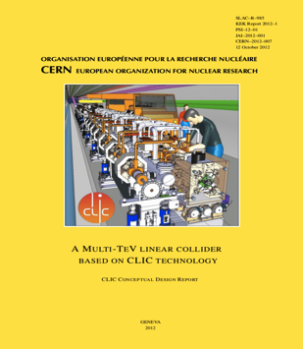
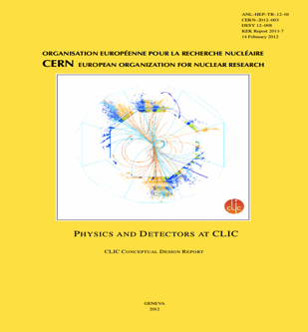
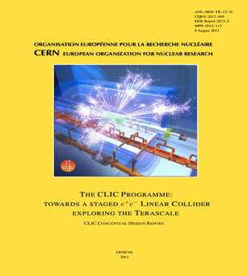
CLIC Conceptual Design Report 2012
Vol 1: The CLIC accelerator and site facilities (H.Schmickler)
- CLIC concept with exploration over multi-TeV energy range up to 3 TeV
- Feasibility study of CLIC parameters optimized at 3 TeV (most demanding)
- Consider also 500 GeV, and intermediate energy range
- Complete, presented in SPC in March 2011, in print: https://edms.cern.ch/document/1234244/
Vol 2: Physics and detectors at CLIC (L.Linssen)
- Physics at a multi-TeV CLIC machine can be measured with high precision, despite challenging background conditions
- External review procedure in October 2011
- Completed and printed, presented in SPC in December 2011 http://arxiv.org/pdf/1202.5940v1
Vol 3: “CLIC study summary” (S.Stapnes)
- Summary and available for the European Strategy process, including possible implementation stages for a CLIC machine as well as costing and cost-drives
- Proposing objectives and work plan of post CDR phase (2012-16)
- Completed and printed, submitted for the European Strategy Open Meeting
in September http://arxiv.org/pdf/1209.2543v1
In addition a shorter overview document was submitted as input to the European Strategy update, available at:
http://arxiv.org/pdf/1208.1402v1
~1400 authors, ~1200 pages

Slide 30

Future Circular Collider Study - SCOPE
CDR and cost review for the next ESU (2018)
Forming an international collaboration to study:
pp-collider (FCC-hh) → main emphasis, defining infrastructure requirements
80-100 km infrastructure in Geneva area
e⁺e⁻ collider (FCC-ee) as potential intermediate step
p-e (FCC-he) option
~16 T ⇒ 100 TeV pp in 100 km
~20 T ⇒ 100 TeV pp in 80 km

Slide 31

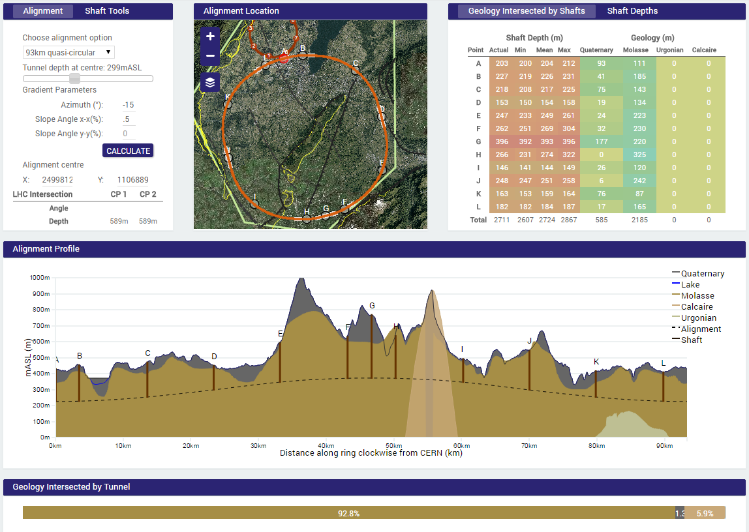
geological tunnel optimization tool,
example: site study 93 km
PRELIMINARY
Preliminary conclusions:
93 km fits geological situation really well, better than a smaller ring size.
100 km tunnel seems also well compatible with geological considerations.
The LHC could be used as an injector
J. Osborne & C. Cook

Slide 32
US P5 Recommendations (2014)
“The motivation for future-generation accelerators must be the Science Drivers”
“A very high-energy proton-proton collider is the most powerful future tool for direct discovery of new particles and interactions under any scenario of physics results that can be acquired in the P5 time window.”

Slide 33

FCC hadron collider motivation:
pushing the energy frontier
hadron collider: presently and for coming decades the
only option for exploring energy scale at 10’s of TeV
energy reach
Cf. LHC: → factor 3.5-4 in radius, → factor 2 in field
→ factor 7-8 in energy
$$E∝B_{dipole}{×ρ}_{bending}$$

Slide 34
FCC-hh luminosity goals & phases
FCC-hh general considerations (assuming operation over 25 years)
  Initial luminosity should be equal to final HL LHC luminosity
    ➔ 5x10³⁴ cm⁻²s⁻¹
  Integrated luminosity (over first 10 years) should be ~ equal to LHC total luminosity ➔ O(3000 fb⁻¹).
  FCC total luminosity should be one order higher than LHC total ➔ O(30,000 fb⁻¹)
Present parameter sets for the two operation phases:
  phase 1 (baseline):
    5x10³⁴ cm⁻²s⁻¹ (peak), average 250 fb⁻¹/year (stops incl.)
    ➔ 2500 fb⁻¹ within total of 10 years (~HL LHC total luminosity)
  phase 2 (ultimate):
    2.5x10³⁵ cm⁻²s⁻¹ (peak), average 1000 fb⁻¹/year (stops incl.)
      ➔ 15,000 fb⁻¹ within 15 years (~6x HL-LHC total luminosity).
  yielding total luminosity ~17,500 fb⁻¹ over 25 years of operation

Slide 35
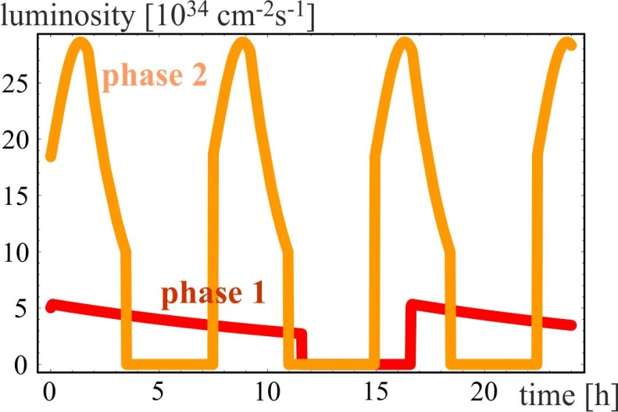
luminosity evolution over 24 h
radiation damping: τ~1 h
  for both phases:
  beam current 0.5 A unchanged!
  total synchrotron radiation power ~5 MW.
phase 1: β*=1.1 m, ΔQ_{tot}=0.01, t_{ta}=5 h
→
phase 2: β*=0.3 m, ΔQ_{tot}=0.03, t_{ta}=4 h

Slide 36

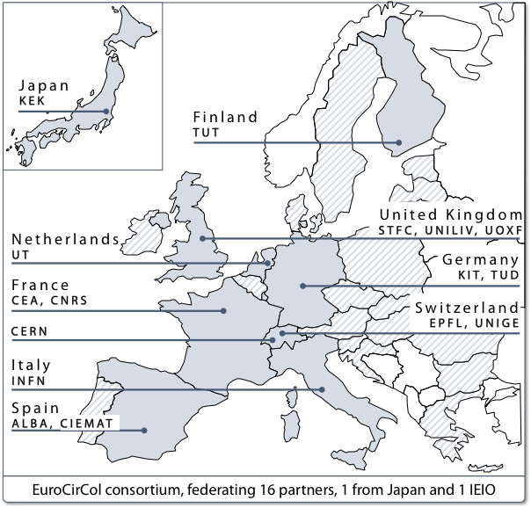
FCC Horizon 2020 Design Study Proposal
approved by European Commission on 28 January 2015, at maximum rating (15/15)
key aspects of 100 TeV energy frontier hadron collider:
conceptual design, feasibility, implementation scenario

Slide 37
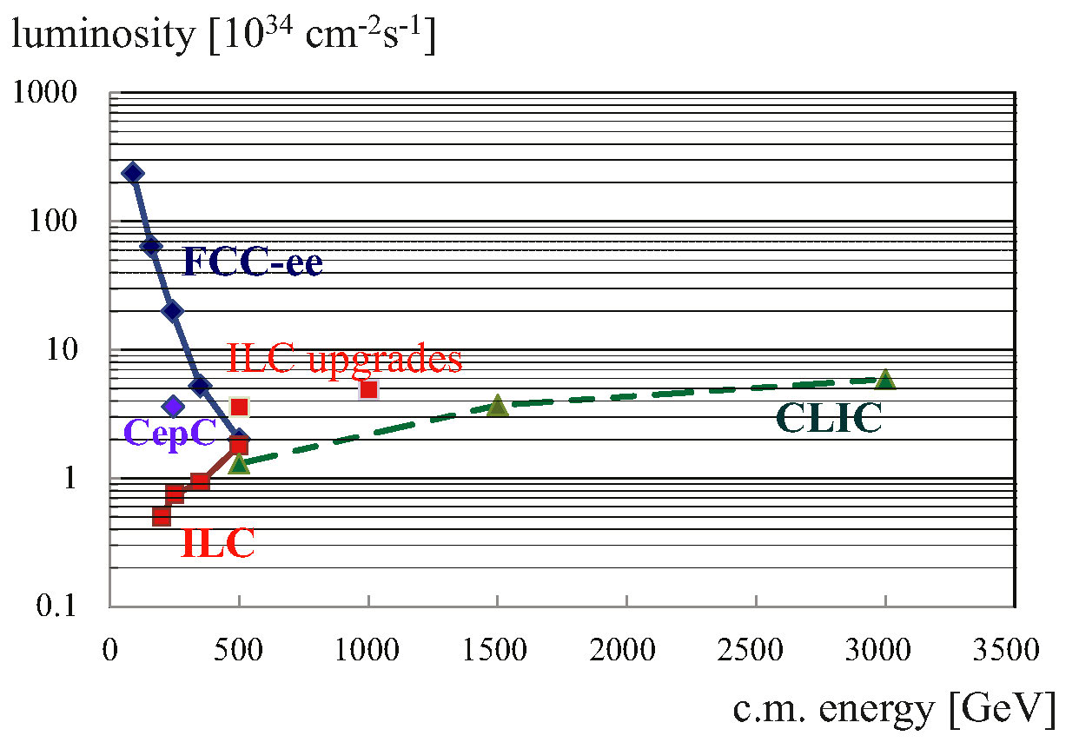
e⁺e⁻ luminosity vs energy
FCC-ee crab waist / improved optics
(Bogomyagkov, Levichev, Piminov, Shatilov, 2014)
additional ILC upgrades
(Harrison, Ross, Walker, 2013)

Slide 38
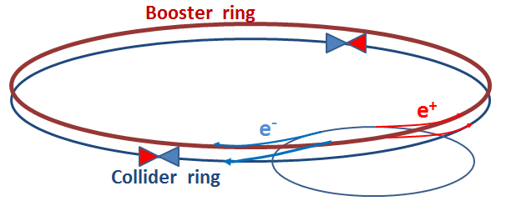
FCC-ee top-up injector
Beside the collider ring(s), a booster of the same size (same tunnel) must provide beams for top-up injection to sustain short beam lifetime due to the extremely high luminosity
  booster injection energy ~5-20 GeV
  bypass around the experiments
A. Blondel
injector complex for e⁺ and e⁻ beams of 10-20 GeV
  Super-KEKB injector ~ almost suitable

Slide 39
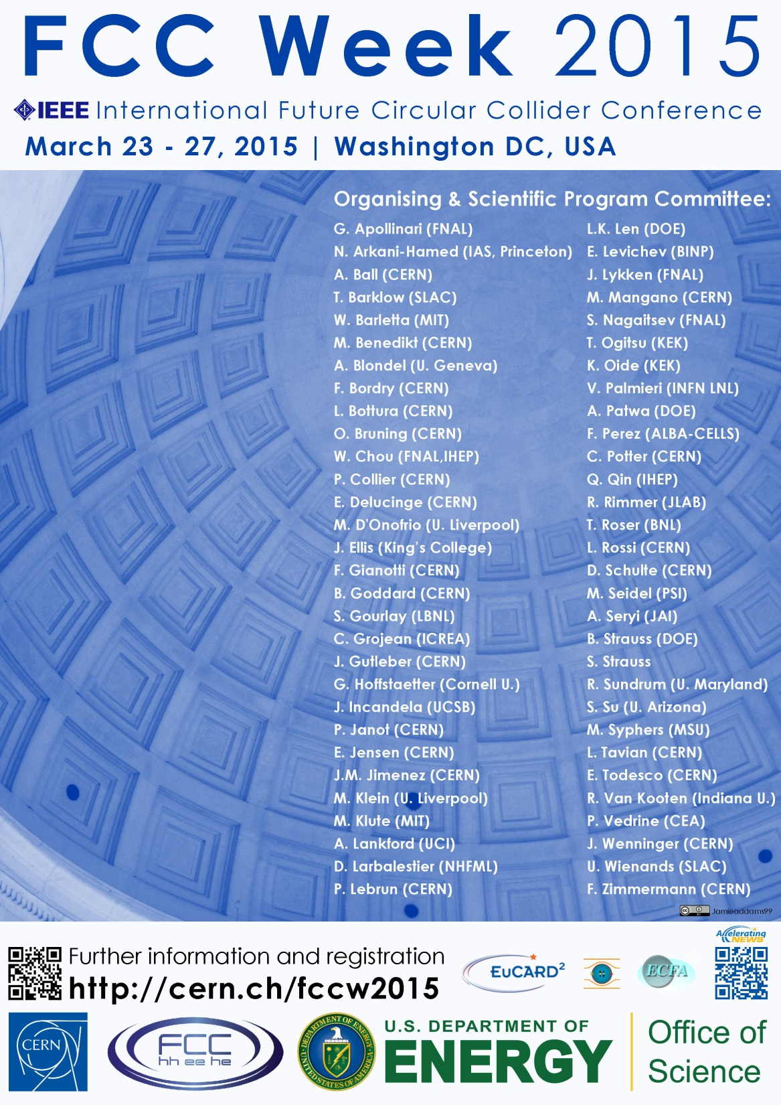
First FCC Week
Conference
Washington DC
23-27 March 2015
http://cern.ch/fccw2015
++...

Slide 40
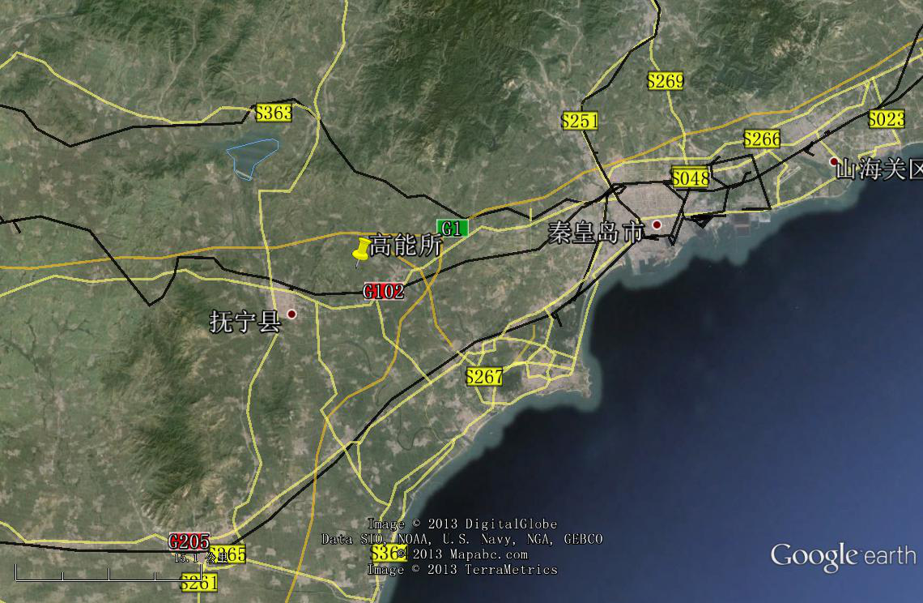
CepC/SppC study (CAS-IHEP), CepC CDR Feb. 2015, e⁺e⁻ collisions ~2028; pp collisions ~2042
Qinhuangdao (秦皇岛）
CepC, SppC
50 km
easy access
300 km from Beijing
3 h by car
1 h by train
70 km
“Chinese Toscana”
Yifang Wang

Slide 41
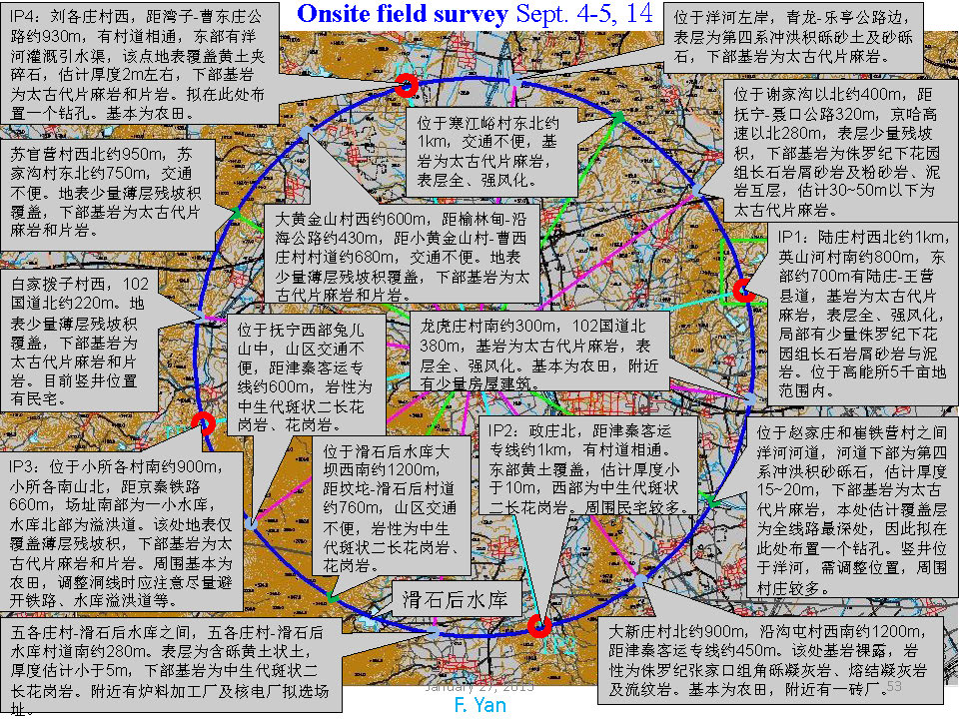

Slide 42
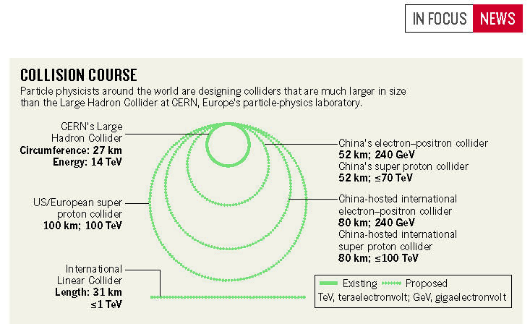
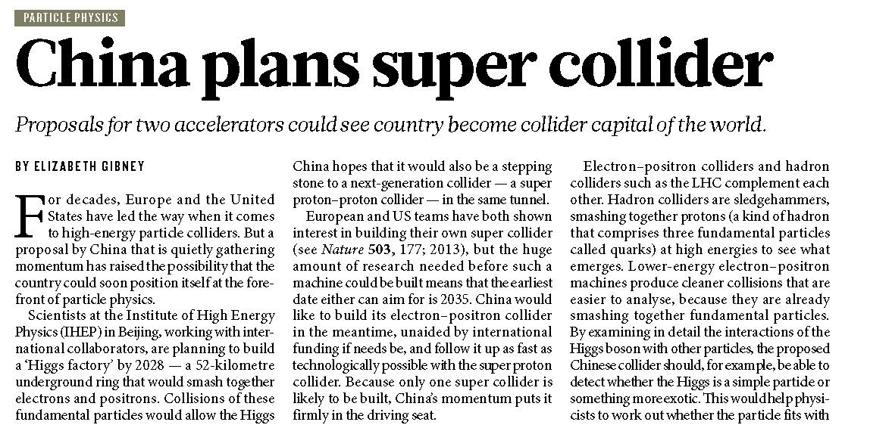
CepC/SppC project – last summer in Nature
24 J U LY 2014 | VO L 511 | NAT U R E | 3

Slide 43
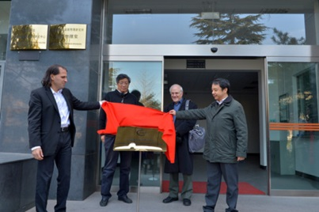
The Center for Future High Energy Physics (CFHEP) was inaugurated in Beijing on December 17, 2013. The director of CFHEP, Prof. Nima Arkani-Hamed and the head of IHEP, Prof. Wang Yifang unveiled the foundation of the center.

Slide 44
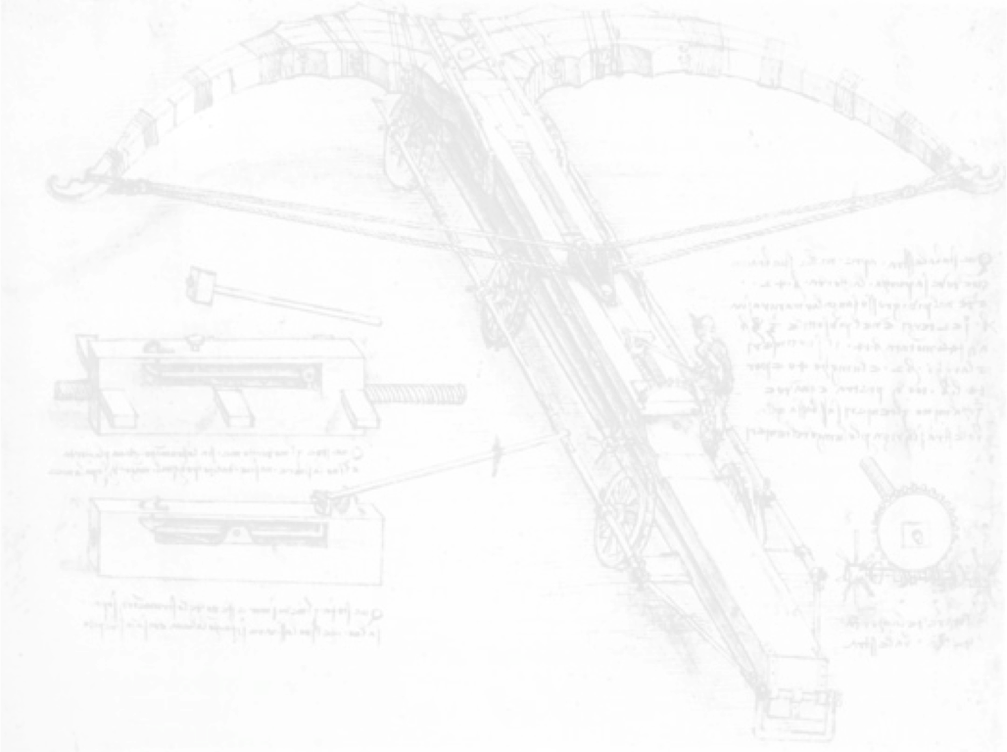

CEPC-SPPC Timeline (preliminary)
CEPC
 |  | 2015 |  |  |  |  | 2020 |  |  |  |  | 2025 |  |  |  |  | 2030 |  |  |  |  | 2035
Pre-studies (2013-2015)
R&D Engineering Design (2016-2020)
Construction (2021-2027)
Data taking (2028-2035)
1st Milestone: Pre-CDR (by the end of 2014) → R&D funding request to Chinese government in 2015 (China’s 13th Five-Year Plan 2016-2020)
SPPC
 |  | 2020 |  |  |  |  |  |  | 2030 |  |  |  |  |  |  |  |  | 2040
R&D (2014-2030)
Engineering Design (2030-2035)
Construction (2035-2042)
Data taking (2042-2055)

Slide 45
to be submitted this month (!) for inclusion in the Chinese government’s next 5-year plan
W. Chou

Slide 46
SRF R&D Program on CEPC Timeline
 |  | 2015 |  |  |  |  |  |  |  | 2020 |  | 2027
Pre-studies (2013-2015)
R&D Engineering Design (2016-2020, 5 yrs.)
Construction (2021-2027, 7 yrs.)
SRF Pre-design
SRF Initial Technology R&D (2016-2020, 5 yrs.)
HOM damping, high Q₀ cavity, coupler window, heat load
SRF Pre-Production R&D (2019-2022, 4 yrs.)
SRF Production and Installation (2023-2027, 5 yrs.)
IHEP site infrastructure
Large scale SRF lab (infrastructure) on CEPC site and in industry (2018)
CEPC SRF Team (~6)
CEPC SRF Core Team (main ring 10 + booster 10 in parallel) (start from 2017)
Facility upgrade, additional space
SRF ~ 200 FTEs (start from 2020), engineers and technicians
Components Prototyping & Performance Demonstration:
Cavity (four for each), helium vessel, vertical test
Power coupler (four for each), HOM dampers, tuners
Short (two-cavity) module for each type, horizontal test
Booster SRF in three years (2023-2025):
test two 1300 MHz cavities per week
assemble and test one cryomodule per month
Main ring SRF in four years (2023-2025):
test two 650 MHz cavities per week
assemble and test two cryomodules per month
Demonstrate Robustness of Fabrication and Assembly Processes of Cryomodule and its Components. Establish procedures, quality control steps, test set ups, assembly sequences, etc. for the production run. Build and test two booster cryomodules and three main ring cryomodules.

Slide 47
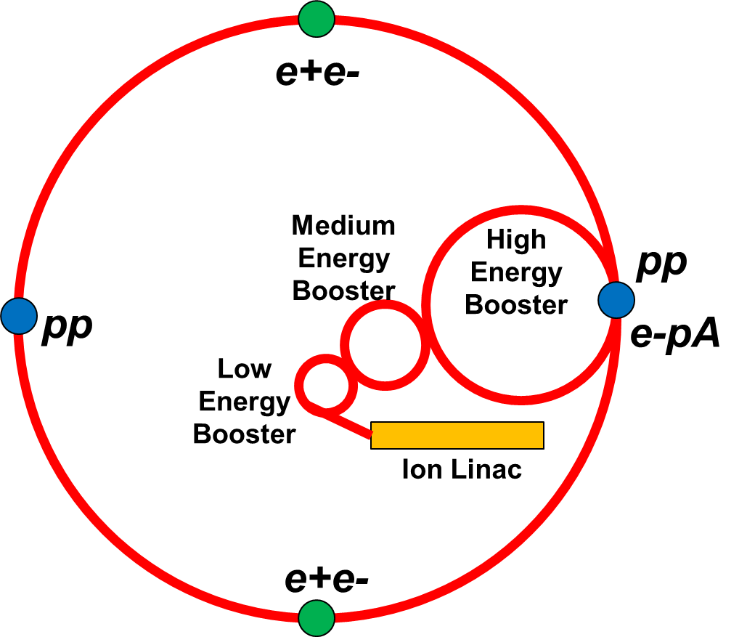
CEPC Upgrade to SPPC
W. Chou

Slide 48

SuperKEKB = FCC-ee demonstrator
beam commissioning will start in 2015
K. Oide et al.
top up injection at high current
β_{y}* =300 μm (FCC-ee: 1 mm)
lifetime 5 min (FCC-ee: ≥20 min)
ε_{y}/ε_{x} =0.25% (similar to FCC-ee)
off momentum acceptance (±1.5%, similar to FCC-ee)
e⁺ production rate (2.5x10¹²/s, FCC-ee: <1.5x10¹²/s (Z cr.waist)
SuperKEKB goes beyond FCC-ee, testing all concepts

Slide 49
High Energy Physics time scale
1980
1985
1995
2000
2005
2010
2015
2020
2025
2030
2035
1990
2040
Construc-tion
Physics
Upgr
LEP
Design
Proto
Construction
Physics
LHC
Design
Construct
Physics
HL-LHC
FCC
Design
Proto
Construction
Physics
CepC
R&D
Construction
Physics
SPPC
R&D
Construction
Physics
ILC
R&D
Construction
Physics

Slide 50
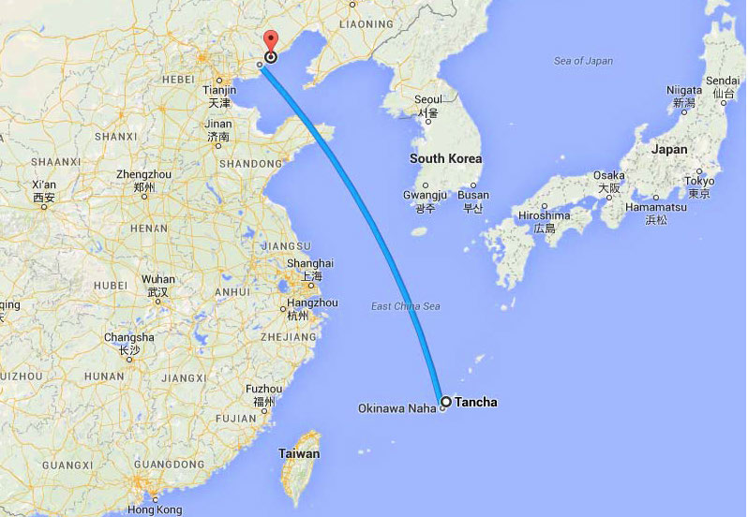
Tancha Bay soon surrounded by colliders?
CEPC/SppC
ILC
FCC or CLIC
in Geneva
ILC #2
CEPC/SppC #2

Slide 51
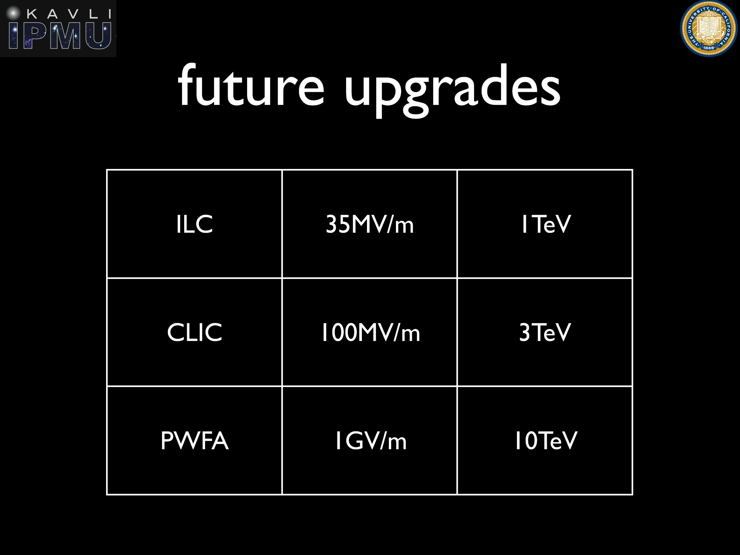
H. Murayama
?

Slide 52
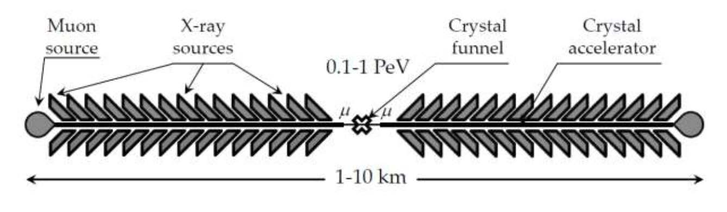
radiation emission due to betatron oscillations
“e± may soon run out of steam in the
high-gradient world!” V. Shiltsev
E_{max} ≈300 GeV for e⁺, 10⁴ TeV μ, 10⁶ TeV for p ?!
Chen & Noble 1997; Dodin & Fisch 2008; Shiltsev ‘12
linear X-ray crystal μ collider?

Slide 53

another (circular) possibility: use crystals as bends: world’s strongest magnets
straight crystal
crystal focusing strength
φ~20-60 eV/Å²
B_{max}≈2000 T !
λ=2πβ=2π (E/φ)^{1/2}
bent crystal
W. Scandale, MPL A (2012)
S.A. Bogacz, D. Cline, 1997

Slide 54


staging of crystal deflectors
schematic layout
of the experimental setup used to
study multiple volume reflection at the H8 beam line of the CERN SPS
quasimosaic
strip
crystals
6 strip crystals in series
(each 2 mm long):
400 GeV/c protons
reflected by 40±2 μrad
[effective field 16 T]
with efficiency 0.93±0.04
proof of principle demonstration!
W. Scandale et al, Observation of Multiple Volume Reflection of Ultrarelativistic Protons by a Sequence of Several Bent Silicon Crystals, Phys.Rev.Lett. 102 (2009) 084801

Slide 55
circular crystal collider?
cryogenic?
crystal
bending
stage
cryogenic?
crystal
bending
stage
tunnel mostly empty
proton beam
energy ramp using induction acceleration
(K. Takayama)

Slide 56

cosmic-ray energy spectrum
10⁴⁵ m⁻²s⁻¹sr⁻¹GeV^{1.5}!
P. Blasi, UHECR2012
circular crystal collider
GZK limit
FCC-hh
LHC p energy
x10⁸

Slide 57

ultimate limit on electromagnetic acceleration
Schwinger critical fields E_{cr} ≈10¹² MV/m, B_{cr}=4.4 x10⁹ T
Planck scale: 10²⁸ eV
“not an inconceivable task for an advanced technological society”
P. Chen, R. Noble, SLAC-PUB-7402, April 1998
circular & linear
Planck-scale colliders:
size ~1/10 distance
earth-sun

Slide 58
Conclusions - Accelerators
bright future for accelerator-based HEP!
ILC is ready to be built in Japan
China has ambitious plan & schedule
  (CEPC/SppC – “domestic project”)
HL-LHC pushes high-field magnet technology
FCC or CLIC possible future projects at CERN
several different routes to PeV collisions
e.g. linear & circular path; crystals key for both:
bending and/or acceleration
eventually outer-space solar-system
accelerator needed to reach Planck mass

Slide 59
Conclusions - Physics
no sign of supersymmetry (yet ?)
Higgs boson is first of its kind; it could
couple to hidden New Physics Sectors;
must be examined closely
“issues at stake are the most difficult &
  profound ones we have faced since the
  1930’s” (N. Arkani-Hamed)
particle physics of the 21st century expected
to be revolutionary; it may profoundly
change our view of the world
(space-time loses its meaning at the Planck scale, …)

Slide 60

No New Physics Beyond the Standard Model? Beware Historical Hubris
"So many centuries after the Creation, it is unlikely that anyone could find hitherto unknown lands of any value”
- Spanish Royal Commission, rejecting Christopher Columbus’ proposal to sail west, < 1492
J. Ellis

Slide 61
spare slides

Slide 62
FCC-hh key parameters
parameter | FCC-hh | LHC
energy | 100 TeV c.m. | 14 TeV c.m.
dipole field | 16 T | 8.33 T
# IP | 2 main, +2 | 4
normalized emittance | 2.2 μm | 3.75 μm
luminosity/IP_{main} | 5 x 10³⁴ cm⁻²s⁻¹ | 1 x 10³⁴ cm⁻²s⁻¹
energy/beam | 8.4 GJ | 0.39 GJ
synchr. rad. | 28.4 W/m/apert. | 0.17 W/m/apert.
bunch spacing | 25 ns (5 ns) | 25 ns
Preliminary, subject to evolution (several luminosity scenarios)

Slide 63
parameter | LHC | HL-LHC | FCC-hh
c.m. energy [TeV] | 14 |  | 100
dipole magnet field [T] | 8.33 |  | 16 (20)
circumference [km] | 36.7 |  | 100 (83)
luminosity [10³⁴ cm⁻²s⁻¹] | 1 | 5 | 5 [→20?]
bunch spacing [ns] | 25 |  | 25 {5}
events / bunch crossing | 27 | 135 | 170 {34}
bunch population [10¹¹] | 1.15 | 2.2 | 1 {0.2}
norm. transverse emitt. [μm] | 3.75 | 2.5 | 2.2 {0.44}
IP beta-function [m] | 0.55 | 0.15 | 1.1
IP beam size [μm] | 16.7 | 7.1 | 6.8 {3}
synchrotron rad. [W/m/aperture] | 0.17 | 0.33 | 28 (44)
critical energy [keV] | 0.044 |  | 4.3 (5.5)
total syn.rad. power [MW] | 0.0072 | 0.0146 | 4.8 (5.8)
longitudinal damping time [h] | 12.9 |  | 0.54 (0.32)
Cms energy
Luminosity
FCC-hh baseline parameters defined in EDMS No. 1342402, FCC-ACC-SPC-0001

Slide 64
FCC as heavy-ion collider
preliminary parameters
 | Unit | LHC Design | FCC-hh | FCC-hh
operation mode | - | Pb-Pb | Pb-Pb | p-Pb
number of bunches |  | 592 | 432 | 432
part. / bunch | [10⁸] | 0.7 | 1.4 | 115(1.4)/1.4
β-functionat IP | [m] | 0.5 | 1.1 | 1.1
RMS beam size at IP | [um] | 15.9 | 8.8 | 8.8
initial luminosity | [10²⁷cm⁻²s⁻¹] | 1 | 3.2 | 267(3.2)
peak luminosity | [10²⁷cm⁻²s⁻¹] | 1 | 12.7 | 5477(3356)
integr. lumi. per fill | [μb⁻¹] | <15 | 83 | 30240
total cross-section | [b] | 515 | 597 | 2
initial luminosity lifetime | [h] | <5.6 | 3.7 | 3.2 (10.6)
M. Schaumann, J. Jowett

Slide 65
FCC-ee baseline parameters
parameter | FCC-ee | LEP2
energy/beam | 45 – 175 GeV | 105 GeV
bunches/beam | 98 – 16700 | 4
beam current | 6.6 – 1450 mA | 3 mA
hor. emittance | ~2 nm | ~22 nm
emittance ratio ε_{y}/ε_{y} | 0.1% | 1%
vert. IP beta function β_{y}* | 1 mm | 50 mm
luminosity/IP | 1.8-28 x 10³⁴ cm⁻²s⁻¹ | 0.0012 x 10³⁴ cm⁻²s⁻¹
energy loss/turn | 0.03-7.55 GeV | 3.34 GeV
synchrotron radiation power | 100 MW | 23 MW
RF voltage | 2.5 – 11 GV | 3.5 GV
  Large number of bunches at Z and WW and H requires 2 rings.
  High luminosity means short beam lifetime (few mins) and requires continues injection.

Slide 66
parameter | LEP2 | FCC-ee
 |  | Z | Z (c.w.) | W | H | t
E_{beam} [GeV] | 104 | 45 | 45 | 80 | 120 | 175
circumference [km] | 26.7 | 100 | 100 | 100 | 100 | 100
current [mA] | 3.0 | 1450 | 1431 | 152 | 30 | 6.6
P_{SR,tot} [MW] | 22 | 100 | 100 | 100 | 100 | 100
no. bunches | 4 | 16700 | 29791 | 4490 | 1360 | 98
N_{b} [10¹¹] | 4.2 | 1.8 | 1.0 | 0.7 | 0.46 | 1.4
ε_{x} [nm] | 22 | 29 | 0.14 | 3.3 | 0.94 | 2
ε_{y} [pm] | 250 | 60 | 1 | 1 | 2 | 2
β∗_{x} [m] | 1.2 | 0.5 | 0.5 | 0.5 | 0.5 | 1.0
β∗_{y} [mm] | 50 | 1 | 1 | 1 | 1 | 1
σ∗_{y} [nm] | 3500 | 250 | 32 | 84 | 44 | 45
σ_{z,SR} [mm] | 11.5 | 1.64 | 2.7 | 1.01 | 0.81 | 1.16
σ_{z,tot} [mm] (w beamstr.) | 11.5 | 2.56 | 5.9 | 1.49 | 1.17 | 1.49
hourglass factor F_{hg} | 0.99 | 0.64 | 0.94 | 0.79 | 0.80 | 0.73
L/IP [10³⁴ cm⁻²s⁻¹] | 0.01 | 28 | 212 | 12 | 6 | 1.7
τ_{beam} [min] | 434 | 298 | 39 | 73 | 29 | 21
the large number of bunches at Z, W & H requires 2 rings
FCC-ee baseline parameters defined in EDMS No. 1346081, FCC-ACC-SPC-0003 (Rev. 2.0)
short lifetimes due to high luminosity → continuous injection (top-up)

Slide 67
parameter | LEP2 | FCC-ee
 |  | Z | Z (c.w.) | W | H | t
E_{beam} [GeV] | 104 | 45 | 45 | 80 | 120 | 175
beam-beam par. ξ_{y}/IP | 0.06 | 0.03 | 0.175 | 0.06 | 0.093 | 0.092
current [mA] | 3.0 | 1450 | 1431 | 152 | 30 | 6.6
P_{SR,tot} [MW] | 22 | 100 | 100 | 100 | 100 | 100
no. bunches | 4 | 16700 | 29791 | 4490 | 1360 | 98
N_{b} [10¹¹] | 4.2 | 1.8 | 1.0 | 0.7 | 0.46 | 1.4
ε_{x} [nm] | 22 | 29 | 0.14 | 3.3 | 0.94 | 2
ε_{y} [pm] | 250 | 60 | 1 | 1 | 2 | 2
β∗_{x} [m] | 1.2 | 0.5 | 0.5 | 0.5 | 0.5 | 1.0
β∗_{y} [mm] | 50 | 1 | 1 | 1 | 1 | 1
σ∗_{y} [nm] | 3500 | 250 | 32 | 84 | 44 | 45
σ_{z,SR} [mm] | 11.5 | 1.64 | 2.7 | 1.01 | 0.81 | 1.16
σ_{z,tot} [mm] (w beamstr.) | 11.5 | 2.56 | 5.9 | 1.49 | 1.17 | 1.49
hourglass factor F_{hg} | 0.99 | 0.64 | 0.94 | 0.79 | 0.80 | 0.73
L/IP [10³⁴ cm⁻²s⁻¹] | 0.01 | 28 | 212 | 12 | 6 | 1.7
τ_{beam} [min] | 434 | 298 | 39 | 73 | 29 | 21

Slide 68
tentative FCC-he parameters
parameter | e⁻ | p
energy/beam | 60 GeV (ERL) | 50 TeV
bunches/beam | - | 10600
bunch intensity | 5x10⁹ | 10¹¹
hor. & vert. emittance | 0.17 nm | 0.04 nm
emittance ratio ε_{y}/ε_{y} | 1 | 1
IP beta function β_{x,y}* | 100 mm | 400 mm
IP beta function σ_{x,y}* | 4 μm
luminosity/IP | 1.0 x 10³⁴ cm⁻²s⁻¹
synchrotron power | ~50 MW | 2.5 MW
Preliminary, subject to evolution (staging scenarios)

Slide 69
collider parameters | FCC ERL | FCC-ee ring |  | protons
species | e⁻ (e⁺?) | e± | e± | p
beam energy [GeV] | 60 | 60 | 120 | 50000
bunches / beam | - | 10600 | 1360 | 10600
bunch intensity [10¹¹] | 0.05 | 0.94 | 0.46 | 1.0
beam current [mA] | 25.6 | 480 | 30 | 500
rms bunch length [cm] | 0.02 | 0.15 | 0.12 | 8
rms emittance [nm] | 0.17 | 1.9 (x) | 0.94 (x) | 0.04 [0.02 y]
β_{x,y}*[mm] | 94 | 8, 4 | 17, 8.5 | 400 [200 y]
σ_{x,y}* [μm] | 4.0 | 4.0, 2.0 |  | equal
beam-b. parameter ξ | (D=2) | 0.13 | 0.13 | 0.022 (0.0002)
hourglass reduction | 0.92 (H_{D}=1.35) | ~0.21 | ~0.39
CM energy [TeV] | 3.5 | 3.5 | 4.9
luminosity[10³⁴cm⁻²s⁻¹] | 1.0 | 6.2 | 0.7
preliminary FCC-he parameters shown at ICHEP’14

Slide 70

no sign of SUSY at the LHC so far
Summary of ATLAS searches for electroweak production of charginos and neutralinos based on 20/fb of pp collision data

Slide 71





Previous studies in Italy (ELOISATRON 300km), USA (SSC 87km, VLHC 233km), Japan (TRISTAN-II 94km)
ex. ELOISATRON
ex. SSC
Supercolliders Superdetectors: Proceedings of the 19th and 25th Workshops of the INFN Eloisatron Project
SSC CDR 1986
ex. TRISTAN
Many aspects of machine design and R&D non-site specific.
Exploit synergies with other projects and prev. studies
Tristan-II
option 2
ex. VLHC
F. Takasaki
H. Ulrich Wienands, The SSC Low Energy Booster: Design and Component Prototypes for the First Injector Synchrotron, IEEE Press, 1997
VLHC Design Study Group Collaboration
June 2001. 271 pp.
SLAC-R-591, SLAC-R-0591, SLAC-591,
SLAC-0591, FERMILAB-TM-2149
Tristan-II
option 1
http://www.vlhc.org/

Slide 72
FCC MoU Status
47 collaboration members & CERN as host institute , 17 Feb. 2015
ALBA/CELLS, Spain
U Bern, Switzerland
BINP, Russia
CASE (SUNY/BNL), USA
CBPF, Brazil
CEA Grenoble, France
CIEMAT, Spain
CNRS, France
Cockcroft Institute, UK
U Colima, Mexico
CSIC/IFIC, Spain
TU Darmstadt, Germany
DESY, Germany
TU Dresden, Germany
Duke U, USA
EPFL, Switzerland
Gangneung-Wonju Nat. U., Korea
U Geneva, Switzerland
Goethe U Frankfurt, Germany
GSI, Germany
Hellenic Open U, Greece
HEPHY, Austria
IFJ PAN Krakow, Poland
INFN, Italy
INP Minsk, Belarus
U Iowa, USA
IPM, Iran
UC Irvine, USA
Istanbul Aydin U., Turkey
JAI/Oxford, UK
JINR Dubna, Russia
FZ Jülich, Germany
KEK, Japan
KIAS, Korea
King’s College London, UK
KIT Karlsruhe, Germany
Korea U Sejong, Korea
MEPhI, Russia
MIT, USA
Northern Illinois U., USA
NC PHEP Minsk, Belarus
U. Liverpool, UK
PSI, Switzerland
Sapienza/Roma, Italy
UC Santa Barbara, USA
U Silesia, Poland
TU Tampere, Finland

Slide 73


FCC Collaboration Board
preparatory meeting 9-10 September 2014 at CERN (~80 participants, 1 / inst.)
Leonid “Lenny” Rivkin (EPFL & PSI) unanimously elected as interim Collaboration Board Chair

Slide 74


collider c.m. energy vs. year
pp
E_{cm}=2ec Bρ
hadron-lepton
factor 10 every
10 years
factor 10 every
20-30 years
ep
FCC-he
LHeC
e⁺e⁻
factor 10⁵-10⁷ in e⁺e⁻
luminosity
Courtesy V. Shiltsev

Slide 75



Instability of Electroweak Vacuum
Large M_{h} → large self-coupling → blow up at low-energy scale Λ due to
renormalization
Small: renormalization
due to t quark drives
quartic coupling < 0
at some scale Λ
→ vacuum unstable
Vacuum could be stabilized by Supersymmetry
Instability @
10^{11.1±1.3} GeV
J, Ellis
Degrassi, Di Vita, Elias-Miro, Giudice, Isodori & Strumia, arXiv:1205.6497

