Slide 1
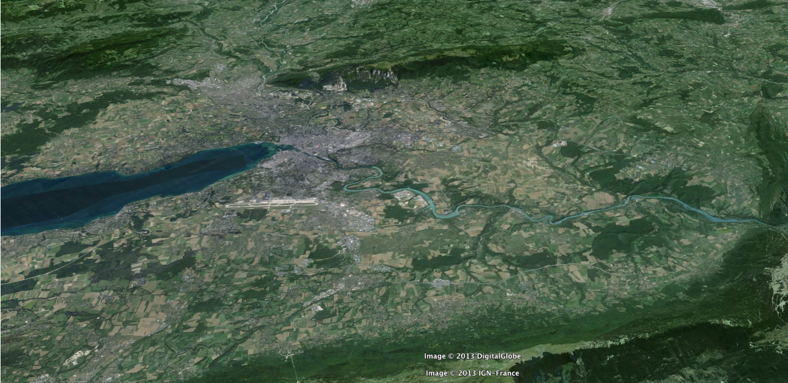
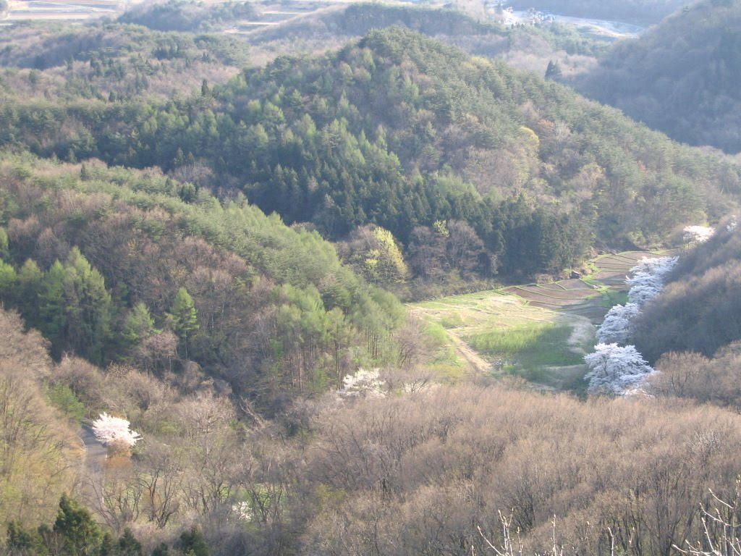





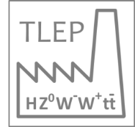





The Next-Generation Particle Accelerator
“with emphasis on TLEP (FCC-ee) vs ILC”
Frank Zimmermann
CERN, BE Department
IOP April Meeting 2014
many thanks for Stewart Boogert & Jocelyn Monroe
http://cern.ch/fcc
Work supported by the European Commission under Capacities 7th Framework Programme, Grant Agreement 312453

Slide 2
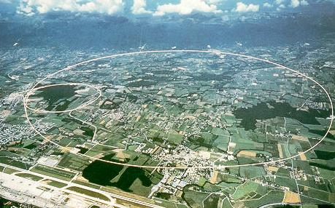
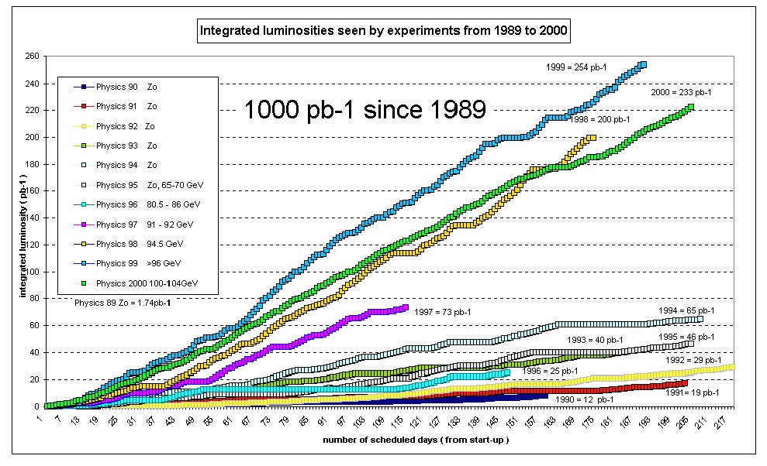
LEP – largest circular e⁺e⁻ collider so far
R. Assmann, Chamonix 2001
1000 pb⁻¹ from 1989 to 2000

Slide 3
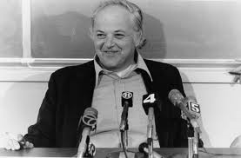
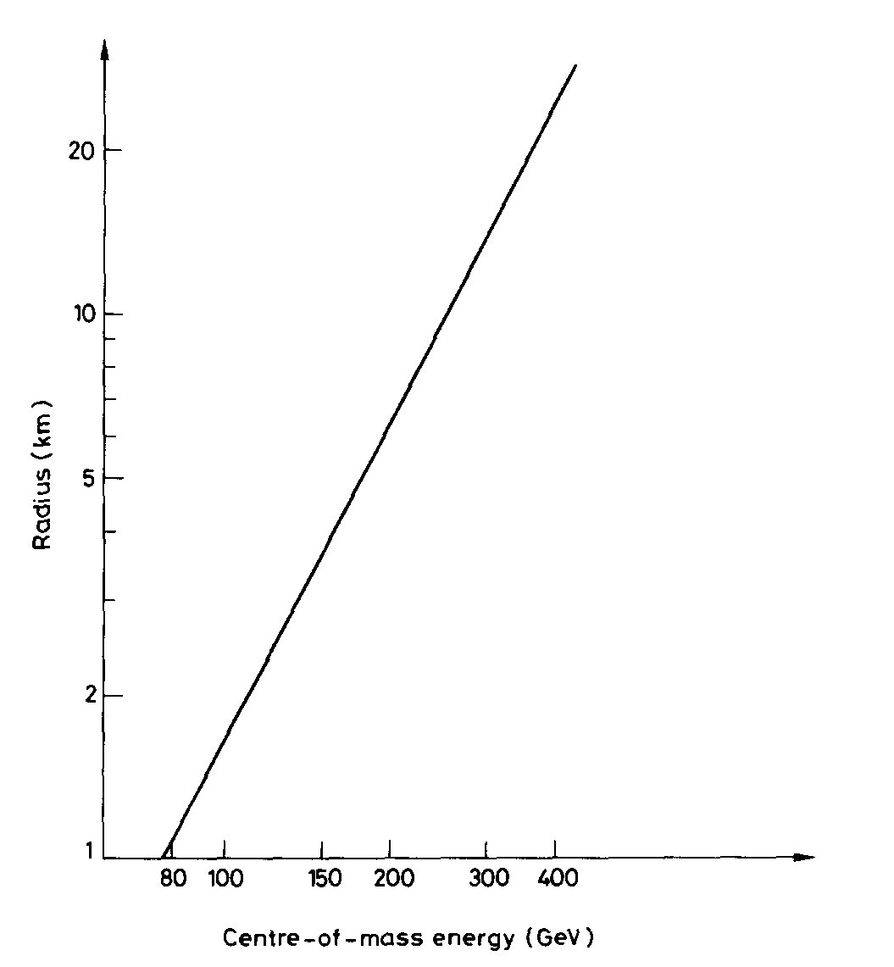
“An e⁺-e ⁻ storage ring in the range of a few hundred GeV in the centre of mass can be built with present technology. ...would seem to be ... most useful project on the horizon.”
(original LEP proposal, 1976)
Burt Richter
1976
350 GeV c.m.
↔
~90 km
cost-optimized
circumference
B. Richter, Very High Energy Electron-Positron Colliding Beams for the Study of Weak Interactions, NIM 136 (1976) 47-60

Slide 4
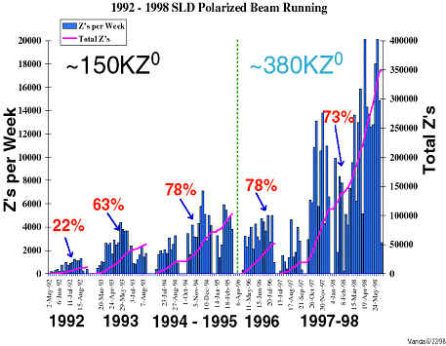
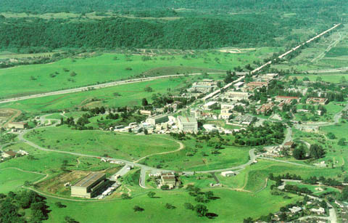
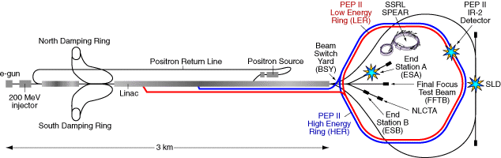
SLC – the first linear collider
20 pb⁻¹ from 1989 to 1998
Burton Richter et al, “The Stanford Linear Collider”, 11th Int. Conf. on High-Energy Accelerators, CERN (1980)

Slide 5
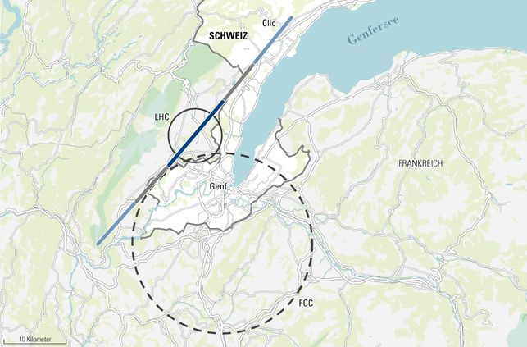
proposed linear & circular colliders
ex. Geneva basin
LHeC
ILC 0.5
ILC 1 TeV
CLIC
to go beyond
the LH(e)C we
need larger
machines
FCC
C NZZ

Slide 6
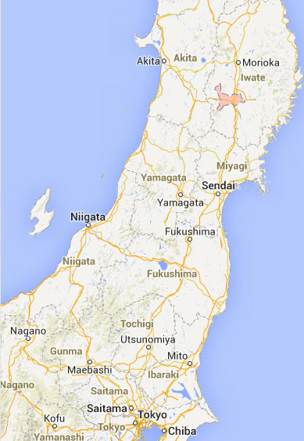
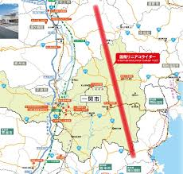
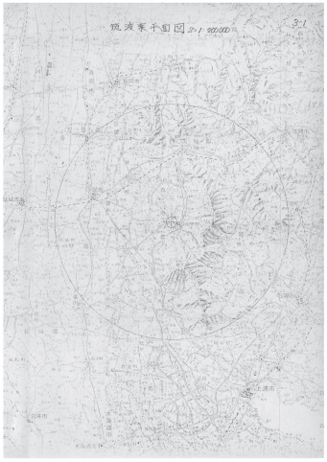
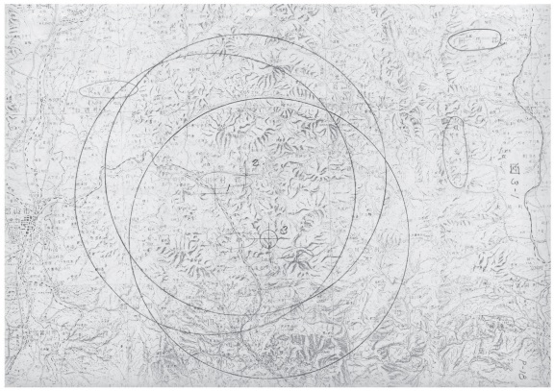
proposed linear & circular colliders
ex. Japan
J-ILC
circular
machines
appear closer
to Tokyo
J-ILC
Tristan-II
(1983)
Kitakami site
F. Takasaki
F. Takasaki
Tristan-II
(1983)
Tsukuba site
Fukushima site

Slide 7
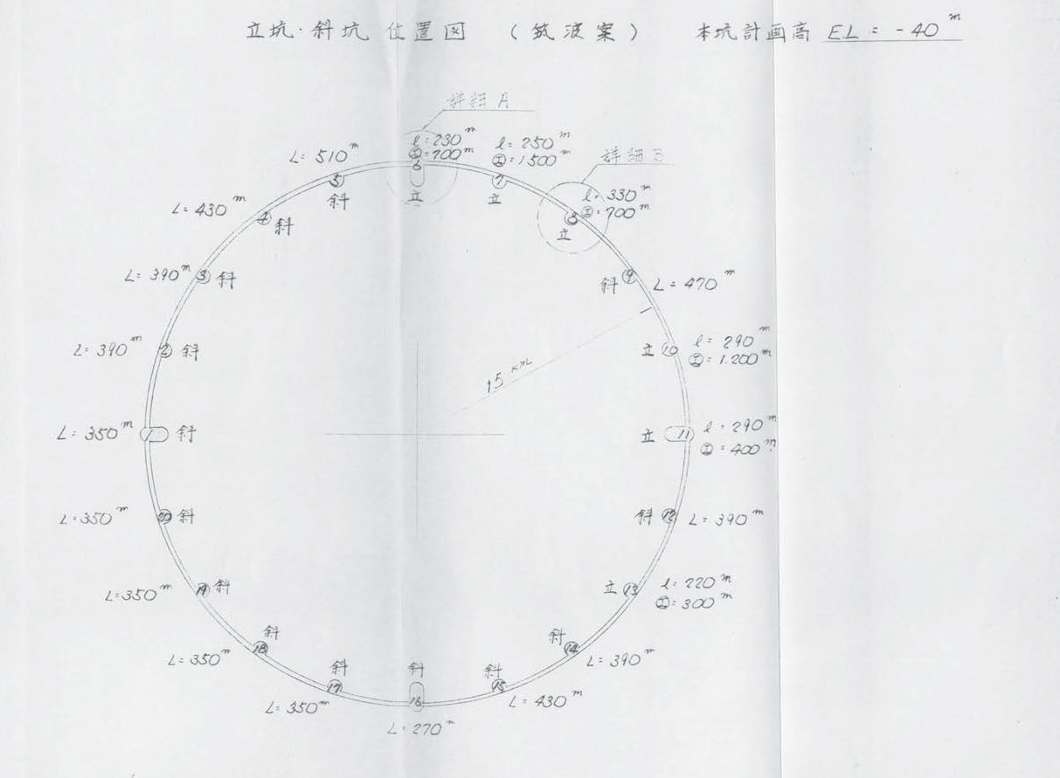
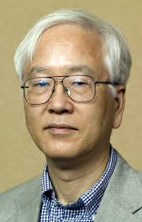
Tristan-II layout
Tsukuba site
(1983)
e⁺e⁻
pp
ep collisions
30 km diameter
94 km circumference
F. Takasaki

Slide 8
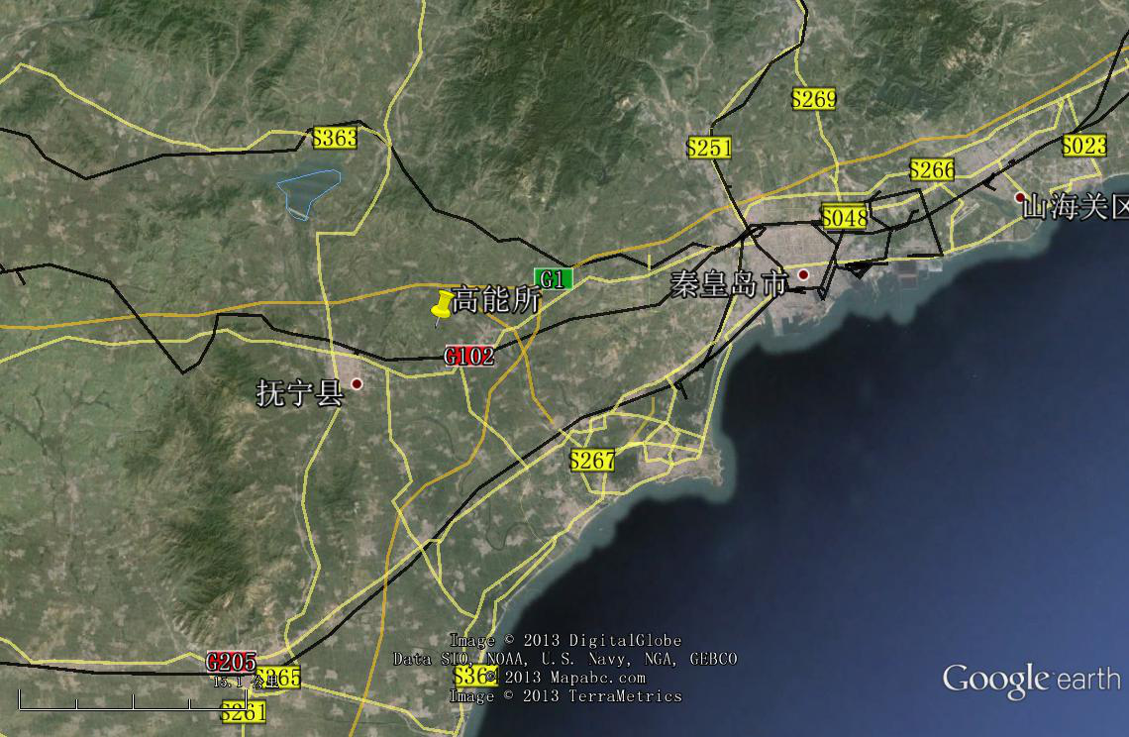
proposed circular colliders
ex. China
Qinhuangdao (秦皇岛）
CepC, SppC
50 km
70 km
easy access
300 km from Beijing
3 h by car
1 h by train
Yifang Wang

Slide 9
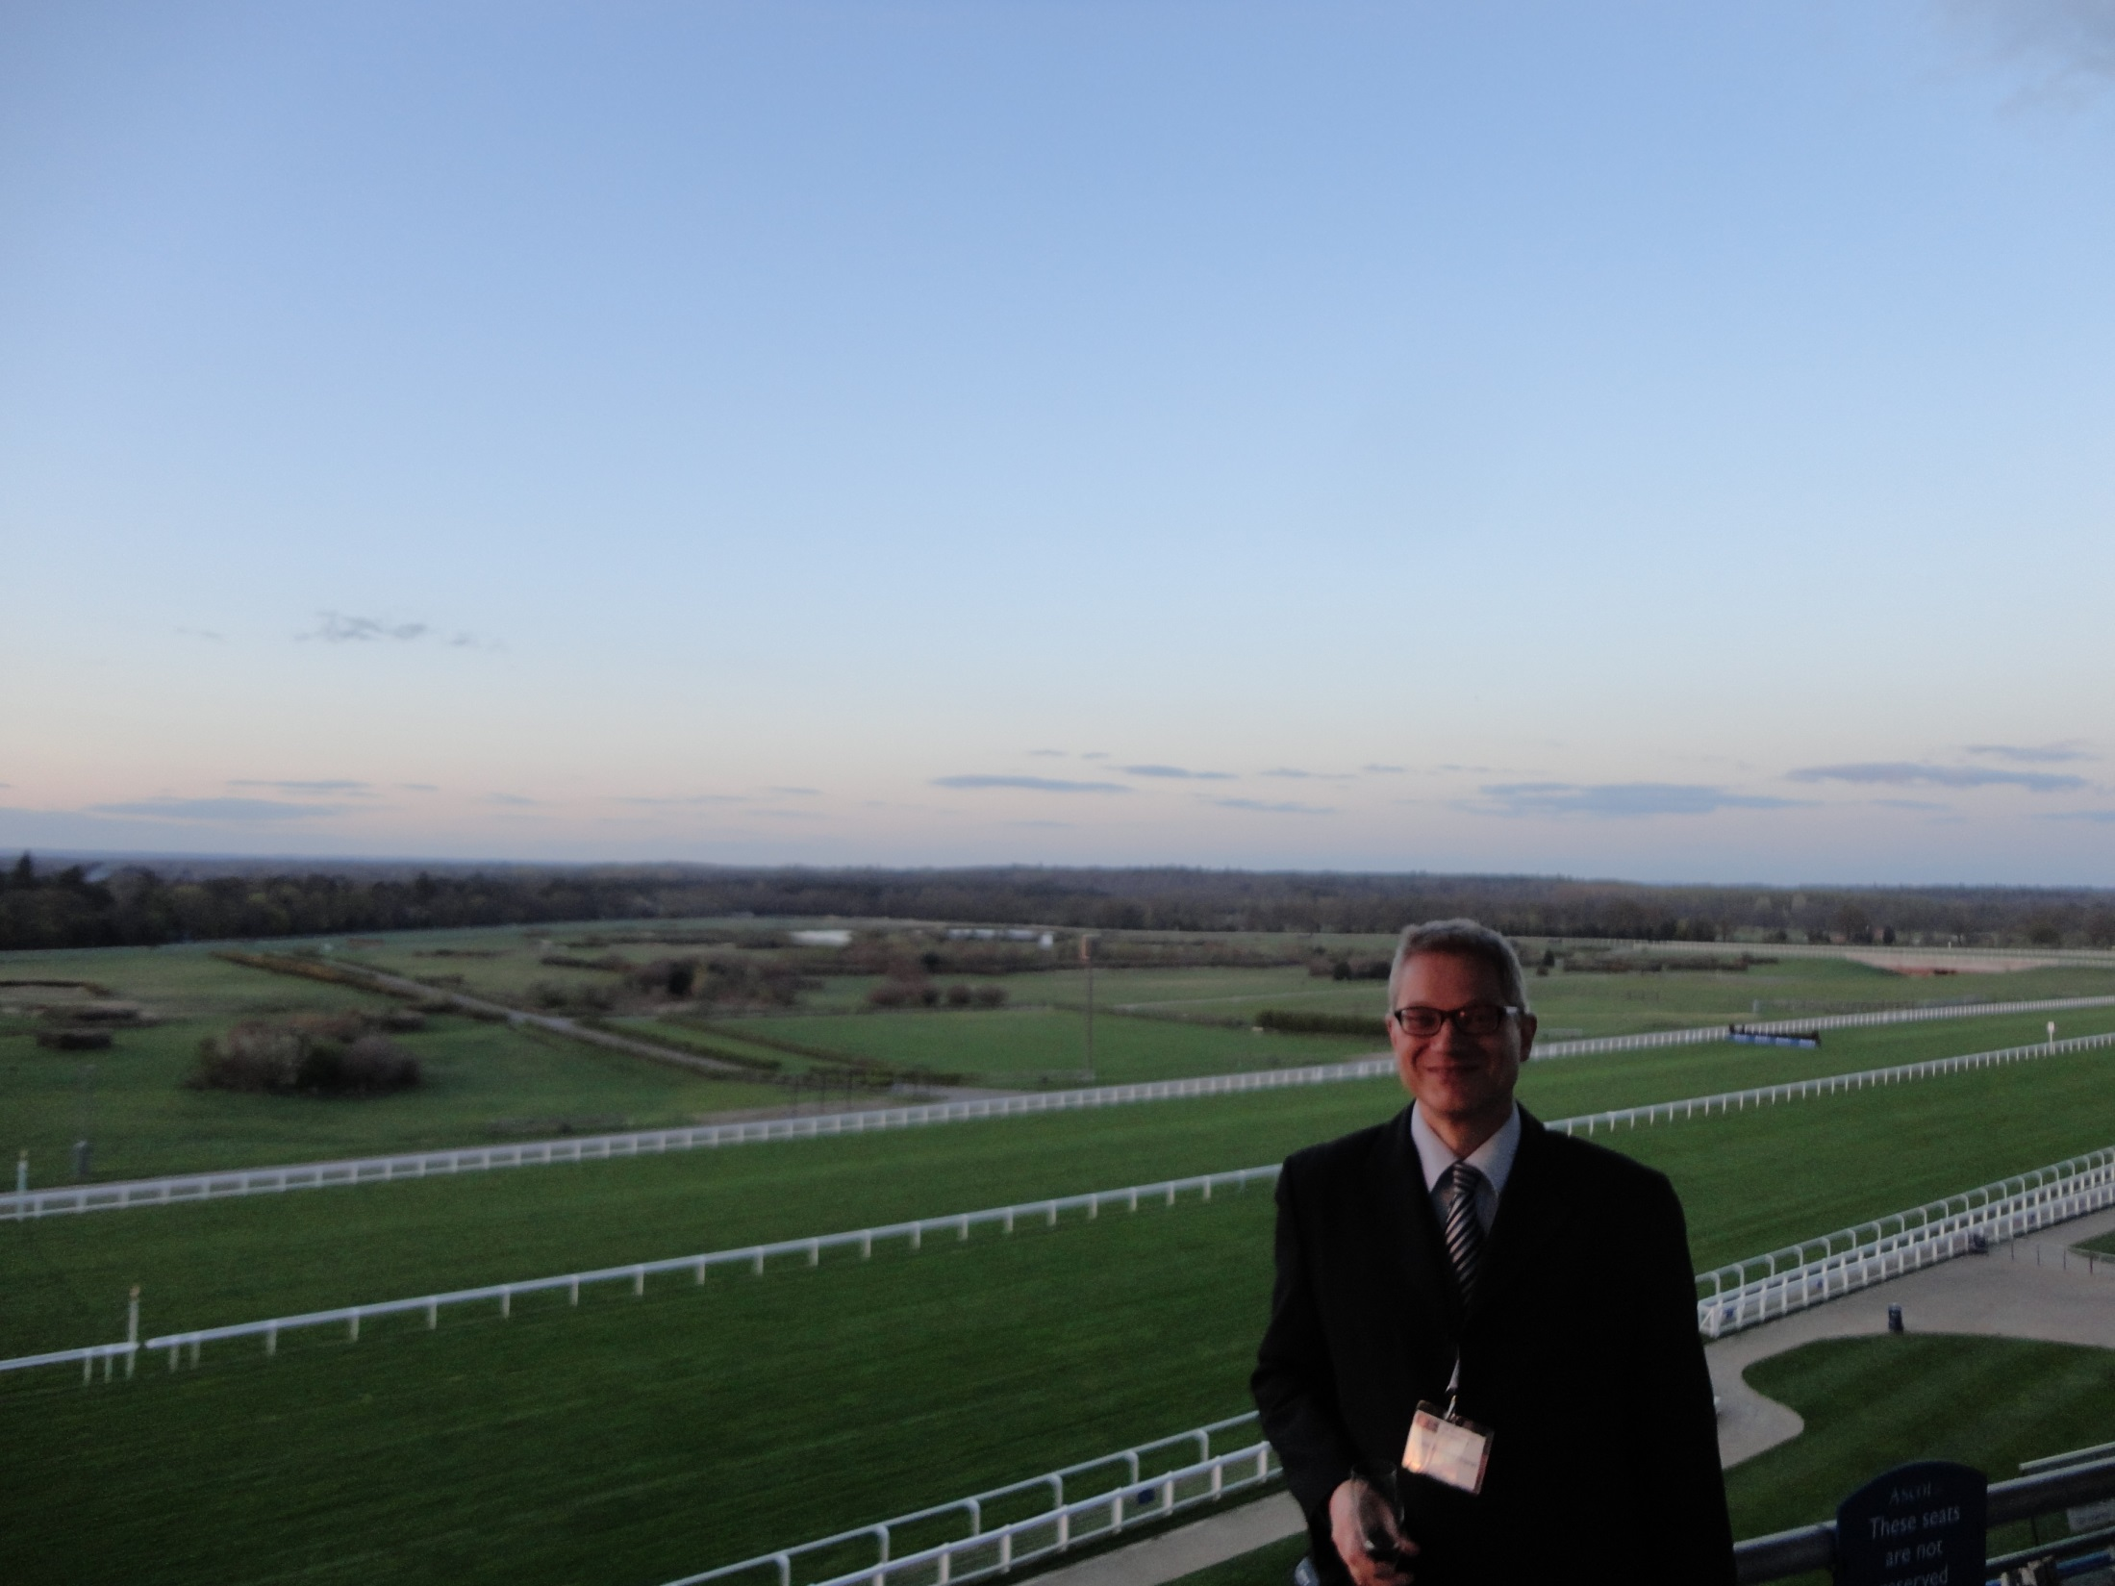
another proposed circular collider?
ex. Ascot/UK
2.8 km
photo courtesy V. Shiltsev

Slide 10
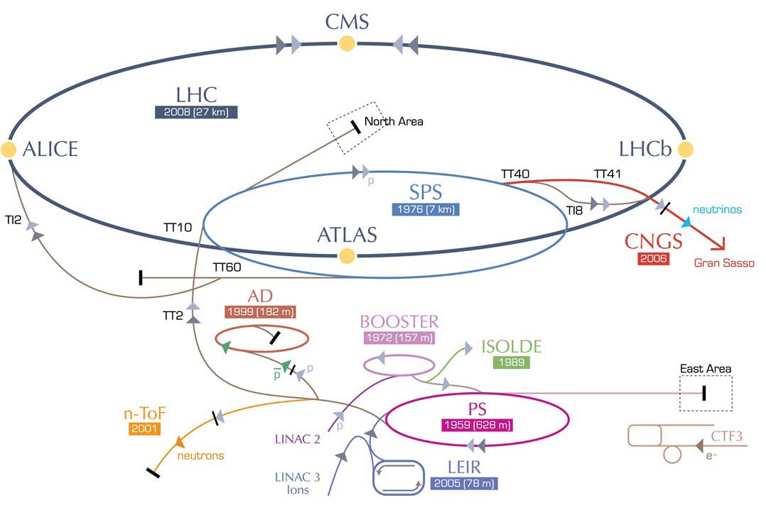
Large Hadron electron Collider (LHeC)
≤ 9 km
ERL LHeC:
recirculating
linac with
energy
recovery
&
SAPPHiRE
γγ collider

Slide 11
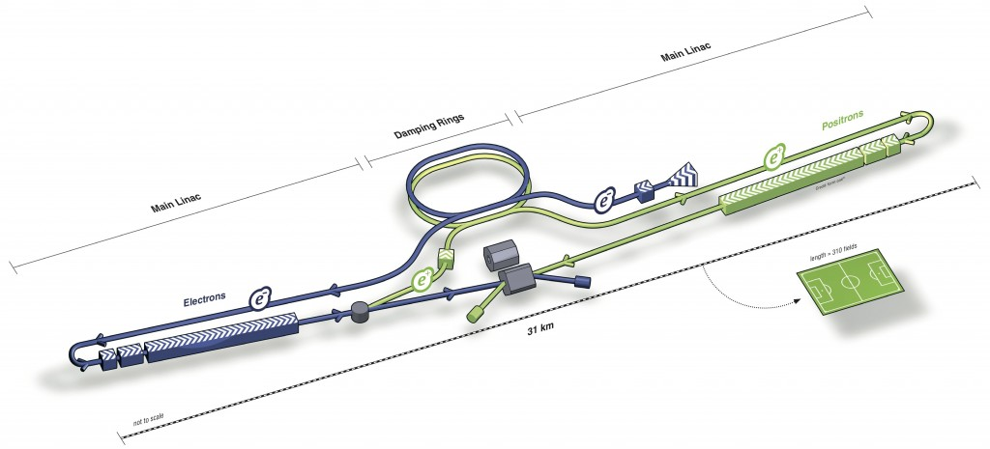
ILC
total length (main linac) ~30 (500 GeV) - 50 km (1 TeV)

Slide 12
CLIC
total length (main linac) ~11 (500 GeV) - 48 km (3 TeV)

Slide 13
TLEP / FCC-ee
circumference 80-100 km
- maximum e⁺e⁻ cm energy 350-500 GeV
- pp collision energy in same tunnel 80-125 TeV
for top up injection
A. Blondel
short beam lifetime (~τ_{LEP2}/40) due to high luminosity supported by top-up injection (used at KEKB, PEP-II, SLS,…); top-up also avoids ramping & thermal transients, + eases tuning

Slide 14
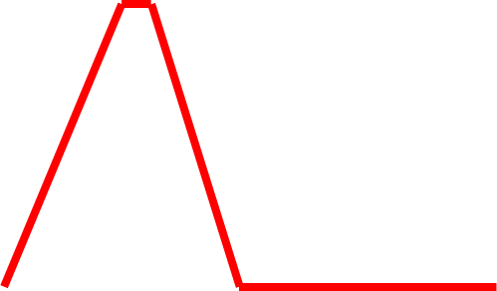
top-up injection: schematic cycle
beam current in collider (15 min. beam lifetime)
100%
99%
almost constant current
energy of accelerator ring
120 GeV
injection into collider
injection into
accelerator
20 GeV
acceleration time = 1.6 s
(assuming SPS ramp rate)
10 s

Slide 15
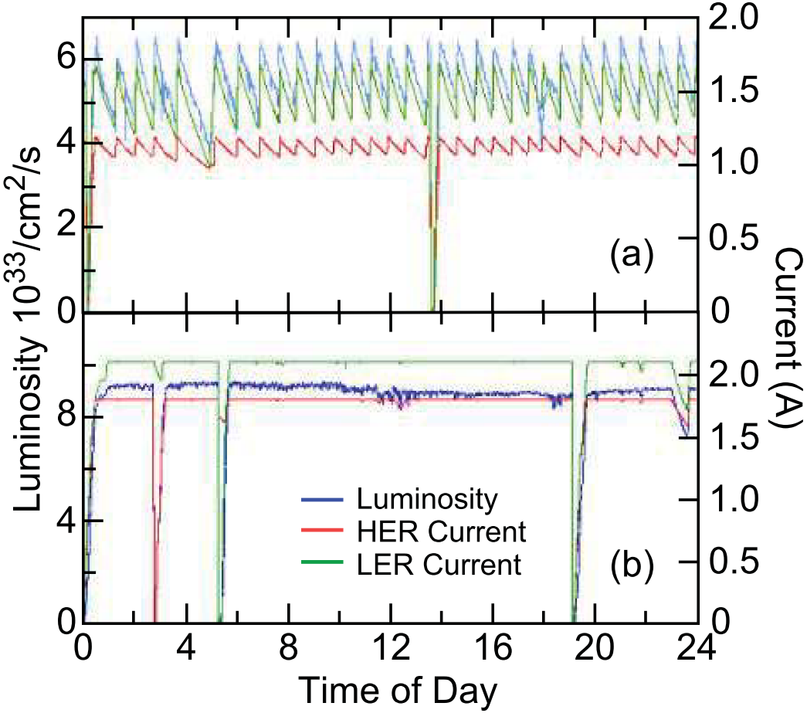
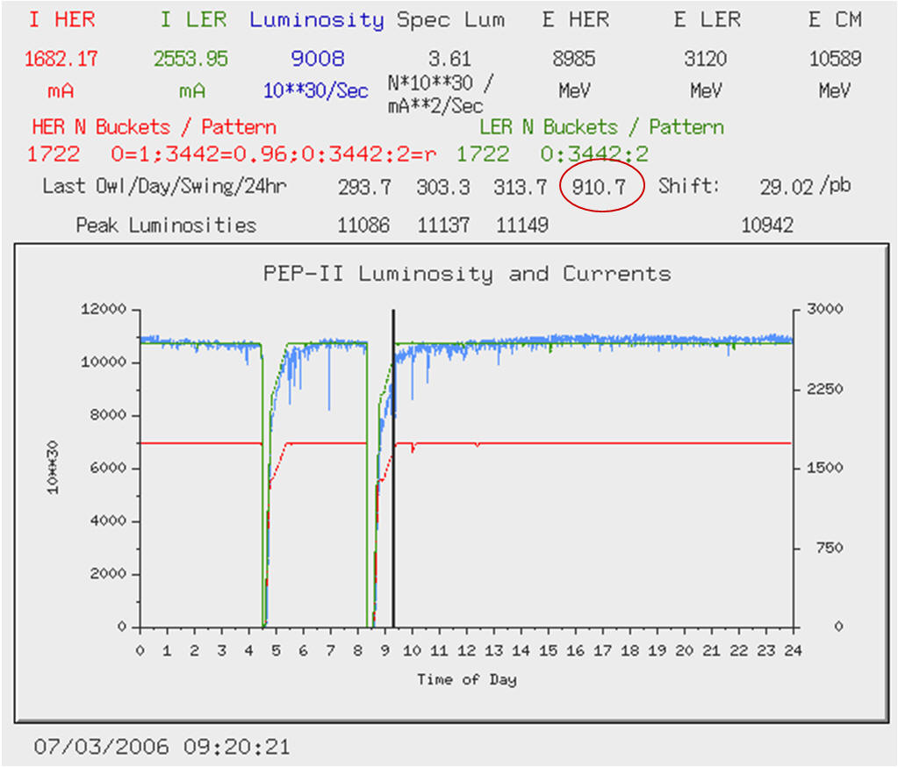
top-up injection at PEP-II
Before Top-Up
After Top-Up
J. Seeman
J. Seeman
average luminosity ≈ peak luminosity
similar results from KEKB

Slide 16
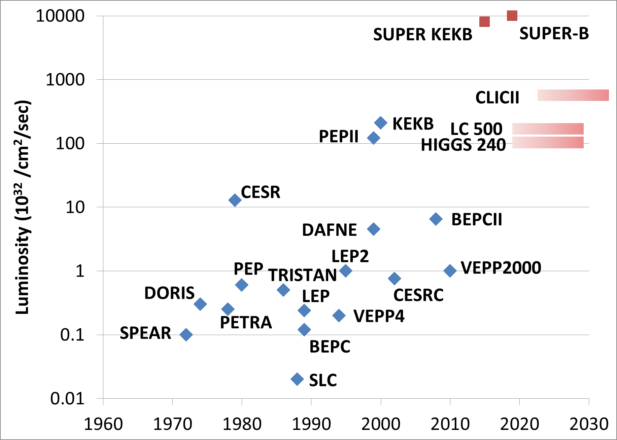
past, future & proposed e⁺e⁻ colliders
FCC-Z
S. Henderson
FCC-W
FCC-H
ILC 500
ILC 250
FCC-t

Slide 17
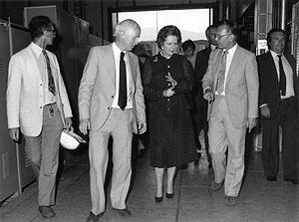
In 1982, when Lady Margaret Thatcher visited CERN, she asked the then CERN Director-General Herwig Schopper why CERN was building a circular collider rather than a linear one

Slide 18
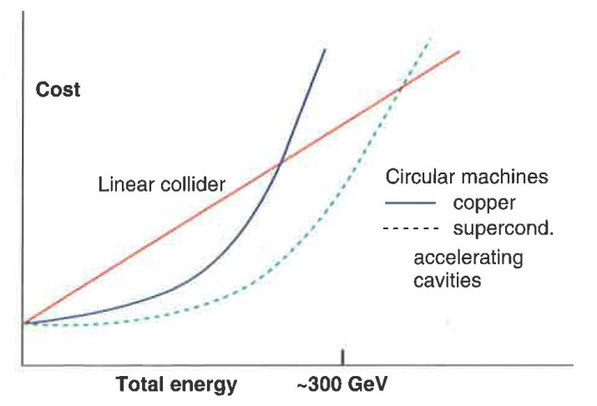
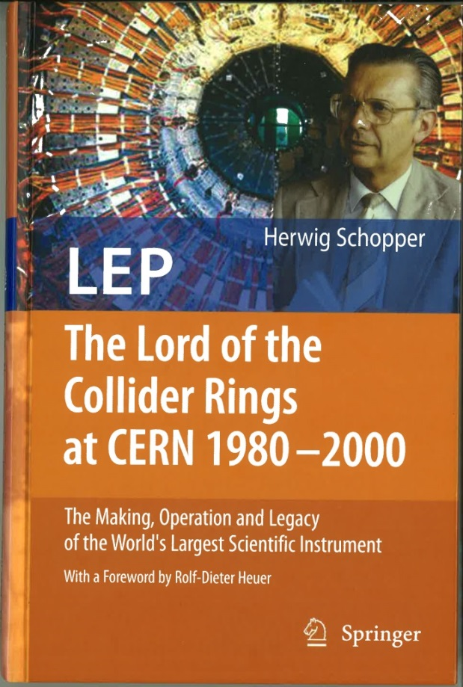
argument accepted by the Prime Minister:
cost of construction
Herwig Schopper, LEP - The Lord of the Collider Rings at CERN 1980 - 2000, Springer 2009
with a foreword by Rolf-Dieter-Heuer
up to a cm energy of at least ~350 GeV circular collider with sc RF is cheapest option
Herwig Schopper, private communication, 2014

Slide 19
energy provided to beam per collision
ILC: long RF sections w 2 x 125 (2 x 500 GV) voltage
e⁻
e⁺
both beams lost after single collision
RF must supply full beam energy for each collision
FCC-ee/CepC:
beams collide many times, e.g. 4x / turn
RF compensates SR loss
(~1% E_{beam} / turn)
e⁻
e⁺
difference in #collisions / (beam energy) ~ 300x

Slide 20
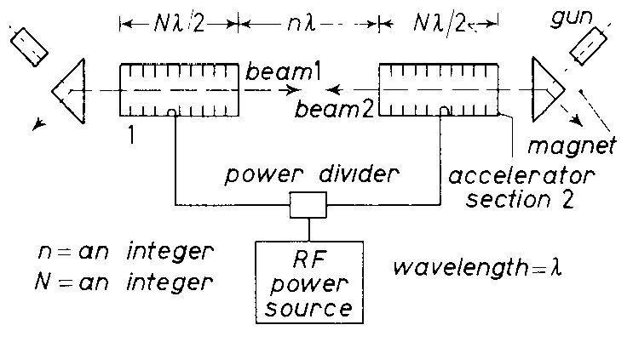
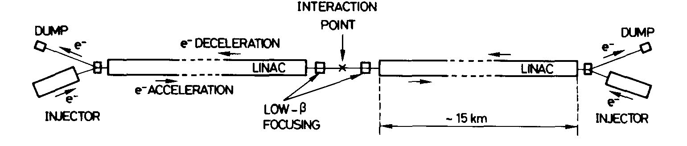
early linear-collider proposals recovered beam energy
Maury Tigner, “A Possible Apparatus for Clashing-Beam Experiments”, Nuovo Cimento 37, 1228 (1965)
Ugo Amaldi, “A possible scheme to obtain e-e- and e+e- collisions at energies of hundreds of GeV”, Physics Letters B61, 313 (1976)

Slide 21
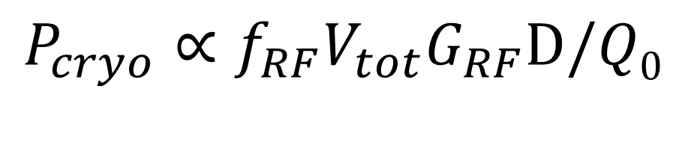
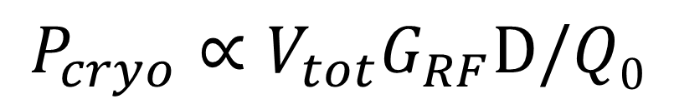
cryo power: ILC vs FCC-ee
$$P_{cryo}∝V_{tot}G_{RF}D/Q0$$
or
$$P_{cryo}∝{f_{RF}V}_{tot}G_{RF}D/Q0$$
(if SC cavity losses dominated by BCS resistance)
 | ILC-H | FCC-ee-H
RF voltage V_{tot} | 240 GV | 6-12 GV
RF gradient G_{RF} | 31.5 MV/m | 15-20 MV/m
effective RF length | 8 km | <800 m
RF frequency f_{RF} | 1.3 GHz | 400 MHz (?)
Q₀: unloaded cavity Q | 10¹⁰ | 2-4x10¹⁰ (higher at lower G_{RF})
D: RF duty factor | 0.75% (pulsed) | 100% (cw)
total cryo power | 16 MW | 10-25 MW (FCC-H & t)
total cryo power 16 MW (ILC-H), 10-25 MW (FCC-H & t)
total cryo power similar for both projects

Slide 22
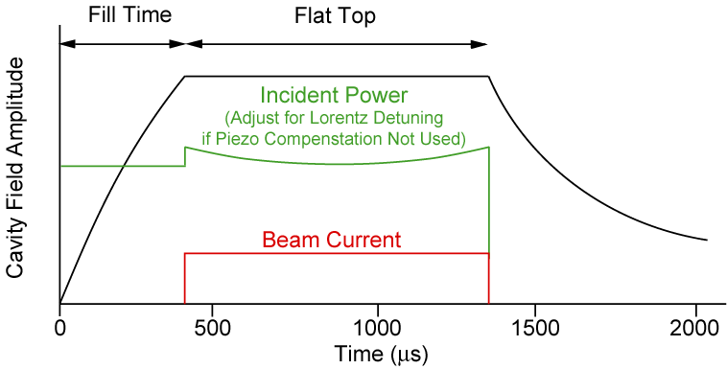
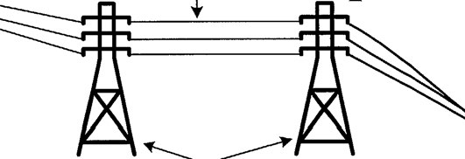
RF power efficiencies: ILC vs FCC-ee
RF distribution (95% vs 93%)
Low-Level RF
Klystron (45% vs 65%)
dynamic margin + pulsed vs
saturation + cw operation
Accelerating
cavities
(44% vs 100%)
pulsed vs cw
Modulator (95%? vs 95%)
pulsed vs cw
Electrical
network
(95%)
ILC pulse
efficiency (RF): wall plug power to beam power
ILC: η~17%
FCC-ee: η~55%
factor ~3 difference in efficiency of
converting wall-plug power to beam energy

Slide 23
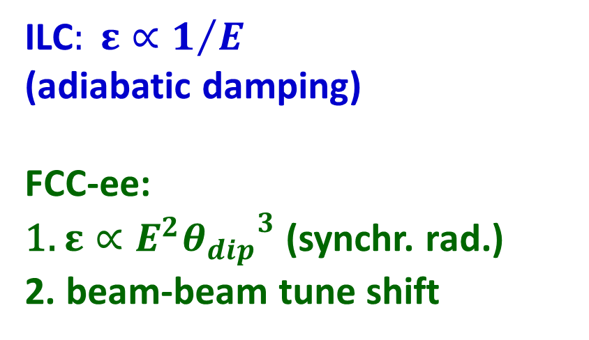
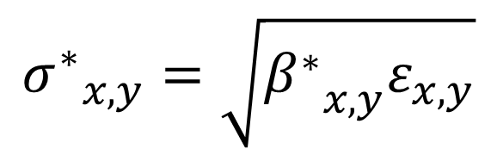
IP spot size
$${σ^{∗}}_{x,y}=\sqrt{{β^{∗}}_{x,y}ε_{x,y}}$$
ILC$: ε∝1/E$
(adiabatic damping)
FCC-ee:
1. $ε∝E^{2}{θ_{dip}}^{3}$ (synchr. rad.)
2. beam-beam tune shift
1. final focus optics
2. bunch length
3. beamstrahlung
(for β_{x})
smaller emittances
needed for linear colliders

Slide 24
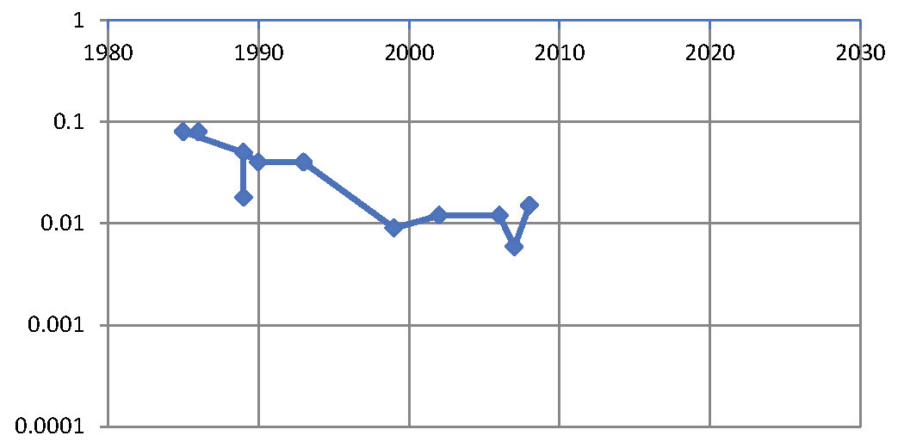
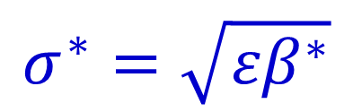
vertical β* history
β* [m]
year
SPEAR
PEP, BEPC, LEP
PETRA
TRISTAN
DORIS
CESR-c, PEP-II
BEPC-II
CESR
DAFNE
KEKB
SLC
FCC-ee
SuperKEKB
ILC
$$σ^{∗}=\sqrt{{εβ}^{∗}}$$

Slide 25
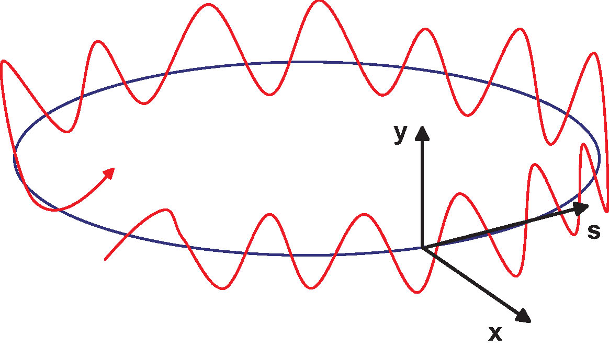
betatron oscillation & tune
schematic of betatron oscillation around storage ring
tune Q_{x,y}= number of (x,y) oscillations per turn
quadrupole magnet
(many)
focusing elements:
quadrupole magnets

Slide 26
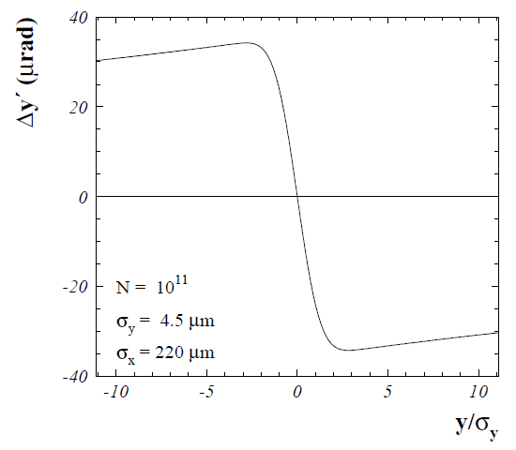
beam-beam tune shift
beam-beam
deflection
center of
opposing
beam
at small amplitude similar to effect of focusing quadrupole
beam-beam tune shift
(for head-on collision)

Slide 27
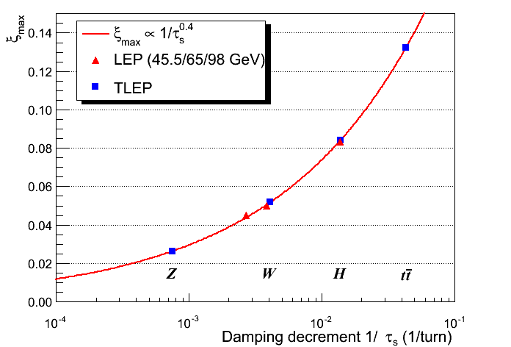
beam-beam tune shift for FCC-ee
tune shift limits empirically scaled from LEP data (also 4 IPs like FCC-ee/TLEP)
J. Wenninger
R. Assmann & K. Cornelis, EPAC2000
in reasonable agreement with simulations
S. White

Slide 28
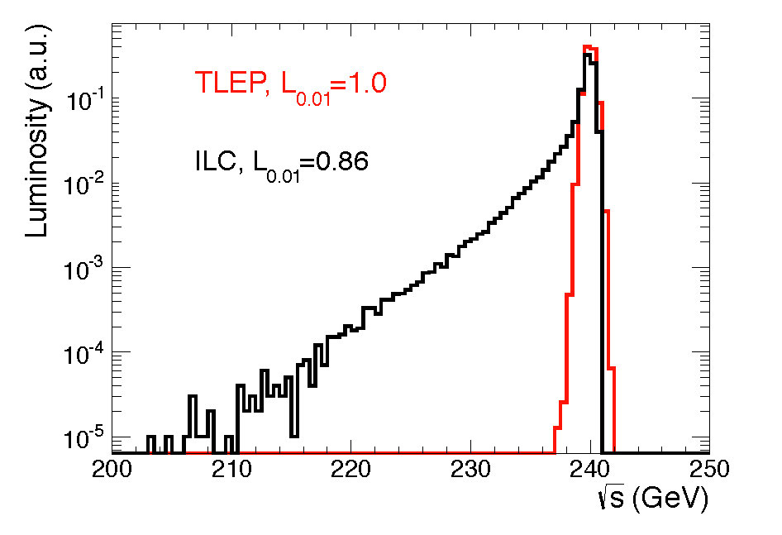
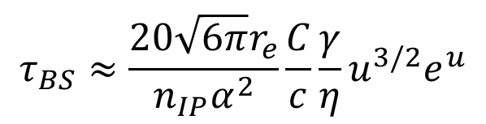

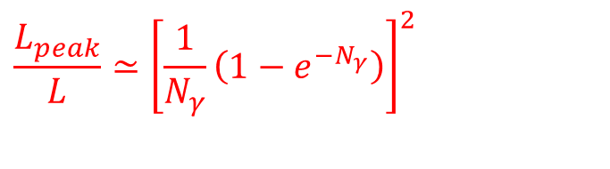
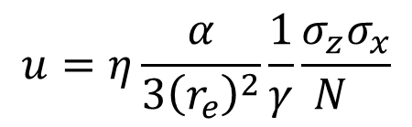
beamstrahlung (BS)
synchrotron radiation in the strong field of opposing beam
some e± emit significant part of their energy
→
degraded luminosity spectrum
limit on beam lifetime (circular collider)
V. Telnov, PRL 110 (2013) 114801
$$τ_{BS}≈\frac{20\sqrt{6π}r_{e}}{n_{IP}α^{2}}\frac{C}{c}\frac{γ}{η}u^{3/2}e^{u}$$
(at 240 GeV)
L_{0.01} is luminosity within 1% of nominal c.m. energy.
$$u=η\frac{α}{3{\left(r_{e}^{}\right)}^{2}}\frac{1}{γ}\frac{σ_{z}σ_{x}}{N_{}}$$
with
η: momentum acceptance
σ_{z}: rms bunch length
σ_{x}: horizontal beam size at IP
$$\frac{L_{peak}}{L}≃{\left[\frac{1}{N_{γ}^{}}\left(1−e^{−N_{γ}}\right)\right]}^{2}$$
$$N_{γ}≃\frac{2αr_{e}N}{σ_{x}}$$
where
denotes average number
of BS photons per e⁻

Slide 29
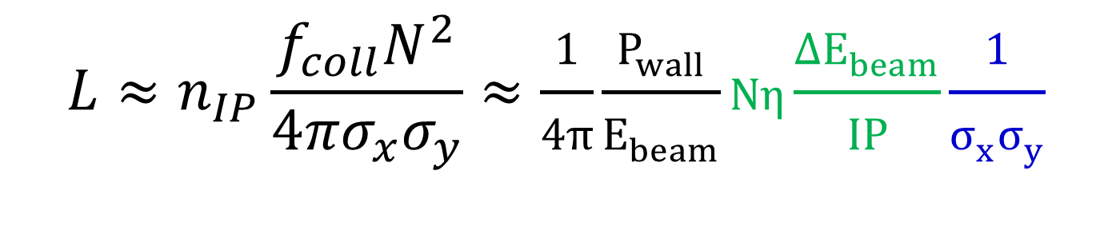
collider luminosity
$$L≈n_{IP}\frac{f_{coll}N^{2}}{4πσ_{x}σ_{y}}≈\frac{1}{4π}\frac{P_{wall}}{E_{beam}}Nη\frac{{ΔE}_{beam}}{IP}\frac{1}{σ_{x}σ_{y}}$$
FCC-ee:
higher bunch charge N (FCC-ee ~2.5x ILC charge / bunch)
several IPs (n_{IP}=4)
3-4 times higher wall-plug power to beam efficiency η
ΔE_{beam}/IP ~300 (instead of 1)
→ total factor 2.5x4x300~3000
ILC:
~200x smaller IP spot size (smaller emittances and β*’s)
→ for equal wall plug power FCC-ee-H has ~15x times
more luminosity than ILC-H

Slide 30
comparison of key design parameters
Parameter | LEP2 | FCC-ee |  |  | ILC
 |  | Z | H | t | H | 500 | 1 TeV
E (GeV) | 104 | 45 | 120 | 175 | 125 | 250 | 500
<I (mA)> | 4 | 1400 | 30 | 7 | 0.000021 | .000021 | .000027
P _{SR/b,tot} [MW] | 22 | 100 | 100 | 100 | 5.9 | 10.5 | 27.2
P_{AC} [MW] | ~200 | ~260 | ~270 | ~300 | ~129 | ~163 | ~300
η_{wall→beam} [%] | ~30 | 30-40 | 30-40 | 30-40 | 4.6 | 6.4 | 9.1
N_{bunch/ring (pulse)} | 4 | 16’700 | 1’330 | 98 | 1312 | 1312 | 2450
f_{coll} (kHz) | 45 | 50000 | 4000 | 294 | 6.6 | 6.6 | 9.8
β*_{x/y} (mm) | 1500/ 50 | 500 / 1 | 500 /1 | 1000/1 | 13 | 11 | 11
ε_{x} (nm) | 30-50 | 29 | 1 | 2 | 0.04 | 0.02 | 0.01
ε_{y} (pm) | ~250 | 60 | 2 | 2 | 0.14 | 0.07 | 0.03
ξ_{y} (ILC: n_{γ}) | 0.07 | 0.03 | 0.09 | 0.09 | (1.12) | (1.72) | (2.12)
n_{IP} | 4 | 4 | 4 | 4 | 1 | 1 | 1
L_{0.01}/IP | 0.012 | 28 | 6.0 | 1.8 | 0.65 | 1.05 | 2.2
L_{0.01,tot} (10³⁴ cm⁻²s⁻¹) | 0.048 | 112 | 24 | 7.2 | 0.65 | 1.05 | 2.2

Slide 31
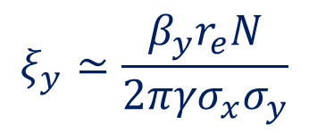
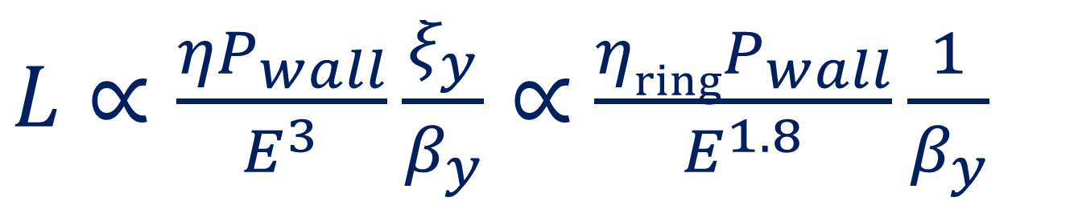
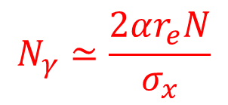


scaling with energy
circular collider
limited by
beam-beam
tune shift
$L∝\frac{{ηP}_{wall}}{E^{3}}\frac{ξ_{y}}{β_{y}}∝$ $\frac{{ηringP}_{wall}}{E^{1.8}}\frac{1}{β_{y}}$
$$ξ_{y}≃\frac{β_{y}r_{e}N}{2π{γσ}_{x}σ_{y}}$$
$$ξ_{y,max}∝\frac{1}{τ^{0.4}}∝E^{1.2}$$
linear collider
limited by
#BS photons
per e±
$$L∝\frac{{ηlinacP}_{wall}}{E}\frac{N_{γ}}{σ_{y}}$$
$$N_{γ}≃\frac{2αr_{e}N}{σ_{x}}$$
(luminosity spectrum)

Slide 32

actual design luminosity vs. energy
ultimate precision
at Z, WW, ZH ;
sensitive to New
Physics in multi-TeV range & to SM closure → case for VHE-LHC
constant power (≤2 x ILC500)
constant β_{y}
2x power ILC500, ½ σ_{y}
ultimate energy reach
up to 1 or 3 TeV ;
direct searches
for New Physics
1x power ILC500,
½ σ_{y}
1x power ILC500,
same σ_{y}
lower power

Slide 33




commissioning times & performance of circular e⁺e⁻ colliders
PEP-II
KEKB
DAΦNE

Slide 34

commissioning time & performance of the first linear collider
LEP1
(per IP)
LEP1 design
SLC design
SLC
CERN-SL-2002- 009 (OP), SLAC–PUB–8042 [K. Oide, 2013]
SLC
½ design value reached after 11 years

Slide 35
comparing commissioning times & performance
 | beam energy [GeV] | design luminosity [10³² cm⁻²s⁻¹] | peak luminosity /design | time to achieve design [y]
LEP1 | 45 | 0.13 | 2 | 5
SLC | 45 | 0.06 | 0.5 | - (>10 )
LEP2 | 60-104.5 | 0.26 | 3 | <0.5
DAFNE | 0.5 | 5.0 | 0.9 | - (>10)
PEP-II | 9, 3.1 | 30 | 4 | 1.5
KEKB | 8, 3.5 | 100 | 2 | 3.5
ATF-2 | 1.28 | 0.000001(eff.) | 0.005 (eff.) | - [>4*]
* not counting the year of the earthquake; ATF-2 operating only for fraction of calendar time

Slide 36


SuperKEKB – FCC-ee demonstrator
beam commissioning will start in early 2015
β_{y}*=300 μm (TLEP: 1 mm)
lifetime 5 min (TLEP: ~15min)
ε_{y}/ε_{x}=0.25% ! (TLEP: 0.2%)
off momentum acceptance (±1.5%, TLEP: ±2%)
e⁺ production rate (2.5x10¹²/s, TLEP: <1x10¹¹/s)

Slide 37

e⁺ source – rate requirements
 | S-KEKB | SLC | CLIC (3 TeV) | ILC (H) | FCC-ee (H)
e⁺ / second | 2.5 x 10¹² | 6 x 10¹² | 110 x 10¹² | 200 x 10¹² | 0.05 x 10¹²
L. Rinolfi
X 18
X 33
/ 120
efficiency of e⁺ usage:
5x10⁻⁵ b⁻¹/e⁺
1 b⁻¹/e⁺
factor 20000
ILC e⁺ source design
20x10⁶
ILC e+ source has no precedent; its performance can be verified only after ILC construction (needs >150 GeV e⁻ beam)

Slide 38

vertical rms IP spot size
collider / test facility | ${σ_{y}}^{∗}$ [nm]
LEP2 | 3500
KEKB | 940
SLC | 700
ATF2, FFTB | 65 (35), 77
SuperKEKB | 50
FCC-ee-H | 44
ILC | 5 – 8
CLIC | 1 – 2
β_{y}*:
5 cm→
1 mm
ε_{y}:
250 pm→
2 pm
in regular
font:
achieved
in italics:
design
values
β_{y}*:
1.5 mm→
0.5 mm
ε_{y}:
90 pm→
0.1 pm

Slide 39
linear scenario (example)
CLIC
3 TeV
drive beam
NC 12 GHz
100 MV/m
48 km
ILC
1 TeV
SC 1.3 GHz
klystrons
36 MV/m?
48 km
ILC
500 GeV
SC 1.3 GHz
klystrons
31.5 MV/m
31 km
≥ 50 years of e⁺e⁻ (e⁻e⁻, γγ) collisions up to 3 TeV c.m.

Slide 40

circular scenario (example)
FCC-ee (80-100 km,
e⁺e⁻, up to
~350 GeV c.m.)
PSB
PS (0.6 km)
LHC (26.7 km)
SPS (6.9 km)
FCC-hh
(pp, up to
100 TeV c.m.)
LHeC & SAPPHiRE?
& e± (50-175 GeV) – p (50 TeV) collisions (FCC-he)
≥50 years of e⁺e⁻, pp, ep/A physics at highest energies

Slide 41


tentative time line - example 1
1980
1990
2000
2010
2020
2030
2040
LHC
Design,
R&D
Proto.
Constr.
Physics
HL-LHC
Design,
R&D
Constr.
Physics
Design,
R&D
TESLA/
ILC
Design, R&D
ee
Constr.
Physics
CLIC
Design, R&D
Constr.
Physics

Slide 42
tentative time line – example 2
1980
1990
2000
2010
2020
2030
2040
LHC
Design,
R&D
Proto.
Constr.
Physics
HL-LHC
Design,
R&D
Constr.
Physics
Design,
R&D
ee
Design,
R&D
Constr.
Physics
FCC
pp
Design,
R&D
Constr.
Physics

Slide 43
tentative time line – example 3
1980
1990
2000
2010
2020
2030
2040
LHC
Design,
R&D
Proto.
Constr.
Physics
HL-LHC
Design,
R&D
Constr.
Physics
LHeC/SAPPHiRE?
Design,
R&D
Constr.
Physics
ILC
Design, R&D
ee
Constr.
Physics
CLIC
Design, R&D
Constr.
Physics
CepC/
FCC-ee
Design,
R&D
Constr.
Physics
SppC/
FCC-hh
Design,
R&D
Constr.
Physics
FCC-he
Design,
R&D
Constr.
Physics

Slide 44


FCC study long-term goal: hadron collider
only approach to get to 100 TeV range in coming decades
high energy and luminosity at affordable power consumption
lead time design & construction > 20 years (LHC study started 1983!) → must start now to be ready for 2035/2040
kick-off
event
expressions of interest (EOI)
proposed 1st
ICB meeting
discussions
iterations
March April May June July August September 2014
invitation of non-committing expressions of interest for contributions from worldwide institutes by end May 2014
5 year time line:
Q2 2014-Q2 2015: Explore options, “weak interaction”, baseline
Q3 2015-Q4 2016: Conceptual study of baseline, “strong interaction”
Q1 2017-Q4 2017: Cost model, LHC results, consolidation, re-scoping
Q3 2018: Release of FCC Conceptual Design Report
M. Benedikt

Slide 45
LHC schedule 2015-2035
LS2 starting in 2018 (July) => 18 months + 3 months BC
LS3 LHC: starting in 2023 => 30 months + 3 months BC
Injectors: in 2024 => 13 months + 3 months BC
Physics
Shutdown
Beam commissioning
Technical stop
30 fb⁻¹
YETS
EYETS
YETS
LS 2
YETS
Run 2
Run 3
Run 2
LS 2
Run 3
FCC CDR & ESU
YETS
LS 3
Run 4
YETS
LS 3
Run 4
300 fb⁻¹
LS 4
Run 5
LS 5
LS 4
Run 5
LS 5
(Extended) Year End Technical Stop: (E)YETS
3’000 fb⁻¹
F. Bordry
LHC schedule approved by CERN management and LHC experiments spokespersons and technical coordinators (December 2013)

Slide 46
conclusions
great history of colliders & collider designs
linear colliders look more challenging technically, also less efficient in terms of “RF wall-plug power per collision” (factor ~1000) and “e⁺ per luminosity” (factor >10000)
various scenarios for “Next Accelerator(s)”:
  ILC e⁺e⁻ collisions up to 500-1000 GeV TeV to look for NP, then CLIC to reach 3 TeV e⁺e⁻ (e⁻e⁻, γγ)
  build circular e⁺e⁻ collider with higher luminosity to study Z, W, H and t up to 350 GeV, then 100 TeV pp collider (+ AA&ep/A collider) in same tunnel
  combinations or all of LHeC/SAPPHiRE, ILC+CLIC, CepC/FCC-ee, SppC/FCC-hh, and FCC-he
LHC results in 2015-18 may define the direction(s)

Slide 47



is history repeating itself…?
When Lady Margaret Thatcher visited CERN in 1982, she also asked the then CERN Director-General Herwig Schopper how big the next tunnel after LEP would be.
Margaret Thatcher,
British PM 1979-90
Dr. Schopper‘s answer was there would be no bigger tunnel at CERN.
Lady Thatcher replied that she had „obtained exactly the same answer from Sir John Adams when the SPS was built“ 10 years earlier, and therefore she didn‘t believe him.
Herwig Schopper
CERN DG 1981-88
built LEP
John Adams
CERN DG 1960-61 & 1971-75
built PS & SPS
maybe the Prime Minister was right!?
Herwig Schopper, private communication, 2013

Slide 48

thank you for your attention!
Nima Arkani-Hamed during the
inauguration of the Center for
Future High Energy Physics
(CFHEP) IHEP Beijing, 17 Dec 2013

Slide 49
a few references:
The International Linear Collider Technical Design Report - Volumes 1-5, ILC-REPORT-2013-040 (2013)
C. Adolphsen, International Linear Collider (ILC) Linac Basics, ILC School 2006
A. Blondel and F. Zimmermann, High Luminosity e+e- Collider in the LHC tunnel to study the Higgs Boson, Dec. 2011, http://arxiv.org/abs/1112.2518
Future Circular Collider (FCC) study web site http://cern.ch/fcc
J. Wenninger et al, Lepton Collider Parameters, CERN FCC-ACC-SPC-0004, EDMS 1346082
A Multi-TeV Linear Collider Based on CLIC Technology - CLIC Conceptual Design Report, CERN-2012-007 (2012)
K. Yokoya, e⁺e⁻ Higgs Factory, Higgs and Beyond, Sendai 8 June 2013
R. Siemann, Progress on Electron-Positron Linear Colliders&Technology,CERN 2002
M. Harrison, ILC Status, LCWS 2013
K. Oide, Risk of “J-ILC,” Science Council of Japan, July 2013
M. Bicer et al, First Look at the Physics Case of TLEP, doi: 10.1007/JHEP01(2014)164JHEP 01 (2014) 164
M.Harrison, M.Ross, N.Walker, Luminosity Upgrades for ILC, arXiv:1308.3726, 2013
A. Blondel et al, Comments on "Wall-plug (AC) power consumption of a very high energy e+/e- storage ring collider" by Marc Ross, arXiv:1308.2629, August 2013
S. Stapnes, CLIC Accelerator Overview, 2014 CLIC Meeting, 3-7 February 2014
J. Abelleira et al, (LHeC CDR), J. Phys. G: Nucl. Part. Phys. 39, 075001 (2012)

Slide 50
Appendix:
commissioning & performance history
of various colliders and facilities

Slide 51

commissioning time: circular colliders - 1
LEP1
LEP2
LEP1
~60% design in 2nd year
design in 5th year
finally >2x design
LEP2
design exceeded after
few months
peak >3x design
Peak luminosity for each year of LEP
operation. [R. Assmann, APAC2001 Beijing]

Slide 52

commissioning time: circular colliders - 2
PEP-2
design reached
after 1.5 years
peak 4x design
design
PEP-II peak luminosity in a given month from 1999 to 2008. A peak luminosity of 1.21x10³⁴/cm²/s was achieved. [J. Seeman, EPAC’08 Genoa]

Slide 53

commissioning time: circular colliders - 3
design
History of the performance of KEKB from October 1999 to June 2010. [Prog. Theor. Exp. Phys. 2013, 03A001]
KEKB
design reached after ~3.5 years
peak >2x design

Slide 54

commissioning time: circular colliders - 4
design
Peak (dots) and integrated (line) luminosity acquired on DAΦNE by the four different experiments (C. Milardi, IPAC’10)
DAFNE
design not (yet) reached after >10 years
peak ~90% of design

Slide 55
commissioning time: linear colliders - 1
LEP1
(per IP)
LEP1 design
SLC design
SLC
CERN-SL-2002- 009 (OP), SLAC–PUB–8042 [K. Oide, 2013]
SLC
½ design value reached after 11 years

Slide 56

commissioning time: linear colliders - 2
ATF2 – goal: demonstrate feasibility of ILC-type final focus
design parameters: σ_{y}=37 nm
(~6x ILC value) at β_{x}*=4mm,
β_{y}*=0.1 mm, N=5x10⁹ e/bunch
350 nm
150 nm
70 nm
65 nm
2009
2010
2011
2012
2013
2014
start
beam
commissioning
originally expected
date to reach design
σ_{y}=37 nm with nominal
β_{x}*, β_{y}*, N
reached σ_{y}<75 nm with
relaxed β_{x}* = 10x design,
N ~1/5 design - equivalent
to <0.5% of “design luminosity” ,
thanks to heroic efforts of KEK +
international team
originally expected
date to reach σ_{y}=75 nm
with nominal β_{x}*, β_{y}*, N
Big Eastern Japan
Earthquake
(for me) much resembling the SLC experience

