Slide 1


Future Highest-Energy Circular Colliders
F. Zimmermann, CERN BE/ABP
Physics Colloquium, Johannes Gutenberg U.
Mainz, 6 January 2015
gratefully acknowledging input from FCC global design study & CepC/SppC team
Work supported by the European Commission under Capacities 7th Framework Programme, Grant Agreement 312453

Slide 2
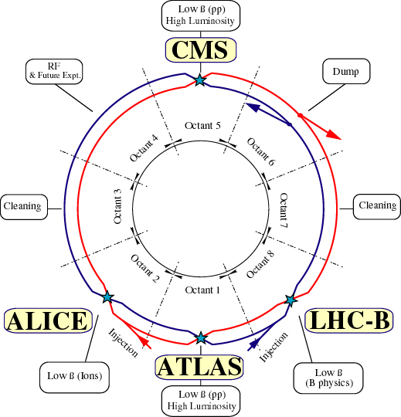
Large Hadron Collider (LHC)
c.m. energy
14 TeV (pp)
luminosity
10³⁴ cm⁻²s⁻¹
1.15x10¹¹ p/bunch
2808 bunches/beam
360 MJ / beam
dipole field 8.33 T

Slide 3
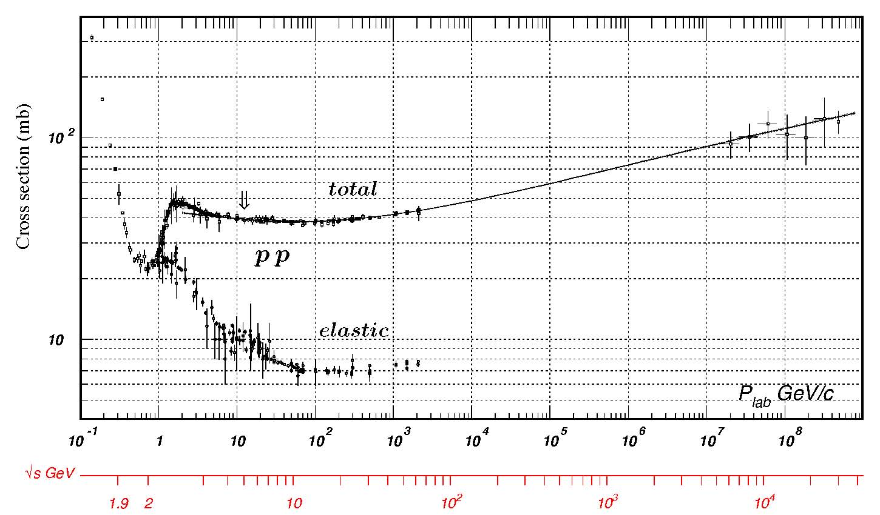
luminosity
R= σ L
luminosity
reaction rate
cross section
C. Amsler et al., Physics Letters B667, 1 (2008)
_{tot}∼
100 mbarn
~ 10⁻²⁵ cm²
from
cosmic rays
_{inelastic}∼
75 mbarn~
7.5x10⁻²⁶cm²
LHC
TOTEM, EPL 101 (2013) 21004
σ_{Higgs} ~ 30 pb → with 300 fb⁻¹ LHC produces ~ 10 million Higgs

Slide 4
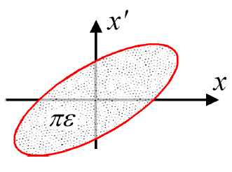
Luminosity
N | Number of particles per bunch
k_{b} | Number of bunches
f | Revolution frequency
σ* | Beam size at interaction point
F | Reduction factor due to crossing angle
ε | Emittance
ε_{n} | Normalized emittance
β* | Beta function at IP
Round beams, beam 1 = beam 2
M. Lamont

Slide 5
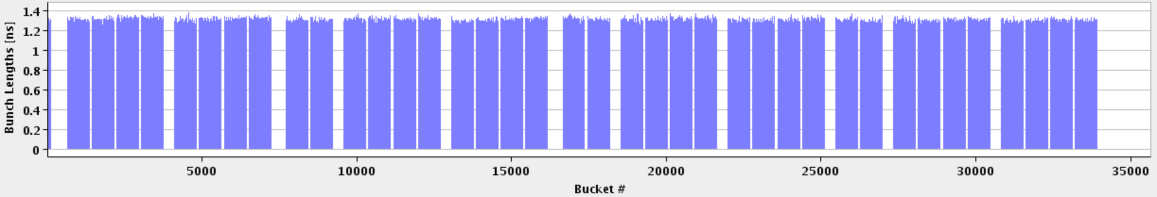
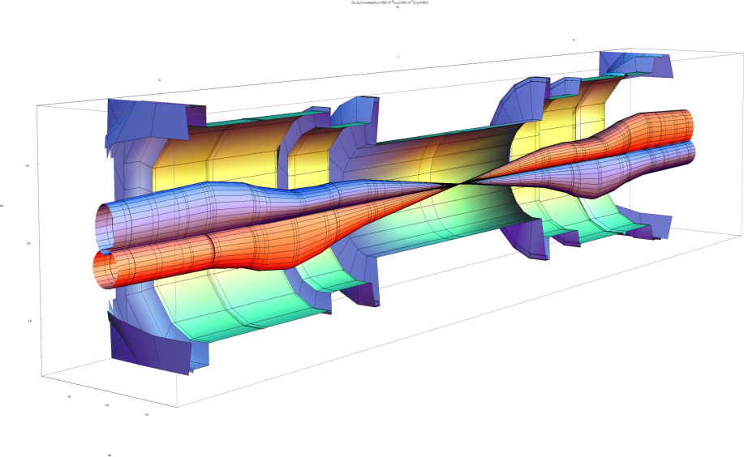
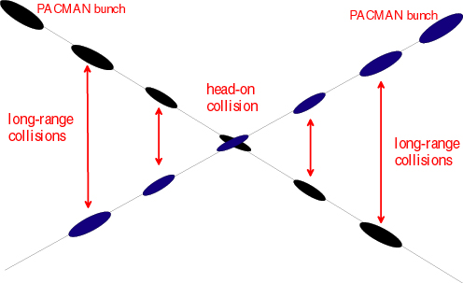
1 PS batch
(36 bunches)
1 SPS batch
(144 bunches)
M. Lamont
Abort gap
26.7 km - 1380 bunches in 2012, ~2800 in 2015
beta* 60 cm
beta_{max} ~4.5 km
25 ns (7.5 m)
John Jowett

Slide 6
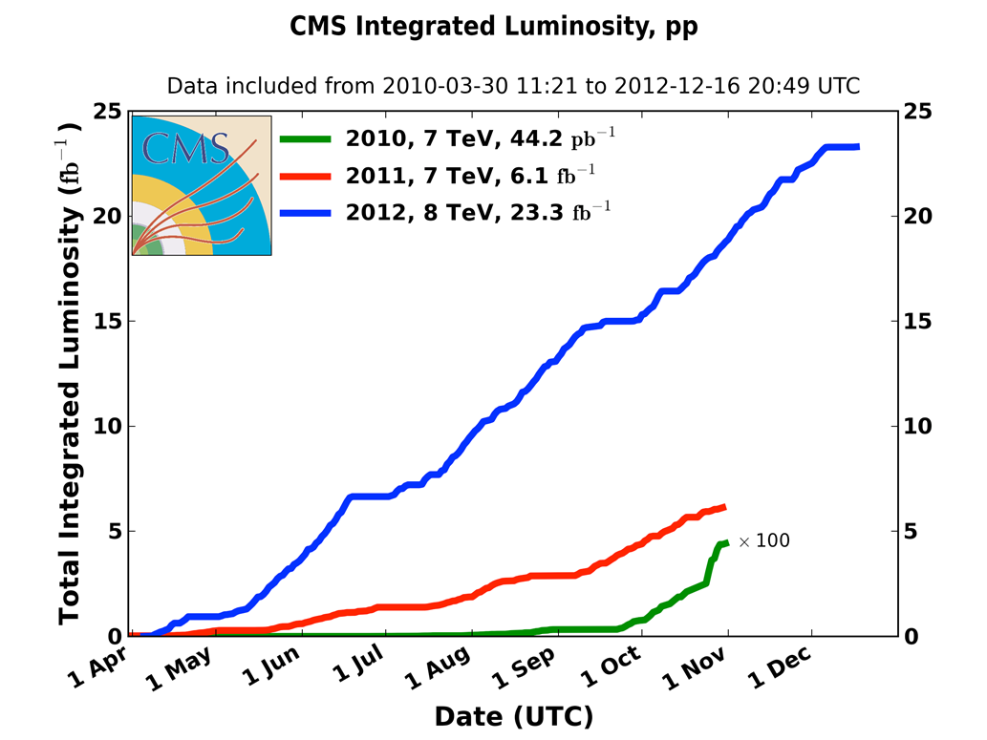
LHC Integrated luminosity 2010-2012
2010: 0.04 fb⁻¹
  7 TeV CoM
  Commissioning
2011: 6.1 fb⁻¹
  7 TeV CoM
  Exploring the limits
2012: 23.3 fb⁻¹
  8 TeV CoM
  Production

Slide 7
LHC peak performance through the years
 | 2010 | 2011 | 2012 | Nominal
Bunch spacing [ns] | 150 | 50 | 50 | 25
No. of bunches | 368 | 1380 | 1380 | 2808
beta* [m] ATLAS and CMS | 3.5 | 1.0 | 0.6 | 0.55
Max bunch intensity [protons/bunch] | 1.2 x 10¹¹ | 1.45 x 10¹¹ | 1.7 x 10¹¹ | 1.15 x 10¹¹
Normalized emittance [mm.mrad] | ~2.0 | ~2.4 | ~2.5 | 3.75
Peak luminosity [cm⁻²s⁻¹] | 2.1 x 10³² | 3.7 x 10³³ | 7.7 x 10³³ | 1.0 x 10³⁴
M. Lamont

Slide 8
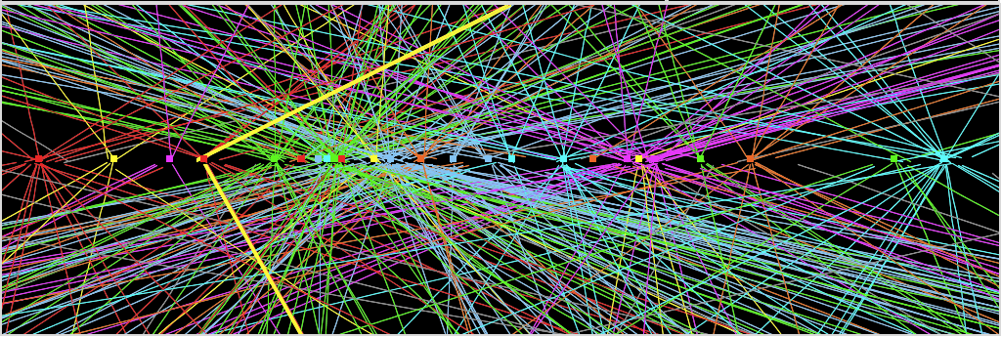
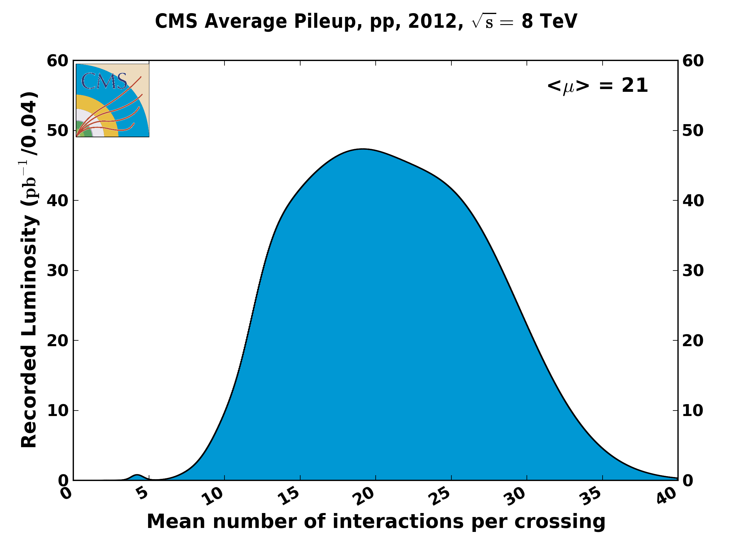
Z→ μμ event from 2012 data with 25 reconstructed vertices
Huge efforts over last months to prepare for high lumi and pile-up expected in 2012:
optimized trigger and offline algorithms (tracking, calo noise treatment, physics objects)
→ mitigate impact of pile-up on CPU, rates, efficiency, identification, resolution
in spite of x2 larger CPU/event and event size → we do not request additional computing
resources (optimized computing model, increased fraction of fast simulation, etc.)
Z→ μμ
8
pile up
will increase
at higher energy
→
experiments
request
25 ns
operation
in 2015
M. Lamont, IPAC’13

Slide 9
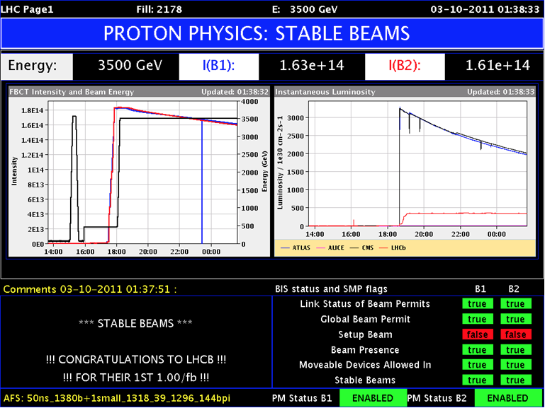
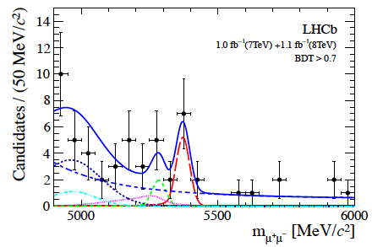
LHCb
luminosity levelling at around 4e32 cm⁻²s⁻¹ via transverse separation
(with tilted crossing angle)
ATLAS/CMS
LHCb
first evidence for the decay B_{s} -> μ⁺ μ⁻
M. Lamont, IPAC’13

Slide 10
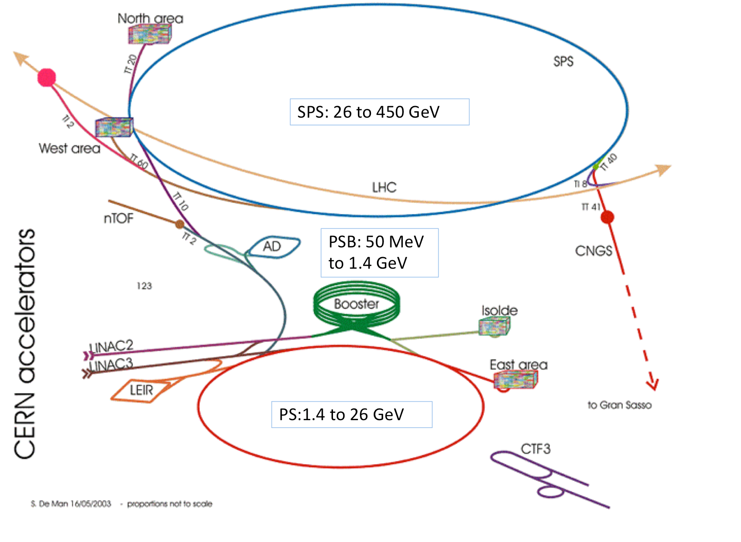
LHC injector complex
M. Lamont

Slide 11
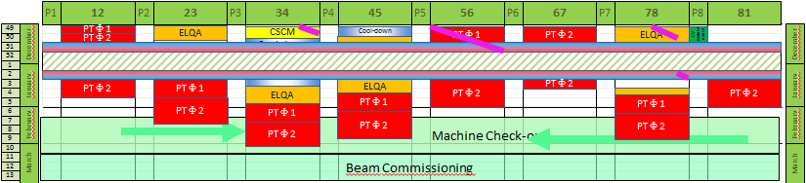
LHC restart schedule (as of 17 Dec. 2014)
K. Foraz
Week 2: last interventions (excl. collimator exchange and ELQA) and patrols
Week 10: last quench training in parallel with cold check-out ?

Slide 12
training quenches in the LHC
& first training quench in SM18
Sector 12
Sector 56 in 2008
Sector 67
2 Firm1
1 Firm 2
«2» Firm 3
0 Firm 1
2 Firm 2
19 Firm 3
0 Firm 1
1 Firm 2
19 Firm 3
S. Le Naour

Slide 13
LHC - 2015
Target energy: 6.5 TeV
  to be confirmed at end of powering tests
Bunch spacing: 25 ns
  strongly favored by experiments (pile-up limit ~ 50)
Beta*: 80 to 40 cm
Energy
25 ns
  Lower quench margins
  Lower tolerance to beam loss
  Lower intensity set-up beams
  Hardware closer to maximum (beam dumps, power converters etc.)
  E-cloud, UFOs
  More long range collisions
  Larger crossing angle, higher beta*
  Higher total beam current
  Higher intensity per injection
M. Lamont

Slide 14
2015 - potential performance
Start with 50 ns – scrub – 25 ns operation
Conservative beta* to start
Conservative bunch population
Reasonable emittance into collisions
Assuming same machine availability as 2012…
M. Lamont
 | Nc | beta* [cm] | ppb | EmitN [um] | Lumi [cm-2s-1] | Days (approx) | Int lumi | Pileup
50 ns | 1300 | 80 | 1.2e11 | 2.5 | 4.6e33 | 21 | ~1 fb⁻¹ | 27
25 ns (1) | 2496 | 80 | 1.1e11 | 2.5 | 7.4e33 | 75 | 6.8 fb⁻¹ | 22
25 ns (2) | 2496 | 40 | 1.1e11 | 2.5 | 1.3e34 | 46 | 9.2 fb⁻¹ | 39
Will lay the foundations for Run 2…

Slide 15
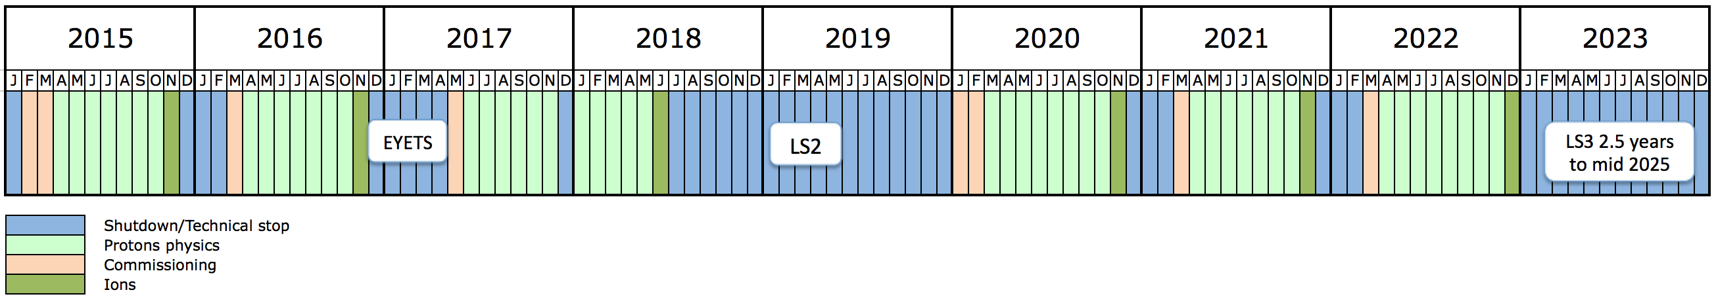
10 year plan
Long years – 13 weeks Christmas stop
Interspersed with long shutdown every 3 to 4 years
Ions very much part of the plan
M. Lamont
Run 2: 13 to 14 TeV c.m. with peak luminosity of ~1.7x10³⁴ cm⁻² s⁻¹
Run 3: 14 TeV c.m. with peak luminosity of ~2x10³⁴ cm⁻² s⁻¹
EYETS ~5 months
Extended year end technical stop (CMS)
LS2: 18 months
Connection of LINAC4
LHC Injectors Upgrade
LS3: 30 months
High Luminosity LHC

Slide 16

Prospects for Particle Physics
With the discovery of a Higgs boson in 2012, we have completed the Standard Model (almost 80 years of theoretical and experimental efforts !)
However: SM is not a complete theory
Several outstanding questions (e.g. composition of dark matter, cause of universe’s accelerated expansion [dark energy / inflation], origin of matter-antimatter asymmetry, neutrino masses, why 3 families?, lightness of Higgs boson, weakness of gravity, … ) which cannot be explained within the SM.
F. Gianotti et al.
These questions require NEW PHYSICS
Present knowledge is insufficient to determine energy scale of new physics ; LHC will provide new information from pp collisions at higher cm energy (13 TeV) by 2017-18

Slide 17
main questions in particle physics and main approaches to address them
question | high-energy colliders | high-precision experiments | neutrino experiments | dedicated searches | cosmic surveys
Higgs, EWSB | X
neutrinos | X |  | X | X | X
dark matter | X |  |  | X
flavour, CP violation | X | X | X | X
new particles and forces | X | X | X | X
universe acceleration |  |  |  |  | X
F. Gianotti et al.
most of these questions require high-energy and/or
high-intensity accelerators

Slide 18
LHC roadmap: schedule until 2035
LS2 starting in 2018 (July) => 18 months + 3 months BC
LS3 LHC: starting in 2023 => 30 months + 3 months BC
Injectors: in 2024 => 13 months + 3 months BC
Physics
Shutdown
Beam commissioning
Technical stop
(Extended) Year End Technical Stop: (E)YETS
YETS
EYETS
YETS
LS 2
YETS
Run 2
Run 3
Run 2
LS 2
Run 3
30 fb⁻¹
PHASE 1
YETS
LS 3
Run 4
YETS
LS 3
Run 4
300 fb⁻¹
PHASE 2
LS 4
Run 5
LS 5
LS 4
Run 5
LS 5
3’000 fb⁻¹
F. Bordry
Phase 2: HL-LHC

Slide 19
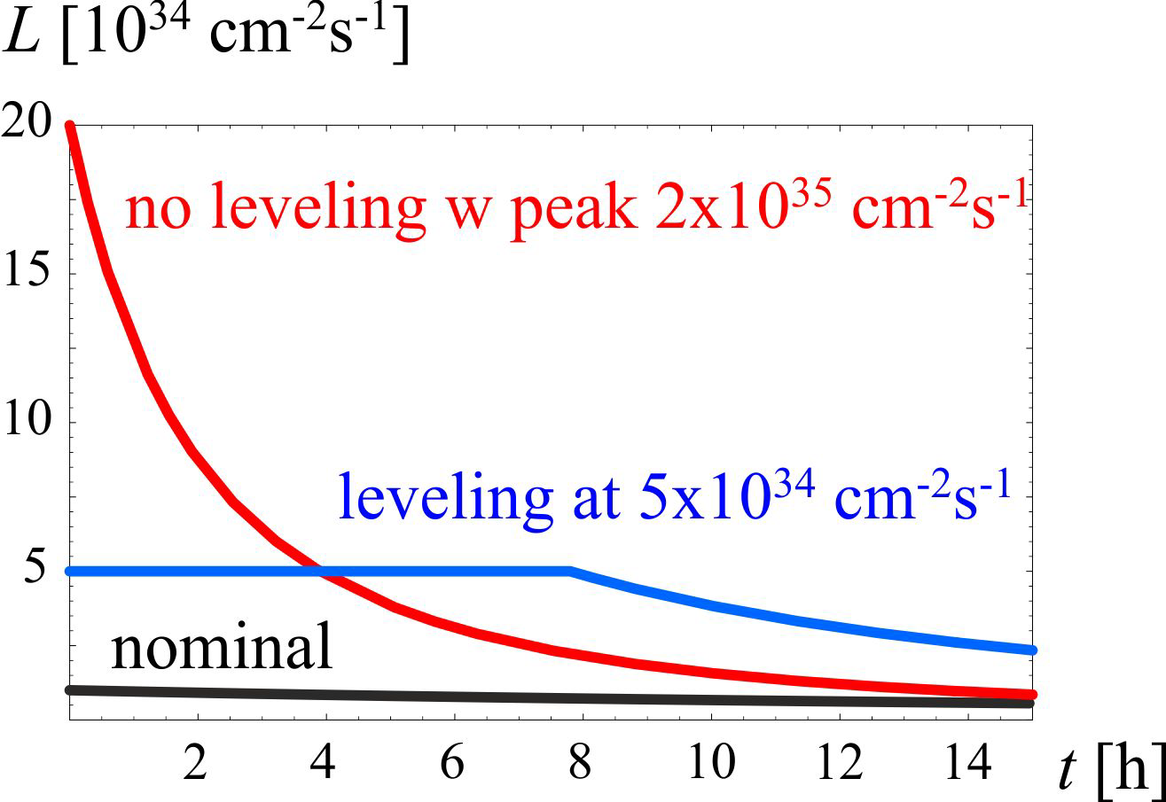
HL-LHC
M. Lamont
3000 fb⁻¹ delivered in the order of 10 years
High “virtual” luminosity with levelling anticipated
Challenging demands on the injector complex
  major upgrades foreseen
5 x 10³⁴ cm⁻²s⁻¹
levelled luminosity
Pile-up ~140
3 fb⁻¹ per day
~250 fb⁻¹ /year

Slide 20
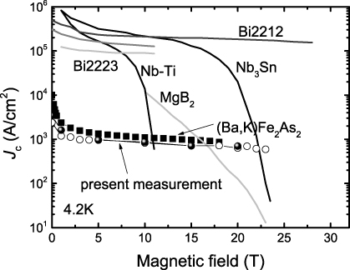
technology transition: Nb-Ti →Nb₃Sn
O. Bruning

Slide 21
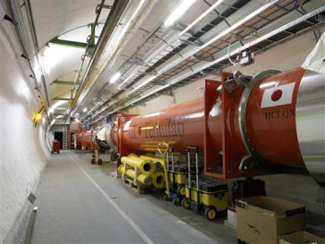



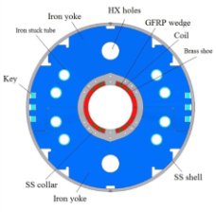

HL-LHC - critical zones around IP1 & IP5
ATLAS
CMS
3. For collimation we also need to change the DS in the continuous cryostat: 11-T Nb₃Sn dipole
2. We also need to modify a large part of the matching section
e.g. Crab Cavities &
D1, D2, Q4 & corrector
New quadrupole triplet based on Nb₃Sn (12 T at coil)
required due to:
-Radiation damage
-Need for more aperture
Changing the triplet region is not enough for reaching the HL-LHC goal!
more than 1.2 km of LHC plus technical infrastructure (e.g. Cryo and Powering)
compact Crab Cavities
Nb₃Sn dipoles & quadrupoles
O. Brüning,
L. Rossi

Slide 22
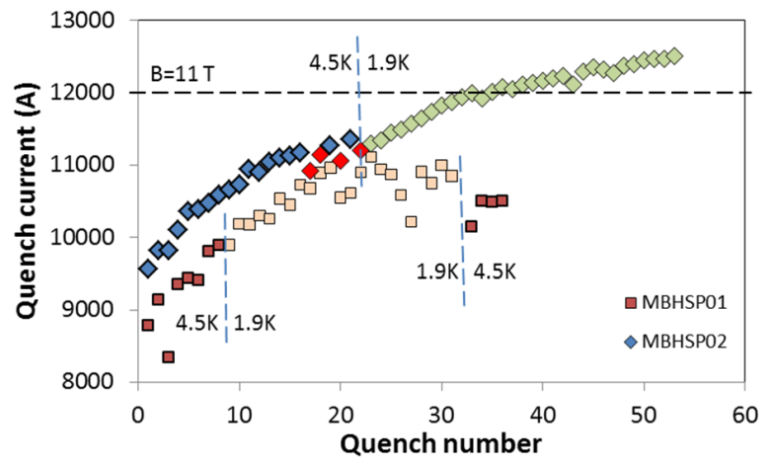
FNAL: Nb₃Sn 11-T dipole demonstrators
US-LARP
MBHSP02 (1 m) passed 11 T field during training at 1.9 K with I = 12080 A on 5 March 2013

Slide 23
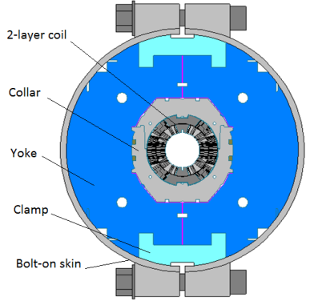
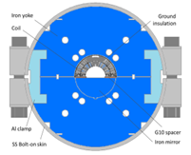
FNAL Nb₃Sn 1-m 11(12)-T dipole models
US-LARP
MBHSP02:
  B_{max}=11.7 T at 1.9 K
  97.5% of B_{des}=12 T
MBHSP03:
  B_{max}=11.7 T at 1.9 K
  97.5% of B_{des}=12 T
MBHSM01:
    B_{max}=12.5 T at 1.9 K
    ~100 (97)% at 4.5 (1.9) K of SSL
MBHSP02, MBHSP03
MBHSM01
A. Zlobin

Slide 24
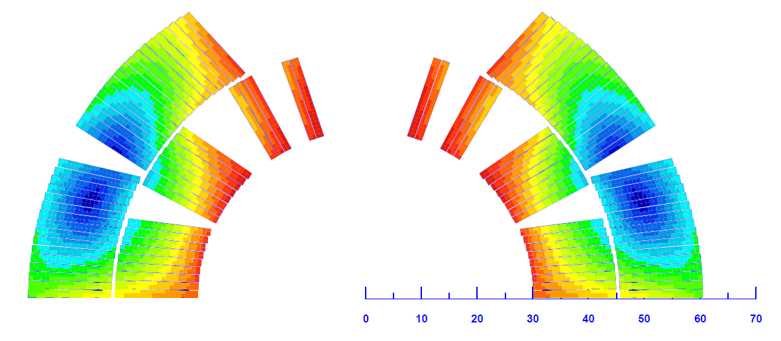
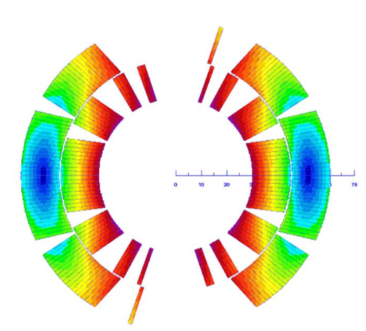
CERN Nb₃Sn 2-m 11-T dipole models
MBHSM101: single coil
CERN
trained up to 97 % of I_{ss} at 1.9 K
- good memory
MBHSP101: single aperture
coils 106 & 107: 4 & 19 training quenches up to nominal current
also at CERN, in 2012 two pairs of racetrack coils obtained 12.5 T in the winding at 1.9 K
G. Willering

Slide 25
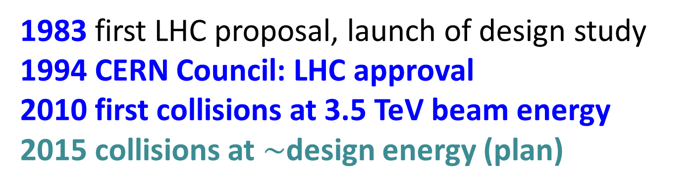
LHC history
1983 first LHC proposal, launch of design study
1994 CERN Council: LHC approval
2010 first collisions at 3.5 TeV beam energy
2015 collisions at $\sim$design energy (plan)
now is the time to plan for 2040!

Slide 26
European Strategy Update 2013
“CERN should undertake design studies for accelerator projects in a global context, with emphasis on proton-proton and electron-positron high-energy frontier machines.”
http://cds.cern.ch/record/1567258/files/esc-e-106.pdf
strategy adopted by the CERN Council

Slide 27
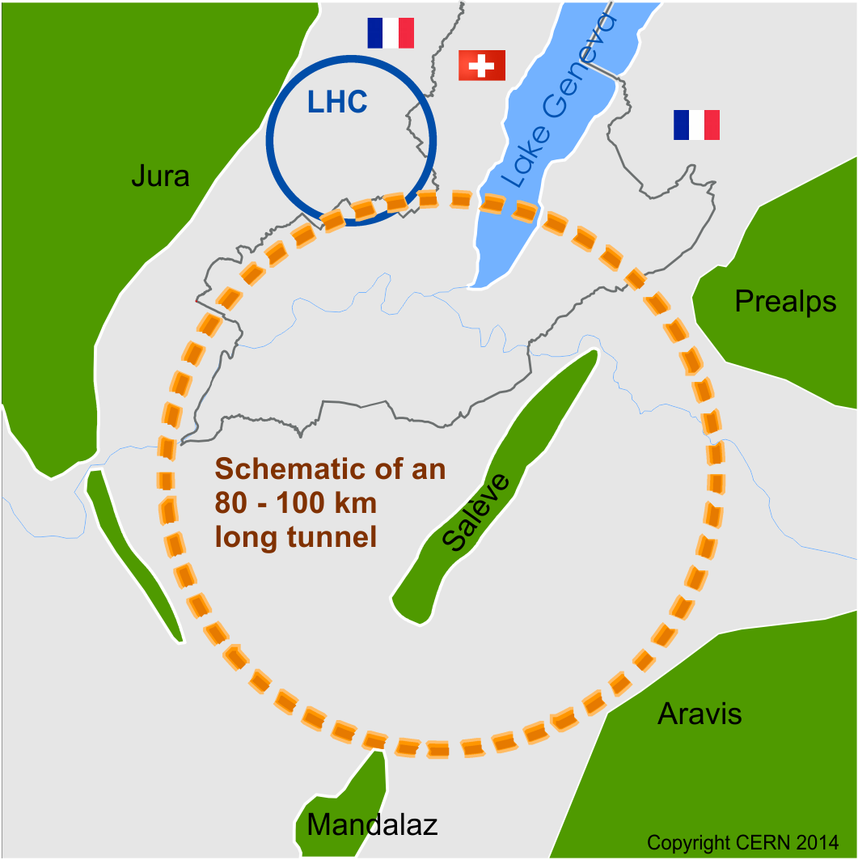
Future Circular Collider Study - SCOPE
CDR and cost review for the next ESU (2018)
Forming an international collaboration to study:
pp-collider (FCC-hh) → defining infrastructure requirements
80-100 km infrastructure in Geneva area
e⁺e⁻ collider (FCC-ee) as potential intermediate step
p-e (FCC-he) option
~16 T ⇒ 100 TeV pp in 100 km
~20 T ⇒ 100 TeV pp in 80 km
M. Benedikt
www.cern.ch/fcc

Slide 28
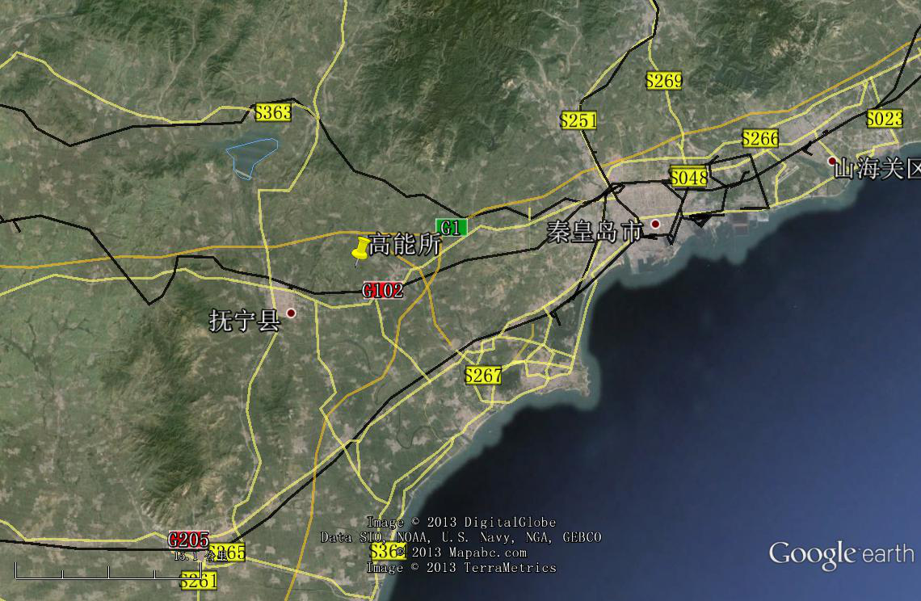
CepC/SppC study (CAS-IHEP), CepC CDR end of 2014, e⁺e⁻ collisions ~2028; pp collisions ~2042
Qinhuangdao (秦皇岛）
CepC, SppC
50 km
easy access
300 km from Beijing
3 h by car
1 h by train
70 km
“Chinese Toscana”
Yifang Wang

Slide 29
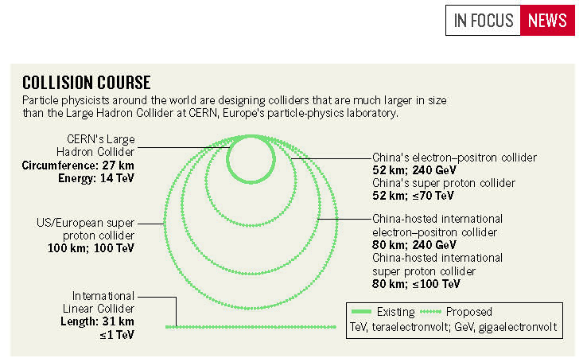
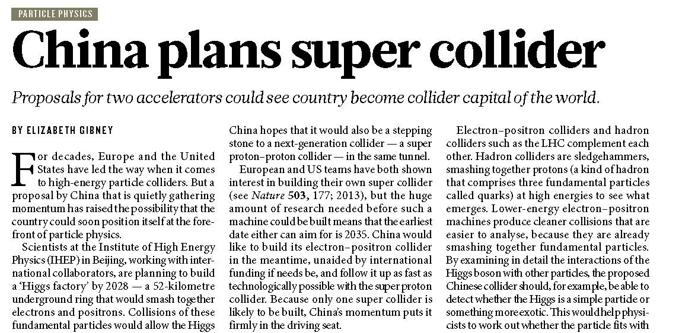
CepC/SppC project – recent news in Nature
24 J U LY 2014 | VO L 511 | NAT U R E | 3

Slide 30


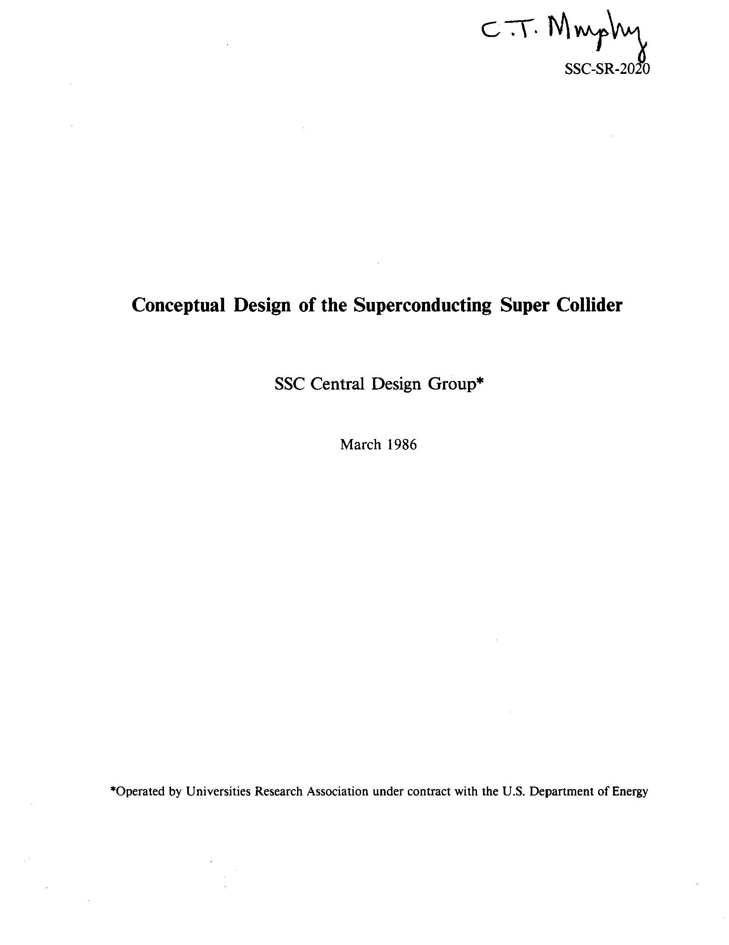
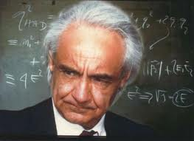
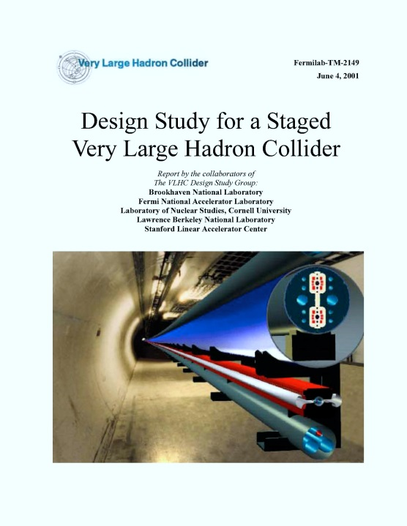
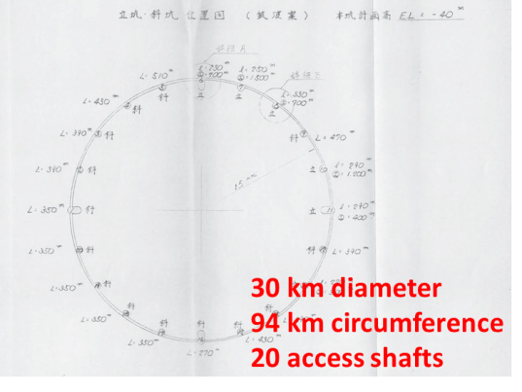
previous studies in Italy (ELOISATRON 300 km), US (SSC 87 km, VLHC/VLLC 233 km) & Japan (94 km)
ex. ELOISATRON
ex. SSC
Supercolliders Superdetectors: Proceedings of the 19th and 25th Workshops of the INFN Eloisatron Project
SSC CDR 1986
H. Ulrich Wienands, The SSC Low Energy Booster: Design and Component Prototypes for the First Injector Synchrotron,
IEEE Press 1997
ex. VLHC
ex. TRISTAN-II
VLHC Design Study Group Collaboration June 2001. 271 pp.
SLAC-R-591, SLAC-R-0591, SLAC-591, SLAC-0591, FERMILAB-TM-2149
http://www.vlhc.org/
study 1983

Slide 31
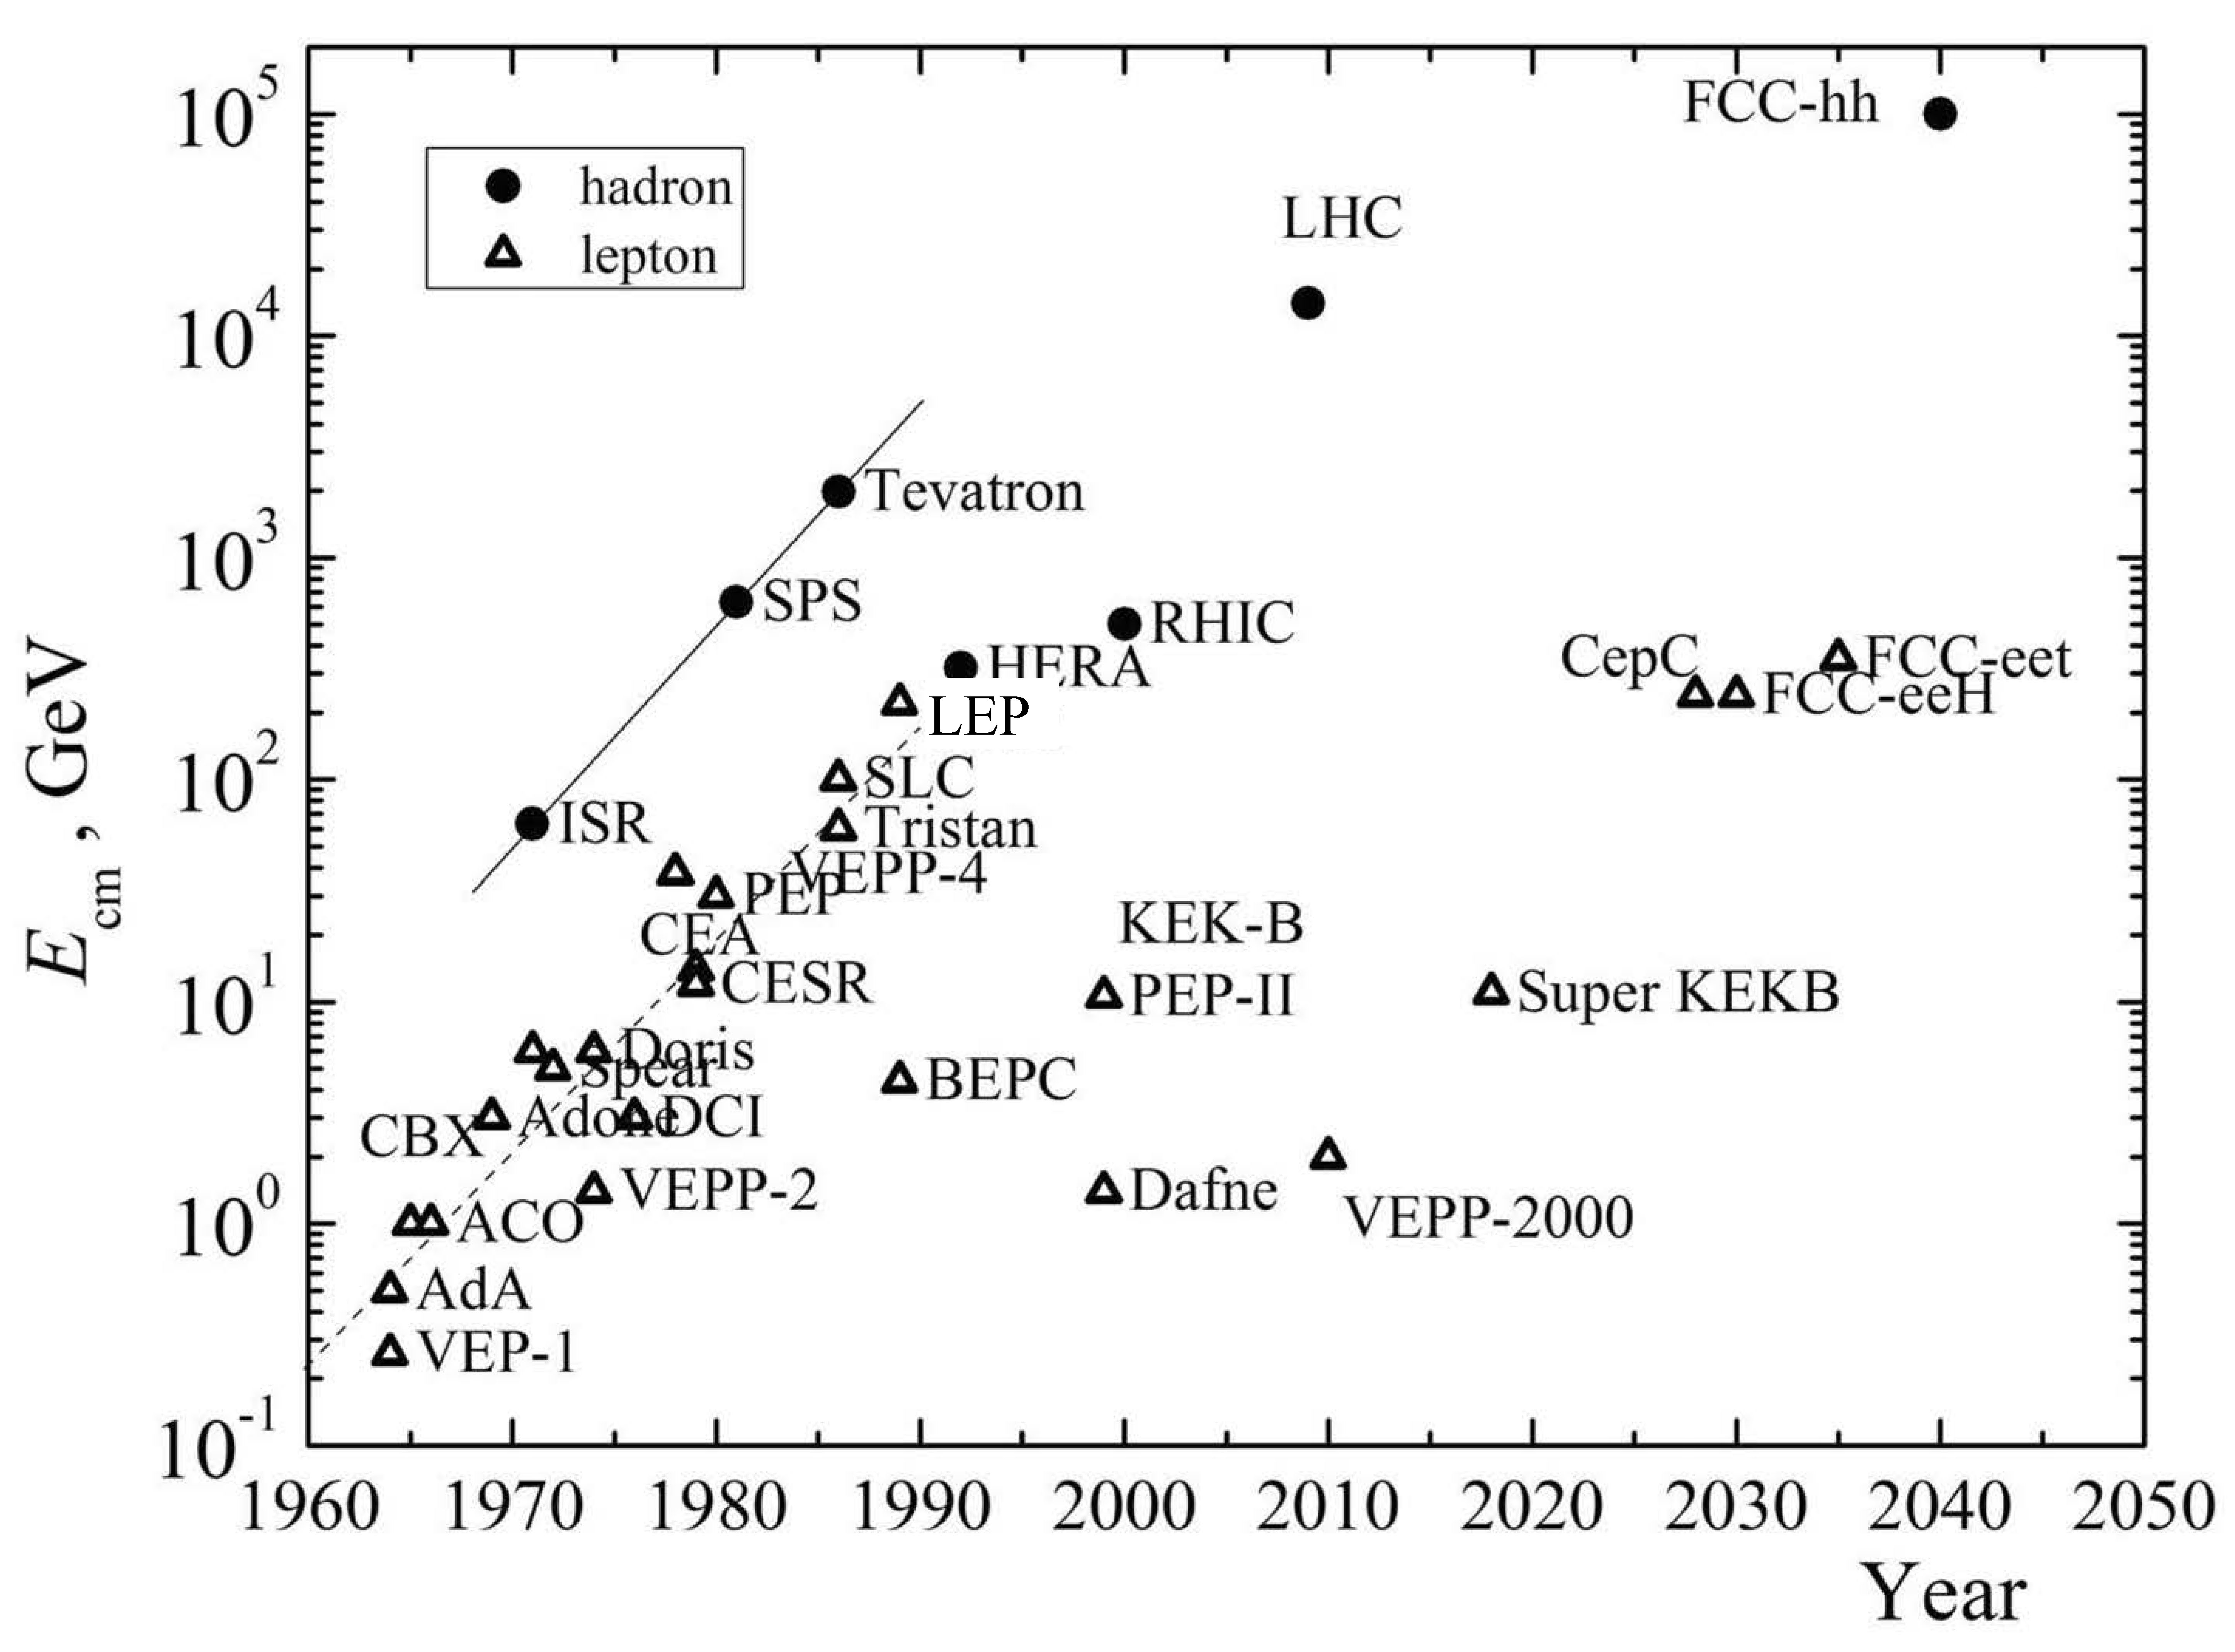

collider c.m. energy vs. year
pp
E_{cm}=2ec Bρ
hadron-lepton
factor 10 every
10 years
factor 10 every
20-30 years
ep
FCC-he
LHeC
e⁺e⁻
factor 10⁵-10⁷ in e⁺e⁻
luminosity
Courtesy V. Shiltsev

Slide 32
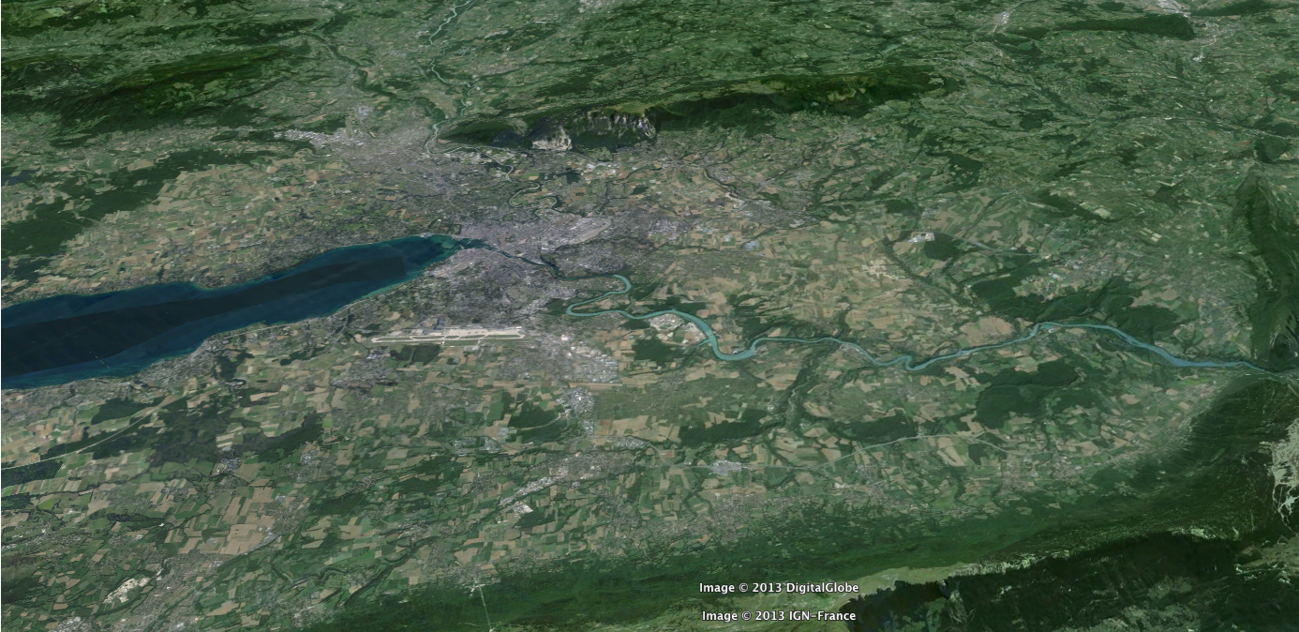
FCC-hh: 100 TeV pp collider
Geneva
PS
SPS
LHC
LHC
27 km, 8.33 T
14 TeV (c.m.)
“HE-LHC”
27 km, 20 T
33 TeV (c.m.)
FCC-hh (alternative)
80 km, 20 T
100 TeV (c.m.)
FCC-hh (baseline)
100 km, 16 T
100 TeV (c.m.)
L. Bottura
B. Strauss

Slide 33
FCC-hh opens three physics windows
➥ Access to new particles in the few TeV to 30 TeV mass range, beyond LHC reach
➥ Immense/much-increased rates for
phenomena in the sub-TeV mass range →
increased precision w.r.t. LHC and possibly ILC
➥ Access to very rare processes in the sub-TeV mass range → search for stealth phenomena, invisible at the LHC
M. Mangano

Slide 34
FCC-hh key parameters
parameter | FCC-hh | LHC
energy | 100 TeV c.m. | 14 TeV c.m.
dipole field | 16 T | 8.33 T
# IP | 2 main, +2 | 4
normalized emittance | 2.2 μm | 3.75 μm
luminosity/IP_{main} | 5 x 10³⁴ cm⁻²s⁻¹ | 1 x 10³⁴ cm⁻²s⁻¹
energy/beam | 8.4 GJ | 0.39 GJ
synchr. rad. | 28.4 W/m/apert. | 0.17 W/m/apert.
bunch spacing | 25 ns (5 ns) | 25 ns
Preliminary, subject to evolution (several luminosity scenarios)

Slide 35
parameter | LHC | HL-LHC | FCC-hh
c.m. energy [TeV] | 14 |  | 100
dipole magnet field [T] | 8.33 |  | 16 (20)
circumference [km] | 26.7 |  | 100 (83)
luminosity [10³⁴ cm⁻²s⁻¹] | 1 | 5 | 5 [→20?]
bunch spacing [ns] | 25 |  | 25 {5}
events / bunch crossing | 27 | 135 | 170 {34}
bunch population [10¹¹] | 1.15 | 2.2 | 1 {0.2}
norm. transverse emitt. [μm] | 3.75 | 2.5 | 2.2 {0.44}
IP beta-function [m] | 0.55 | 0.15 | 1.1
IP beam size [μm] | 16.7 | 7.1 | 6.8 {3}
synchrotron rad. [W/m/aperture] | 0.17 | 0.33 | 28 (44)
critical energy [keV] | 0.044 |  | 4.3 (5.5)
total syn.rad. power [MW] | 0.0072 | 0.0146 | 4.8 (5.8)
longitudinal damping time [h] | 12.9 |  | 0.54 (0.32)
Cms energy
Luminosity
FCC-hh baseline parameters defined in EDMS No. 1342402, FCC-ACC-SPC-0001

Slide 36
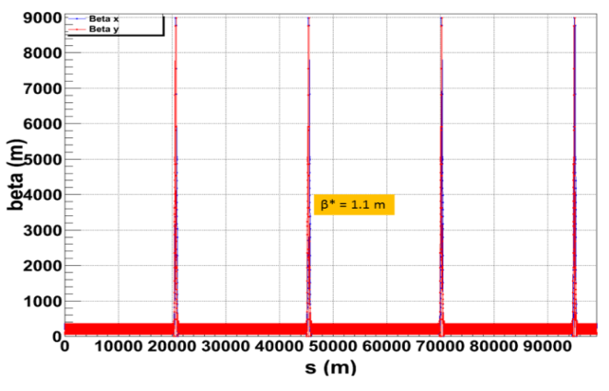
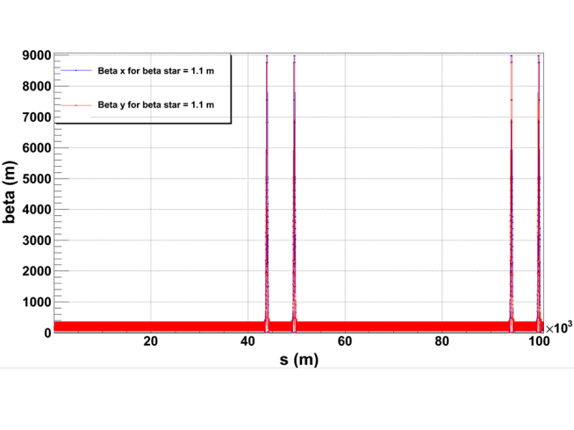
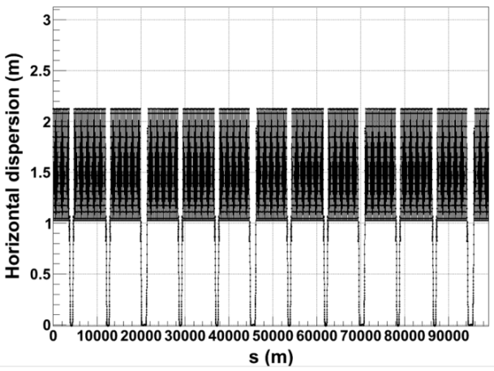
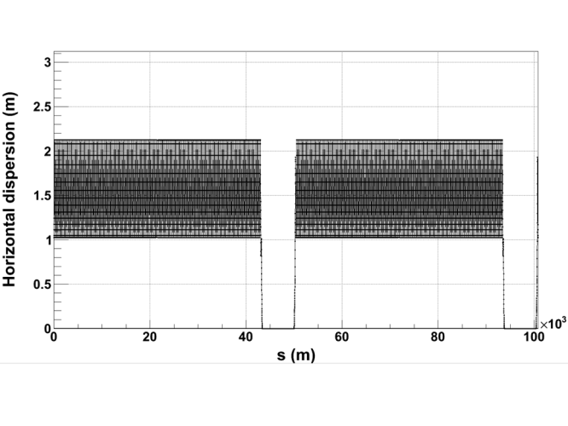
ring optics for alternative layouts
LHC-like
circular
SSC-like
race-
track
R. Alemany,
B. Holzer,
R. Tomas,
D. Schulte
L_{insertion}~7.4 km
C=99.13 km
C=100.8 km
β_{x,y} [m]
work in progress
FODO arc
optics,
cell length
~200 m
D_{x} [m]

Slide 37
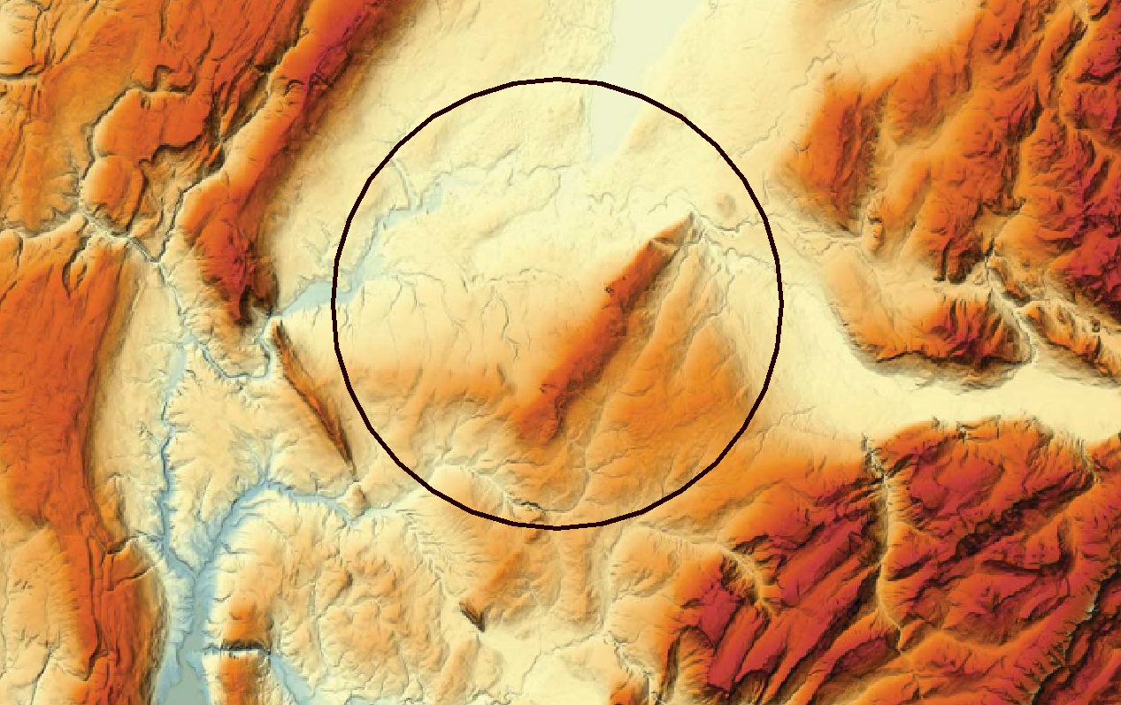
FCC topography
Lac Léman
300 – 372 m/mer
Massif du Jura
550 – 1720 m/mer
Plaine du genevois
350 – 550 m/mer
Pré-Alpes du Chablais
600 – 2500 m/mer
Vallée du Rhône
∼330 m/mer
Mont Salève
550 - 1380
Valée de l’Arve
400 – 600 m/mer
Plateau du Mont Sion
550 – 860 m/mer
Mont Vuache
550 - 1100
Plateau des Bornes
600 – 850 m/mer
Vallon des Usses
380 – 500 m/mer
Mandallaz
Bornes – Aravis
600 – 2500 m/mer
J. Osborne

Slide 38
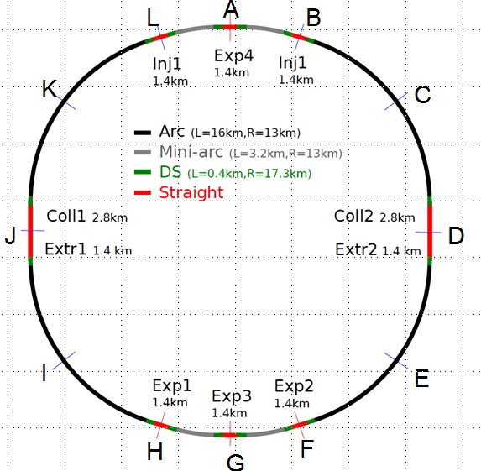
FCC tunnel configuration
FCC circumference is a multiple of LHC :
  80 km
  87 km
  93 km
  100 km
Ph. Lebrun
38

Slide 39
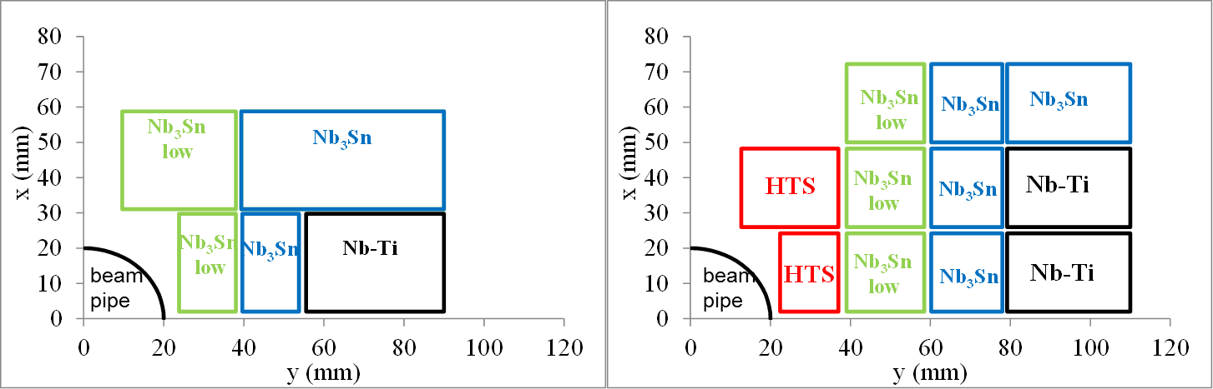
cost-optimized high-field dipole magnets
15-16 T: Nb-Ti & Nb₃Sn
20 T: Nb-Ti & Nb₃Sn & HTS
only a quarter is shown
“hybrid magnets”
example block-coil layout
L. Rossi, E. Todesco, P. McIntyre

Slide 40
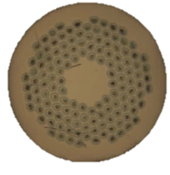
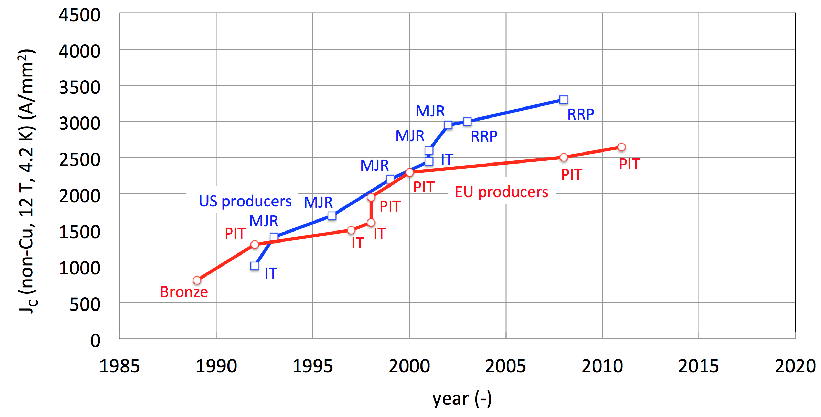
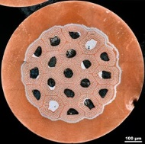
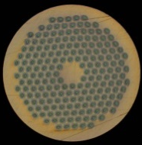
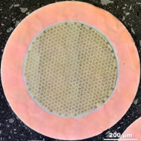



From ITER- to HEP-class Nb₃Sn
HL-LHC
ITER
FCC specs
HL-LHC specs
CARE-NED
EuCARD
US-CDP
FCC
L. Bottura

Slide 41
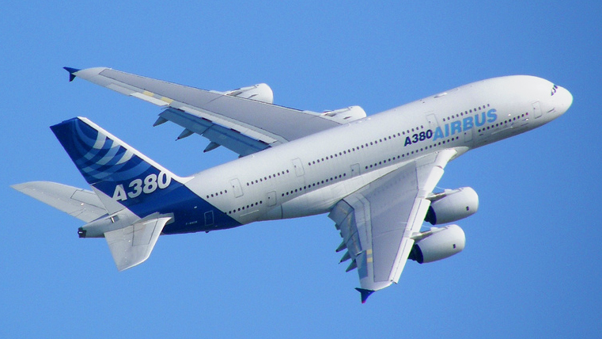
machine protection
energy per proton beam
LHC: 0.4 GJ → FCC-hh: 8 GJ (20x more !)
  kinetic energy of Airbus A380 at 720 km/h
  can melt 12 tons of copper, or drill a 300-m long hole

Slide 42
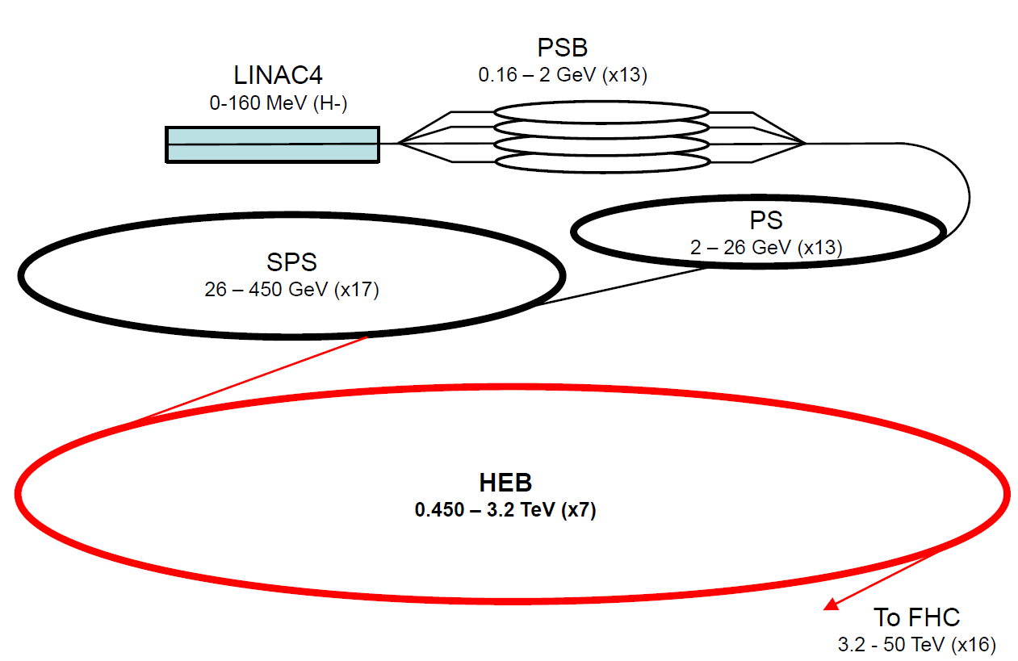
FCC-hh injector complex
based on existing & planned (HL-LHC/LIU) injector chain;
HEB in LHC tunnel (e.g. modified LHC) or FCC tunnel
B. Goddard,
W. Herr, et al.

Slide 43
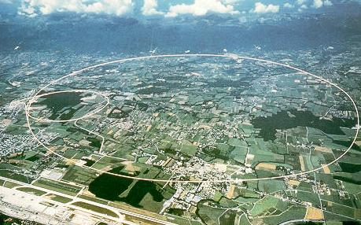
LEP – highest energy e⁺e⁻ collider so far
maximum c.m. energy 209 GeV
maximum synchrotron radiation power 23 MW

Slide 44
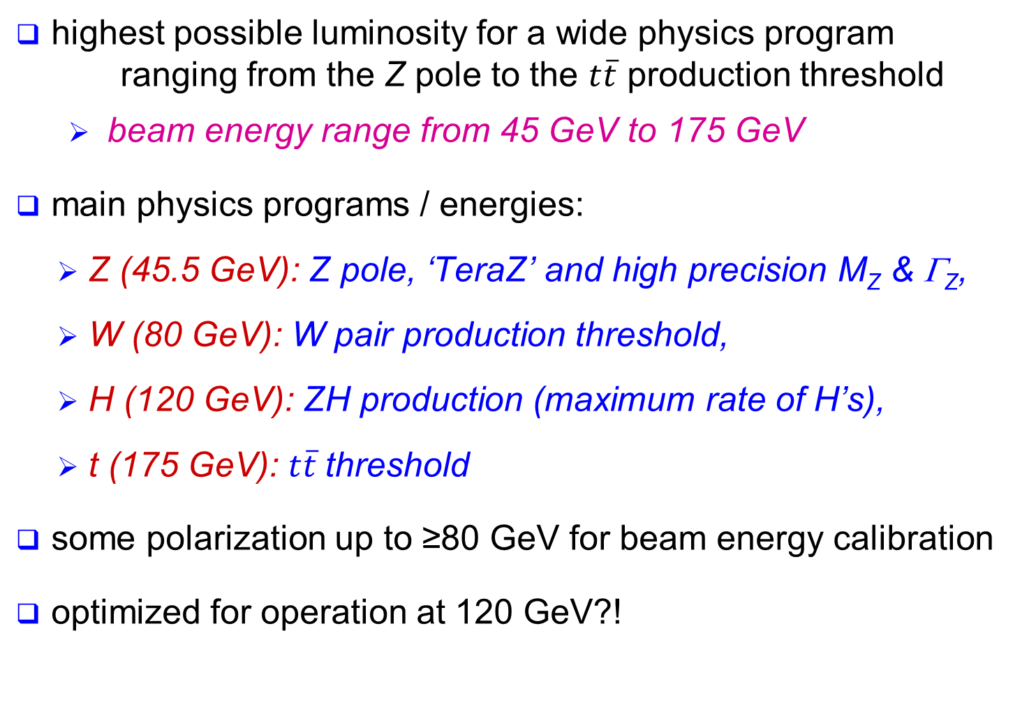
physics requirements for FCC-ee
highest possible luminosity for a wide physics program ranging from the Z pole to the $t\overline{t}$ production threshold
  beam energy range from 45 GeV to 175 GeV
main physics programs / energies:
  Z (45.5 GeV): Z pole, ‘TeraZ’ and high precision M_{Z} & Γ_{Z},
  W (80 GeV): W pair production threshold,
  H (120 GeV): ZH production (maximum rate of H’s),
  t (175 GeV): $t\overline{t}$threshold
some polarization up to ≥80 GeV for beam energy calibration
optimized for operation at 120 GeV?!

Slide 45
FCC-ee key parameters
parameter | FCC-ee | LEP2
energy/beam | 45 – 175 GeV | 105 GeV
bunches/beam | 98 – 16700 | 4
beam current | 6.6 – 1450 mA | 3 mA
hor. emittance | ~2 nm | ~22 nm
emittance ratio ε_{y}/ε_{y} | 0.1% | 1%
vert. IP beta function β_{y}* | 1 mm | 50 mm
luminosity/IP | 1.8-28 x 10³⁴ cm⁻²s⁻¹ | 0.0012 x 10³⁴ cm⁻²s⁻¹
energy loss/turn | 0.03-7.55 GeV | 3.34 GeV
synchr. power | 100 MW | 23 MW
RF voltage | 2.5 – 11 GV | 3.5 GV
Preliminary, subject to evolution (staging scenarios)

Slide 46
parameter | LEP2 | FCC-ee |  |  |  |  | CepC
 |  | Z | Z (c.w.) | W | H | t | H
E_{beam} [GeV] | 104 | 45 | 45 | 80 | 120 | 175 | 120
circumference [km] | 26.7 | 100 | 100 | 100 | 100 | 100 | 54
current [mA] | 3.0 | 1450 | 1431 | 152 | 30 | 6.6 | 16.6
P_{SR,tot} [MW] | 22 | 100 | 100 | 100 | 100 | 100 | 100
no. bunches | 4 | 16700 | 29791 | 4490 | 1360 | 98 | 50
N_{b} [10¹¹] | 4.2 | 1.8 | 1.0 | 0.7 | 0.46 | 1.4 | 3.7
ε_{x} [nm] | 22 | 29 | 0.14 | 3.3 | 0.94 | 2 | 6.8
ε_{y} [pm] | 250 | 60 | 1 | 1 | 2 | 2 | 20
β∗_{x} [m] | 1.2 | 0.5 | 0.5 | 0.5 | 0.5 | 1.0 | 0.8
β∗_{y} [mm] | 50 | 1 | 1 | 1 | 1 | 1 | 1.2
σ∗_{y} [nm] | 3500 | 250 | 32 | 130 | 44 | 45 | 160
σ_{z,SR} [mm] | 11.5 | 1.64 | 2.7 | 1.01 | 0.81 | 1.16 | 2.3
σ_{z,tot} [mm] (w beamstr.) | 11.5 | 2.56 | 5.9 | 1.49 | 1.17 | 1.49 | 2.7
hourglass factor F_{hg} | 0.99 | 0.64 | 0.94 | 0.79 | 0.80 | 0.73 | 0.61
L/IP [10³⁴ cm⁻²s⁻¹] | 0.01 | 28 | 212 | 12 | 6 | 1.7 | 1.8
τ_{beam} [min] | 300 | 287 | 39 | 72 | 30 | 23 | 40
the large number of bunches at Z, W & H requires 2 rings
short lifetimes due to high luminosity → continuous injection (top-up)

Slide 47


FCC-ee luminosity vs energy
crab waist & improved parameters
baseline
Z
W
H
$$t\overline{t}$$
M. Benedikt, A. Blondel, A. Bogomyagkov, E. Levichev, D. Shatilov, J. Wenninger, F. Zimmermann,…

Slide 48

emittances in good company
Y. Papaphilippou

Slide 49

FCC-ee injection
beside the collider ring(s), a booster of the same size (same tunnel) must provide beams for top-up injection
  same RF voltage, but low power (~ MW)
  top up frequency ~0.1 Hz
  booster injection energy ~5-20 GeV
  bypass around the experiments
injector complex for e⁺ and e⁻ beams of 10-20 GeV
  Super-KEKB injector ~ almost suitable
A. Blondel

Slide 50

SuperKEKB = FCC-ee demonstrator
beam commissioning will start in 2015
K. Oide et al.
top up injection at high current
β_{y}* =300 μm (FCC-ee: 1 mm)
lifetime 5 min (FCC-ee: ≥20 min)
ε_{y}/ε_{x} =0.25% (similar to FCC-ee)
off momentum acceptance (±1.5%, similar to FCC-ee)
e⁺ production rate (2.5x10¹²/s, FCC-ee: <1.5x10¹²/s (Z cr.waist)
SuperKEKB goes beyond FCC-ee, testing all concepts

Slide 51
layout & optics at 120 & 175 GeV
Lattice V12b-s
arc cell
BPM
Corrector
Q
Q
S
B
B
Q
S
B
B
layout
B = bending magnet, Q = quadrupole, S = sextupole
FODO cell optics
cell length 50 m
full ring optics
100
80
m
60
n
i
x
t
e
b
40
Circumference: 100 km
Arc length: 2 × 3.4 km
Straight section: 1.5 km
20
0
0
2
4
6
8
10
12
s in km
B. Harer, B. Holzer

Slide 52




optics 175 & 120 → 80 & 45.5 GeV
80 GeV
45.5 GeV
example: 100 m cell length
example: 300 m cell length
all emittances ε_{x} ≤ 0.5 baseline
B. Harer, B. Holzer

Slide 53

synchrotron radiation power
The maximum synchrotron radiation (SR) power P_{SR} is set to 50 MW per beam – design choice ⇔ power dissipation.
  defines the maximum beam current at each energy.
  Note that a margin of a few % is required for losses in straight sections.
  ρ = 3.1 km
V_{RF} ~35 GV
V_{RF} ~10-11 GV
  ρ = 11 km
J.Wenninger

Slide 54

SC RF System
RF system requirements are characterized by two regimes.
  High gradients for H and $t\overline{t}$ – up to ~11 GV.
  High beam loading with currents of ~1.5 A at the Z pole.
RF system must be distributed over the ring to minimize energy excursions (~4.5% energy loss @ 175 GeV).
  Optics errors driven by energy offsets, effect on η.
Aiming for SC RF cavities with gradients of ~20 MV/m.
RF frequency of 400 & 800 MHz (current baseline).
  Nano-beam / crab waist favors lower frequency, e.g. 400 MHz.
Conversion efficiency (wall plug to RF power) is critical. Aiming for 75% or higher → R&D !
  An important item for FCC-ee power budget.~65% achieved for LEP2.
J. Wenninger, A. Butterworth, E. Jensen, et al.

Slide 55
luminosity
H ≤ 1
Hour-glass
F ≤ 1
Crossing angle
2Φ
Beam-beam parameter
J. Wenninger

Slide 56


beam-beam parameter
beam-beam parameter ξ measures strength of field sensed by the particles in a collision
beam-beam parameter limits are empirically scaled from LEP data (also 4 IPs)
R. Assmann & K. Cornelis, EPAC2000
In reasonable agreement with first simulations for FCC ee
The beam-beam limit may be raised significantly with Crab-Waist schemes !
J. Wenninger, R. Assmann, S. White, K. Ohmi, D. Shatilov, et al.

Slide 57

beamstrahlung
hard photon emission at the IPs, ‘Beamstrahlung’, can become lifetime / performance limit for large bunch populations (N), small hor. beam size (σ_{x}) & short bunches (σ_{s})
e
γ
e
ρ : mean bending radius at the IP (in the field of the opposing bunch)
η : ring energy acceptance
lifetime expression by V. Telnov, modified version by A. Bogomyagkov et al
to ensure an acceptable lifetime, ρ×η must be sufficiently large
  flat beams (large σ_{x}) !
  bunch length !
  large momentum acceptance of the lattice: 1.5 – 2% required.
    LEP: < 1% acceptance, SuperKEKB ~ 1-1.5%.
J. Wenninger, et al

Slide 58
beam-beam limits: 2 regimes
beamstrahlung
lifetime (300 s) w. η=2.0%
beamstrahlung
lifetime w. η=1.5%
ε_{y} = 2 pm,
β_{y}* = 1 mm
M. Koratzinos, A. Bogomyagkov, E. Levichev, D. Shatilov, K. Yokoya, V. Telnov, K. Oide, …

Slide 59

The Twin Frontiers of FCC-ee Physics
Precision Measurements
Rare Decays
Springboard for sensitivity to new physics
Theoretical issues:
  Higher-order QCD
  Higher-order EW
  Mixed QCD + EW
Direct searches for new physics
Many opportunities
Z: 10¹²
b, c, τ: 10¹¹
W: 10⁸
H: 10⁶
t: 10⁶
HL-LHC
ILC500
FCC-ee 350
CepC, 4/ab
Higgs coupling
measurements
M. Bicer et al., “First Look at the Physics Case of TLEP,’’ JHEP 01, 164 (2014)
S. Dawson et al., arXiv:1310.8361v2
J. Ellis
P. Janot
M. Ruan

Slide 60


high-energy lepton-hadron collider
LHeC CDR , published in 2012
RR LHeC:
new ring
in LHC tunnel,
with bypasses
around
experiments
LR LHeC:
recirculating
linac with
energy
recovery
similar two options for FCC:
(1) FCC-ee ring, (2) ERL – from LHeC or new

Slide 61

Higgs physics at LHeC & FCC-he
h-e Higgs-boson production and decay; and precision measurements of the H–bb coupling in WW–H production; FCC-he also gives access to Higgs self-coupling H–HH (<10% precision!? - under study), to lepto-quarks up to ≈4 TeV & to Bjorken x as low as 10⁻⁷ - 10⁻⁸ [of interest for ultra high energy ν scattering]
M. Klein and H. Schopper, CERN Courier June2014

Slide 62
collider technology “readiness matrix”
 | HL-LHC | LHeC | ILC | CLIC | FCC-ee/hh | CepC/SppC
leptons | - | cw SRF at 800 or 400 MHz | Pulsed SRF at 31.5 MV/m at 1.3 GHz | Pulsed NC RF at 100 MV/m at 12 GHz | cw SRF at 800 or 400 MHz with 15-20 MV/m | cw SRF at 650 MHz with 15.5 MV/m (& 1.3 GHz booster)
 | - | RF power source | RF power source | RF power source | RF power source | RF power source
 | - | High-E high-I ERL | final focus | final focus | IR optics with large E acceptance | IR optics with large E acceptance
 | - |  | damping ring | drive beam dynamics |  | Pretzel scheme
 | - |  | e+ source | e+ source
hadrons | 11-12 T Nb₃Sn dipoles & quad’s | - | - | - | 15-16 T Nb₃Sn dipoles & quad’s | 19-20 T HTS dipoles
 | Compact crab cavities | - | - | - | efficient cooling of SR | efficient cooling of SR
 | SC link | - | - | -
color code:
state of the art
not fully demonstrated
more R&D needed

Slide 63

FCC global design study – time line
2014 |  |  |  | 2015 |  |  |  | 2016 |  |  |  | 2017 |  |  |  | 2018
Q1 | Q2 | Q3 | Q4 | Q1 | Q2 | Q3 | Q4 | Q1 | Q2 | Q3 | Q4 | Q1 | Q2 | Q3 | Q4 | Q1 | Q2 | Q3 | Q4
Prepare
Kick-off, collaboration forming,
→study plan and organisation
Ph 1: Explore options
“weak interaction”
Workshop & Review →identification of baseline
Ph 2: Conceptual study of baseline “strong interact.”
Workshop & Review, cost model, LHC results → study re-scoping?
Ph 3: Study
consolidation
4 large FCC Workshops distributed over participating regions
Workshop & Review
→ contents of CDR
Report
Release CDR & Workshop on next steps
we are here
M. Benedikt

Slide 64


FCC Kick-off Meeting
University of Geneva
12-15 February 2014
>340 participants
http://indico.cern.ch/e/fcc-kickoff
http://cern.ch/fcc

Slide 65





presently signing FCC MoUs with partners

Slide 66
FCC MoU’s, status 9 Dec. 2014
ALBA/CELLS, Spain
U. Bern, Switzerland
BINP, Russia
CASE (SUNY/BNL), USA
CBPF, Brazil
CEA Grenoble, France
CIEMAT, Spain
CNRS, France
Cockcroft Institute, UK
U Colima, Mexico
CSIC/IFIC, Spain
TU Darmstadt, Germany
DESY, Germany
TU Dresden, Germany
Duke U., USA
EPFL, Switzerland
Gangneung-Wonju Nat. U., Korea
U Geneva, Switzerland
Goethe U. Frankfurt, Germany
GSI, Germany
Hellenic Open U, Greece
HEPHY, Austria
IFJ PAN Krakow, Poland
INFN, Italy
INP Minsk, Belarus
U Iowa, USA
IPM, Iran
Istanbul Aydin U. ,Turkey
JAI/Oxford, UK
JINR Dubna, Russia
KEK, Japan
KIAS, Korea
King’s College London, UK
Korea U. Sejong, Korea
MEPhI, Russia
Northern Illinois U., USA
NC PHEP Minsk, Belarus
PSI, Switzerland
Sapienza/Roma, Italy
UC Santa Barbara, USA
U Silesia, Poland
TU Tampere, Finland

Slide 67
FCC Study Coordination Group
Study Coordination
M. Benedikt, F. Zimmermann
Hadron Collider Physics and Experiments
F. Gianotti, A. Ball, M. Mangano
Lepton Collider Physics and Experiments
A. Blondel, J. Ellis, C. Grojean, P. Janot
e-p Physics, Experiments, IP Integration
M. Klein, O. Bruning
Hadron Injectors
B. Goddard
Hadron Collider
D. Schulte, M. Syphers, J.M. Jimenez
Lepton Injectors
Y. Papaphilippou
Lepton Collider
J. Wenninger, U. Wienands, J.M. Jimenez
Accelerator R & D Technologies
M. Benedikt, F. Zimmermann
Infrastructures and Operation
P. Lebrun, P. Collier
Costing Planning
F. Sonnemann, P. Lebrun

Slide 68


FCC Collaboration Board
preparatory meeting 9-10 September 2014 at CERN (~80 participants, 1 / inst.)
Leonid “Lenny” Rivkin (EPFL & PSI) unanimously elected as interim Collaboration Board Chair

Slide 69

FCC Horizon 2020 Design Study Proposal
submitted to Brussels on
2 September 2014
key aspects of 100 TeV energy frontier hadron collider:
conceptual design, feasibility, implementation scenario

Slide 70
Work Breakdown Structure
Physics and Experiments
Accelerators
Infrastructures
and Operation
Implementation
and Planning
Study and Quality
Management
Hadron Collider Physics
Hadron Injectors
Civil Engineering
Project Risk Assessment
Study Administration
Hadron Collider Experiments
Hadron Collider
Technical Infrastructures
Implementation Scenarios
Communications
Lepton Collider Physics
Lepton Injectors
Operation and Energy Efficiency
Cost Models
Conceptual
Design Report
Lepton Collider Experiments
Lepton Collider
Integration
Lepton-Hadron Collider Physics
Lepton-Hadron Collider
Computing and
Data Services
Lepton-Hadron Collider Experiment
Technology R&D
Safety, RP and Environment

Slide 71

WBS – H2020 EU DS proposal
Physics and Experiments
Accelerators
Infrastructures
and Operation
Implementation
and Planning
Study and Quality
Management
Hadron Collider Physics
Hadron Injectors
Civil Engineering
Project Risk Assessment
Study Administration
Hadron Collider Experiments
Hadron Collider
Technical Infrastructures
Implementation Scenarios
Communications
Lepton Collider Physics
Lepton Injectors
Operation and Energy Efficiency
Cost Models
Conceptual
Design Report
Lepton Collider Experiments
Lepton Collider
Integration
Lepton-Hadron Collider Physics
Lepton-Hadron Collider
Computing and
Data Services
Lepton-Hadron Collider Experiment
Technology R&D
Safety, RP and Environment

Slide 72

possible evolution of FCC complex
FCC-ee (80-100 km,
e⁺e⁻, up to 350
or 500 GeV c.m.)
PSB
PS (0.6 km)
LHC (26.7 km)
SPS (6.9 km)
FCC-hh
(pp up to
100 TeV c.m.
& AA)
HL-LHC
LHeC & SAPPHiRE (γγ)
FCC-he as ring-ring
collider ?!
LHeC as FCC-ee injector?
LHeC-based FCC-he collider?!
FCC-he: e± (60-250 GeV) – p(50 TeV)/A collisions
≥50 years e⁺e⁻, pp, e±p/A physics at highest energies

Slide 73



is history repeating itself…?
When Lady Margaret Thatcher visited CERN in 1982, she also asked the then CERN Director-General Herwig Schopper how big the next tunnel after LEP would be.
Margaret Thatcher,
British PM 1979-90
Dr. Schopper‘s answer was there would be no bigger tunnel at CERN.
Lady Thatcher replied that she had „obtained exactly the same answer from Sir John Adams when the SPS was built“ 10 years earlier, and therefore she didn‘t believe him.
Herwig Schopper
CERN DG 1981-88
built LEP
John Adams
CERN DG 1960-61 & 1971-75
built PS & SPS
maybe the Prime Minister was right!?
Herwig Schopper, private communication, 2013

Slide 74
HEP time scale
1980
1985
1995
2000
2005
2010
2015
2020
2025
2030
2035
1990
Construc-tion
Physics
Upgr
LEP
Design
Proto
Construction
Physics
LHC
Design
Construct
Physics
HL-LHC
Future Collider
Design
Proto
Construction
Physics
25 years
Today
CDR & Cost

Slide 75

First FCC Week
Conference
Washington DC
23-27 March 2015
http://cern.ch/fccw2015
++...

Slide 76

First FCC Week, Washington DC
23-27 March 2015 – DRAFT SCHEDULE
hoping to see you there!
… despite the unpromising historical precedence

Slide 77



„Wenn mein Sohn von Frankfurt nach Mainz reist, so bringt er mehr Kenntnis heim als andere aus Amerika.“
Catharina Elisabeth Goethe

Slide 79
spare slides

Slide 80

e⁺ source – rate requirements
 | S-KEKB | SLC | CLIC (3 TeV) | ILC (H) | FCC-ee (H)
e⁺ / second | 2.5 x 10¹² | 6 x 10¹² | 110 x 10¹² | 200 x 10¹² | 0.05 x 10¹²
L. Rinolfi
X 18
X 33
/ 120
efficiency of e⁺ usage:
5x10⁻⁵ b⁻¹/e⁺
1 b⁻¹/e⁺
factor 20000
ILC e⁺ source design
20x10⁶
ILC e+ source has no precedent; its performance can be verified only after ILC construction (needs >150 GeV e⁻ beam)

Slide 81
FCC as heavy-ion collider
preliminary parameters
 | Unit | LHC Design | FCC-hh | FCC-hh
operation mode | - | Pb-Pb | Pb-Pb | p-Pb
number of bunches |  | 592 | 432 | 432
part. / bunch | [10⁸] | 0.7 | 1.4 | 115(1.4)/1.4
β-functionat IP | [m] | 0.5 | 1.1 | 1.1
RMS beam size at IP | [um] | 15.9 | 8.8 | 8.8
initial luminosity | [10²⁷cm⁻²s⁻¹] | 1 | 3.2 | 267(3.2)
peak luminosity | [10²⁷cm⁻²s⁻¹] | 1 | 12.7 | 5477(3356)
integr. lumi. per fill | [μb⁻¹] | <15 | 83 | 30240
total cross-section | [b] | 515 | 597 | 2
initial luminosity lifetime | [h] | <5.6 | 3.7 | 3.2 (10.6)
M. Schaumann, J. Jowett

Slide 82
parameter | LEP2 | FCC-ee |  |  |  |  | CepC
 |  | Z | Z (c.w.) | W | H | t | H
E_{beam} [GeV] | 104 | 45 | 45 | 80 | 120 | 175 | 120
circumference [km] | 26.7 | 100 | 100 | 100 | 100 | 100 | 54
current [mA] | 3.0 | 1450 | 1431 | 152 | 30 | 6.6 | 16.6
P_{SR,tot} [MW] | 22 | 100 | 100 | 100 | 100 | 100 | 100
no. bunches | 4 | 16700 | 29791 | 4490 | 1360 | 98 | 50
N_{b} [10¹¹] | 4.2 | 1.8 | 1.0 | 0.7 | 0.46 | 1.4 | 3.7
ε_{x} [nm] | 22 | 29 | 0.14 | 3.3 | 0.94 | 2 | 6.8
ε_{y} [pm] | 250 | 60 | 1 | 1 | 2 | 2 | 20
β∗_{x} [m] | 1.2 | 0.5 | 0.5 | 0.5 | 0.5 | 1.0 | 0.8
β∗_{y} [mm] | 50 | 1 | 1 | 1 | 1 | 1 | 1.2
σ∗_{y} [nm] | 3500 | 250 | 32 | 130 | 44 | 45 | 160
σ_{z,SR} [mm] | 11.5 | 1.64 | 2.7 | 1.01 | 0.81 | 1.16 | 2.3
σ_{z,tot} [mm] (w beamstr.) | 11.5 | 2.56 | 5.9 | 1.49 | 1.17 | 1.49 | 2.7
hourglass factor F_{hg} | 0.99 | 0.64 | 0.94 | 0.79 | 0.80 | 0.73 | 0.61
L/IP [10³⁴ cm⁻²s⁻¹] | 0.01 | 28 | 212 | 12 | 6 | 1.7 | 1.8
τ_{beam} [min] | 300 | 287 | 39 | 72 | 30 | 23 | 40

Slide 83
parameter | LEP2 | FCC-ee
 |  | Z | Z (c.w.) | W | H | t
E_{beam} [GeV] | 104 | 45 | 45 | 80 | 120 | 175
circumference [km] | 26.7 | 100 | 100 | 100 | 100 | 100
current [mA] | 3.0 | 1450 | 1431 | 152 | 30 | 6.6
P_{SR,tot} [MW] | 22 | 100 | 100 | 100 | 100 | 100
no. bunches | 4 | 16700 | 29791 | 4490 | 1360 | 98
N_{b} [10¹¹] | 4.2 | 1.8 | 1.0 | 0.7 | 0.46 | 1.4
ε_{x} [nm] | 22 | 29 | 0.14 | 3.3 | 0.94 | 2
ε_{y} [pm] | 250 | 60 | 1 | 1 | 2 | 2
β∗_{x} [m] | 1.2 | 0.5 | 0.5 | 0.5 | 0.5 | 1.0
β∗_{y} [mm] | 50 | 1 | 1 | 1 | 1 | 1
σ∗_{y} [nm] | 3500 | 250 | 32 | 84 | 44 | 45
σ_{z,SR} [mm] | 11.5 | 1.64 | 2.7 | 1.01 | 0.81 | 1.16
σ_{z,tot} [mm] (w beamstr.) | 11.5 | 2.56 | 5.9 | 1.49 | 1.17 | 1.49
hourglass factor F_{hg} | 0.99 | 0.64 | 0.94 | 0.79 | 0.80 | 0.73
L/IP [10³⁴ cm⁻²s⁻¹] | 0.01 | 28 | 212 | 12 | 6 | 1.7
τ_{beam} [min] | 434 | 298 | 39 | 73 | 29 | 21
the large number of bunches at Z, W & H requires 2 rings
FCC-ee baseline parameters defined in EDMS No. 1346081, FCC-ACC-SPC-0003 (Rev. 2.0)
short lifetimes due to high luminosity → continuous injection (top-up)

Slide 84
parameter | LEP2 | FCC-ee
 |  | Z | Z (c.w.) | W | H | t
E_{beam} [GeV] | 104 | 45 | 45 | 80 | 120 | 175
beam-beam par. ξ_{y}/IP | 0.06 | 0.03 | 0.175 | 0.06 | 0.093 | 0.092
current [mA] | 3.0 | 1450 | 1431 | 152 | 30 | 6.6
P_{SR,tot} [MW] | 22 | 100 | 100 | 100 | 100 | 100
no. bunches | 4 | 16700 | 29791 | 4490 | 1360 | 98
N_{b} [10¹¹] | 4.2 | 1.8 | 1.0 | 0.7 | 0.46 | 1.4
ε_{x} [nm] | 22 | 29 | 0.14 | 3.3 | 0.94 | 2
ε_{y} [pm] | 250 | 60 | 1 | 1 | 2 | 2
β∗_{x} [m] | 1.2 | 0.5 | 0.5 | 0.5 | 0.5 | 1.0
β∗_{y} [mm] | 50 | 1 | 1 | 1 | 1 | 1
σ∗_{y} [nm] | 3500 | 250 | 32 | 84 | 44 | 45
σ_{z,SR} [mm] | 11.5 | 1.64 | 2.7 | 1.01 | 0.81 | 1.16
σ_{z,tot} [mm] (w beamstr.) | 11.5 | 2.56 | 5.9 | 1.49 | 1.17 | 1.49
hourglass factor F_{hg} | 0.99 | 0.64 | 0.94 | 0.79 | 0.80 | 0.73
L/IP [10³⁴ cm⁻²s⁻¹] | 0.01 | 28 | 212 | 12 | 6 | 1.7
τ_{beam} [min] | 434 | 298 | 39 | 73 | 29 | 21

Slide 85
comparison of key design parameters
Parameter | LEP2 | FCC-ee |  |  | ILC
 |  | Z | H | t | H | 500 | 1 TeV
E (GeV) | 104 | 45 | 120 | 175 | 125 | 250 | 500
<I (mA)> | 4 | 1400 | 30 | 7 | 0.000021 | .000021 | .000027
P _{SR/b,tot} [MW] | 22 | 100 | 100 | 100 | 5.9 | 10.5 | 27.2
P_{AC} [MW] | ~200 | ~260 | ~270 | ~300 | ~129 | ~163 | ~300
η_{wall→beam} [%] | ~30 | 30-40 | 30-40 | 30-40 | 4.6 | 6.4 | 9.1
N_{bunch/ring (pulse)} | 4 | 16’700 | 1’330 | 98 | 1312 | 1312 | 2450
f_{coll} (kHz) | 45 | 50000 | 4000 | 294 | 6.6 | 6.6 | 9.8
β*_{x/y} (mm) | 1500/ 50 | 500 / 1 | 500 /1 | 1000/1 | 13 | 11 | 11
ε_{x} (nm) | 30-50 | 29 | 1 | 2 | 0.04 | 0.02 | 0.01
ε_{y} (pm) | ~250 | 60 | 2 | 2 | 0.14 | 0.07 | 0.03
ξ_{y} (ILC: n_{γ}) | 0.07 | 0.03 | 0.09 | 0.09 | (1.12) | (1.72) | (2.12)
n_{IP} | 4 | 4 | 4 | 4 | 1 | 1 | 1
L_{0.01}/IP | 0.012 | 28 | 6.0 | 1.8 | 0.65 | 1.05 | 2.2
L_{0.01,tot} (10³⁴ cm⁻²s⁻¹) | 0.048 | 112 | 24 | 7.2 | 0.65 | 1.05 | 2.2

Slide 86

e⁺e⁻ luminosity vs energy
FCC-ee crab waist / improved optics
(Bogomyagkov, Levichev, Piminov, Shatilov, 2014)
additional ILC upgrades
(Harrison, Ross, Walker, 2013)

Slide 87
collider parameters | FCC ERL | FCC-ee ring |  | protons
species | e⁻ (e⁺?) | e± | e± | p
beam energy [GeV] | 60 | 60 | 120 | 50000
bunches / beam | - | 10600 | 1360 | 10600
bunch intensity [10¹¹] | 0.05 | 0.94 | 0.46 | 1.0
beam current [mA] | 25.6 | 480 | 30 | 500
rms bunch length [cm] | 0.02 | 0.15 | 0.12 | 8
rms emittance [nm] | 0.17 | 1.9 (x) | 0.94 (x) | 0.04 [0.02 y]
β_{x,y}*[mm] | 94 | 8, 4 | 17, 8.5 | 400 [200 y]
σ_{x,y}* [μm] | 4.0 | 4.0, 2.0 |  | equal
beam-b. parameter ξ | (D=2) | 0.13 | 0.13 | 0.022 (0.0002)
hourglass reduction | 0.92 (H_{D}=1.35) | ~0.21 | ~0.39
CM energy [TeV] | 3.5 | 3.5 | 4.9
luminosity[10³⁴cm⁻²s⁻¹] | 1.0 | 6.2 | 0.7
preliminary FCC-he parameters shown at ICHEP’14

Slide 88

ILC parameters (TDR)
Upgradeable to 1 GeV – parameter sets also available

Slide 89




Possible CLIC stages studied in the CDR
Key features:
High gradient (energy/length)
Small beams (luminosity)
Repetition rates and bunch spacing (experimental conditions)
S. Stapnes

Slide 90

crab crossing
crossing angle reduces
luminosity, reduction factor
effective cross section
effect worse for smaller β*,
principle of
crab crossing:

Slide 92
Future Highest-Energy Circular Colliders
In preparation for the post-LHC era, the Future Circular Collider (FCC) study, launched in early 2014, is developing a 100-TeV c.m. proton-proton collider (FCC-hh), based on 16-T Nb3Sn magnets and a new 100-km tunnel infrastructure. The FCC study also includes the design of a high-luminosity e+e- collider in the same tunnel (FCC-ee, formerly TLEP), operating at c.m. energies from 91 GeV up to 350-500 GeV, as a potential intermediate step. In addition, the FCC study considers a highest-energy proton-lepton option (FCC-he). A parallel design study in China prepares for a similar, but smaller e+e-/pp collider, called CepC/SppC.
FCC-hh, FCC-ee, and FCC-he offer a rich and complementary physics programme at the high-energy frontier.
The key design challenges for FCC-ee include efficient high-gradient cw SRF systems, top-up injection scheme, optics design for arcs and final focus, effects of beamstrahlung, beam polarization, energy calibration, as well as power consumption. FCC-hh faces other challenges, such as high-field magnets, machine protection, and the effective handling of large synchrotron radiation power in a superconducting machine.
Depending on the LHC results and on decisions taken elsewhere, several possible scenarios and alternative evolutions of the CERN complex can be conceived.

Slide 93
To do
European magnet test 11-T dipole

