Slide 1
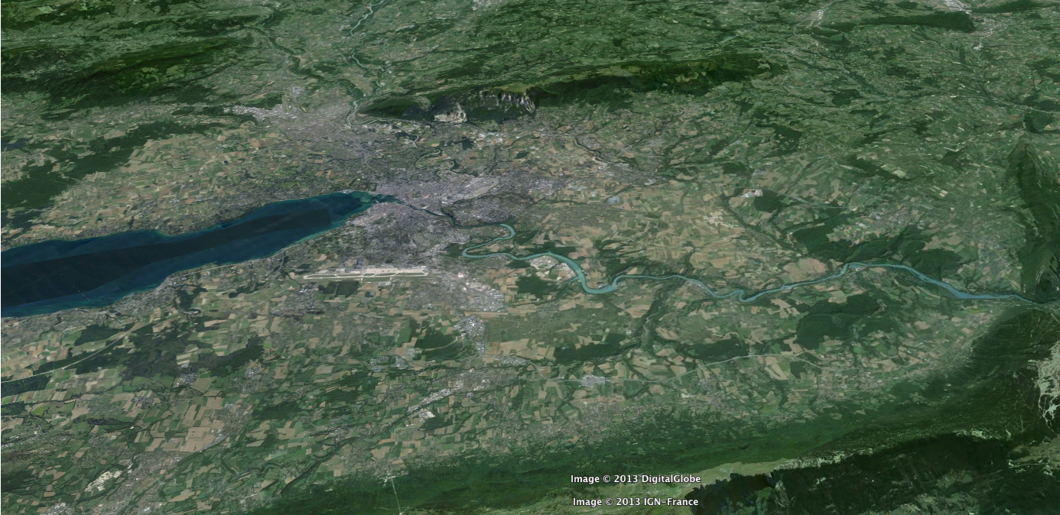
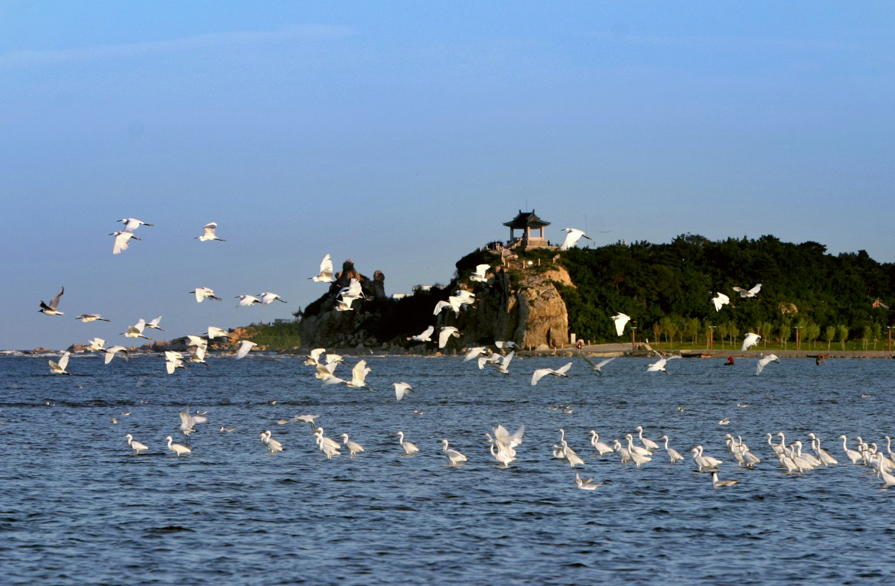
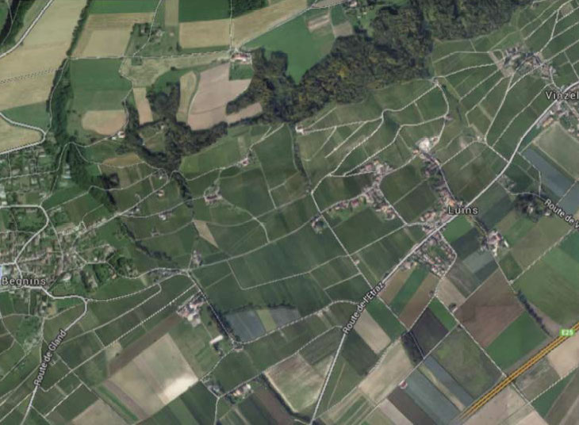
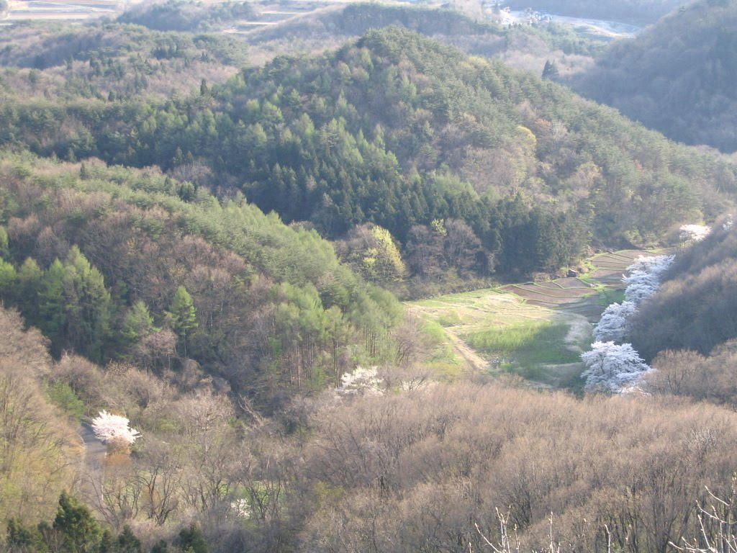







Future Colliders – Overview & Status
Frank Zimmermann
CERN, BE Department
5 November 2014
Work supported by the European Commission under Capacities 7th Framework Programme, Grant Agreement 312453

Slide 2
LHC roadmap: schedule until 2035
LS2 starting in 2018 (July) => 18 months + 3 months BC
LS3 LHC: starting in 2023 => 30 months + 3 months BC
Injectors: in 2024 => 13 months + 3 months BC
Physics
Shutdown
Beam commissioning
Technical stop
(Extended) Year End Technical Stop: (E)YETS
YETS
EYETS
YETS
LS 2
YETS
Run 2
Run 3
Run 2
LS 2
Run 3
30 fb⁻¹
PHASE 1
YETS
LS 3
Run 4
YETS
LS 3
Run 4
300 fb⁻¹
PHASE 2
LS 4
Run 5
LS 5
LS 4
Run 5
LS 5
3’000 fb⁻¹
F. Bordry
Phase 2: HL-LHC

Slide 3
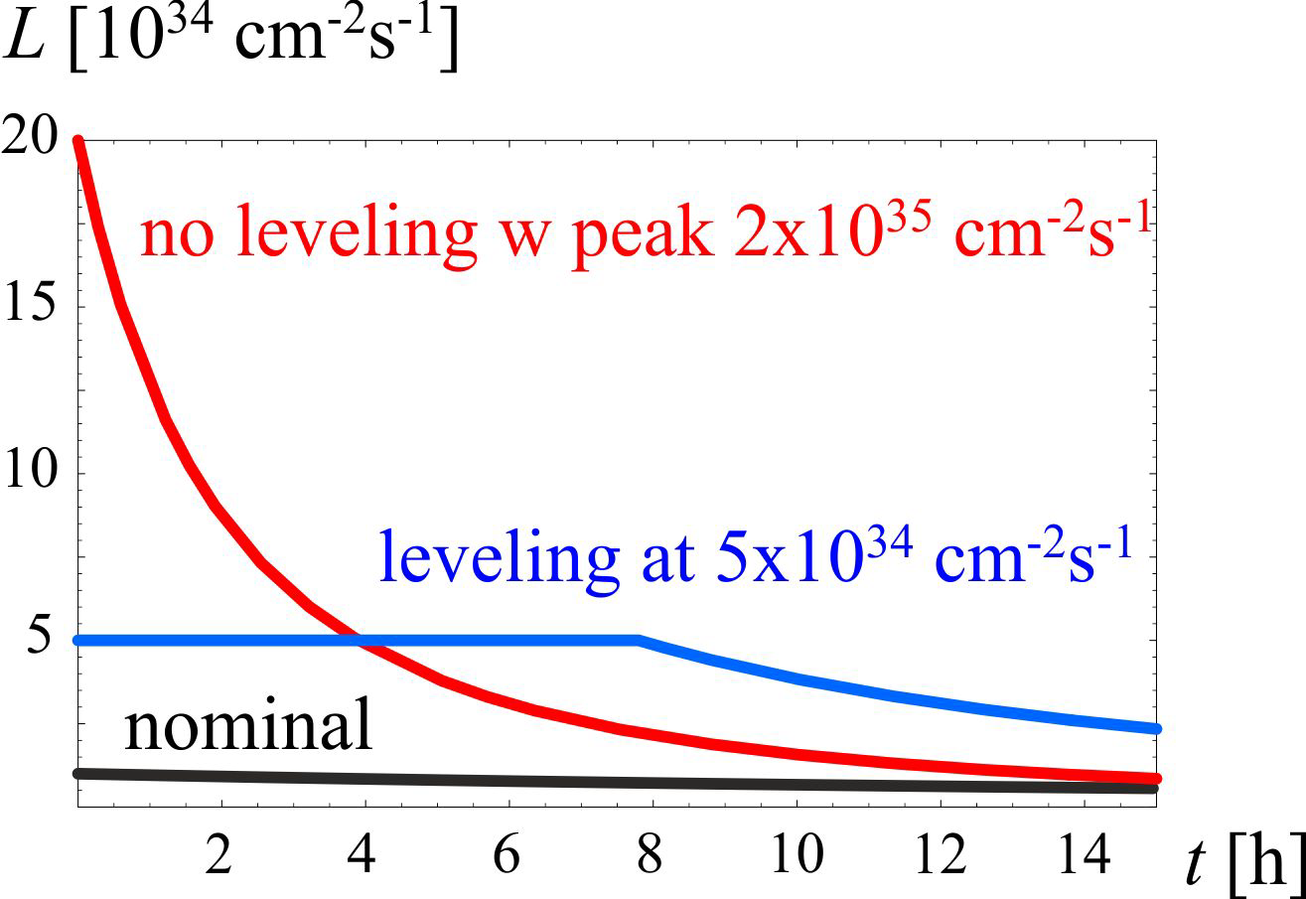
HL-LHC
3000 fb⁻¹ delivered in the order of 10 years
High “virtual” luminosity with levelling
5 x 10³⁴ cm⁻²s⁻¹
levelled luminosity
Pile-up ~140
3 fb⁻¹ per day
~250 fb⁻¹ /year

Slide 4
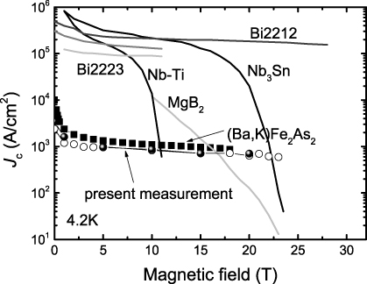
technology transition: Nb-Ti →Nb₃Sn
O. Bruning

Slide 5
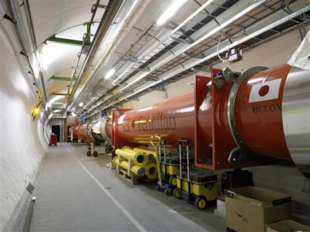



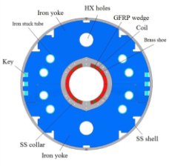

HL-LHC - critical zones around IP1 & IP5
ATLAS
CMS
3. For collimation we also need to change the DS in the continuous cryostat: 11-T Nb₃Sn dipole
2. We also need to modify a large part of the matching section
e.g. Crab Cavities &
D1, D2, Q4 & corrector
New quadrupole triplet based on Nb₃Sn (12 T at coil)
required due to:
-Radiation damage
-Need for more aperture
Changing the triplet region is not enough for reaching the HL-LHC goal!
more than 1.2 km of LHC plus technical infrastructure
(e.g. Cryo and Powering)
Nb₃Sn dipoles & quadrupoles
O. Brüning,
L. Rossi

Slide 6
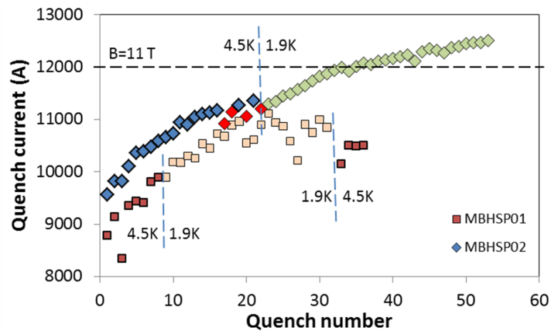
FNAL: Nb₃Sn dipole demonstrators
US-LARP
MBHSP02 (1 m) passed 11 T field during training at 1.9 K with I = 12080 A on 5 March 2013

Slide 7
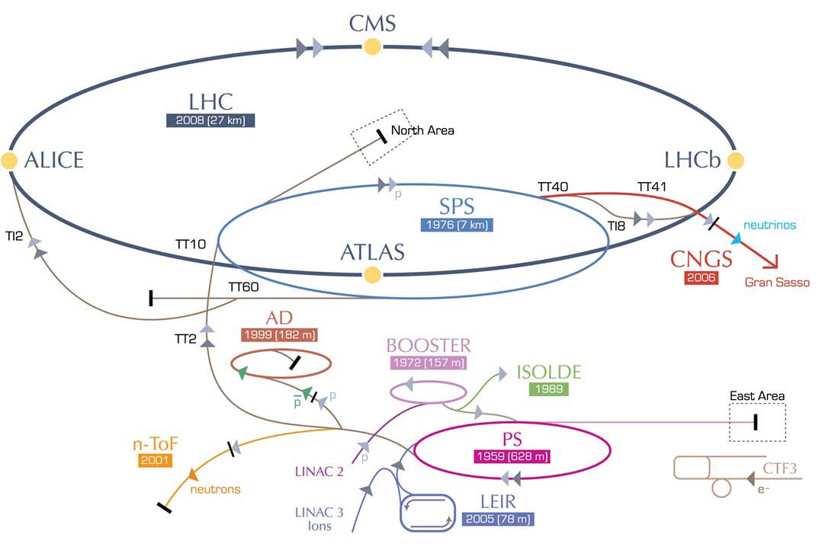
Large Hadron electron Collider (LHeC)
ERL LHeC:
recirculating
linac with
energy
recovery

Slide 8
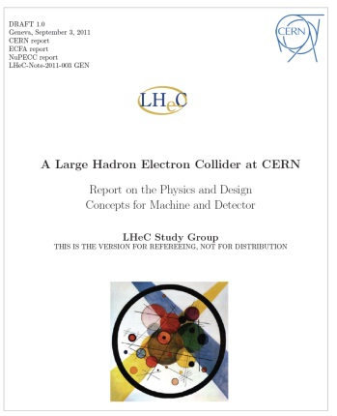
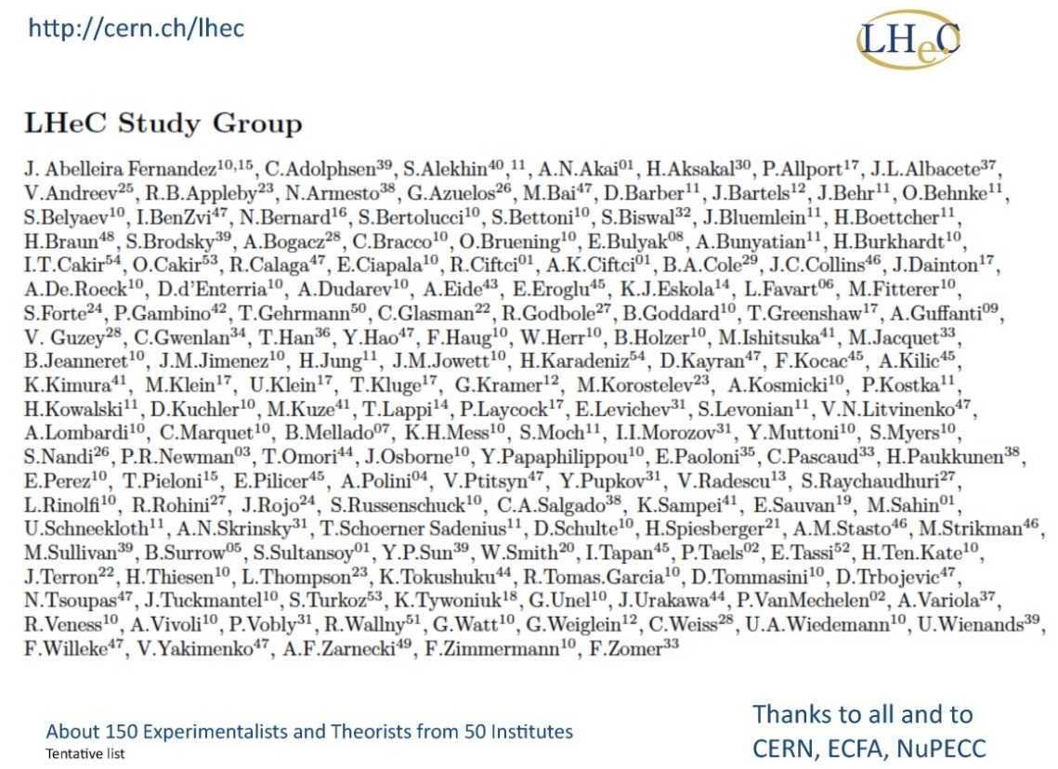
LHeC Conceptual Design Report
LHeC CDR published in
J. Phys. G: Nucl. Part. Phys. 39
075001 (2012)
~150 authors, ~600 pages
LHeC should start well before the end of HL-LHC, that is around 2027 (2028)

Slide 9
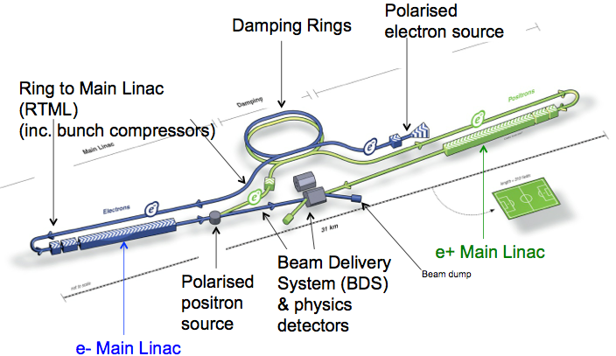
International Linear Collider (ILC)
total length ~30 (500 GeV) - 50 km (1 TeV)
S. Stapnes
SC acceleration structures ~ 30 MV/m; TDR completed in 2012, ILC technology used for XFEL at DESY; present optimistic time line: construction start in 2018 & 1st physics in 2027?

Slide 10
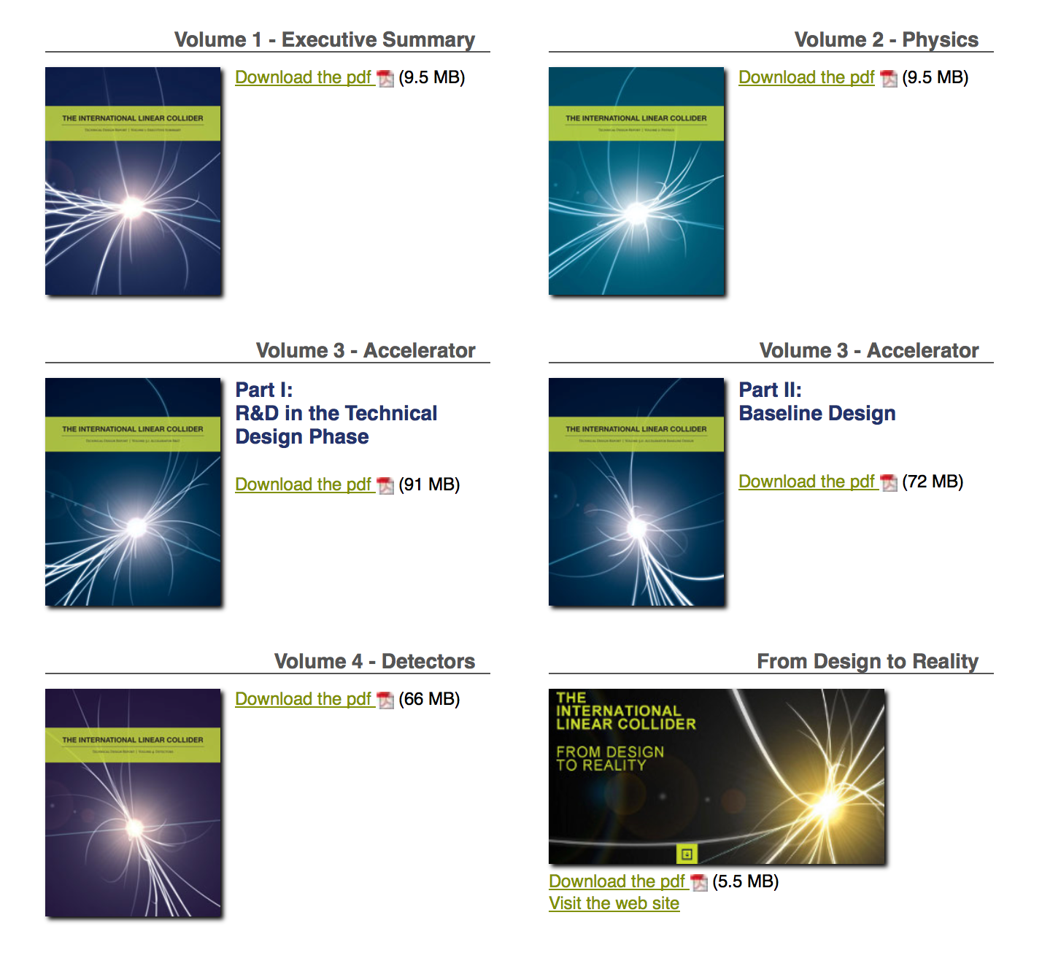
ILC – TDR (2013)
S. Stapnes
2399
signatories
5 volumes
Text about TDR and picture
http://www.linearcollider.org/ILC/Publications/Technical-Design-Report

Slide 11
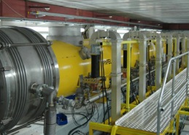
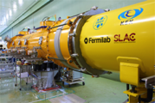
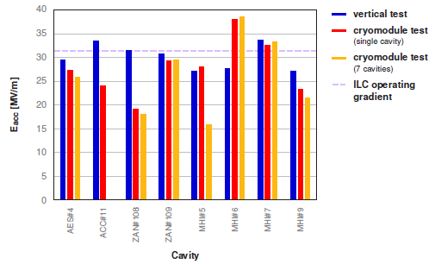
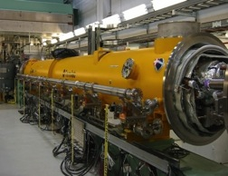
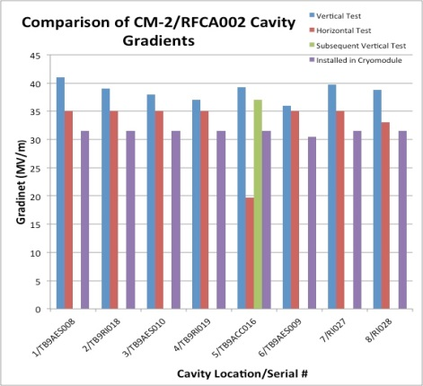
ILC – cryomodule system tests
DESY: FLASH
1.25 GeV linac (TESLA-Like tech.)
ILC-like bunch trains:
600 ms, 9 mA beam (2009);
800 ms 4.5 mA (2012)
RF-cryomodule string with beam → PXFEL1 operational at FLASH
S. Stapnes
XFEL Prototype at PXFEL1
← Demonstrated
PXFEL1 : ~ 32MV/m>
KEK: STF/STF2
S1-Global: completed (2010)
Quantum Beam Accelerator (Inverse Llaser Compton): 6.7 mA, 1 ms
CM1 test with beam (2014 ~2015)
STF-COI: Facility to demonstrate
CM assembly/test in near future
S1 Global Cryomodule at STF:
← Demonstrated
Cavity string: < 26MV/m>
  FNAL: ASTA
  (Advanced Superconducting Test Accelerator)
CM1 test complete
CM2 operation (2013)
CM2 with beam (soon)
CM2 at NML Facility:
CM2: > 31.5 MV/m>
+ XFEL, LCLS-II, …

Slide 12
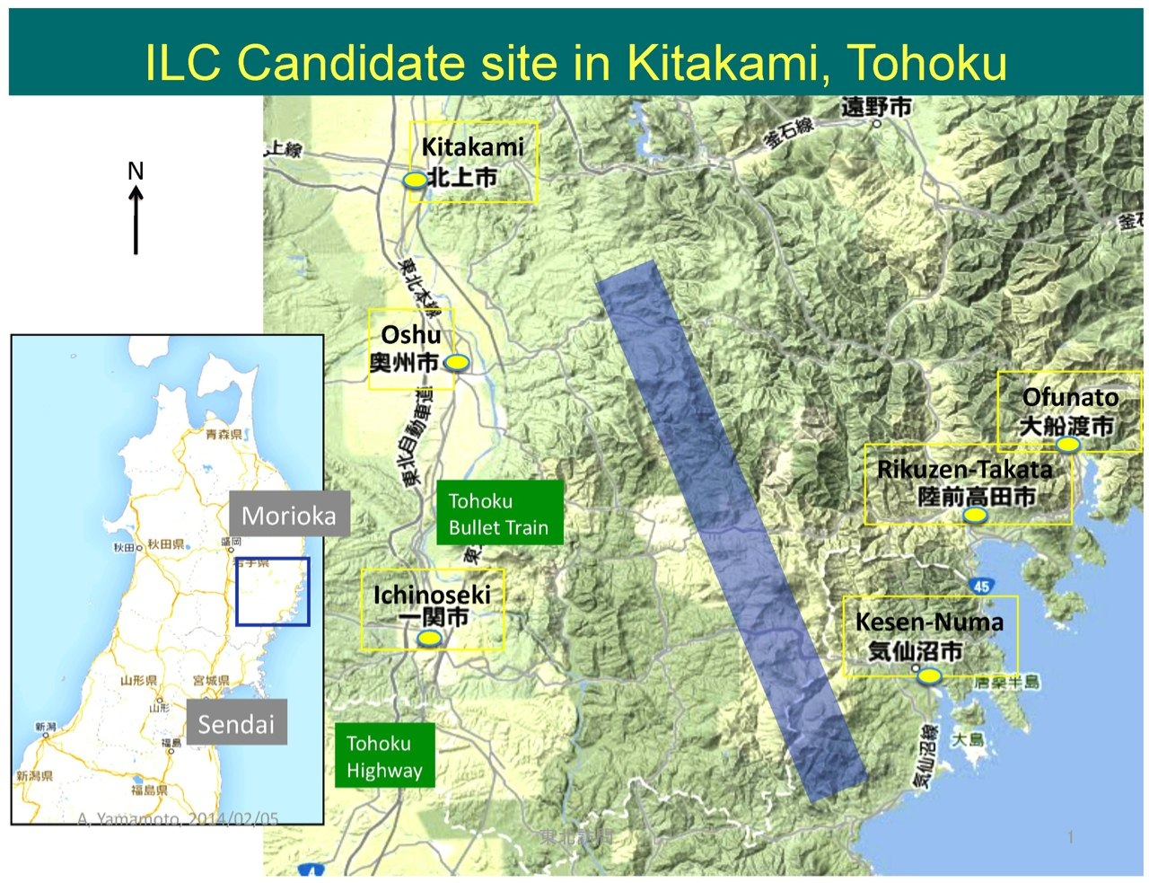
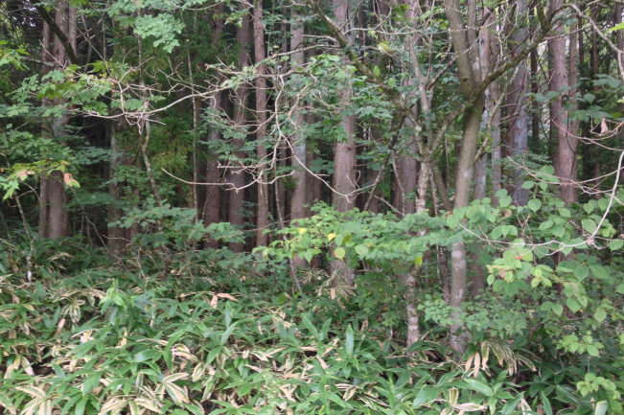
ILC – candidate site
Japanese HEP community expressed interest in hosting the ILC. Site chosen: 北上市 (Kitakami) in Northern Japan. Under review by Japanese ministry MEXT.
Courtesy F. Simon

Slide 13
Schedule for MEXT Committee and WGs
S. Stapnes
Experts committee
 | date
1 | 5/8
2 | (11/14)
Physics WG
 | date | Subject
1 | 6/24 | Status of Particle Physics and ILC physics overview
2 | 7/29 | Future prospect in the US and in Europe
3 | 8/27 | Cosmic-ray and Astrophysics, and ILC
4 | 9/22 | Flavor and Neutrino physics, and ILC
5 | 10/21 | Interium summary to be input to the Experts Committee
TDR Validation WG
 | date | Subjects
1 | --- | Overview
2 | --- | ML and SRF
3 | --- | SRF Q&A,, CFS
4 | --- | (Schedule and Project Management including Cost and Human Resource)
Additional:
MEXT has issued a call for tender for a company to investigate technology spin-off and economic ripple effects from ILC.
A report is due 31 March 2015 (?)

Slide 14
ILC schedule
Years | TDR Baseline Scenario
1 - 2 | Pre-preparation for 2yrs (for technical effort continuity)
3 - 6 | Preparation (4 yrs)
7 - 15 | Construction (9 yrs)
(12 -) | (start installation)
(13 -) | (start preparation for Operation)
16 - | Beam Commissioning start
17 – | Operation at 250 ~ 500 GeV (550 GeV)
TBD | Toward 500 GeV HL upgrade
TBD | Toward 1 TeV upgrade
S. Stapnes
ILC-500 could start physics around 2027

Slide 15
European Strategy Update 2013
“CERN should undertake design studies for accelerator projects in a global context, with emphasis on proton-proton and electron-positron high-energy frontier machines.”
http://cds.cern.ch/record/1567258/files/esc-e-106.pdf
strategy adopted by the CERN Council

Slide 16
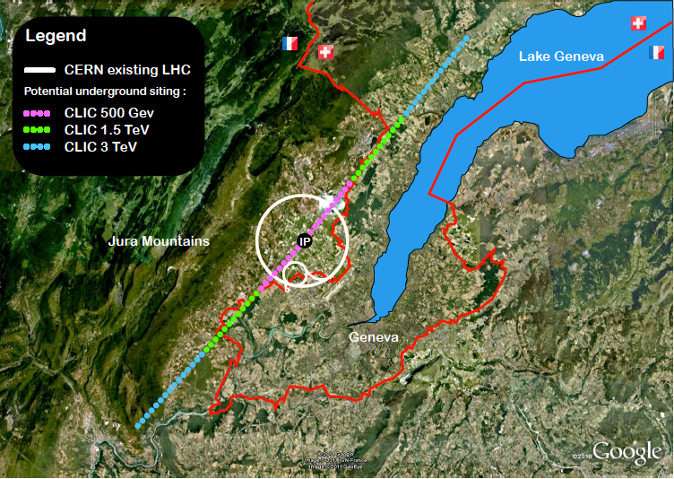
Compact Linear Collider (CLIC)
total length (main linac) ~11 (500 GeV) - 48 km (3 TeV)
accelerating gradient
~100 MV/m
key technologies: 2-beam accel., drive-beam , X-band RF

Slide 17
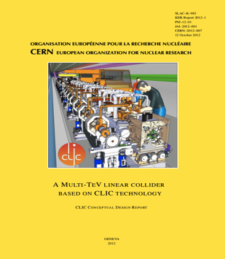
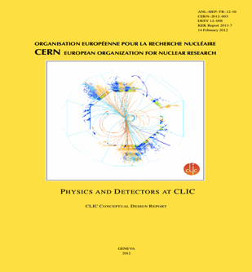
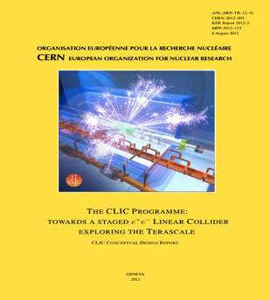
CLIC Conceptual Design Report 2012
Vol 1: The CLIC accelerator and site facilities (H.Schmickler)
- CLIC concept with exploration over multi-TeV energy range up to 3 TeV
- Feasibility study of CLIC parameters optimized at 3 TeV (most demanding)
- Consider also 500 GeV, and intermediate energy range
- Complete, presented in SPC in March 2011, in print: https://edms.cern.ch/document/1234244/
Vol 2: Physics and detectors at CLIC (L.Linssen)
- Physics at a multi-TeV CLIC machine can be measured with high precision, despite challenging background conditions
- External review procedure in October 2011
- Completed and printed, presented in SPC in December 2011 http://arxiv.org/pdf/1202.5940v1
Vol 3: “CLIC study summary” (S.Stapnes)
- Summary and available for the European Strategy process, including possible implementation stages for a CLIC machine as well as costing and cost-drives
- Proposing objectives and work plan of post CDR phase (2012-16)
- Completed and printed, submitted for the European Strategy Open Meeting
in September http://arxiv.org/pdf/1209.2543v1
In addition a shorter overview document was submitted as input to the European Strategy update, available at:
http://arxiv.org/pdf/1208.1402v1
~1400 authors, ~1200 pages

Slide 18
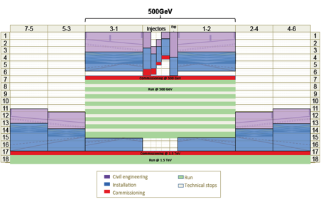
CLIC time line
2013-18 Development Phase
Develop a Project Plan for a staged implementation in agreement with LHC findings; further technical developments with industry, performance studies for accelerator parts and systems, as well as for detectors.
4-5 year Preparation Phase
Finalise implementation parameters, Drive Beam Facility and other system verifications, site authorisation and preparation for industrial procurement.
Prepare detailed Technical Proposals for the detector-systems.
Construction Phase
Stage 1 construction of CLIC, in parallel with detector construction.
Preparation for implementation of further stages.
2018-19 Decisions
On the basis of LHC data
and Project Plans (for CLIC and other potential projects as FCC), take decisions about next project(s) at the Energy Frontier.
2024-25 Construction Start
Ready for full construction
and main tunnel excavation.
Commissioning
Becoming ready for data-taking as the LHC programme reaches completion.
S. Stapnes
first stage (500 GeV) could start physics around 2030

Slide 19
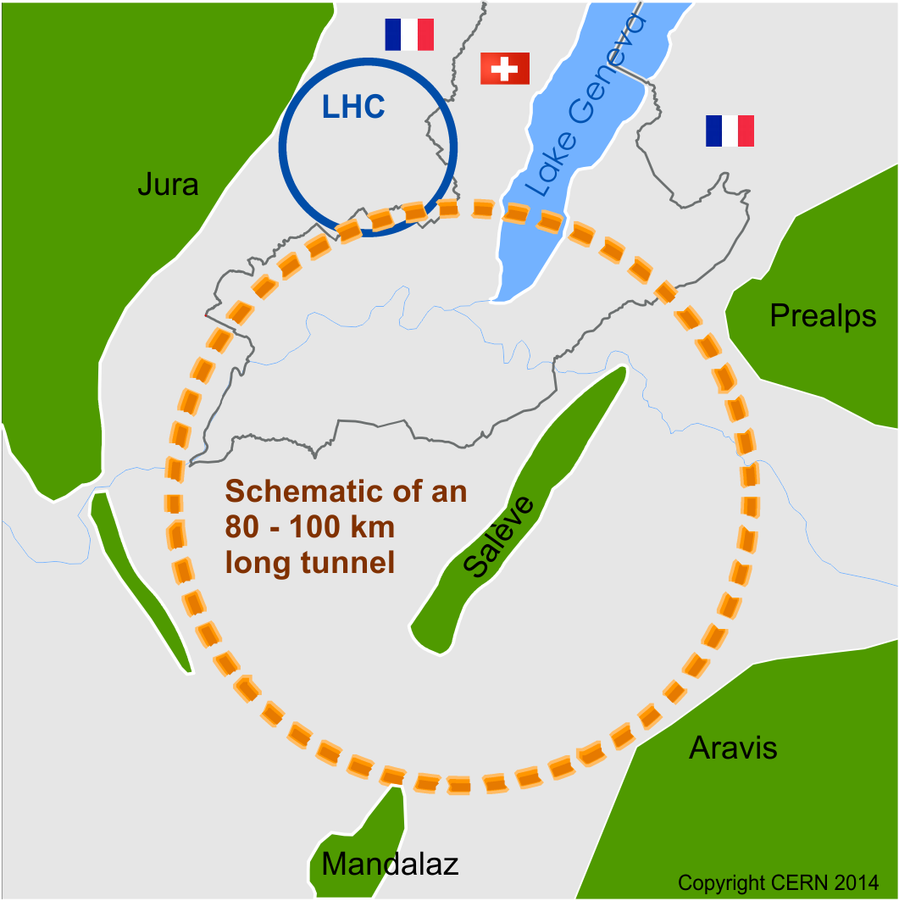
Future Circular Collider Study - SCOPE
CDR and cost review for the next ESU (2018)
In response to 2013 ESU forming an international collaboration to study:
pp-collider (FCC-hh) → defining infrastructure requirements
80-100 km infrastructure in Geneva area
e⁺e⁻ collider (FCC-ee) as potential intermediate step
p-e (FCC-he) option
~16 T ⇒ 100 TeV pp in 100 km
~20 T ⇒ 100 TeV pp in 80 km

Slide 20
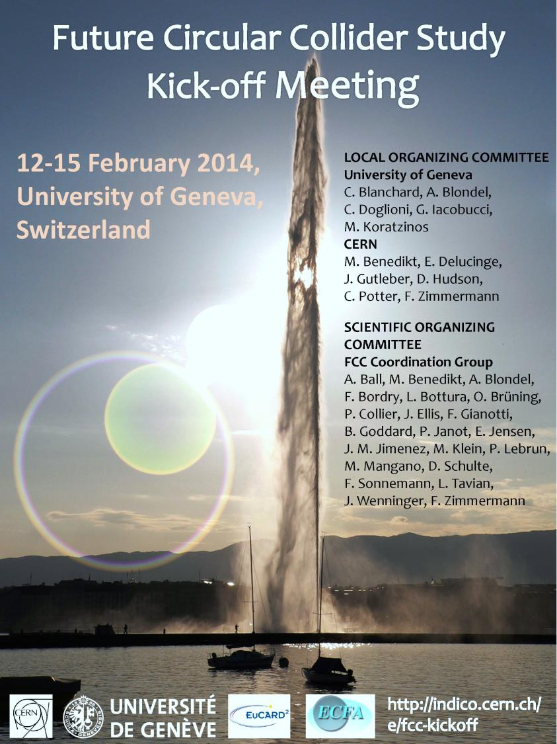
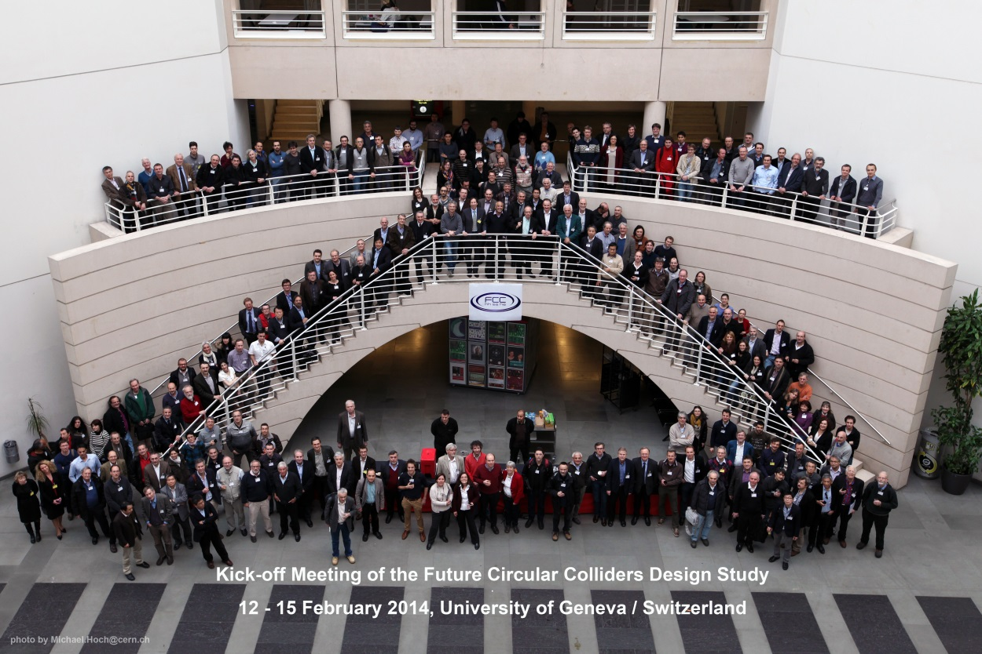
FCC Kick-off Meeting
University of Geneva
12-15 February 2014
>340 participants
http://indico.cern.ch/e/fcc-kickoff
http://cern.ch/fcc

Slide 21
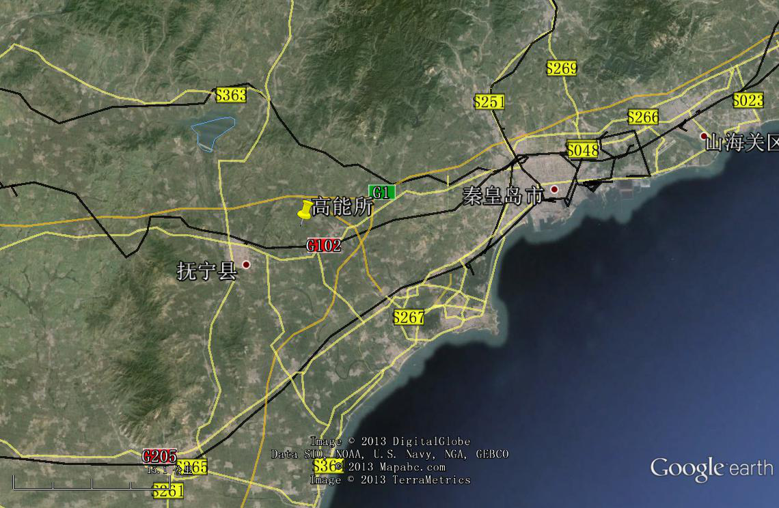
CepC/SppC study (CAS-IHEP), CepC CDR end of 2014, e⁺e⁻ collisions ~2028; pp collisions ~2042
Qinhuangdao (秦皇岛）
CepC, SppC
50 km
easy access
300 km from Beijing
3 h by car
1 h by train
70 km
“Chinese Toscana”
Yifang Wang

Slide 22

CEPC-SppC Project Timeline (optimistic)
CEPC
 |  | 2015 |  |  |  |  | 2020 |  |  |  |  | 2025 |  |  |  |  | 2030 |  |  |  |  | 2035
Pre-studies (2013-2015)
R&D Engineering Design (2016-2020)
Construction (2021-2027)
Data taking (2028-2035)
1st Milestone: pre-CDR (by the end of 2014) → R&D funding request to Chinese government in 2015 (China’s 13th Five-Year Plan 2016-2020)
SppC
 |  | 2020 |  |  |  |  |  |  | 2030 |  |  |  |  |  |  |  |  | 2040
R&D (2014-2030)
Engineering Design (2030-2035)
Construction (2035-2042)
Data taking (2042-2055)
Weiren Chou

Slide 23
SRF R&D Program on CEPC Timeline
Y. Sun
 |  | 2015 |  |  |  |  |  |  |  | 2020 |  | 2027
Pre-studies (2013-2015)
R&D Engineering Design (2016-2020, 5 yrs.)
Construction (2021-2027, 7 yrs.)
SRF Pre-design
SRF Initial Technology R&D (2016-2020, 5 yrs.)
HOM damping, high Q₀ cavity, coupler window, heat load
SRF Pre-Production R&D (2019-2022, 4 yrs.)
SRF Production and Installation (2023-2027, 5 yrs.)
IHEP site infrastructure
Now
Large scale SRF lab (infrastructure) on CEPC site and in industry (2018)
2017
CEPC SRF Team (~ 6)
CEPC SRF Core Team (main ring 10 + booster 10 in parallel) (start from 2017)
Facility upgrade, additional space
SRF ~ 200 FTEs (start from 2020), engineers and technicians
Components Prototyping & Performance Demonstration:
Cavity (four for each), helium vessel, vertical test
Power coupler (four for each), HOM dampers, tuners
Short (two-cavity) module for each type, horizontal test
2020
Booster SRF in three years (2023-2025):
test two 650 MHz cavities per week
assemble and test one cryomodule per month
Main ring SRF in four years (2023-2025):
test two 1300 MHz cavities per week
assemble and test two cryomodules per month
Demonstrate Robustness of Fabrication and Assembly Processes of Cryomodule and its Components. Establish procedures, quality control steps, test set ups, assembly sequences, etc. for the production run. Build and test two booster cryomodules and three main ring cryomodules.

Slide 24
20-T magnet working group in China
Q. Xu
NIN (Northwest Institute for Non-ferrous Metal Research) & WST (Western Superconducting Tech. Co.)
NIN: Advanced Bi-2212 R&D. Significant progress in past several years.
WST: Qualified Nb₃Sn supplier for ITER. High J_{c} Nb₃Sn R&D.
Shanghai JiaoTong U.& SST (Shanghai Superconductor Tech. Co.)
YBCO R&D and production. Significant progress in past several years.
Tsinghua U. & Innost (Innova Superconductor Tech. Co.)
10+ years R&D and production of Bi-2223. Modification of production lines for Bi-2212 is under discussion.
CHMFL (High Magnetic Field Laboratory of the Chinese Academy of Sciences)
Nb₃Sn CICC conductor & high field solenoids; advanced insulation materials;…
IHEP (Institute of High Energy Physics, Chinese Academy of Sciences)
Accelerator Center Magnet Group：30+ years R&D and production of conventional accelerator magnets.
Superconducting Magnet Engineering Center：10+ years R&D and production of superconducting solenoids for particle detectors and industries.
+ me (from Apr. 2014): 10+ years R&D on superconducting magnets including 6 years on high field/ large aperture accelerator magnets at KEK & CERN.

Slide 25
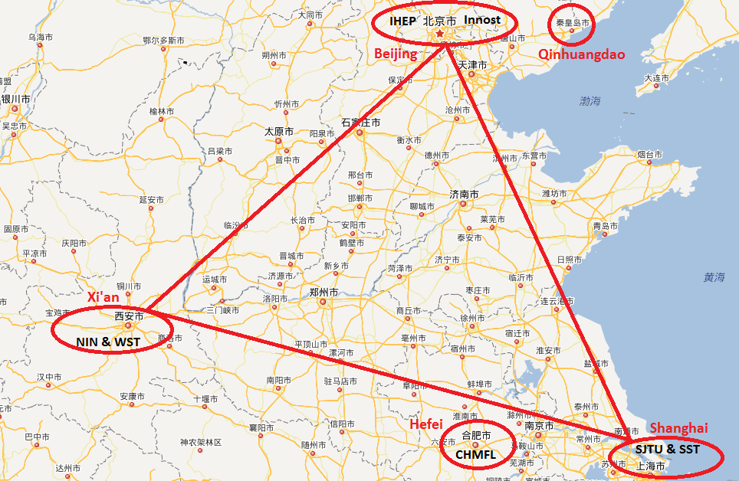


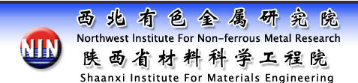


20-T magnet working group in China
Q. Xu

Slide 26
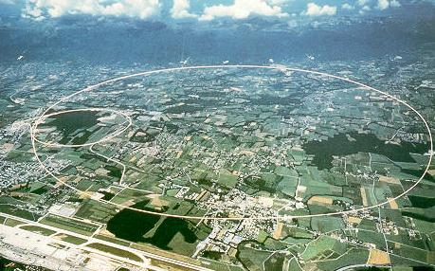
LEP – highest energy e⁺e⁻ collider so far
maximum c.m. energy 209 GeV
maximum synchrotron radiation power 23 MW

Slide 27
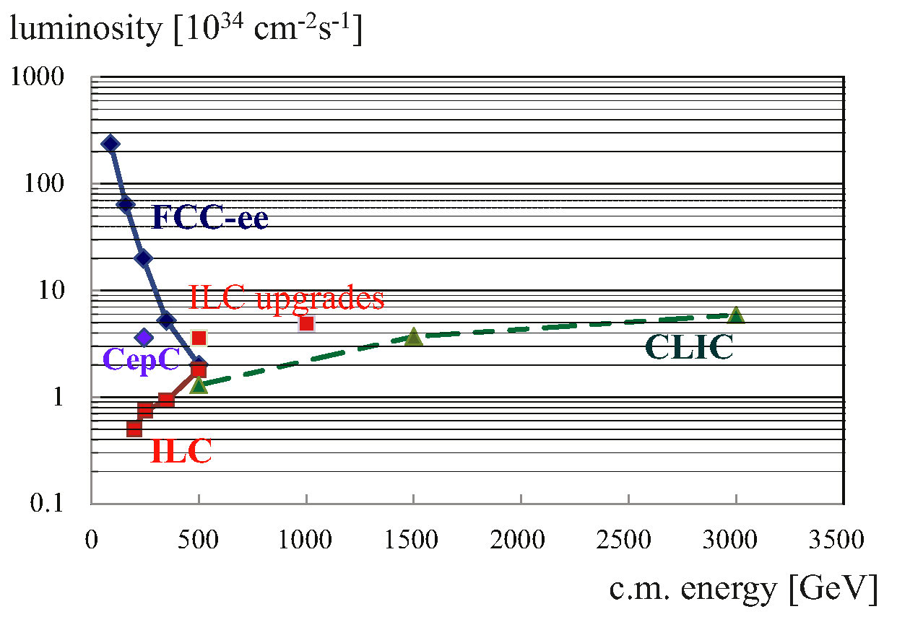
e⁺e⁻ luminosity vs energy
FCC-ee crab waist / improved optics
(Bogomyagkov, Levichev, Piminov, Shatilov, 2014)
additional ILC upgrades
(Harrison, Ross, Walker, 2013)

Slide 28
parameter | LEP2 | FCC-ee |  |  |  |  | CepC
 |  | Z | Z (c.w.) | W | H | t | H
E_{beam} [GeV] | 104 | 45 | 45 | 80 | 120 | 175 | 120
circumference [km] | 26.7 | 100 | 100 | 100 | 100 | 100 | 54
current [mA] | 3.0 | 1450 | 1431 | 152 | 30 | 6.6 | 16.6
P_{SR,tot} [MW] | 22 | 100 | 100 | 100 | 100 | 100 | 100
no. bunches | 4 | 16700 | 29791 | 4490 | 1360 | 98 | 50
N_{b} [10¹¹] | 4.2 | 1.8 | 1.0 | 0.7 | 0.46 | 1.4 | 3.7
ε_{x} [nm] | 22 | 29 | 0.14 | 3.3 | 0.94 | 2 | 6.8
ε_{y} [pm] | 250 | 60 | 1 | 1 | 2 | 2 | 20
β∗_{x} [m] | 1.2 | 0.5 | 0.5 | 0.5 | 0.5 | 1.0 | 0.8
β∗_{y} [mm] | 50 | 1 | 1 | 1 | 1 | 1 | 1.2
σ∗_{y} [nm] | 3500 | 250 | 32 | 130 | 44 | 45 | 160
σ_{z,SR} [mm] | 11.5 | 1.64 | 2.7 | 1.01 | 0.81 | 1.16 | 2.3
σ_{z,tot} [mm] (w beamstr.) | 11.5 | 2.56 | 5.9 | 1.49 | 1.17 | 1.49 | 2.7
hourglass factor F_{hg} | 0.99 | 0.64 | 0.94 | 0.79 | 0.80 | 0.73 | 0.61
L/IP [10³⁴ cm⁻²s⁻¹] | 0.01 | 28 | 212 | 12 | 6 | 1.7 | 1.8
τ_{beam} [min] | 300 | 287 | 39 | 72 | 30 | 23 | 40

Slide 29
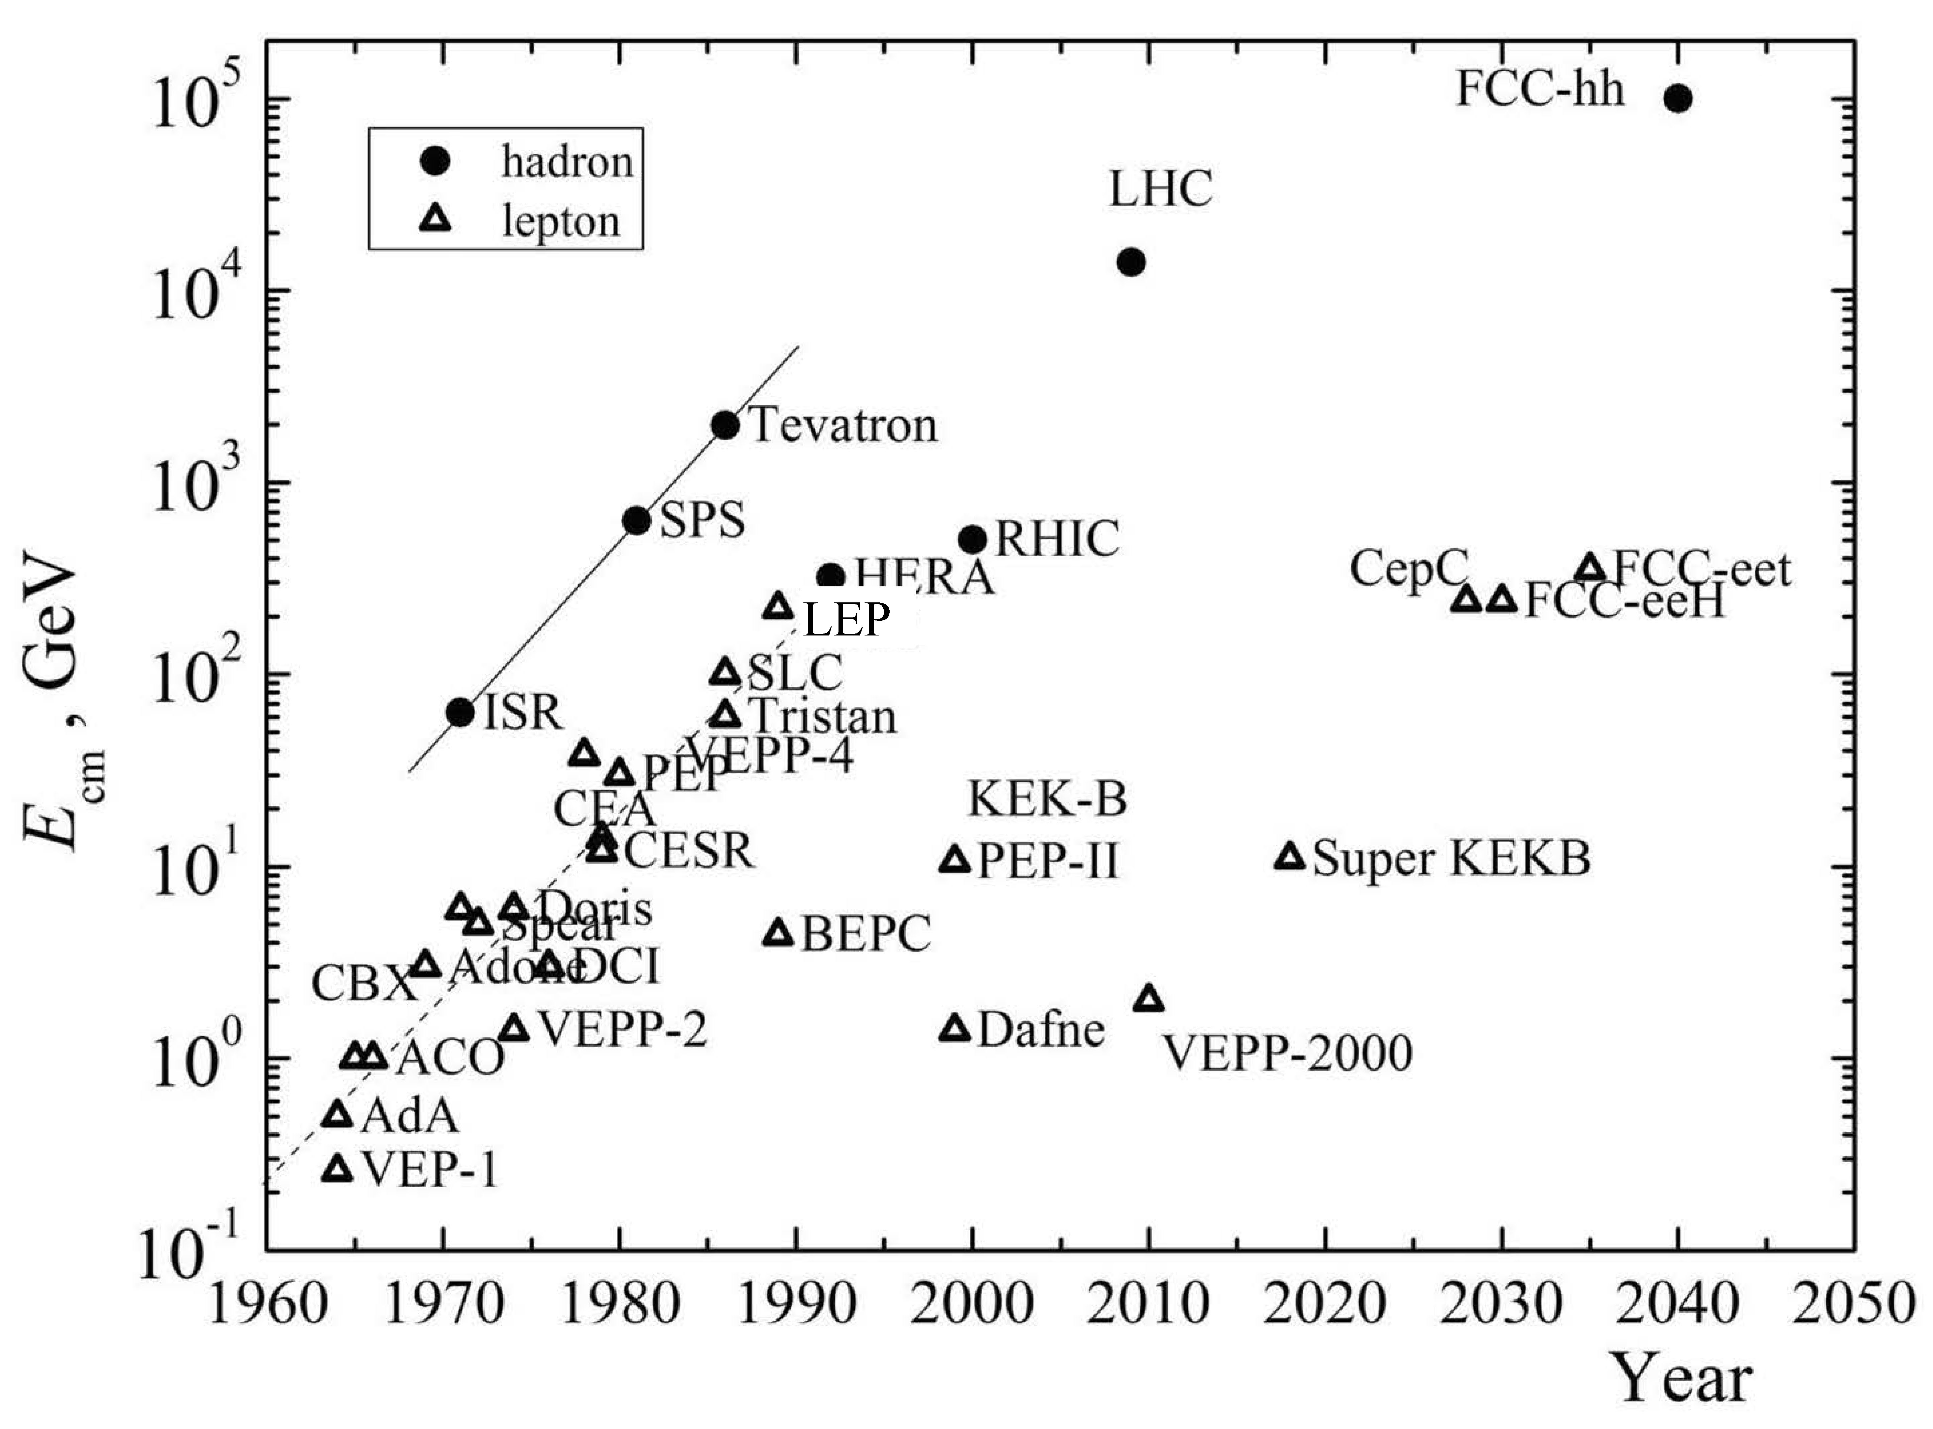

collider c.m. energy vs. year
pp
E_{cm}=2ec Bρ
hadron-lepton
factor 10 every
10 years
factor 10 every
20-30 years
ep
FCC-he
LHeC
e⁺e⁻
factor 10⁵-10⁷ in e⁺e⁻
luminosity
Courtesy V. Shiltsev

Slide 30
FCC-hh: 100 TeV pp collider
Geneva
PS
SPS
LHC
LHC
27 km, 8.33 T
14 TeV (c.m.)
“HE-LHC”
27 km, 20 T
33 TeV (c.m.)
FCC-hh (alternative)
80 km, 20 T
100 TeV (c.m.)
FCC-hh (baseline)
100 km, 16 T
100 TeV (c.m.)
L. Bottura
B. Strauss

Slide 31
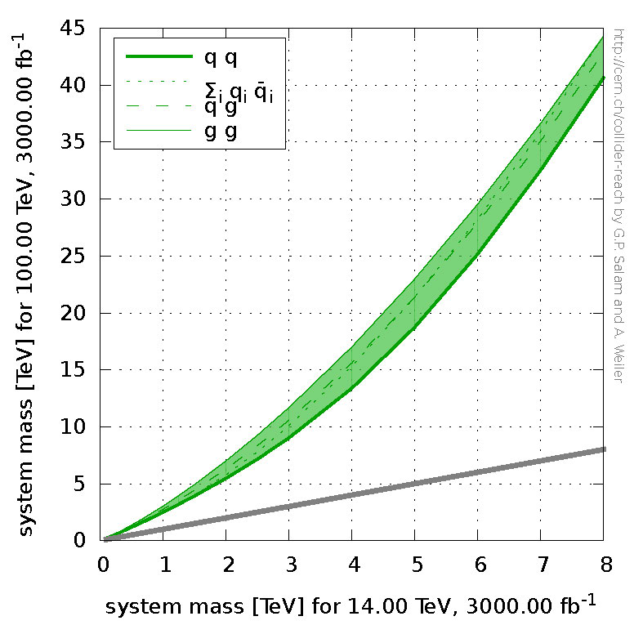
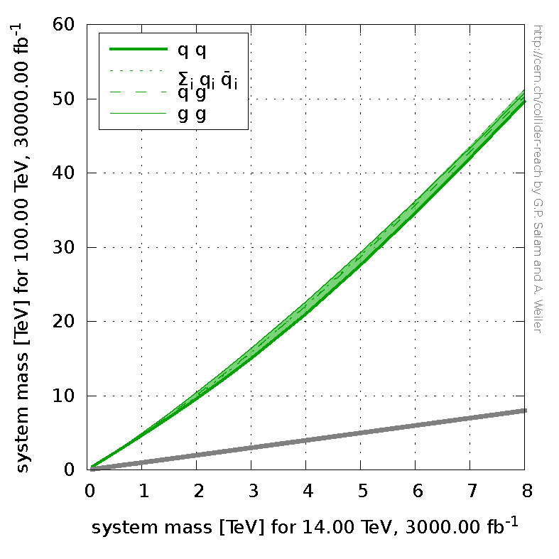
which pp luminosity?
FCC-hh, 100 TeV, 3 ab⁻¹
FCC-hh, 100 TeV, 30 ab⁻¹
HL-LHC
14 TeV
3 ab⁻¹
HL-LHC
14 TeV
3 ab⁻¹
shown are the parton-parton system masses for an equal number of events
G. Salam and A. Weiler, http://collider-reach.web.cern.ch/

Slide 32
technology matrix
 | HL-LHC | LHeC | ILC | CLIC | FCC-ee/hh | CepC/SppC
leptons | - | cw SRF at 800 or 400 MHz | Pulsed SRF at 31.5 MV/m at 1.3 GHz | Pulsed NC RF at 100 MV/m at 12 GHz | cw SRF at 800 or 400 MHz with 15-20 MV/m | cw SRF at 650 MHz with 15.5 MV/m (& 1.3 GHz booster)
 | - | RF power source | RF power source | RF power source | RF power source | RF power source
 | - | High-E high-I ERL | final focus | final focus | IR optics with large E acceptance | IR optics with large E acceptance
 | - |  | damping ring | drive beam dynamics |  | Pretzel scheme
 | - |  | e+ source | e+ source
hadrons | 11-12 T Nb₃Sn dipoles & quad’s | - | - | - | 15-16 T Nb₃Sn dipoles & quad’s | 19-20 T HTS dipoles
 | Compact crab cavities | - | - | - | efficient cooling of SR | efficient cooling of SR
 | SC link | - | - | -

Slide 33

FCC global design study – time line
2014 |  |  |  | 2015 |  |  |  | 2016 |  |  |  | 2017 |  |  |  | 2018
Q1 | Q2 | Q3 | Q4 | Q1 | Q2 | Q3 | Q4 | Q1 | Q2 | Q3 | Q4 | Q1 | Q2 | Q3 | Q4 | Q1 | Q2 | Q3 | Q4
Prepare
Kick-off, collaboration forming,
→study plan and organisation
Ph 1: Explore options
“weak interaction”
Workshop & Review →identification of baseline
Ph 2: Conceptual study of baseline “strong interact.”
Workshop & Review, cost model, LHC results → study re-scoping?
Ph 3: Study
consolidation
4 large FCC Workshops distributed over participating regions
Workshop & Review
→ contents of CDR
Report
Release CDR & Workshop on next steps
we are here
M. Benedikt

Slide 34
HEP Timescale
1980
1985
1995
2000
2005
2010
2015
2020
2025
2030
2035
1990
Construc-tion
Physics
Upgr
LEP
Design
Proto
Construction
Physics
LHC
Design
Construct
Physics
HL-LHC
Future Collider
Design
Proto
Construction
Physics
25 years
Today
CDR & Cost

Slide 35

First FCC Week
Conference
Washington DC
23-27 March 2015
http://cern.ch/fccw2015
++...
hoping to see you there!
draft poster

Slide 36
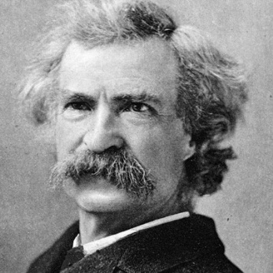
is future circular or linear or both?
“A circle is a round straight line with a hole in the middle.”
  Mark Twain,
  in "English as She Is Taught",
  Century Magazine, May 1887

Slide 37
spare slides

Slide 38
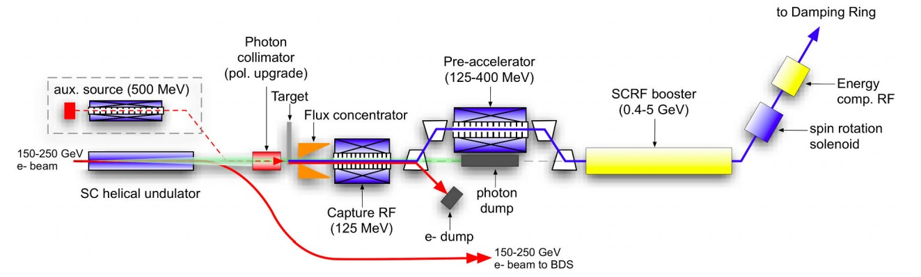
e⁺ source – rate requirements
 | S-KEKB | SLC | CLIC (3 TeV) | ILC (H) | FCC-ee (H)
e⁺ / second | 2.5 x 10¹² | 6 x 10¹² | 110 x 10¹² | 200 x 10¹² | 0.05 x 10¹²
L. Rinolfi
X 18
X 33
/ 120
efficiency of e⁺ usage:
5x10⁻⁵ b⁻¹/e⁺
1 b⁻¹/e⁺
factor 20000
ILC e⁺ source design
20x10⁶
ILC e+ source has no precedent; its performance can be verified only after ILC construction (needs >150 GeV e⁻ beam)

Slide 39
parameter | LHC | HL-LHC | FCC-hh
c.m. energy [TeV] | 14 |  | 100
dipole magnet field [T] | 8.33 |  | 16 (20)
circumference [km] | 36.7 |  | 100 (83)
luminosity [10³⁴ cm⁻²s⁻¹] | 1 | 5 | 5 [→20?]
bunch spacing [ns] | 25 |  | 25 {5}
events / bunch crossing | 27 | 135 | 170 {34}
bunch population [10¹¹] | 1.15 | 2.2 | 1 {0.2}
norm. transverse emitt. [μm] | 3.75 | 2.5 | 2.2 {0.44}
IP beta-function [m] | 0.55 | 0.15 | 1.1
IP beam size [μm] | 16.7 | 7.1 | 6.8 {3}
synchrotron rad. [W/m/aperture] | 0.17 | 0.33 | 28 (44)
critical energy [keV] | 0.044 |  | 4.3 (5.5)
total syn.rad. power [MW] | 0.0072 | 0.0146 | 4.8 (5.8)
longitudinal damping time [h] | 12.9 |  | 0.54 (0.32)
Cms energy
Luminosity
FCC-hh baseline parameters defined in EDMS No. 1342402, FCC-ACC-SPC-0001

Slide 40
FCC as heavy-ion collider
preliminary parameters
 | Unit | LHC Design | FCC-hh | FCC-hh
operation mode | - | Pb-Pb | Pb-Pb | p-Pb
number of bunches |  | 592 | 432 | 432
part. / bunch | [10⁸] | 0.7 | 1.4 | 115(1.4)/1.4
β-functionat IP | [m] | 0.5 | 1.1 | 1.1
RMS beam size at IP | [um] | 15.9 | 8.8 | 8.8
initial luminosity | [10²⁷cm⁻²s⁻¹] | 1 | 3.2 | 267(3.2)
peak luminosity | [10²⁷cm⁻²s⁻¹] | 1 | 12.7 | 5477(3356)
integr. lumi. per fill | [μb⁻¹] | <15 | 83 | 30240
total cross-section | [b] | 515 | 597 | 2
initial luminosity lifetime | [h] | <5.6 | 3.7 | 3.2 (10.6)
M. Schaumann, J. Jowett

Slide 41
parameter | LEP2 | FCC-ee |  |  |  |  | CepC
 |  | Z | Z (c.w.) | W | H | t | H
E_{beam} [GeV] | 104 | 45 | 45 | 80 | 120 | 175 | 120
circumference [km] | 26.7 | 100 | 100 | 100 | 100 | 100 | 54
current [mA] | 3.0 | 1450 | 1431 | 152 | 30 | 6.6 | 16.6
P_{SR,tot} [MW] | 22 | 100 | 100 | 100 | 100 | 100 | 100
no. bunches | 4 | 16700 | 29791 | 4490 | 1360 | 98 | 50
N_{b} [10¹¹] | 4.2 | 1.8 | 1.0 | 0.7 | 0.46 | 1.4 | 3.7
ε_{x} [nm] | 22 | 29 | 0.14 | 3.3 | 0.94 | 2 | 6.8
ε_{y} [pm] | 250 | 60 | 1 | 1 | 2 | 2 | 20
β∗_{x} [m] | 1.2 | 0.5 | 0.5 | 0.5 | 0.5 | 1.0 | 0.8
β∗_{y} [mm] | 50 | 1 | 1 | 1 | 1 | 1 | 1.2
σ∗_{y} [nm] | 3500 | 250 | 32 | 130 | 44 | 45 | 160
σ_{z,SR} [mm] | 11.5 | 1.64 | 2.7 | 1.01 | 0.81 | 1.16 | 2.3
σ_{z,tot} [mm] (w beamstr.) | 11.5 | 2.56 | 5.9 | 1.49 | 1.17 | 1.49 | 2.7
hourglass factor F_{hg} | 0.99 | 0.64 | 0.94 | 0.79 | 0.80 | 0.73 | 0.61
L/IP [10³⁴ cm⁻²s⁻¹] | 0.01 | 28 | 212 | 12 | 6 | 1.7 | 1.8
τ_{beam} [min] | 300 | 287 | 39 | 72 | 30 | 23 | 40

Slide 42
parameter | LEP2 | FCC-ee
 |  | Z | Z (c.w.) | W | H | t
E_{beam} [GeV] | 104 | 45 | 45 | 80 | 120 | 175
circumference [km] | 26.7 | 100 | 100 | 100 | 100 | 100
current [mA] | 3.0 | 1450 | 1431 | 152 | 30 | 6.6
P_{SR,tot} [MW] | 22 | 100 | 100 | 100 | 100 | 100
no. bunches | 4 | 16700 | 29791 | 4490 | 1360 | 98
N_{b} [10¹¹] | 4.2 | 1.8 | 1.0 | 0.7 | 0.46 | 1.4
ε_{x} [nm] | 22 | 29 | 0.14 | 3.3 | 0.94 | 2
ε_{y} [pm] | 250 | 60 | 1 | 1 | 2 | 2
β∗_{x} [m] | 1.2 | 0.5 | 0.5 | 0.5 | 0.5 | 1.0
β∗_{y} [mm] | 50 | 1 | 1 | 1 | 1 | 1
σ∗_{y} [nm] | 3500 | 250 | 32 | 84 | 44 | 45
σ_{z,SR} [mm] | 11.5 | 1.64 | 2.7 | 1.01 | 0.81 | 1.16
σ_{z,tot} [mm] (w beamstr.) | 11.5 | 2.56 | 5.9 | 1.49 | 1.17 | 1.49
hourglass factor F_{hg} | 0.99 | 0.64 | 0.94 | 0.79 | 0.80 | 0.73
L/IP [10³⁴ cm⁻²s⁻¹] | 0.01 | 28 | 212 | 12 | 6 | 1.7
τ_{beam} [min] | 434 | 298 | 39 | 73 | 29 | 21
the large number of bunches at Z, W & H requires 2 rings
FCC-ee baseline parameters defined in EDMS No. 1346081, FCC-ACC-SPC-0003 (Rev. 2.0)
short lifetimes due to high luminosity → continuous injection (top-up)

Slide 43
parameter | LEP2 | FCC-ee
 |  | Z | Z (c.w.) | W | H | t
E_{beam} [GeV] | 104 | 45 | 45 | 80 | 120 | 175
beam-beam par. ξ_{y}/IP | 0.06 | 0.03 | 0.175 | 0.06 | 0.093 | 0.092
current [mA] | 3.0 | 1450 | 1431 | 152 | 30 | 6.6
P_{SR,tot} [MW] | 22 | 100 | 100 | 100 | 100 | 100
no. bunches | 4 | 16700 | 29791 | 4490 | 1360 | 98
N_{b} [10¹¹] | 4.2 | 1.8 | 1.0 | 0.7 | 0.46 | 1.4
ε_{x} [nm] | 22 | 29 | 0.14 | 3.3 | 0.94 | 2
ε_{y} [pm] | 250 | 60 | 1 | 1 | 2 | 2
β∗_{x} [m] | 1.2 | 0.5 | 0.5 | 0.5 | 0.5 | 1.0
β∗_{y} [mm] | 50 | 1 | 1 | 1 | 1 | 1
σ∗_{y} [nm] | 3500 | 250 | 32 | 84 | 44 | 45
σ_{z,SR} [mm] | 11.5 | 1.64 | 2.7 | 1.01 | 0.81 | 1.16
σ_{z,tot} [mm] (w beamstr.) | 11.5 | 2.56 | 5.9 | 1.49 | 1.17 | 1.49
hourglass factor F_{hg} | 0.99 | 0.64 | 0.94 | 0.79 | 0.80 | 0.73
L/IP [10³⁴ cm⁻²s⁻¹] | 0.01 | 28 | 212 | 12 | 6 | 1.7
τ_{beam} [min] | 434 | 298 | 39 | 73 | 29 | 21

Slide 44
comparison of key design parameters
Parameter | LEP2 | FCC-ee |  |  | ILC
 |  | Z | H | t | H | 500 | 1 TeV
E (GeV) | 104 | 45 | 120 | 175 | 125 | 250 | 500
<I (mA)> | 4 | 1400 | 30 | 7 | 0.000021 | .000021 | .000027
P _{SR/b,tot} [MW] | 22 | 100 | 100 | 100 | 5.9 | 10.5 | 27.2
P_{AC} [MW] | ~200 | ~260 | ~270 | ~300 | ~129 | ~163 | ~300
η_{wall→beam} [%] | ~30 | 30-40 | 30-40 | 30-40 | 4.6 | 6.4 | 9.1
N_{bunch/ring (pulse)} | 4 | 16’700 | 1’330 | 98 | 1312 | 1312 | 2450
f_{coll} (kHz) | 45 | 50000 | 4000 | 294 | 6.6 | 6.6 | 9.8
β*_{x/y} (mm) | 1500/ 50 | 500 / 1 | 500 /1 | 1000/1 | 13 | 11 | 11
ε_{x} (nm) | 30-50 | 29 | 1 | 2 | 0.04 | 0.02 | 0.01
ε_{y} (pm) | ~250 | 60 | 2 | 2 | 0.14 | 0.07 | 0.03
ξ_{y} (ILC: n_{γ}) | 0.07 | 0.03 | 0.09 | 0.09 | (1.12) | (1.72) | (2.12)
n_{IP} | 4 | 4 | 4 | 4 | 1 | 1 | 1
L_{0.01}/IP | 0.012 | 28 | 6.0 | 1.8 | 0.65 | 1.05 | 2.2
L_{0.01,tot} (10³⁴ cm⁻²s⁻¹) | 0.048 | 112 | 24 | 7.2 | 0.65 | 1.05 | 2.2

Slide 45
collider parameters | FCC ERL | FCC-ee ring |  | protons
species | e⁻ (e⁺?) | e± | e± | p
beam energy [GeV] | 60 | 60 | 120 | 50000
bunches / beam | - | 10600 | 1360 | 10600
bunch intensity [10¹¹] | 0.05 | 0.94 | 0.46 | 1.0
beam current [mA] | 25.6 | 480 | 30 | 500
rms bunch length [cm] | 0.02 | 0.15 | 0.12 | 8
rms emittance [nm] | 0.17 | 1.9 (x) | 0.94 (x) | 0.04 [0.02 y]
β_{x,y}*[mm] | 94 | 8, 4 | 17, 8.5 | 400 [200 y]
σ_{x,y}* [μm] | 4.0 | 4.0, 2.0 |  | equal
beam-b. parameter ξ | (D=2) | 0.13 | 0.13 | 0.022 (0.0002)
hourglass reduction | 0.92 (H_{D}=1.35) | ~0.21 | ~0.39
CM energy [TeV] | 3.5 | 3.5 | 4.9
luminosity[10³⁴cm⁻²s⁻¹] | 1.0 | 6.2 | 0.7
preliminary FCC-he parameters shown at ICHEP’14

Slide 46
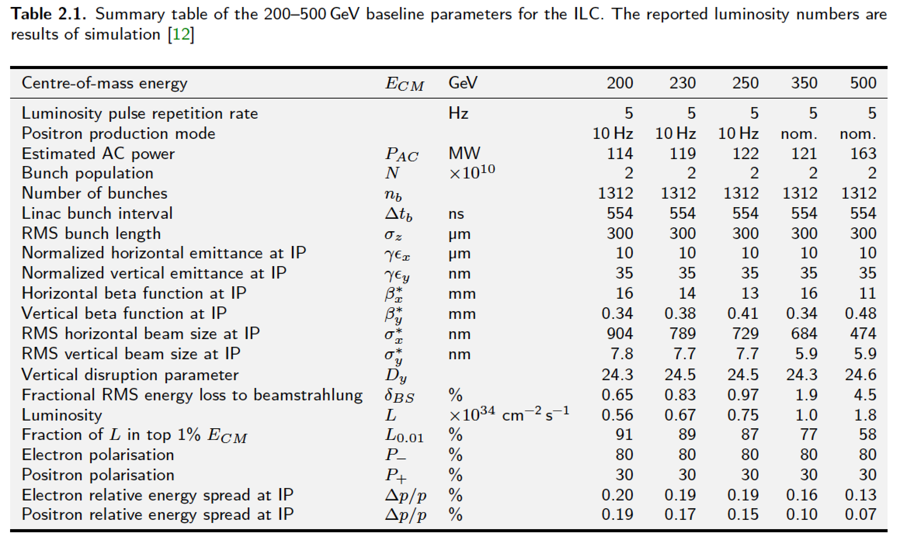
ILC parameters (TDR)
Upgradeable to 1 GeV – parameter sets also available

Slide 47
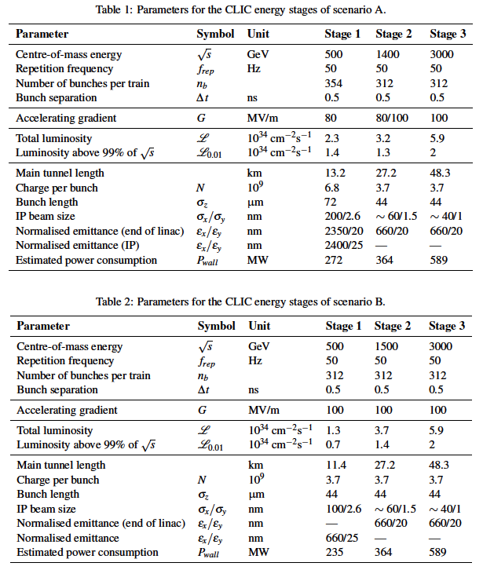
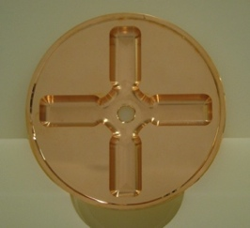
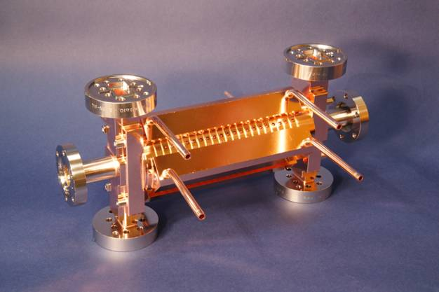
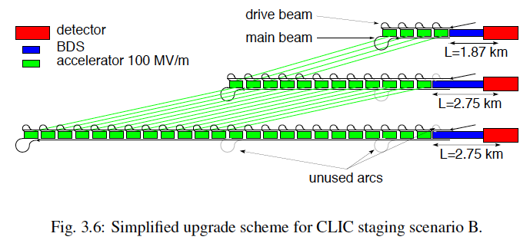
Possible CLIC stages studied in the CDR
Key features:
High gradient (energy/length)
Small beams (luminosity)
Repetition rates and bunch spacing (experimental conditions)
S. Stapnes

