Slide 1
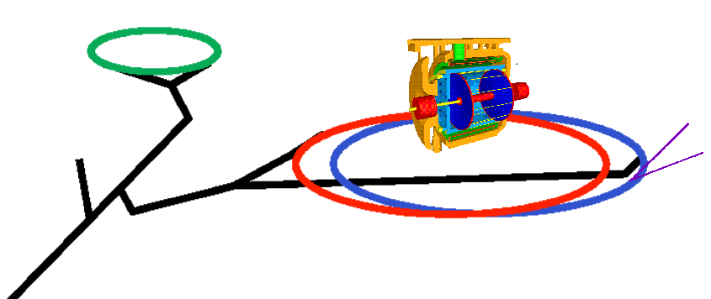
DAFNE Test Facility
Frank Zimmermann
INFN Frascati, 10 November 2014
many thanks to
Michael Benedikt, Manuela Boscolo, & Catia Milardi
Work supported by the European Commission under Capacities 7th Framework Programme, Grant Agreement 312453

Slide 2
proposal: Converting DAFNE to European/Int’l high-current beam & cw SRF Test Facility
(M. Benedikt)
1. qualifying multi-cell SC cavities for high current CW operation (truly unique facility!)
extremely relevant for all proposed future circular colliders, FCC-ee, FCC-hh, CepC, SppC, LHeC, HL-LHC, FCC-he, eRHIC, MEIC [+ also for ERLs, synchrotron light sources, etc.]
potentially huge group or partners and users
key issues: trapped modes, longitudinal & transverse impedance, fundamental power coupler, HOM losses,… cavity design optimization

Slide 3
Converting DAFNE to European/Int’l high-current beam & cw SRF Test Facility
2. demonstrating target SRF efficiency (wall plug to beam power)
another key issue for all future facilities
3. impedance & HOM effects for other accelerator components
qualification of vacuum chamber prototypes, collimators and masks, kickers, etc. for e and p colliders
qualification of novel beam diagnostics for e and p colliders

Slide 4
Converting DAFNE to European/Int’l high-current beam & cw SRF Test Facility
4. tests & demonstration of other essential, or proposed, concepts for future circular colliders
crab-waist collision scheme
novel pretzel –orbit wake field effects
SR effects on vacuum for ee and hh colliders
energy calibration methods (?)
mono-chromatization schemes (?)
e⁺ source studies, polarization issues ?
4-beam collisions? plasma b-b compensation? crystals?
some of these concepts might also strengthen DAFNE physics program

Slide 5
big question: can we use multi-cell SC cavities with A beam current? (Ross, Yokoya)
past operation of multi (4 or 5)-cell SC cavities at KEK, CERN, and DESY
maximum beam current:
TRISTAN: ~14.5 mA
LEP: ~8.5 mA
HERA: <100 mA
more modern higher-current (Ampere-scale) facilities
PEP-II: only normal conducting RF.
KEKB: mostly NC storage cavities & a few 1-cell SC cavities
present/past designs of multi-cell cavities for high current
BNL eRHIC for 0.6 to 1 A, DAFNE for > 1 A

Slide 6
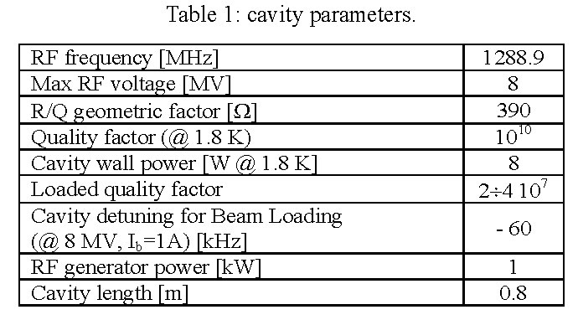
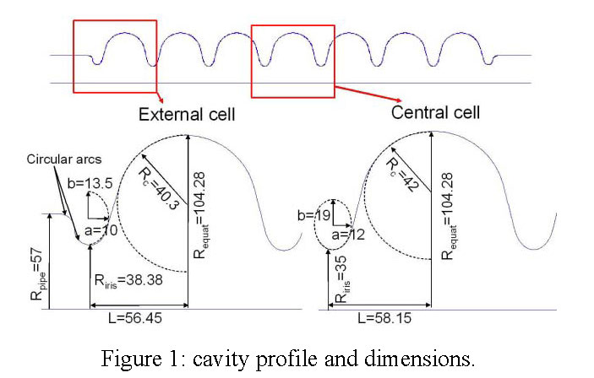
installing multi-cell SC cavities in DAFNE proposed earlier
(for another purpose) - so this could be done

Slide 7
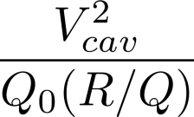
estimate of required cryo power
heat load per cavity =
maximum voltage per cavity (1 m) ~ 20 MV
Q₀ ~ 2x10¹⁰
R/Q ~400 – 1000 Ω (frequency dependent)
→ maximum dynamic heat load per cavity
~ 20 – 50 W at 2 K

Slide 8
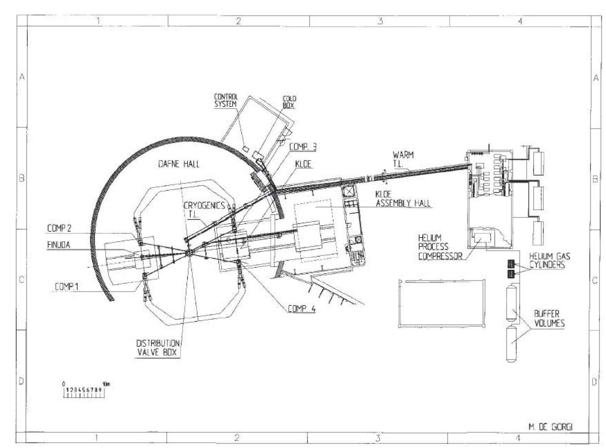
existing DAFNE cryogenic system
layout of DAFNE cryo system for 6 SC magnets
marginal for 4.4 K operation of 1 cavity ?
G.O. Delle Monache, DAFNE, CR-1 (2005)
refrigerator plant LINDE TCF 50
nominal compressor power of 250 kW, delivering two cold He lines:
• 4.4 K @ 3.0 bar (100 W nominal power + 1.14 g/s LHe);
• 77 K @ 10 bar (900 W nominal power).

Slide 9
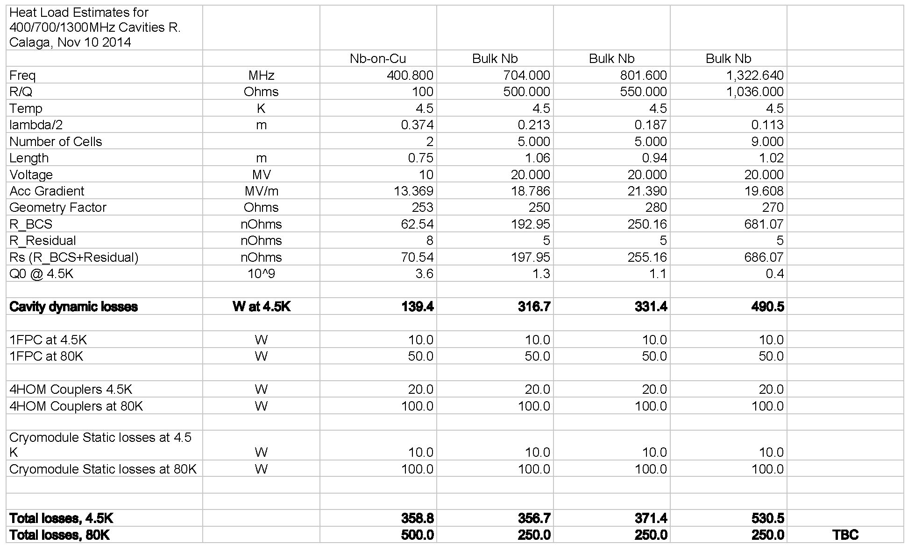
estimated heat load at 4.5 K
R. Calaga

Slide 10
beam currents around the world
 | beam current I [A] | bunch population N_{b} [10¹¹] | rms bunch length [mm] | bunch spacing [ns] | comment
PEP-II | 2.1 (e⁻), 3.2 (e⁺) | 0.5, 0.9 | 12 | 4.2 | terminated
KEKB | 1.2 (e⁻), 1.6 (e⁺) | 0.7, 0.5 | 7 | 6 | not available
DAFNE | 2.4 (e⁻), 1.4 (e⁺) | 0.4, 0.3 | 18 (flexibility?) | 2.7 | available?
BEPC-II | 0.8 | 0.4 | <15? | 8
CesrTA | 0.2 | 0.2 | 6.8 | 4
VEPP-2000 | 0.2 | 1 | 33 | 80 (1 b)
LHC (des) | 0.58 | 1.15 | 75.5 | 25
ESRF | 0.2 | 0.04 | 6.0 | 2.8
APS | 0.1 | 0.02 | 6.0 | 2.8
Spring8 | 0.1 | 0.01 | 4.0 | 2.0
SLS | 0.4 | 0.05 | 9.0 | 2.0

Slide 11
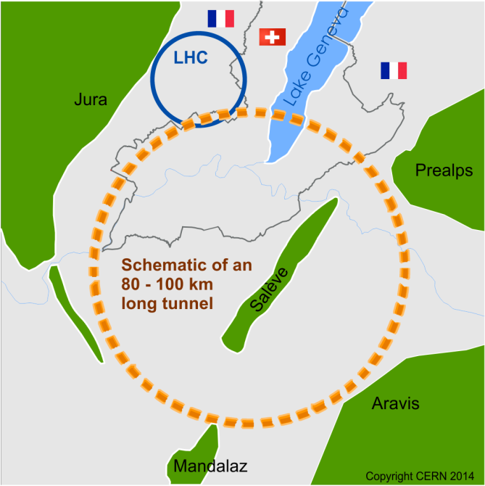
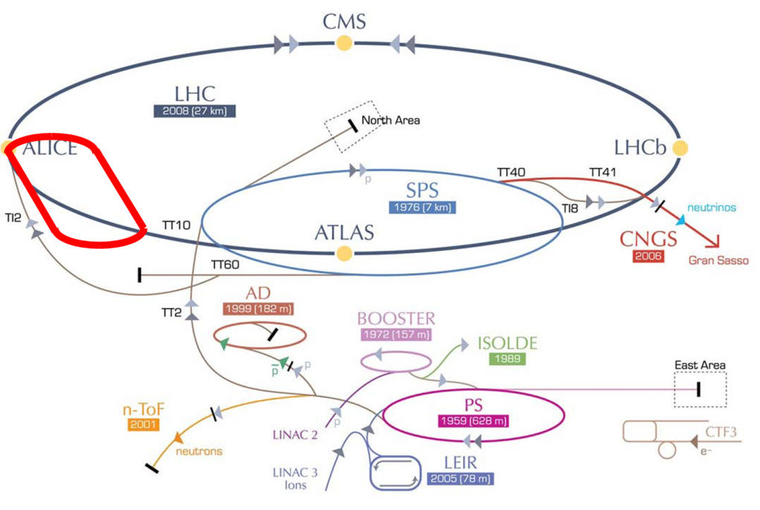
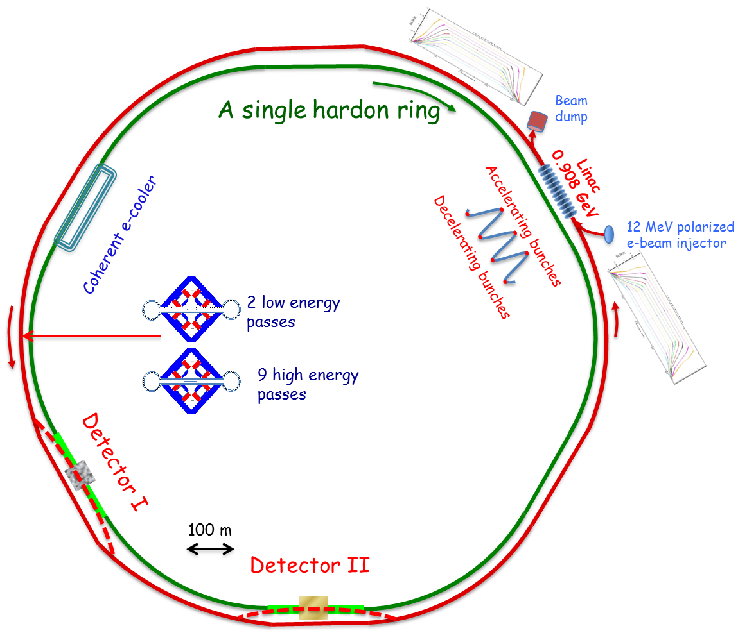
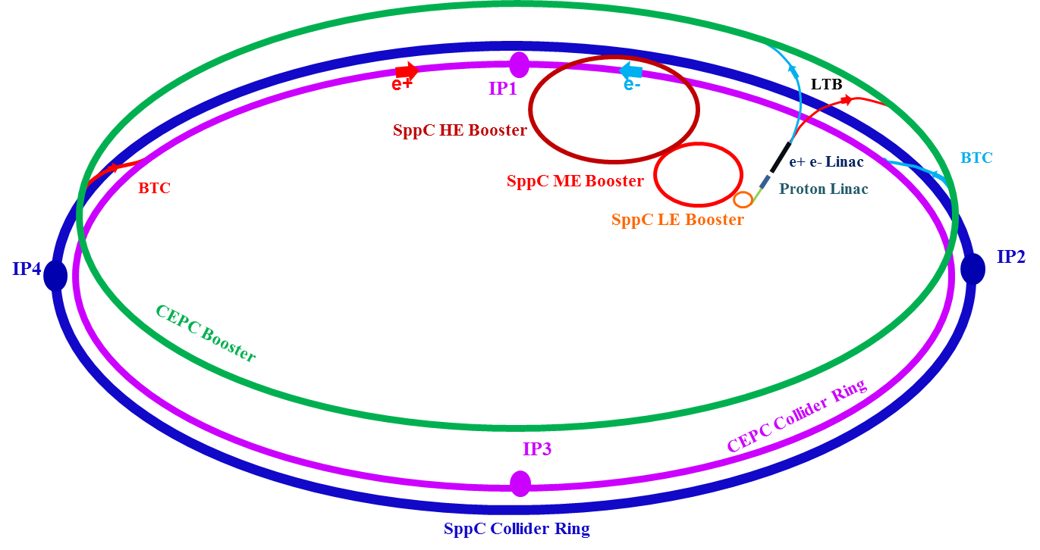
future circular colliders
HL-LHC
FCC
FCC-hh
FCC-ee
FCC-he
LHeC
eRHIC
CepC/SppC

Slide 12
future currents & beams
 | HL-LHC | FCC-ee (Z) | CepC (Z) | FCC-hh |  | SppC | LHeC | eRHIC
I [A] | 1.0 | 1.45 | ? | 0.5 |  | 1.0 | 0.15 | 0.4 | 1.1
N_{b} [10¹¹] | 2.2 | 1.8 | ? | 1 | 0.2 | 2.0 | 0.01 | 0.3 | 0.3
bunch spacing [ns] | 25 | 20 | ? | 25 | 5 | 25 | ~4 | ~10
rms bunch length [mm] | 75.5 | 2.6 | ? | 80 |  | ~80? | ≤1 | 50 | 4
f_{RF} [MHz] | 200 | 400 | 650 | 400? |  | 400 | 400 /800 | 28& 197 | 412
V_{RF} [GV] | 0.02 | 2.5[11] | [6.9] | ~0.03 |  | ~0.03 | 20 | ? | 0.9
pwr/cav [kW] |  | 180 | 260 |  |  |  |  |  | 400
input power per cavity ~several 100 kW (→ coupler R&D)

Slide 13
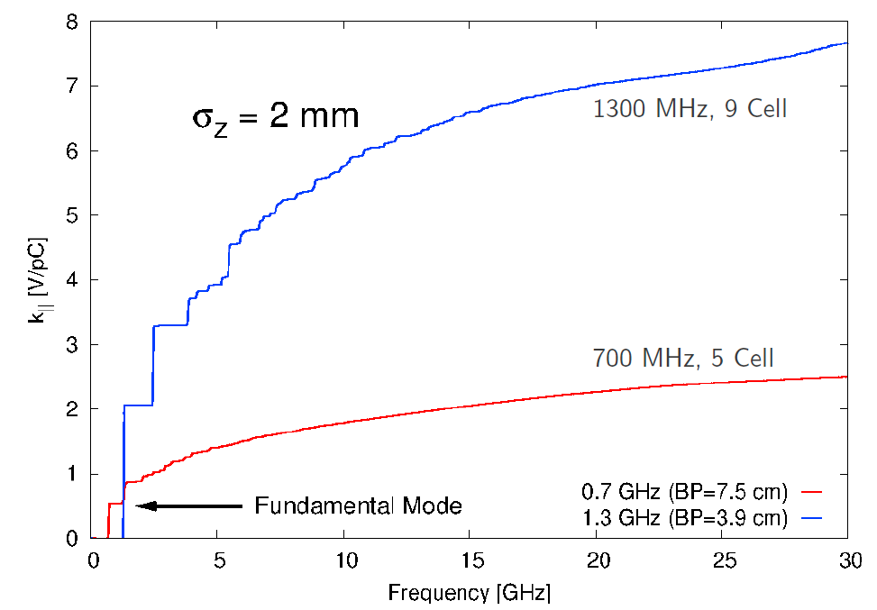
future HOM power levels
A. Butterworth
loss factor
R. Calaga
average P_{HOM} = k||.Q_{bunch}.I_{beam}
 | FCC-ee-Z | FCC-hh-H
Beam current [mA] | 48.6 | 10.8
Num. bunches | 160 | 24
Bunch charge [nC] | 41 | 60
HOM power (704 MHz cavities) [kW] | 110 | 0.6
HOM power (1.3 GHz cavities) [kW] | 342 | 1.8
k|| = 8.19 V/pC
k|| = 2.64 V/pC
project | Beam current [mA] | HOM power / cav [W]
CEBAF upgrade | 0.10 | 0.05
XFEL | 5 | 1
BerlinPRO | 100 | 150
eRHIC | 300 | 7,500
FCC-ee-Z | 1450 | 110,000
Challenge: HOM powers in the kW range to remove from the cavity at 2 K

Slide 14
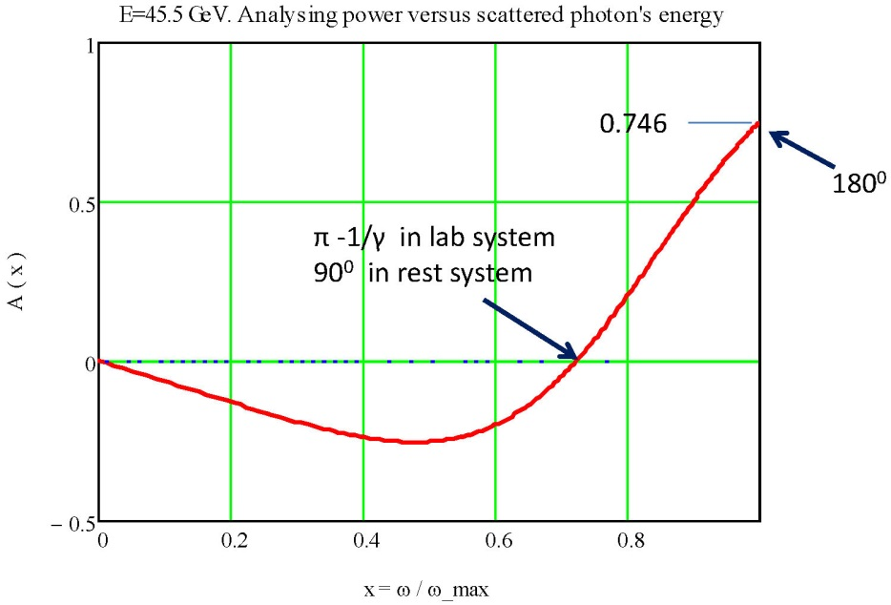
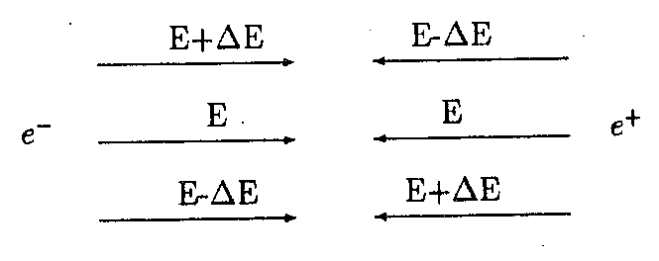
examples of other beam tests for future projects
orbit wake field effects
(A. Chao, Na Wang)
SR effects on vacuum for ee and pp colliders (R. Cimino et al.)
techniques & photon beam lines available:
IR for micro imaging and FTIR) spectroscopy
DXR2 (2–10 eV) for reflection, absorption, scatt., det. calibration
XUV-LEB (30–200 eV) for photoemission, PY, photon reflectivity
XUV-HEB (60–1000 eV) for photoemission and SR-XPS and PY
DXR1 (900–3100 eV) for soft X ray absorption spectroscopy
synergy with other proposals
energy calibration, e.g. by Compton scattering & selection
(A. Muchnoi)
monochromatization
(A. Faus-Golfe)
synergy with other proposals
synergy with other proposals?

Slide 15
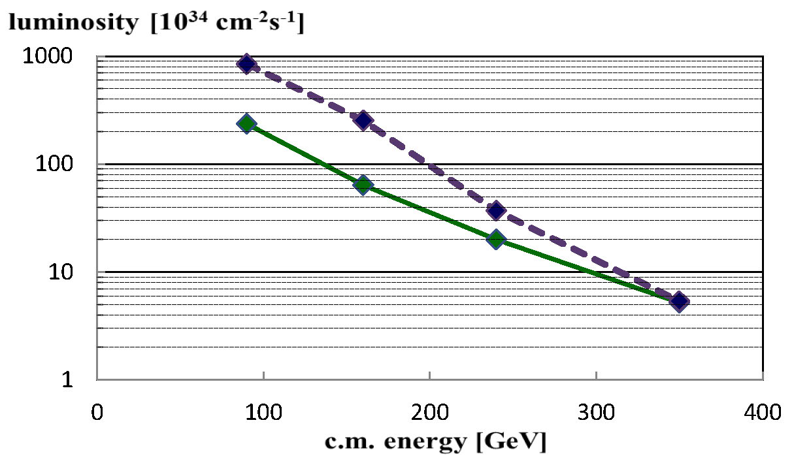
FCC-ee luminosity vs energy
principal concept proven at DAFNE!
crab waist & improved parameters
(Bogomyagkov, Levichev, Shatilov, 2014)
baseline
Z
W
H
$$t\overline{t}$$
benchmarking of off-momentum dynamic aperture?!

Slide 16
possible next steps
discussions with potentially interested partners,
in particular
Italian SRF community (C. Pagani, E. Palmieri, …)
CERN (DIR, RF group, HL-LHC, FCC, LHeC,
beam dynamics, vacuum)
BNL (I. Ben-Zvi, S. Belomestnykh),
JLAB, UK RF experts (e.g. from Daresbury, Sheffield)
BINP
CEA & CNRS
CepC/SppC SRF & beam dynamics groups, …
preparation of proposals for EU/H2020 funding,
e.g. as transnational access facility

Slide 17
summary
“… an SRF and high-current test facility [in Frascati] could nicely complement CERN’s SRF development program and could be also relevant for testing any high-current related effects (impedances, vacuum, beam heating, etc.) while making efficient use of an existing infrastructure and supporting in this case strongly the Italian accelerator community”
Michael Benedikt, FCC Study Leader,
10 November 2014

Slide 18
a few references

Slide 19
References for multi-cell cavities:
W. Xu et al, Progress on the High-Current 704 MHz Superconducting RF Cavity at BNL, IPAC’12
http://accelconf.web.cern.ch/AccelConf/IPAC2012/papers/weppc113.pdf
P. Jain, S.A. Belmonestnykh et al, “Development of a Fundamental Power Coupler for High-Current Superconducting RF Cavity,” IPAC’12, http://accelconf.web.cern.ch/AccelConf/IPAC2012/papers/weppc112.pdf
S. A. Belomestnykh et al,, “Superconducting RF Systems for eRHIC”, IPAC’12
http://accelconf.web.cern.ch/AccelConf/IPAC2012/papers/weppc112.pdf
In 2005 a 7-cell 1.3 GHz cavity was designed for DAFNE (~1 A beam currents) -
D. Alesini et al, Proc. PAC 2005, Knoxville, TPPT060

