Slide 1




LHC & Future High-Energy Frontier Circular Colliders
Frank Zimmermann, CERN/BE
CINVESTAV Merida
5 September 2013
thanks to R. Aleksan, R. Assmann, A. Blondel,
Y. Cai, O. Dominguez, J. Ellis, B. Holzer, P. Janot,
M. Koratzinos, H. Maury Cuna, S. Myers, K. Ohmi,
K. Oide, J. Osborne, L. Rossi, J. Seeman, V. Telnov,
R. Tomas, U. Wienands, K. Yokoya, M. Zanetti, …
Work supported by the European Commission under Capacities 7th Framework Programme, Grant Agreement 312453

Slide 2
outline
CERN
“accelerators”
LHC
history, 2010-12 run, next 10 years, HL-LHC
ep & γγ Higgs factories: LHeC & SAPPHiRE
in parallel to HL-LHC? preparing for future e⁺e⁻ H factory
high-energy hadron colliders: HE-LHC & VHE-LHC
sharing tunnel with leptons
circular e⁺e⁻ Higgs factory: TLEP
long-term strategy

Slide 3
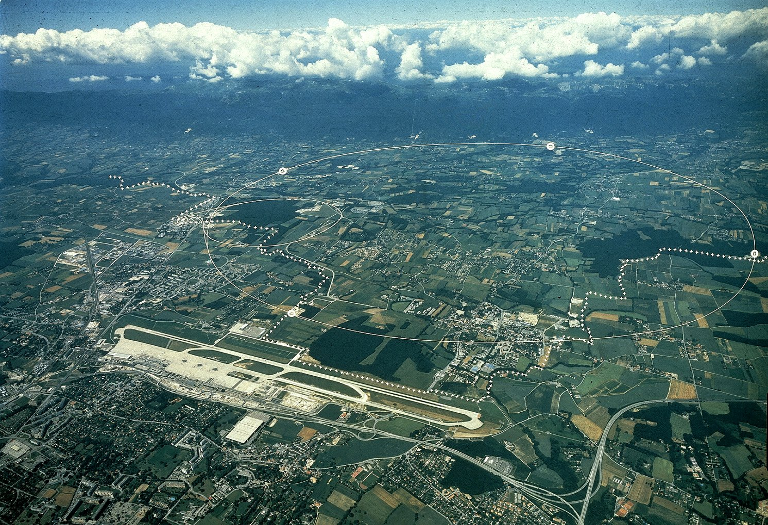
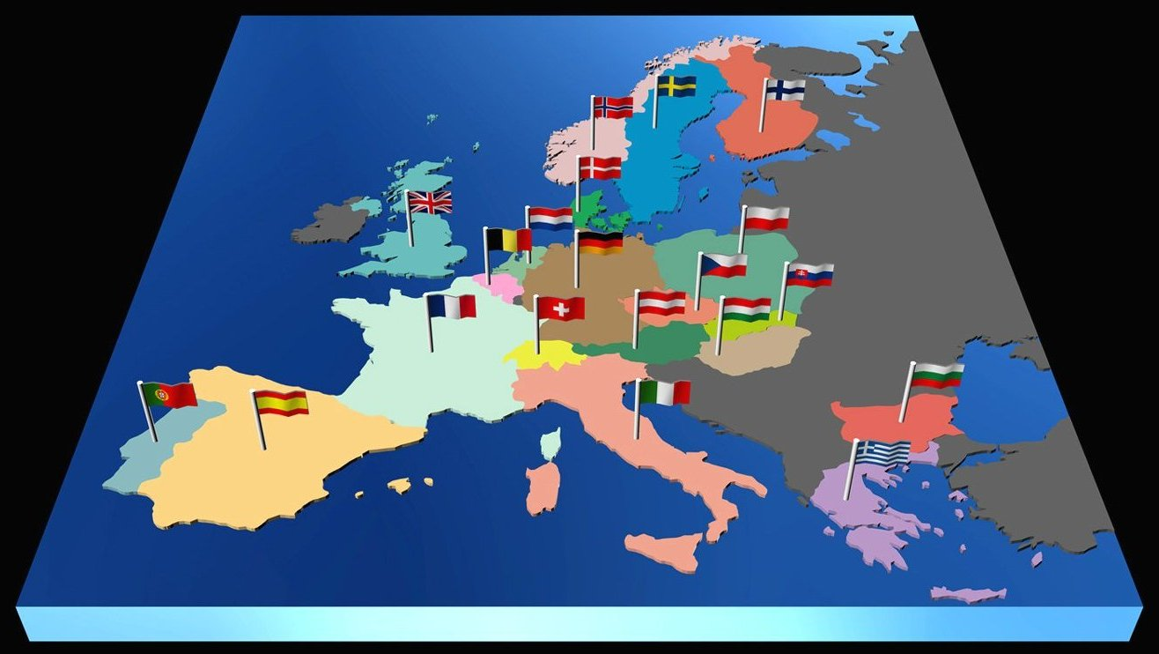

CERN – The World’s Largest Particle Physics Laboratory
LHC
ALICE
Meyrin
Prévessin
SPS
ATLAS
CMS
CPS
LHC-b
CERN was founded in 1954 with the aim of ‘Science for Peace’
It now has 20 member states – most of europe, with observers including USA and Russia
It employs ~2300 staff, with ~11’000 users, mainly from univiersities and institutes

Slide 4
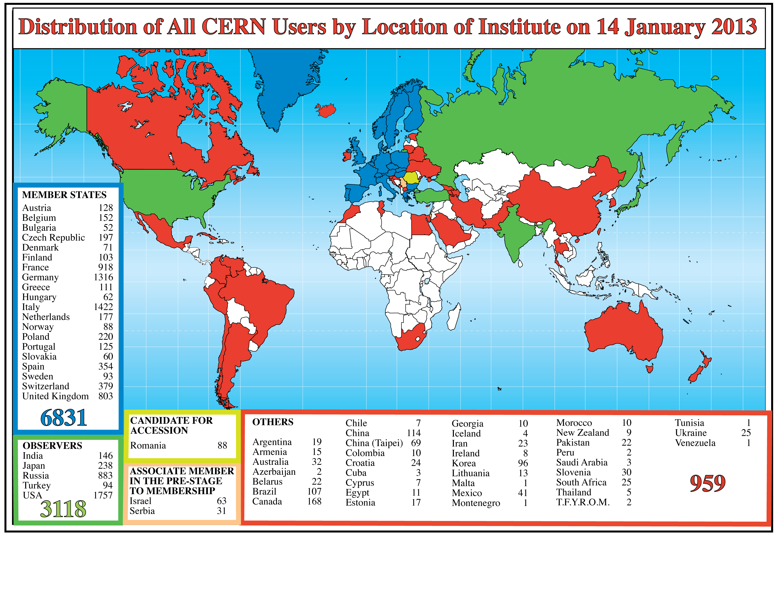
Science is getting more and more global
41
Notes:
4
4

Slide 5
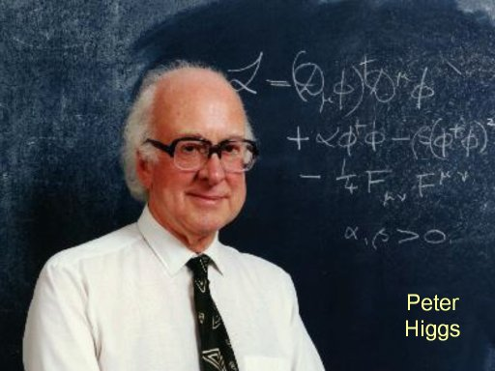
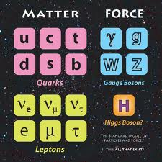
The ‘Standard Model’
We have a model, but it is (was) missing the Higgs Boson
But the Higgs Boson is very heavy, so to discover it, we need a very high energy accelerator

Slide 6
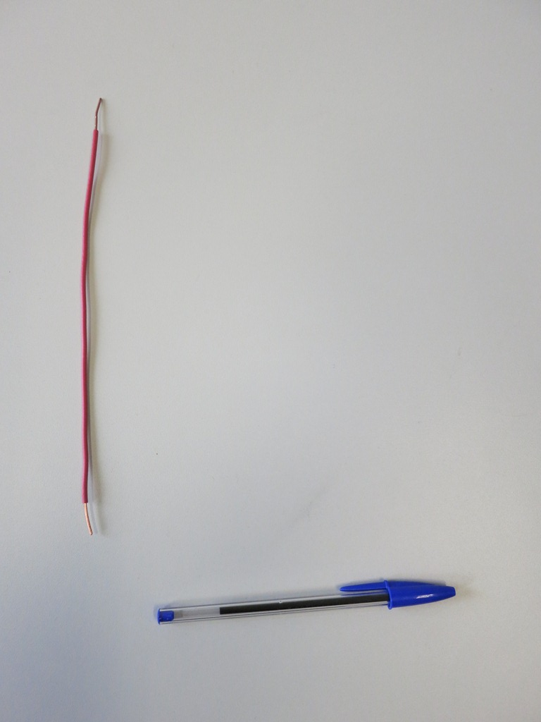
A standard household power cable will carry 13 Amps of electrical current
13 Amps at room temperature

Slide 7
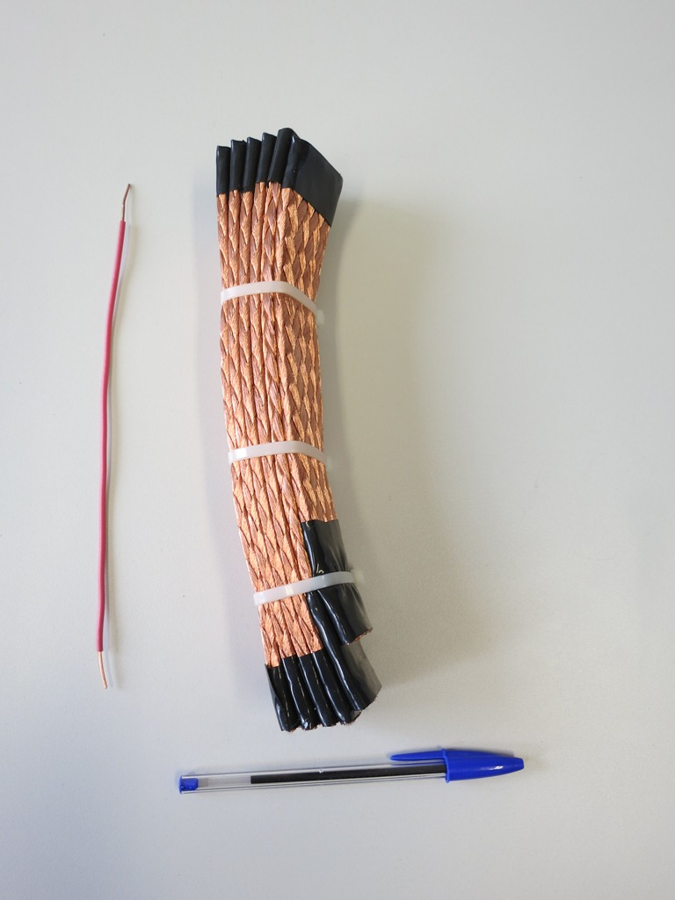
To make a magnet strong enough for the LHC in our existing tunnel, we needed 13’000 Amps of current
13’000 Amps at room temperature
13 Amps at room temperature

Slide 8
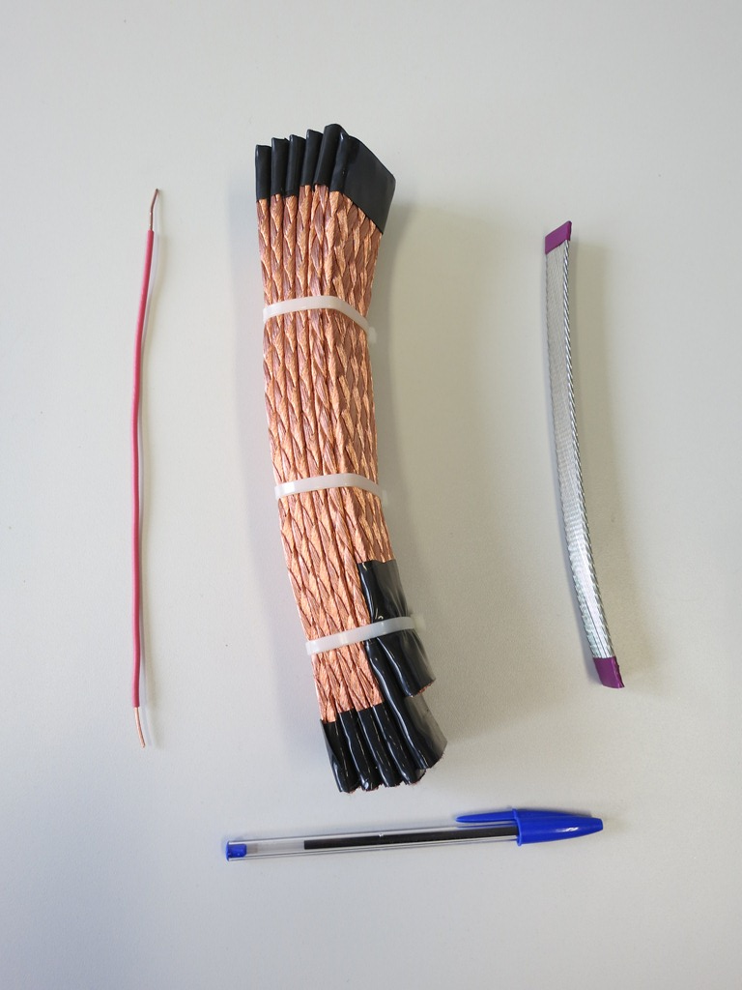
Making magnets from superconducting cable, operating at 2 Kelvin (-271 C) was the only way for the LHC
13’000 Amps at 2 Kelvin
13’000 Amps at room temperature
13 Amps at room temperature

Slide 9
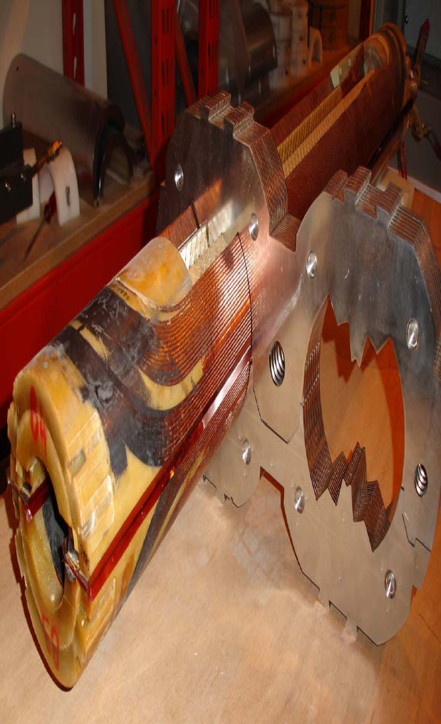
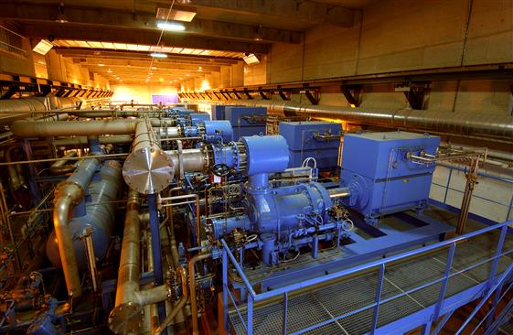
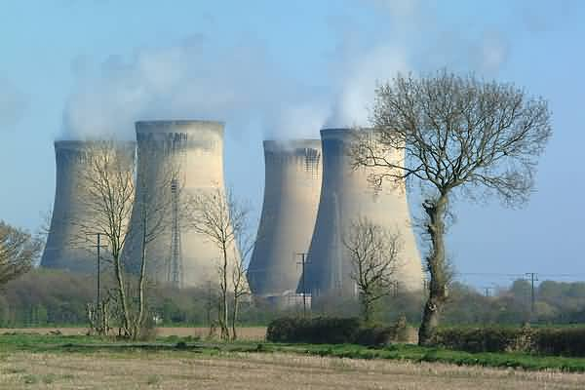
If it used resistive magnets operating at 1.8 T the circumference would have to be about 100 km, and the electrical consumption 900 MW (a good-sized power plant), this cost would be too high, both for the project and for the environment
The LHC has a circumference of 26.7 km, out of which some 20 km is main superconducting magnets providing 8.3 Tesla dipole field. Maintaining this field uses virtually no electrical power.
However, the LHC is not completely free… the cryogenics plant to cool the ~700 m³ of liquid helium needed to keep the magnets at 2 Kelvin will consume about 40 MW electrical power from the mains.

Slide 10
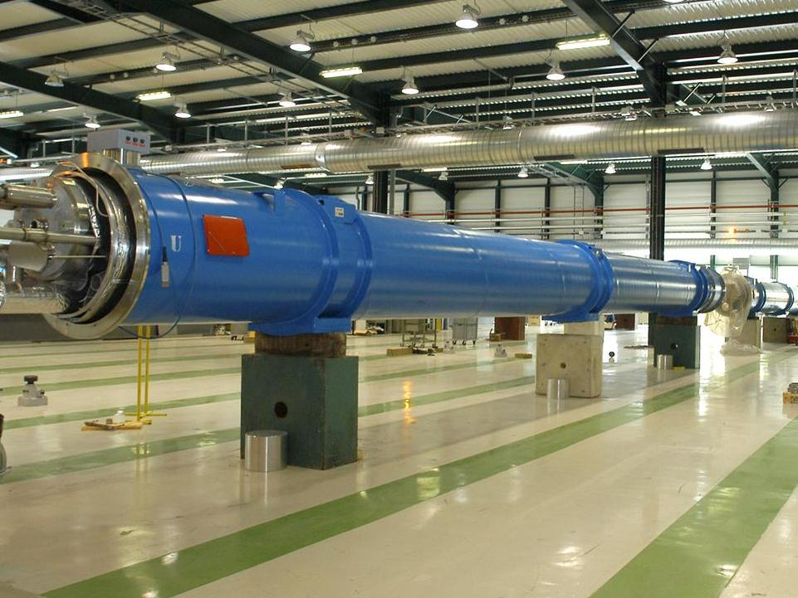

Slide 11
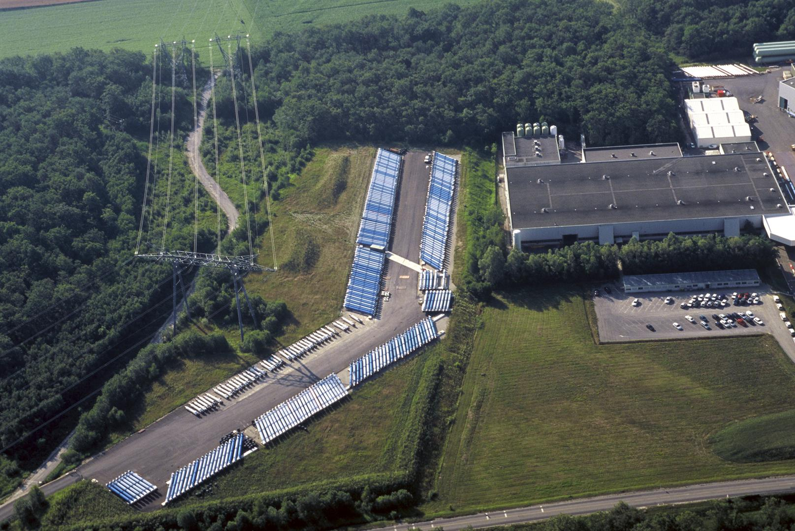

Slide 12
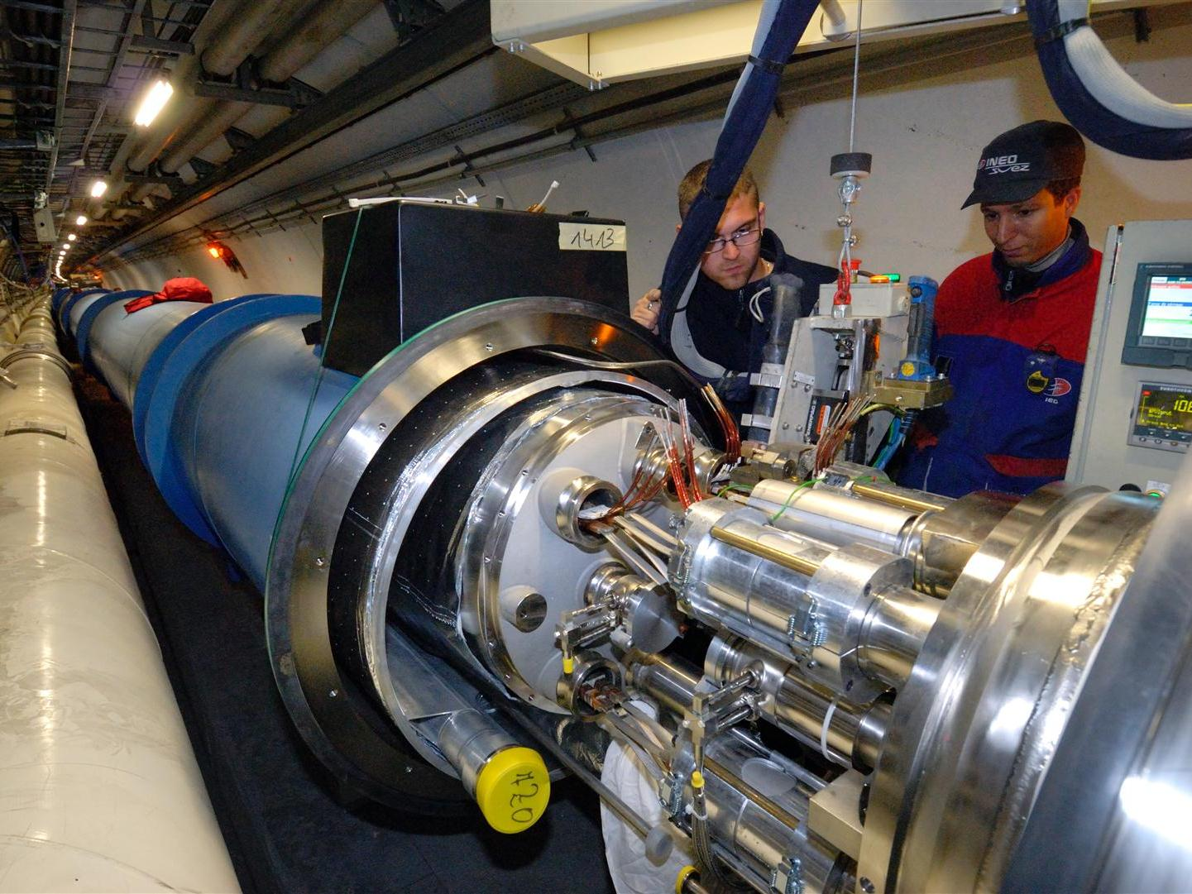
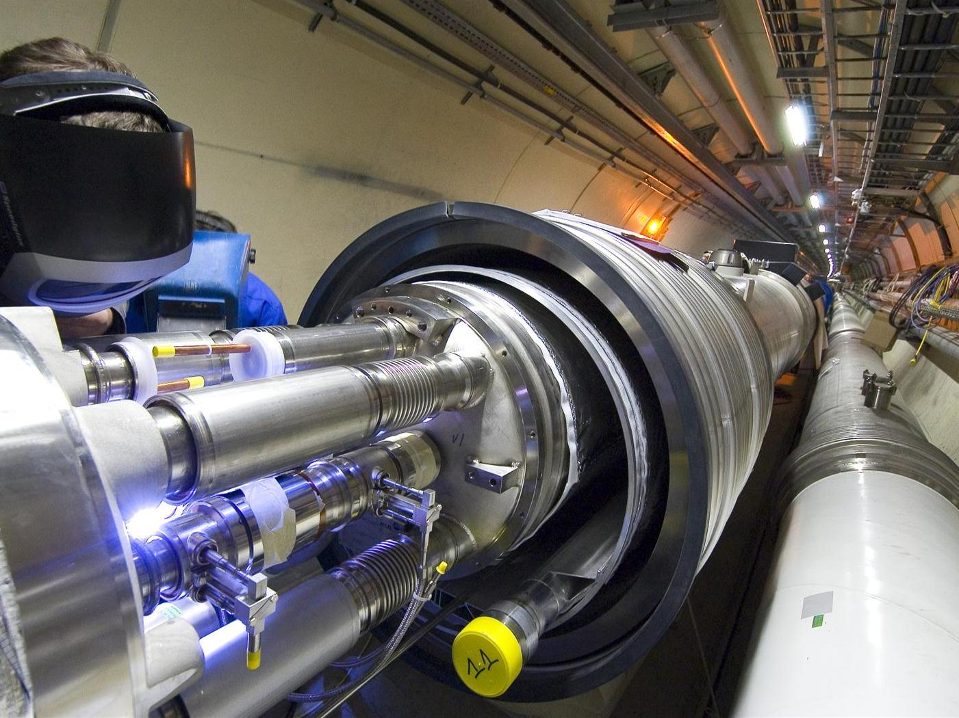

Slide 13
colliding beams
centre-of-mass energy:
beam hits
a “fixed target”
two beams collide
colliding two beams against each other can provide
much higher centre-of-mass energies than fixed target!

Slide 14
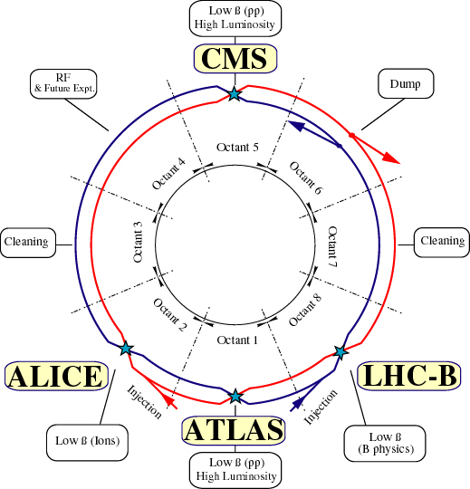
LHC: highest energy pp, AA, and pA collider
design parameters
c.m. energy = 14 TeV (p)
luminosity =10³⁴ cm⁻²s⁻¹
1.15x10¹¹ p/bunch
2808 bunches/beam
360 MJ/beam
γε=3.75 μm
β*=0.55 m
θ_{c}=285 μrad
σ_{z}=7.55 cm
σ*=16.6μm

Slide 15
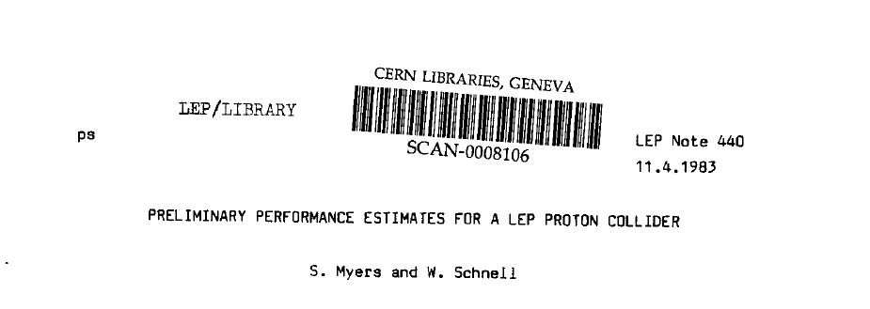
short LHC history
1983 LEP Note 440 - S. Myers and W. Schnell propose
twin-ring pp collider in LEP tunnel with 9-T dipoles
1991 CERN Council: LHC approval in principle
1992 EoI, LoI of experiments
1993 SSC termination
1994 CERN Council: LHC approval
1995-98 cooperation w.Japan,India,Russia,Canada,&US
2000 LEP completion
2006 last s.c. dipole delivered
2008 first beam
2010 first collisions at 3.5 TeV beam energy
2015 collisions at ~design energy (plan)
>30 years!
now is the time to plan for ~2040

Slide 16
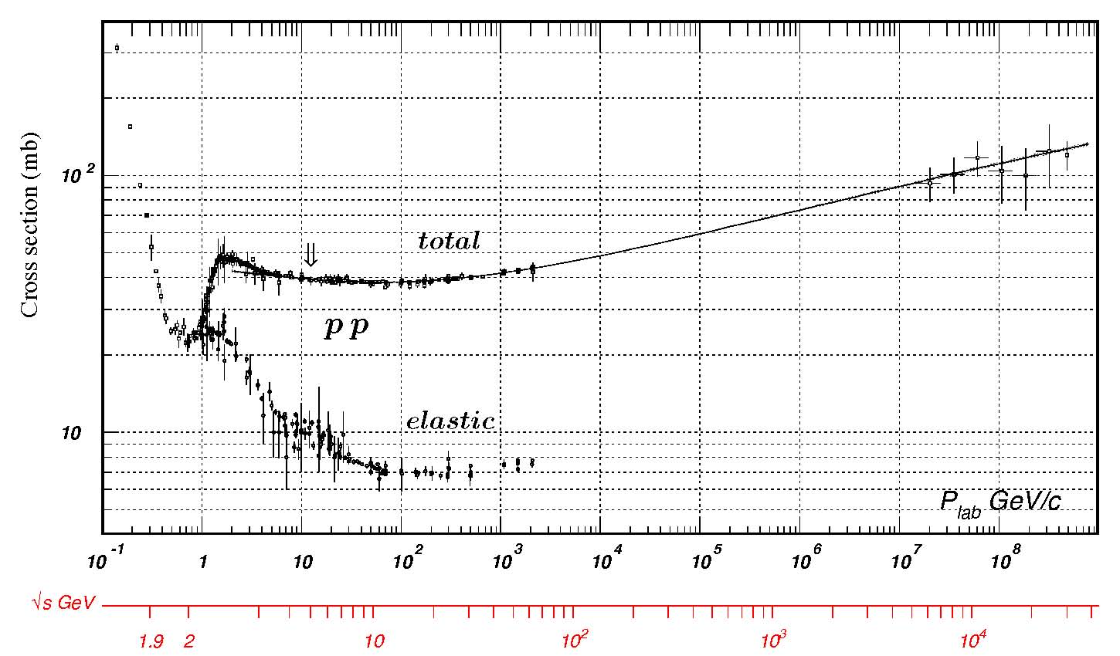
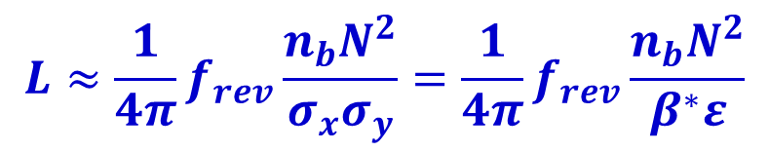
luminosity
R= σ L
luminosity
reaction rate
cross section
$$L≈\frac{1}{4π}f_{rev}\frac{n_{b}N_{}^{2}}{σ_{x}σ_{y}}=\frac{1}{4π}f_{rev}\frac{n_{b}N_{}^{2}}{β^{∗}ε}$$
C. Amsler et al., Physics Letters B667, 1 (2008)
_{tot}∼
100 mbarn
~ 10⁻²⁵ cm²
from
cosmic rays
_{inelastic}∼
80 mbarn~
8x10⁻²⁶ cm²
LHC

Slide 17
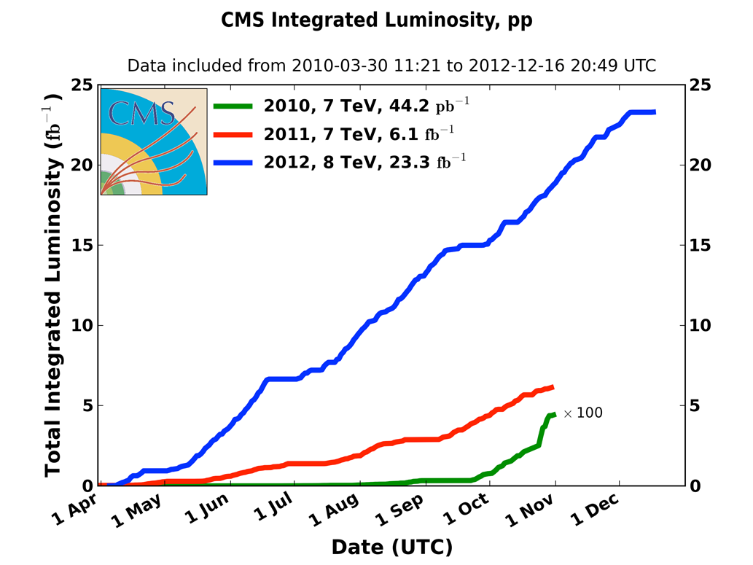
integrated pp luminosity 2010-12
2010: 0.04 fb⁻¹
  7 TeV CoM
  Commissioning
2011: 6.1 fb⁻¹
  7 TeV CoM
  Exploring the limits
2012: 23.3 fb⁻¹
  8 TeV CoM
  Production
M. Lamont, IPAC’13

Slide 18
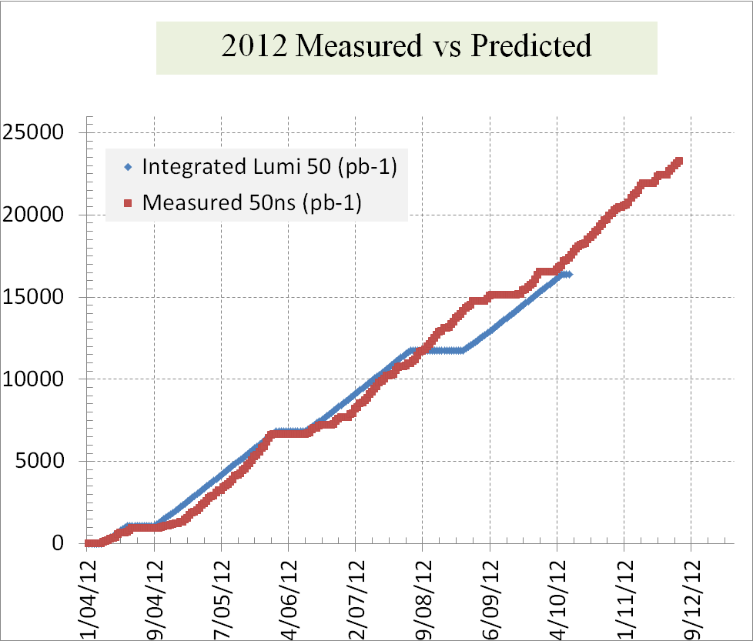
reliable luminosity forecasts

Slide 19
peak performance through the years
 | 2010 | 2011 | 2012 | Nominal
bunch spacing [ns] | 150 | 50 | 50 | 25
no. of bunches n_{b} | 368 | 1380 | 1380 | 2808
β* [m] ATLAS and CMS | 3.5 | 1.0 | 0.6 | 0.55
max. bunch intensity N [protons/bunch] | 1.2 x 10¹¹ | 1.45 x 10¹¹ | 1.7 x 10¹¹ | 1.15 x 10¹¹
normalized emittance γε [mm-mrad] | ~2.0 | ~2.4 | ~2.5 | 3.75
peak luminosity L [cm⁻²s⁻¹] | 2.1 x 10³² | 3.7 x 10³³ | 7.7 x 10³³ | 1.0 x 10³⁴
>2x design when scaled to 7 TeV
M. Lamont, IPAC’13

Slide 20
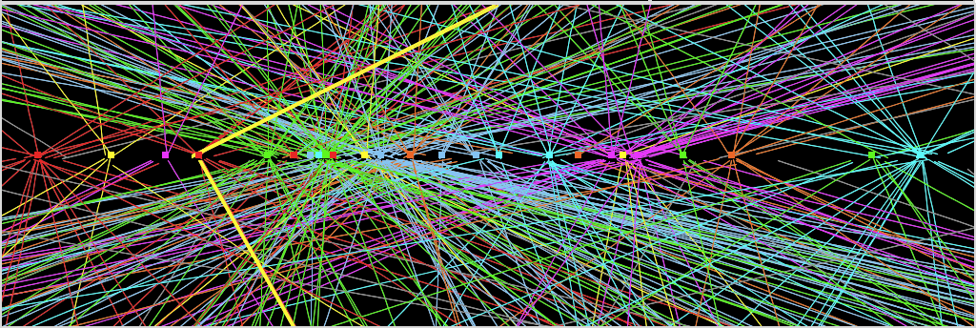
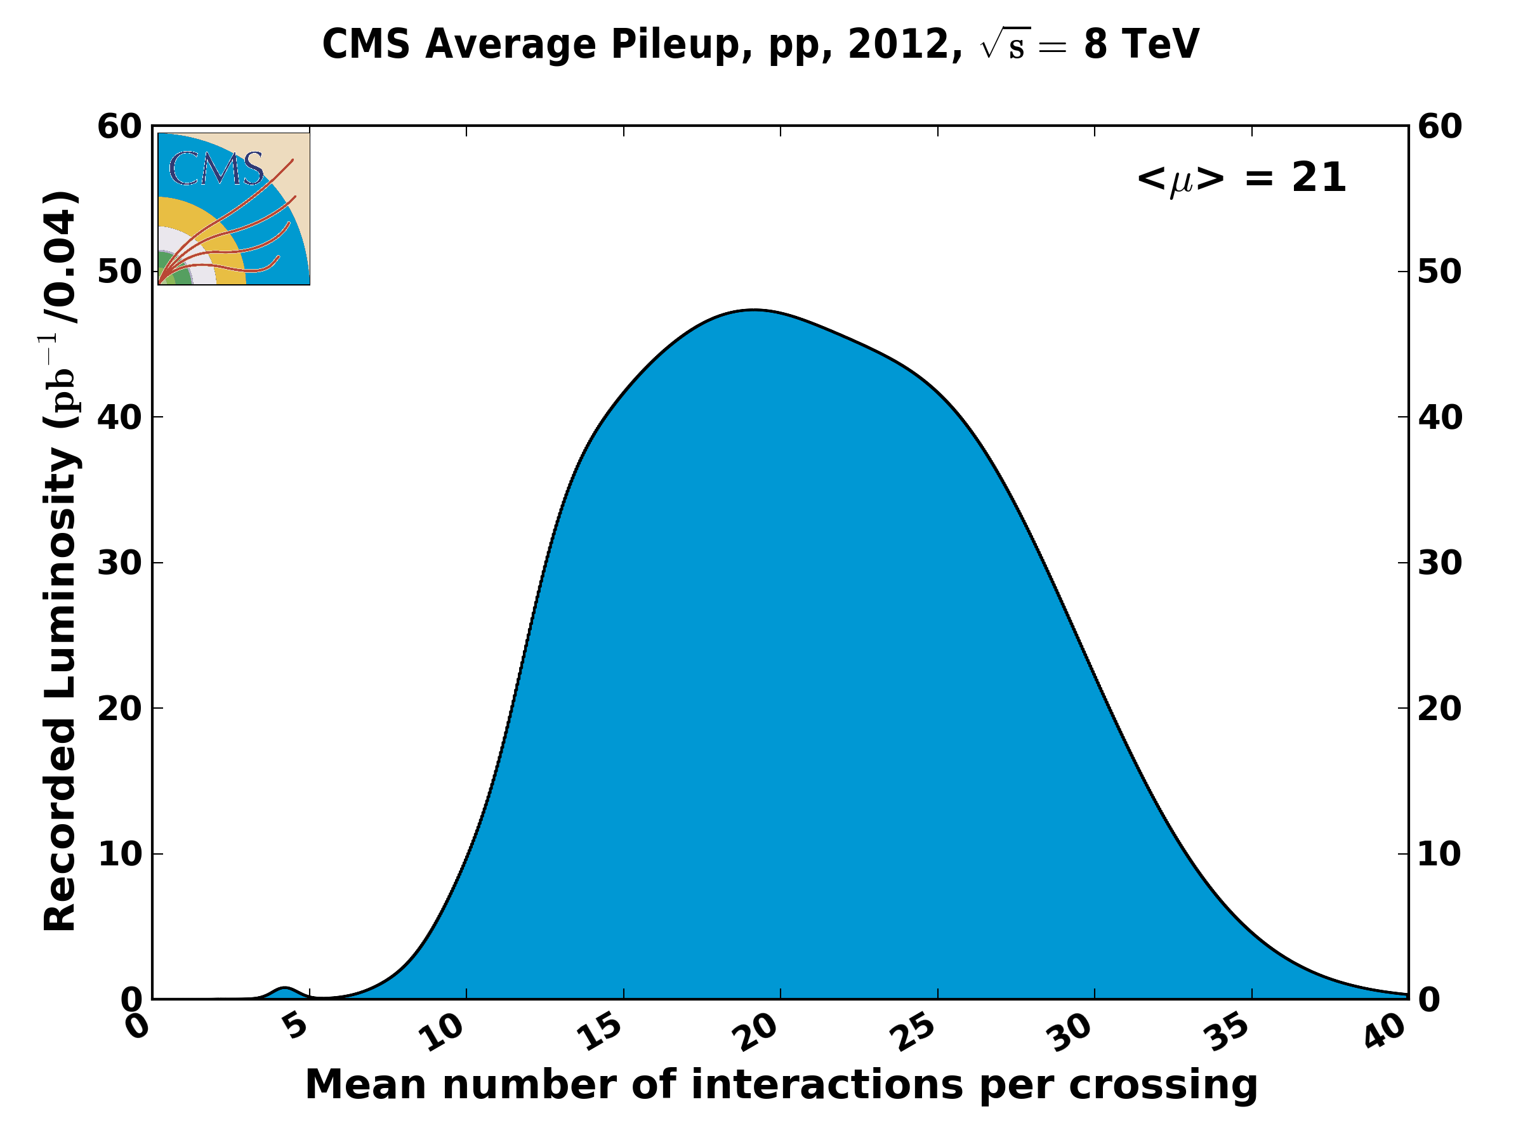
Z→ μμ event from 2012 data with 25 reconstructed vertices
event pile up
Huge efforts over last months to prepare for high lumi and pile-up expected in 2012:
optimized trigger and offline algorithms (tracking, calo noise treatment, physics objects)
→ mitigate impact of pile-up on CPU, rates, efficiency, identification, resolution
in spite of x2 larger CPU/event and event size → we do not request additional computing
resources (optimized computing model, increased fraction of fast simulation, etc.)
Z→ μμ
20
pile up
will increase
at higher energy
→
experiments
request
25 ns
operation
in 2015
M. Lamont, IPAC’13

Slide 21

ATLAS & CMS pp physics

Slide 22
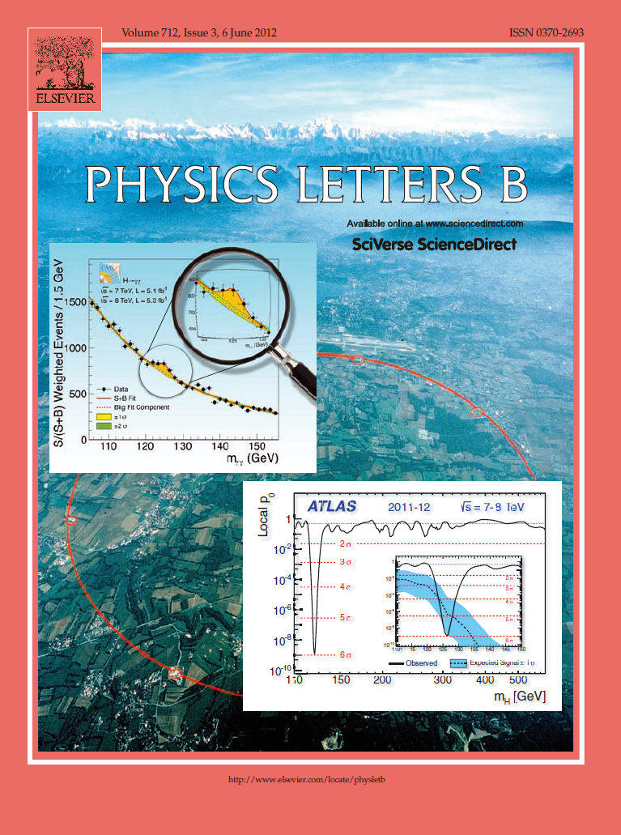

The highlight of a remarkable year 2012

Slide 23
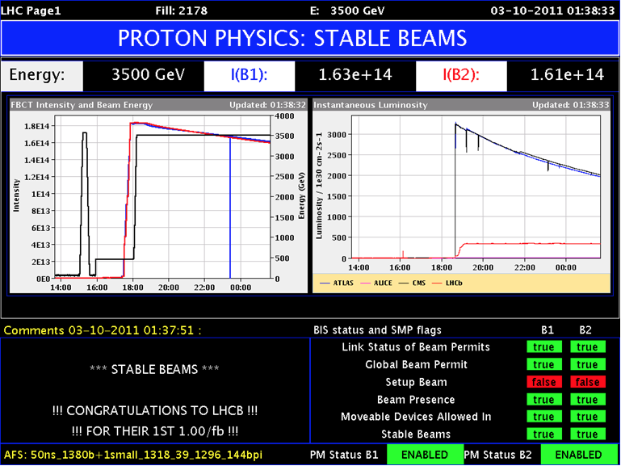
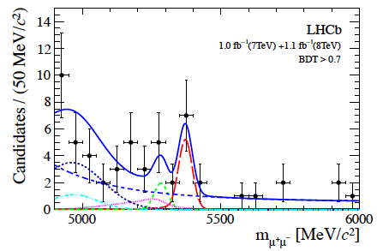
LHCb
luminosity levelling
at around 4e32 cm⁻²s⁻¹ via transverse separation
ATLAS/CMS
beam 1
beam 2
LHCb
first evidence for the decay B_{s} -> μ⁺ μ⁻
M. Lamont, IPAC’13

Slide 24
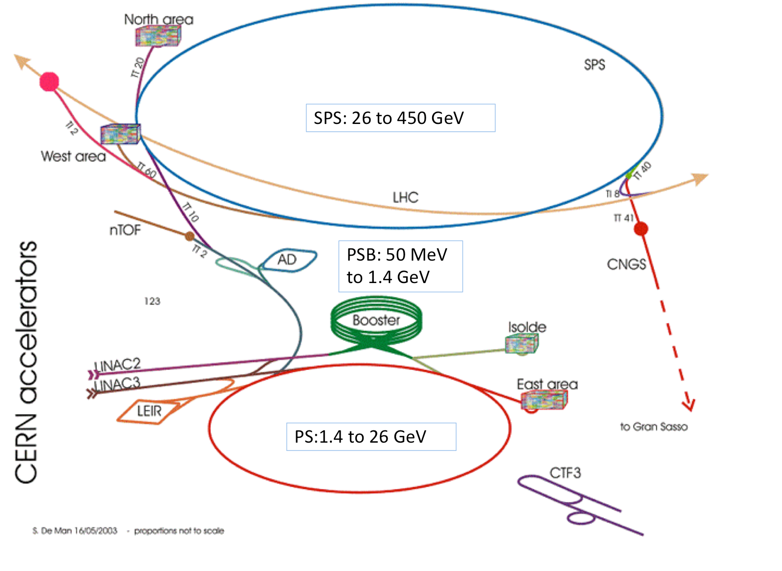
LHC injector complex
M. Lamont
LHC also provides Pb-Pb (2011) and Pb-p collisions (2013)

Slide 25
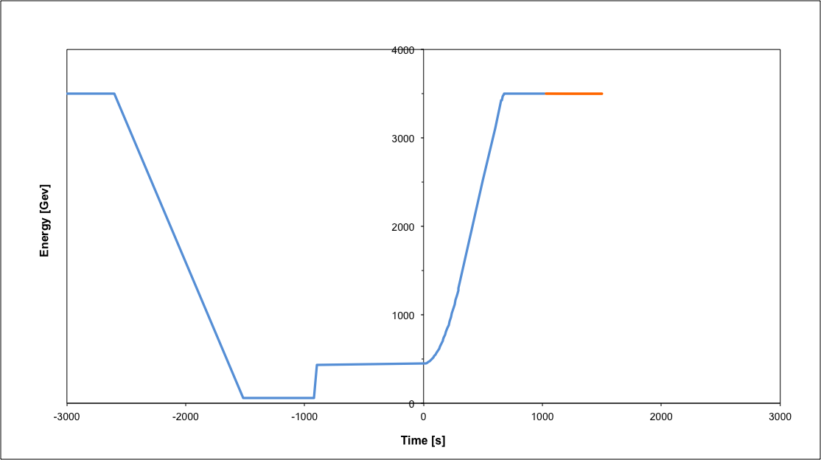
operational cycle
Beam dump
Squeeze
Stable beams
Collide
Ramp
Ramp down/precycle
Ramp down | 35 mins
Injection | ~30 mins
Ramp | 12 mins
Squeeze | 15 mins
Collide | 5 mins
Stable beams | 0 – 30 hours
Injection
turn around 2 to 3 hours on a good day
M. Lamont, IPAC’13

Slide 26
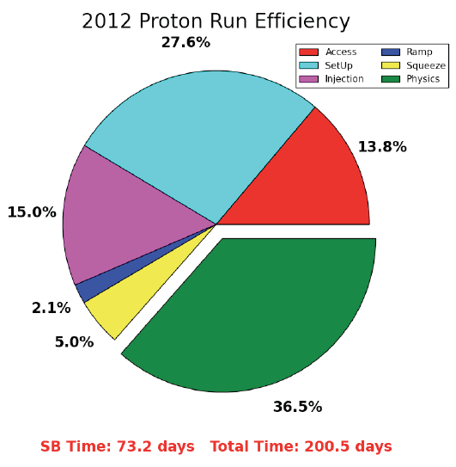
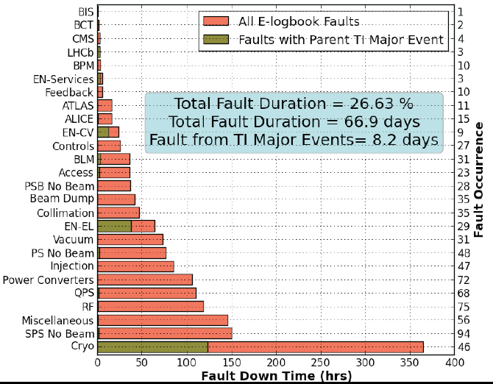
availability
“There are a lot of things that can go wrong – it’s always a battle”
Pretty good availability considering the complexity and principles of operation
Cryogenics availability in 2012: 93.7%
M. Lamont, IPAC’13

Slide 27
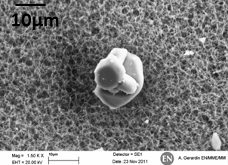
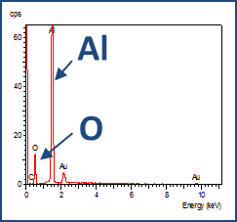
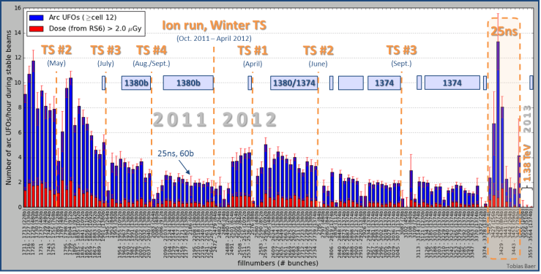
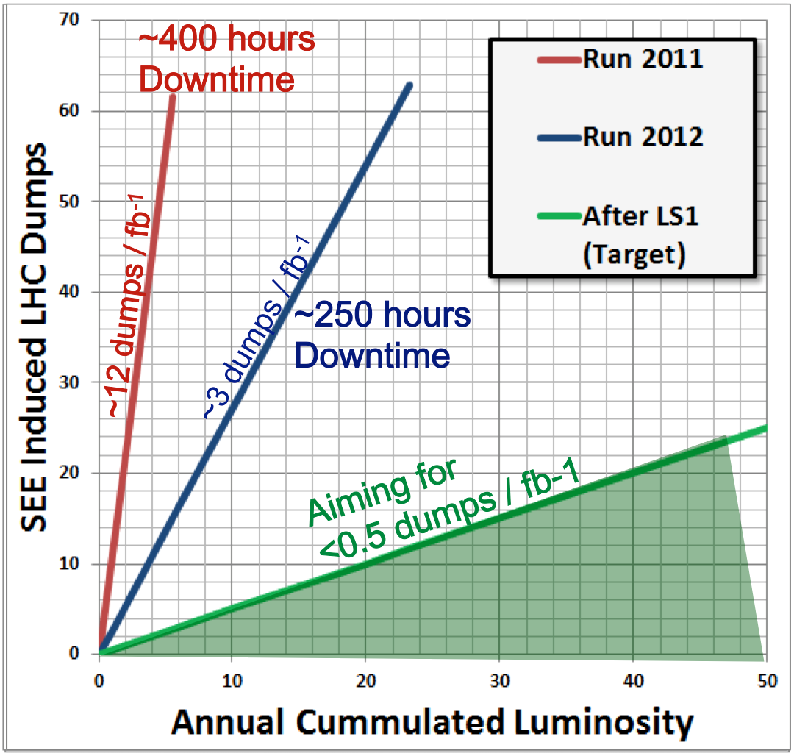
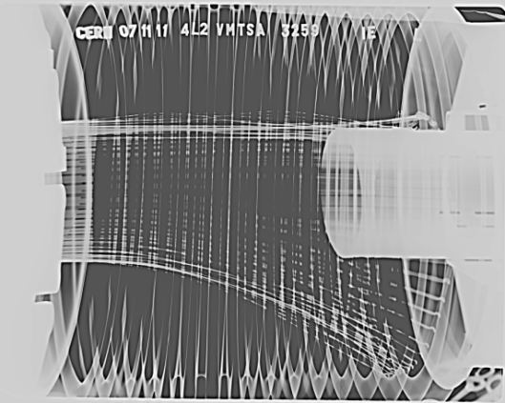
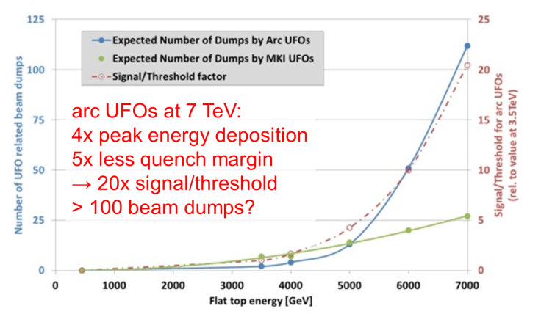
some issues in 2011-12 operation
Beam induced heating
Local non-conformities (design, installation)
  injection protection devices
  sync. Light mirrors
  vacuum assemblies
UFOs
20 dumps in 2012
time scale 50-200 µs
conditioning observed
worry about 6.5 TeV and 25 ns spacing
Radiation to electronics
“single event upsets”
concerted program of mitigation measures (shielding, relocation…)
premature dump rate down from 12/fb⁻¹ in 2011 to 3/fb⁻¹ in 2012
T. Baer

Slide 28
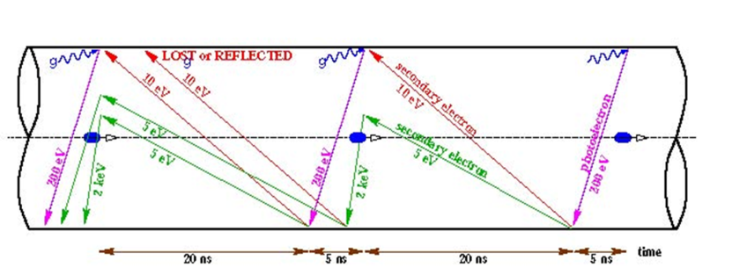
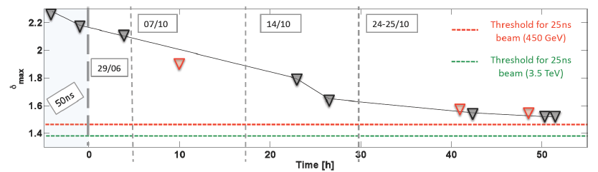
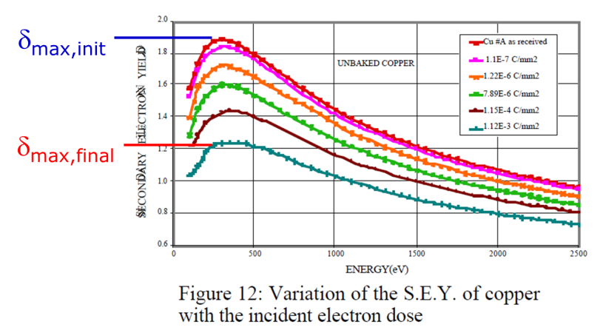
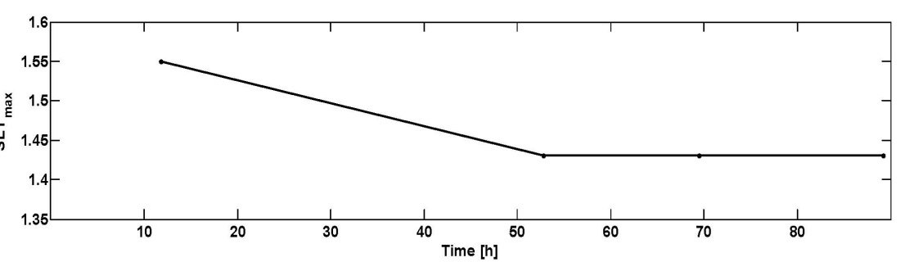
another big issue : electron cloud
H. Maury Cuna
beam induced multipactoring process, depending on secondary emission yield
LHC strategy based on surface conditioning (scrubbing runs)
worry about 25 ns (more conditioning needed) and 6.5 TeV (photoelectrons)
25-ns scrubbing in 2011 – decrease of SEY
25-ns scrubbing in 2012 – conditioning stop?
G. Iadarola, H. Maury, G. Rumolo

Slide 29
Long Shutdown 1 - motivation
after 2008 incident partial consolidation
& problem of imperfect Cu
stabilizer continuity
in 2010-12 LHC operated at 7 & 8 TeV c.m.
beam energy to avoid any risk
presently: Long Shutdown 1 (LS1) ~2 yr
to prepare LHC for 13-14 TeV c.m.,
detector upgrades in parallel

Slide 30
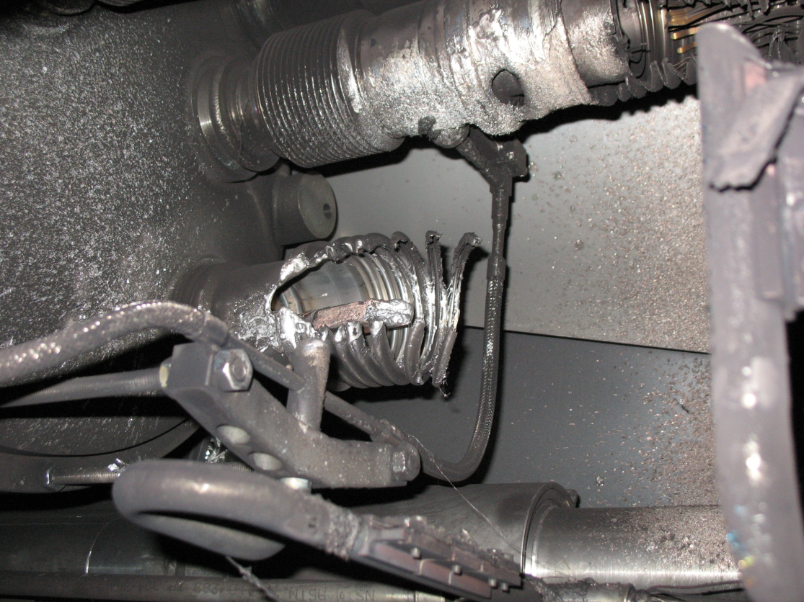
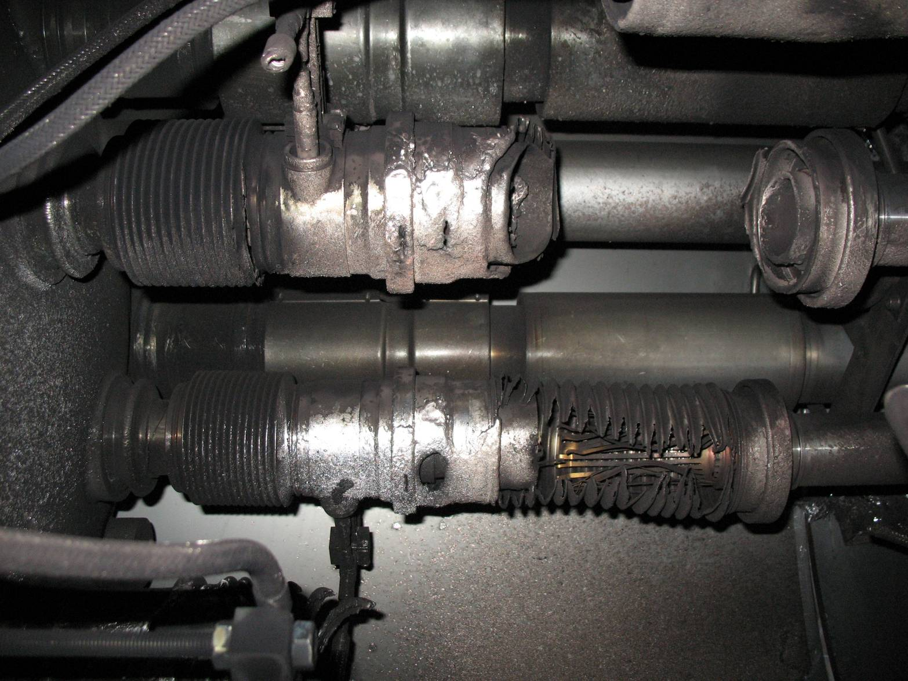
2008 “incident”
A faulty bus-bar (SC splice) in a magnet interconnect failed, leading to an electric arc which dissipated some 275 MJ
This burnt through beam vacuum and cryogenic lines, rapidly releasing ~2 tons of liquid helium into the vacuum enclosure
R. Veness

Slide 31
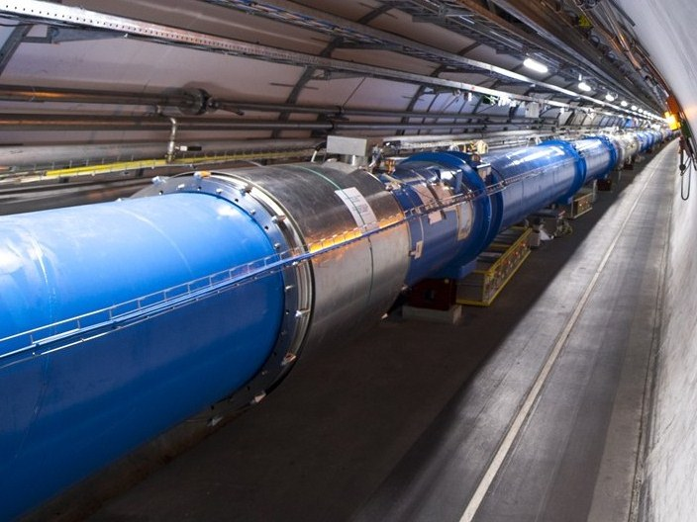
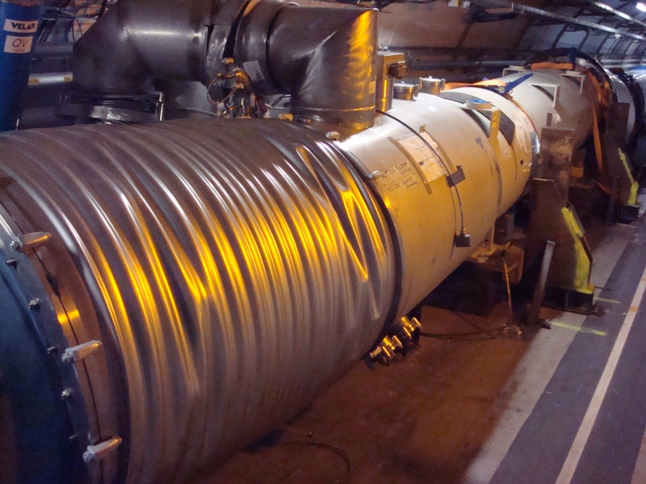

Slide 32
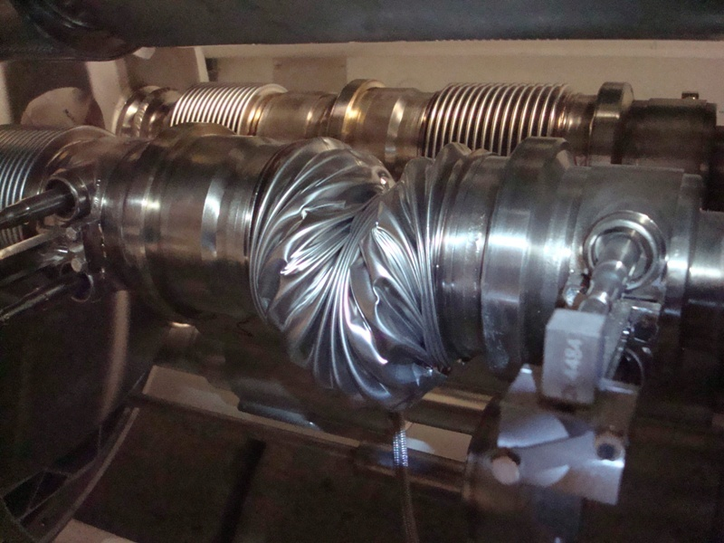

Slide 33
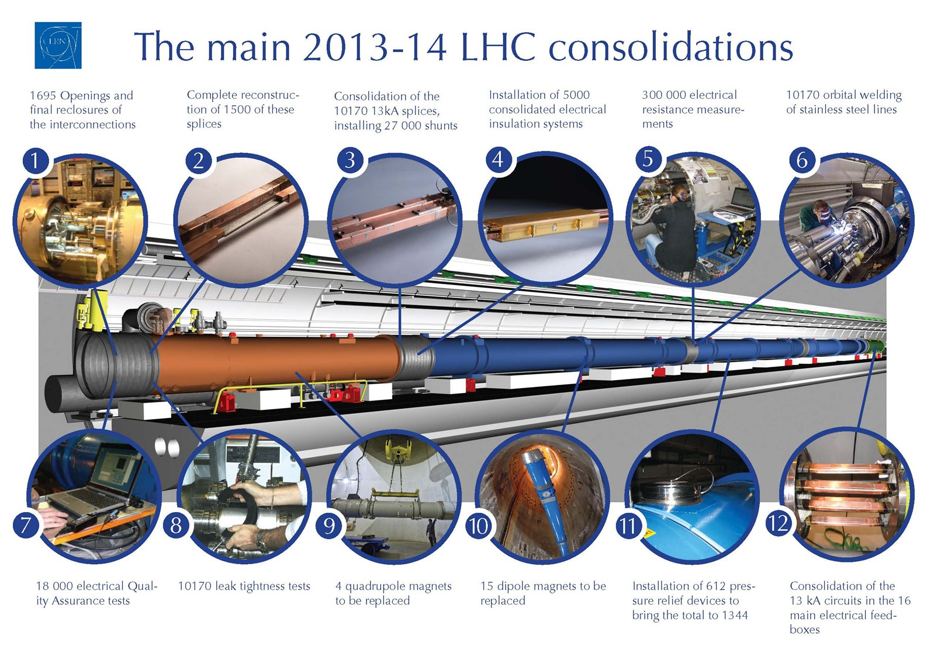

Slide 34
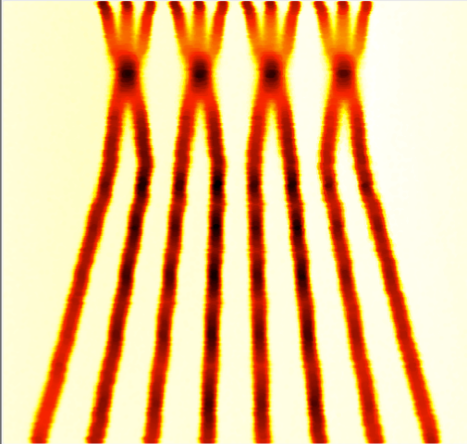
2015 – post LS1
energy: 6.5 TeV (magnet retraining)
bunch spacing: 25 ns
  pile-up considerations
injectors potentially able to offer nominal intensity with even lower emittance
BCMS = Batch Compression and Merging and Splitting
 | Number of bunches | Ib LHC FT[1e11] | Emit LHC [um] | Peak Lumi [cm-²s⁻¹] | ~Pile-up | Int. Lumi per year [fb⁻¹]
25 ns low emit | 2520 | 1.15 | 1.9 | 1.7e34 | 52 | ~45
expected maximum luminosity
from inner triplet heat load
(collisions debris) 1.7×10 ³⁴ cm⁻²s⁻¹ ±20%

Slide 35
uncertainties for 2015:
electron cloud
UFOs
both get more difficult at 25 ns &
at higher energy
energy (limited by retraining)

Slide 36
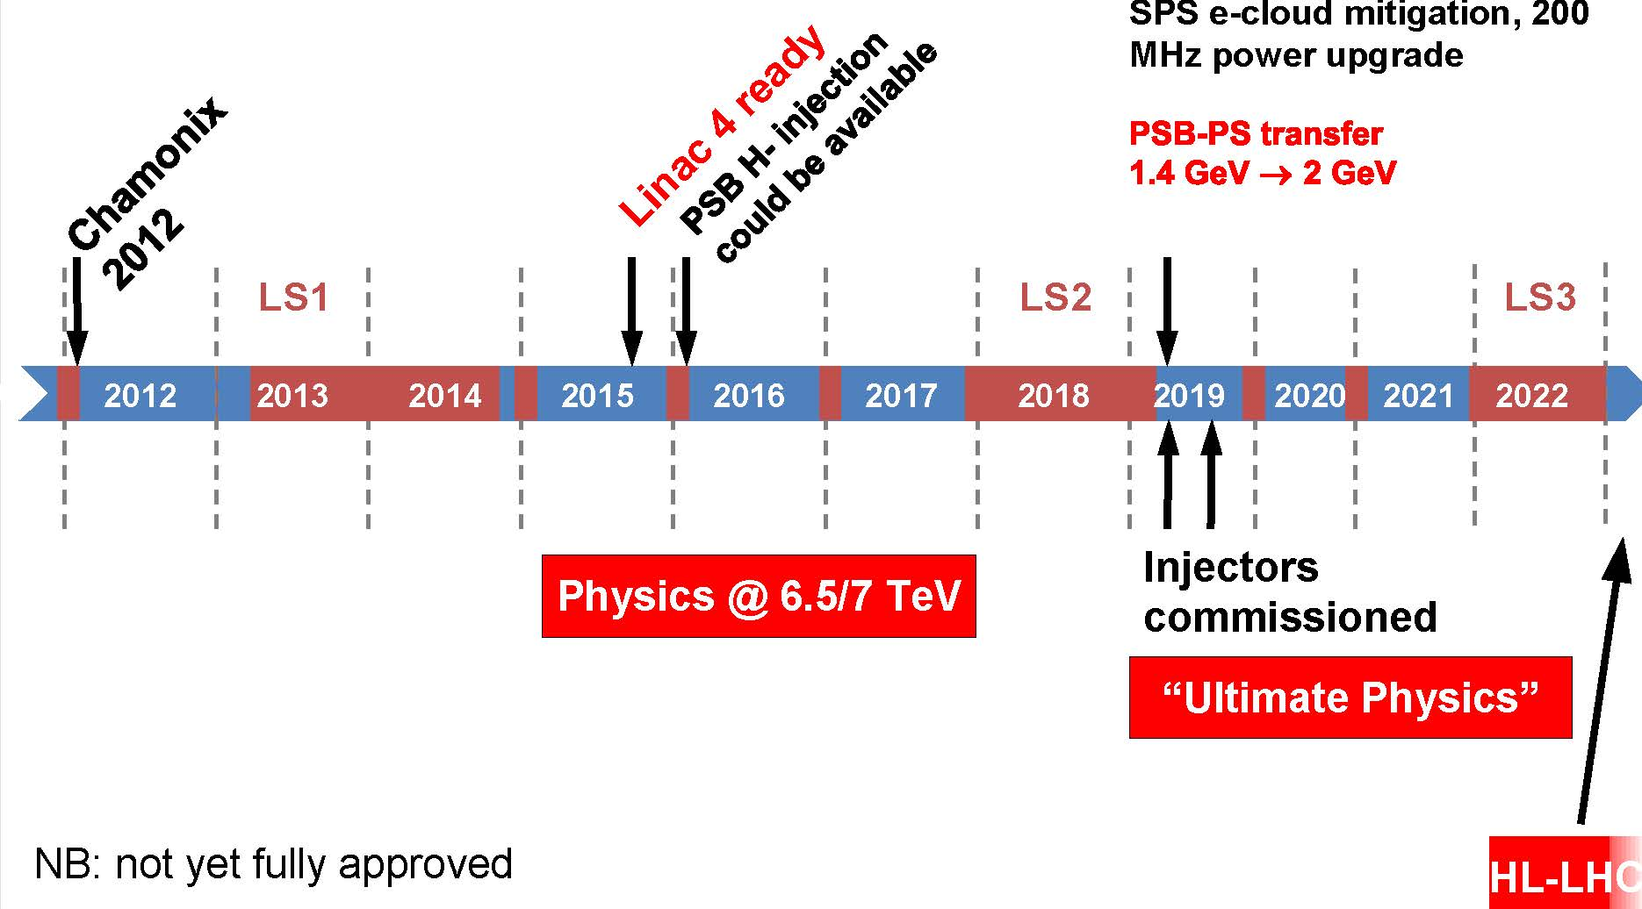
example LHC time line – next ten years
Ralph Steinhagen, ICHEP2012

Slide 37
LHC luminosity forecast
~30/fb at 3.5 & 4 TeV
~400/fb at 6.5-7 TeV
~3000/fb at 7 TeV
2012 DONE
2021 goal (?)
2035 goal (??)
to obtain 3000/fb by 2035
we need the HL-LHC

Slide 38
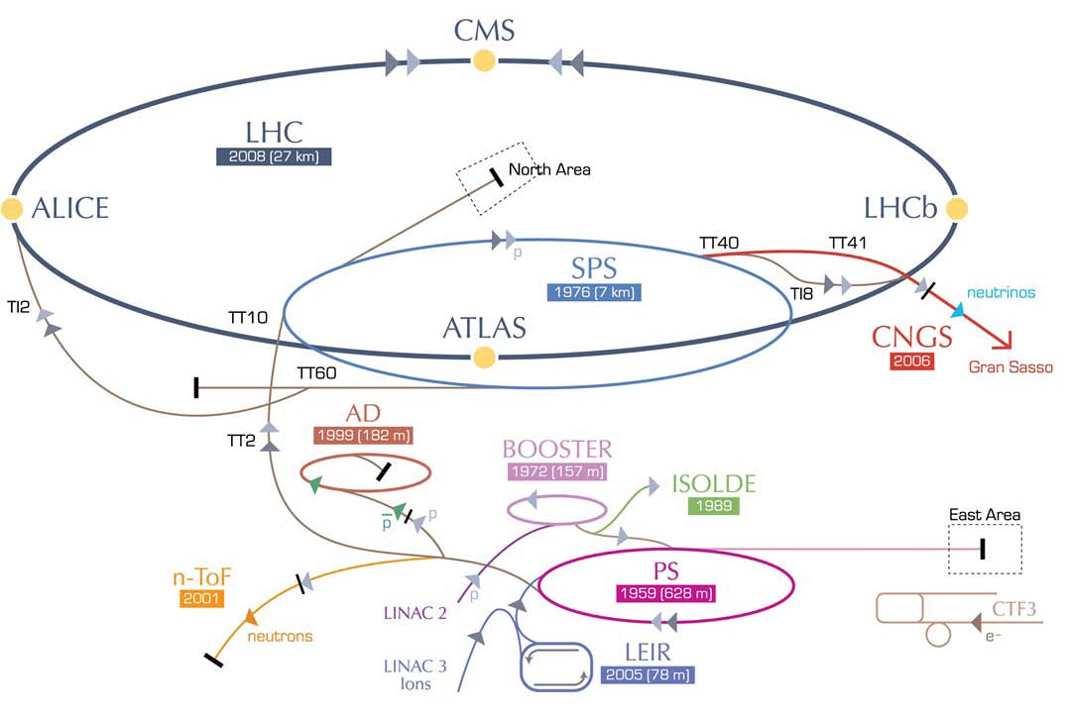
HL-LHC – modifications
IR upgrade
(detectors, low-β quad’s, crab cavities, a few high-field dipoles, etc)
~2022
SPS enhancements
(anti e-cloud coating?,RF,
impedance), 2012-2022
Booster energy upgrade
1.4 → 2 GeV, ~2018
Linac4,
~2015
Cristhian Valerio
U. Sinaloa

Slide 39
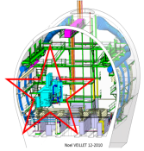



in LHC: 1.2 km of new equipment …
6.5 kW@4.5K cryoplant
2 x 18 kW @4.5K cryoplants for IRs

Slide 40
HL-LHC Official Beam Parameters
Parameter | nominal | 25ns | 50ns
N | 1.15E+11 | 2.2E+11 | 3.5E+11
n_{b} | 2808 | 2808 | 1404
beam current [A] | 0.58 | 1.12 | 0.89
x-ing angle [μrad] | 300 | 590 | 590
beam separation [σ] | 10 | 12.5 | 11.4
β* [m] | 0.55 | 0.15 | 0.15
ε_{n} [μm] | 3.75 | 2.5 | 3.0
ε_{L} [eVs] | 2.51 | 2.5 | 2.5
energy spread | 1.20E-04 | 1.20E-04 | 1.20E-04
bunch length [m] | 7.50E-02 | 7.50E-02 | 7.50E-02
IBS horizontal [h] | 106 | 20.0 | 20.7
IBS longitudinal [h] | 60 | 15.8 | 13.2
Piwinski parameter | 0.68 | 3.1 | 2.9
geom. reduction | 0.83 | 0.35 | 0.33
beam-beam / IP | 3.10E-03 | 3.9E-03 | 5.0E-03
Peak Luminosity | 1 10³⁴ | 7.4 10³⁴ | 8.5 10³⁴
Virtual Luminosity | 1.2 10³⁴ | 21 10³⁴ | 26 10³⁴
6.2 10¹⁴ and 4.9 10¹⁴
p/beam
(Leveled to 5 10³⁴ cm⁻² s⁻¹
and 2.5 10³⁴ cm⁻² s⁻¹)
27
Events / crossing (peak & leveled L) | 19 | 210 | 475 | 140 | 140

Slide 41

luminosity leveling at the HL-LHC
example: maximum pile up 140
(σ_{inel}~85 mbarn)

Slide 42

luminosity leveling at the HL-LHC
example: maximum pile up 140

Slide 43

luminosity & integrated luminosity during 30 h at the HL-LHC
example: maximum pile up 140
~4 fb⁻¹ per day,
with 40% of efficiency
~250 fb⁻¹ /year

Slide 44

final goal : 3000 fb⁻¹ by 2030’s…
Full project
Enhanced consolidation

Slide 45







some HL-LHC ingredients
new final quadrupoles
Nb₃Sn instead of Nb-Ti
larger aperture
allowing smaller β*
11-T dipoles for dispersion suppressors
Nb₃Sn instead of Nb-Ti
provide space for extra
collimators catching off
-energy protons or ions
at ALICE, collimator
sections, ATLAS & CMS
SC link
move radiation
sensitive power
converters away from
machine
first prototype, 20 m – 20 kA, under test at CERN!
also of interest for electrical power distribution
LQS03 (90 mm ap., 3.7 m long):
208 T/m@4.6 K, 210 T/m@1.9 K
T. Baer
June 2013
HQ02a (120 mm, 1.5 m long):
150 T/m@4.6 K, 170 T/m@1.9 K
1-m model tested in April 2013,
B_{nom}=11 T achieved!
tests of novel MgB₂ and HTS (YBCO and BSCCO) cables
Goal: 150 mm ap, 140 T/m
Next: 2-m single bore, then 2-in-1

Slide 46

luminosity reduction due to crossing angle
is more pronounced at smaller β*
“Piwinski angle”
luminosity reduction factor
θ_{c}/2
nominal
LHC
crab cavities
eff. beam size:
σ∗_{x,eff} ≈ σ_{x}∗/R_{θ}
HL-LHC
~1/β*

Slide 47
schematic of crab crossing
θ_{c}
RF crab cavity deflects head and tail in opposite direction so that collision is effectively “head on” for luminosity and tune shift
bunch centroids still cross at an angle (easy separation)
1st proposed in 1988, used in operation at KEKB since 2007
until recently plan was to vary crab cavity voltage for leveling, but this would change
size of luminous region & is disliked by experiments (instead leveling by β* or offset?)

Slide 48



HL-LHC needs compact crab cavities
only 19 cm beam separation, but long bunches
Final down-selected compact cavity designs for the LHC upgrade: 4-rod cavity design by Cockcroft I. & JLAB (left), λ/4 TEM cavity by BNL (centre), and double-ridge λ/2 TEM cavity by SLAC & ODU (right).
Prototype compact Nb-Ti crab cavities for the LHC: 4-rod cavity (left) and double-ridge cavity (right).

Slide 49


PoP double-ridge cavity achieved 7 MV deflecting voltage cw in 1st attempt
J. Delayen
S. De Silva
et al -
ODU,
SLAC,
JLAB,
Niowave
2.0 K
Expected
Q₀ = 6.7×10⁹
  At R_{S} = 22 nΩ
  And R_{res} = 20 nΩ
Achieved
Q₀ = 4.0×10⁹
Achieved fields
  E_{T} = 18.6 MV/m
  V_{T} = 7.0 MV
  E_{P} = 75 MV/m
  B_{P} = 131 mT
4.2 K
Quench
HL-LHC goal:
3.3 MV in operation
B. Yee Rendon, CiINVESTAV Mexico
better than required!
J. Delayen, LARP CM20

Slide 50

HL-LHC preliminary budget estimate
 | Improving Consolidation | Full performance | Total HL-LHC
Mat. (MCHF) | 476 | 360 | 836
Pers. (MCHF) | 182 | 31 | 213
Pers. (FTE-y) | 910 | 160 | 1070
TOT (MCHF) | 658 | 391 | 1,049

Slide 51
RLIUP 2013
“Review of LHC and injector upgrade plans”
CERN, October 2013
3 scenarios | PICs Performance Improving Consolidations | US1 Upgrade Scenario 1 | US2 Upgrade Scenario 2
 |  | +HHRF?+DS collimators? | +crab cavities, e-lens,…
integrated luminosity by 2035 | 1000-1200/fb | 2000/fb | 3000/fb
physics needs & motivation?; also, reasons to go >3000/fb?

Slide 52


Slide 53
Large Hadron electron Collider (LHeC)
ERL LHeC:
recirculating
linac with
energy
recovery

Slide 54


LHeC Conceptual Design Report
LHeC CDR published in
J. Phys. G: Nucl. Part. Phys. 39
075001 (2012)
~600 pages

Slide 55

LHeC ERL layout
two SC linacs, 3-pass up, 3-pass down; 6.4-mA 60-GeV e⁻’s collide w. LHC p/ions, e⁻ RF grad ~20 MV/m, 800 MHz
A. Bogacz, O. Brüning,
M. Klein, D. Schulte,
F. Zimmermann, et al
(C=1/3 LHC allows for ion clearing gaps)

Slide 56

LHeC SRF & ERL test facility
design under study

Slide 57

LHeC baseline & Higgs factory parameters
L_{ep} ~2 10³⁴ cm⁻²s⁻¹

Slide 58

SAPPHiRE

Slide 59





γγ collider Higgs factory
IR
s-channel production;
lower energy;
no e⁺ source
physics
few J pulse
energy with
λ~350 nm
passive optical cavity → relaxed laser parameters
power evolution of cw double-clad fiber lasers with diffraction limited beam quality over the past decade: factor 100 increase!
laser
optical cavity
Source: Fiber lasers and amplifiers: an ultrafast performance evolution, Jens Limpert, Thomas Schreiber, and Andreas Tünnermann, Applied Optics, Vol. 49, No. 25 (2010)
K. Moenig et al, DESY Zeuthen

Slide 60

Reconfigured LHeC
SAPPHiRE γγ Higgs Factory
scale ~ European XFEL,
about 10-20k Higgs per year
SAPPHiRE: Small Accelerator for Photon-Photon Higgs production using Recirculating Electrons

Slide 61



laser options for SAPPHiRE
EuCARD SAPPHiRE Day 19 February 2013
industry
Livermore
J. Gronberg, LLNL
Y. Zaouter, Amplitude Systems
full power
w/o optical
cavity!
10 J at 10 kHz
ICAN
G. Mourou, LOA;
M. Velasco,
Northwestern U.

Slide 62
LHeC Higgs factory comparison
(1 year = 10⁷ s at design luminosity).
machine | LHeC | LHeC-HF | SAPPHiRE
luminosity [10³⁴ cm⁻²s⁻¹] | 0.1 (ep) | 2 (ep) | 0.06 (γγ >125 GeV)
cross section | ~200 fb | ~200 fb | >1.7 pb
no. Higgs/yr | 2k | 40k | >10k

Slide 63
higher-energy
pp colliders

Slide 64

circular pp Higgs factories
1 M Higgs produced so far – more to come!
15 H bosons / min – and more to come
LHC: 1st circular Higgs factory!
E_{CM}=8-14 TeV,$\hat{ L}\sim$10³⁴cm⁻²s⁻¹
HL-LHC: planned (~2022-2035):
E_{CM}=14 TeV,$L\sim$5x10³⁴cm⁻²s⁻¹ (leveled)
HE-LHC: proposed in LHC tunnel (2038-?)
E_{CM}=33 TeV,$L≥5$x10³⁴cm⁻²s⁻¹
or
VHE-LHC: proposed in new 80-100 km tunnel (2040?)
E_{CM}=84-104 TeV,$L≥5$x10³⁴cm⁻²s⁻¹
THE ultimate Higgs factory!
10x more Higgs
6x higher cross section
for H self coupling
42x higher cross section
for H self coupling

Slide 65
High-Energy LHC
HE-LHC
20-T dipole magnets
S-SPS?
higher energy
transfer lines
2-GeV Booster
Linac4

Slide 66

20-T dipole magnet
beam
pipe
E. Todesco, L. Rossi, P.. McIntyre

Slide 67

VHE-LHC
VHE-LHC
VHE-LHC-LER

Slide 68

80 or 100-km tunnel for VHE-LHC
J. Osborne, C. Waaijer,
CERN, ARUP & GADZ
the same tunnel could host an e⁺e⁻ Higgs factory “TLEP” and a highest-luminosity highest-energy e-p/A collider

Slide 69
HE-LHC & VHE-LHC parameters
O. Dominguez,
L. Rossi, F. Zimmermann
parameter | LHC | HL-LHC | HE-LHC | VHE-LHC
c.m. energy [TeV] | 14 | 14 | 33 | 100
circumference [km] | 26.7 | 26.7 | 26.7 | 80 (or 100)
dipole field [T] | 8.33 | 8.33 | 20 | 20 (or 16)
beam current [A] | 0.58 | 1.12 | 0.48 | 0.49
rms IP spot size [μm] | 16/7 | 7.1 (min) | 5.2 | 6.7
stored beam energy [MJ] | 362 | 694 | 701 | 6610
SR power per ring [kW] | 3.6 | 7.3 | 96.2 | 2900
arc SR heat load [W/m/apert.] | 0.17 | 0.33 | 4.35 | 43.4
energy loss per turn [keV] | 6.7 | 6.7 | 201 | 5857
critical photon energy [eV] | 44 | 44 | 575 | 5474
longit. SR emit. damping time [h] | 12.9 | 12.9 | 1.03 | 0.32
peak events / crossing | 27 | 135 (lev.) | 147 | 171
peak luminosity [10³⁴ cm⁻²s⁻¹] | 1.0 | 5.0 | ≥5.0 | ≥5.0
beam lifetime due to burn off [h] | 45 | 15.4 | 5.7 | 14.8
optimum av. luminosity / day [fb⁻¹] | 0.5 | 2.8 | 1.4 | 2.1

Slide 70



VHE-LHC: time evolution over 11 h in physics
with p burn off & controlled blow up
O. Dominguez
luminosity
& bunch intensity
$⊥\& ∥$emittances
SR damping counteracted by transverse + longit. noise injection (constant tune shift & bunch length)
HE-LHC &VHE-LHC luminosities could greatly improve for bunch spacings < 25 ns, e.g. by factor 5 for 5 ns, making better use of strong radiation damping!
are 5 ns spacing & 2.5x10³⁵cm⁻²s⁻¹ acceptable for detectors?

Slide 71

circular e⁺e⁻ Higgs factories
2012 - LHC discovered Higgs boson at 126 GeV
cross section for H production in e⁺e⁻ collisions maximum at ~15% higher beam energy than LEP2
circular collider (“TLEP”) in new 80-100 tunnel: 300x LEP2 luminosity at 4 IPs (precision H studies)
recipe for high luminosity: smaller β* (esp. y), lower emittance (x & y), top-up injection
operation up to $t\overline{t}$ threshold; very high luminosity at Z pole & WW threshold (+ polarized beams!)
in same tunnel: pp collider up to 100-TeV c.m. (VHE-LHC), and ep collider
TLEP will enhance VHE-LHC physics case

Slide 72

luminosity - past&planned e⁺e⁻ colliders
TLEP-Z
S. Henderson
TLEP-W
TLEP-H
TLEP-t
the circular route

Slide 73
TLEP beam lifetime: two limits
1. radiative Bhabha scattering (σ≈0.215 barn)
LEP2: τ_{beam,LEP2}~ 6 h
TLEP with L~5x10³⁴ cm⁻²s⁻¹ at 4 IPs:
τ_{beam,TLEP}~21 minutes, unavoidable
2. beamstrahlung (synchr. rad. during the collision)
mitigated by:
(1) large momentum acceptance η
(2) flat beams [i.e. small ε_{y} & large β_{x}*]
(3) fast replenishing
(M. Koratzinos, V.Telnov, K. Yokoya, M. Zanetti,…)

Slide 74
TLEP - circular e⁺e⁻ collider to study
the «Higgs boson» X(126)
a relatively young concept (2011)
A. Blondel
short beam lifetime (~τ_{LEP2}/40) due to high luminosity
supported by top-up injection (used at KEKB, PEP-II, SLS,…)

Slide 75

top-up injection: schematic cycle
beam current in collider (15 min. beam lifetime)
100%
99%
almost constant current
energy of accelerator ring
120 GeV
injection into collider
injection into
accelerator
20 GeV
acceleration time = 1.6 s
(assuming SPS ramp rate)
10 s

Slide 76

K. Oide

Slide 77


top-up performance at PEP-II/BaBar
J. Seeman
Before Top-Up
After Top-Up
J. Seeman
average luminosity ≈ peak luminosity

Slide 78




proposed circular e⁺e⁻ Higgs factories
SLAC/LBNL
design:
27 km
TLEP: 80 or 100 km
near Geneva
LEP3: 27 km
TLEP (LEP4): 80 km
near Geneva
SuperTRISTAN in Tsukuba: 40 (& 60 or 80 “TLEP”) km
or HF in 27-km
LHC tunnel
(“LEP3”)
Mike Koratzinos et al
FNAL site filler, 16 km
FNAL Snowmass proposal:
100 km “TLEP”
& FNAL VLLC 233 km ring
Chinese Higgs Factory CEPC
+ Super pp Collider
50 or 70 km
Qing QIN et al

Slide 79

parameters | TLEP Z | TLEP W | TLEP H | TLEP t
E_{c.m.} [GeV] | 91 | 160 | 240 | 350
beam current [mA] | 1440 | 154 | 29.8 | 6.7
# bunches/beam | 7500 | 3200 | 167 | 160 | 20
#e−/bunch [10¹¹] | 4.0 | 1.0 | 3.7 | 0.88 | 7.0
ε_{x}, ε_{y} [nm] | 29.2, 0.06 | 3.3,0.017 | 7.5, 0.015 | 2, .002
β∗_{x,y} [mm] | 500, 1 | 200, 1 | 500, 1 | 1000, 1
σ∗_{x,y}[μm] | 121, 0.25 | 26, 0.13 | 61, 0.12 | 45,.045 | 126,.13
σ^{tot}_{z,rms} [mm] (w BS) | 2.93 | 1.98 | 2.11 | 0.77 | 1.95
E^{SR}_{loss}/turn [GeV] | 0.03 | 0.3 | 1.7 | 7.5
V_{RF},tot [GV] | 2 | 2 | 6 | 12
ξ_{x,,y}/IP | 0.068 | 0.086 | 0.094 | 0.057
$𝓛$ /IP[10³⁴cm⁻²s⁻¹] | 59 | 16 | 5 | 1.3 | 1.0
#IPs | 4 | 4 | 4 | 4
τ_{beam}[min] (rad.B) | 99 | 38 | 24 | 21 | 26
τ_{beam}[min] (BS,η=2%) | >10²⁵ | >10⁶ | 38 | 14 | 2

Slide 80

parameters | TLEP W | TLEP H | TLEP t |  | ZHH&ttH
E_{c.m.} [GeV] | 160 | 240 | 350 |  | 500
beam current [mA] | 154 | 29.8 | 6.7 |  | 1.6
# bunches/beam | 3200 | 167 | 160 | 20 | 10
#e−/bunch [10¹¹] | 1.0 | 3.7 | 0.88 | 7.0 | 3.3
ε_{x}, ε_{y} [nm] | 3.3,0.017 | 7.5, 0.015 | 2, .002 |  | 4., 0.004
β∗_{x,y} [mm] | 200, 1 | 500, 1 | 1000, 1 |  | 1000, 1
σ∗_{x,y}[μm] | 26, 0.13 | 61, 0.12 | 45,.045 | 126,.13 | 63, 0.063
σ^{tot}_{z,rms} [mm] (w BS) | 1.98 | 2.11 | 0.77 | 1.95 | 1.81
E^{SR}_{loss}/turn [GeV] | 0.3 | 1.7 | 7.5 |  | 31.4
V_{RF},tot [GV] | 2 | 6 | 12 |  | 35
ξ_{x,,y}/IP | 0.086 | 0.094 | 0.057 |  | 0.075
$𝓛$ /IP[10³⁴cm⁻²s⁻¹] | 16 | 5 | 1.3 | 1.0 | 0.5
#IPs | 4 | 4 | 4 |  | 4
τ_{beam}[min] (rad.B) | 38 | 24 | 21 | 26 | 13
τ_{beam}[min] (BS,η=2%) | >10⁶ | 38 | 14 | 2 | 3 (η=3%)
TLEP
energy
upgrade

Slide 81


optics – TLEP arc cell
Y. Cai,
B. Holzer,
H. Burkhardt
dispersion
beta functions
from LEP to TLEP
ρ=3100 m, L_{cell}=79 m
ρ=9100 m, L_{cell}=50 m
ε_{x}=48 nm at 104.5 GeV → ε_{x}=1.5 nm at 175 GeV
$$ε∝γ^{2}θ_{}^{3}$$
: at lower beam energy increase cell length (“θ”) x2 or x6!

Slide 82


SuperKEKB
– a TLEP demonstrator
beam commissioning will start in early 2015
β_{y}*=300 μm (TLEP: 1 mm)
lifetime 5 min (TLEP: ~15min)
ε_{y}/ε_{x}=0.25% ! (TLEP: 0.2%)
off momentum acceptance (±1.5%, TLEP: ±2%)
e⁺ production rate (2.5x10¹²/s, TLEP: <1x10¹¹/s)

Slide 83


other TLEP challenges
efficient RF system
  need 12 GeV/turn at 350 GeV
    ~600 m of SC RF cavities @ 20 MV/m
      LEP2 had 600 m at 7 MV/m
  very high power : up to 200 kW / cavity in collider ring
    power couplers similar to ESS –
    700-800 MHz preferred
operation at Z pole
  7500 bunches : e⁺ source, impedance effects, parasitic collisions
    two separate rings for e⁺ and e⁻ beams will help here too
BNL 5-cell 700 MHz cavity
RF Coupler
(ESS/SPL)

Slide 84



polarization
R. Assmann
LEP
LEP
observations
+ model predictions
loss of polarization due to growing energy spread
$$σ_{E}∝{E^{2}}/{\sqrt{ρ}}$$
polarization scaling (energy spread!):
LEP at 61 GeV → TLEP at 81 GeV
TLEP
optimized scenario
U Wienands, April 2013
TLEP
➔ 100 keV beam energy calibration by resonant depolarization (using pilot bunches) around Z peak and W pair threshold:
Δm_{Z} ~0.1 MeV, ΔΓ_{Z} ~0.1 MeV, Δm_{W} ~ 0.5 MeV
ρ = 9000 m, C = 80 km
lower energy spread, high polarization up to W threshold
A. Blondel

Slide 85

e⁺e⁻ Higgs factories: luminosity
ultimate precision
at Z, WW, ZH ;
sensitive to New
Physics in multi-TeV range & to SM closure → case for VHE-LHC
ultimate energy reach
up to 1 or 3 TeV ;
direct searches
for New Physics

Slide 86
vertical rms IP spot sizes in nm
in regular
font:
achieved
in italics:
design
values
LEP2 | 3500
KEKB | 940
SLC | 500
TLEP-H | 120
ATF2, FFTB | 60 (35), 60 (40)
SuperKEKB | 50
ILC | 5 – 8
CLIC | 1 – 2
β_{y}*:
5 cm→
1 mm
TLEP
will learn
from ATF2 &
SuperKEKB

Slide 87

Higgs factory performances
Precision on couplings, cross sections, mass, width, Summary of the ICFA HF2012 workshop (FNAL, Nov. 2012) arxiv1302:3318
Circular Higgs Factory really goes to
precision at few per mill level

Slide 88

CERN Courier article, 19 July 2013
John Ellis

Slide 89

TLEP design study: http://cern.ch/tlep
where you can subscribe for work, information, newsletter , etc…
R. Aleksan,
A. Blondel,
J. Ellis,
P. Janot,
M. Koratzinos,
et al
welcome on board!
Global endeavour: collaborators from Europe, US, Japan, China, Mexico (!), …
Next events: 6th TLEP workshop 16-18 October, CERN
Joint VHE-LHC+ TLEP+VHE-LHeC kick-off meeting in February 2014

Slide 90




VHE-LHC + TLEP
L. Rossi
HE-LHC-LER (0.17→1.5 T)
TLEP collider (0.07 or 0.05T)
TLEP injector (0.007→0.05/7 T)
transmission line magnet
(B. Foster, H. Piekarz)
20 mm thick shield around cable
Gaps: 2 x V30xH60 mm
HE-LHC
(20 T)
super-resistive cable
multipurpose
tunnel
based on MgB₂ SC
only 12 MEuro/100 km!

Slide 91


GMS-2T (TLEP)
common modular detectors for e⁺e⁻ and pp collisions!?
GMS-4T (VHE-LHC)
E. Meschi

Slide 92

possible long-term strategy
CERN implementation
TLEP (80-100 km,
e⁺e⁻, up to
~350 GeV c.m.)
PSB
PS (0.6 km)
LHC (26.7 km)
SPS (6.9 km)
HL-LHC
VHE-LHC
(pp, up to
100 TeV c.m.)
LHeC & SAPPHiRE?
& e± (120 GeV) – p (7, 16 & 50 TeV) collisions ([(V)HE-]TLHeC)
≥50 years of e⁺e⁻, pp, ep/A physics at highest energies

Slide 93
conclusions – LHC & HL-LHC
LHC running well & predictably; LS1 in progress
in 2015 LHC will operate close to design energy with peak luminosity likely to exceed the design
new performance limits will be encountered (e.g. triplet cooling limit)
baseline for 2015 is 25 ns, but uncertainties: e-cloud & UFOs; backup option: 50 ns w leveling
HL-LHC well defined, prototype tests successful
plan & goals for HL-LHC under review
- budget considerations & LHC results

Slide 94
conclusions – beyond HL-LHC
HL-LHC develops the technology (Nb₃Sn magnets, 20-kA HTS cables) for future higher energy pp colliders: HE-LHC (33 TeV c.m.) and/or VHE-LHC (100 TeV c.m.)
TLEP, in VHE-LHC tunnel, being studied as highest-luminosity e⁺e⁻ Higgs factory
- excellent energy resolution, & superb performance at Z pole , W & top threshold
coherent long-term strategy emerging, based on sharing, staging & synergies (high performance, minimum total cost, maximum energy reach)

Slide 95


possible long-term time line
1980
1990
2000
2010
2020
2030
2040
LHC
Design,
R&D
Proto.
Constr.
Physics
Design,
R&D
HL-LHC
Constr.
Physics
LHeC/SAPPHiRE?
Design,
R&D
Constr.
Physics
{
HE-LHC
Design,
R&D
Constr.
Physics
?
or TLEP
Design,
R&D
Constr.
Physics
VHE-LHC
Design,
R&D
Constr.
Physics

Slide 96


muchas gracias
dyos bo’otik

Slide 97
spare slides

Slide 98


Pb-Pb
good performance from the injectors - bunch intensity and emittance
preparation, Lorentz’ law: impressively quick switch from protons to ions
peak luminosity around 5 x 10²⁶ cm⁻²s⁻¹ at 3.5Z TeV (2011) – nearly twice design when scaled to 6.5Z TeV
M. Lamont, IPAC’13

Slide 99


proton-lead
beautiful result in early 2013
final integrated luminosity above experiments’ request of 30 nb⁻¹
injectors: average number of ions per bunch was ~1.4x10⁸ at start of stable beams, i.e. around twice the nominal intensity
B1(p)
B2(Pb)
H(mm)
H(mm)
V(mm)
V(mm)
beam orbits at top energy with RF frequencies locked to Beam 1
M. Lamont, IPAC’13

Slide 100


LS1 status (24 July 2013)
>1/2 LHC opened, 15% shunts
installed and 3% M welds done
good overall progress : R2E ahead, SMACC on schedule (minor delays)
high number of splices to redo Baseline = 15%, Reality 25%-35%→addt’l resources
SC Magnets and Circuits Consolidation
Shunts
still ahead of schedule but
the rate is not YET nominal
Weld M
late due to non availability of ICs to weld because of interference between insulation system and cryopipes
on the critical path
actual production rate good
K. Foraz, LMC, 24 July 2013

Slide 101

HL-LHC optics
S. Fartoukh
  Achromatic Telescopic Squeeze (ATS), «fully proven» MDs (β* = 15 cm «easy», room for β* ~ 10-12 cm)
squeeze through
the arcs to enhance
effective sextupole
strength;
tested with beam
in LHC MDs of
2011 & 2012
typical ATS collision optics with IR1 & IR5 squeezed down to β*=10 cm

Slide 102
L-R LHeC road map to ≥10³³ cm⁻²s⁻¹
luminosity of LR collider:
H_{D}~1.3
(round beams)
D. Schulte
LHeC2010
average e⁻
current
limited by
energy
recovery
efficiency
I_{e}=6.4 mA
maximize geometric
overlap factor
head-on collision
small e- emittance
θ_{c}=0
H_{hg}≥0.9
highest proton
beam brightness “permitted”
(ultimate LHC values)
γε=3.75 μm
N_{b}=1.7x10¹¹
bunch spacing
25 or 50 ns
smallest conceivable
proton β* function:
reduced l* (23 m → 10 m)
squeeze only one p beam
new magnet technology Nb₃Sn
β*_{p}=0.1 m

Slide 103

synchroton-radiation: heat load
TLEP has >10 times less SR heat load per meter than PEP-II or SPEAR! (though higher photon energy)
N. Kurita, U. Wienands, SLAC

Slide 104



synchrotron radiation: activation
A. Fasso
3rd TLEP3 Day
LEP design:
(ρ∼3100 m)
higher photon energies
than TLEP!
(175 GeV,
ρ=9.1 or 11 km)

Slide 105
TLEP cost breakdown – extremely rough (GEuro)
 | TLEP
Bare tunnel (with shafts & 8 caverns) | 3.1 ⁽¹⁾
Services & additional infrastructure (electricity, cooling, ventilation, service cavern, RP, surface structure, access roads) | 1.0 ⁽²⁾
RF system | 0.7 ⁽³⁾
Cryo system | 0.2 ⁽⁴⁾
Vacuum system & RP | 0.5⁽⁵⁾
Magnet system for collider & injector ring | 0.8⁽⁶⁾
Pre-injector complex SPS reinforcements | 0.5
Total | 6.8
preliminary – not endorsed by anybody
(1): J. Osborne, Amrup study
(2): very rough guess, conservative escalated extrapolation from LEP
(3): O. Brunner, Note, May 2013; B. Rimmer, SRF cost /GeV/Watt for CEBAF upgrade, 2010
(4): 2x LHeC cryo plant cost [Friedrich Haug, 4th TLEP workshop]
(5): factor 2.5 higher than KEK estimate for 80 km ring
(6): 24,000 magnets for collider & injector; cost per magnet 30 kCHF (LHeC study); 10% added; no cost saving from mass production assumed
Note: detector costs not included

Slide 106

Performance Comparison
Need sub-percent precision for sensitivity to multi-TeV New Physics
  Compare (LHC), HL-LHC, ILC, TLEP
    TLEP reaches the needed sub-percent accuracy
    much theoretical work also needed
HF2012
J. Ellis et al.
see talk by A. Blondel
P. Janot

Slide 107





TLEP TeraZ, Oku-W & Mega-Top
see talk by A. Blondel
Precision tests of EWSB
  measure m_{Z}, Γ_{Z} to < 0.1 MeV, m_{W} to < 1 MeV, sin²θ_{W} to 2.10⁻⁶ from A_{LR}
  TLEP beam polarization up to W threshold, for energy calibration
Asymmetries, Lineshape
 | LEP | ILC | TLEP
√s ~ m_{Z} | Mega-Z | Giga-Z | Tera-Z
#Z / year Polarization Precision vs LEP1 Error on m_{Z}, Γ_{Ζ} | 2×10⁷ Yes (T) 1 2 MeV | Few 10⁹ Easy 1/5 to 1/10 – | 10¹² (>10¹¹ b,c,τ) Yes (T,L) ~1/100 < 0.1 MeV
√s ~ 2m_{W}
#W pairs / year Polarization Error on m_{W} | Few dozens No 220 MeV | 2×10⁵ Easy 7 MeV | 2.5×10⁷ Yes (T) 0.5 MeV
√s = 240 GeV |  |  | Oku-W
# W pairs / 5 years Error on m_{W} | 4×10⁴ 33 MeV | 4×10⁶ 3 MeV | 2×10⁸ 0.5 MeV
√s ~ 350 GeV |  |  | Mega-Top
# top pairs / 5 years Error on m_{top} Error on λ_{t} | – – – | 100,000 30 MeV 40% | 500,000 13 MeV 15%
WW threshold scan
TLEP : Repeat the LEP1 physics programme every 15 min
Transverse polarization up to the WW threshold
  Exquisite beam energy determination (10 keV)\
Longitudinal polarization at the Z pole
        Measure sin²θ_{W} to 2.10⁻⁶ from A_{LR}
WW production
-
tt threshold scan
P. Janot

Slide 108

interim
R. Aleksan, A. Blondel, J. Ellis, P. Janot, M. Koratzinos, M. Zanetti, F. Zimmermann ad interim
F. Zimmermann ad interim
P. Janot ad interim
J. Ellis ad interim

Slide 109
TLEP average power consumption rough estimate
system | el. power [MW]
RF (w/o cryogenics) | 180
RF for accelerator ring | 5
cryogenics | 34
cooling | 5
ventilation | 21
magnet systems | 14
general services | 20
total | ~274
→ talks by
Mike Koratzinos
and Qing Qin
large part of power (~200 MW) is proportional to beam current & luminosity; e.g. running
TLEP-H with 5x10³⁴ cm⁻²s⁻¹ (4 IPs) instead of 2x10³⁵ cm⁻²s⁻¹ total power would be ~120 MW

Slide 110


beamstrahlung: lifetime & L spectrum
simulation w 360M macroparticles (Guinea-Pig code)
τ varies exponentially with momentum acceptance η
TLEP at 240 GeV: post-collision
E tail → beam lifetime τ
luminosity energy
spectrum
τ>20 s at η=1.0%
τ>3 min at η=1.5%
τ>20 min at η=2.0%
τ>4h at η=3%
M. Zanetti (MIT)
required acceptance smaller for flatter beams
beamstrahlung in circular collider much weaker than for LC

Slide 111




beamstrahlung: equilibrium σ_{z}
beamstrahlung excites (surviving) e± longitudinally,
adding to effect of SR quantum excitation
→ collisions increase σ_{z} & σ_{δ} (K. Yokoya)
1st ever self-consistent beam-beam simulations with BS (K. Ohmi):
rms bunch length
no BS
weak strong
2012 design
self-consistent
self-consistent
no beamstrahlung
bunch luminosity
final bunch length from simulation
consistent w analytical expectation
including BS: σ_{z}=4.3 mm! (2012 TLEP parameters)
nonlinear
equation

Slide 112


luminosity with beamstrahlung
TLEP-H simulations for latest parameters
rms bunch length
total luminosity / IP
July 2013
May 2013 parameters
design luminosity
July 2013 parameters
May 2013
final bunch length from simulation
consistent w analytical expectation
including BS: σ_{z}=2.1 mm! (July 2013 parameters)
K. Ohmi, 17 July 2013

Slide 113




IR optics - momentum acceptance η
with synchrotron motion &
radiation
(sawtooth)
KEK design
before optics
correction
KEK design
after optics
correction
±1.1%
±1.3%
K. Oide
±2.0%
±1.6%
FNAL site filler
SLAC/LBNL design
Y. Cai
T. Sen, E. Gianfelice-Wendt, Y. Alexahin

Slide 114
optics - energy sawtooth
K. Oide
SuperTRISTAN
240 GeV, 40 km, 8 segments
350 GeV, 80 km, 16 segments
optics correction by shifting sextupoles onto sawtooth orbit
→ separate arcs/rings for e⁺ and e⁻

Slide 115
parameters for TLHeC & VHE-TLHeC (e⁻ at 120 GeV)
collider parameters | TLHeC |  | VHE-TLHeC
species | e± | p | e± | p
beam energy [GeV] | 120 | 7000 | 120 | 50000
bunch spacing [μs] | 3 | 3 | 3 | 3
bunch intensity [10¹¹] | 5 | 3.5 | 5 | 3.5
beam current [mA] | 24.3 | 51.0 | 24.3 | 51.0
rms bunch length [cm] | 0.17 | 4 | 0.17 | 2
rms emittance [nm] | 10,2 | 0.40 | 10,2 | 0.06
β_{x,y}*[cm] | 2,1 | 60,5 | 0.5,0.25 | 60,5
σ_{x,y}* [μm] | 15, 4 |  | 6, 2
beam-beam parameter ξ | 0.05, 0.09 | 0.03,0.01 | 0.07,0.10 | 0.03,0.007
hourglass reduction | 0.63 |  | 0.42
CM energy [TeV] | 1.8 |  | 4.9
luminosity [10³⁴cm⁻²s⁻¹] | 0.5 |  | 1.6

Slide 116
parameters for TLHeC & VHE-TLHeC (e⁻ at 60 GeV)
collider parameters | TLHeC |  | VHE-TLHeC
species | e± | p | e± | p
beam energy [GeV] | 60 | 7000 | 60 | 50000
bunch spacing [μs] | 0.2 | 0.2 | 0.2 | 0.2
bunch intensity [10¹¹] | 5 | 3.5 | 5 | 3.5
beam current [mA] | 390 | 51.0 | 390 | 51.0
rms bunch length [cm] | 0.18 | 4 | 0.18 | 2
rms emittance [nm] | 10, 2 | 0.40 | 10, 2 | 0.06
β_{x,y}*[cm] | 2, 1 | 60, 5 | 0.5, 0.25 | 60,5
σ_{x,y}* [μm] | 15, 4 |  | 6, 2
beam-beam parameter ξ | 0.10, 0.18 | 0.03,0.01 | 0.14, 0.20 | 0.03,0.007
hourglass reduction | 0.63 |  | 0.42
CM energy [TeV] | 1.3 |  | 3.5
luminosity [10³⁴cm⁻²s⁻¹] | 8.0 |  | 25.6

Slide 117
How a Particle Accelerator Works
Old-style television: Cathode ray tube
Anode (+)
Steering system
Anode (+)
-
-
-
-
Fluorescent screen
Filament
Cathode (-)
Electron beam
Focussing system

Slide 118


A Circular ‘Synchrotron’ Accelerator
+
-
The magnetic field is increased to keep the particles circulating with the same circumference as the energy increases

