Slide 1
WP5 XBEAM Steering Meeting
Kurt Aulenbacher, Marica Biagini, Mamad Eshraqi,
Giuliano Franchetti, Jürgen Struckmeier,
Frank Zimmermann
Campus Hotel, UAB, Barcelona
23 April 2015

Slide 2
agenda
achievements of the past year
milestones and deliverables
plan for the coming two years
presentations, publications and EuCARD-2 acknowledgements

Slide 3
dissemination/outreach
Michael Benedikt and Frank Zimmermann, “The Future Circular Collider study,” CERN Courier, April 2014
Giuliano Franchetti, “ Beam Dynamics meets Magnets supported by EuCARD-2”, Accelerating News #11, Autumn 2014
F. Zimmermann, “Collider Beam Physics”, http://cds.cern.ch/record/1968965?ln=en , invited article for RAST vol. 7, 2014
Highlights of AOC workshop, 5-6 February 2015, CERN, http://indico.cern.ch/event/349643/ to appear in ICFA Newsletter
Michael Benedikt and Frank Zimmermann, “A successful week for the Future Circular Collider (FCC) Study,” to appear in CERN Courier, April 2015
+ numerous invited talks & seminars (other than at EuCARD-2 workshops)

Slide 4
XBEAM workshops in Y2
XCOLL
Impedance 2014, Erice, Italy, 23-29 April 2014
MulCoPim 2014 , Valencia, Spain, 17-19 Sept. 2014
Channelling 2014, Capri, Italy, 5-10 Oct. 2014
Higgs factory 2014, Beijing, China, 9.-12.10.2014
FCC Week 2015, Washington DC, 23-27 March 2015
XCOLL+XRING
Advanced Optics Control CERN, 5.-6.02.2015
XRING
SC Collaboration Meeting 2014, CERN, 20-21 May 2014
Beam Dynamics meets Magnets II, Bad Zurzach, 1-4 December 2014
Space Charge 2015, Oxford, 23-27 March 2015
XLINAC
XPOL
EuCAN Universities meet Laboratories, Frankfurt, 30 Sept. -2 Oct. 2014

Slide 5
deliverables :
Preliminary strategies, optimization, limitations, paths & parameters for
future hadron & lepton colliders;
future high-performance hadron rings;
future high-power high-current SC linacs; and
future polarized beams
[month 36]
Strategy for
future extreme beam facilities;
[month 48]
none at the moment

Slide 6
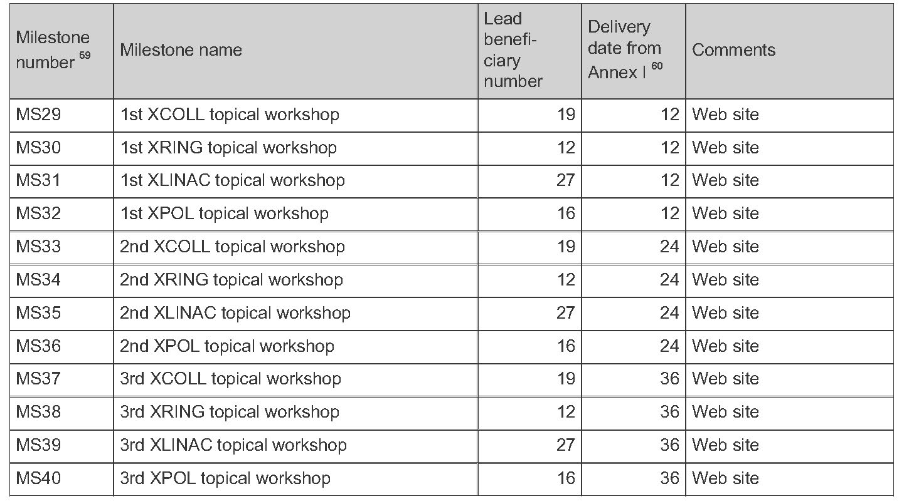
milestones :
≥1 workshop per task per year
accomplished:
11 workshops for XCOLL
5 workshops for XRING
1 workshop for XLINAC
1 workshop for XPOL
planned:
3 workshops for XCOLL
3 workshops for XRING
3 workshops for XLINAC
3 workshops for XPOL

Slide 7
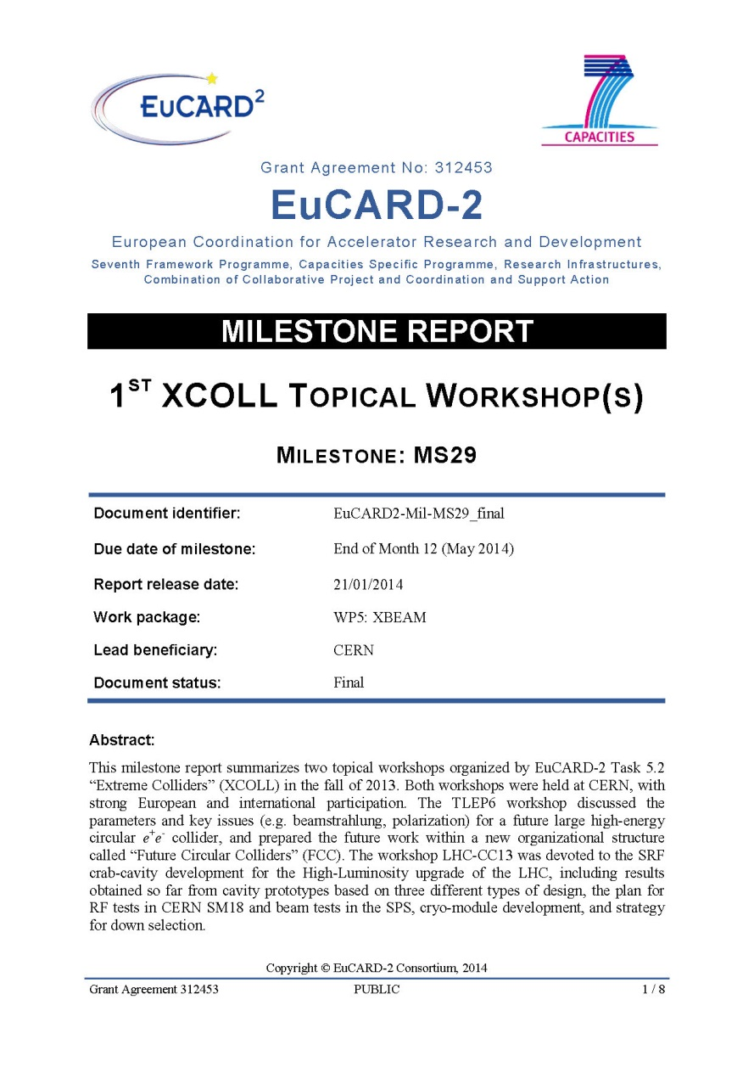
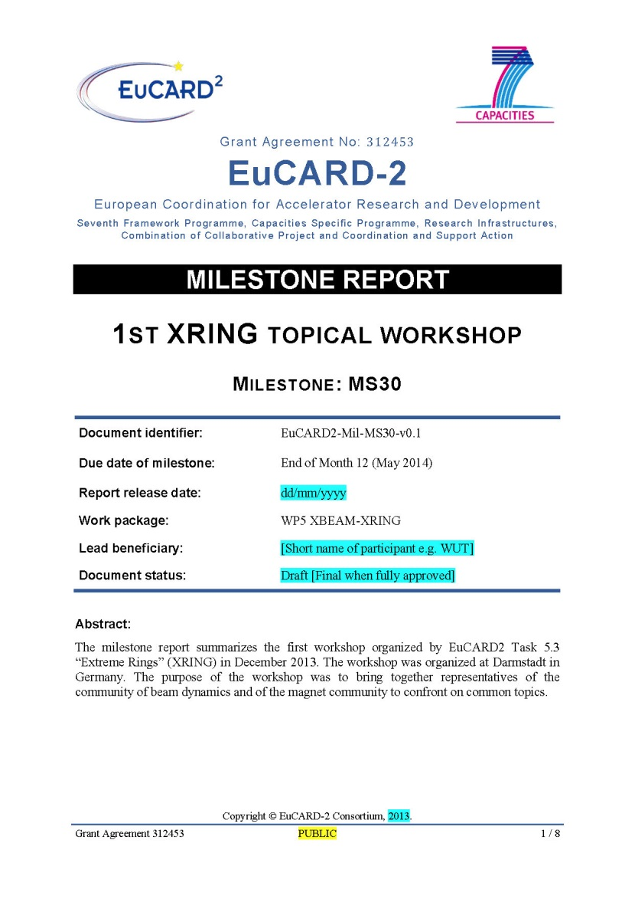
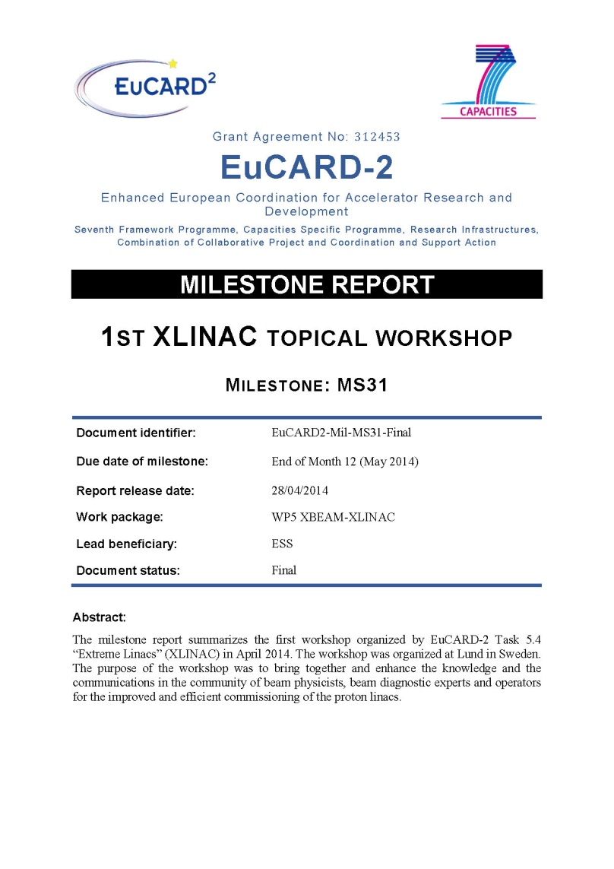
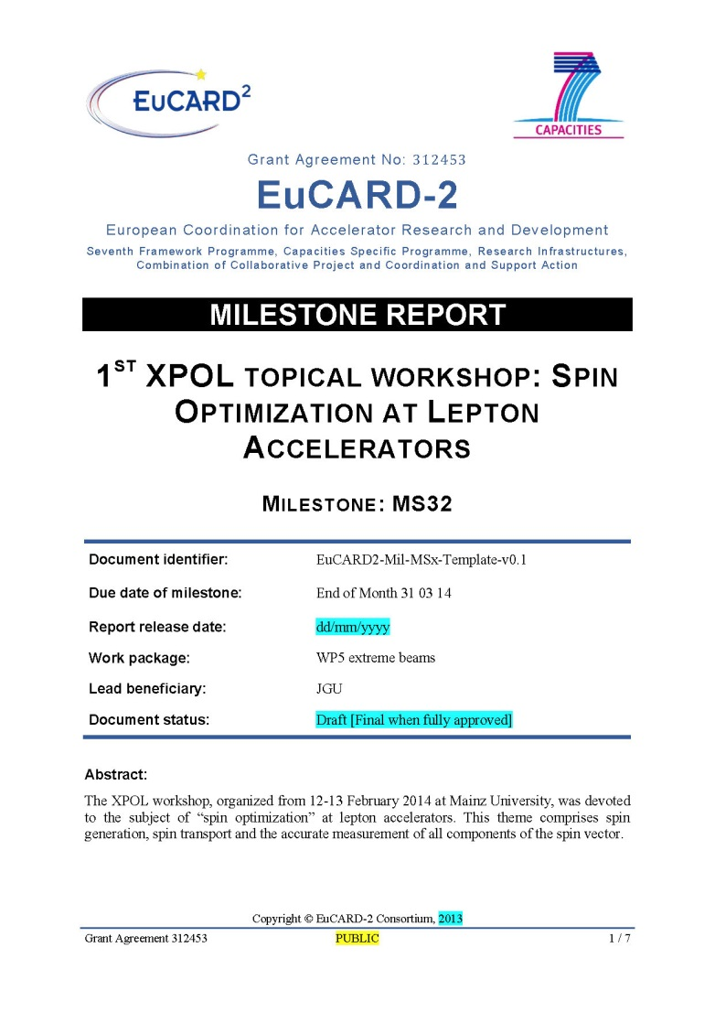
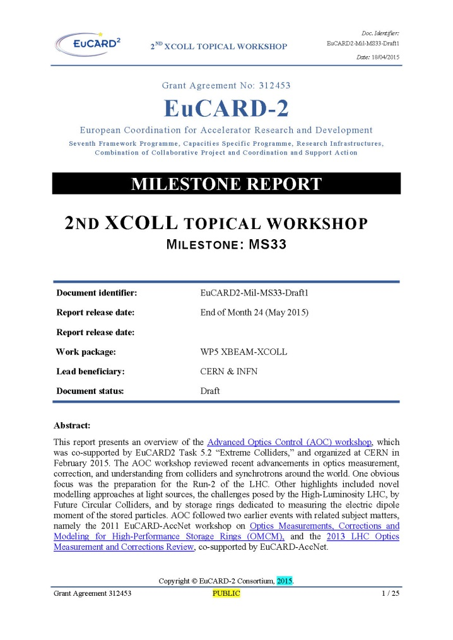
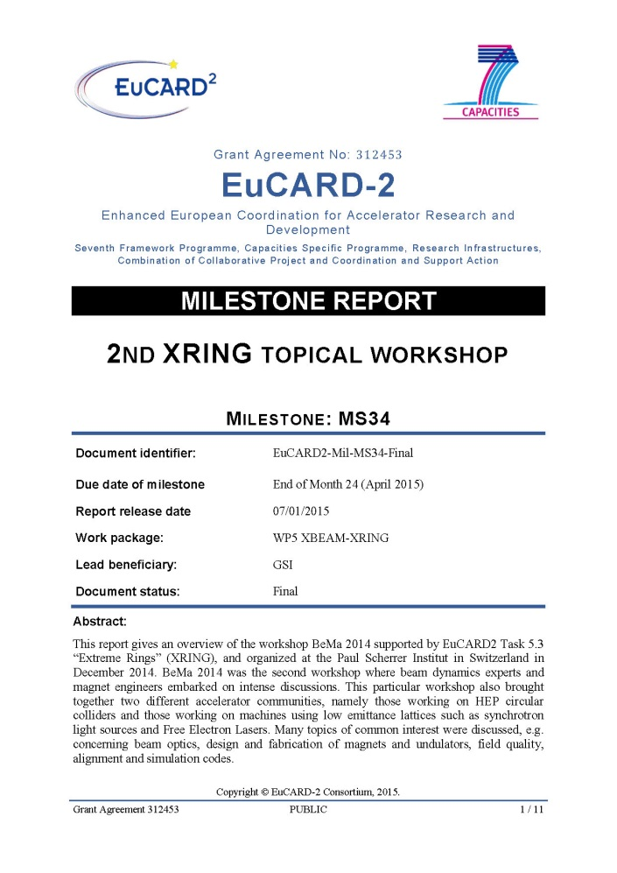
WP5 XBEAM MS reports
EuCARD2-Mil-MS29
EuCARD2-Mil-MS30
EuCARD2-Mil-MS31
EuCARD2-Mil-MS32
EuCARD2-Mil-MS33
EuCARD2-Mil-MS34

Slide 8
EuCARD2-Mil-MS35 –
2nd topical workshop of XLINAC
delayed to June 2015
Reason: originally planned WS on “Feeding High Power to Cavities” was organized by another entity, independent of EuCARD-2 – planned new workshop will be on “Mutual Needs of the LLRF and Beam Dynamics in Hadron Linacs”.
EuCARD2-Mil-MS36
2nd topical workshop of XPOL
delayed to September 2015
Reason: unavailability of key experts
delay justification documents submitted

Slide 9
planned workshops for Y3&4
XCOLL
LHeC 2015, CERN & Chavannes-de-Bogis, 24-26 June 2015
XCOLL-XRING-XPOL
Energy Frontiers meet Precision Frontiers, FZ Jülich, spring/summer 2016
XCOLL-EuroNNAc2
Focus: Future Frontiers in Accelerators “F³IA”, Germany, Summer 2016
XRING
Beam dynamics meets diagnostics, Firenze, 4-6 November 2015
SC collaboration meeting, Darmstadt, Spring 2016?
XLINAC
LLRF and Beam Physics , 1-2 June 2015, Lund,
Second XLINAC workshop on Commissioning of High-Power Linacs, 2016
Beam Dynamics Issues of High Power Linacs, CERN, autumn 2015

Slide 10
XPOL
Search for the electron EDM in an electrostatic storage ring, Mainz, 10-11 Sept. 2015
Polarization issues for FCC, Rome, April 2016
EuCAN Universities meet Laboratories – 2, Paris, autumn 2016
XCOLL-XRING-XLINAC-XPOL
Final workshop, Valencia?, January or February 2017

Slide 11
talks, publications, acknowledgements
everybody in XBEAM is highly productive
please do not forget to include EuCARD-2 acknowledgement
“This work was supported[, in part,] by the European Commission under the FP7 Capacities project EuCARD-2, grant agreement 312453.”
in all related talks and publications
kindly inform Frank so that talks or papers are included on the web site
send all pertinent publications to one of the two Julias for inclusion in EuCARD-2 CDS database

