Slide 1
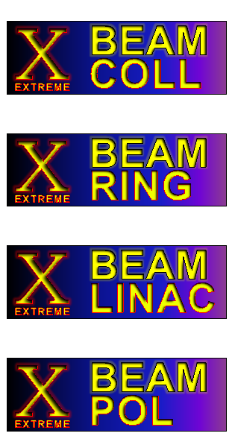
EuCARD-2 WP5 XBEAM
Frank Zimmermann
EuCARD-2 Steering Committee Meeting
11 September 2013
with kind input from Giuliano Franchetti, Mohamad Eshraqi, Marica Biagini, and Kurt Aulenbacher
Work supported by the European Commission under Capacities 7th Framework Programme, Grant Agreement 312453

Slide 2
contents
a) what has been done so far
b) program until the end of the year
c) coming milestones and deliverables

Slide 3
WP5 achievements
web site created: http://cern.ch/xbeam
mailing lists created & ‘filled’:
eucard2-wp5-coordinators@cern.ch
eucard2-wp5.*-info@cern.ch
dissemination effort:
IHEP Higgs symposium, Beijing/China, 12 August’13
CINVESTAV Merida/Mexico, 5 September 2013
ERL workshop, BINP, 12 September 2013

Slide 4
planned XBEAM workshops
XCOLL – TLEP6 workshop, CERN, 16-18 Oct. 2013
XCOLL – SuperKEKB commissioning workshop, KEK, 11-13 Nov. 2013
XRING – "Beam Dynamics meets Magnets,” Darmstadt, 2-4 December 2013
XCOLL – LHC-CC13 LHC crab-cavity workshop, CERN, 9-10 December 2013
XCOLL/IHEP – “circular e⁻e⁺ & pp colliders,” IHEP, 16-17 December 2013
XCOLL+XPOL – LHeC workshop 20-21 January 2014 incl. XPOL session
XLINAC – WP3/EnEfficient joint workshop on IOTs, ESS/Lund, early 2014
XCOLL – co-sponsored workshop “kick-off for projects on Future Circular Colliders”, CERN, February 2014
XPOL – workshop in Mainz, March 2014 ? – to be confirmed
XRING – SpaceCharge2015 in UK
General EuCARD-2 meeting “universities meet laboratories” 2014?

Slide 5
courtesy
G. Franchetti

Slide 6
deliverables :
Preliminary strategies, optimization, limitations, paths & parameters for
future hadron & lepton colliders;
future high-performance hadron rings;
future high-power high-current SC linacs; and
future polarized beams
[month 36]
Strategy for
future extreme beam facilities;
[month 48]
none at the moment

Slide 7
milestones :
Milestone name | Work package(s) involved | Expected date | Means of verification
XCOLL topical workshop | 5 (Task 5.2) | M12 | XCOLL web pages
XRING topical workshop | 5 (Task 5.3) | M12 | XRING web pages
XLINAC topical workshop | 5 (Task 5.4) | M12 | XLINAC web pages
XPOL topical workshop | 5 (Task 5.5) | M12 | XPOL web pages
XCOLL topical workshop | 5 (Task 5.2) | M24 | XCOLL web pages
XRING topical workshop | 5 (Task 5.3) | M24 | XRING web pages
XLINAC topical workshop | 5 (Task 5.4) | M24 | XLINAC web pages
XPOL topical workshop | 5 (Task 5.5) | M24 | XPOL web pages
XCOLL topical workshop | 5 (Task 5.2) | M36 | XCOLL web pages
XRING topical workshop | 5 (Task 5.3) | M36 | XRING web pages
XLINAC topical workshop | 5 (Task 5.4) | M36 | XLINAC web pages
XPOL topical workshop | 5 (Task 5.5) | M36 | XPOL web pages
XCOLL topical workshop | 5 (Task 5.2) | M48 | XCOLL web pages
XRING topical workshop | 5 (Task 5.3) | M48 | XRING web pages
XLINAC topical workshop | 5 (Task 5.4) | M48 | XLINAC web pages
XPOL topical workshop | 5 (Task 5.5) | M48 | XPOL web pages
≥1 workshop per task in year 1

