Slide 1






EuCARD-2 WP5 XBEAM
& WP1 EuCAN
Giuliano Franchetti, Frank Zimmermann
EuCARD-2 Steering Committee Meeting
2 October 2014
with kind input from Kurt Aulenbacher, Marica Biagini, and Mohamad Eshraqi
Work supported by the European Commission under Capacities 7th Framework Programme, Grant Agreement 312453

Slide 2
contents
a) progress since May 2014
b) future program for 2014 & 15
c) milestones and deliverables

Slide 3
XBEAM events since May’14
SC Collaboration Meeting 2014 (XRING), CERN, 20-21 May 2014
MulCoPim’14 (XCOLL), Valencia, 17-19 Sept. 2014
Communications since May’14
Beam Dynamics meets Magnets supported by EuCARD-2,
Giuliano Franchetti, Accelerating News #11, Autumn 2014

Slide 4
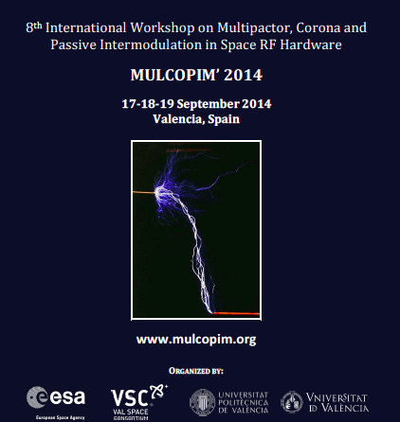


Slide 5
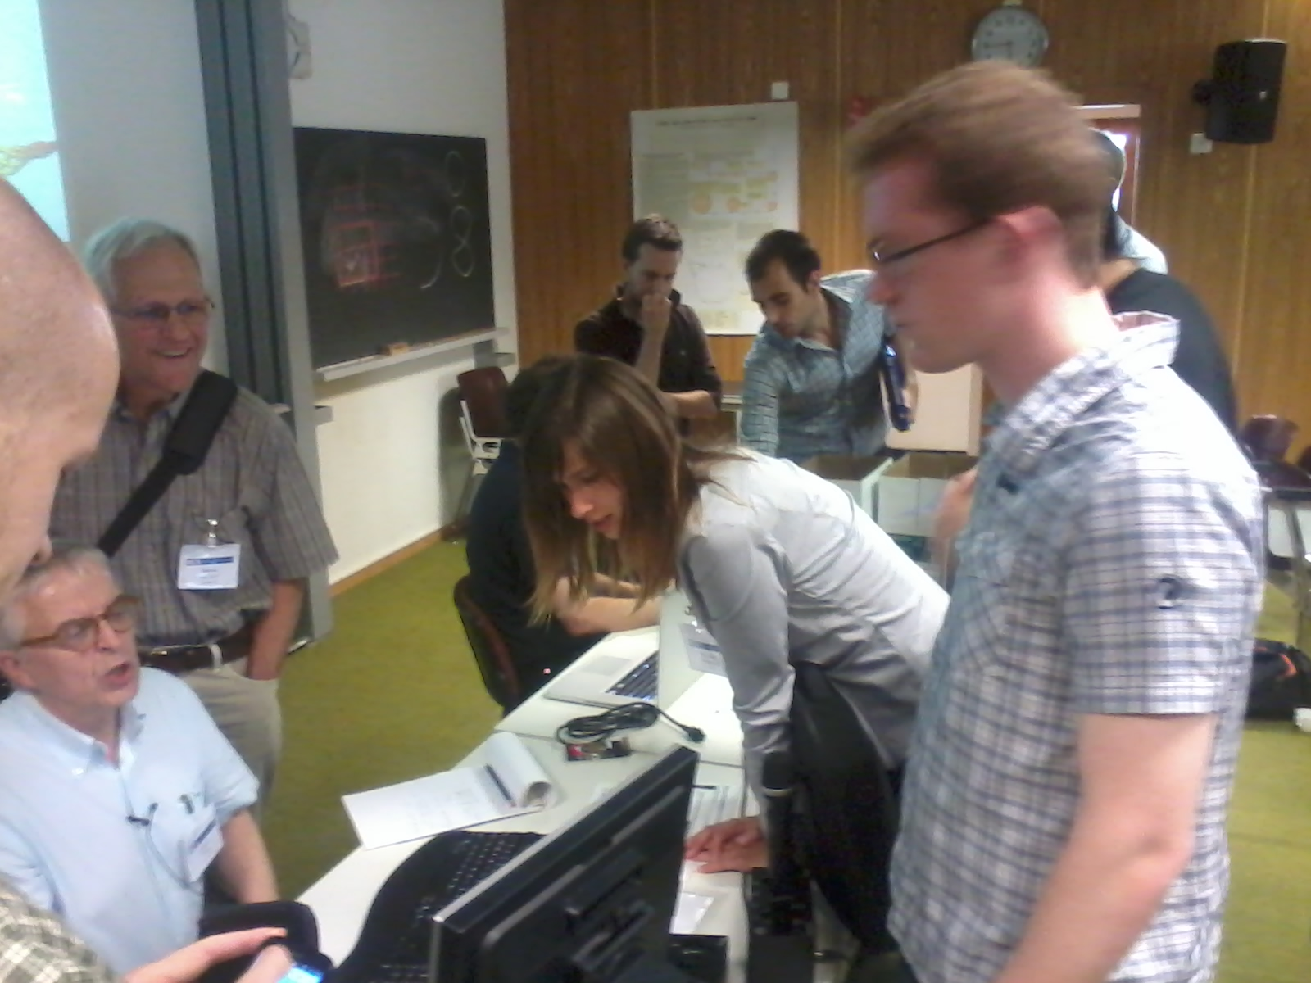
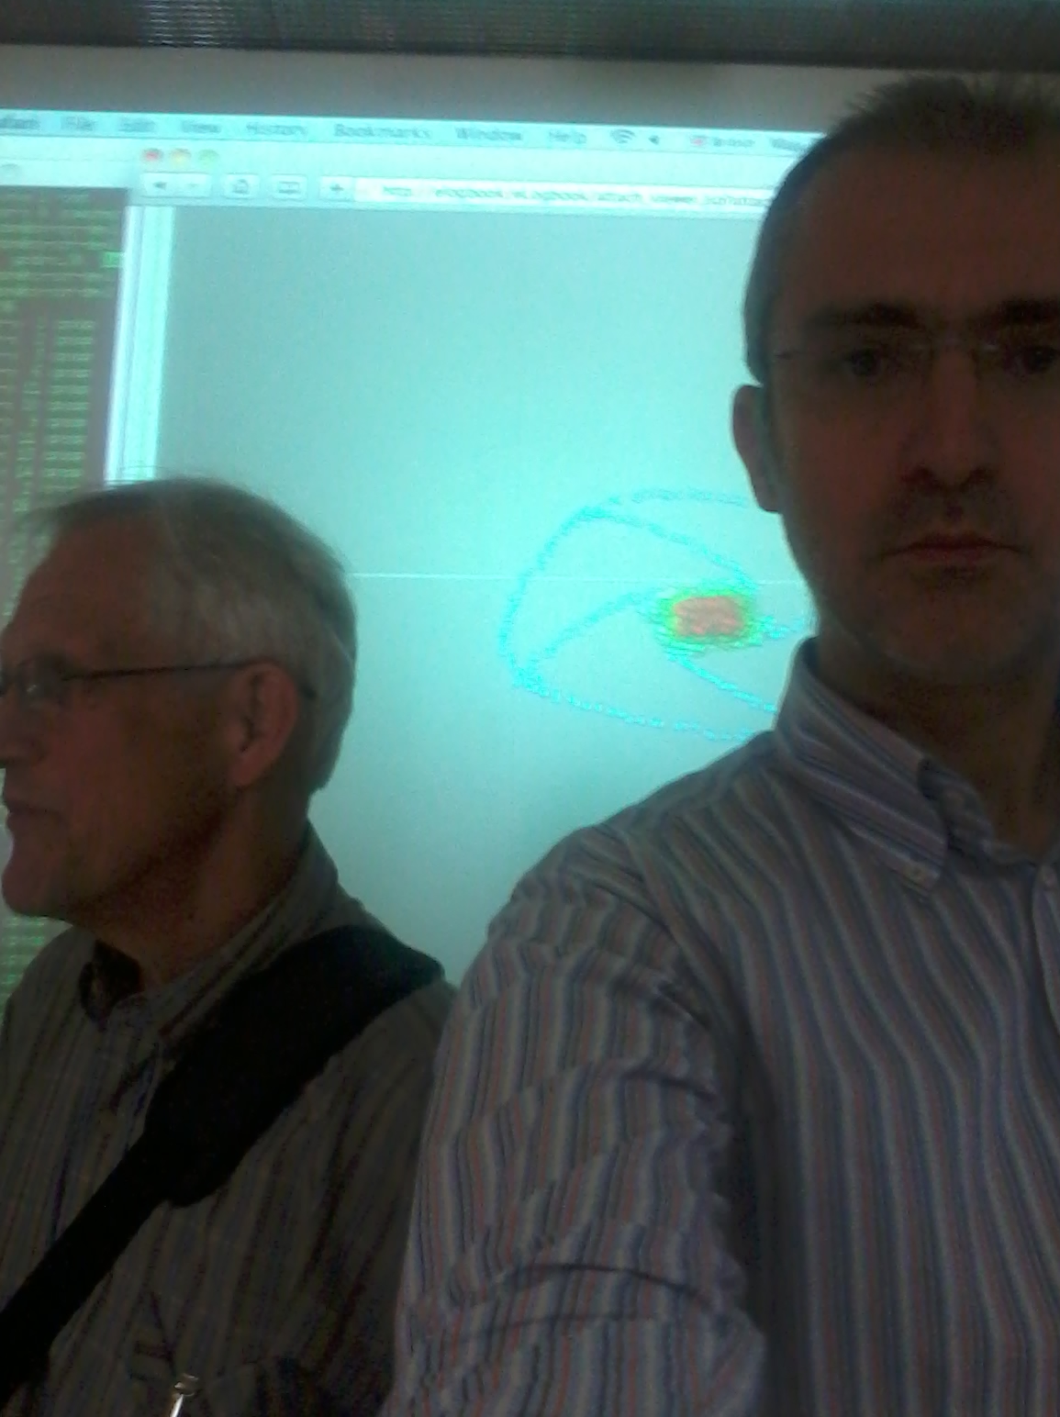
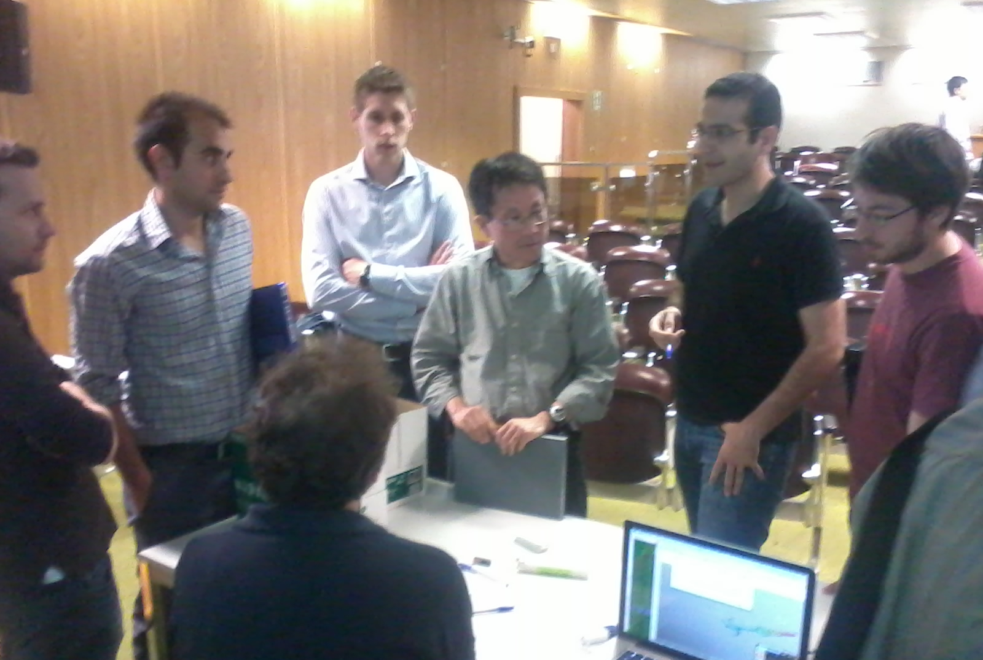
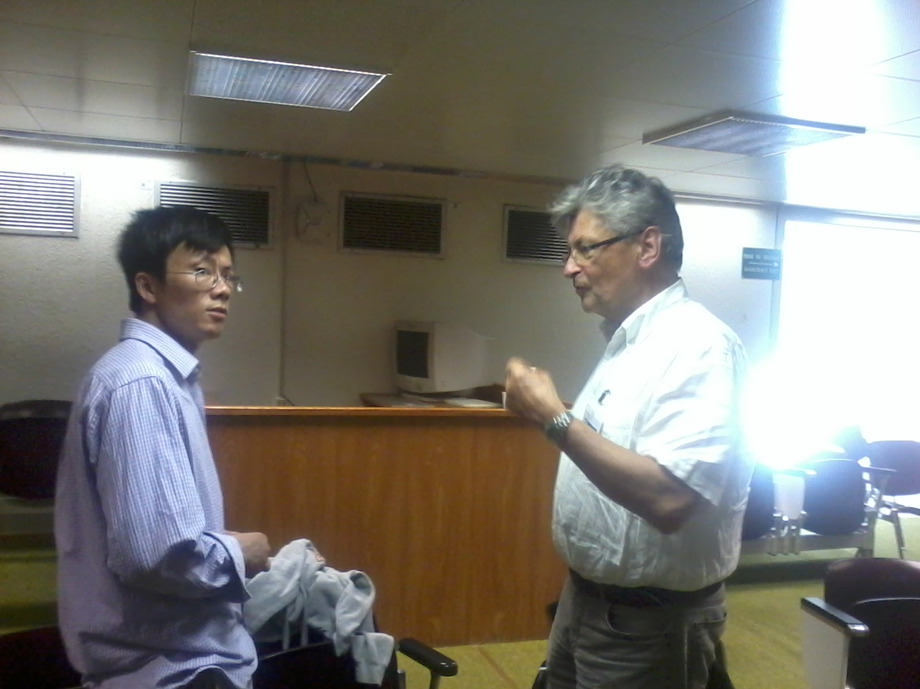
Space Charge collaboration meeting
CERN 20-21 May 2014
Attendees:
Switzerland (CERN): 14
Germany (GSI, Frankfurt University, Helmholtz-Zentrum Berlin): 8
UK (STFC): 1
USA (Fermilab, Oakridge, BNL, LBNL): 5
themes: space charge studies for LIU, code benchmarking and experiments
Summary of the Space Charge Collaboration Meeting May 2014, F. Schmidt, CERN-ACC-2014-0208

Slide 6
outreach talks/seminars since May’14
M. Benedikt, D. Schulte, J. Wenninger, F. Zimmermann, Challenges for Highest-Energy Circular Colliders, IPAC'14 Dresden, 16 June 2014
F. Zimmermann, Der Future Circular Collider am CERN - Beschleuniger und Physik, Physikalisches Kolloquium KIT Karlsruhe, 27 June 2014
F. Zimmermann, Future Accelerators, oPAC School, Royal Holloway, 12 July 2014
K. Oide, Circular e+e- Colliders, Physics at LHC and beyond , Quy Nhon (Vietnam) , August 10 - 17, 2014
S. Chattopadhyay, High-Energy Proton-Proton Colliders , Physics at LHC and beyond , Quy Nhon (Vietnam) , August 10 - 17, 2014
F. Zimmermann, Future Highest-Energy Circular Colliders, Corfu Summer School and Workshop, 12 September 2014

Slide 7
publications since May’14
Challenges for highest energy circular colliders, M. Benedikt, D. Schulte, J. Wenninger, F. Zimmermann, Proc. IPAC’14 Dresden, CERN-ACC-2014-0153
FCC-ee/CepC Beam-beam Simulations with Beamstrahlung, K. Ohmi, F. Zimmermann
Proc. IPAC’14, Dresden, p. 3766
Summary of the Space Charge Collaboration Meeting May 2014, F. Schmidt, CERN-ACC-2014-0208

Slide 8
upcoming events in 2014/15 – 1
6th Int'l Conf., Charged & Neutral Particles Channeling Phenomena - Channeling 2014 (XCOLL) Italy, 5-10 Oct. 2014
High Luminosity Circular e⁺e⁻ Colliders – Higgs Factory (HF2014) (XCOLL), Beijing, China, 9-12 Oct. 2014
Beam Dynamics meets Magnets II (XRING), PSI, Switzerland, 1-4 December 2014
Advanced Optics Control (XRING & XCOLL), CERN, 5-6 February 2015

Slide 9
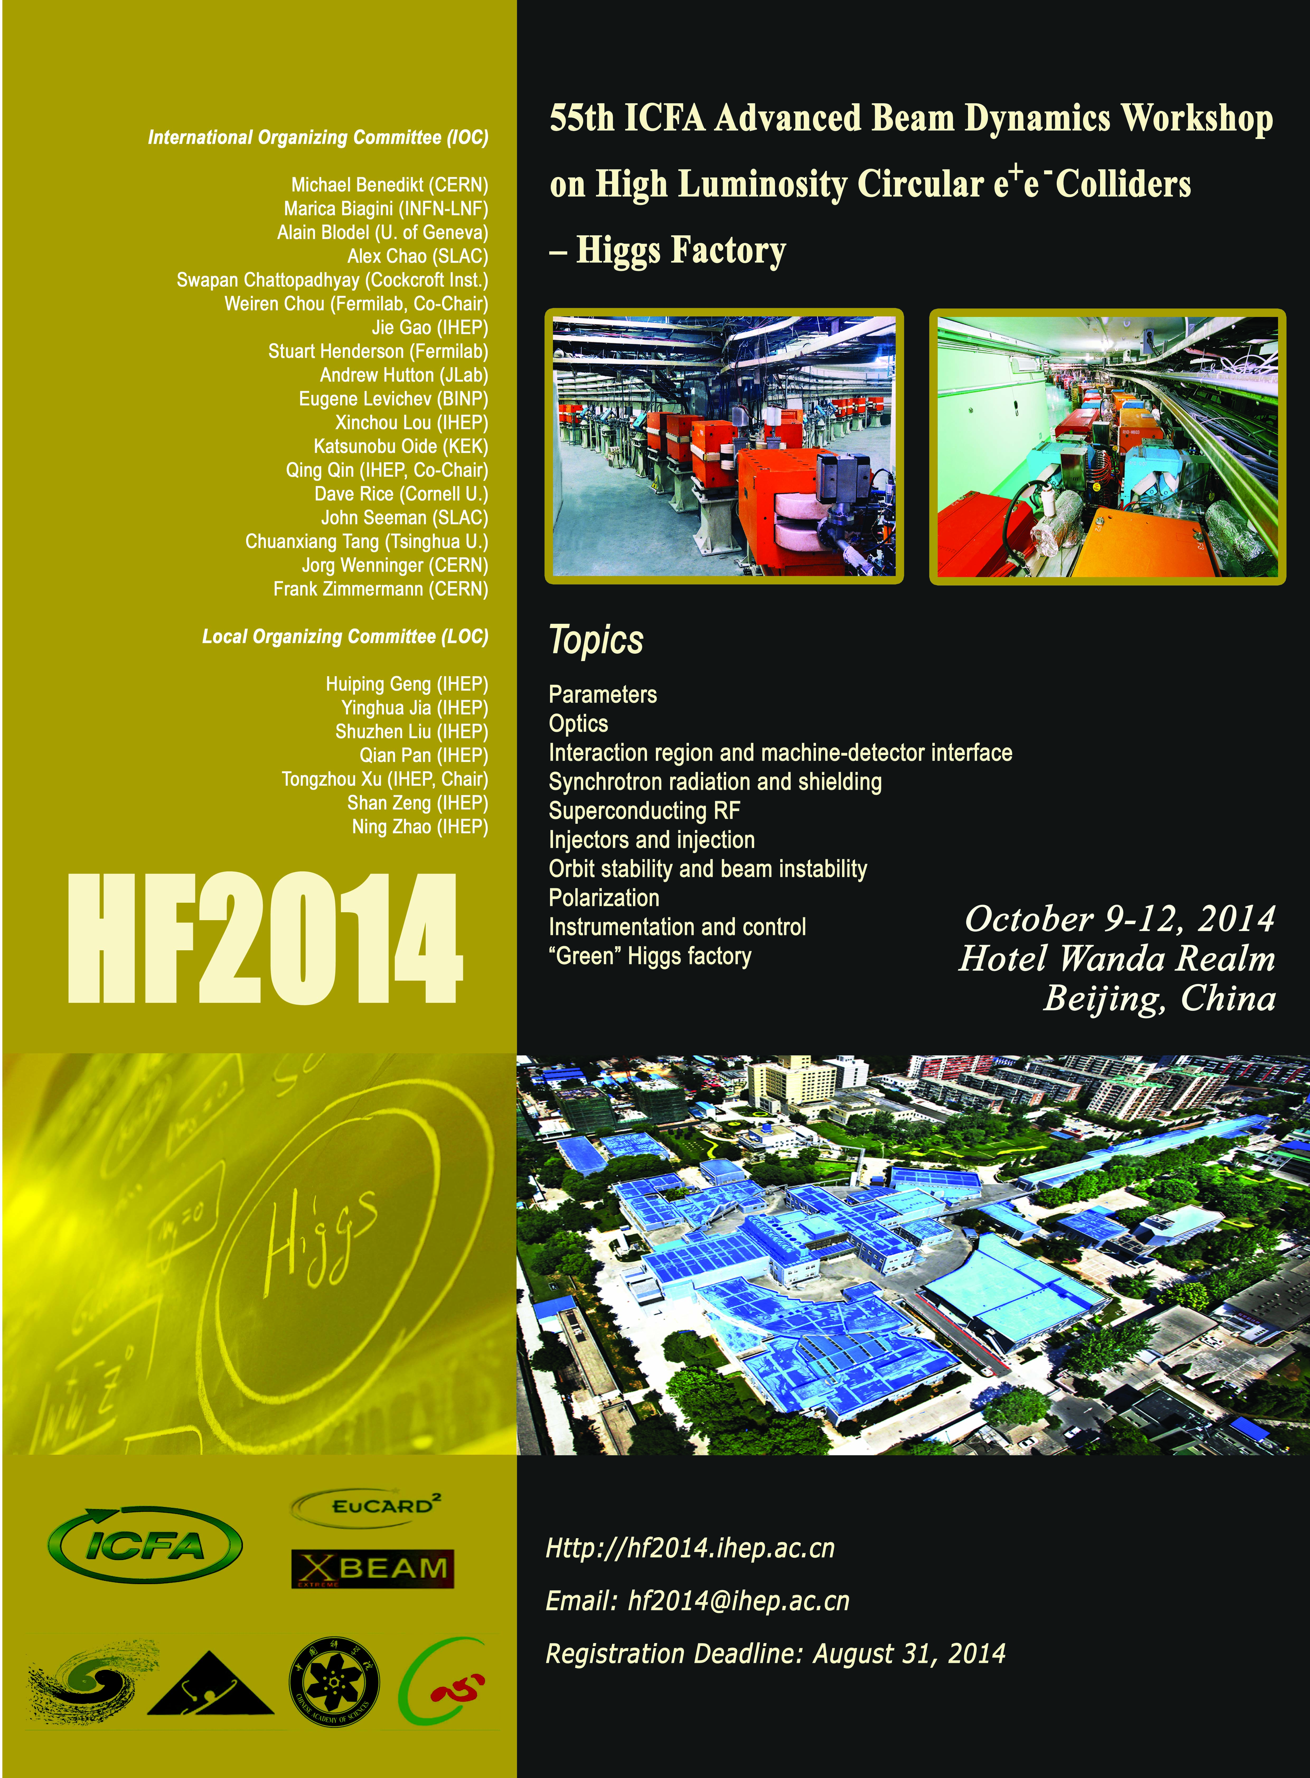
High Luminosity Circular e⁺e⁻ Colliders – Higgs Factory (HF2014), Beijing, 9-12.10. 2014
co-sponsored by
XBEAM (XCOLL)
China 44
Italy 2
India 1
Japan 7
Mongolia 3
Russia 10
South Africa 1
Sweden 1
Switzerland 11
USA 17
97 registrants

Slide 10
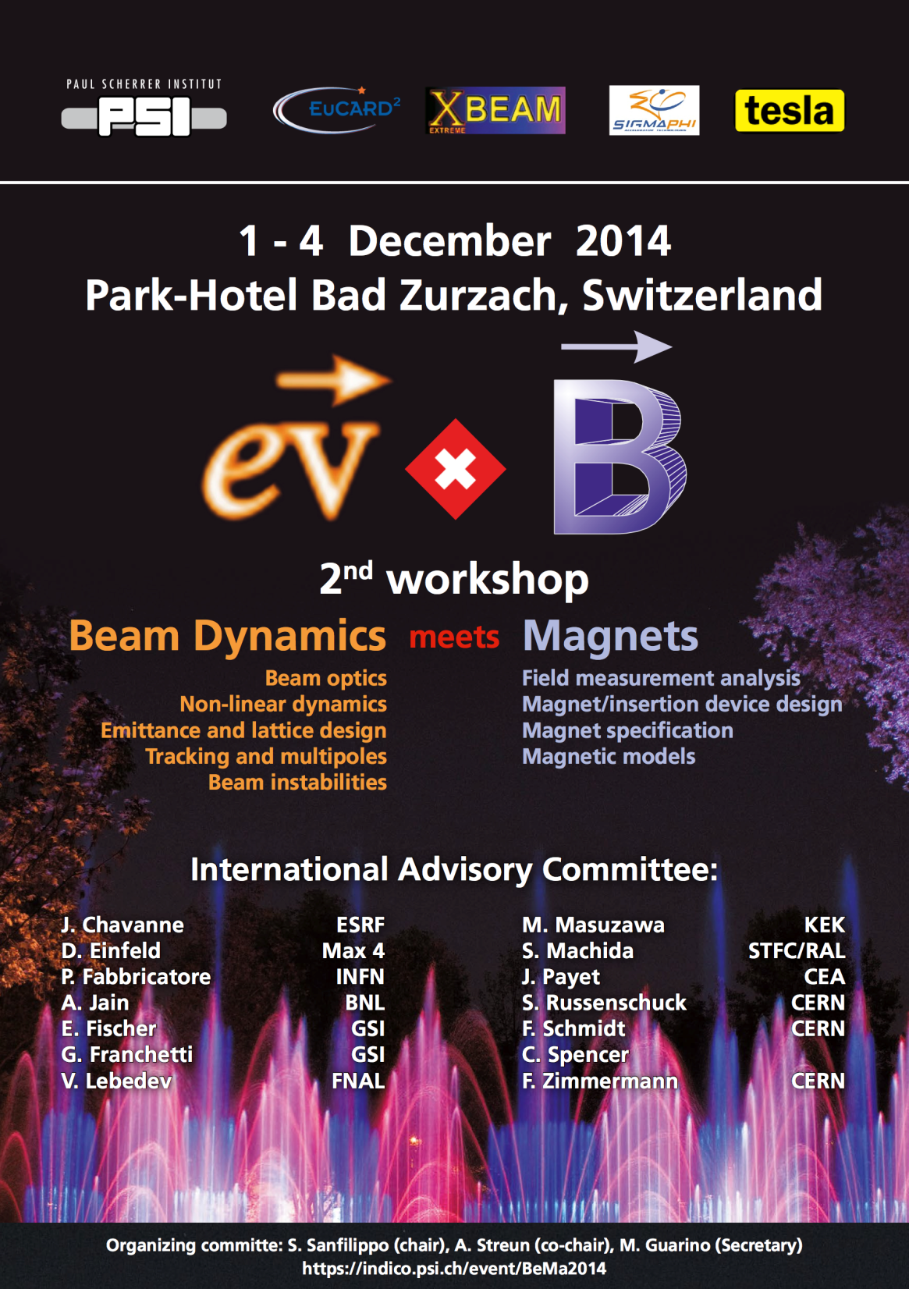
Upcoming workshop
“Beam dynamics meets Magnets-II” (XRING)
continuation of the forum
started in Darmstadt,
with involvement of industry
https://indico.psi.ch/conferenceDisplay.py?confId=3033
France 4
Germany 5
Italy 1
Japan 2
Malta 1
Sweden 3
Switzerland 27
UK 5
USA 10
58 registrants

Slide 11
Workshop on Advanced Optics Control (XCOLL&XRING)
CERN, 5-6 February 2015
Scope: Review of recent advancements in optics measurement, correction
and understanding from colliders and synchrotrons around the world
Organizers: Mei Bai, Giuliano Franchetti, Mike Lamont, Massimo Giovannozzi, Rogelio Tomas and Frank Zimmermann,… (preliminary)
Session I (modern colliders)
-Optics needs for LHC at 6.5 TeV, beta* leveling in RHIC, Tevatron, DAFNE, VEPP-2000, SuperKEKB and Injector commissioning
Session II (light sources)
-ESRF upgrade, DIAMOND upgrade, SLS, SOLEIL (including resonance driving terms)
Session III (exotic topics)
-PS islands measurements/MTE, septum-less injection/extraction , "Fixed lines“, optics needs for EDM storage ring
Session IV (improvements of the LHC complex)
-Non-linear puzzles of the LHC, Advanced algorithms for the LHC optics, Linear and non-linear coupling in the LHC, Resonance mapping in the PS

Slide 12
upcoming events in 2014/15 – 2
Electrostatic Rings for EDM Experiments (XPOL), Mainz, 23-24 February 2015
Space Charge 2015 (XRING), Oxford, 23-27 March’15
Future Circular Collider workshop (XCOLL), 23-27 March 2015, Washington DC
Linac High-Power Couplers (XLINAC), 2014-15
Commissioning of High-Power Linacs – 2 (LINAC)
Beam Dynamics Issues of High Power Linacs (XLINAC), CERN, 2014/15?
Beam dynamics meets Diagnostics (XRING), end’15?

Slide 13
Electrostatic Rings for EDM Experiments Mainz, 23-24 February 2015
Organizer: Kurt Aulenbacher
Motivation:
“Several initiatives try to measure hadron EDM's in custom-build storage rings. Since specialized hadron storage rings are quite expensive, it was discussed to erect an electron storage ring, because such a device can be very compact (frozen spin in electrostatic bends at ~15 MeV) and may serve as a test bench to develop technology and measurement techniques which could later be applied to the hadron EDM.”
Workshop topics related to the EDM electron storage ring:
technology: vacuum, electrostatic deflectors, polarized injector, polarimetry, spin dynamics
project development, cost,...
positrons...
physics case for measuring the EDM of the electron
related subjects e.g. g-2 (Muon)

Slide 14
Space Charge 2015
March 23rd – 27th, 2015
Trinity College Oxford
Organizer: Chris Prior

Slide 15
WP5 XBEAM
Milestones & Deliverables

Slide 16
deliverables :
Preliminary strategies, optimization, limitations, paths & parameters for
  future hadron & lepton colliders;
  future high-performance hadron rings;
  future high-power high-current SC linacs; and
  future polarized beams
  [month 36]
Strategy for
  future extreme beam facilities;
  [month 48]
none at the moment

Slide 17

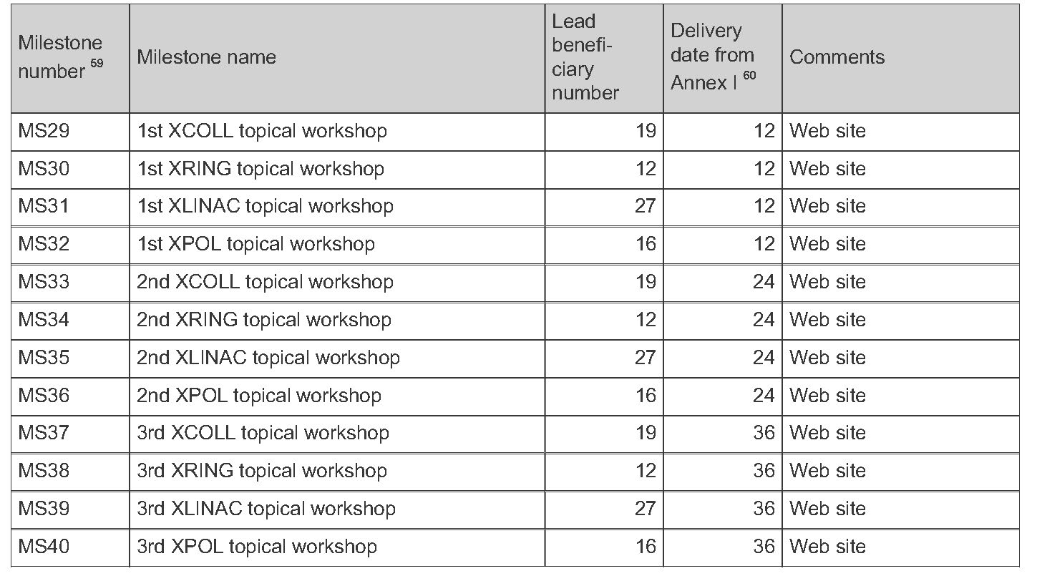
milestones :
≥1 workshop per task in year 1
accomplished by Oct’14:
7 workshops for XCOLL
2 workshop for XRING
1 workshop for XLINAC
1 workshop for XPOL
planned for 2014/15:
4 workshops for XCOLL
3 workshops for XRING
3 workshops for XLINAC
1 workshop for XPOL

Slide 18
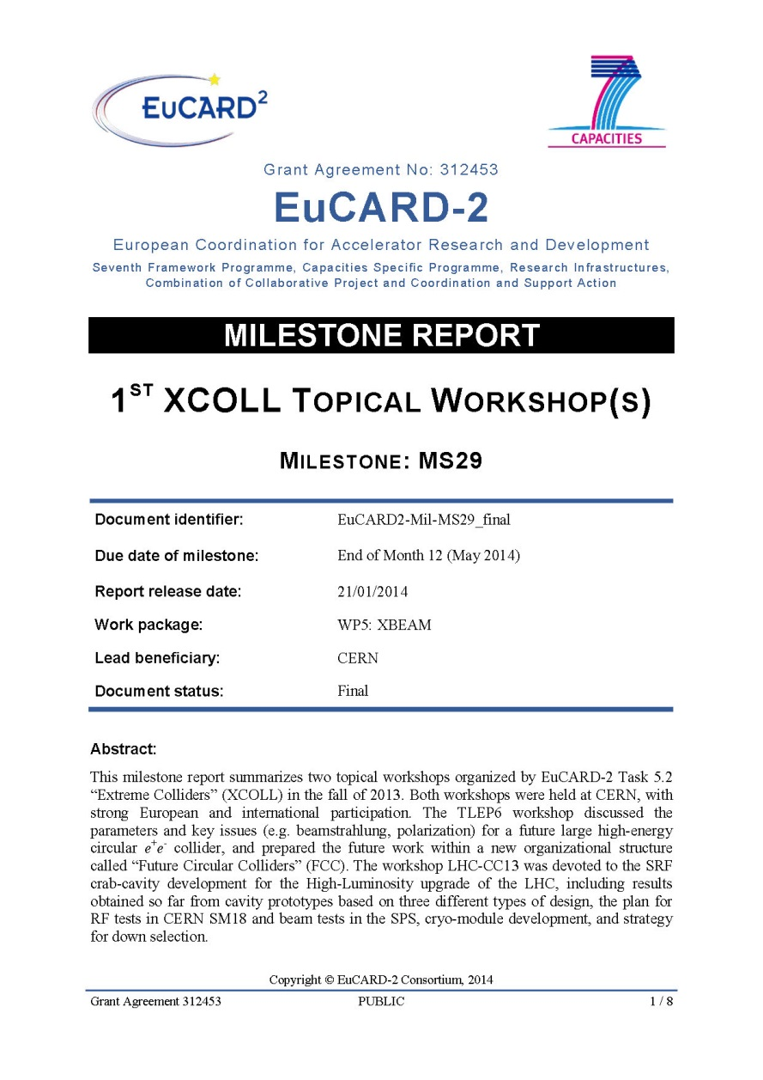
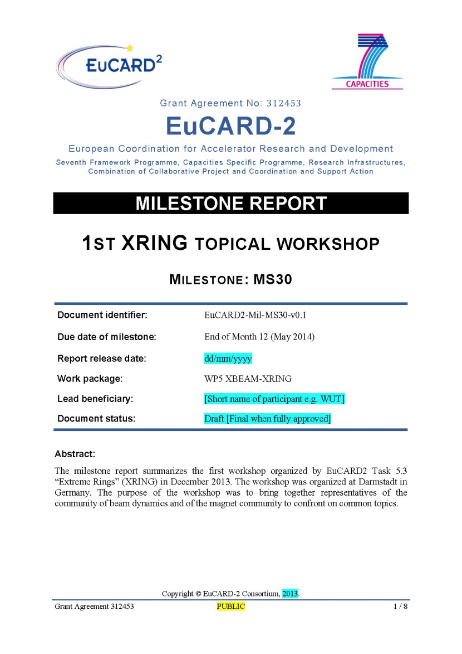
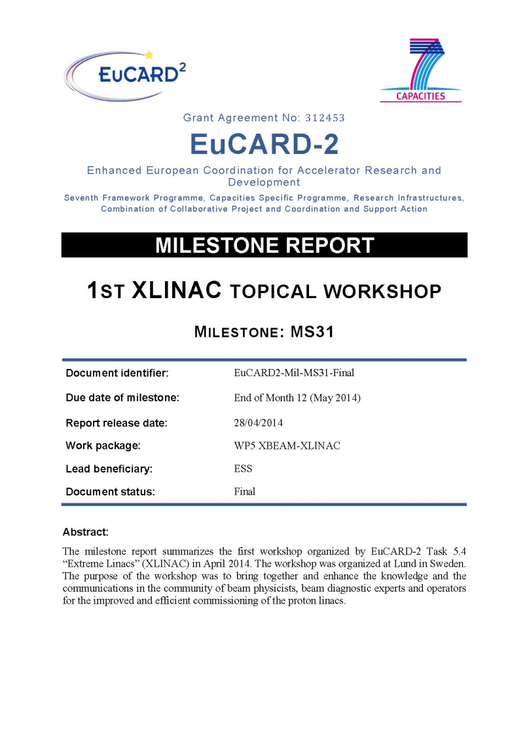
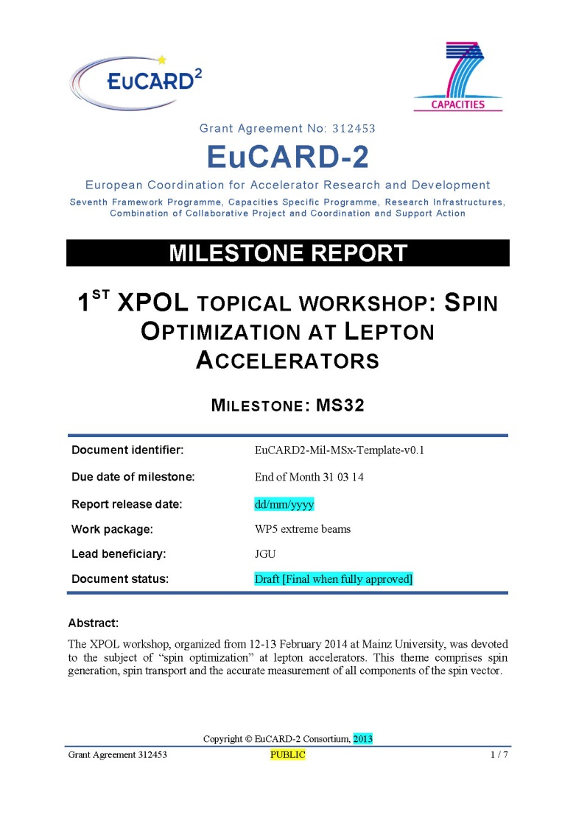
WP5 XBEAM MS reports
EuCARD2-Mil-MS29
EuCARD2-Mil-MS30
EuCARD2-Mil-MS31
EuCARD2-Mil-MS32

Slide 19
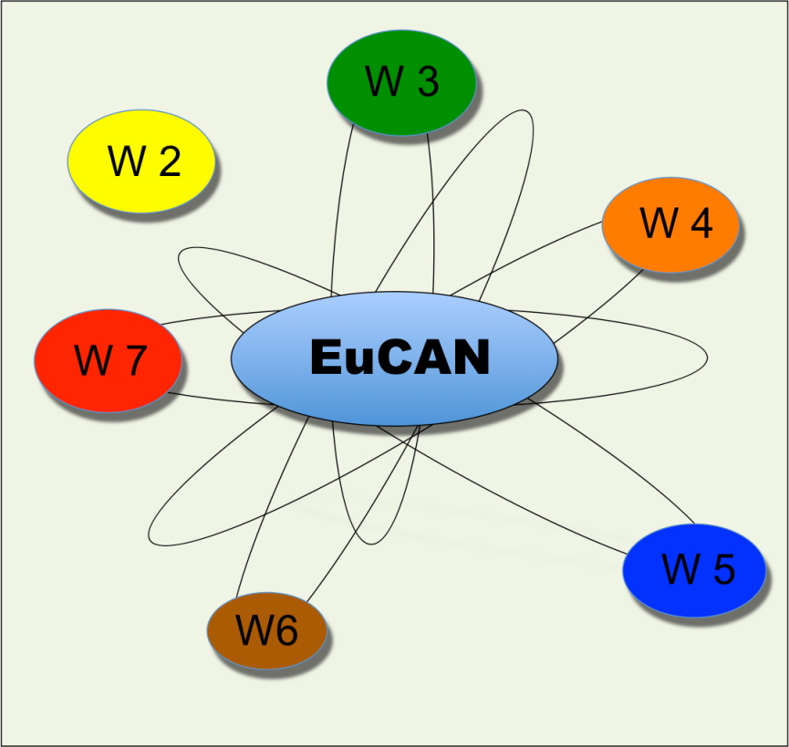
WP1.4 EuCAN
Coordinating the activities of the accelerator networks within EuCARD-2, platform for information exchange, interface, etc.

Slide 20

EuCAN WS "Universities meet Labs" (EuCAN), Frankfurt am Main,
30 Sept. -2 Oct. 2014
themes
Training & accelerator schools across world
Students between two worlds
Collaboration of Universities and laboratories
Research ranking in different countries
Journals, impact factor, Hirsch index
Physical societies & status of accelerator physics
Funding/collaboration initiatives, e.g. in Germany & Hessen (LOEWE, FIAS, Helmholtz Institutes, KFB, DPG AKBP) but also Spain (CONECTA)
Frankfurt accelerator facilities (w. tour)
Funding
EuCARD-2 networks
40 participants

Slide 21
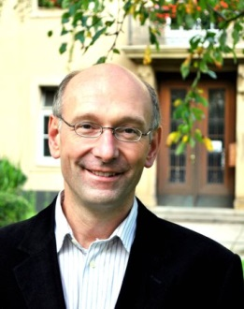
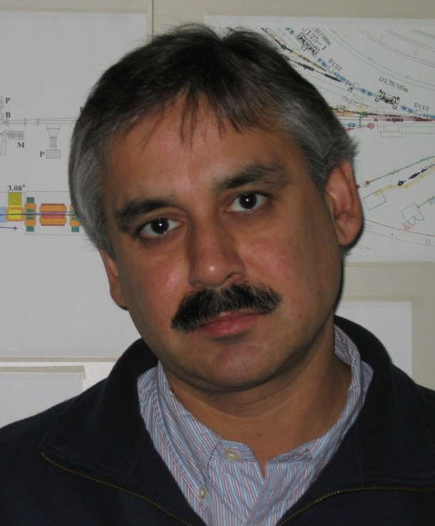
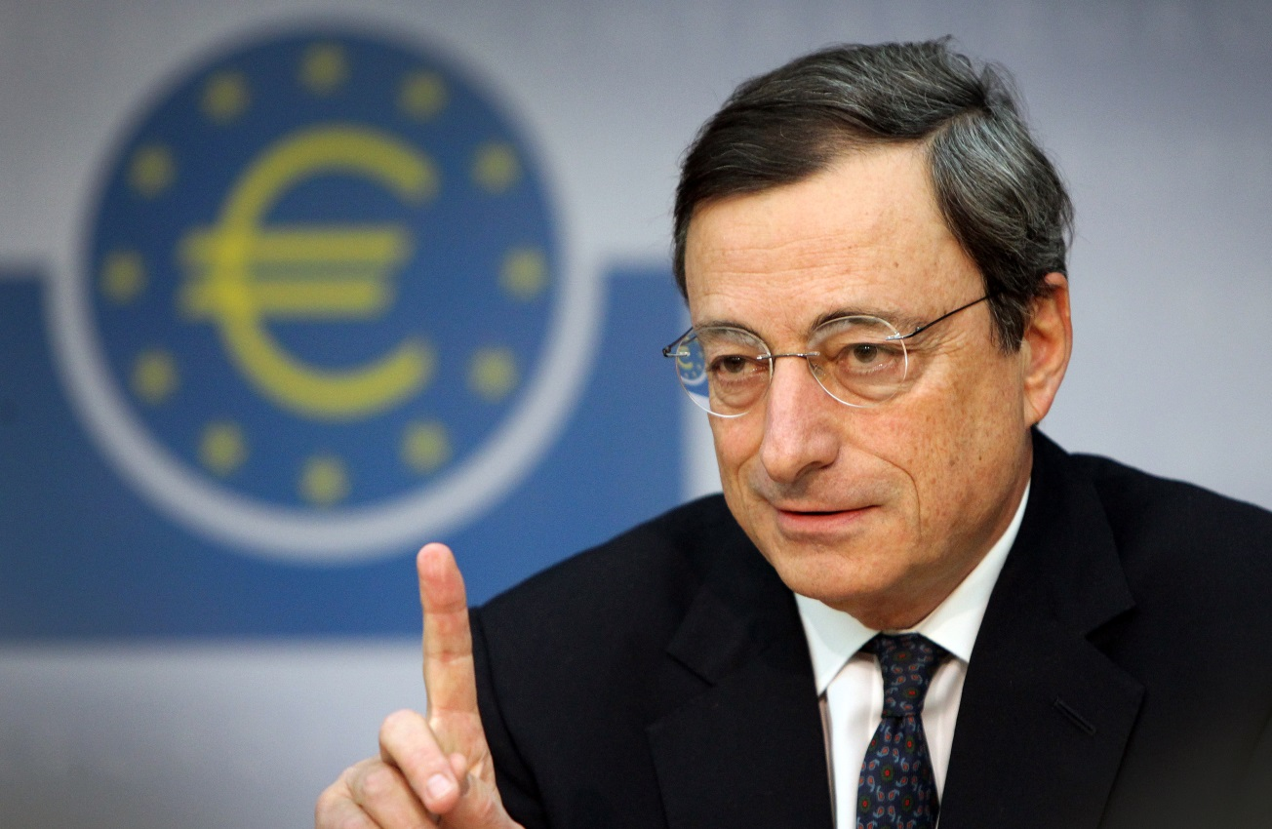
three invitees could not come…

Slide 22
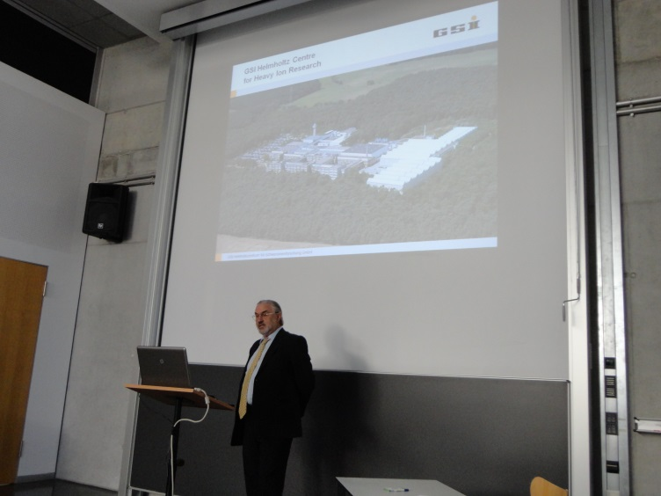
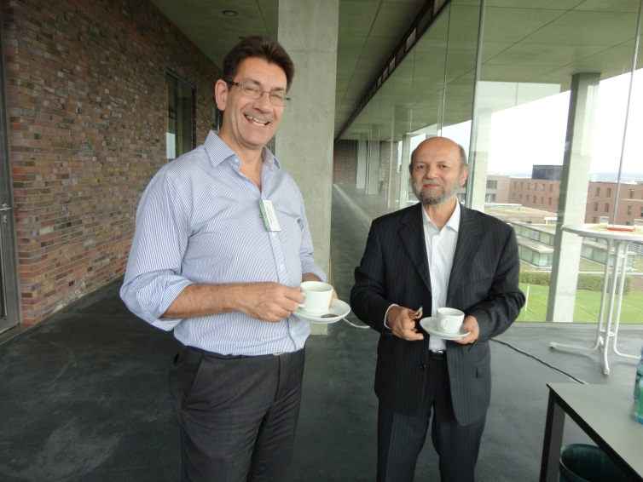
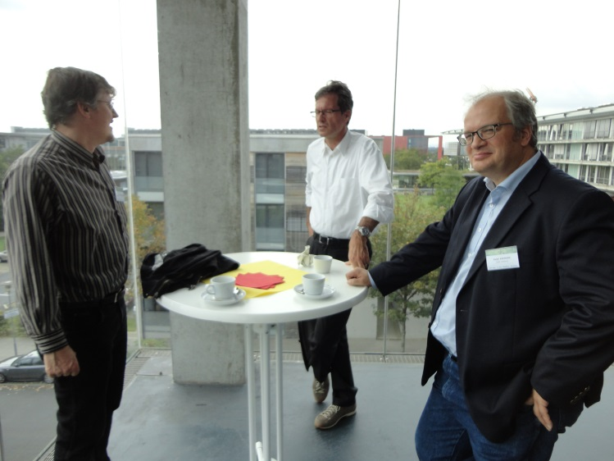
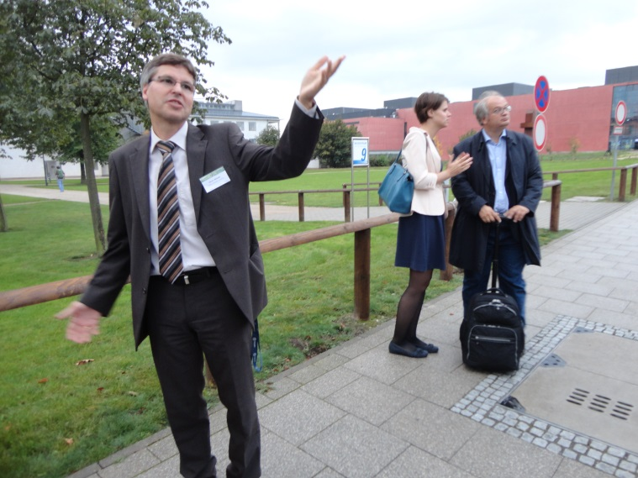
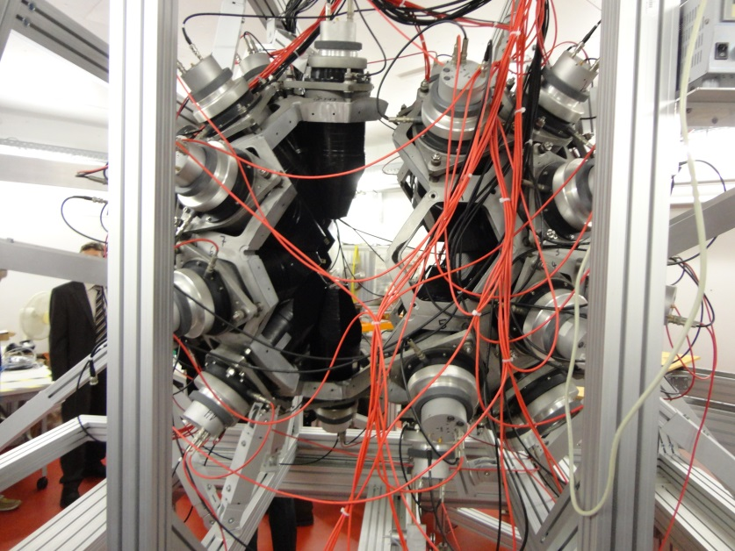
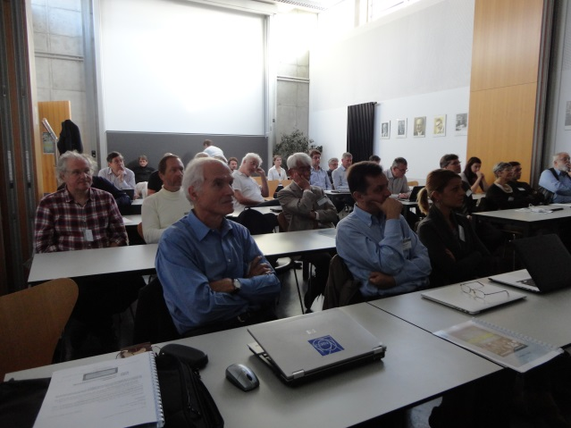
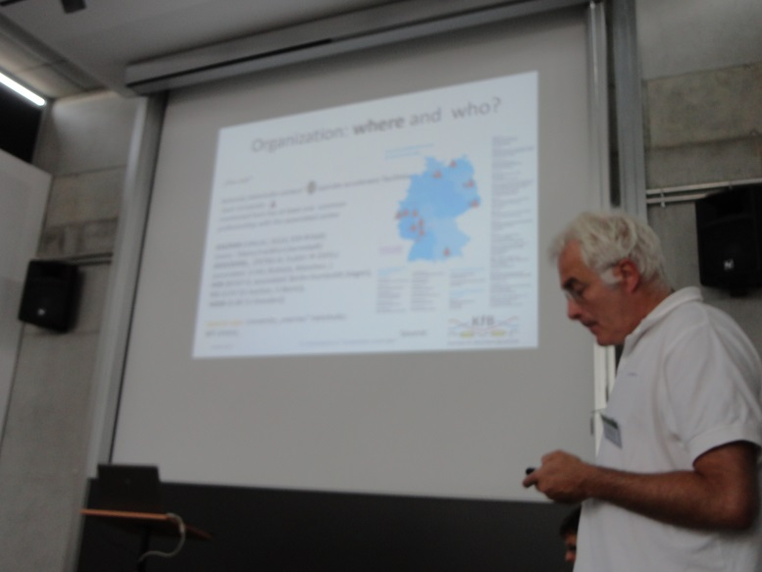
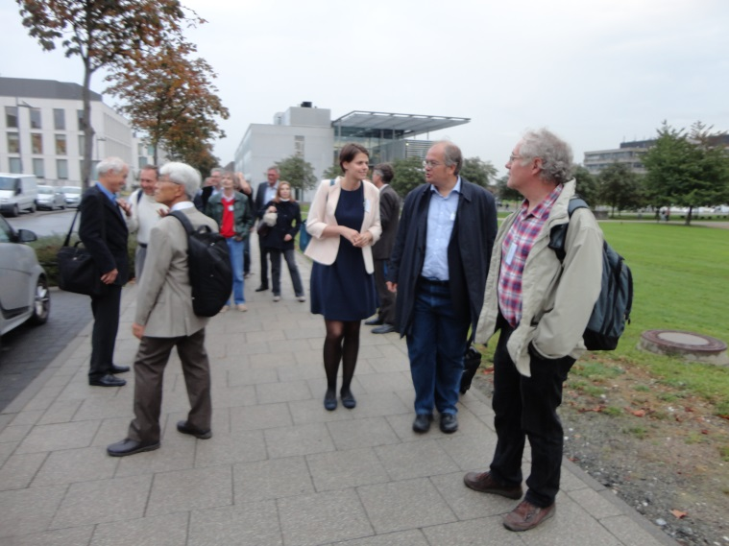
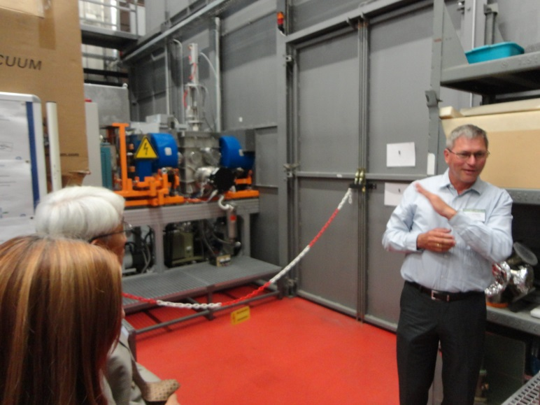
despite this the workshop was successful …

Slide 23
EuCAN WP1
deliverable
key results of 5 accelerator networks
M18
due rather soon
input from EuCAN WS

Slide 24
open issues:
update of TIARA surveys by EuCARD-2?
  suggestion from EuCAN workshop
  do we want to do this?
  If yes, how should we proceed?
a question: can EuCARD-2 activities prepare responses to EU Horizon2020 calls?

