Slide 1
EuCARD-2 WP5 XBEAM & WP1 EuCAN
Frank Zimmermann
EuCARD-2 Steering Committee Meeting
19 March 2014
with kind input from Kurt Aulenbacher, Marica Biagini, Mohamad Eshraqi, and Giuliano Franchetti
Work supported by the European Commission under Capacities 7th Framework Programme, Grant Agreement 312453

Slide 2
contents
a) achievements so far
b) program for 2014 & beyond
c) milestones and deliverables

Slide 3
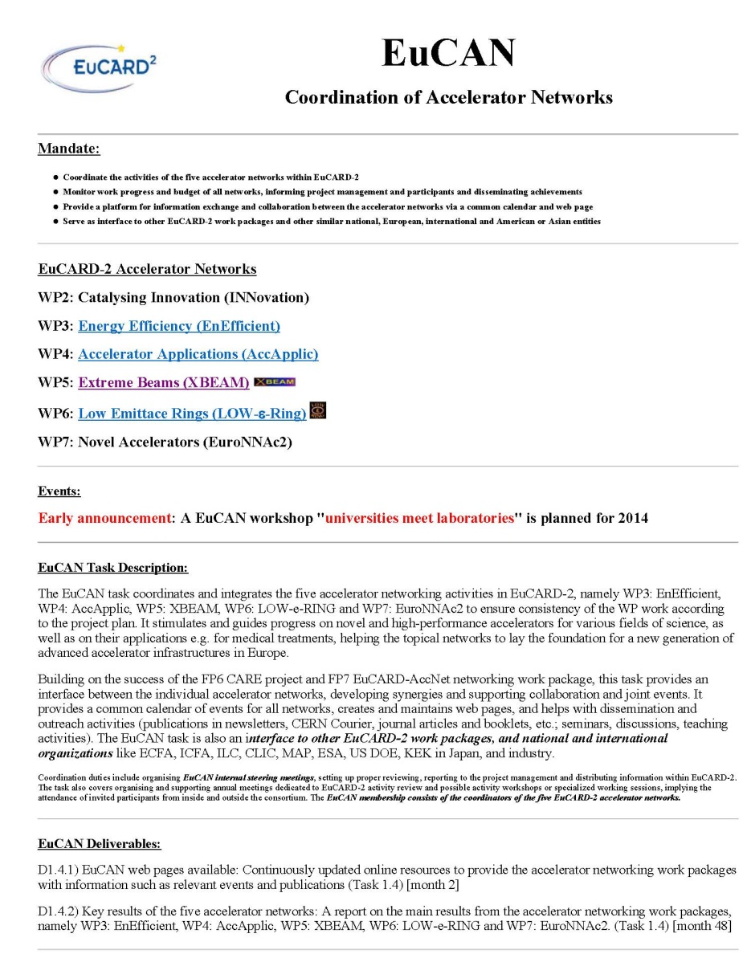
WP1 EuCAN achievements
web site created: http://cern.ch/eucan
milestone
report
EuCARD2-Mil-MS4
CERN-ACC-2013-0263

Slide 4
WP5 achievements
web site created: http://cern.ch/xbeam
mailing lists created & ‘filled’:
eucard2-wp5-coordinators@cern.ch
eucard2-wp5.*-info@cern.ch
dissemination effort:
IHEP Higgs symposium, Beijing/China, 12 August’13
CINVESTAV Merida/Mexico, 5 September 2013
ERL workshop, BINP, 12 September 2013, DESY 11 October 2013, KfB Darmstadt 29 November 2013
Future High Energy Circular Colliders, Beijing, 16-17.12.13
three milestone reports (see later)

Slide 5
XBEAM events in 2013
EuCARD-2 kick off meeting, CERN, 10-14 June 2013
XBEAM Steering Meeting 14 June 2013
XCOLL TLEP6 workshop, CERN, 16-18 Oct. 2013
SuperKEKB commissioning workshop (XCOLL) KEK, 11-13 Nov. 2013
"Beam Dynamics meets Magnets" (XRING), Darmstadt, 2-4 December 2013
LHC-CC13 LHC crab-cavity workshop (XCOLL), CERN, 9-10 December 2013

Slide 6
XBEAM events in 2014 so far
LHeC workshop (XCOLL), 20-21 January 2014
“Future Circular Colliders Study Kickoff” (XCOLL), CERN, 12-15 Feb 2014
EUCARD workshop "Spin optimization at Lepton accelerators“ (XPOL), Mainz, 12-13 February 2014

Slide 7
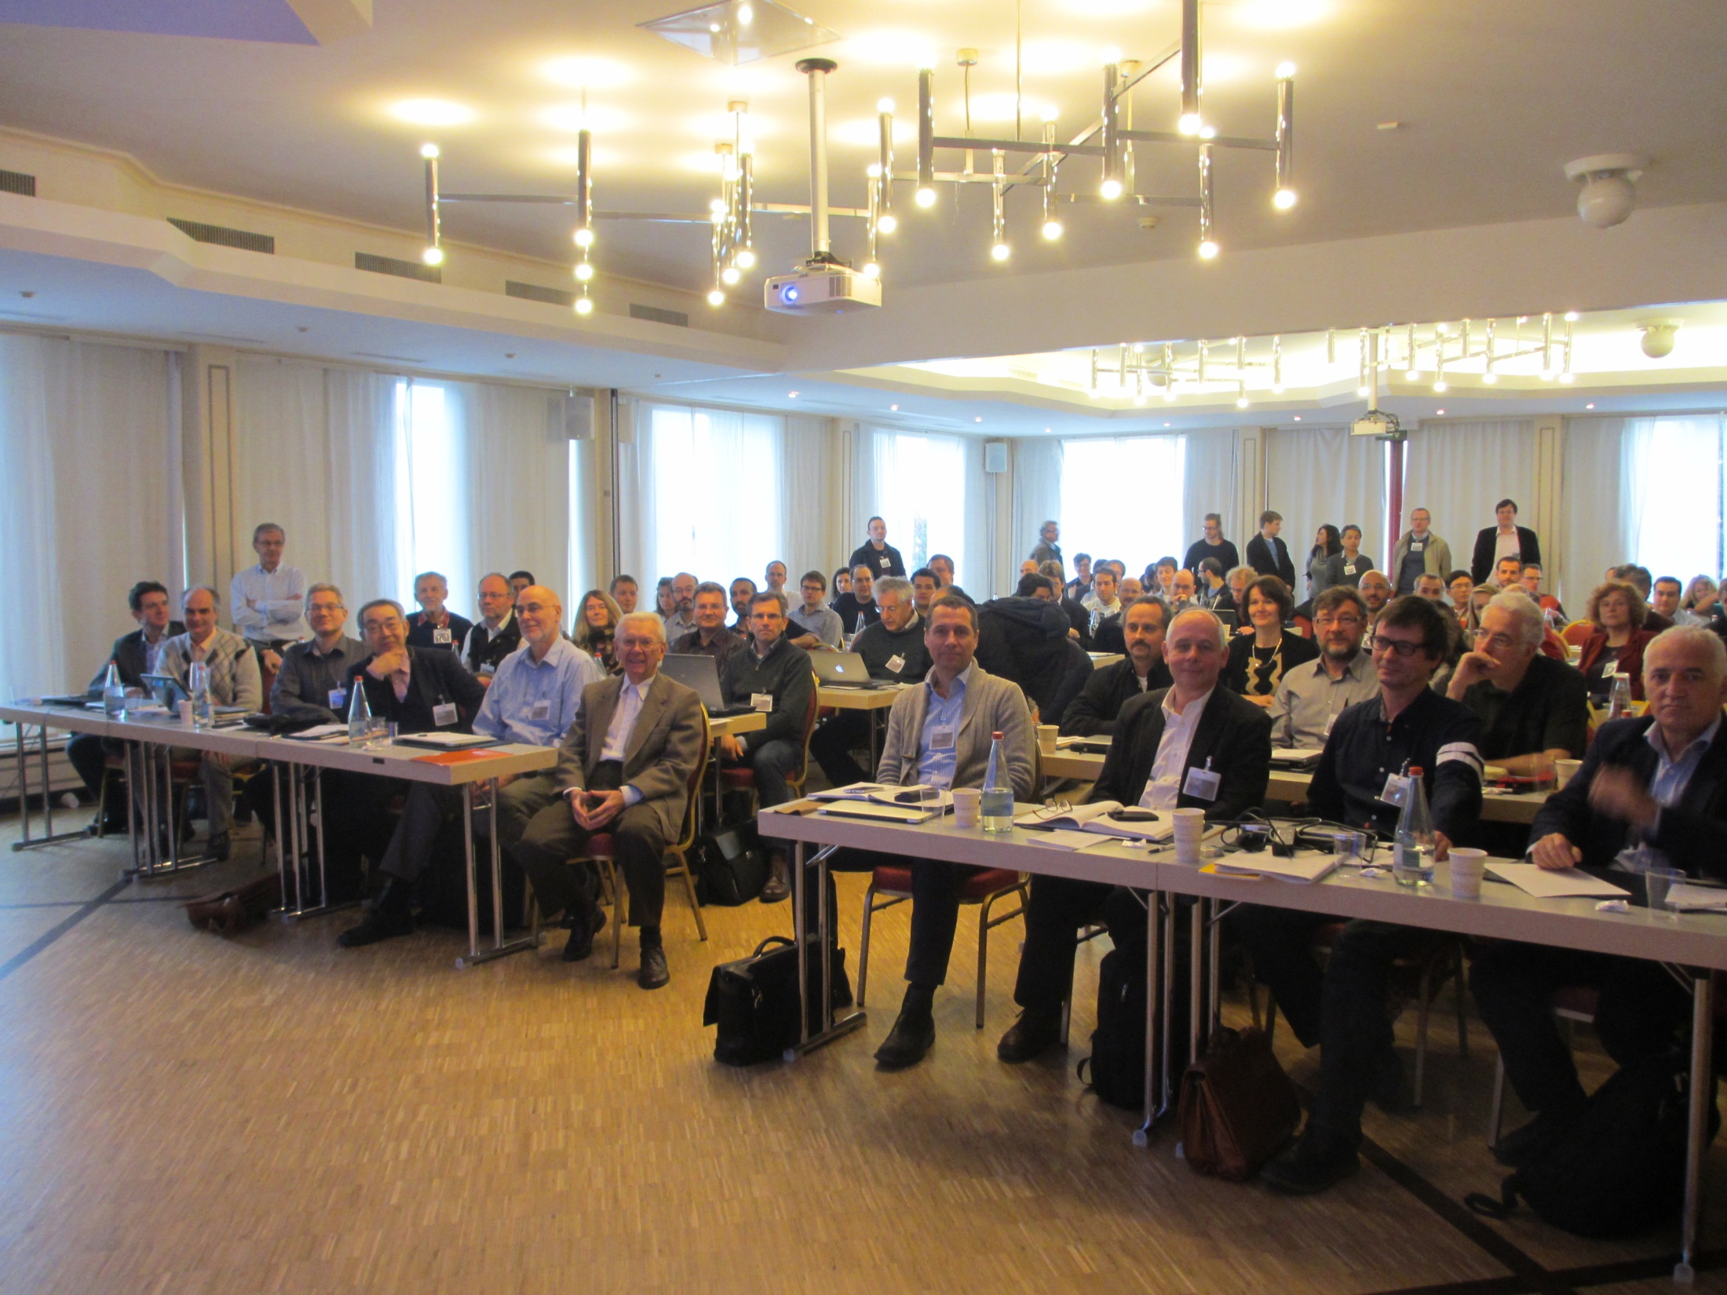
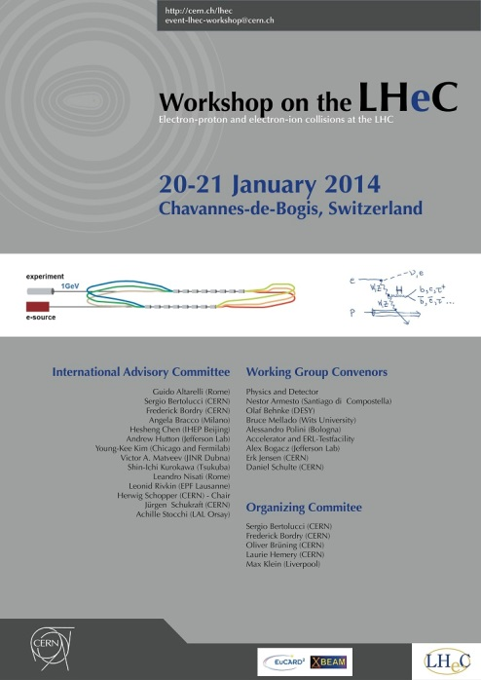
LHeC workshop, 20-21 January ‘ 14, Chavannes-de-Bogis - 109 participants (USA: 14, Asia: 4, Africa: 3, Latin America: 2, CERN: 48, Europe: 37)
launch of IAC & Coordination Group
physics case & detector design
new ideas (FFAG, CSR, p-beam cooling)
CERN Test Facility (applications, layout)
collaboration & ERLs: plans around the world
future needs and integration in FCC
participation by CERN Directors Frederick Bordry & Sergio Bertolucci + former CERN DG Herwig Schopper

Slide 8
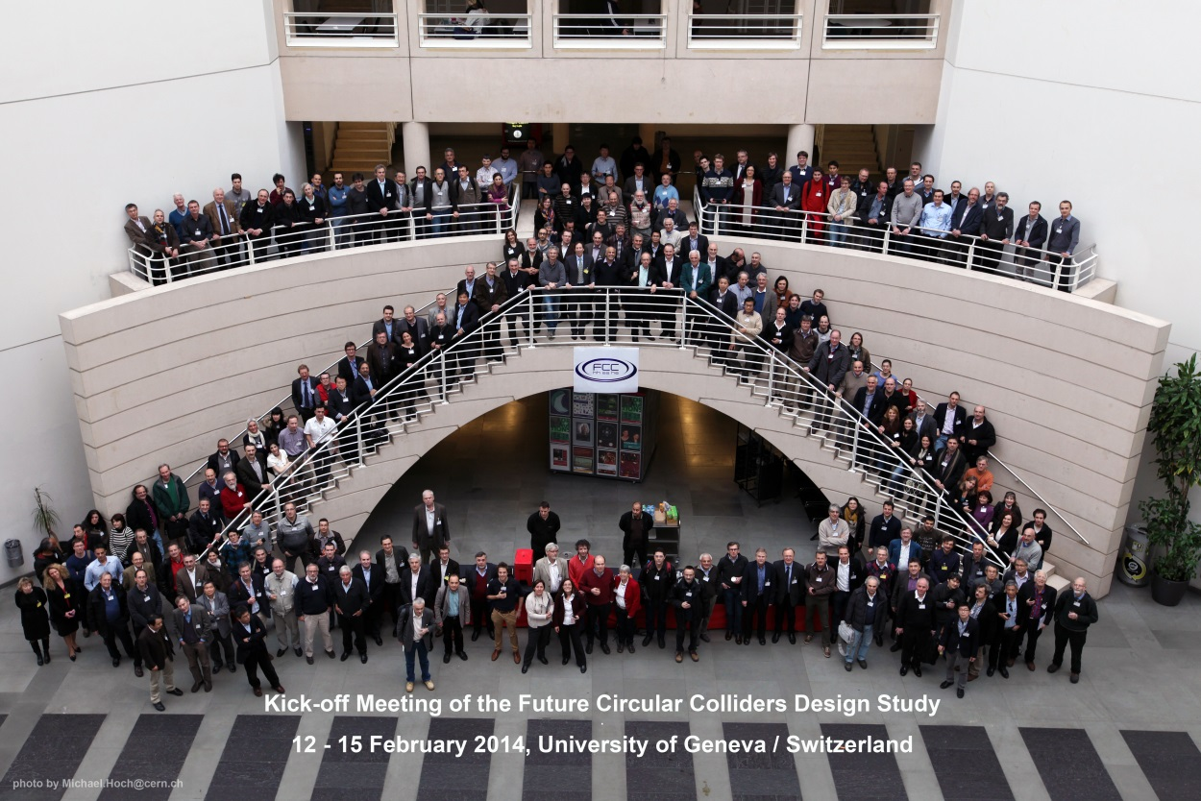
Kick-Off meeting for Future Circular Collider study (FCC) U. Geneva, 12-15 February 2014 341 registered participants (Americas: 37, Asia: 19, Africa: 1. CERN: 140, Europe: 144)
all FCC aspects
refined study scope
schedule, WBS, milestones
path towards international collaboration

Slide 9
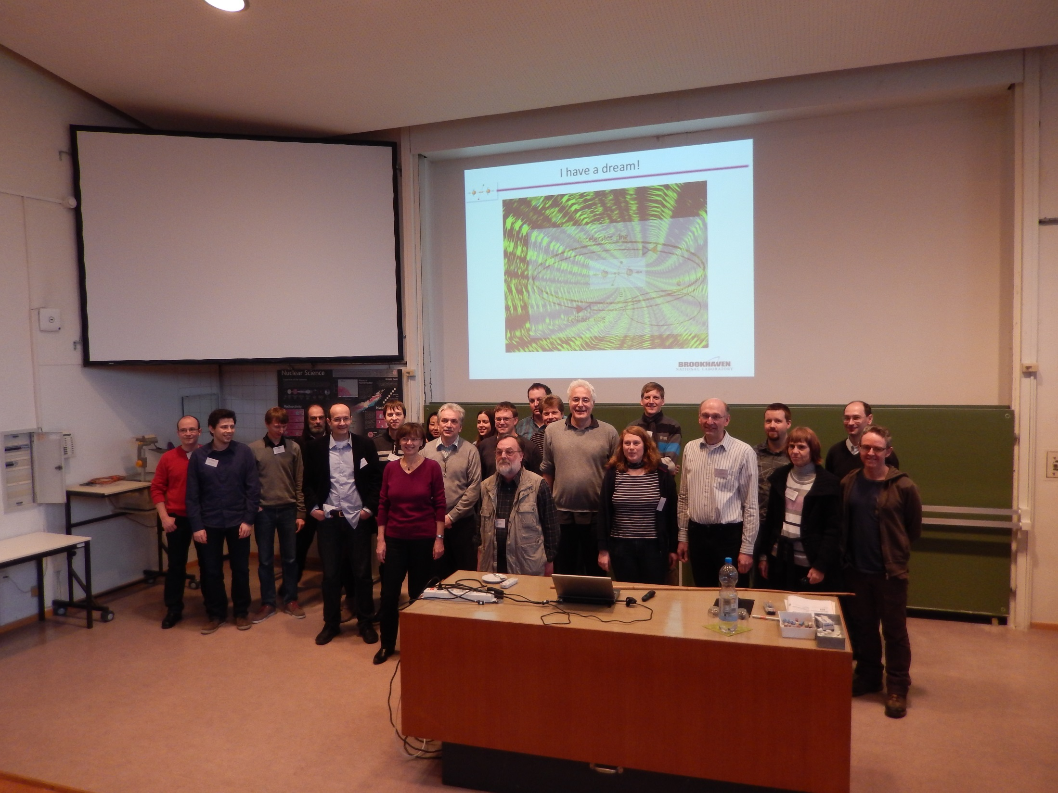
XPOL workshop “Spin Optimization at Lepton Accelerators,” U. Mainz, 12-13 February 2014 - 25 participants Germany: 23 (U.Mainz, DESY Hamburg, U. Munich, U. Bonn, U. Hamburg, U. Heidelberg, DESY Zeuthen), US: 2 (BNL)
spin generation, spin transport
accurate measurement of spin vector
contributions from universities
milestones accomplished & road ahead
challenges for linear & circular machines

Slide 10
outreach events & presentations
F. Zimmermann, LHC & Future High-Energy Frontier Circular Colliders, ISHP 2013, Beijing/China, 12 August 2013
F. Zimmermann, LHC & Future High-Energy Frontier Circular Colliders, CINVESTAV Merida/Mexico 5 September 2013
K. Aulenbacher, Electron Beam Polarimetry at ERL's, ERL2013 workshop, BINP September 2013
F. Zimmermann, Future High Energy Circular Colliders, DESY Hamburg, 11 October 2013
J.B. Rosenzweig (UCLA), The Birth of the 5th Generation Light Source, CERN ATS Seminar, 22 November 2013
F. Zimmermann, Zukünftige Beschleunigerprojekte am CERN, KfB Annual Meeting, Darmstadt/G., 29 November 2013
F. Zimmermann, CERN Future Circular Collider Study, Beijing/China, 16 December 2013
P. Raimondi, invited visit to CERN, 24 March 2014 (next week)

Slide 11
communications
Exploring the accelerator frontiers, Frank Zimmermann with Mathilde Chaudron, Accelerating News #7, Autumn 2013
CERN prepares for Future Circular Collider Study, Michael Benedikt and Frank Zimmermann, Accelerating News #9, Spring 2014
The Future Circular Collider study, Michael Benedikt and Frank Zimmermann, CERN Courier, April 2014
EuCARD(-2) monographs
No. 23, César Octavio Domínguez Sánchez De La Blanca, Electron Cloud Studies for the LHC and Future Proton Colliders
No. 24, José Luis Abelleira Fernández, Optics Designs of Final-Focus Systems for Future LHC Upgrades

Slide 12
upcoming events in 2014/15
Commissioning of Proton Linacs (XLINAC), ESS, 8-9 April 2014
Impedance 2014 (XCOLL), Erice, 23-29 April 2014
SpaceCharge collaboration workshop (XCOLL & XRING), CERN, 20-21 May 2014
EnEfficient joint workshop on IOTs (XLINAC/WP3), UK, June’14
Beam Dynamics Issues of High Power Linacs (XLINAC), CERN?
6th Int’l Conf., “Charged & Neutral Particles Channeling Phenomena - Channeling 2014” (XCOLL), Oct 5-10, 2014
High Luminosity Circular e+e- Colliders, Beijing, 8-11.10. 14
EuCAN “Universities meet Labs” (EuCAN), 2014 ?
MulCoPim’14 (XCOLL), Valencia, 17-19 Sept. 2014
"Beam Dynamics meets Magnets 2“ (XRING), PSI, 1-4.12.14
Space Charge 2015 (XRING), UK, Oxford, April 2015

Slide 13
EuCAN WP1
deliverable
key results of 5 accelerator networks
M18
due rather soon

Slide 14
deliverables :
Preliminary strategies, optimization, limitations, paths & parameters for
future hadron & lepton colliders;
future high-performance hadron rings;
future high-power high-current SC linacs; and
future polarized beams
[month 36]
Strategy for
future extreme beam facilities;
[month 48]
none at the moment

Slide 15
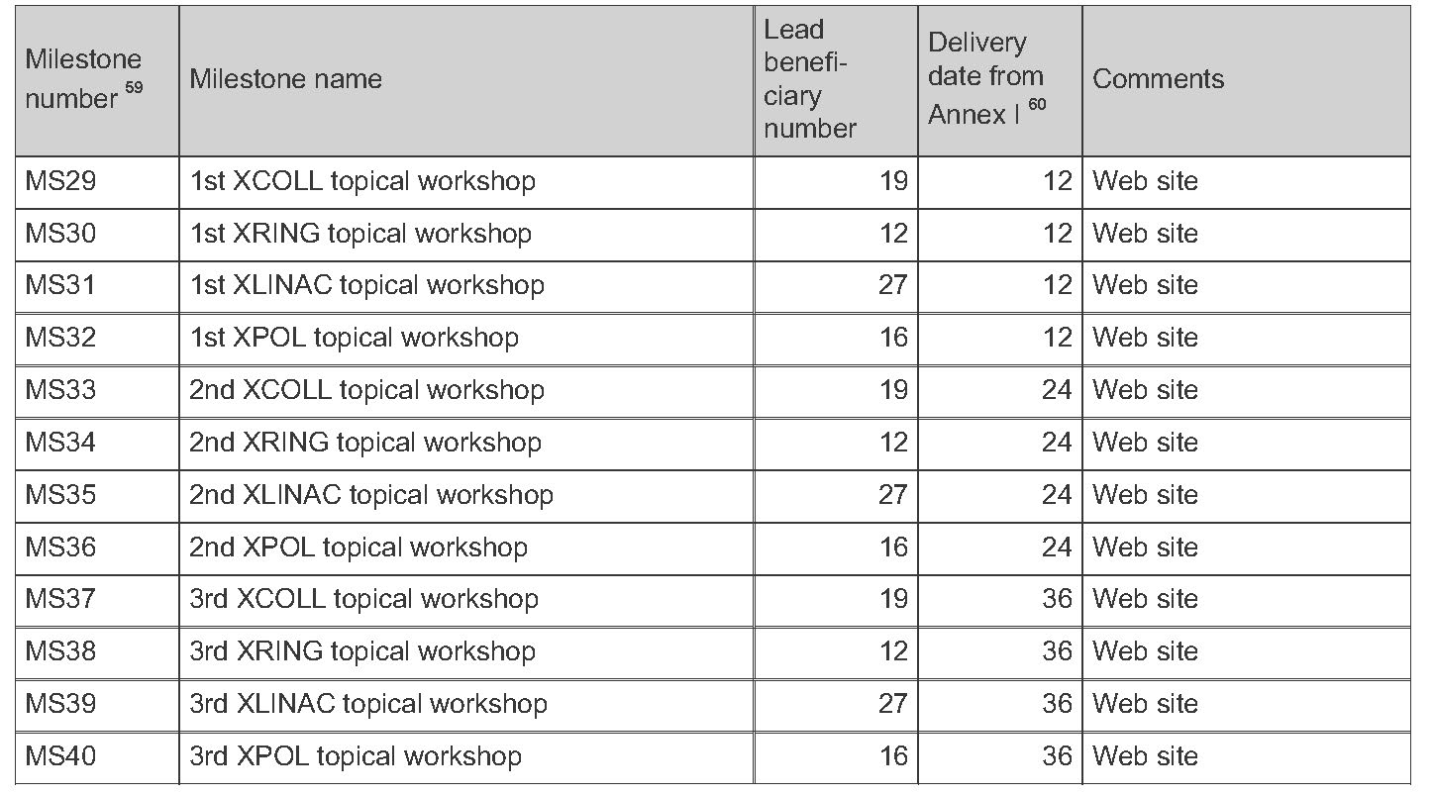
milestones :
≥1 workshop per task in year 1
2013 (done):
3 workshops for XCOLL
1 workshop for XRING
0 workshops for XLINAC
0 workshops for XPOL
2014 (done & planned):
2 & 4 workshops for XCOLL
0 & 2 workshops for XRING
0 & 2 workshops for XLINAC
1 & 0 workshops for XPOL

Slide 16
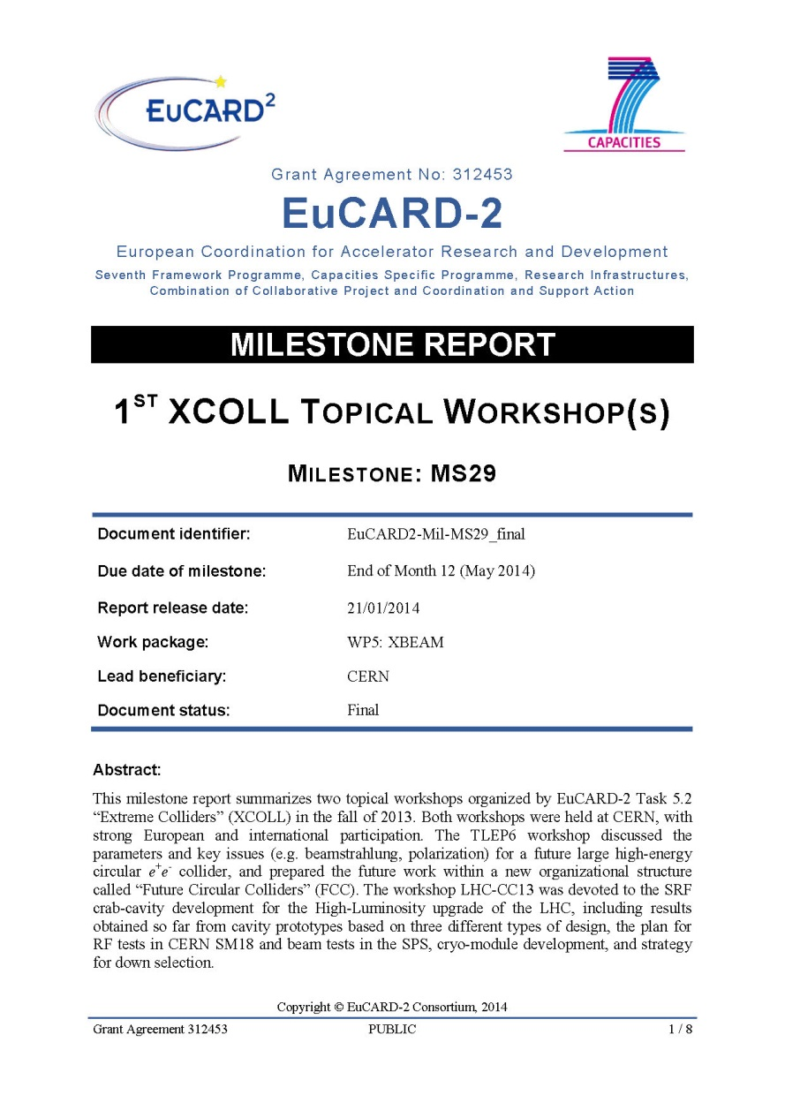
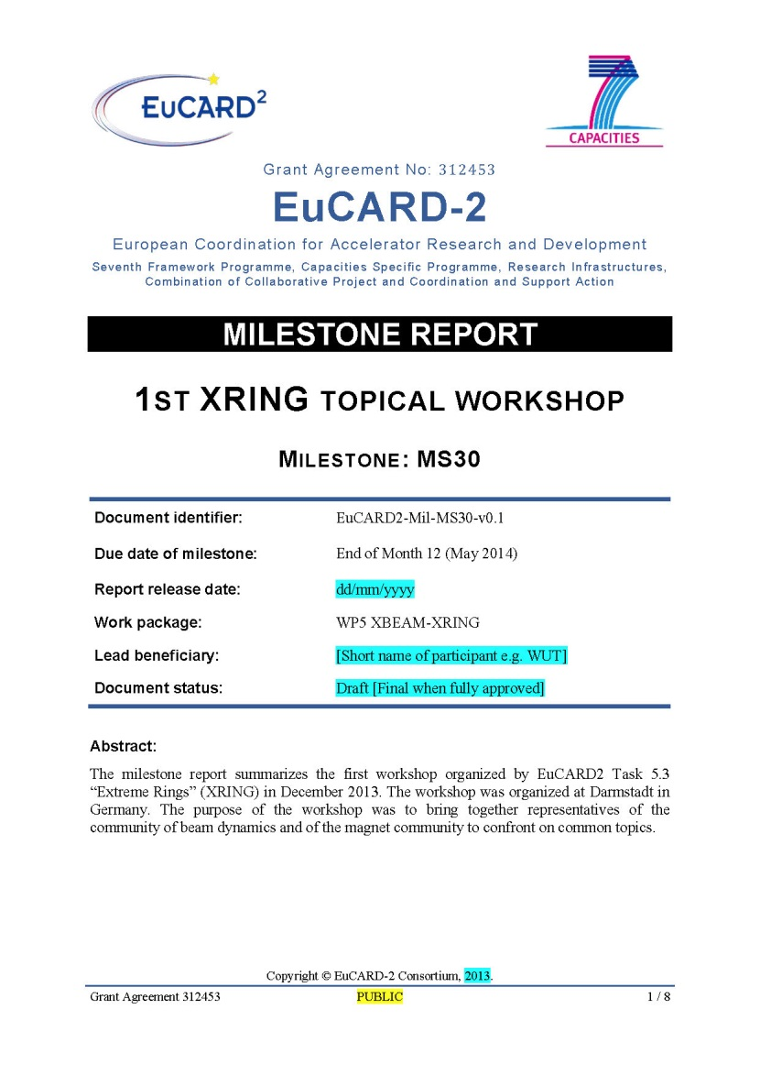
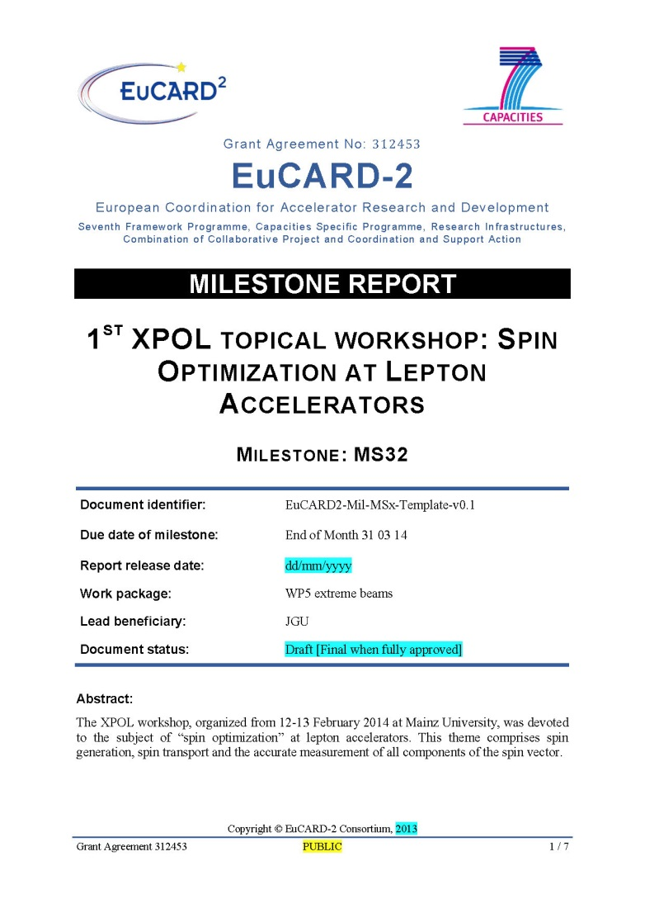
WP5 XBEAM MS reports
EuCARD2-Mil-MS29
CERN-ACC-2014-02
EuCARD2-Mil-MS30
EuCARD2-Mil-MS32
only XLINAC missing
(workshop in early April)

Slide 17
open issues:
- CDS submission of EuCARD-2 documents?
“universities meet labs” workshop!?
M18 report on accelerator networks (EuCAN)
XBEAM & EuCAN steering meetings during EuCARD-2 Annual Meeting?

