Slide 1
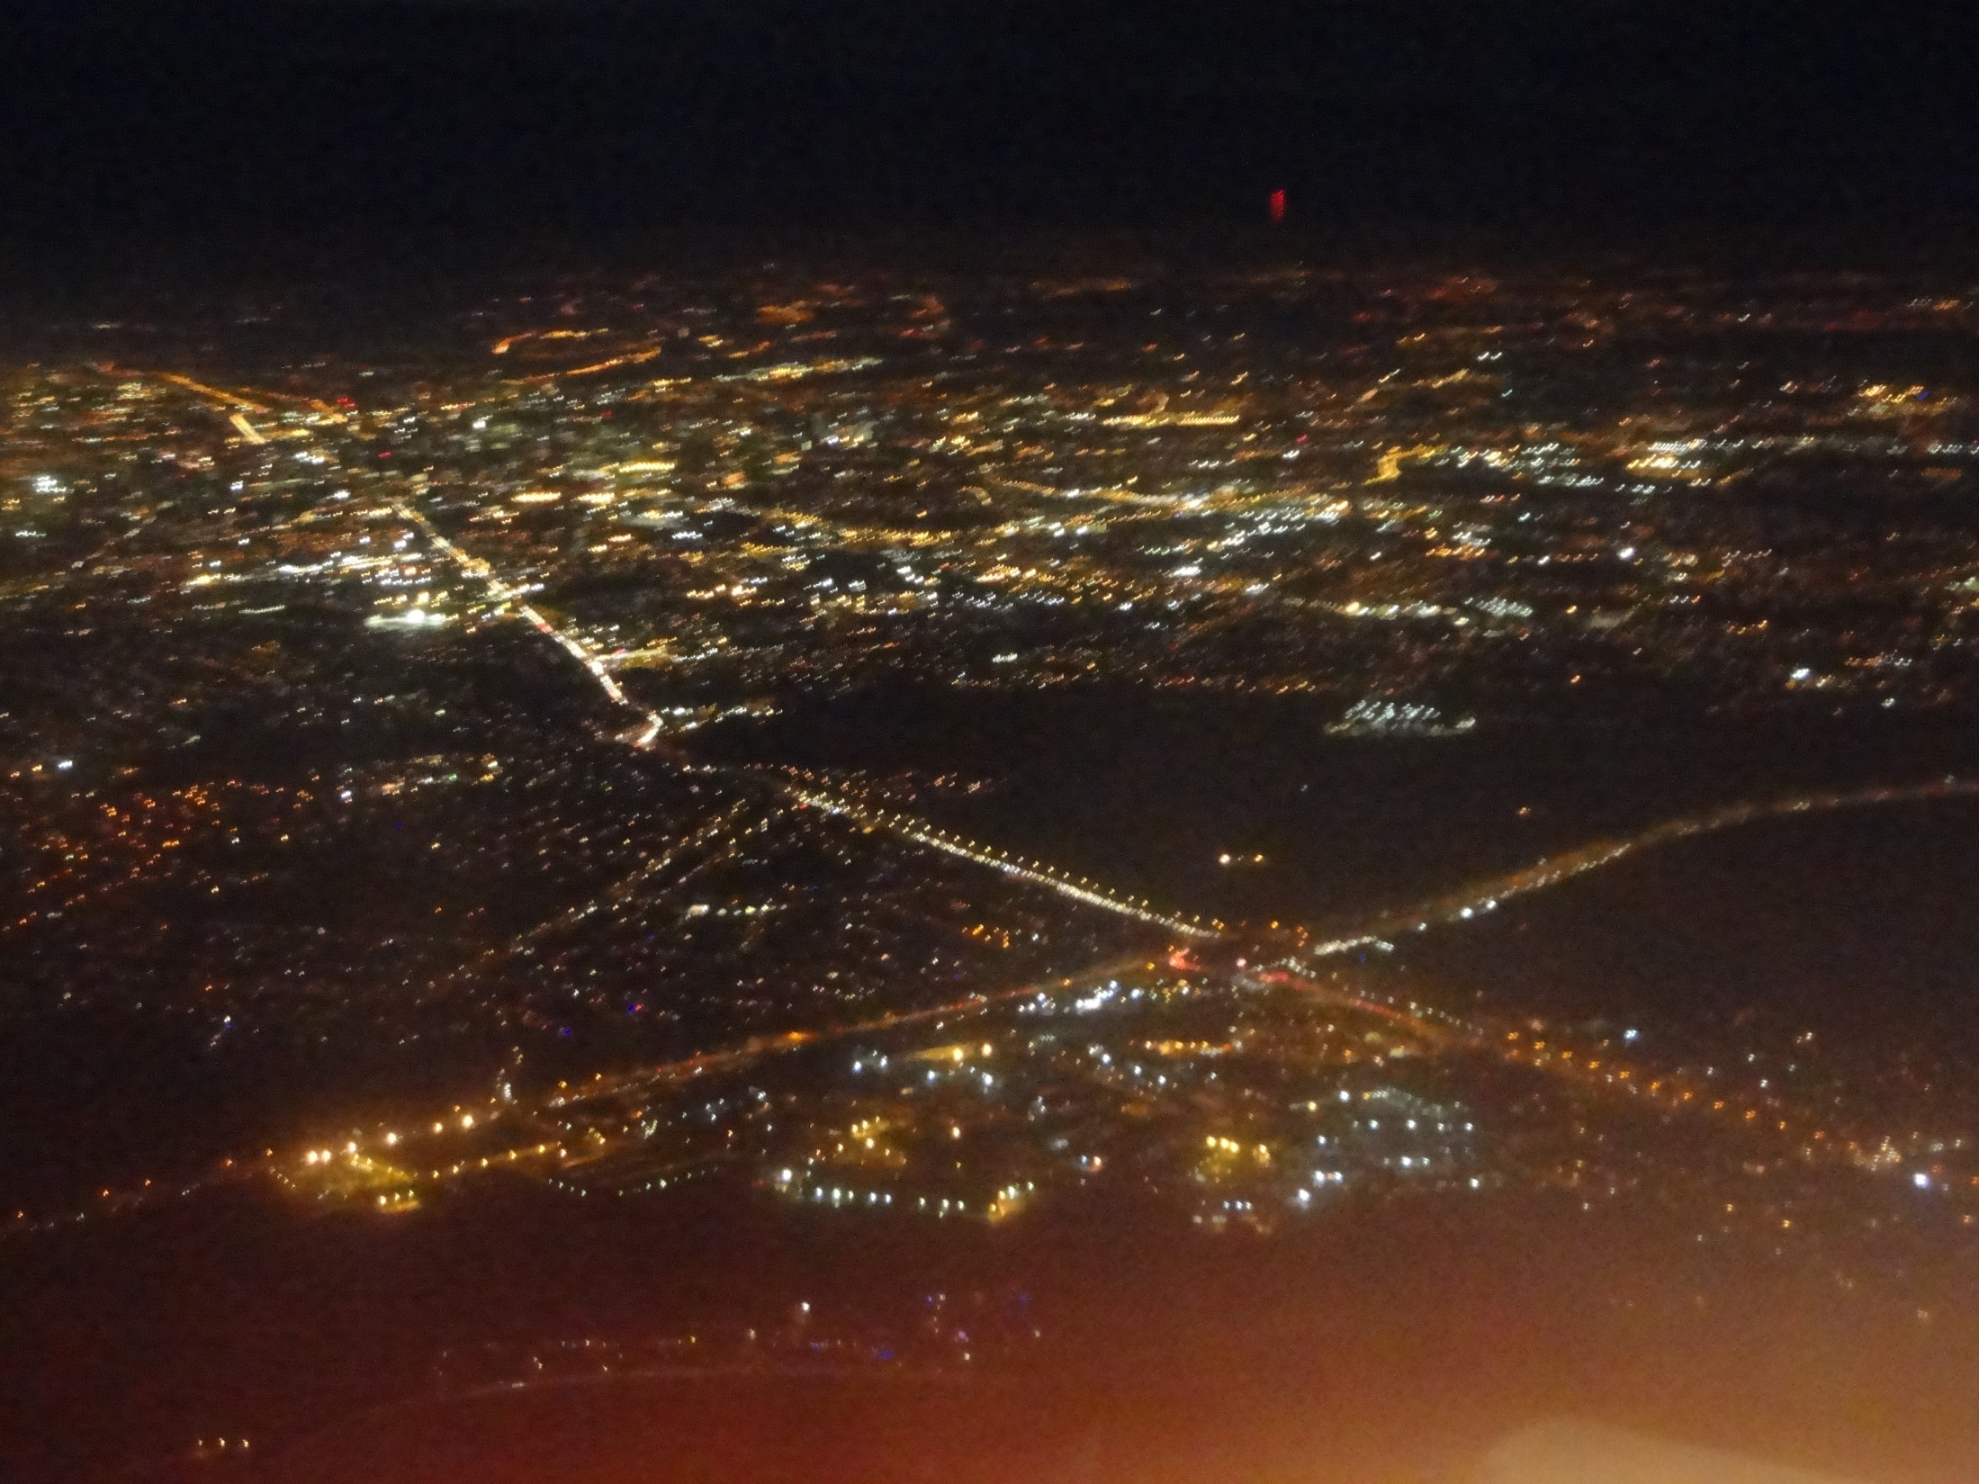
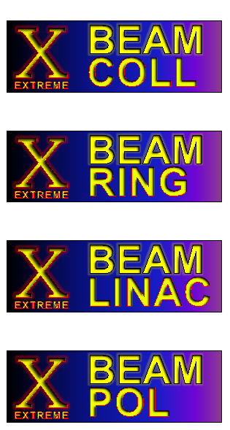
EuCARD-2 WP5 XBEAM & WP1 EuCAN
Frank Zimmermann
EuCARD-2 Steering Committee Meeting
12 December 2013
with kind input from Kurt Aulenbacher, Marica Biagini, Mohamad Eshraqi, and Giuliano Franchetti
Work supported by the European Commission under Capacities 7th Framework Programme, Grant Agreement 312453

Slide 2
contents
a) achievements in 2013
b) program for 2014 & beyond
c) milestones and deliverables

Slide 3
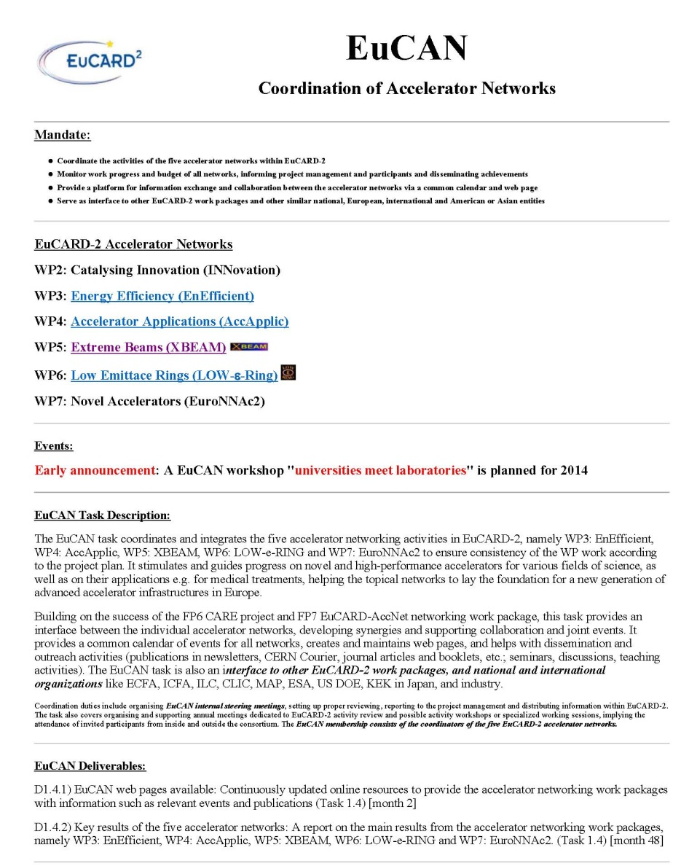
WP1 EuCAN achievements
web site created: http://cern.ch/eucan
milestone
report
EuCARD2-Mil-MS4
CERN-ACC-2013-0263

Slide 4
----Original Message-----
From: no-reply (Unmonitored address)
Sent: 12 December 2013 11:58 AM
Subject: CERN-ACC-2013-0263 has been deleted from the EuCARD-2 Document Database
Hello:
This is to inform you that the publication <CERN-ACC-2013-0263>, for WP/TASK: 1.4: Coordination of Accelerator Networks (EUCAN)
title: "EUCAN web pages available"
author(s): Zimmermann, F.: CERN
submitted by: livia.lapadatescu@cern.ch
with URL: <http://cds.cern.ch/record/1635893>
has been deleted from the EuCARD-2 Document Database.

Slide 5
WP5 achievements
web site created: http://cern.ch/xbeam
mailing lists created & ‘filled’:
eucard2-wp5-coordinators@cern.ch
eucard2-wp5.*-info@cern.ch
dissemination effort:
IHEP Higgs symposium, Beijing/China, 12 August’13
CINVESTAV Merida/Mexico, 5 September 2013
ERL workshop, BINP, 12 September 2013, DESY 11 October 2013, KfB Darmstadt 29 November 2013

Slide 6
XBEAM events in 2013
EuCARD-2 kick off meeting, CERN, 10-14 June 2013
XBEAM Steering Meeting 14 June 2013
XCOLL TLEP6 workshop, CERN, 16-18 Oct. 2013
SuperKEKB commissioning workshop (XCOLL) KEK, 11-13 Nov. 2013
"Beam Dynamics meets Magnets" (XRING), Darmstadt, 2-4 December 2013
LHC-CC13 LHC crab-cavity workshop (XCOLL), CERN, 9-10 December 2013

Slide 7
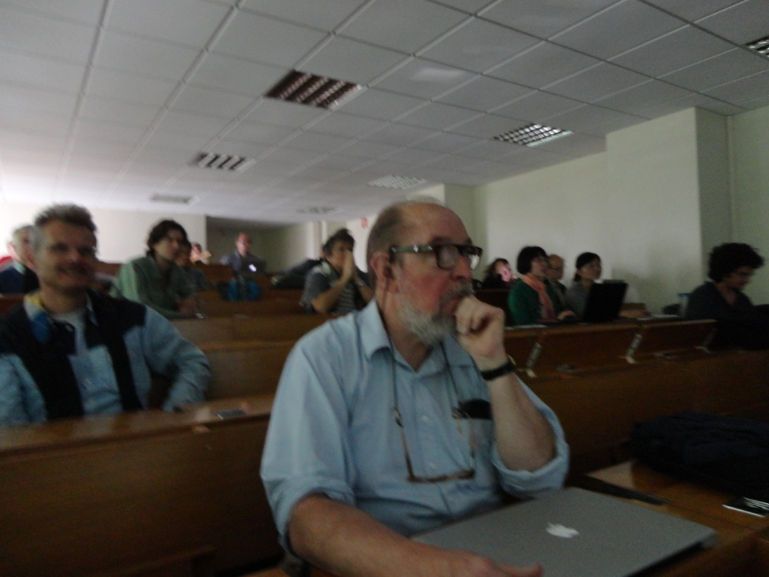
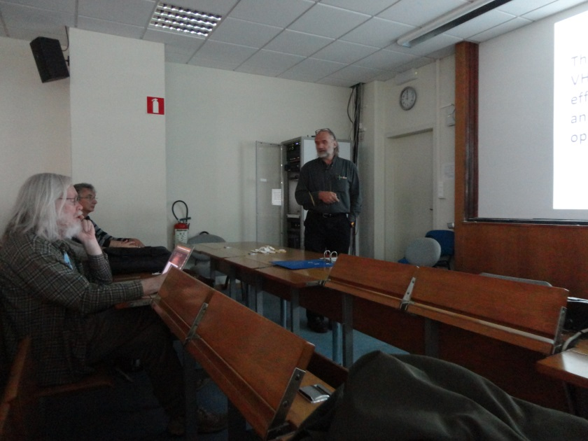
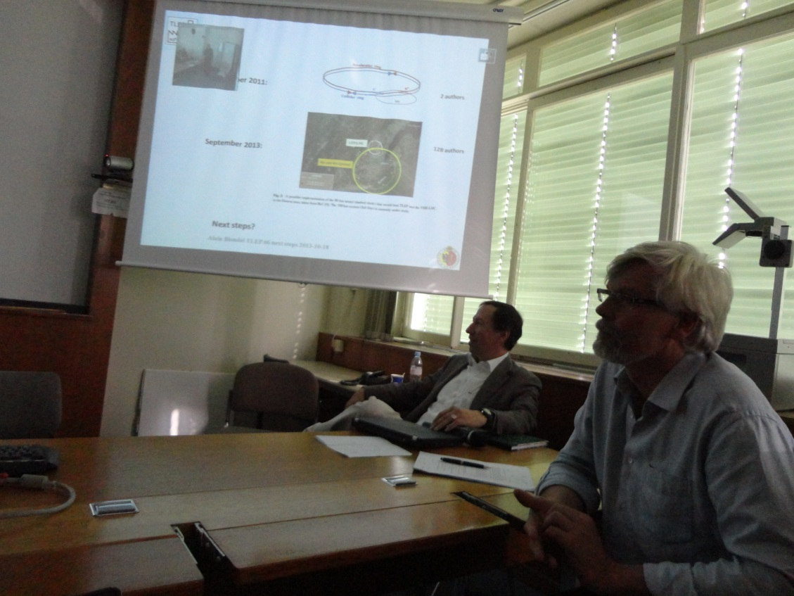
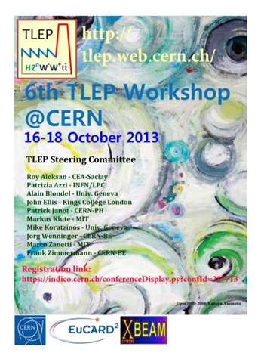
TLEP6, 16-18 October 2013, 84 participants (USA: 5, Asia: 11, Mexico: 3, Europe: 66)
participation by CERN Director of Research Sergio Bertolucci,
and former CERN DG Herwig Schopper

Slide 8
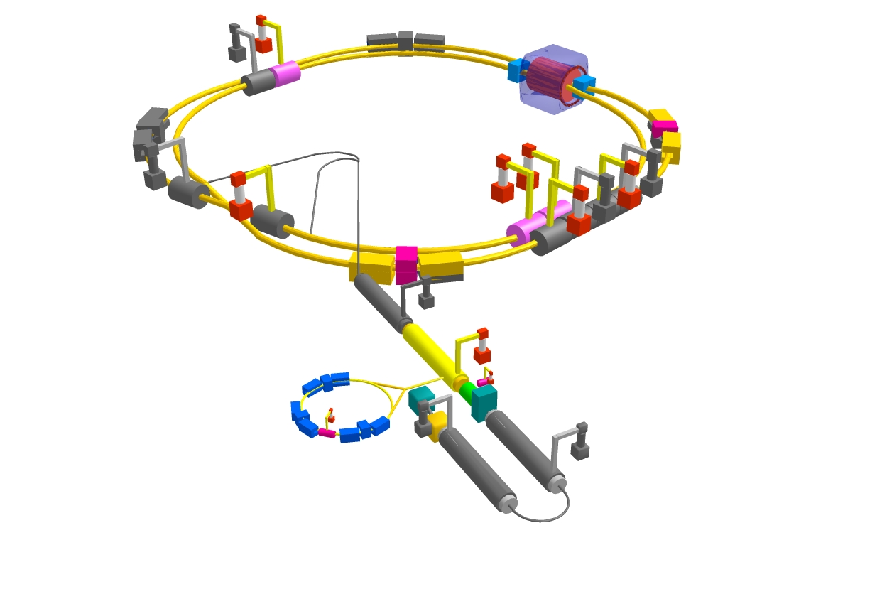
SuperKEKB commissioning workshop, KEK, 11-13 November 2013, 68 participants (Europe: 7, USA: 8, Japan: 51, China: 1, Russia: 2)
beam commissioning will start in early 2015
β_{y}*=300 μm (TLEP: 1 mm)
lifetime 5 min (TLEP: ~15min)
ε_{y}/ε_{x}=0.25% ! (TLEP: 0.2%)
off momentum acceptance (±1.5%, TLEP: ±2%)
e⁺ production rate (2.5x10¹²/s, TLEP: <1x10¹¹/s)
sponsored by ICFA co-sponsored by￼ EuCARD-2 XBEAM Extreme Beams￼

Slide 9
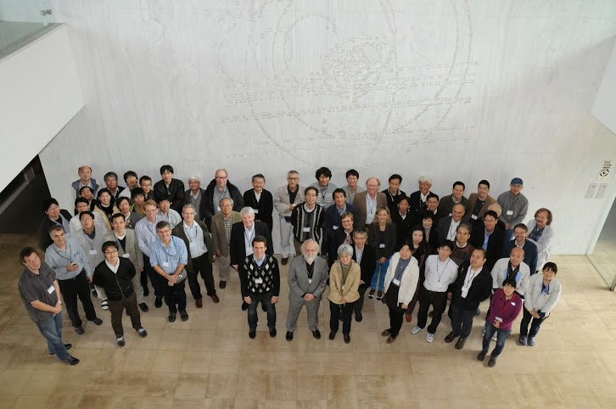
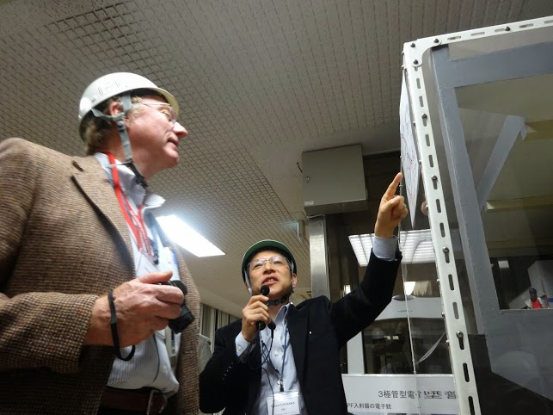
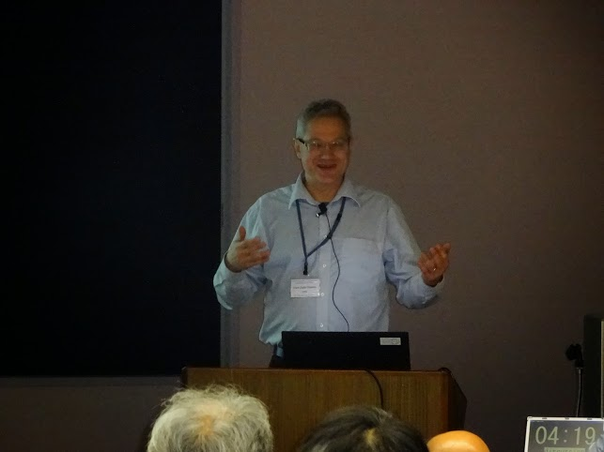
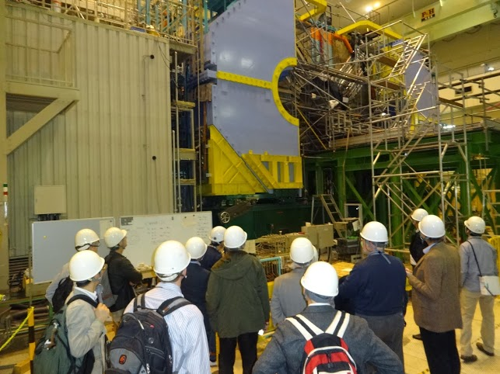
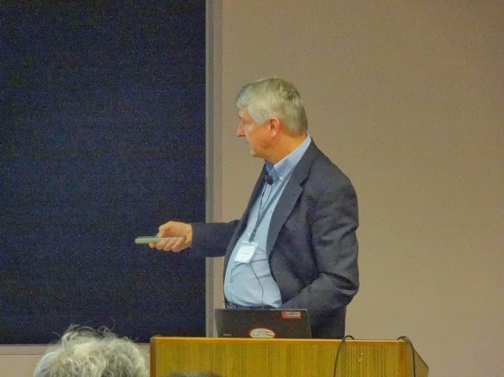
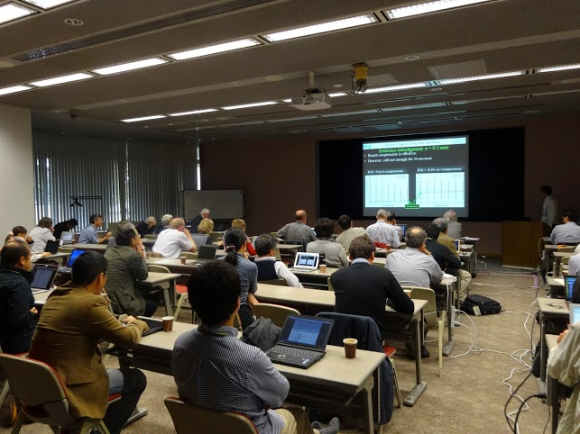
SuperKEKB commissioning workshop, KEK, 11-13 November 2013

Slide 10
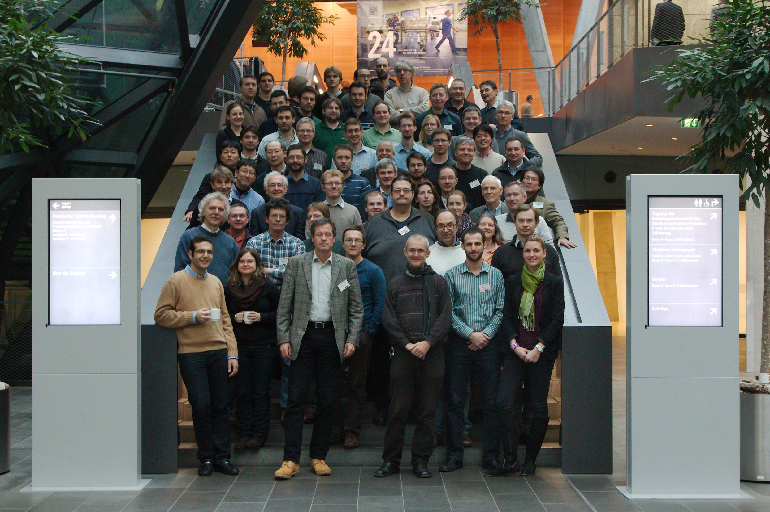
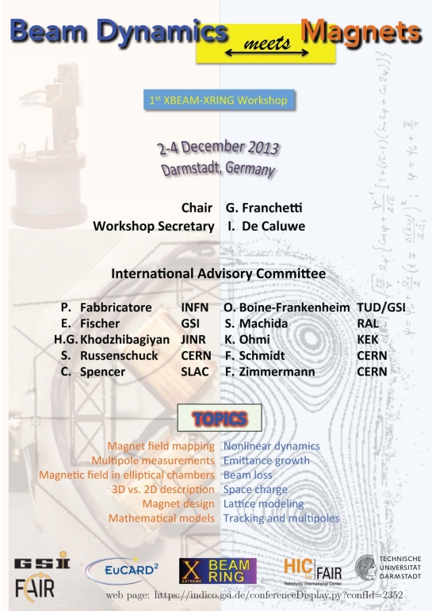
“beam dynamics meets magnets”, Darmstadt, 2-4 December 2013, 84 participants (Japan: 3, USA: 2, Europe: 79)

Slide 11
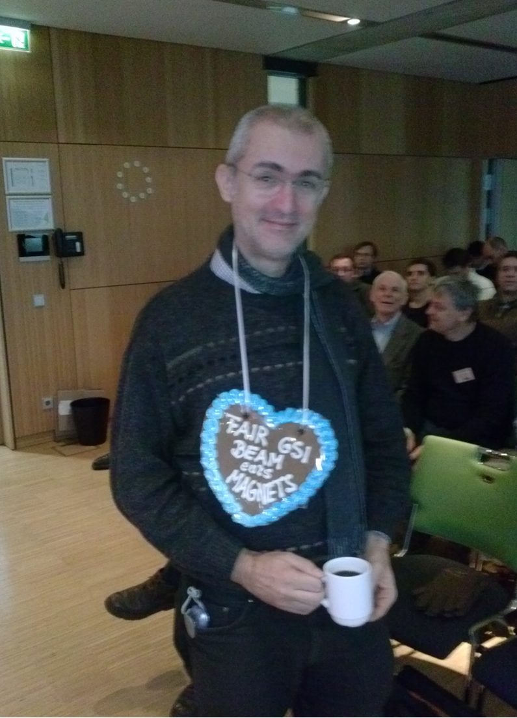
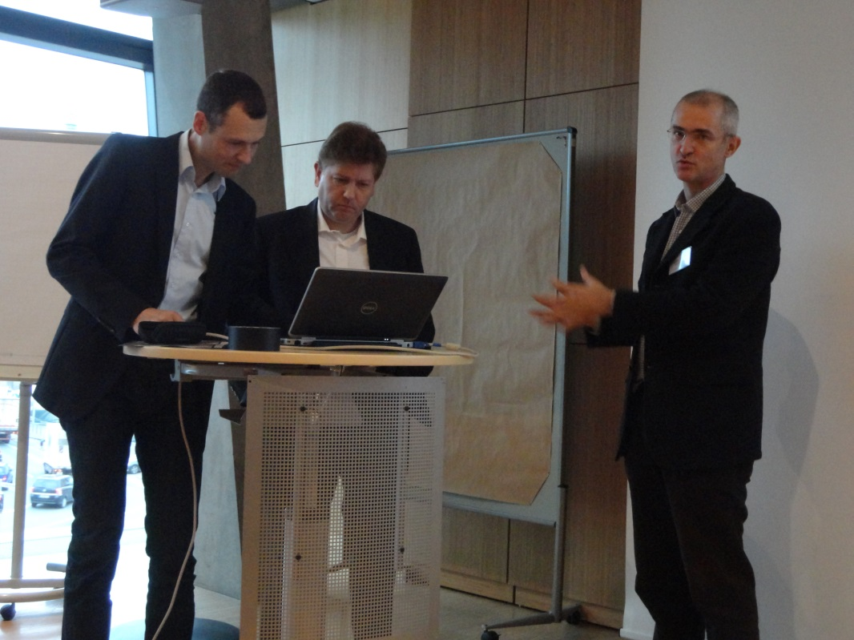
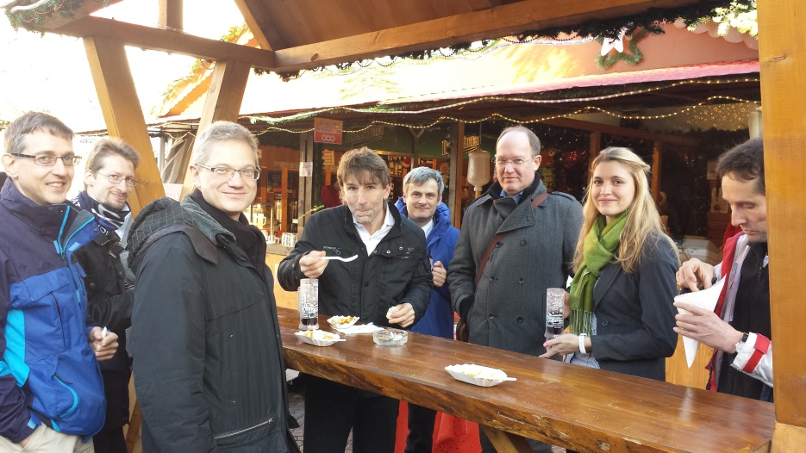
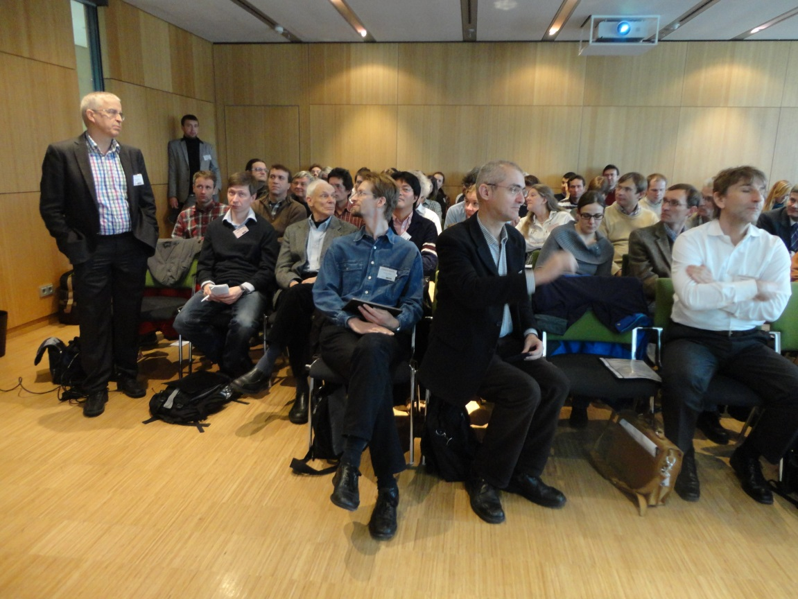
“beam dynamics meets magnets”, Darmstadtium, 2-4 December 2013

Slide 12
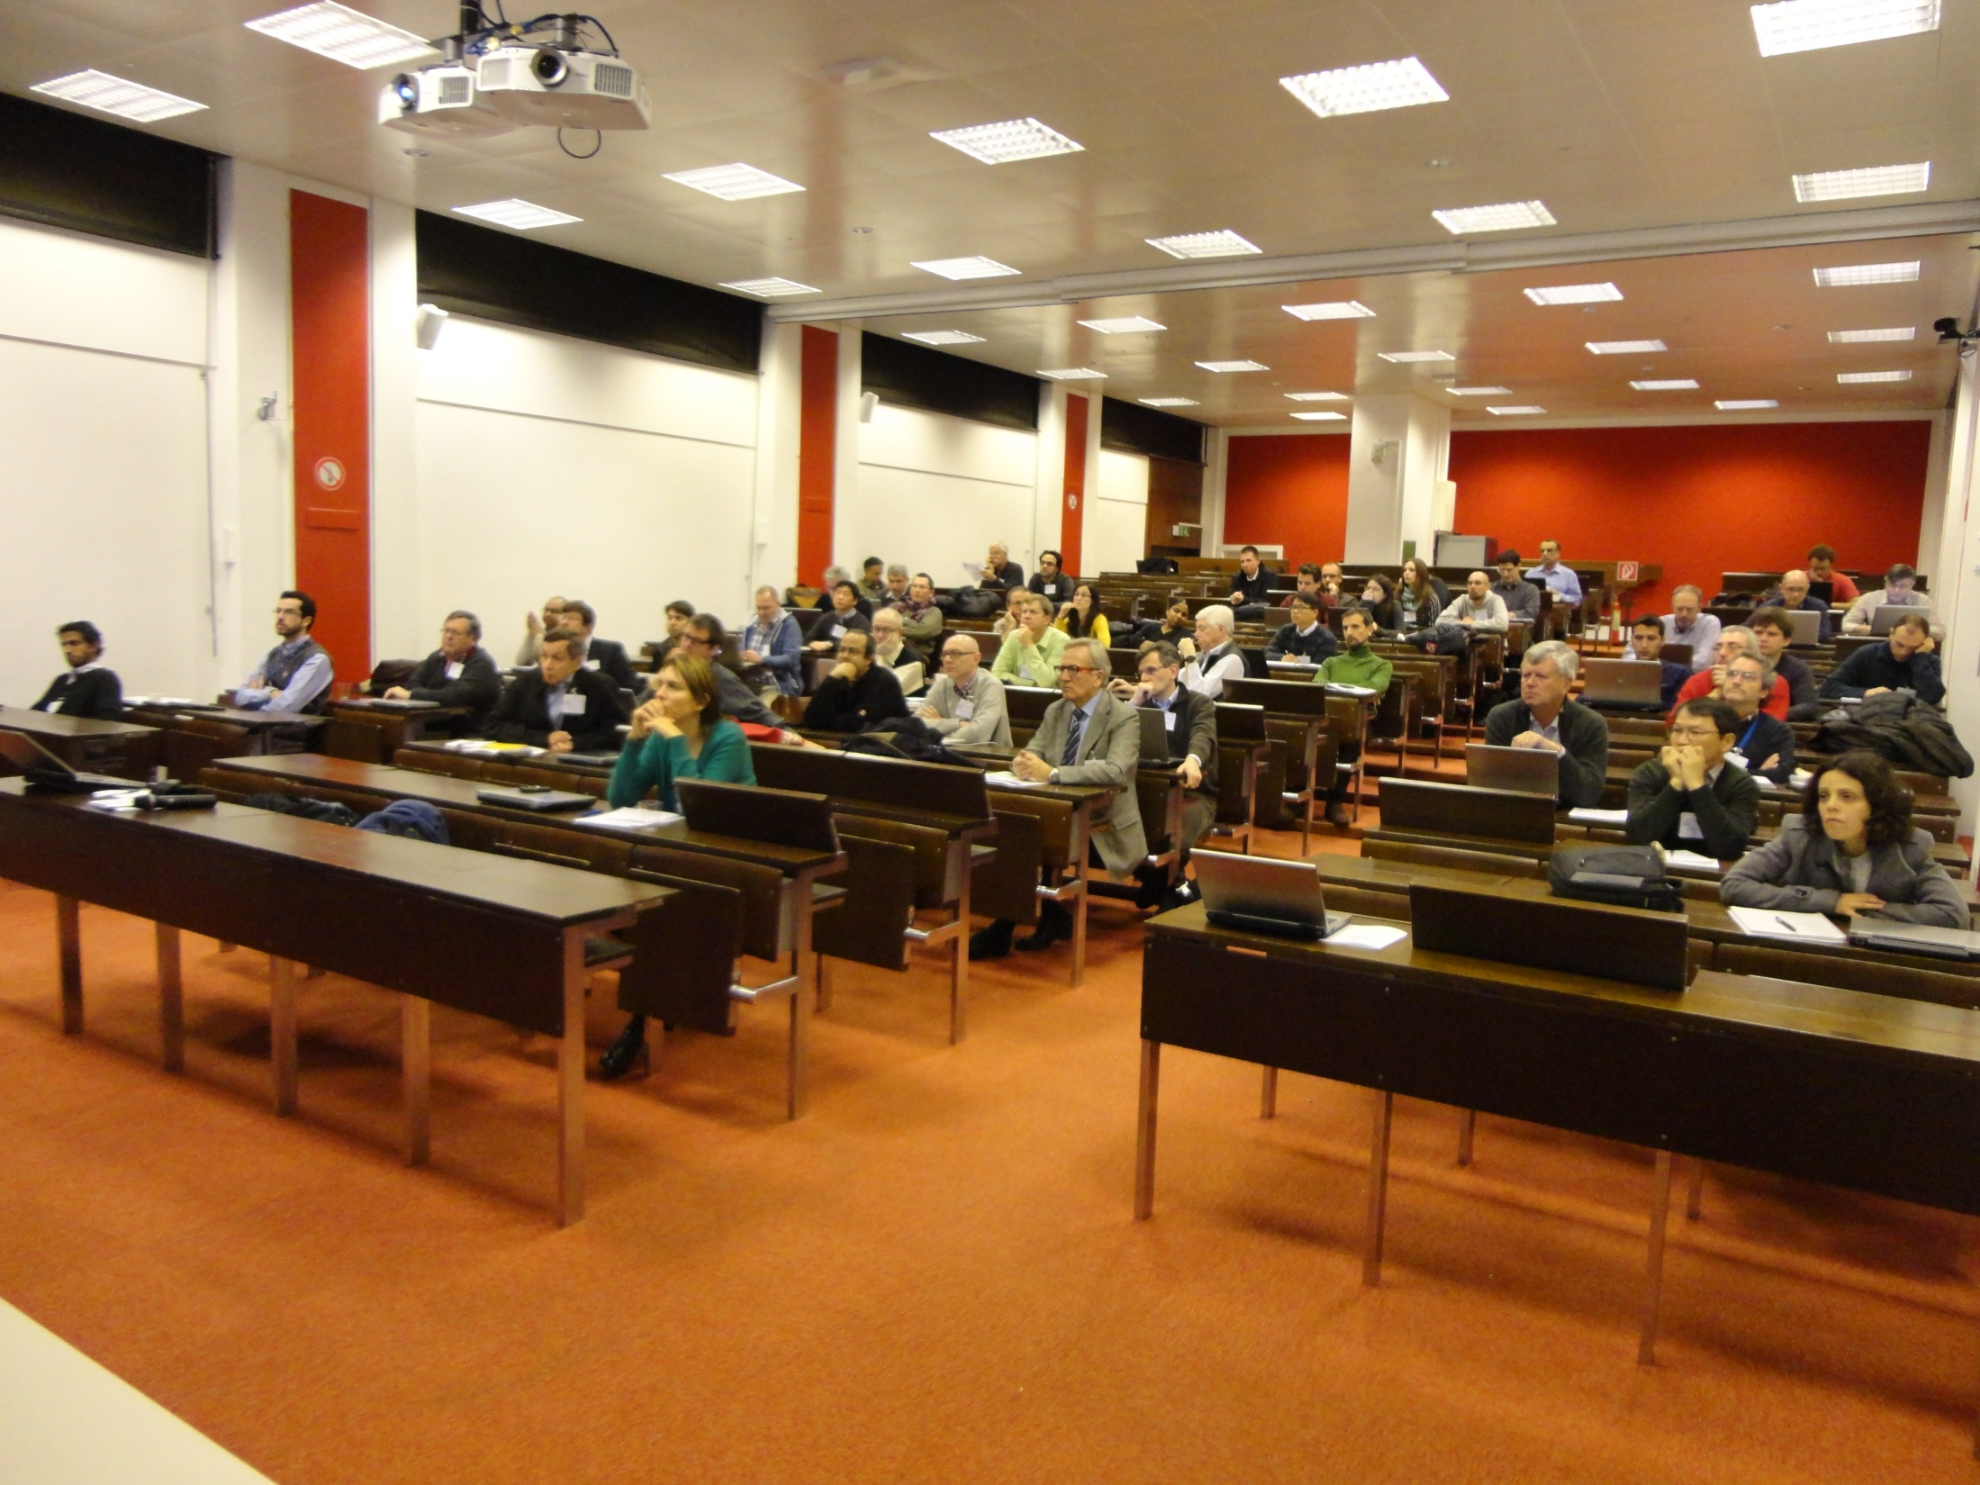
LHC-CC13, 6th LHC crab cavity workshop, CERN, 9-11 Dec. 2013, 63 participants (USA: 15, Japan: 3, Europe: 45)
main objectives:
Compact cavity RF test results and performance validation
Cryomodule and RF system development for SM18, SPS tests & LHC
Preparation for SPS beam tests and future roadmap

Slide 13
outreach events & presentations
F. Zimmermann, LHC & Future High-Energy Frontier Circular Colliders, ISHP 2013, Beijing/China, 12 August 2013
F. Zimmermann, LHC & Future High-Energy Frontier Circular Colliders, CINVESTAV Merida/Mexico 5 September 2013
K. Aulenbacher, Electron Beam Polarimetry at ERL's, ERL2013 workshop, BINP September 2013
F. Zimmermann, Future High Energy Circular Colliders, DESY Hamburg, 11 October 2013
J.B. Rosenzweig (UCLA), The Birth of the 5th Generation Light Source, CERN ATS Seminar, 22 November 2013
F. Zimmermann, Zukünftige Beschleunigerprojekte am CERN, KfB Annual Meeting, Darmstadt, 29 November 2013

Slide 14
planned workshops in 2014/15
LHeC workshop (XCOLL), 20-21 January 2014
“Future Circular Colliders Study Kickoff” (XCOLL), CERN, 12-15 Feb 2014
EUCARD workshop "Spin optimization at Lepton accelerators“ (XPOL), Mainz, 12-13 February 2014
XBEAM-XLINAC/WP3-EnEfficient joint workshop on IOTs, Daresbury, 3-4 June 2014
6th Int’l Conf., “Charged & Neutral Particles Channeling Phenomena - Channeling 2014” (XCOLL), Oct 5-10, 2014
EuCAN “Universities meet Labs” (EuCAN), June-July 2014 ?
"Beam Dynamics meets Magnets 2014“ (XRING), PSI, end ‘14
SC collaboration workshop, CERN, 27-28 May 2014
Space Charge 2015 (XRING), UK, Oxford, April 2015

Slide 15
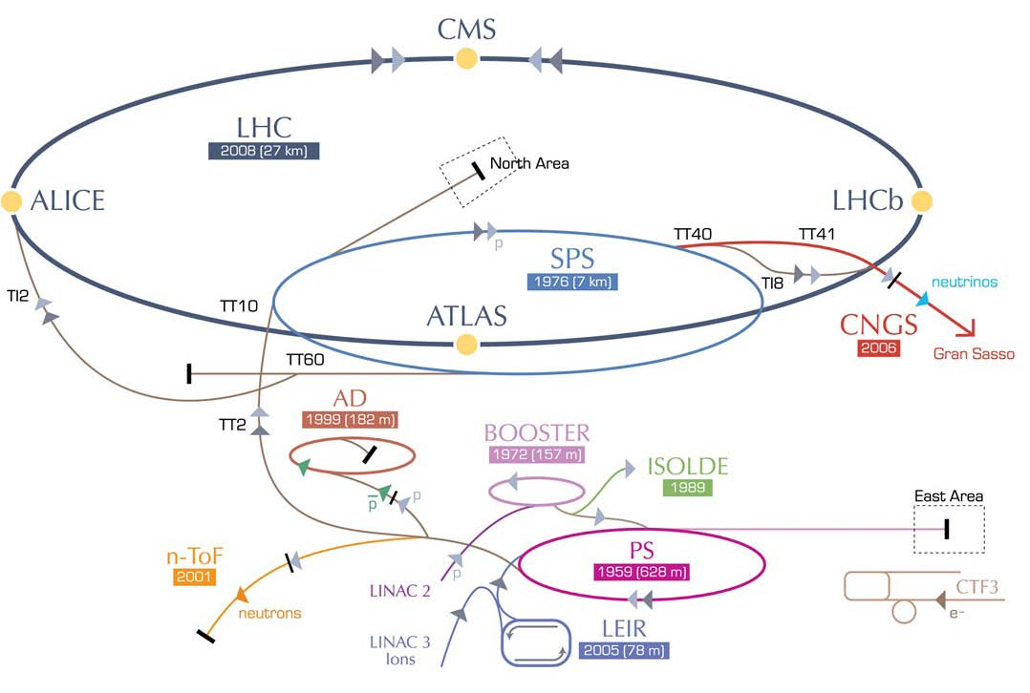
EuCARD-2 XCOLL - LHeC workshop
)
100 MW total wall-plug power,
L_{ep} up to 2x10³⁴ cm⁻²s⁻¹
Chavannes-de-Bogis
20-21 January 2014
indico.cern.ch
confId=278903
ERL LHeC:
recirculating
linac with
energy
recovery

Slide 16
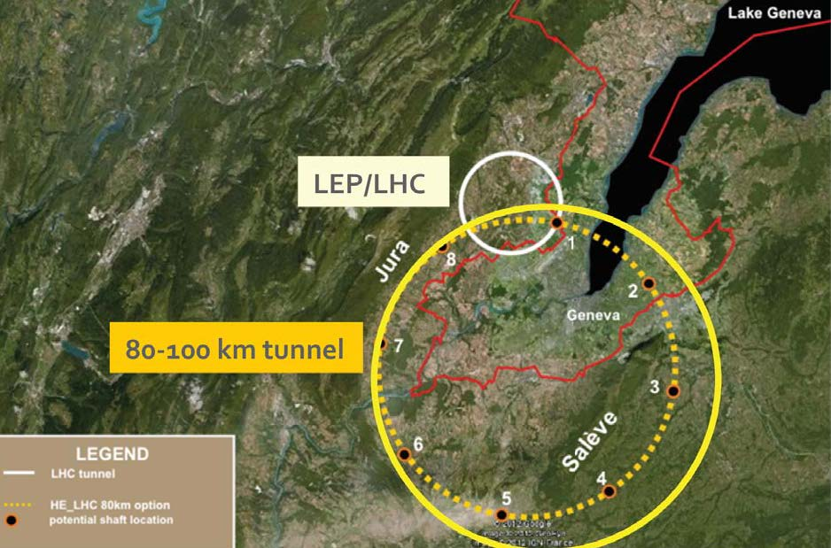
Future Circular Colliders Study
J. Osborne, C. Waaijer, CERN, ARUP & GADZ,
submitted to European Strategy Symposium 2012
TLEP/VHE-LHC

Slide 17
FCC “kick-off meeting”
U. Geneva 12-15 February 2014!
http://indico.cern.ch/e/fcc-kickoff

Slide 18
EuCAN WP1
deliverable
key results of 5 accelerator networks
M18
due rather soon

Slide 19
deliverables :
Preliminary strategies, optimization, limitations, paths & parameters for
future hadron & lepton colliders;
future high-performance hadron rings;
future high-power high-current SC linacs; and
future polarized beams
[month 36]
Strategy for
future extreme beam facilities;
[month 48]
none at the moment

Slide 20
milestones :
different from web site?!
Milestone name | Work package(s) involved | Expected date | Means of verification
XCOLL topical workshop | 5 (Task 5.2) | M12 | XCOLL web pages
XRING topical workshop | 5 (Task 5.3) | M12 | XRING web pages
XLINAC topical workshop | 5 (Task 5.4) | M12 | XLINAC web pages
XPOL topical workshop | 5 (Task 5.5) | M12 | XPOL web pages
XCOLL topical workshop | 5 (Task 5.2) | M24 | XCOLL web pages
XRING topical workshop | 5 (Task 5.3) | M24 | XRING web pages
XLINAC topical workshop | 5 (Task 5.4) | M24 | XLINAC web pages
XPOL topical workshop | 5 (Task 5.5) | M24 | XPOL web pages
XCOLL topical workshop | 5 (Task 5.2) | M36 | XCOLL web pages
XRING topical workshop | 5 (Task 5.3) | M36 | XRING web pages
XLINAC topical workshop | 5 (Task 5.4) | M36 | XLINAC web pages
XPOL topical workshop | 5 (Task 5.5) | M36 | XPOL web pages
XCOLL topical workshop | 5 (Task 5.2) | M48 | XCOLL web pages
XRING topical workshop | 5 (Task 5.3) | M48 | XRING web pages
XLINAC topical workshop | 5 (Task 5.4) | M48 | XLINAC web pages
XPOL topical workshop | 5 (Task 5.5) | M48 | XPOL web pages
≥1 workshop per task in year 1
2013 (done):
3 workshops for XCOLL
1 workshop for XRING
0 workshops for XLINAC
0 workshops for XPOL
2014 (plan):
4 workshops for XCOLL
2-3 workshops for XRING
1 workshops for XLINAC
1 workshops for XPOL

Slide 21
actions / open questions:
MS reports for 2013 workshops
consistency of milestones on web site
missing milestones from 2013?
M18 report on accelerator networks
preparation for “universities meets labs”
workshop

