Slide 1





Future Circular Collider
Frank Zimmermann for the FCC collaboration
Future Research Infrastructures – Challenges and Opportunities
Varenna, 9 July 2015
gratefully acknowledging input
from Michael Benedikt & Johannes Gutleber
Work supported by the European Commission under Capacities 7th Framework Programme projest EuCARD-2, Grant Agreement 312453, and the HORIZON 2020 project EuroCirCol, Grant Agreement 654305
Photo: courtesy J. Wenninger

Slide 2
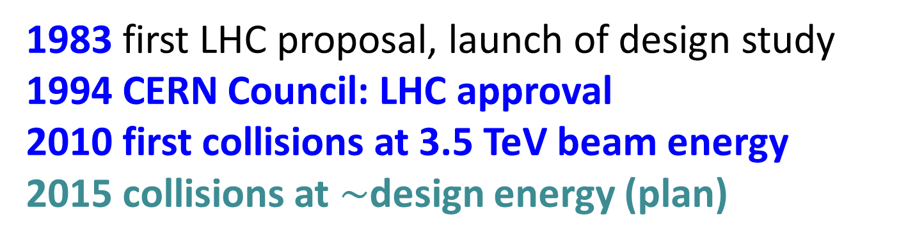
LHC history
1983 first LHC proposal, launch of design study
1994 CERN Council: LHC approval
2010 first collisions at 3.5 TeV beam energy
2015 collisions at $\sim$design energy (plan)
now is the time to plan for 2040!

Slide 3


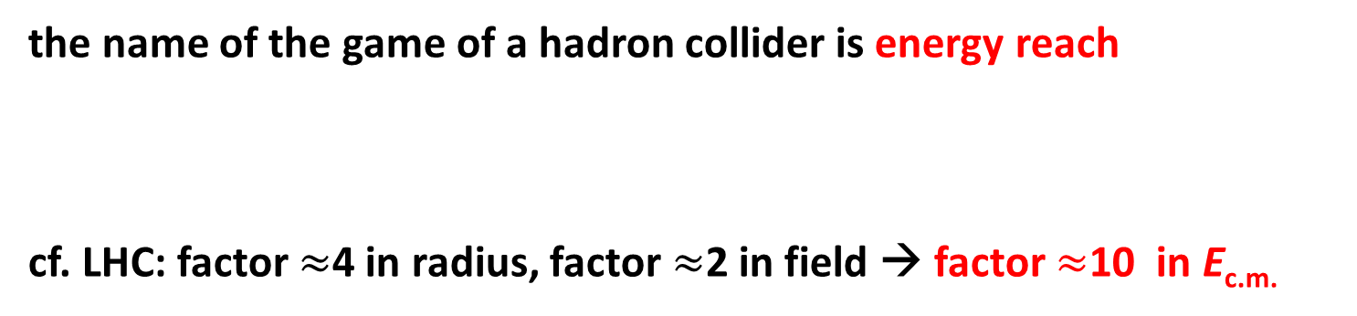
physics motivation for hadron collider:
pushing the energy frontier
a very large circular hadron collider seems the only approach to reach 100 TeV c.m. range in coming decades
access to new particles (direct production) in the few TeV to 30 TeV mass range, far beyond LHC reach
much-increased rates for phenomena in the sub-TeV mass range → increased precision w.r.t. LHC and possibly ILC
M. Mangano
the name of the game of a hadron collider is energy reach
cf. LHC: factor $≈$4 in radius, factor $≈$2 in field → factor $≈$10 in E_{c.m.}
$$E∝B_{dipole}{×ρ}_{bending}$$

Slide 4
strategic motivation
European Strategy for Particle Physics 2013:
  “…to propose an ambitious post-LHC accelerator project….., CERN should undertake design studies for accelerator projects in a global context,…with emphasis on proton-proton and electron-positron high-energy frontier machines..…”
ICFA statement 2014:
  ”…. ICFA supports studies of energy frontier circular colliders and encourages global coordination.….”
US P5 recommendation 2014:
  ”….A very high-energy proton-proton collider is the most powerful tool for direct discovery of new particles and interactions under any scenario of physics results that can be acquired in the P5 time window….”

Slide 5

Future Circular Collider Study
GOAL: CDR and cost review for the next ESU (2018)
international FCC collaboration to study:
pp-collider (FCC-hh) → main emphasis, defining infrastructure requirements
80-100 km infrastructure in Geneva area
e⁺e⁻ collider (FCC-ee) as potential intermediate step
p-e (FCC-he) option
~16 T ⇒ 100 TeV pp in 100 km

Slide 6
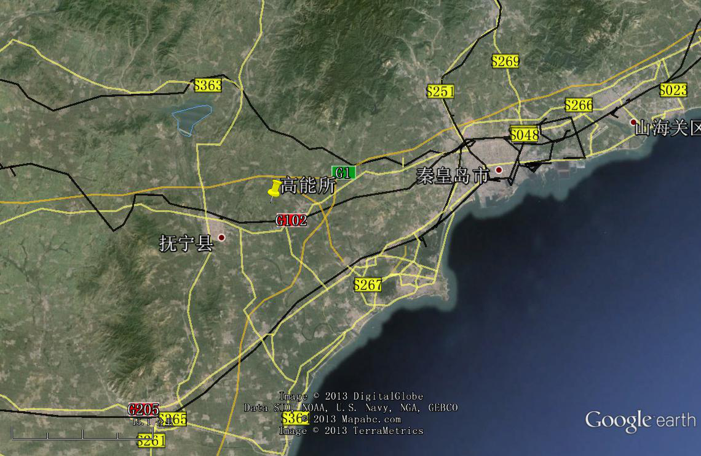
CepC/SppC study (CAS-IHEP) 50-70 km
e⁺e⁻ collisions ~2028; pp collisions ~2042
Qinhuangdao (秦皇岛）
CepC, SppC
50 km
easy access
300 km from Beijing
3 h by car
1 h by train
70 km
“Chinese Toscana”
Yifang Wang

Slide 7


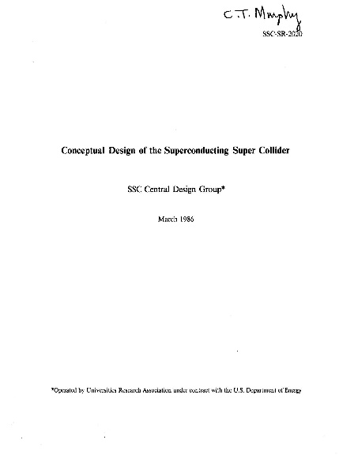
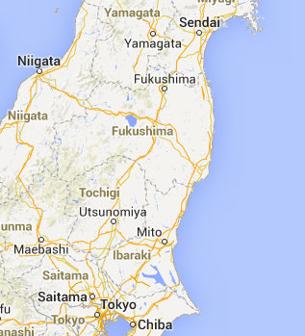
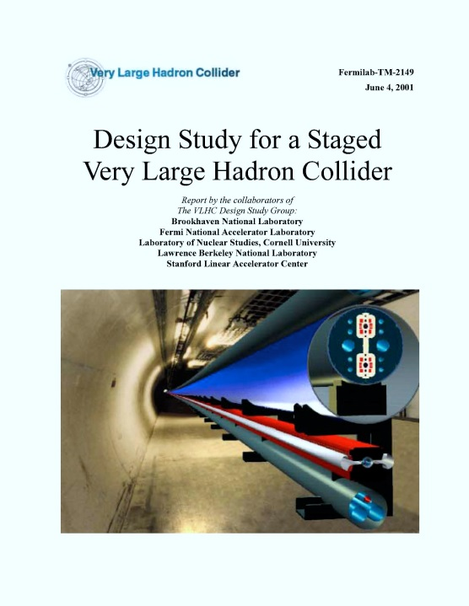
Previous studies in Italy (ELOISATRON 300km), USA (SSC 87km, VLHC 233km), Japan (TRISTAN-II 94km)
ex. ELOISATRON
ex. SSC
Supercolliders Superdetectors: Proceedings of the 19th and 25th Workshops of the INFN Eloisatron Project
SSC CDR 1986
ex. TRISTAN II
many aspects of machine design and R&D non-site specific.
exploit synergies with other projects and previous studies
Tristan-II
option 2
H. Ulrich Wienands, The SSC Low Energy Booster: Design and Component Prototypes for the First Injector Synchrotron, IEEE Press, 1997
ex. VLHC
F. Takasaki,
1983
VLHC Design Study Group Collaboration
June 2001. 271 pp.
SLAC-R-591, SLAC-R-0591, SLAC-591,
SLAC-0591, FERMILAB-TM-2149
Tristan-II
option 1
http://www.vlhc.org/

Slide 8
key challenges for FCC-hh/SppC
high energy
  high field superconducting magnets
  large tunnel infrastructures
high luminosity
  beam optics
  beam current
  synchrotron radiation impacting SC magnets
  IR shielding and component lifetime
high stored beam energy
  machine protection
  beam handling
  beam injection and beam dumping

Slide 9
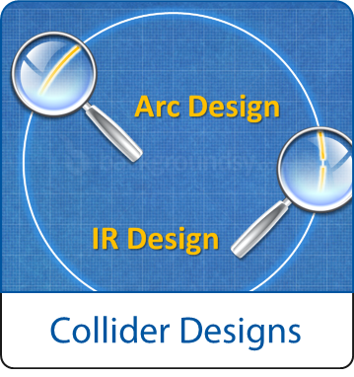
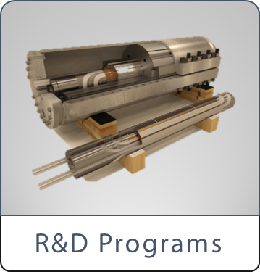
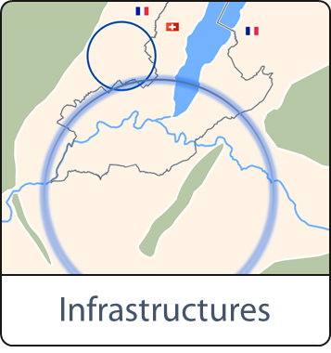
FCC Study Scope:
Accelerator and Infrastructure
FCC-hh: 100 TeV pp collider as long-term goal
→ defines infrastructure needs
FCC-ee: e⁺e⁻ collider, potential intermediate step
FCC-he: integration aspects of pe collisions
Push key technologies
in dedicated R&D programmes e.g.
16 Tesla magnets for 100 TeV pp in 100 km
SRF technologies and RF power sources
Tunnel infrastructure in Geneva area, linked to CERN accelerator complex
Site-specific, requested by European strategy

Slide 10

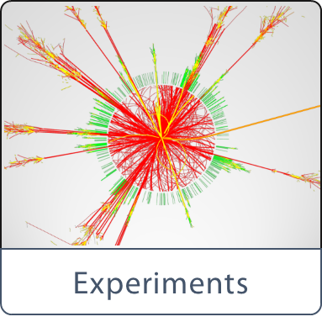

FCC Scope: Physics & Experiments
Elaborate and document
- Physics opportunities
- Discovery potentials
Experiment concepts for hh, ee and he
Machine Detector Interface studies
Concepts for worldwide data services
Overall cost model
Cost scenarios for collider options
Including infrastructure and injectors
Implementation and governance models

Slide 11
FCC-hh parameters
parameter | FCC-hh |  | LHC | HL LHC
c.m. energy [TeV] | 100 |  | 14
dipole field [T] | 16 |  | 8.3
# interaction points (IPs) | 2 main & 2 |  | 2 main & 2
bunch intensity [10¹¹] | 1 | 1 (0.2) | 1.1 | 2.2
bunch spacing [ns] | 25 | 25 (5) | 25 | 25
luminosity/IP [10³⁴ cm⁻²s⁻¹] | 5 | 20 | 1 | 5
events/bunch crossing | 170 | 680 (136) | 27 | 135
stored energy/beam [GJ] | 8.4 |  | 0.36 | 0.7
synchr. rad. [W/m/aperture] | 30 |  | 0.2 | 0.35

Slide 12
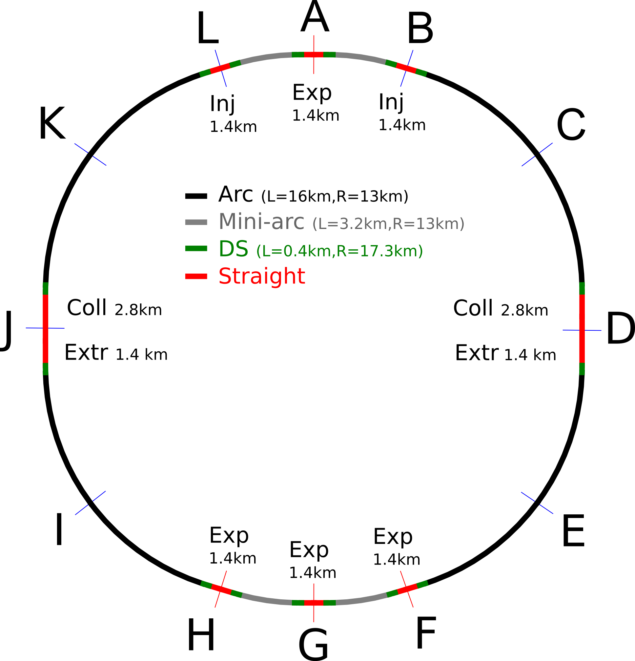
FCC-hh preliminary layout
100 km layout for FCC-hh
(different sizes under investigation)
two high-luminosity experiments (A and G)
two other experiments (F and H)
two collimation straights
two injection and two extraction straights
orthogonal functions for each insertion section

Slide 13
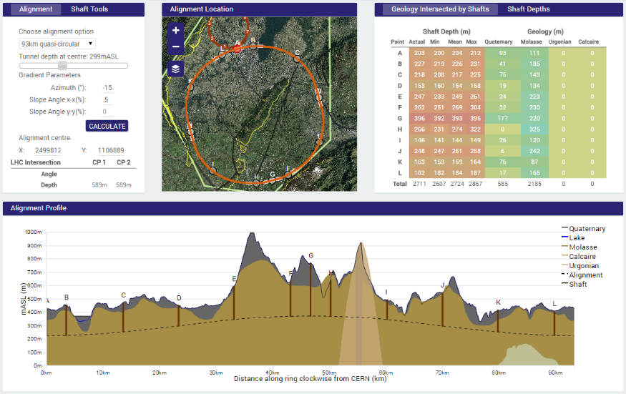
site study - 93 km example
J. Osborne, C. Cook, et al.
90 – 100 km fits geological situation well
LHC suitable as potential injector

Slide 14
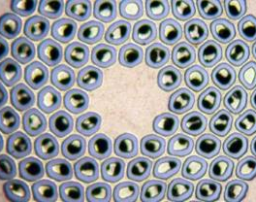
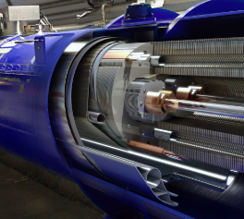
key technology R&D – high field magnets
Nb₃Sn
16 T
Conductor R&D
Magnet Design
increase critical current density
obtain high quantities at
required quality
material Processing
reduce cost
develop 16T short models
field quality and aperture
optimum coil geometry
manufacturing aspects
cost optimisation

Slide 15
FCC Magnet Technology Program
Main Milestones of the FCC Magnets Technologies
Milestone | Description | 15 | 2016 |  | 2017 |  | 2018 |  | 2019 |  | 2020 |  | 21
M0 | Supporting wound conductor program
M1 | Design of an RMM with existing wire
M2 | Manufacture and test of a first 16T RMM
M3 | Procurement 35 km state of the art high J_{c} wire
M4 | Design of a 16T demonstrator with above wire
M5 | Manufacture and test of the 16T demonstrator
M6 | Procurement 70 km of enhanced high J_{c} wire
M7 | EuroCirCol design 16T accelerator quality model
 | Manufacture and test of the EuroCirCol model

Slide 16

FCC-hh: some design challenges
  stored beam energy: 8 GJ/beam (0.4 GJ LHC) = 16 GJ total
  ➔ equivalent to an Airbus A380 (560 t) at full speed (850 km/h)
  collimation, beam loss control, radiation effects: important
  injection/dumping/beam transfer: critical operations
  magnet/machine protection: to be considered early on

Slide 17
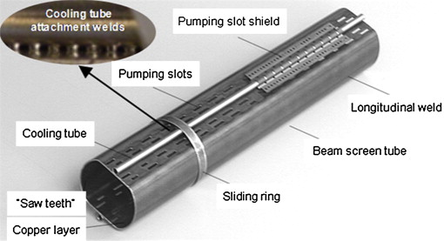
Synchrotron radiation/beam screen
high synchrotron radiation load (SR) of protons @ 50 TeV:
~30 W/m/beam (@16 T)
5 MW total in arcs
(LHC <0.2W/m)
beam screen to capture SR and “protect” cold mass
power mostly cooled at beam screen temperature
only fraction reaches magnets at 2 – 4 K
→ optimization of temperature, space, vacuum, impedance, e-cloud, etc.
D. Schulte

Slide 18
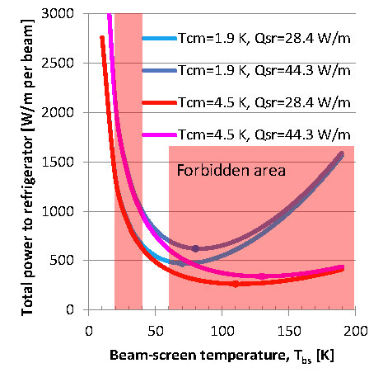
cryo power for cooling of SR heat
contributions: beam screen (BS) & cold bore (BS heat radiation)
Contributions to cryo load:
beam screen (BS) &
cold bore (BS heat radiation)
At 1.9 K cm optimum BS temperature range: 50-100 K;
but impedance increases with temperature → instabilities
40-60 K favoured by vacuum & impedance considerations
→ 100 MW refrigerator power on cryo plant
At 4.5 K cold bore, one could potentially increase beam-screen temperature and lower refrigerator power to 50 MW.
P. Lebrun, L. Tavian

Slide 19
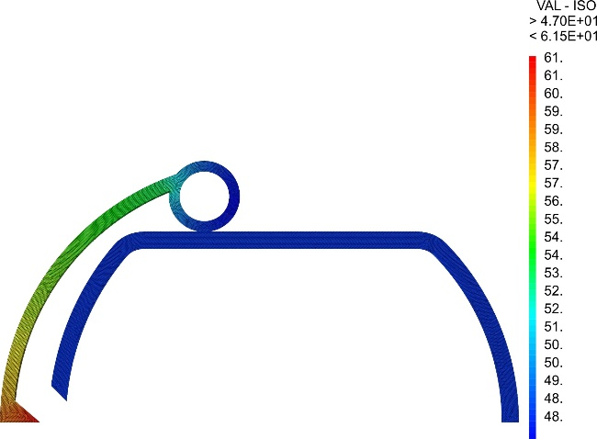
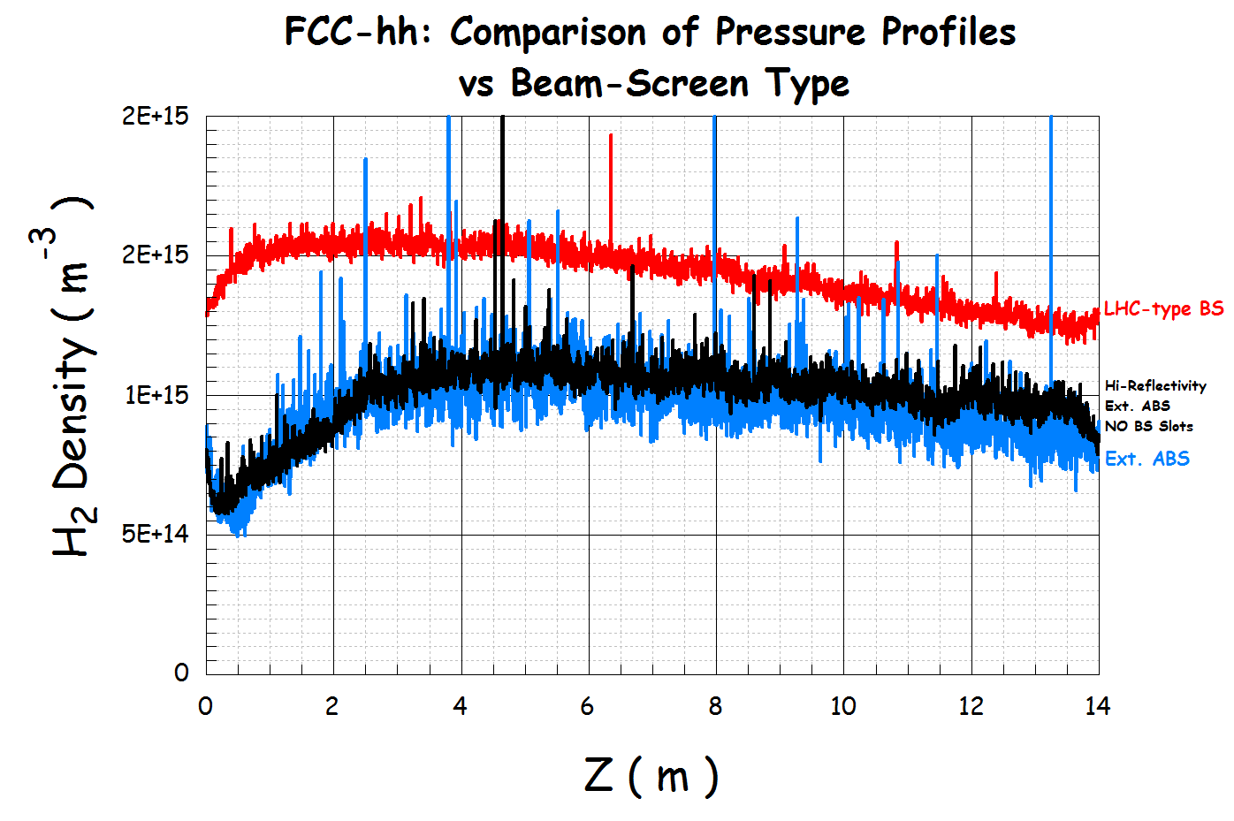
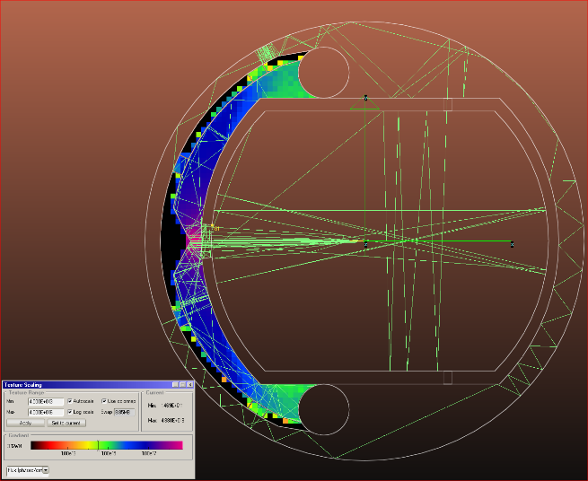
novel beam screen - design example
Heat transport
Vacuum quality
Photon distribution
new type of ante-chamber
absorption of synchrotron radiation
avoids photo-electrons
helps beam vacuum
R. Kersevan,
C. Garion,
L. Tavian, et al.

Slide 20

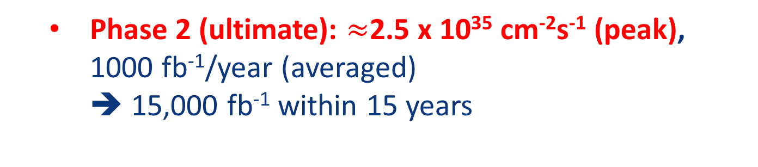
FCC-hh luminosity goals & phases
Two parameter sets for two operation phases:
  Phase 1 (baseline): 5 x 10³⁴ cm⁻²s⁻¹ (peak),
  250 fb⁻¹/year (averaged)
    2500 fb⁻¹ within 10 years (~HL LHC total luminosity)
  Phase 2 (ultimate): $≈$2.5 x 10³⁵ cm⁻²s⁻¹ (peak),
  1000 fb⁻¹/year (averaged)
  ➔ 15,000 fb⁻¹ within 15 years
  Yielding total luminosity O(20,000) fb⁻¹
  over $≈$25 years of operation

Slide 21
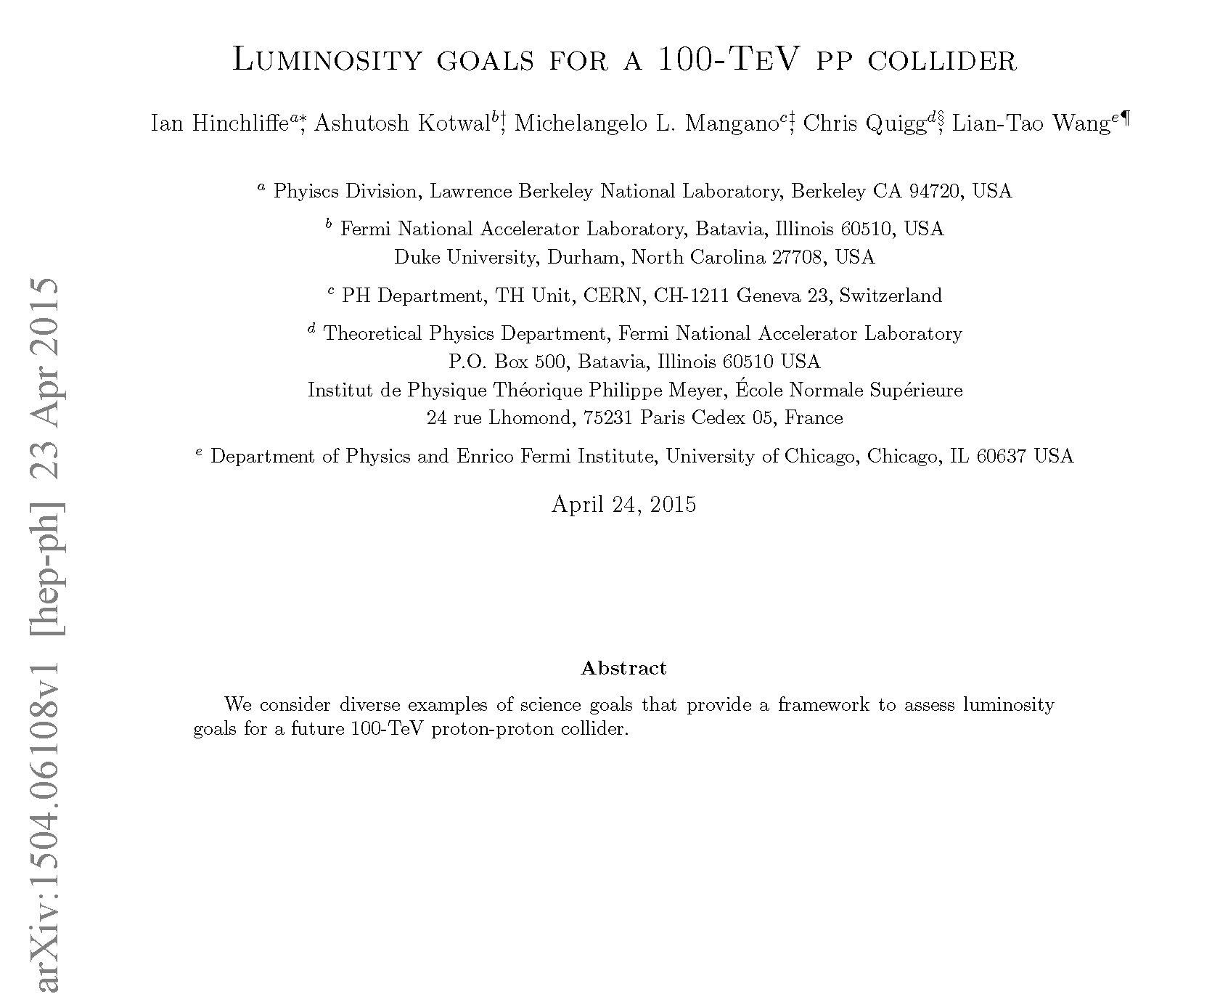
20 ab⁻¹ OK for physics

Slide 22
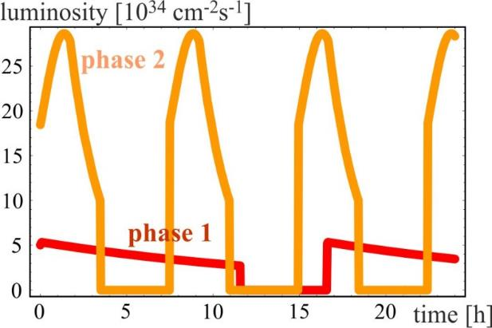
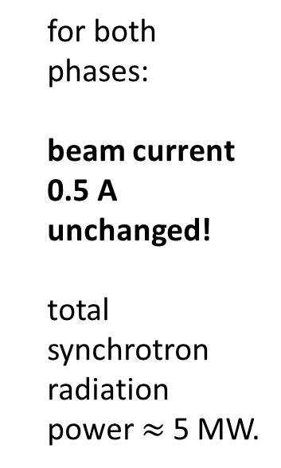

luminosity evolution over 24 h
radiation damping: τ$≈$1 h
  for both phases:
  beam current 0.5 A unchanged!
  total synchrotron radiation power $≈$5 MW.
phase 1: β*=1.1 m, ΔQ_{tot}=0.01, t_{ta}=5 h
phase 2: β*=0.3 m, ΔQ_{tot}=0.03, t_{ta}=4 h

Slide 23
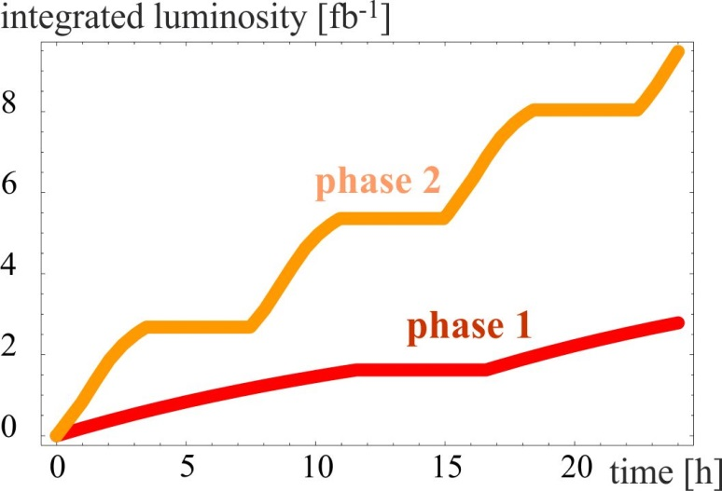
integrated luminosity / day
phase 1: β*=1.1 m, ΔQ_{tot}=0.01, t_{ta}=5 h
phase 2: β*=0.3 m, ΔQ_{tot}=0.03, t_{ta}=4 h

Slide 24
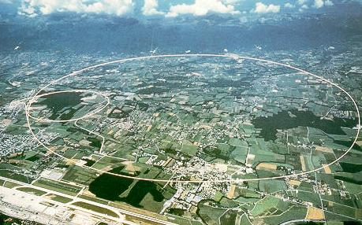
LEP – highest energy e⁺e⁻ collider so far
circumference 27 km
in operation from 1989 to 2000
maximum c.m. energy 209 GeV
maximum synchrotron radiation power 23 MW

Slide 25
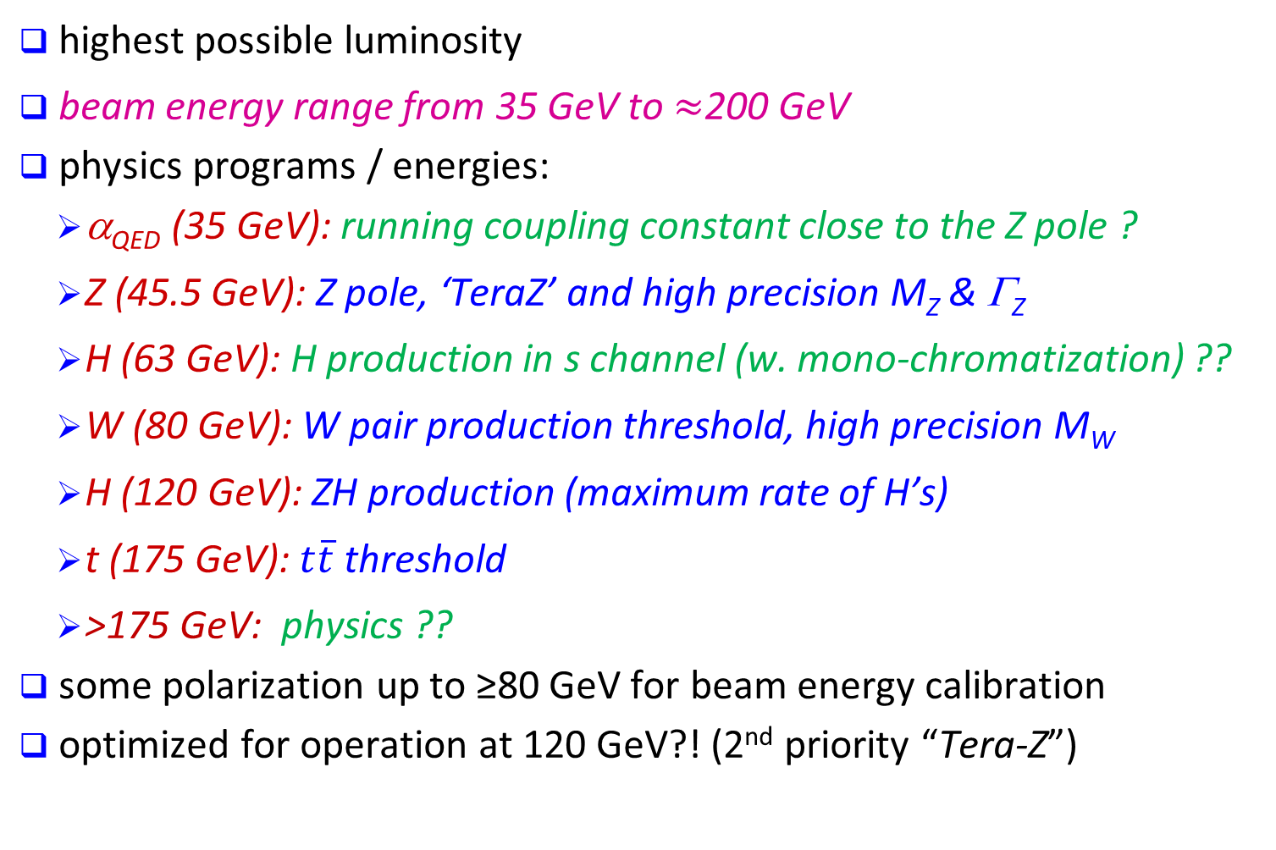
physics requirements for FCC-ee
highest possible luminosity
beam energy range from 35 GeV to $≈$200 GeV
physics programs / energies:
  α_{QED} (35 GeV): running coupling constant close to the Z pole ?
  Z (45.5 GeV): Z pole, ‘TeraZ’ and high precision M_{Z} & Γ_{Z}
  H (63 GeV): H production in s channel (w. mono-chromatization) ??
  W (80 GeV): W pair production threshold, high precision M_{W}
  H (120 GeV): ZH production (maximum rate of H’s)
  t (175 GeV): $t\overline{t}$threshold
  >175 GeV: physics ??
some polarization up to ≥80 GeV for beam energy calibration
optimized for operation at 120 GeV?! (2nd priority “Tera-Z”)
A. Blondel, P. Janot, et al.

Slide 26
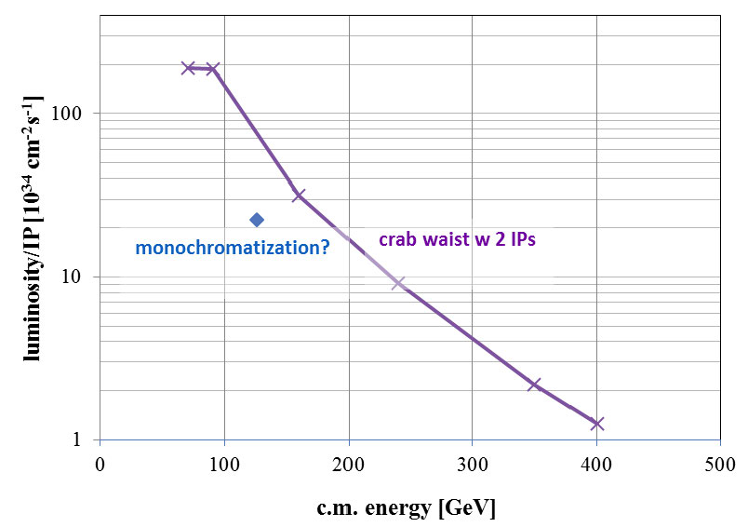

luminosity vs c.m. energy
α_{QED}
Z
H?
WW
HZ
$$t\overline{t}$$
?

Slide 27
key parameters FCC-ee
parameter | FCC-ee |  |  | LEP2
energy/beam [GeV] | 45 | 120 | 175 | 105
bunches/beam | 13000- 60000 | 500- 1400 | 51- 98 | 4
beam current [mA] | 1450 | 30 | 6.6 | 3
luminosity/IP x 10³⁴ cm⁻²s⁻¹ | 21 - 280 | 5 - 11 | 1.5 - 2.6 | 0.0012
energy loss/turn [GeV] | 0.03 | 1.67 | 7.55 | 3.34
synchrotron power [MW] | 100 |  |  | 22
RF voltage [GV] | 0.2-2.5 | 3.6-5.5 | 11 | 3.5
dependency: crab-waist vs. baseline optics and 2 vs. 4 IPs

Slide 28
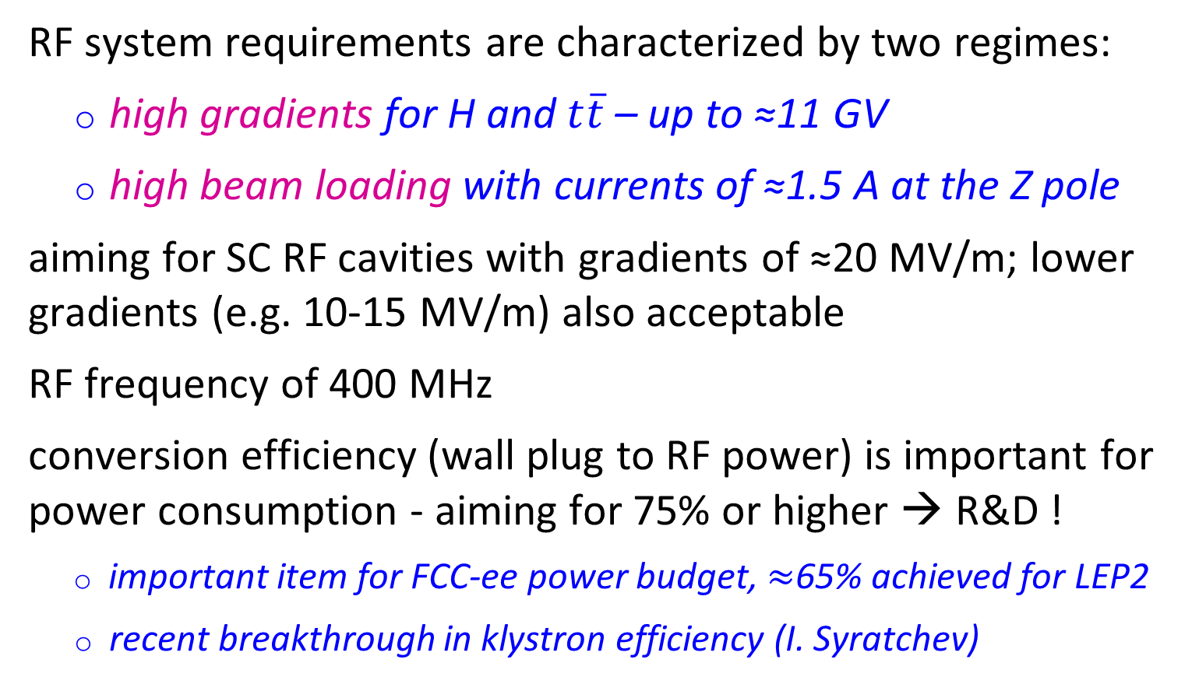
SC RF System
RF system requirements are characterized by two regimes:
  high gradients for H and $t\overline{t}$ – up to ≈11 GV
  high beam loading with currents of ≈1.5 A at the Z pole
aiming for SC RF cavities with gradients of ≈20 MV/m; lower gradients (e.g. 10-15 MV/m) also acceptable
RF frequency of 400 MHz
conversion efficiency (wall plug to RF power) is important for power consumption - aiming for 75% or higher → R&D !
  important item for FCC-ee power budget, $≈$65% achieved for LEP2
  recent breakthrough in klystron efficiency (I. Syratchev)
J. Wenninger, A. Butterworth, E. Jensen, et al.

Slide 29
luminosity scaling: larger E & ρ
H ≤ 1
Hour-glass
F ≤ 1
Crossing angle
2Φ
Beam-beam parameter
J. Wenninger

Slide 30
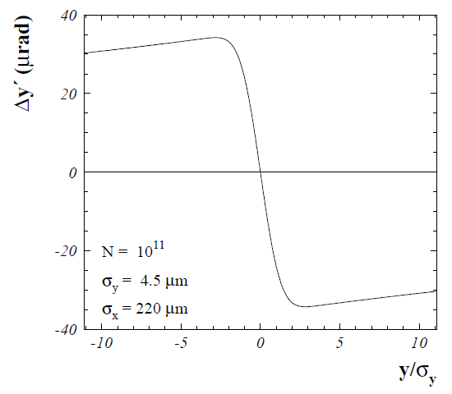
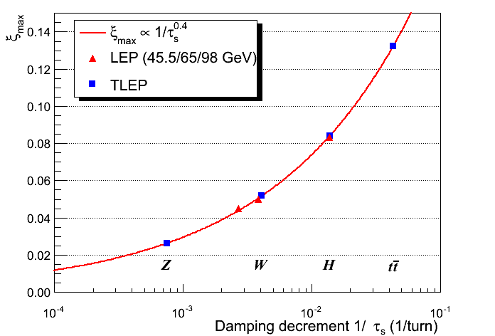

luminosity scaling: damping
beam-beam parameter ξ measures strength of field sensed by the particles in a collision
beam-beam parameter limits are empirically scaled from LEP data (4 IPs)
R. Assmann & K. Cornelis, EPAC2000
x4.5
FCC-ee
vs LEP
x4
In reasonable agreement with first simulations for FCC ee
<x2
x1/50
$→$ extremely high luminosity
J. Wenninger, R. Assmann, S. White, K. Ohmi, D. Shatilov, et al.

Slide 31
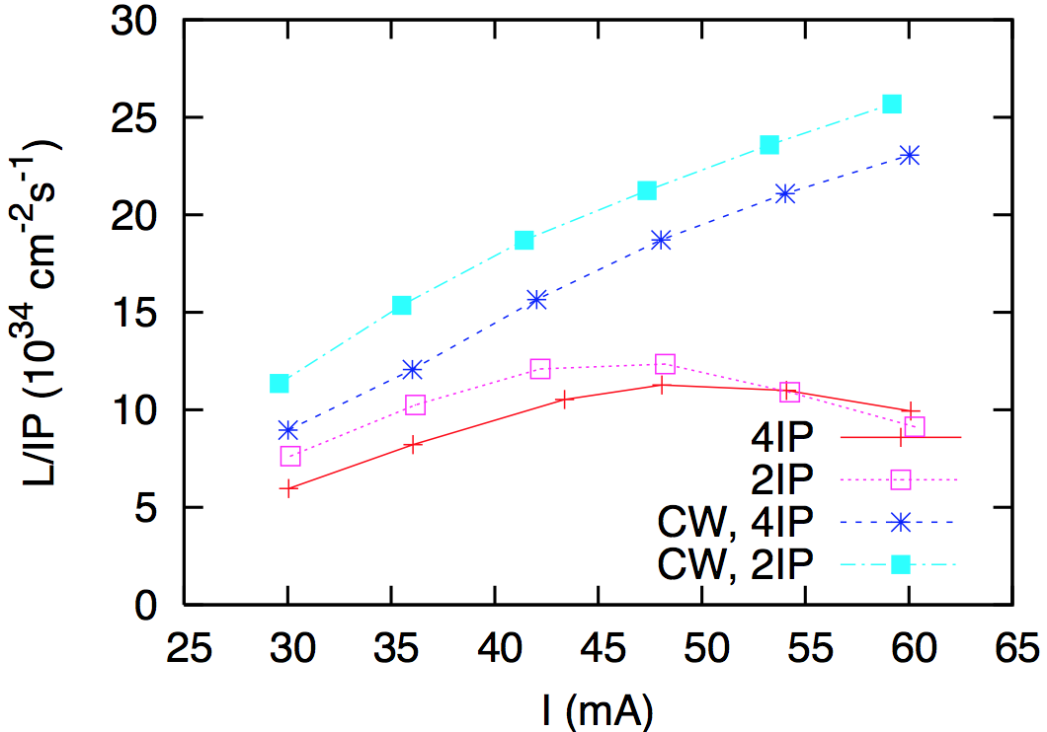
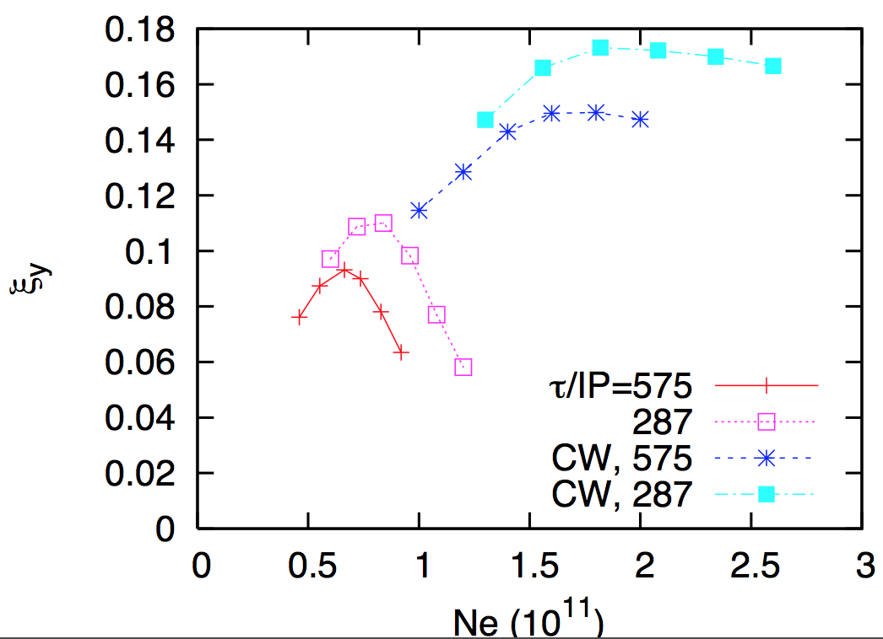
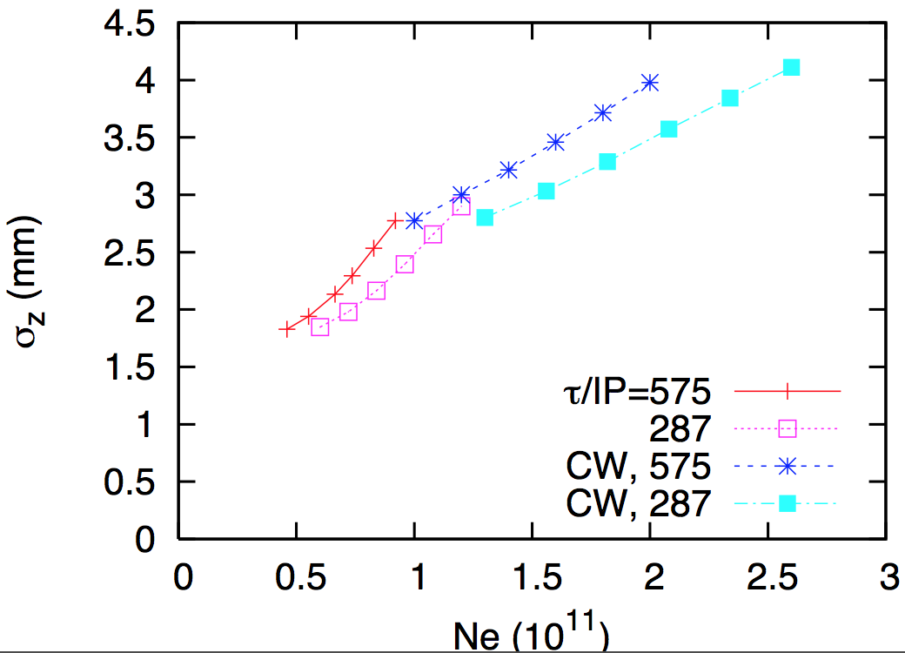
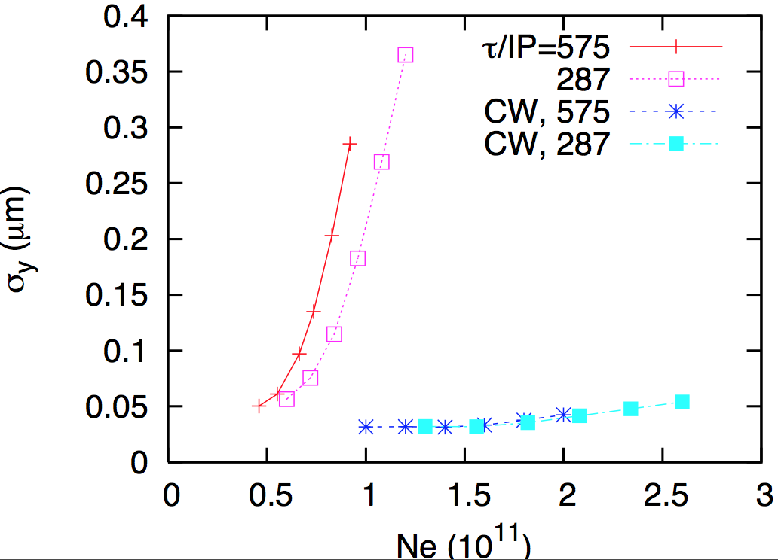
beam-beam simulations
analytical estimates confirmed by the simulations
The beam-beam limit may further be raised with crab-waist schemes !
K. Ohmi, D. Shatilov

Slide 32
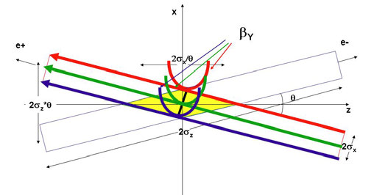
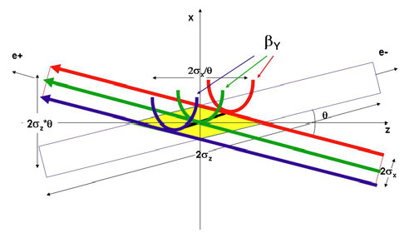
crab-waist crossing for flat beams
regular crossing
P. Raimondi,
et al. (SuperB, DAFNE)
crab waist -
vertical waist position
in s varies with horizontal
position x
allows for small β_{y}*
and avoids betatron resonances

Slide 33

beamstrahlung – a new limit at 175 GeV
hard photon emission at the IPs, ‘Beamstrahlung’, can become lifetime / performance limit for large bunch populations (N), small hor. beam size (σ_{x}) & short bunches (σ_{s})
e
γ
e
ρ : mean bending radius at the IP (in the field of the opposing bunch)
η : ring energy acceptance
lifetime expression by V. Telnov, modified version by A. Bogomyagkov et al
for acceptable lifetime, ρ×η must be sufficiently large
  flat beams (large σ_{x}) !
  bunch length !
  large momentum acceptance: ≥1.5% at 175 GeV
    - LEP: <1% acceptance, SuperKEKB ~ 1.5%
J. Wenninger, et al

Slide 34

SuperKEKB = FCC-ee demonstrator
beam commissioning will start in 2015
K. Oide et al.
top up injection at high current
β_{y}* =300 μm (FCC-ee: 1 mm)
lifetime 5 min (FCC-ee: ≥20 min)
ε_{y}/ε_{x} =0.25% (similar to FCC-ee)
off momentum acceptance (±1.5%, similar to FCC-ee)
e⁺ production rate (2.5x10¹²/s, FCC-ee: <1.5x10¹²/s (Z crab waist)
SuperKEKB goes beyond FCC-ee, testing all concepts

Slide 35
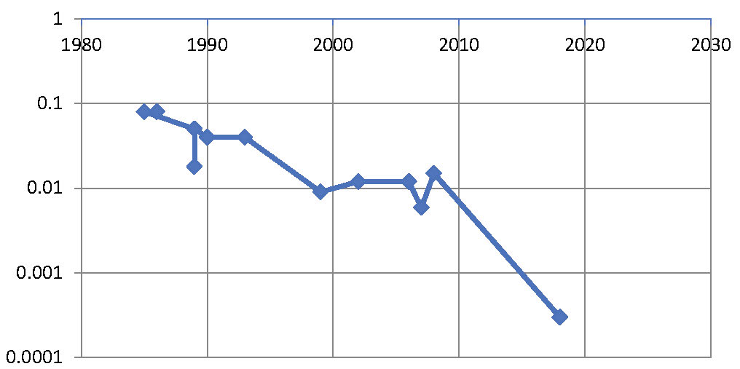
β_{y}* evolution over 40 years
β* [m]
year
SPEAR
PEP, BEPC, LEP
PETRA
TRISTAN
DORIS
CESR-c, PEP-II
BEPC-II
CESR
DAFNE
KEKB
6 mm
FCC-ee
SuperKEKB
1 mm
0.3 mm
entering a new regime for ring colliders –
SuperKEKB will pave the way towards β*≤1 mm

Slide 36
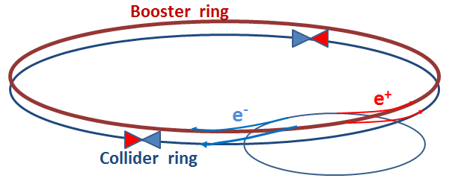
FCC-ee injection
beside the collider ring(s), a booster of the same size (same tunnel) must provide beams for top-up injection
  same size of RF system, but low power (~ MW)
  top up frequency ≈0.1 Hz
  booster injection energy ≈20 GeV
  bypass around the experiments
injector complex for e⁺ and e⁻ beams of 10-20 GeV
  Super-KEKB injector ≈ almost suitable
A. Blondel

Slide 37
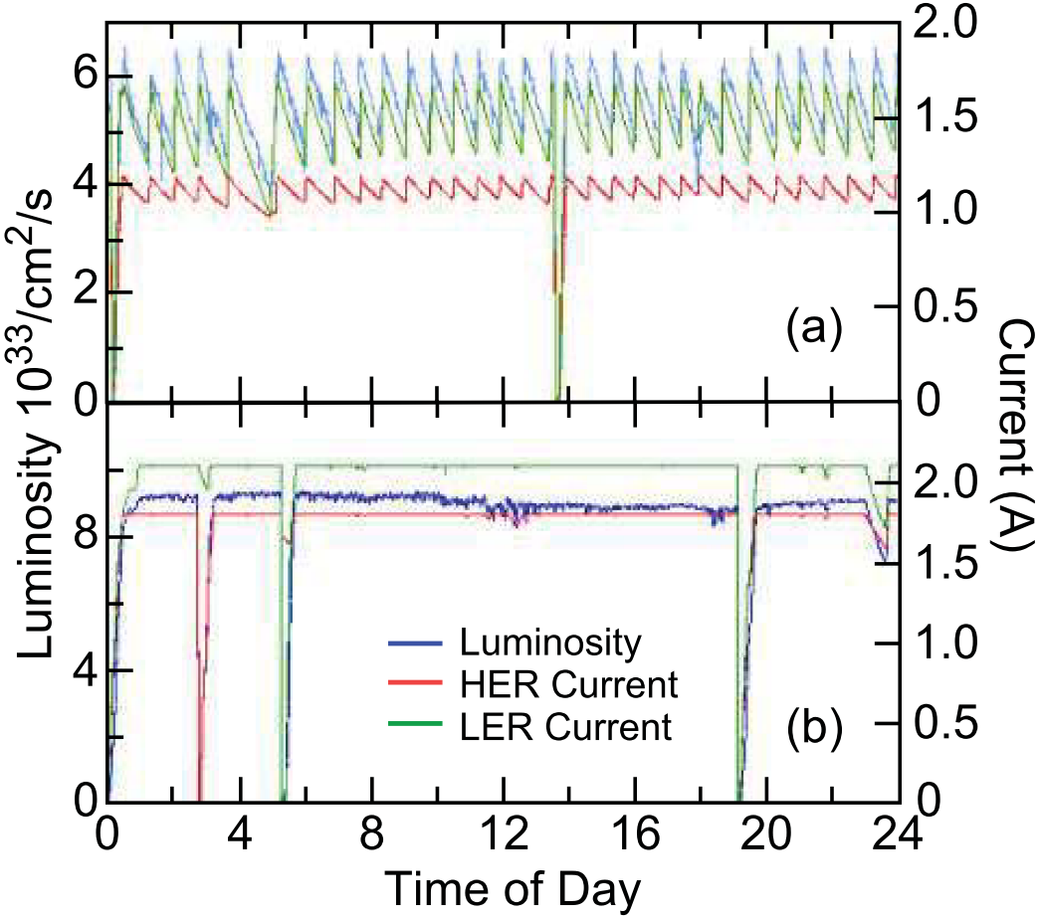
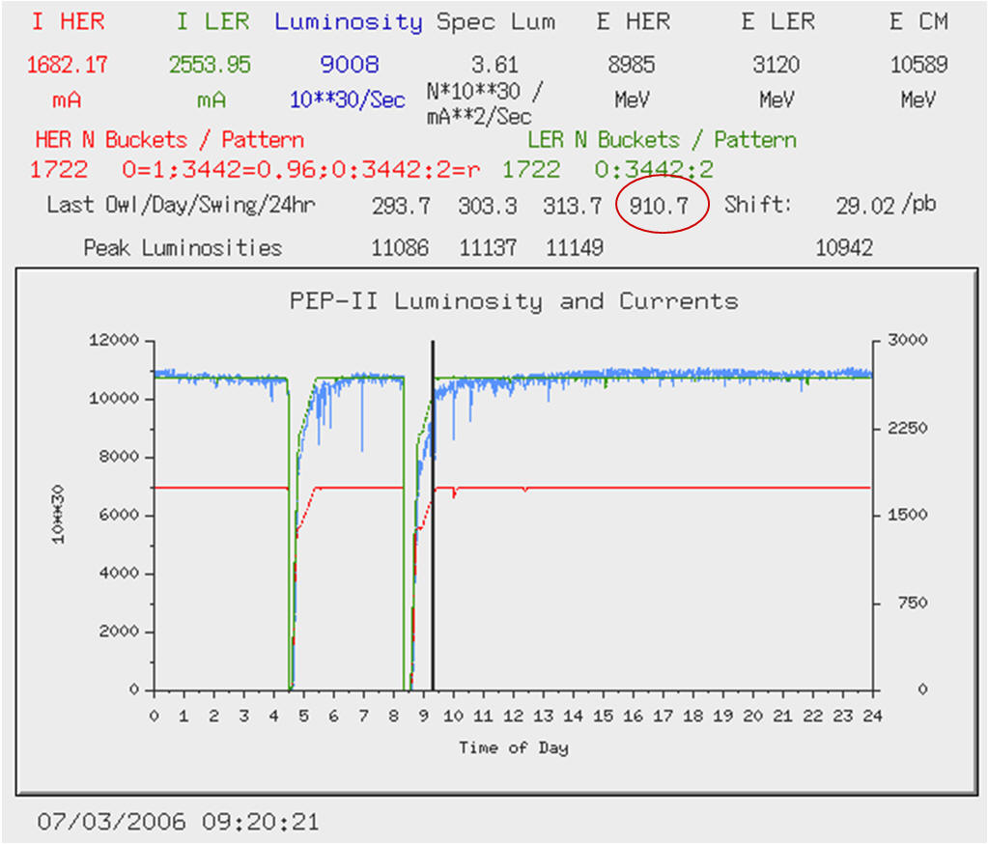
top-up injection at PEP-II
Before Top-Up
After Top-Up
average luminosity ≈ peak luminosity
similar results from KEKB
J. Seeman

Slide 38
FCC-ee top-up
two new options for top-up:
off-momentum multipole kicker injection
or kicker-less (“dream injection”)
*
Wire septum
2nd turn (δ~-3%)
Injection point (δ=-4%)
M. Aiba, A. Saa Hernandez, PSI
* earlier proposal by R. Talman

Slide 39
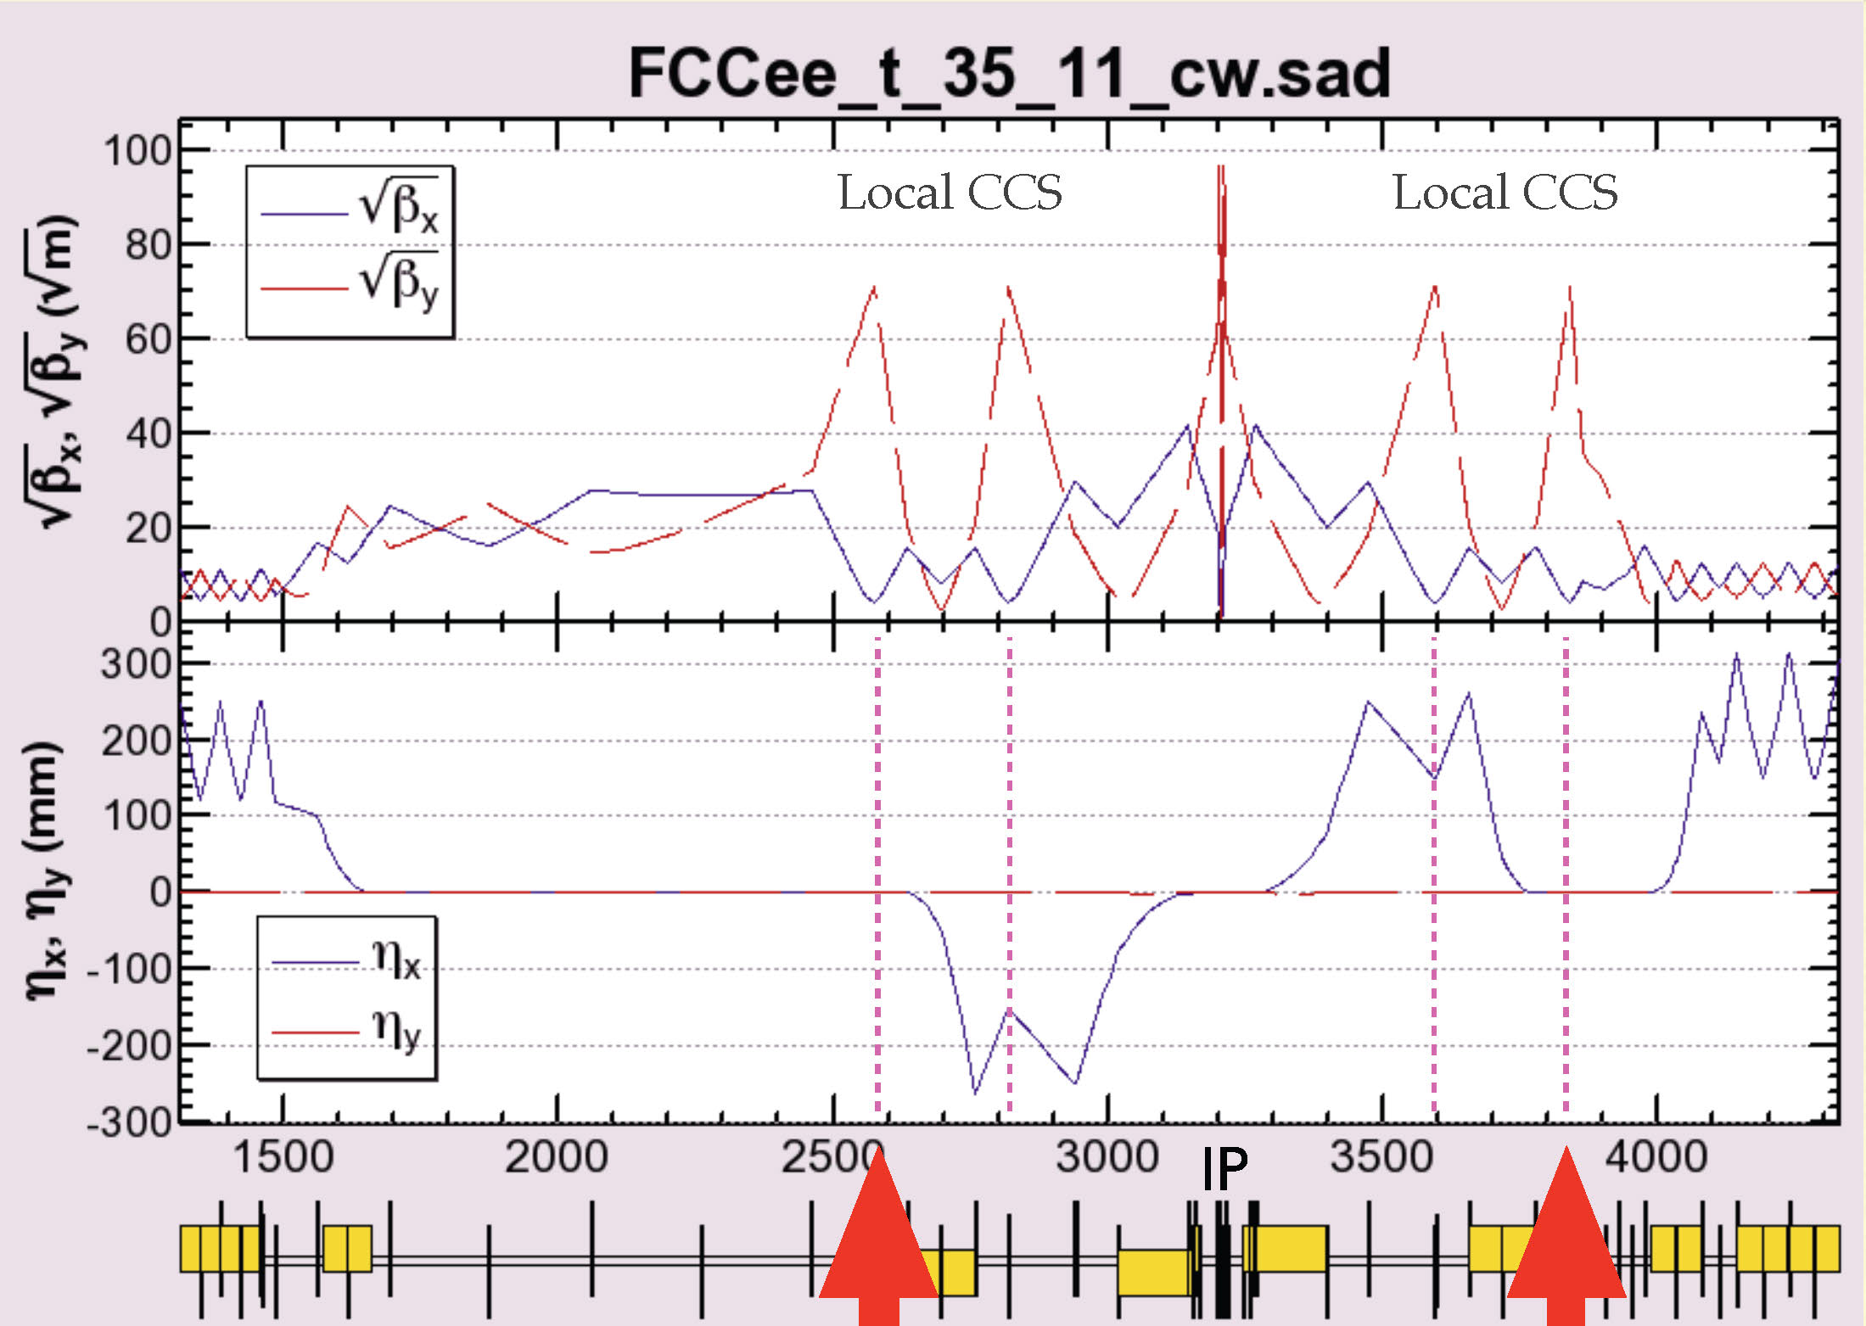
IR optics with crab waist and solenoids
these sextupoles work as crab waist sextupoles
K. Oide

Slide 40
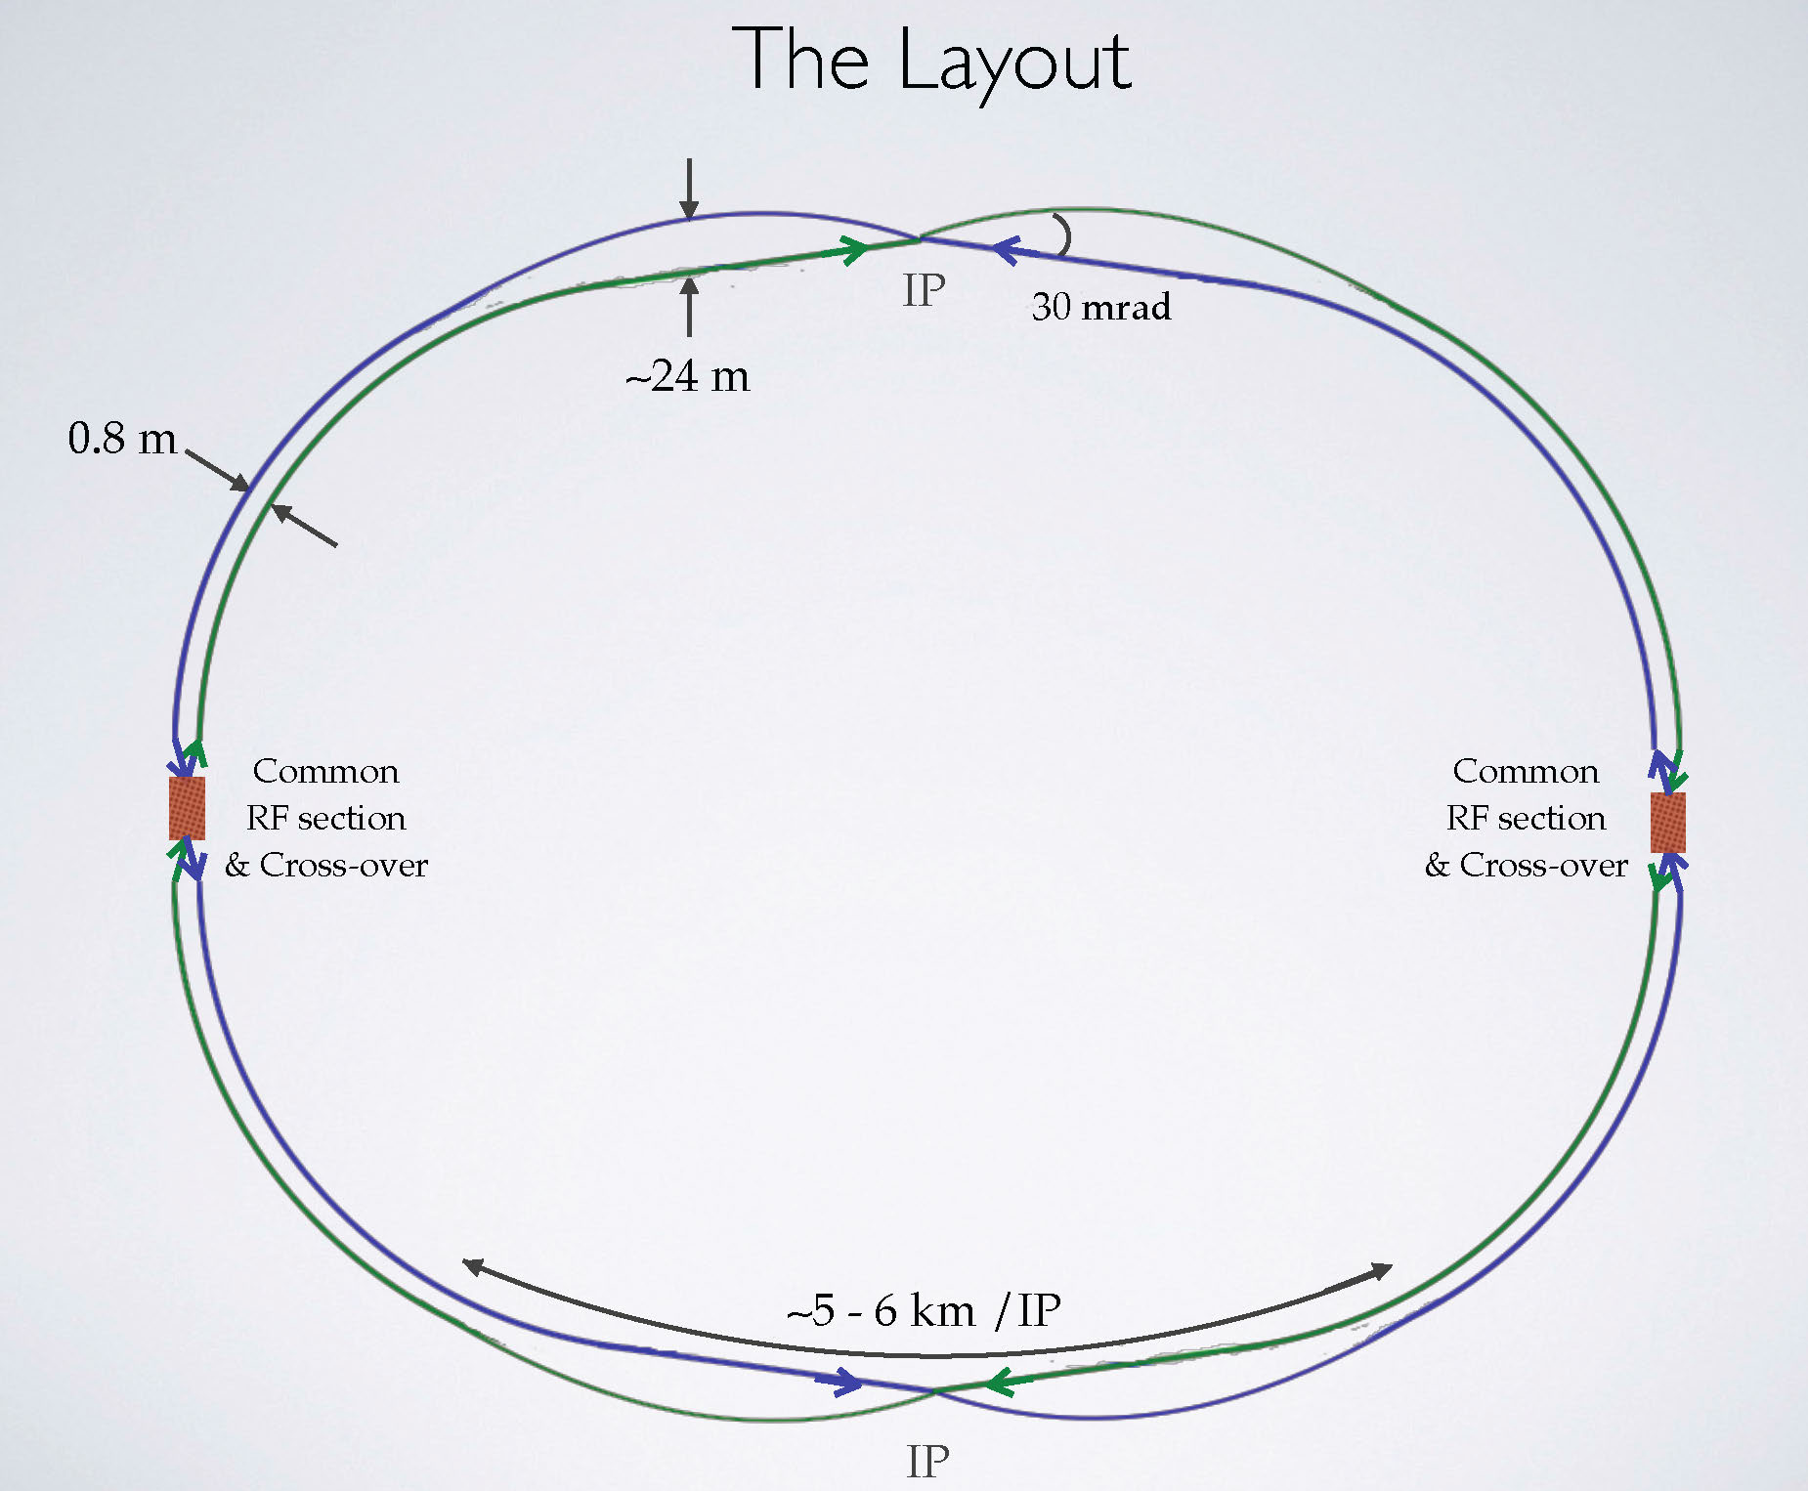
complete draft optics & geometry for FCC-ee
a bypass for the injector?
asymmetric layout -
less bending for incoming beam, stronger bending for outgoing beam; reduced synchrotron radiation towards the IP
K. Oide

Slide 41
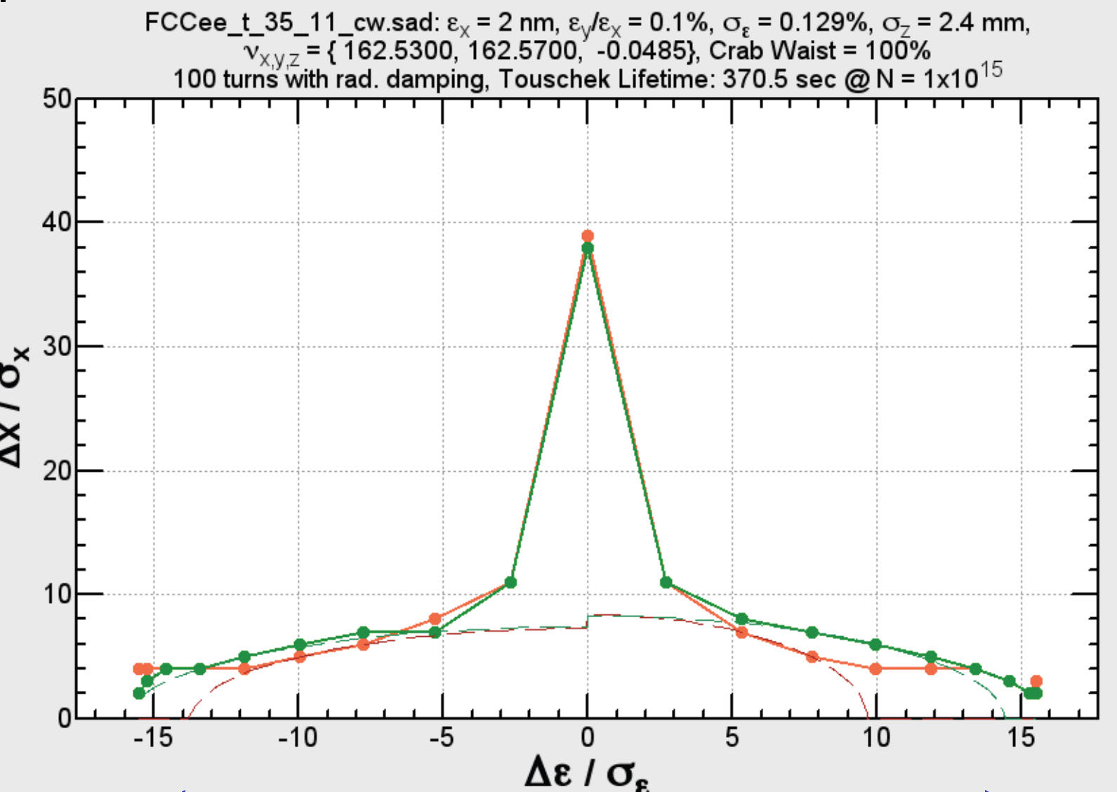
dynamic aperture
±2%
K. Oide

Slide 42
FCC-he baseline: linac-ring collider
luminosity of LR collider:
H_{D}~1.3
(round beams)
D. Schulte
LHeC2010
highest proton
beam brightness
available
average e⁻
current
limited by
energy
recovery
efficiency
I_{e}=25.6 mA (LHeC-HF)
maximize geometric
overlap factor
head-on collision
small e- emittance
θ_{c}=0
H_{hg}≥0.7
smallest possible
proton β* function:
reduced l*
squeeze only
one p beam

Slide 43
one option: reuse the LHeC
FCC
gap turn 1
gap turn 2
gap turn 3
gap turn 1
gap turn 2
gap turn 3
IP#2
IP#1
ΔC=k C_{LHeC}
LHC
C_{LHeC}=C_{LHC}/n
m, n (=3 or 4), k: integer
p = 1 or 2
future: C_{LHeC}=pC_{FCC}/m

Slide 44
LHeC HF → FCC-he (FCC-hh phase 2)
parameter [unit] |  | FCC-hh
species | e- | p
beam energy (/nucleon) [GeV] | 60 | 7000→ 50000
bunch spacing [ns] | 25 | 25
bunch intensity (nucl,) [10¹⁰] | 0.4 | 22→ 10
beam current [mA] | 25.6 | 1110 → 500
normalized rms emittance [μm] | 20 → 10 | 2.5 → 0.75
geometric rms emittance [nm] | 0.17→0.085 | 0.34 → 0.014
IP beta function β_{x,y}* [m] | 0.10→0.048 | 0.05 → 0.3
IP rms spot size [μm] | 4.1 → 2.0 | 4.1 →2.0
lepton D & hadron ξ | 23 → 48 | 0.0002→0.0007
hourglass reduction factor H_{hg} | 0.80→ 0.80
pinch enhancement factor H_{D} | ~1.35
luminosity/nucl. [10³³cm⁻¹s⁻¹] | 14.4 → 27.6

Slide 45
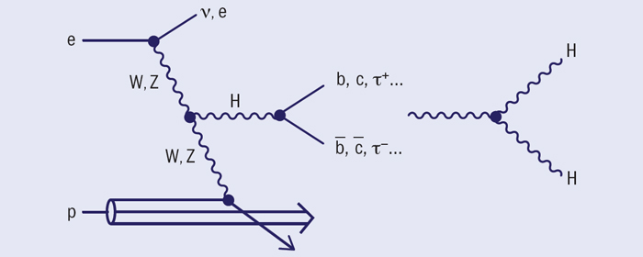
Higgs physics at FCC-he
h-e Higgs-boson production and decay; and precision measurements of the H–bb coupling in WW–H production; FCC-he also gives access to Higgs self-coupling H–HH (<10% precision!? - under study), to lepto-quarks up to ≈4 TeV & to Bjorken x as low as 10⁻⁷ - 10⁻⁸ [of interest for ultra high energy ν scattering]
M. Klein and H. Schopper, CERN Courier June2014

Slide 46
CERN Circular Colliders + FCC
1980
1985
1990
1995
2000
2005
2010
2015
2020
2025
2030
2035
20 years
Constr.
Physics
LEP
Design
Proto
Construction
Physics
LHC
Design
Construction
Physics
HL-LHC
FCC
Design
Proto
Construction
Physics

Slide 47



Study time line towards FCC CDR
2014 |  |  |  | 2015 |  |  |  | 2016 |  |  |  | 2017 |  |  |  | 2018
Q1 | Q2 | Q3 | Q4 | Q1 | Q2 | Q3 | Q4 | Q1 | Q2 | Q3 | Q4 | Q1 | Q2 | Q3 | Q4 | Q1 | Q2 | Q3 | Q4
Study plan, scope definition
Explore options
“weak interaction”
conceptual study of baseline “strong interact.”
FCC Week 2015:
work towards baseline
FCC Week 17 & Review
Cost model, LHC results
→ study re-scoping?
FCC Week 2016
Progress review
Elaboration,
consolidation
FCC Week 2018
→ contents of CDR
Report
CDR ready

Slide 48
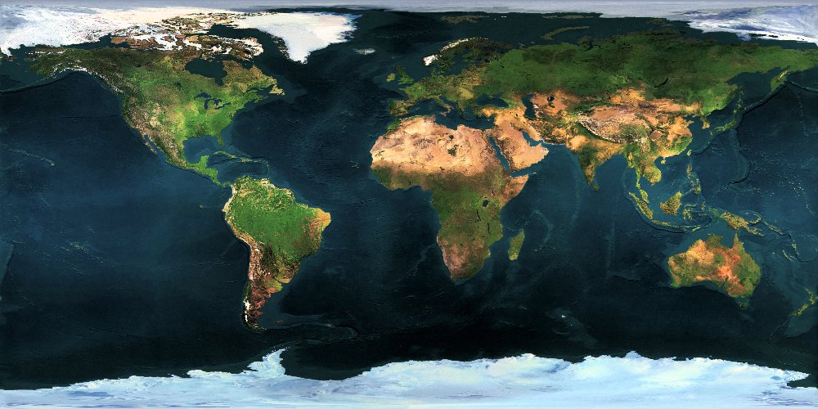























FCC Collaboration Status
58 institutes
22 countries + EC

Slide 49
FCC Collaboration Status
58 collaboration members & CERN as host institute, 8 July 2015
ALBA/CELLS, Spain
Ankara U., Turkey
U Belgrade, Serbia
U Bern, Switzerland
BINP, Russia
CASE (SUNY/BNL), USA
CBPF, Brazil
CEA Grenoble, France
CEA Saclay, France
CIEMAT, Spain
CNRS, France
Cockcroft Institute, UK
U Colima, Mexico
CSIC/IFIC, Spain
TU Darmstadt, Germany
DESY, Germany
TU Dresden, Germany
Duke U, USA
EPFL, Switzerland
GWNU, Korea
U Geneva, Switzerland
Goethe U Frankfurt, Germany
GSI, Germany
Hellenic Open U, Greece
HEPHY, Austria
U Houston, USA
IFJ PAN Krakow, Poland
INFN, Italy
INP Minsk, Belarus
U Iowa, USA
IPM, Iran
UC Irvine, USA
Istanbul Aydin U., Turkey
JAI/Oxford, UK
JINR Dubna, Russia
FZ Jülich, Germany
KAIST, Korea
KEK, Japan
KIAS, Korea
King’s College London, UK
KIT Karlsruhe, Germany
Korea U Sejong, Korea
MEPhI, Russia
MIT, USA
NBI, Denmark
Northern Illinois U., USA
NC PHEP Minsk, Belarus
U. Liverpool, UK
U Oxford, UK
PSI, Switzerland
Sapienza/Roma, Italy
UC Santa Barbara, USA
U Silesia, Poland
TU Tampere, Finland
TOBB, Turkey
U Twente, Netherlands
TU Vienna, Austria
Wroclaw UT, Poland

Slide 50
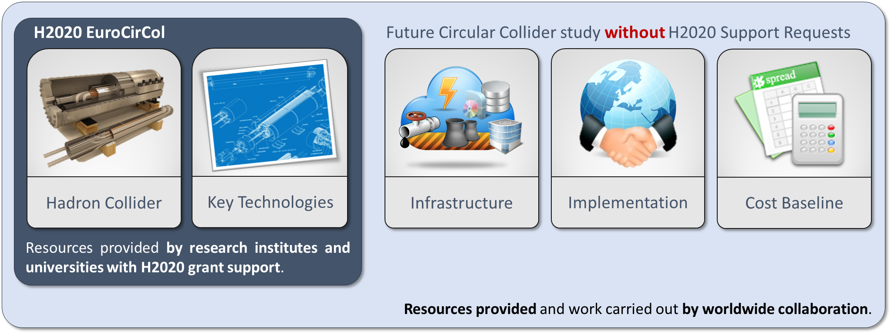
EuroCirCol EU Horizon 2020 Grant
EC contributes with funding to FCC-hh study
Core aspects of hadron collider design: arc & IR optics design, 16 T magnet program, cryogenic beam vacuum system
Recognition of FCC Study by European Commission

Slide 51
EuroCirCol Consortium + Associates
CERN | IEIO
TUT | Finland
CEA | France
CNRS | France
KIT | Germany
TUD | Germany
INFN | Italy
UT | Netherlands
ALBA | Spain
CIEMAT | Spain
STFC | United Kingdom
UNILIV | United Kingdom
UOXF | United Kingdom
KEK | Japan
EPFL | Switzerland
UNIGE | Switzerland
NHFML-FSU | USA
BNL | USA
FNAL | USA
LBNL | USA
Japan
KEK
Finland
TUT
United Kingdom
STFC, UNILIV, UOXF
Netherlands
UT
Germany
KIT, TUD
France
CEA, CNRS
CERN
Switzerland
EPFL, UNIGE
Italy
INFN
Spain
ALBA, CIEMAT
Consortium Beneficiaries, signing the Grant Agreement

Slide 52
Conclusions
bright future for accelerator-based HEP!
we now need to urgently prepare for post-LHC period
circular hadron collider - only path available in this century towards direct discoveries at 10s of TeV energy
FCC-hh further develops the new Nb₃Sn magnet technology of the HL-LHC, it also promotes many other technological innovations (cryogenics, chamber production,…)
FCC-ee: attractive intermediate step towards FCC-hh & highly synergetic (infrastructure, time, physics, + SRF)
FCC-he: complementary physics, extension of LHeC
great worldwide interest - forming global collaboration

Slide 53
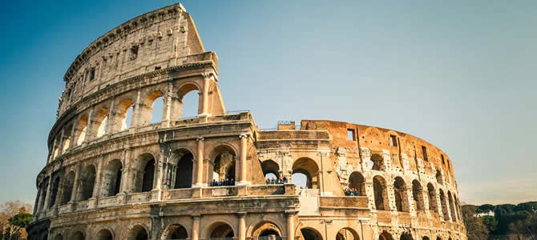





FCC Week 2016
Rome, 11-15 April 2016

Slide 54
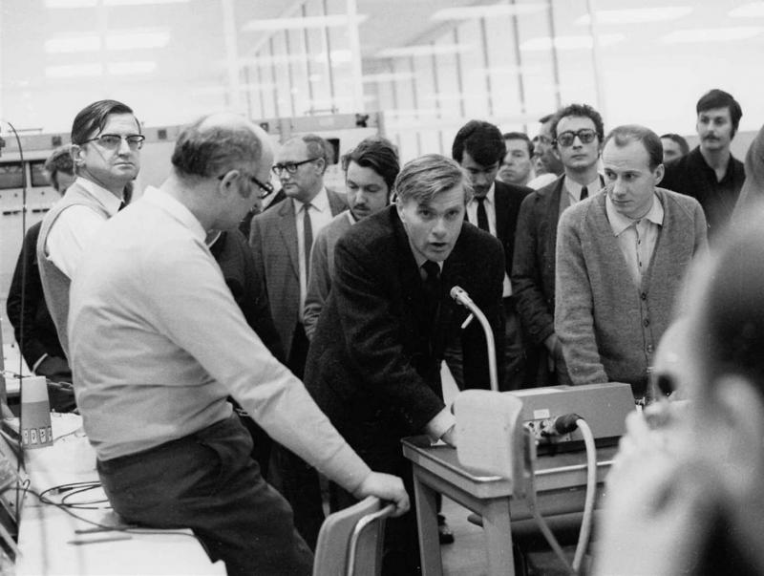
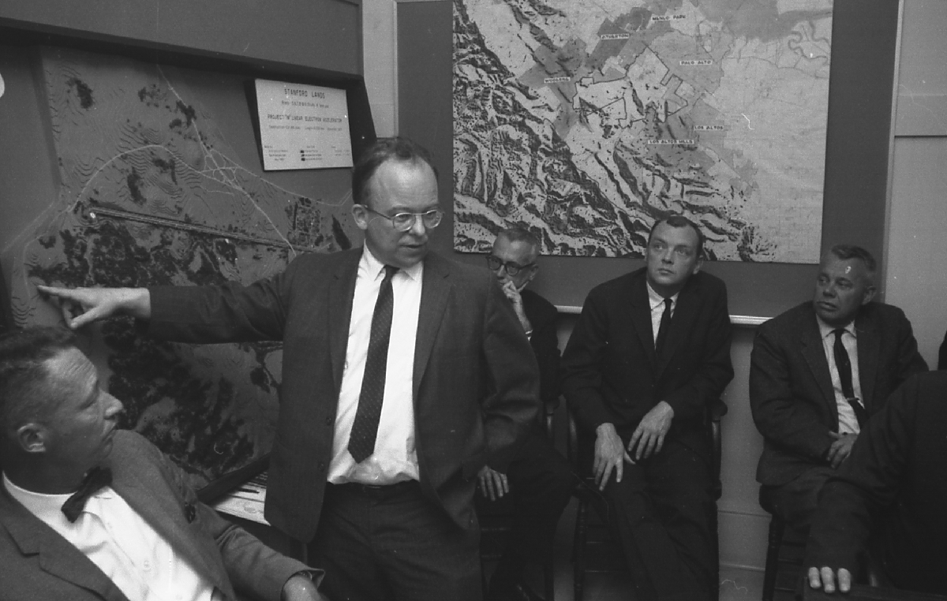
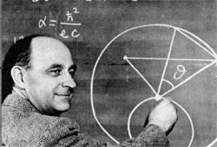






… surely great times ahead!

Slide 55
spare slides

Slide 56


collider c.m. energy vs. year
pp
E_{cm}=2ec Bρ
hadron-lepton
factor 10 every
10 years
factor 10 every
20-30 years
ep
FCC-he
LHeC
e⁺e⁻
factor 10⁵-10⁷ in e⁺e⁻
luminosity
Courtesy V. Shiltsev

Slide 57

FCC-hh: 100 TeV pp collider
Geneva
PS
SPS
LHC
LHC
27 km, 8.33 T
14 TeV (c.m.)
“HE-LHC”
27 km, 20 T
33 TeV (c.m.)
FCC-hh (alternative)
80 km, 20 T
100 TeV (c.m.)
FCC-hh (baseline)
100 km, 16 T
100 TeV (c.m.)
L. Bottura
B. Strauss

