Slide 1

CERN strategy
& future large scale projects
F. Zimmermann, CERN/BE
gratefully acknowledging input from FCC global design study & CepC team
special thanks to M. Benedikt, D. Schulte, S. Stapnes, J. Wenninger
Channeling2014 Conference, Capri, 5 October 2014
Work supported by the European Commission under Capacities 7th Framework Programme, Grant Agreement 312453

Slide 2
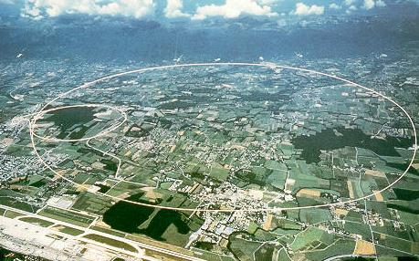
LEP – highest energy e⁺e⁻ collider so far
maximum c.m. energy 209 GeV
maximum synchrotron radiation power 23 MW

Slide 3
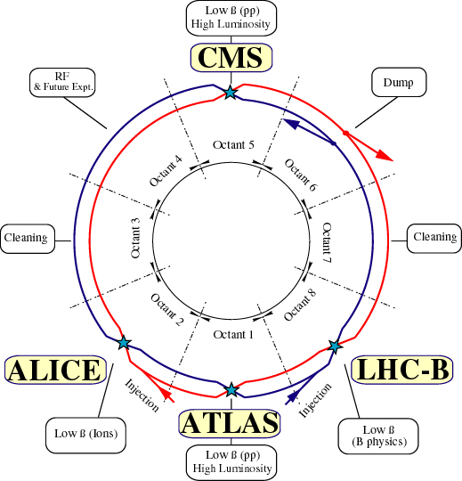
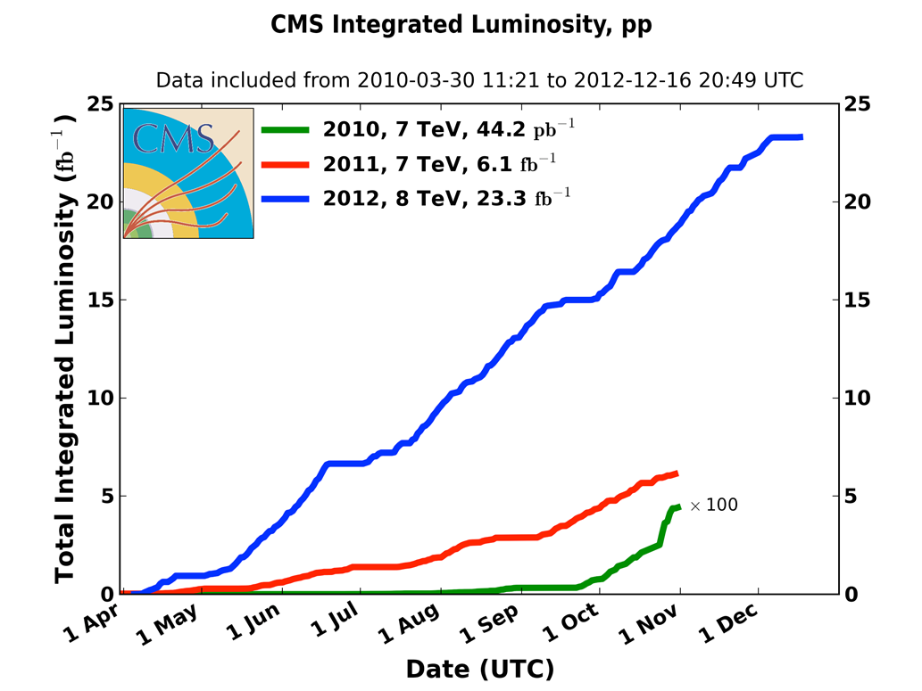
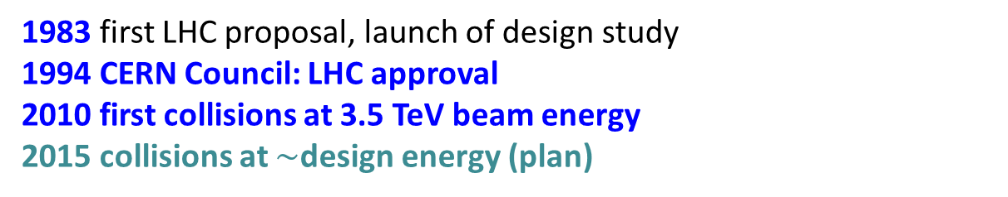
Large Hadron Collider (LHC)
design:
c.m. energy 14 TeV (pp);
luminosity 10³⁴ cm⁻²s⁻¹; 1.15x10¹¹ p/bunch;
2808 bunches/beam;
360 MJ / beam
1983 first LHC proposal, launch of design study
1994 CERN Council: LHC approval
2010 first collisions at 3.5 TeV beam energy
2015 collisions at $\sim$design energy (plan)
now is the time to plan for 2040!

Slide 4

Prospects for Particle Physics
With the discovery of a Higgs boson in 2012, we have completed the Standard Model (almost 80 years of theoretical and experimental efforts !)
However: SM is not a complete theory
Several outstanding questions (e.g. composition of dark matter, cause of universe’s accelerated expansion [dark energy / inflation], origin of matter-antimatter asymmetry, neutrino masses, why 3 families?, lightness of Higgs boson, weakness of gravity, … ) which cannot be explained within the SM.
F. Gianotti et al.
These questions require NEW PHYSICS
Present knowledge is insufficient to determine energy scale of new physics ; LHC will provide new information from pp collisions at higher cm energy (13 TeV) by 2017-18

Slide 5
main questions in particle physics and main approaches to address them
question | high-energy colliders | high-precision experiments | neutrino experiments | dedicated searches | cosmic surveys
Higgs, EWSB | X
neutrinos | X |  | X | X | X
dark matter | X |  |  | X
flavour, CP violation | X | X | X | X
new particles and forces | X | X | X | X
universe acceleration |  |  |  |  | X
F. Gianotti et al.
most of these questions require high-energy and/or
high-intensity accelerators

Slide 6
LHC roadmap: schedule until 2035
LS2 starting in 2018 (July) => 18 months + 3 months BC
LS3 LHC: starting in 2023 => 30 months + 3 months BC
Injectors: in 2024 => 13 months + 3 months BC
Physics
Shutdown
Beam commissioning
Technical stop
(Extended) Year End Technical Stop: (E)YETS
YETS
EYETS
YETS
LS 2
YETS
Run 2
Run 3
Run 2
LS 2
Run 3
30 fb⁻¹
PHASE 1
YETS
LS 3
Run 4
YETS
LS 3
Run 4
300 fb⁻¹
PHASE 2
LS 4
Run 5
LS 5
LS 4
Run 5
LS 5
3’000 fb⁻¹
F. Bordry
Phase 2: HL-LHC

Slide 7
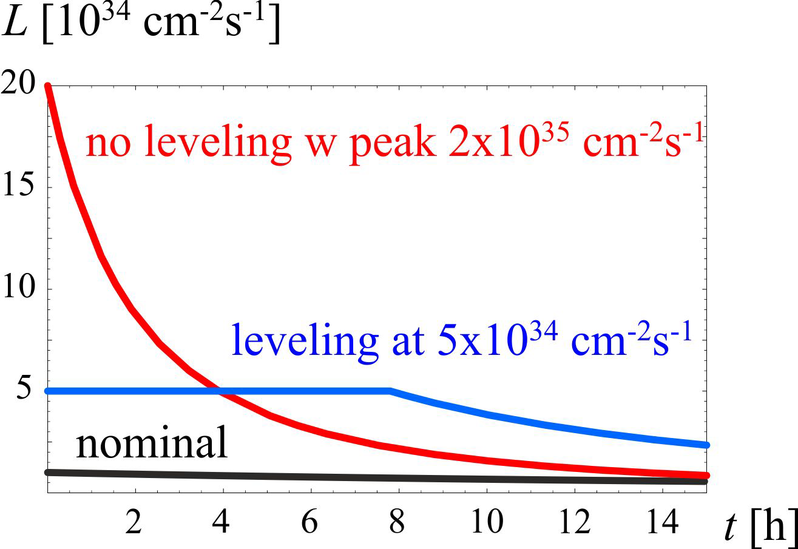
HL-LHC
M. Lamont
3000 fb⁻¹ delivered in the order of 10 years
High “virtual” luminosity with levelling anticipated
Challenging demands on the injector complex
  major upgrades foreseen
5 x 10³⁴ cm⁻²s⁻¹
levelled luminosity
Pile-up ~140
3 fb⁻¹ per day
~250 fb⁻¹ /year

Slide 8
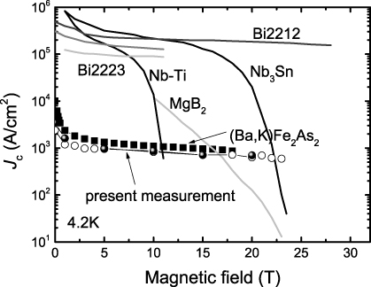
technology transition: Nb-Ti →Nb₃Sn
O. Bruning

Slide 9
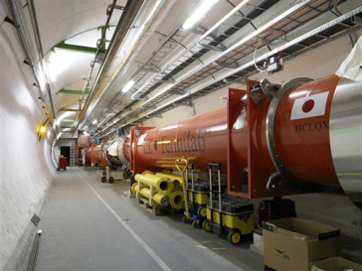



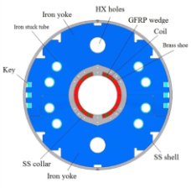

HL-LHC - critical zones around IP1 & IP5
ATLAS
CMS
3. For collimation we also need to change the DS in the continuous cryostat: 11-T Nb₃Sn dipole
2. We also need to modify a large part of the matching section
e.g. Crab Cavities &
D1, D2, Q4 & corrector
New quadrupole triplet based on Nb₃Sn (12 T at coil)
required due to:
-Radiation damage
-Need for more aperture
Changing the triplet region is not enough for reaching the HL-LHC goal!
more than 1.2 km of LHC plus technical infrastructure
(e.g. Cryo and Powering)
Nb₃Sn dipoles & quadrupoles
O. Brüning,
L. Rossi

Slide 10
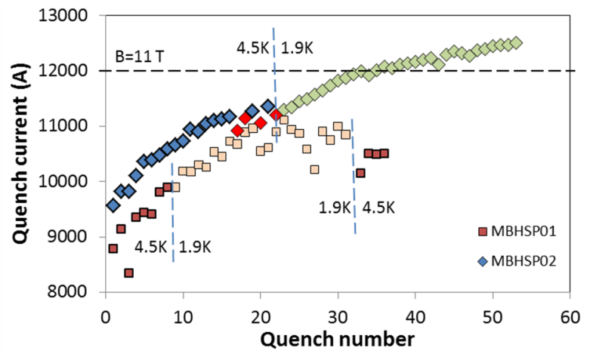
FNAL: Nb₃Sn dipole demonstrators
US-LARP
MBHSP02 (1 m) passed 11 T field during training at 1.9 K with I = 12080 A on 5 March 2013

Slide 11
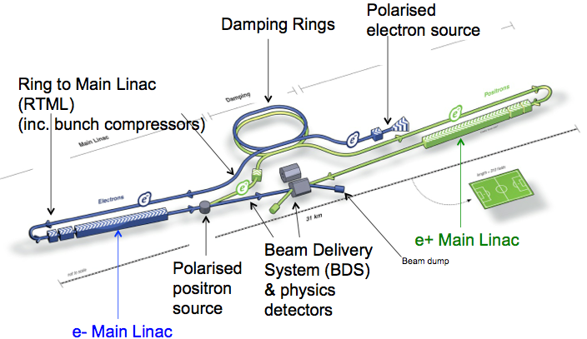
International Linear Collider (ILC)
total length ~30 (500 GeV) - 50 km (1 TeV)
SC acceleration structures ~ 30 MV/m; TDR completed in 2012, ILC technology used for XFEL at DESY; present optimistic time line: construction start in 2018 & 1st physics in 2027?

Slide 12
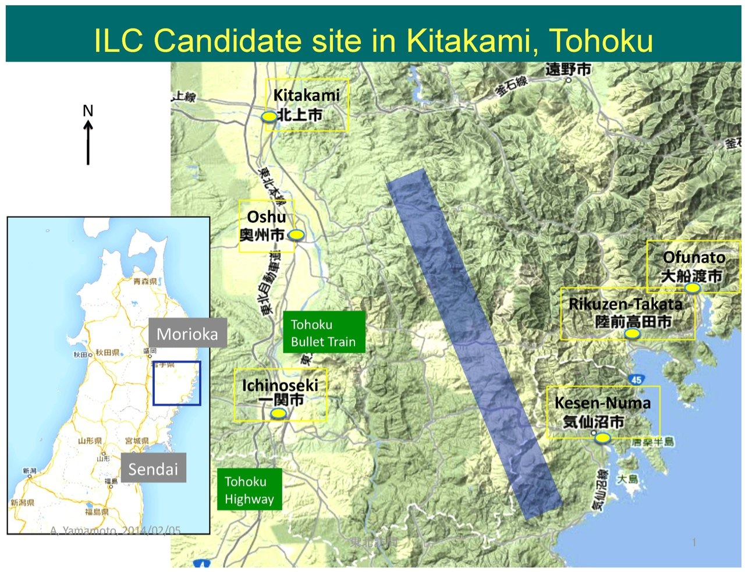
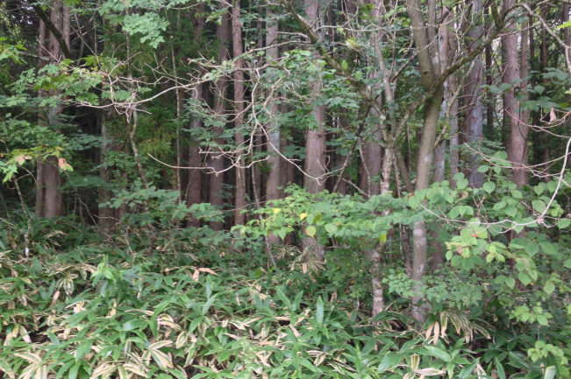
International Linear Collider (ILC) - 2
Japanese HEP community expressed interest in hosting the ILC. Site chosen: 北上市 (Kitakami) in Northern Japan. Under review by Japanese ministry MEXT.
Courtesy F. Simon

Slide 13
European Strategy Update 2013
“CERN should undertake design studies for accelerator projects in a global context, with emphasis on proton-proton and electron-positron high-energy frontier machines.”
http://cds.cern.ch/record/1567258/files/esc-e-106.pdf
strategy adopted by the CERN Council

Slide 14
Compact Linear Collider (CLIC)
total length (main linac) ~11 (500 GeV) - 48 km (3 TeV)
accelerating gradient
~100 MV/m
key technologies: 2-beam accel., drive-beam , X-band RF

Slide 15
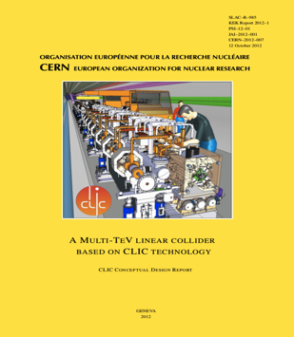
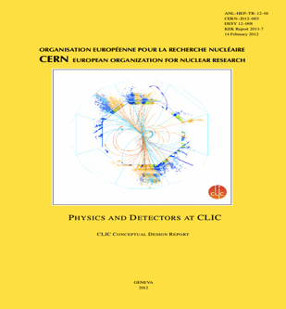
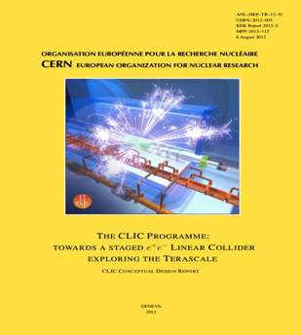
CLIC Conceptual Design Report 2012
Vol 1: The CLIC accelerator and site facilities (H.Schmickler)
- CLIC concept with exploration over multi-TeV energy range up to 3 TeV
- Feasibility study of CLIC parameters optimized at 3 TeV (most demanding)
- Consider also 500 GeV, and intermediate energy range
- Complete, presented in SPC in March 2011, in print: https://edms.cern.ch/document/1234244/
Vol 2: Physics and detectors at CLIC (L.Linssen)
- Physics at a multi-TeV CLIC machine can be measured with high precision, despite challenging background conditions
- External review procedure in October 2011
- Completed and printed, presented in SPC in December 2011 http://arxiv.org/pdf/1202.5940v1
Vol 3: “CLIC study summary” (S.Stapnes)
- Summary and available for the European Strategy process, including possible implementation stages for a CLIC machine as well as costing and cost-drives
- Proposing objectives and work plan of post CDR phase (2012-16)
- Completed and printed, submitted for the European Strategy Open Meeting
in September http://arxiv.org/pdf/1209.2543v1
In addition a shorter overview document was submitted as input to the European Strategy update, available at:
http://arxiv.org/pdf/1208.1402v1
~1400 authors, ~1200 pages

Slide 16
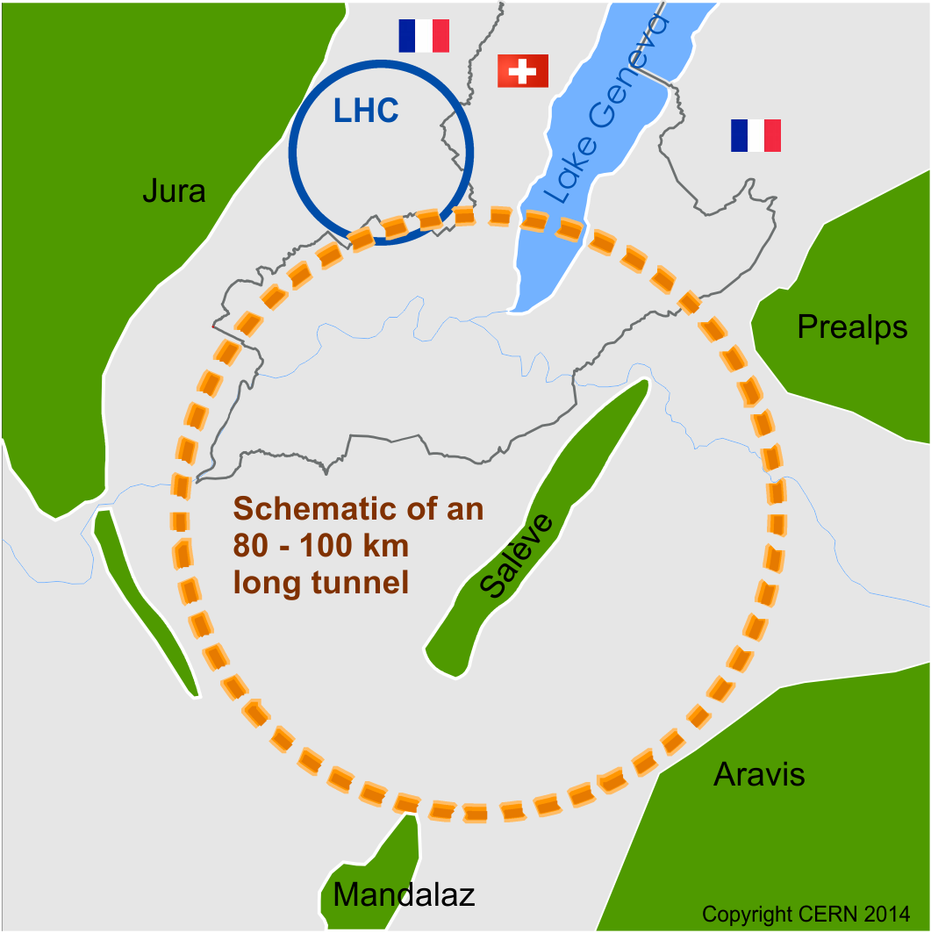
Future Circular Collider Study - SCOPE
CDR and cost review for the next ESU (2018)
Forming an international collaboration to study:
pp-collider (FCC-hh) → defining infrastructure requirements
80-100 km infrastructure in Geneva area
e⁺e⁻ collider (FCC-ee) as potential intermediate step
p-e (FCC-he) option
~16 T ⇒ 100 TeV pp in 100 km
~20 T ⇒ 100 TeV pp in 80 km

Slide 17
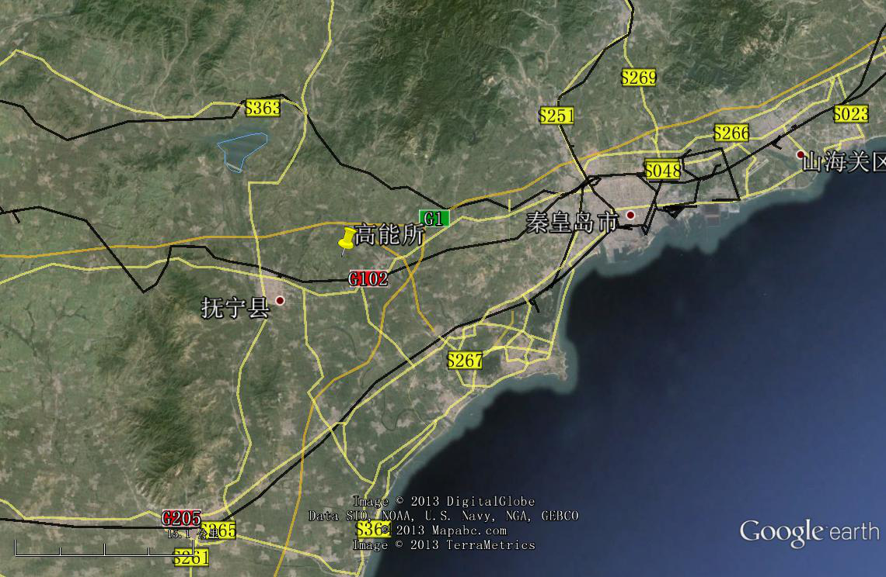
CepC/SppC study (CAS-IHEP), CepC CDR end of 2014, e⁺e⁻ collisions ~2028; pp collisions ~2042
Qinhuangdao (秦皇岛）
CepC, SppC
50 km
easy access
300 km from Beijing
3 h by car
1 h by train
70 km
“Chinese Toscana”
Yifang Wang

Slide 18
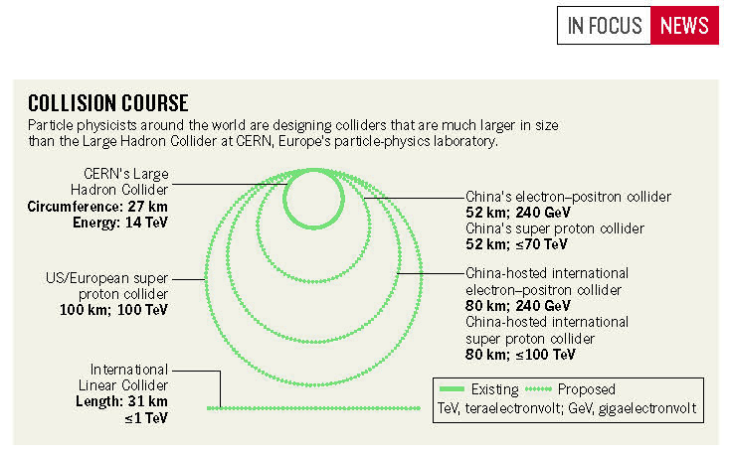
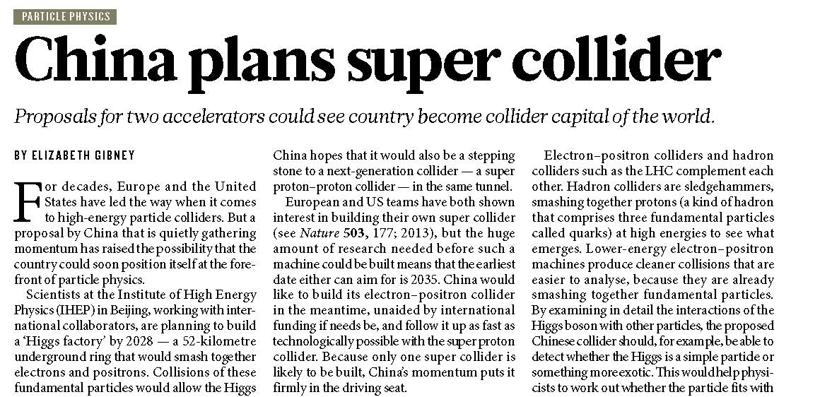
CepC/SppC project – recent news in Nature
24 J U LY 2014 | VO L 511 | NAT U R E | 3

Slide 19

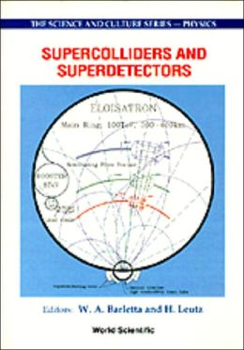
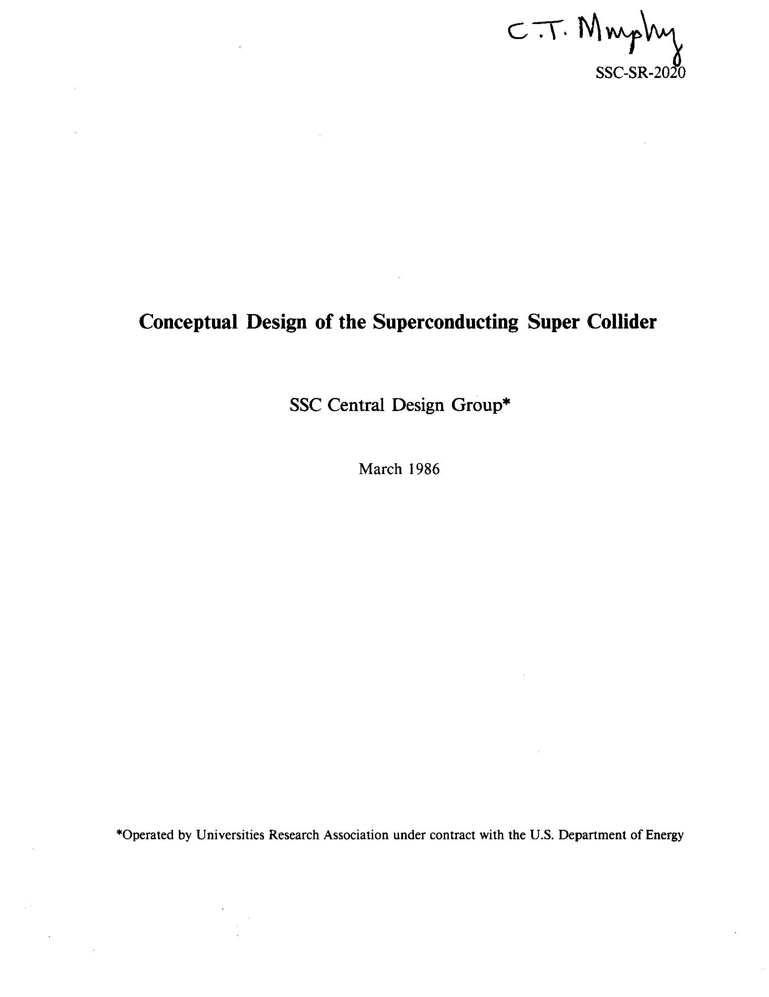
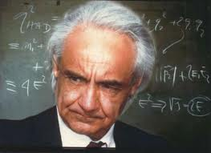
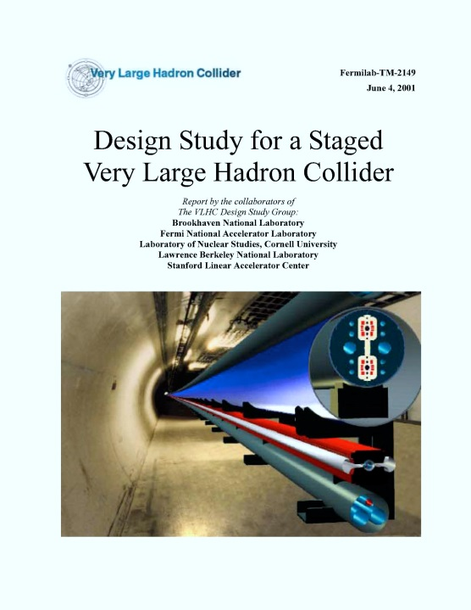
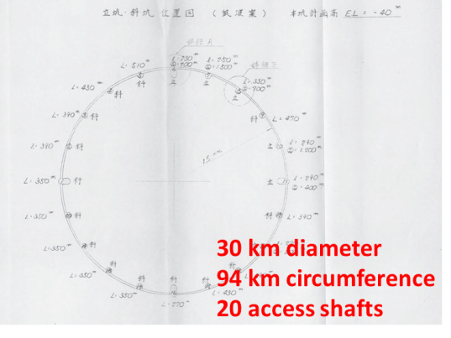
previous studies in Italy (ELOISATRON 300 km), US (SSC 87 km, VLHC/VLLC 233 km) & Japan (94 km)
ex. ELOISATRON
ex. SSC
Supercolliders Superdetectors: Proceedings of the 19th and 25th Workshops of the INFN Eloisatron Project
SSC CDR 1986
H. Ulrich Wienands, The SSC Low Energy Booster: Design and Component Prototypes for the First Injector Synchrotron,
IEEE Press 1997
ex. VLHC
ex. TRISTAN-II
VLHC Design Study Group Collaboration June 2001. 271 pp.
SLAC-R-591, SLAC-R-0591, SLAC-591, SLAC-0591, FERMILAB-TM-2149
http://www.vlhc.org/
study 1983

Slide 20
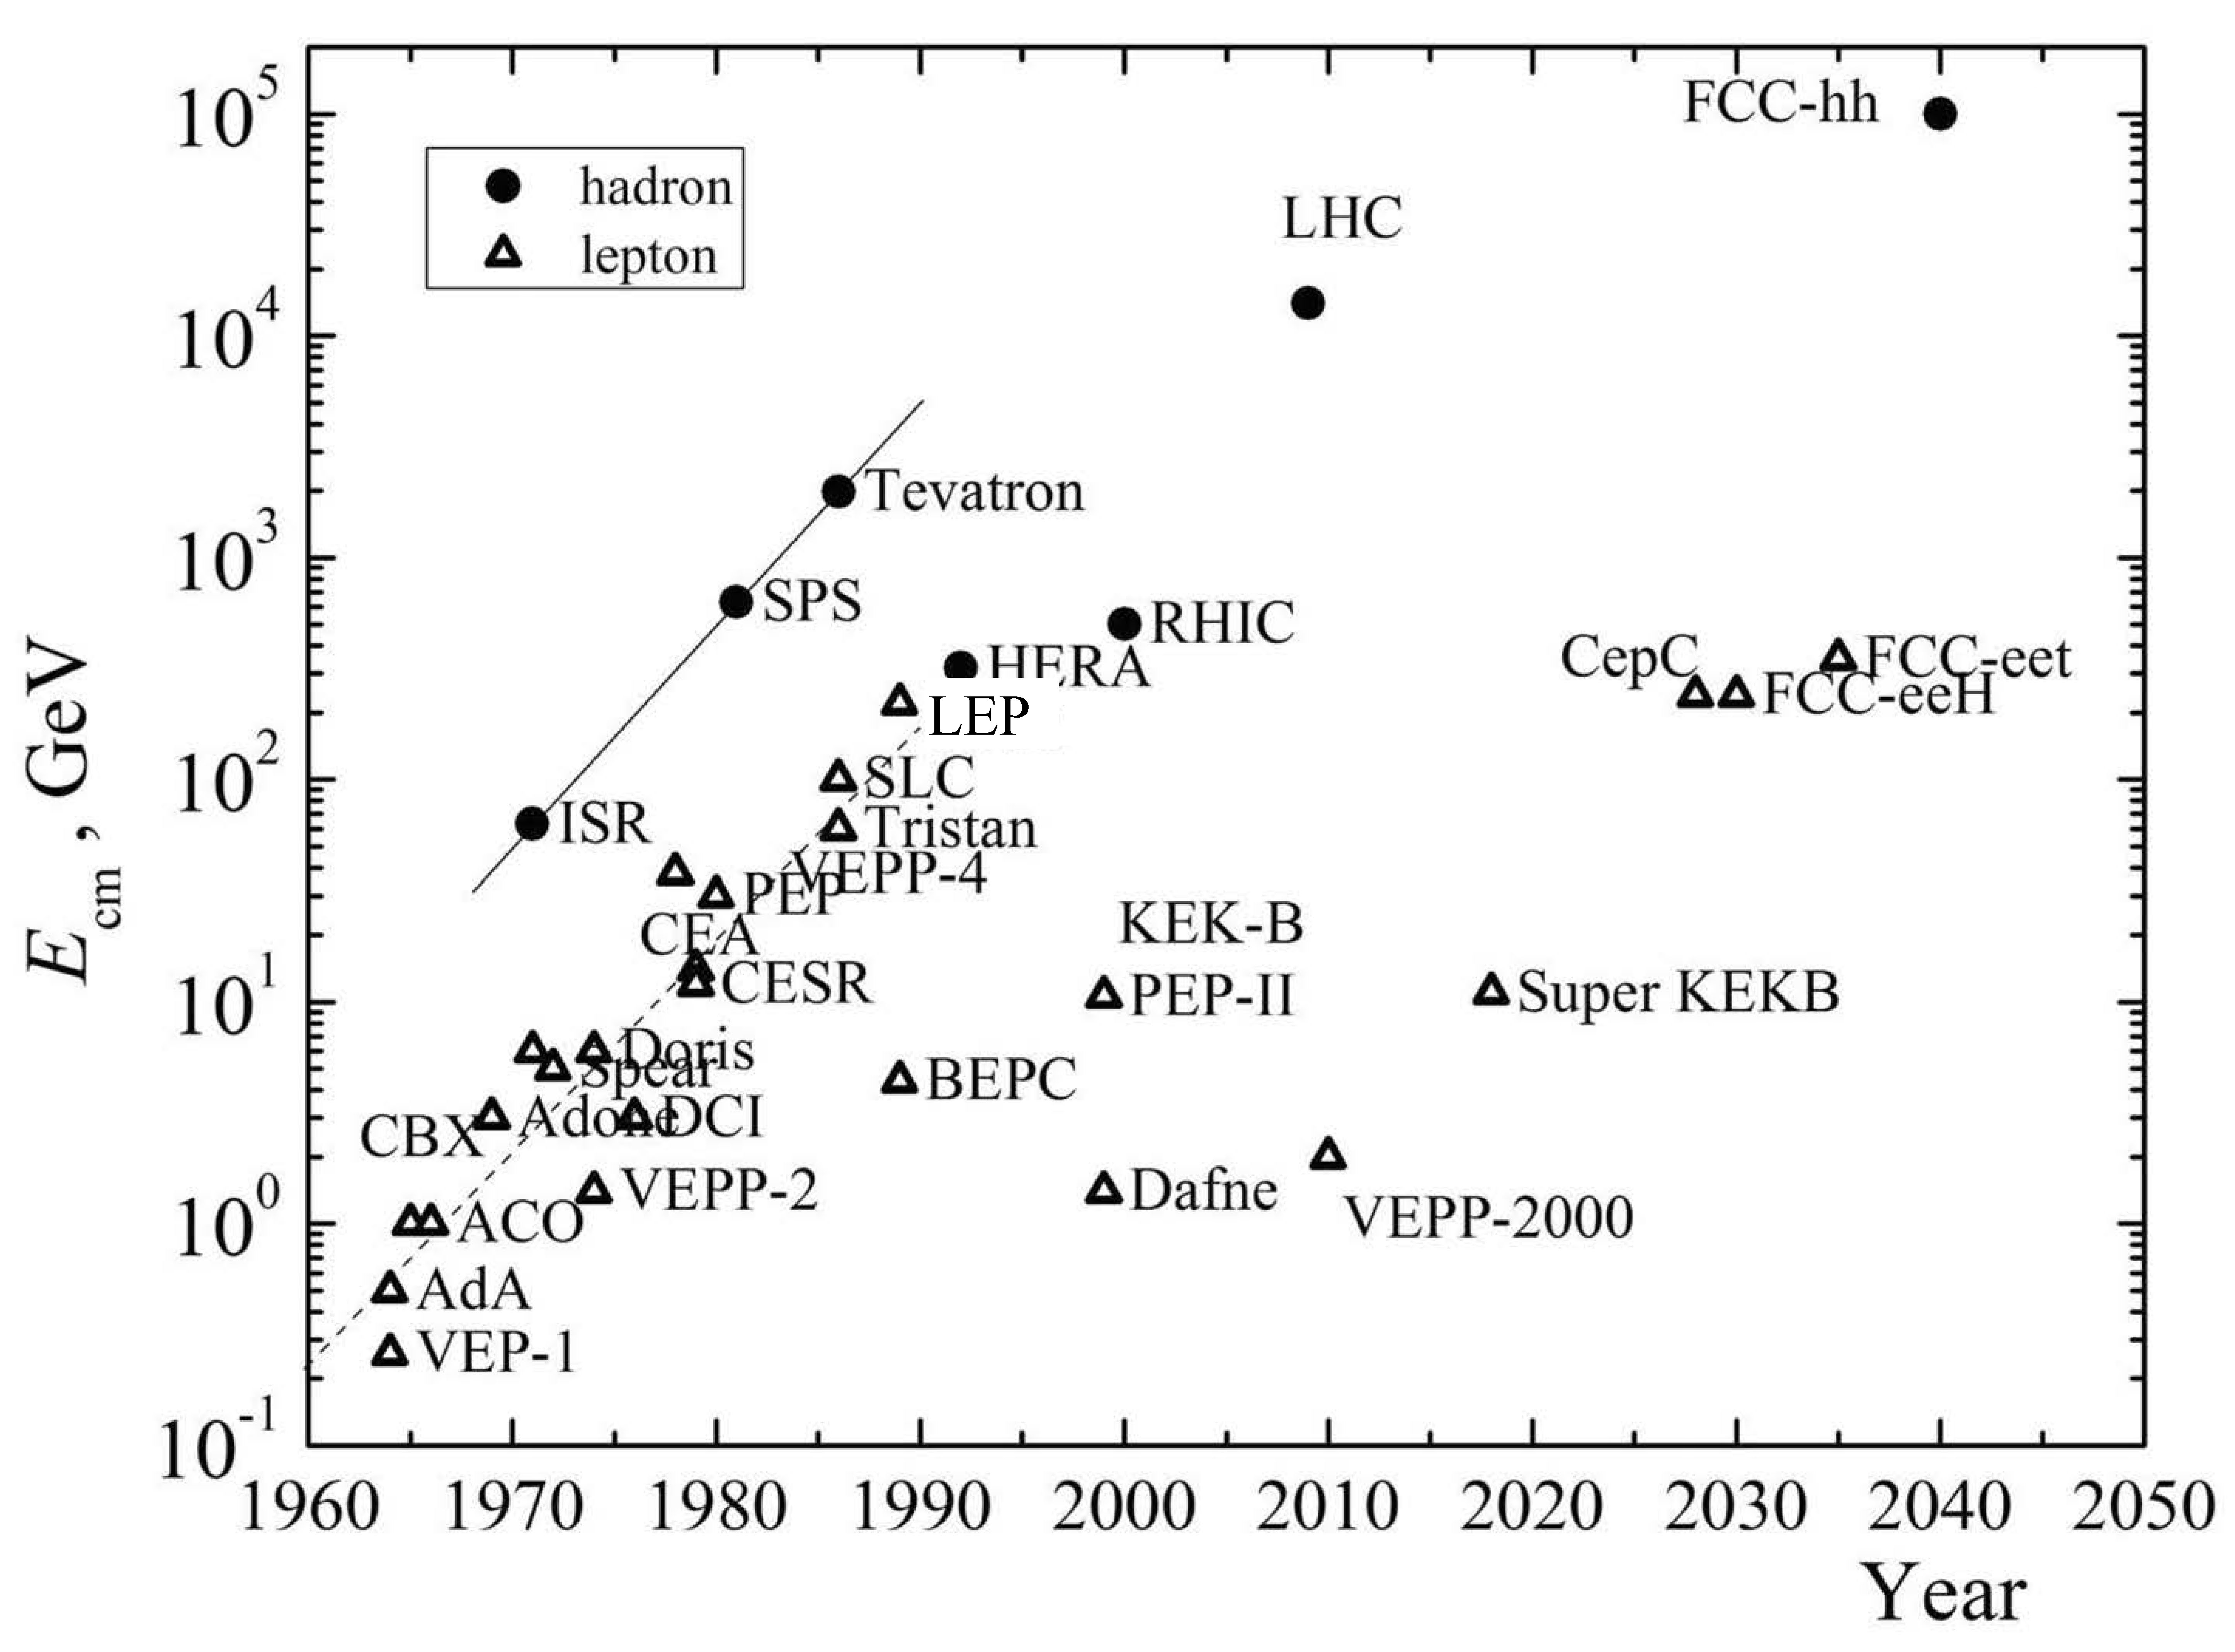

collider c.m. energy vs. year
pp
E_{cm}=2ec Bρ
hadron-lepton
factor 10 every
10 years
factor 10 every
20-30 years
ep
FCC-he
LHeC
e⁺e⁻
factor 10⁵-10⁷ in e⁺e⁻
luminosity
Courtesy V. Shiltsev

Slide 21
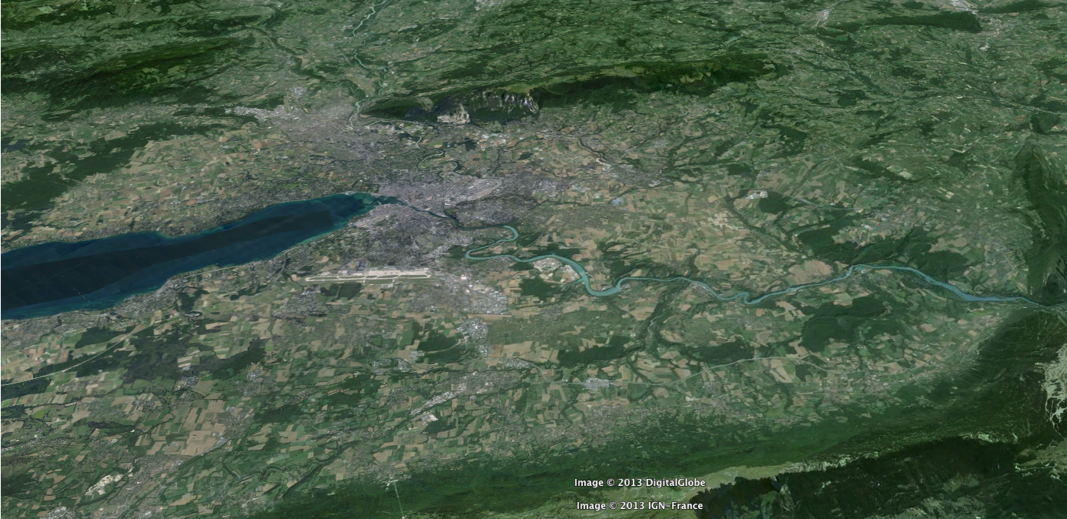
FCC-hh: 100 TeV pp collider
Geneva
PS
SPS
LHC
LHC
27 km, 8.33 T
14 TeV (c.m.)
“HE-LHC”
27 km, 20 T
33 TeV (c.m.)
FCC-hh (alternative)
80 km, 20 T
100 TeV (c.m.)
FCC-hh (baseline)
100 km, 16 T
100 TeV (c.m.)
L. Bottura
B. Strauss

Slide 22
FCC-hh opens three physics windows
➥ Access to new particles in the few TeV to 30 TeV mass range, beyond LHC reach
➥ Immense/much-increased rates for
phenomena in the sub-TeV mass range →
increased precision w.r.t. LHC and possibly ILC
➥ Access to very rare processes in the sub-TeV mass range → search for stealth phenomena, invisible at the LHC
M. Mangano

Slide 23
FCC-hh Key Parameters
Parameter | FCC-hh | LHC
Energy | 100 TeV c.m. | 14 TeV c.m.
Dipole field | 16 T | 8.33 T
# IP | 2 main, +2 | 4
Luminosity/IP_{main} | 5 x 10³⁴ cm⁻²s⁻¹ | 1 x 10³⁴ cm⁻²s⁻¹
Energy/beam | 8.4 GJ | 0.39 GJ
Synchr. rad. | 28.4 W/m/apert. | 0.17 W/m/apert.
Bunch spacing | 25 ns (5 ns) | 25 ns
Preliminary, subject to evolution

Slide 24
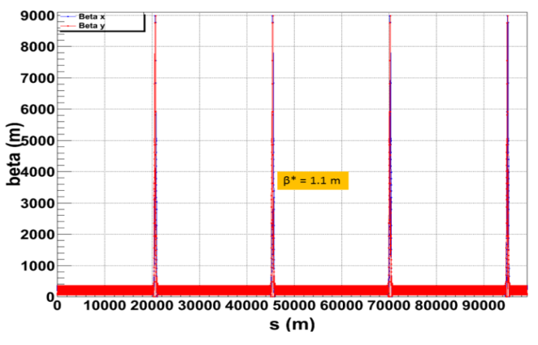
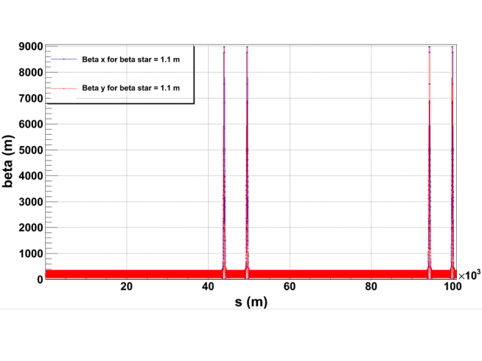
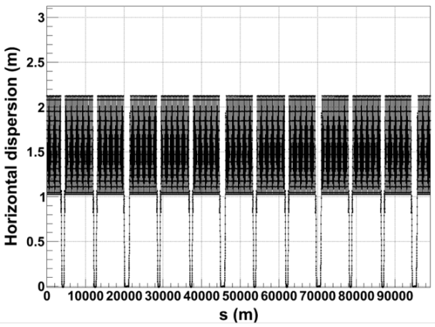
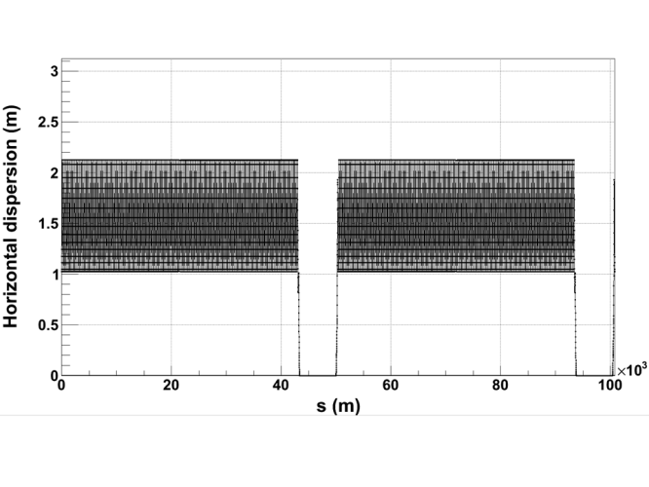
ring optics for alternative layouts
LHC-like
circular
SSC-like
race-
track
R. Alemany,
B. Holzer,
R. Tomas,
D. Schulte
L_{insertion}~7.4 km
C=99.13 km
C=100.8 km
β_{x,y} [m]
work in progress
FODO arc
optics,
cell length
~200 m
D_{x} [m]

Slide 25
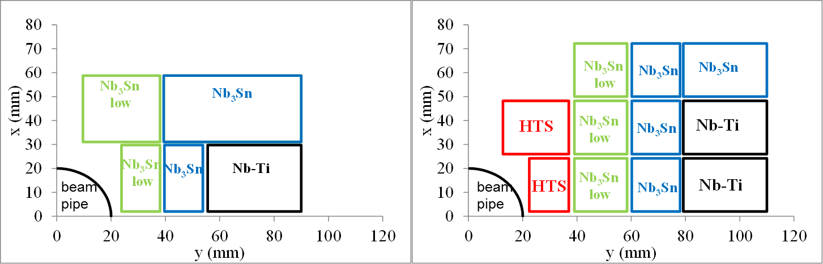
cost-optimized high-field dipole magnets
15-16 T: Nb-Ti & Nb₃Sn
20 T: Nb-Ti & Nb₃Sn & HTS
only a quarter is shown
“hybrid magnets”
example block-coil layout
L. Rossi, E. Todesco, P. McIntyre

Slide 26
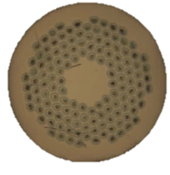
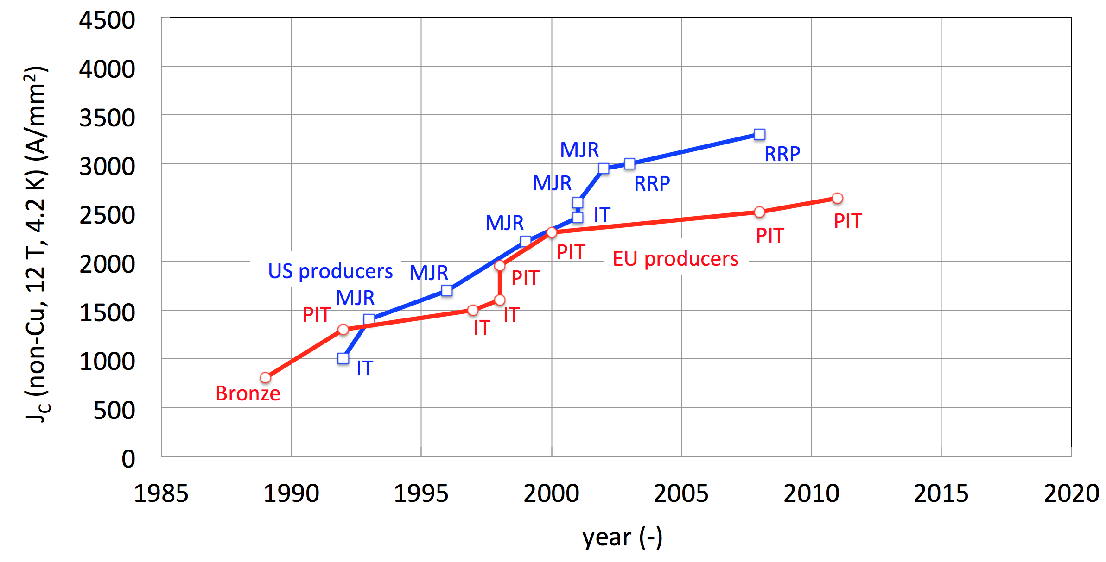
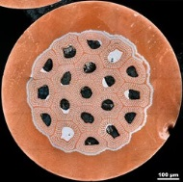
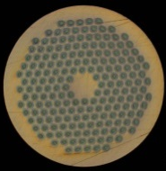
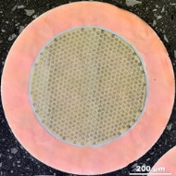



From ITER- to HEP-class Nb₃Sn
HL-LHC
ITER
FCC specs
HL-LHC specs
CARE-NED
EuCARD
US-CDP
FCC
L. Bottura

Slide 27
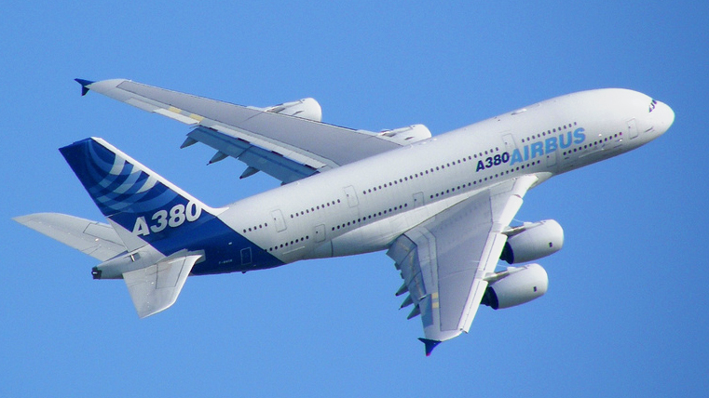
machine protection
energy per proton beam
LHC: 0.4 GJ → FCC-hh: 8 GJ (20x more !)
  kinetic energy of Airbus A380 at 720 km/h
  can melt 12 tons of copper, or drill a 300-m long hole

Slide 28
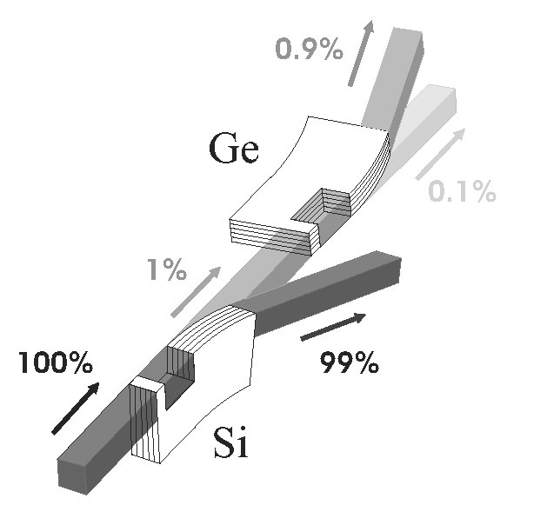
Crystal Collimation
LHC-type solution is baseline, but other approaches should be investigated:
hollow e⁻ beam as collimator
crystals to extract particles
renewable collimators
D. Schulte,
S. Redaelli
A. Lobko,
V. Tikhomirov,
INP Minsk
Volume reflection mode
− multiple volume reflection effect
− increases deflection angle to 5 times

Slide 29
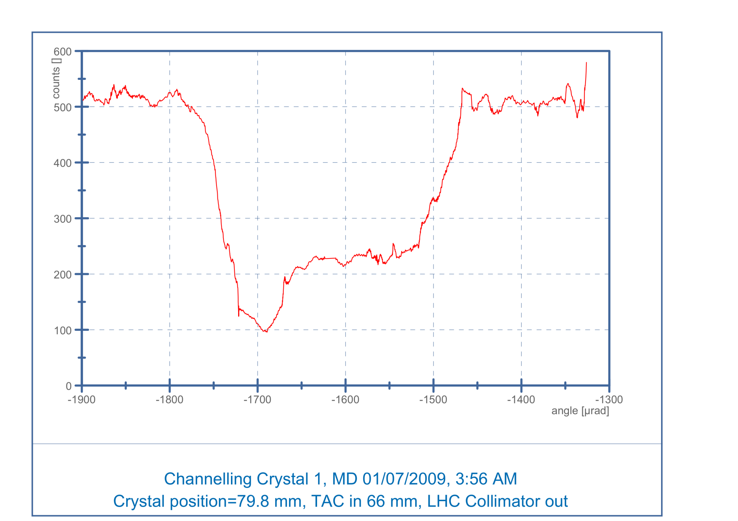
crystal extraction experiment UA9
SPS
2009
500
Amorphous orientation
Amorphous orientation
× 5 reduction rate
counts
Nuclear loss rate seen by a scintillator telescope downstream of the crystal
Reflection range
100
⬆
Channeling peak
-1800
-1700
-1600
-1500
Angle [μrad]
Nuclear loss rate (including diffractive) strongly depressed
W. Scandale

Slide 30
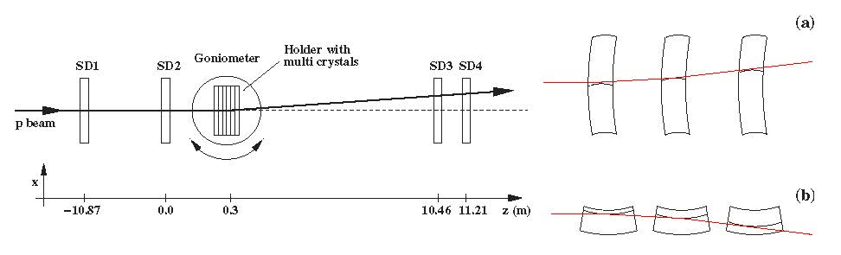
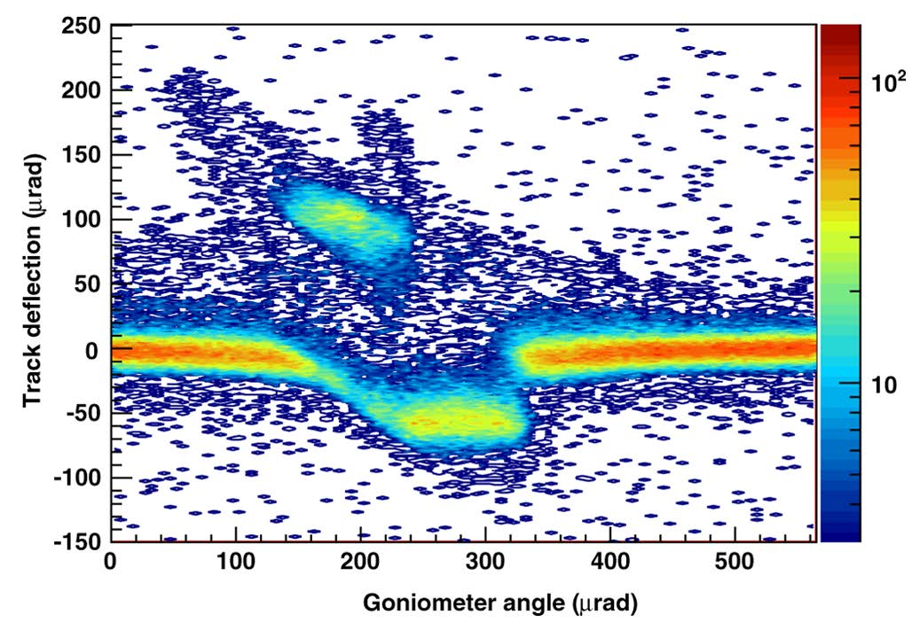
staging of crystal deflectors
schematic layout
of the experimental setup used to
study multiple volume reflection at the H8 beam line of the CERN SPS
quasimosaic
strip
crystals
6 strip crystals in series
(each 2 mm long):
400 GeV/c protons
reflected by 40±2 μrad
[effective field 16 T]
with efficiency 0.93±0.04
proof of principle demonstration!
W. Scandale et al, Observation of Multiple Volume Reflection of Ultrarelativistic Protons by a Sequence of Several Bent Silicon Crystals, Phys.Rev.Lett. 102 (2009) 084801

Slide 31
Crystal Calorimetry
strong-field QED effects enhance radiation and pair production:
production and measurement of e-, γ & hyperon polarization;
reduced radiation length and calorimeter thickness;
increased mass resolution
A. Lobko,
INP Minsk

Slide 32
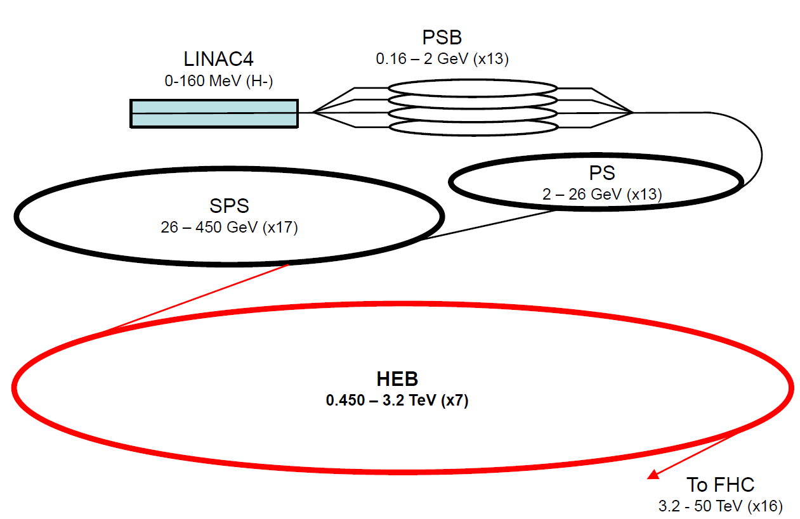
FCC-hh injector complex
based on existing & planned (HL-LHC/LIU) injector chain;
HEB in LHC tunnel (e.g. modified LHC) or FCC tunnel
B. Goddard,
W. Herr, et al.
crystal extraction for
fixed target physics?!
W. Scandale

Slide 33
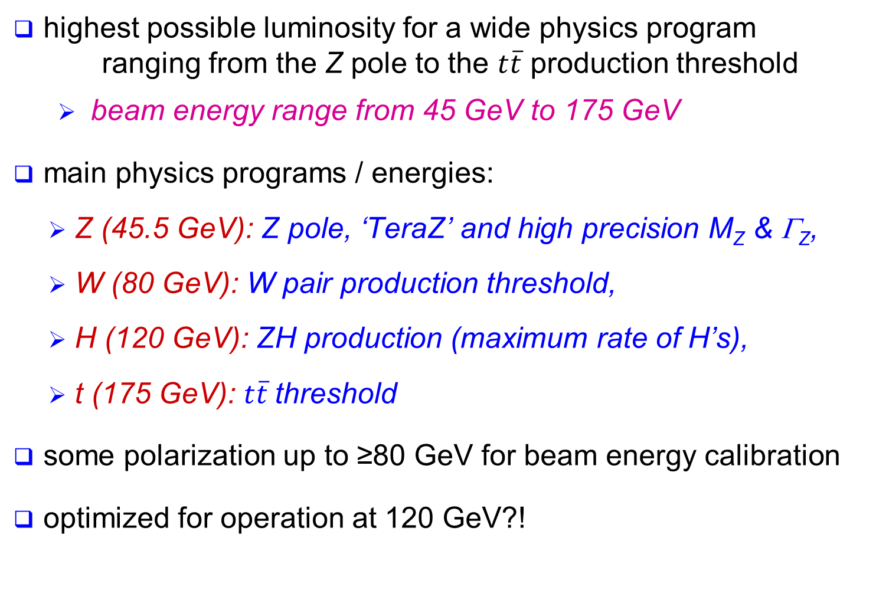
physics requirements for FCC-ee
highest possible luminosity for a wide physics program ranging from the Z pole to the $t\overline{t}$ production threshold
  beam energy range from 45 GeV to 175 GeV
main physics programs / energies:
  Z (45.5 GeV): Z pole, ‘TeraZ’ and high precision M_{Z} & Γ_{Z},
  W (80 GeV): W pair production threshold,
  H (120 GeV): ZH production (maximum rate of H’s),
  t (175 GeV): $t\overline{t}$threshold
some polarization up to ≥80 GeV for beam energy calibration
optimized for operation at 120 GeV?!

Slide 34
FCC-ee Key Parameters
Parameter | FCC-ee | LEP2
Energy/beam | 45 – 175 GeV | 105 GeV
Bunches/beam | 98 – 16700 | 4
Beam current | 6.6 – 1450 mA | 3 mA
Luminosity/IP | 1.8-28 x 10³⁴ cm⁻²s⁻¹ | 0.0012 x 10³⁴ cm⁻²s⁻¹
Energy loss/turn | 0.03-7.55 GeV | 3.34 GeV
Synchr. power | 100 MW | 22 MW
RF Voltage | 2.5 – 11 GV | 3.5 GV
Preliminary, subject to evolution

Slide 35
layout & optics at 120 & 175 GeV
Lattice V12b-s
arc cell
BPM
Corrector
Q
Q
S
B
B
Q
S
B
B
layout
B = bending magnet, Q = quadrupole, S = sextupole
FODO cell optics
cell length 50 m
full ring optics
100
80
m
60
n
i
x
t
e
b
40
Circumference: 100 km
Arc length: 2 × 3.4 km
Straight section: 1.5 km
20
0
0
2
4
6
8
10
12
s in km
B. Harer, B. Holzer

Slide 36
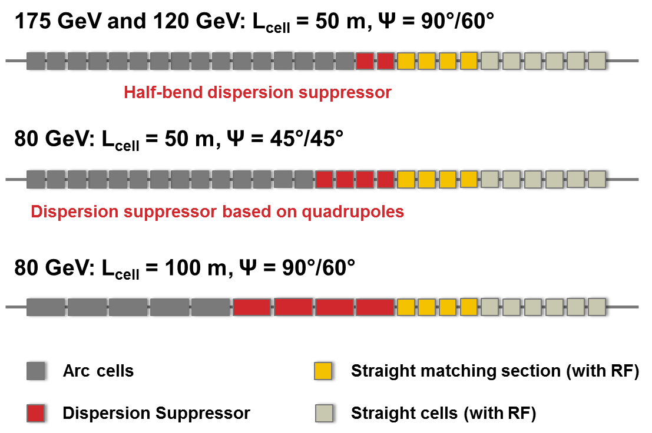
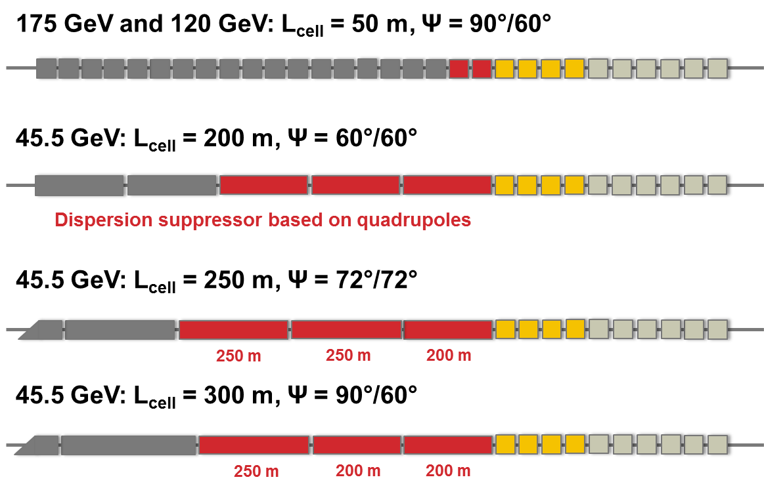
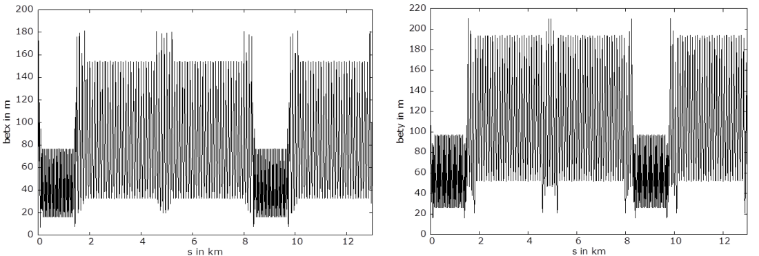
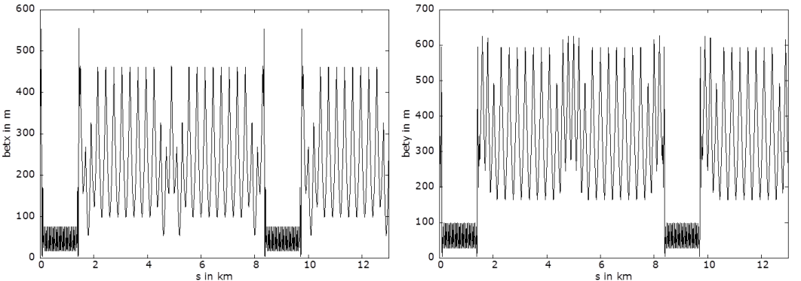
optics 175 & 120 → 80 & 45.5 GeV
80 GeV
45.5 GeV
example: 100 m cell length
example: 300 m cell length
B. Harer, B. Holzer
all emittances ε_{x} ≤ 0.5 baseline

Slide 37
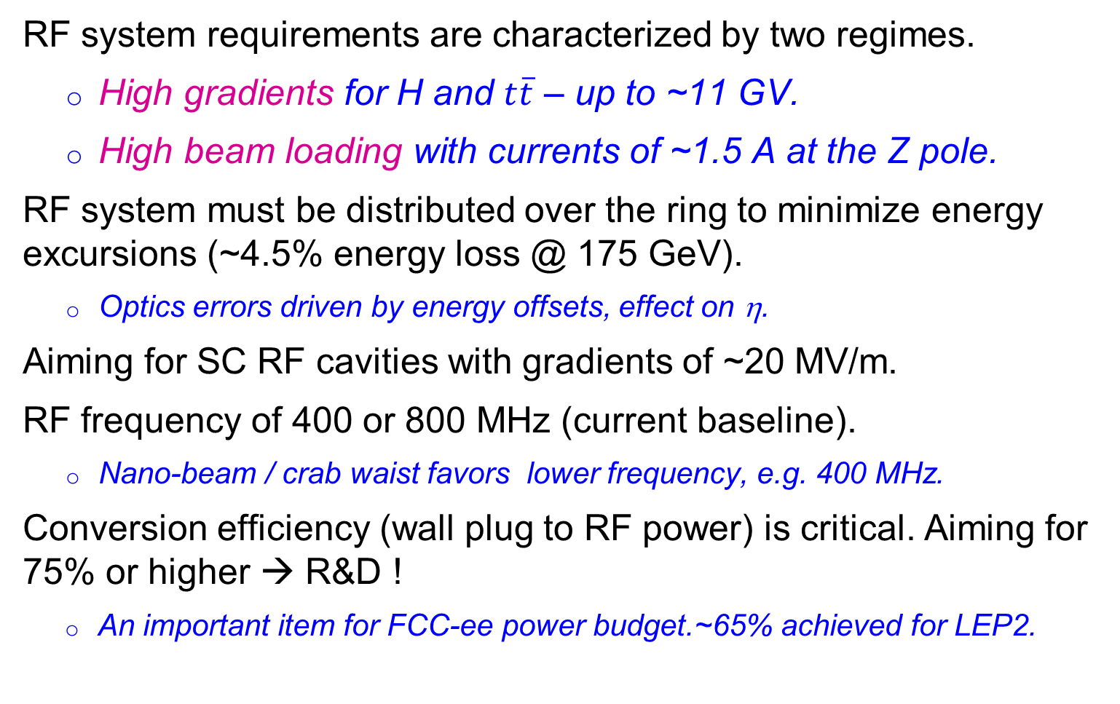
SC RF System
RF system requirements are characterized by two regimes.
  High gradients for H and $t\overline{t}$ – up to ~11 GV.
  High beam loading with currents of ~1.5 A at the Z pole.
RF system must be distributed over the ring to minimize energy excursions (~4.5% energy loss @ 175 GeV).
  Optics errors driven by energy offsets, effect on η.
Aiming for SC RF cavities with gradients of ~20 MV/m.
RF frequency of 400 or 800 MHz (current baseline).
  Nano-beam / crab waist favors lower frequency, e.g. 400 MHz.
Conversion efficiency (wall plug to RF power) is critical. Aiming for 75% or higher → R&D !
  An important item for FCC-ee power budget.~65% achieved for LEP2.
J. Wenninger, A. Butterworth, E. Jensen, et al.

Slide 38
luminosity
H ≤ 1
Hour-glass
F ≤ 1
Crossing angle
2Φ
Beam-beam parameter
J. Wenninger

Slide 39
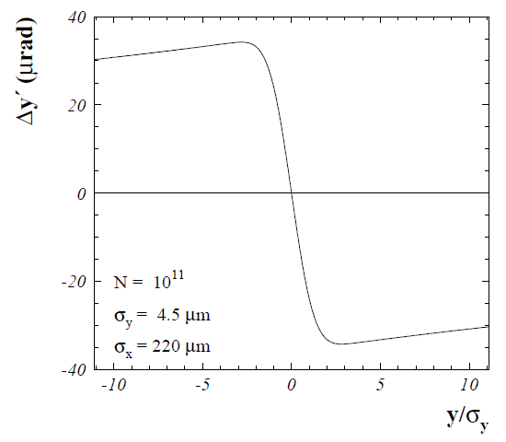
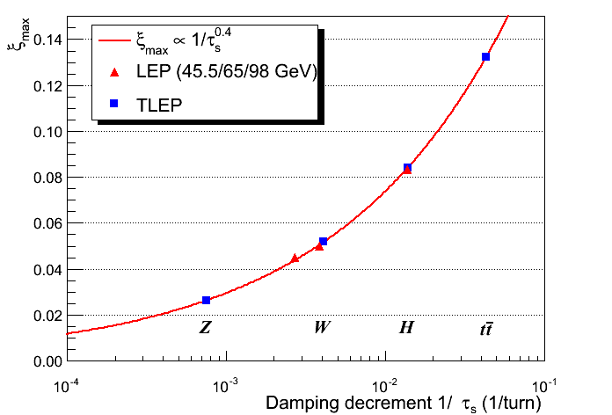
beam-beam parameter
beam-beam parameter ξ measures strength of field sensed by the particles in a collision
beam-beam parameter limits are empirically scaled from LEP data (also 4 IPs)
R. Assmann & K. Cornelis, EPAC2000
In reasonable agreement with first simulations for FCC ee
The beam-beam limit may be raised significantly with Crab-Waist schemes !
J. Wenninger, R. Assmann, S. White, K. Ohmi, D. Shatilov, et al.

Slide 40

beamstrahlung
hard photon emission at the IPs, ‘Beamstrahlung’, can become lifetime / performance limit for large bunch populations (N), small hor. beam size (σ_{x}) & short bunches (σ_{s})
e
γ
e
ρ : mean bending radius at the IP (in the field of the opposing bunch)
η : ring energy acceptance
lifetime expression by V. Telnov, modified version by A. Bogomyagkov et al
to ensure an acceptable lifetime, ρ×η must be sufficiently large
  flat beams (large σ_{x}) !
  bunch length !
  large momentum acceptance of the lattice: 1.5 – 2% required.
    LEP: < 1% acceptance, SuperKEKB ~ 1-1.5%.
J. Wenninger, et al

Slide 41
beam-beam limits: 2 regimes
beamstrahlung
lifetime (300 s) w. η=2.0%
beamstrahlung
lifetime w. η=1.5%
ε_{y} = 2 pm,
β_{y}* = 1 mm
M. Koratzinos, A. Bogomyagkov, E. Levichev, D. Shatilov, K. Yokoya, V. Telnov, K. Oide, …

Slide 42

e⁺e⁻ luminosity vs energy
FCC-ee crab waist / improved optics
(Bogomyagkov, Levichev, Piminov, Shatilov, 2014)
additional ILC upgrades
(Harrison, Ross, Walker, 2013)

Slide 43

FCC-ee injection
beside the collider ring(s), a booster of the same size (same tunnel) must provide beams for top-up injection
  same size of RF system, but low power (~ MW)
  top up frequency ~0.1 Hz
  booster injection energy ~20 GeV
  bypass around the experiments
injector complex for e⁺ and e⁻ beams of 10-20 GeV
  Super-KEKB injector ~ almost suitable
A. Blondel

Slide 44

SuperKEKB = FCC-ee demonstrator
beam commissioning will start in 2015
K. Oide et al.
top up injection at high current
β_{y}* =300 μm (FCC-ee: 1 mm)
lifetime 5 min (FCC-ee: ≥20 min)
ε_{y}/ε_{x} =0.25% (similar to FCC-ee)
off momentum acceptance (±1.5%, similar to FCC-ee)
e⁺ production rate (2.5x10¹²/s, FCC-ee: <1.5x10¹²/s (Z cr.waist)
SuperKEKB goes beyond FCC-ee, testing all concepts

Slide 45

The Twin Frontiers of FCC-ee Physics
Precision Measurements
Rare Decays
Springboard for sensitivity to new physics
Theoretical issues:
  Higher-order QCD
  Higher-order EW
  Mixed QCD + EW
Direct searches for new physics
Many opportunities
Z: 10¹²
b, c, τ: 10¹¹
W: 10⁸
H: 10⁶
t: 10⁶
HL-LHC
ILC500
FCC-ee 350
CepC, 4/ab
Higgs coupling
measurements
M. Bicer et al., “First Look at the Physics Case of TLEP,’’ JHEP 01, 164 (2014)
S. Dawson et al., arXiv:1310.8361v2
J. Ellis
P. Janot
M. Ruan

Slide 46
Crystal applications for FCC-ee, ILC or CLIC
faster electromagnetic shower generation
smaller electromagnetic calorimeters
generation or measurement of beam polarization
enhanced positron sources
e± crystal collimation
…

Slide 47


FCC-he: high-energy lepton-hadron collider
LHeC CDR , published in 2012
RR LHeC:
new ring
in LHC tunnel,
with bypasses
around
experiments
LR LHeC:
recirculating
linac with
energy
recovery
similar two options for FCC:
(1) FCC-ee ring, (2) ERL – from LHeC or new

Slide 48
FCC Key Technologies
16 T superconducting magnets
Superconducting RF cavities
RF power sources
Affordable & reliable cryogenics
Reliability & availability concepts

Slide 49


Future Circular
Collider Study
Large scale technical infrastructures
Conceptual design study 2014 – 2018
Driven by international contributions
Establish long-term liaisons with industry
Collaborate on technology evolution (> 2025)
Notes:
CERN

Slide 50




presently signing FCC MoUs with partners

Slide 51
FCC MoU’s 3 Oct. 2014
ALBA/CELLS, Spain
BINP, Russia
CASE (SUNY/BNL), USA
CBPF, Brazil
CERN, Switzerland (Int’l)
CIEMAT, Spain
CNRS, France
Cockcroft Institute, UK
CSIC/IFIC, Spain
DESY, Germany
EPFL, Switzerland
Gangneung-Wonju Nat. U., Korea
Goethe U. Frankfurt, Germany
GSI, Germany
Hellenic Open U, Greece
IFJ PAN Krakow, Poland
INFN, Italy
INP Minsk, Belorussia
IPM, Iran
JAI/Oxford, UK
KEK, Japan
King’s College London, UK
MEPhI, Russia
Northern Illinois U., USA
NC PHEP Minsk, Belorussia
Sapienza/Roma, Italy
UC Santa Barbara, USA
TU Darmstadt, Germany
TU Tampere, Finland
U. Geneva, Switzerland
U. Iowa, USA
U Silesia, Poland

Slide 52
FCC Study Coordination Group
Study Coordination
M. Benedikt, F. Zimmermann
Hadron Collider Physics and Experiments
F. Gianotti, A. Ball, M. Mangano
Lepton Collider Physics and Experiments
A. Blondel, J. Ellis, P. Janot
e-p Physics, Experiments, IP Integration
M. Klein, O. Bruning
Hadron Injectors
B. Goddard
Hadron Collider
D. Schulte, M. Syphers, J.M. Jimenez
Lepton Injectors
Y. Papaphilippou (tbc)
Lepton Collider
J. Wenninger, U. Wienands, J.M. Jimenez
Accelerator R & D Technologies
M. Benedikt, F. Zimmermann
Infrastructures and Operation
P. Lebrun, P. Collier
Costing Planning
F. Sonnemann, P. Lebrun

Slide 53


FCC Collaboration Board
preparatory meeting 9-10 September 2014 at CERN (~80 participants, 1 / inst.)
Leonid “Lenny” Rivkin (EPFL & PSI) unanimously elected as interim Collaboration Board Chair

Slide 54

FCC Horizon 2020 Design Study Proposal
submitted to Brussels on
2 September 2014
key aspects of 100 TeV energy frontier hadron collider:
conceptual design, feasibility, implementation scenario

Slide 55
Work Breakdown Structure
Physics and Experiments
Accelerators
Infrastructures
and Operation
Implementation
and Planning
Study and Quality
Management
Hadron Collider Physics
Hadron Injectors
Civil Engineering
Project Risk Assessment
Study Administration
Hadron Collider Experiments
Hadron Collider
Technical Infrastructures
Implementation Scenarios
Communications
Lepton Collider Physics
Lepton Injectors
Operation and Energy Efficiency
Cost Models
Conceptual
Design Report
Lepton Collider Experiments
Lepton Collider
Integration
Lepton-Hadron Collider Physics
Lepton-Hadron Collider
Computing and
Data Services
Lepton-Hadron Collider Experiment
Technology R&D
Safety, RP and Environment

Slide 56

WBS – H2020 EU DS proposal
Physics and Experiments
Accelerators
Infrastructures
and Operation
Implementation
and Planning
Study and Quality
Management
Hadron Collider Physics
Hadron Injectors
Civil Engineering
Project Risk Assessment
Study Administration
Hadron Collider Experiments
Hadron Collider
Technical Infrastructures
Implementation Scenarios
Communications
Lepton Collider Physics
Lepton Injectors
Operation and Energy Efficiency
Cost Models
Conceptual
Design Report
Lepton Collider Experiments
Lepton Collider
Integration
Lepton-Hadron Collider Physics
Lepton-Hadron Collider
Computing and
Data Services
Lepton-Hadron Collider Experiment
Technology R&D
Safety, RP and Environment

Slide 57
HEP Timescale
1980
1985
1995
2000
2005
2010
2015
2020
2025
2030
2035
1990
Construction
Physics
Upgr
LEP
Design
Proto
Construction
Physics
LHC
Design
Construct
Physics
HL-LHC
Future Collider
Design
Proto
Construction
Physics
25 years
Today
CDR & Cost

Slide 58

First FCC Week
Conference
Washington DC
23-27 March 2015
http://cern.ch/fccw2015

Slide 59
how to go further?

Slide 60
circular crystal collider?
cryogenic?
crystal
bending
stage
cryogenic?
crystal
bending
stage
tunnel mostly empty
proton beam
a dream or our future ?
energy ramp using induction acceleration?

Slide 61

possible evolution of FCC complex
FCC-ee (80-100 km,
e⁺e⁻, up to 350
or 500 GeV c.m.)
PSB
PS (0.6 km)
LHC (26.7 km)
SPS (6.9 km)
FCC-hh
(pp up to
100 TeV c.m.
& AA)
HL-LHC
LHeC & SAPPHiRE (γγ)
CCC,
> 1 PeV
FCC-he as ring-ring
collider ?!
LHeC as FCC-ee injector?
LHeC-based FCC-he collider?!
FCC-he: e± (60-250 GeV) – p(50 TeV)/A collisions
≥50 years e⁺e⁻, pp, e±p/A physics at highest energies
followed by >1 PeV circular crystal collider (CCC)?!?

Slide 62
and on the linear route …

Slide 63
dielectric & plasma accelerators
dielectric materials (quartz, diamond, garnets,.)
higher breakdown limits than metals;
dielectric structures driven in THz,
optical or near-IR regime
G=1-3 GV/m
driven by e⁻ beam or by laser (external fiber laser or
integrated semiconductor laser)
plasma acceleration
G≈ 100 GV/m (n₀ [10¹⁸ cm⁻³])^{1/2} ; n₀≈10¹⁷-10¹⁸ cm⁻³
driven by laser, e⁻ beam, or p beam
unlimited acceleration is predicted to be possible ?!
Kostyukov, Nerush, Litvak, 2012

Slide 64
crystal accelerators
acceleration in crystal channels
G≈ 10 TV/m (n₀ [10²² cm⁻³])^{1/2} ; n₀ ≈10²²-10²³ cm⁻³
driven by x-ray laser
max. energy set by radiation emission due to betatron oscillations between crystal planes
E_{max} ≈300 GeV for e⁺, 10⁴ TeV μ, 10⁶ TeV for p ?! Chen & Noble 1997; Dodin & Fisch 2008; Shiltsev ‘12
[is there no equivalent limit for lower-density plasmas?]
10 TV/m – disposable crystal accelerator
or 0.1 TV/m – reusable crystal accelerator
side injection of x-ray pulses using long fibers
now/soon available!
LCLS, Spring-8, XFEL, SwissFEL …

Slide 65

e± may soon run out of steam in the
high-gradient world!
→ need to change particle type
linear X-ray crystal μ collider
issues:
μ production rate
neutrino radiation
ν beam
Vladimir Shiltsev, 2012
ν beam
μ linac 1
μ linac 2
earth

Slide 66
highest-energy particles
4 July 2012 CERN, Geneva, Switzerland
Higgs boson – “God particle”? – mass 1.25x10¹¹ eV, neither matter nor force!
15 October 1991 Dugway Proving Ground, Utah, U.S.A.
“Oh-my-God-particle”!
(kinetic) energy 3x10²⁰ eV
(=3x10¹¹ GeV = 300 EeV)!

Slide 67

cosmic-ray energy spectrum
10⁴⁵ m⁻²s⁻¹sr⁻¹GeV^{1.5}!
P. Blasi, UHECR2012
circular crystal collider
GZK limit
FCC-hh
LHC p energy
x10⁸

Slide 68
cosmic-ray energy spectrum
10⁴⁵ m⁻²s⁻¹sr⁻¹GeV^{1.5}!
P. Blasi, UHECR2012
crystal accelerator driven by X-ray laser
GZK limit
dielectric & plasmas
LHC p energy
x10⁸

Slide 69
ultimate limit of electromagnetic acceleration
E_{cr} ≈10¹⁸ V/m critical field for e⁺e⁻
pair creation - ħ/(m_{e}c) e E_{cr} ~ m_{e}c²
reaching Planck scale of 10²⁸ eV
would need 10¹⁰ m long accelerator
[10¹⁰ m= 1/10th of distance earth-sun]
“not an inconceivable task for an
advanced technological society”
P. Chen, R, Noble, SLAC-PUB-7402, April 1998

Slide 70
Summary
bright future for accelerator-based HEP!
HL-LHC prepares FCC technology
Channeling conferences look beyond
several different routes to 10-TeV/100-TeV &
1 PeV collisions
e.g. linear path: ILC→CLIC →DWAC→ XRCMC
circular path: FCC-ee→FCC-hh→CCC
crystals are key for both:
bending and/or acceleration
eventually outer-space solar-system
accelerator needed to reach Planck mass

Slide 71

is future circular or linear or both?
“A circle is a round straight line with a hole in the middle.”
  Mark Twain,
  in "English as She Is Taught",
  Century Magazine, May 1887

Slide 72
First FCC Week
Conference
Washington DC
23-27 March 2015
http://cern.ch/fccw2015

Slide 73
spare slides

Slide 74
European Strategy Update 2013
Design studies and R&D at the energy frontier
….“to propose an ambitious post-LHC accelerator project at CERN by the time of the next Strategy update”:
d) CERN should undertake design studies for accelerator projects in a global context,
with emphasis on proton-proton and electron-positron high-energy frontier machines.
These design studies should be coupled to a vigorous accelerator R&D programme, including high-field magnets and high-gradient accelerating structures,
in collaboration with national institutes, laboratories and universities worldwide.
http://cds.cern.ch/record/1567258/files/esc-e-106.pdf
strategy adopted at Brussels in May 2013, during exceptional session of the CERN Council in presence of the European Commission

Slide 75
parameter | LHC | HL-LHC | FCC-hh
c.m. energy [TeV] | 14 |  | 100
dipole magnet field [T] | 8.33 |  | 16 (20)
circumference [km] | 26.7 |  | 100 (83)
luminosity [10³⁴ cm⁻²s⁻¹] | 1 | 5 | 5 [→20?]
bunch spacing [ns] | 25 |  | 25 (5)
events / bunch crossing | 27 | 135 | 170 (34)
bunch population [10¹¹] | 1.15 | 2.2 | 1 (0.2)
norm. transverse emitt. [μm] | 3.75 | 2.5 | 2.2 (0.44)
IP beta-function [m] | 0.55 | 0.15 | 1.1
IP beam size [μm] | 16.7 | 7.1 | 6.8 (3)
synchrotron rad. [W/m/aperture] | 0.17 | 0.33 | 28 (44)
critical energy [keV] | 0.044 |  | 4.3 (5.5)
total syn.rad. power [MW] | 0.0072 | 0.0146 | 4.8 (5.8)
longitudinal damping time [h] | 12.9 |  | 0.54 (0.32)
Cms energy
Luminosity

Slide 76
FCC-hh as heavy-ion collider
preliminary parameters
 | Unit | LHC Design | FCC-hh | FCC-hh
operation mode | - | Pb-Pb | Pb-Pb | p-Pb
number of bunches |  | 592 | 432 | 432
part. / bunch | [10⁸] | 0.7 | 1.4 | 115(1.4)/1.4
β-functionat IP | [m] | 0.5 | 1.1 | 1.1
RMS beam size at IP | [um] | 15.9 | 8.8 | 8.8
initial luminosity | [10²⁷cm⁻²s⁻¹] | 1 | 3.2 | 267(3.2)
peak luminosity | [10²⁷cm⁻²s⁻¹] | 1 | 12.7 | 5477(3356)
integr. lumi. per fill | [μb⁻¹] | <15 | 83 | 30240
total cross-section | [b] | 515 | 597 | 2
initial luminosity lifetime | [h] | <5.6 | 3.7 | 3.2 (10.6)
M. Schaumann, J. Jowett

Slide 77
parameter | LEP2 | FCC-ee |  |  |  |  | CepC
 |  | Z | Z (c.w.) | W | H | t | H
E_{beam} [GeV] | 104 | 45 | 45 | 80 | 120 | 175 | 120
circumference [km] | 26.7 | 100 | 100 | 100 | 100 | 100 | 54
current [mA] | 3.0 | 1450 | 1431 | 152 | 30 | 6.6 | 16.6
P_{SR,tot} [MW] | 22 | 100 | 100 | 100 | 100 | 100 | 100
no. bunches | 4 | 16700 | 29791 | 4490 | 1360 | 98 | 50
N_{b} [10¹¹] | 4.2 | 1.8 | 1.0 | 0.7 | 0.46 | 1.4 | 3.7
ε_{x} [nm] | 22 | 29 | 0.14 | 3.3 | 0.94 | 2 | 6.8
ε_{y} [pm] | 250 | 60 | 1 | 1 | 2 | 2 | 20
β∗_{x} [m] | 1.2 | 0.5 | 0.5 | 0.5 | 0.5 | 1.0 | 0.8
β∗_{y} [mm] | 50 | 1 | 1 | 1 | 1 | 1 | 1.2
σ∗_{y} [nm] | 3500 | 250 | 32 | 130 | 44 | 45 | 160
σ_{z,SR} [mm] | 11.5 | 1.64 | 2.7 | 1.01 | 0.81 | 1.16 | 2.3
σ_{z,tot} [mm] (w beamstr.) | 11.5 | 2.56 | 5.9 | 1.49 | 1.17 | 1.49 | 2.7
hourglass factor F_{hg} | 0.99 | 0.64 | 0.94 | 0.79 | 0.80 | 0.73 | 0.61
L/IP [10³⁴ cm⁻²s⁻¹] | 0.01 | 28 | 212 | 12 | 6 | 1.7 | 1.8
τ_{beam} [min] | 300 | 287 | 39 | 72 | 30 | 23 | 40

Slide 78
collider parameters | FCC ERL | FCC-ee ring |  | protons
species | e⁻ (e⁺?) | e± | e± | p
beam energy [GeV] | 60 | 60 | 120 | 50000
bunches / beam | - | 10600 | 1360 | 10600
bunch intensity [10¹¹] | 0.05 | 0.94 | 0.46 | 1.0
beam current [mA] | 25.6 | 480 | 30 | 500
rms bunch length [cm] | 0.02 | 0.15 | 0.12 | 8
rms emittance [nm] | 0.17 | 1.9 (x) | 0.94 (x) | 0.04 [0.02 y]
β_{x,y}*[mm] | 94 | 8, 4 | 17, 8.5 | 400 [200 y]
σ_{x,y}* [μm] | 4.0 | 4.0, 2.0 |  | equal
beam-b. parameter ξ | (D=2) | 0.13 | 0.13 | 0.022 (0.0002)
hourglass reduction | 0.92 (H_{D}=1.35) | ~0.21 | ~0.39
CM energy [TeV] | 3.5 | 3.5 | 4.9
luminosity[10³⁴cm⁻²s⁻¹] | 1.0 | 6.2 | 0.7
preliminary FCC-he parameters shown at ICHEP’14

Slide 79
International Linear Collider (ILC) - 2
Japanese HEP community expressed interest in hosting the ILC. Site chosen: 北上市 (Kitakami) in Northern Japan. Now 2-year review process by Japanese MEXT.

